Slide 1

Institute of data
Mini project 2
Samantha Carlson
March 2021

Slide 2

Employee absenteeism

Slide 3

The Business question
Can we predict employee absenteeism?

Slide 4

The business Environment
Public sector
Provision of services (not products)
Court services
Police
International relations
Health
Welfare
Etc.

Slide 5
Background information
The public sector is funded by the government through taxes, meaning it is funded by the population it is servicing → tax payers.
In many public sector entities, employee costs form around 80% of budget.
Absenteeism costs are estimated to be between $1,600 and $2,600 per employee/per year.
Example:
A company of approximately 300 salaried employees:
absenteeism cost = $480,000 to $780,000 per year.

Slide 6

Definition of absenteeism
Non-attendance at work where work attendance is scheduled

Slide 7
Absences from work
Unplanned
Industrial disputes
Health
Sickness
Injury
Planned
Recreational
Long-service
Study
Non-illness (e.g. maternity/paternity leave)
Special
Bereavement
Military service

Slide 8
Impacts of absenteeism
Increased costs
Lower morale
Increased workloads
Frustrated managers and supervisors
Loss of productivity
Non-achievement of objectives
Reduced provision of services
Decreased product quality
Adverse public perception and confidence
Adverse effects on consumers

Slide 9
Benefits of absenteeism
Reduced risk of injury to self and others
Reduced transmission of infectious disease
Reduces injury risk
Maximises rate of recovery
Maintains productive workforce
Maintains workplace safety

Slide 10
pipeline
Data acquisition
01
Clean & Explore
02
Visualisation
03
Data analysis
04
Modelling
05
Validation
06

Slide 11
The data
Absenteeism at work: https://archive.ics.uci.edu/ml/datasets/Absenteeism+at+work
Data collected over a period of 3 years from a Brazilian courier company

Slide 12
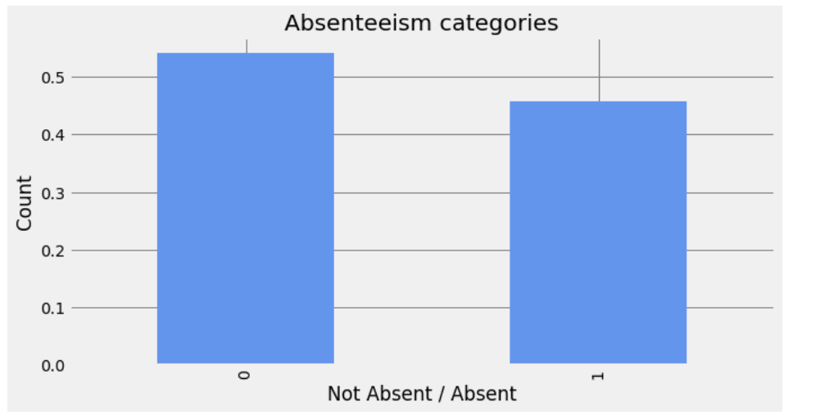
Target selection
Target = Absenteeism
Two categories
740 values, split by median value (3 hours/3 years)

Slide 13
feature selection
Features selected | Features excluded
Transport_expense Children Month Avg_workload Distance_to_work Target Age Service_time Disc_fail Illness | Day Seasons Education Social_drinker Social_smoker Pet Weight Height BMI

Slide 14
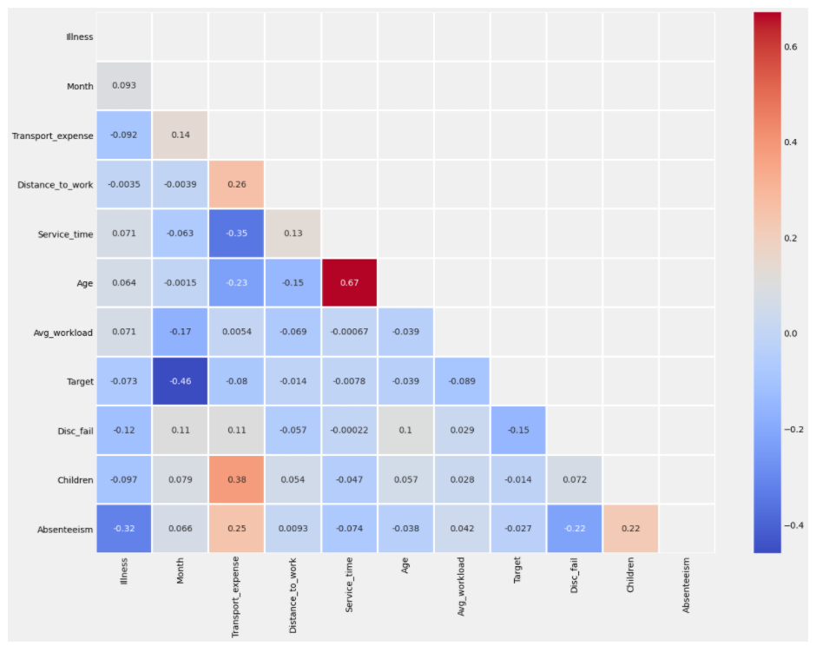
Absenteeism Correlations:
Transport_expense 0.246761
Children 0.223815
Month 0.066388
Avg_workload 0.041579
Distance_to_work 0.009341
Target -0.027488
Age -0.037933
Service_time -0.074167
Disc_fail -0.219790
Illness -0.316715

Slide 15
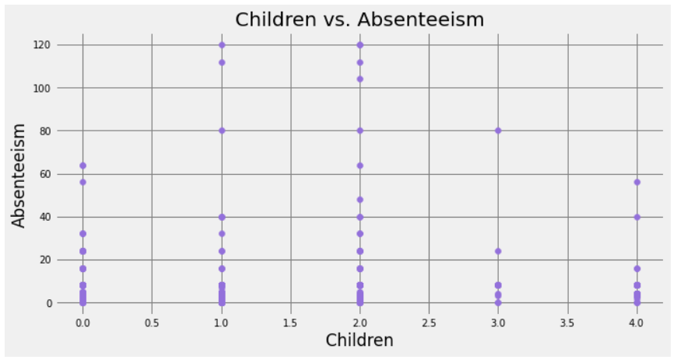
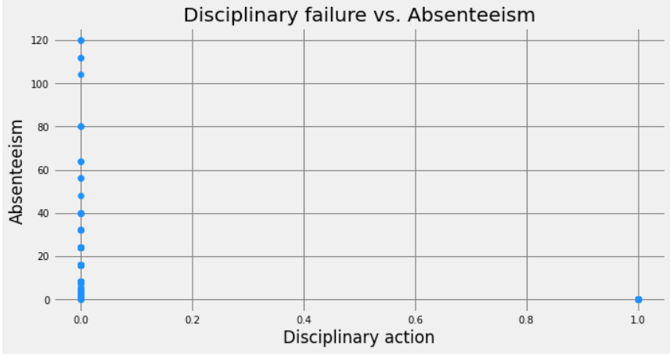
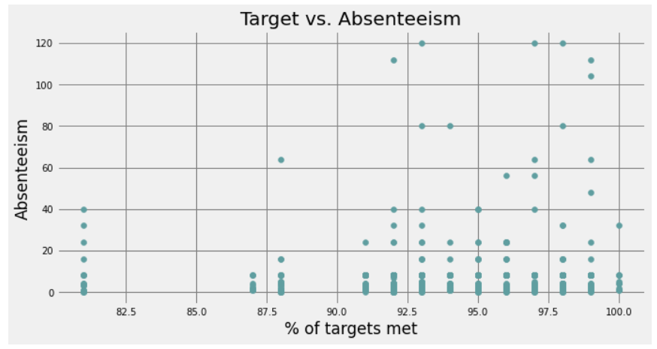
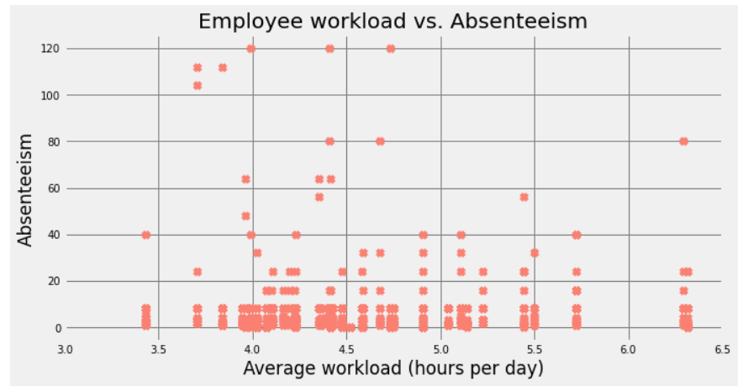

Slide 16

What are we trying to model?
Based on the features selected, can we predict whether an employee will be absent from work?
Why?
If an organisation can predict absenteeism, it can better arrange its operations to be more cost efficient (monetary and resource)

Slide 17
Modelling Results
Slide included for mini project presentation only but would not be included for a business presentation
Model | F1
Logistic Regression | 0.75
Naïve Bayes | 0.71
SVC | 0.75
XGBoost | 0.75

Slide 18
Modelling Validation
Slide included for mini project presentation only but would not be included for a business presentation
Model | Cross Validation (5)
Logistic Regression | 0.69
Naïve Bayes | 0.63
SVC | 0.69
XGBoost | 0.68

Slide 19
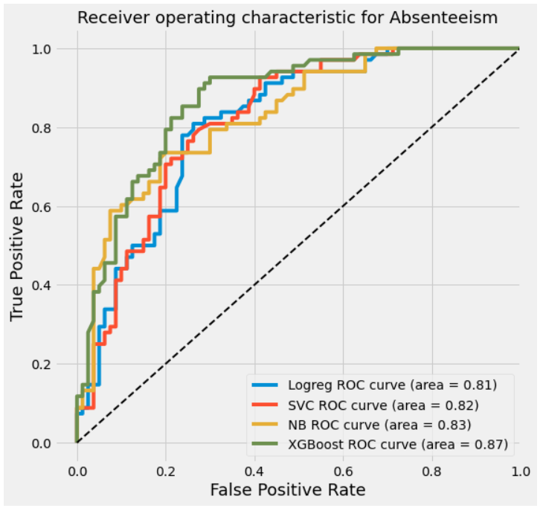
Modelling - AUC-ROC

Slide 20
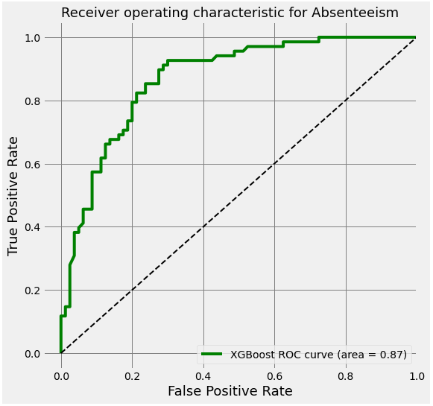
Modelling - AUC-ROC

Slide 21
Modelling - AUC-ROC
Business language:
There is an 0.87 (or 87%) chance that the selected model (XGBoost) will be able to distinguish between Absenteeism and No Absenteeism in employees.
https://towardsdatascience.com/understanding-auc-roc-curve-68b2303cc9c5

Slide 22
Conclusion
Using XGBoost modelling we can best predict whether someone is likely to have a high absenteeism rate from work.
This enables organisations to:
Pre-emptively provide solutions to absenteeism-related issues (e.g. flexible/remote working if transport costs are prohibitive for employee(s))
Arrange back-up options to ensure no additional costs are incurred should an employee have unplanned leave from work (e.g. job/task sharing)
Ultimately, if we can reduce the impact of absenteeism, we can ensure more effective spending of public sector finances.

Slide 23

Limitations
Human behaviour is subject to change (cannot easily be predicted)
Mental wellbeing is not a feature of this data set
Small data set
Limited information about job type/level

Slide 24
Questions?

Slide 25
References
https://www.forbes.com/sites/investopedia/2013/07/10/the-causes-and-costs-of-absenteeism-in-the-workplace/?sh=7d3e66a23eb6
https://www.racp.edu.au/docs/default-source/fellows/resources/afoem/workplace-attendance-and-absenteeism.pdf?sfvrsn=b0232f1a_6
https://www.foruminsurance.com/an-informal-introduction-to-uk-public-sector-organisations-industries
https://exclusive.multibriefs.com/content/absenteeism-costs-employers-billions-of-dollars-every-year/retail
http://blog.tracksmart.com/why-it-matters-the-direct-and-indirect-costs-of-absenteeism/
https://www.aigroup.com.au/resourcecentre/hr/QA-HR/measuring-absenteeism/
https://www.analyticsinhr.com/blog/absenteeism-rate/
https://www.abc.net.au/news/2016-04-12/presenteeism-costing-the-economy-billions/7318832

Slide 26
Extreme Gradient Boosting (XGBoost)
ML Model
A decision-tree-based ensemble Machine Learning algorithm
An approach where new models are trained to predict the residuals (i.e errors) of prior models.
https://towardsdatascience.com/https-medium-com-vishalmorde-xgboost-algorithm-long-she-may-rein-edd9f99be63d
https://towardsdatascience.com/a-beginners-guide-to-xgboost-87f5d4c30ed7low.
Calculate errors
Add Model to ensemble
Train Model predicting errors

