Slide 1
Institute of data – capstone presentation Samantha Carlson 29 may 2021

Slide 2

Agenda
Welcome and introduction
Biography
Introduction to employee attrition
The business environment
Business and data questions
Exclusions to the study
Data pipeline
Introduction to the data
Exploratory Data Analysis
Machine modelling results
Ensemble modelling results
Answers to business and data questions
Recommendation
Limitations
Questions

Slide 3

Biography: Samantha Carlson
Professional Certificate, Data and AI, 2021
PRINCE2, 2019
Bachelor of Arts, French and Public Relations, Honours, 2009.
Data Scientist
Corporate Governance and Risk Specialist
10+ years international public sector experience

Slide 4
Employee attrition

Slide 5
Employee attrition
Also referred to as ‘employee turnover’
Refers to the number of workers who leave an organization and are replaced by new employees.
Costs ~33% of an employee’s annual salary.
In August 2018, the Australian Human Resources Institute (AHRI) reported that the desirable rate for attrition is 10% or less.

Slide 6



The business Environment
Victorian Public sector (VPS)
The public sector is funded by the government through taxes, meaning it is funded by the population it is servicing → taxpayers.
Provision of services (not products)
Court services
Police
International relations
Health
Welfare
Etc.

Slide 7
In figures…
For the 2019-20 financial year, the Victorian Public Sector (VPS) had an attrition rate of 13%.
As of June 2020, the VPS employment totalled 266,272 employees.
If we consider that the median salary over 2019-20 for a VPS employee was $95,549 and calculate attrition costs at the rate of 13%, this is a potential cost to the taxpayer of over $3 billion.
If we could decrease attrition to the desired state of 10%, this would save the Victorian taxpayer over $5 hundred million, per year

Slide 8


Business question
Can we predict which employees are most likely to leave an organisation?
Data question
Which factors that can be addressed lawfully by an employer most impact employee attrition?

Slide 9
Background – Exclusions to study
Race
Colour
Sex
Sexual Orientation
Age
Disability
Marital Status
Family or Carer responsibilities
Pregnancy
Religion
Political opinion
National extraction
Social origin
In Australia, the Fair Work Act details protected attributes.
These attributes are features which cannot be used to discriminate against an employee.
While reasonable managerial or performance action is not discrimination, there are grey areas.
To remove ambiguity from this study, I have removed all of those features that are protected under the Fair Work Act.

Slide 10
Data pipeline
1. Data acquisition
2. Data cleaning
3. Exploratory Data Analysis
Feature correlations
4. Modelling (individual)
5. Modelling (ensemble)
6. Model validation

Slide 11
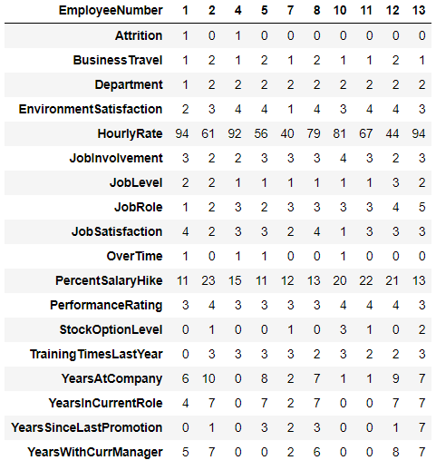
The data
Sourced from data.world
Generated by IBM
Contains 1470 rows and 34 columns
(reduced to 18 with protected attributes and duplicate information removed – see image).

Slide 12
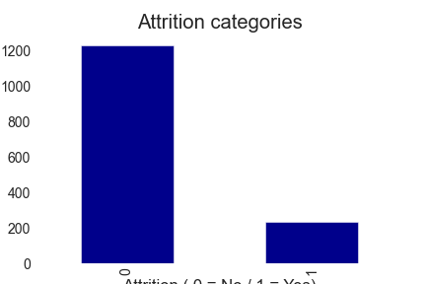
Exploratory data analysis - attrition
ADDRESSING CLASS IMBALANCE
To balance my models, I have:
weighted each of the classes within the machine learning models
split the data into the train/test with ‘stratify’, and
have used 5 kFold validation
No
Yes

Slide 13
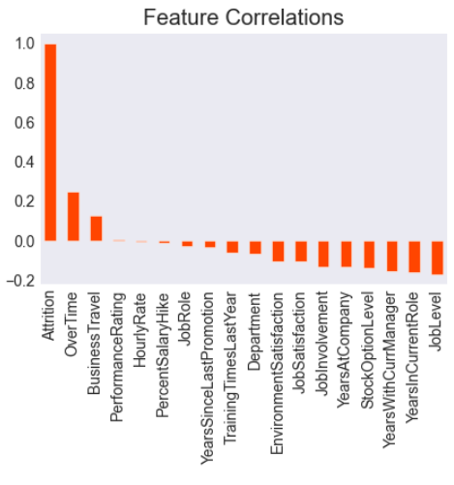
Exploratory data analysis Features vs. attrition

Slide 14
Individual Machine modelling results
Model | Precision | Recall | F1 | Accuracy
CatBoost | 0.93 | 0.78 | 0.85 | 0.76
XGBoost | 0.89 | 0.95 | 0.92 | 0.85
K-Nearest Neighbour | 0.85 | 0.97 | 0.91 | 0.83
Random Forest | 0.87 | 0.99 | 0.92 | 0.86
Light GBM | 0.89 | 0.94 | 0.91 | 0.84
Logistic Regression | 0.95 | 0.80 | 0.87 | 0.79
Recommendations from this study focus on overall workplace improvement strategies, for this particular study, there are no significant impacts of incorrectly classed employees (false positives/false negatives).

Slide 15
Ensemble modelling results
Ensemble Model | Precision | Recall | F1 | Accuracy
Stacking | 0.88 | 0.95 | 0.92 | 0.85
Boosting | 0.90 | 0.98 | 0.94 | 0.89
Bagging | 0.87 | 0.98 | 0.92 | 0.85

Slide 16
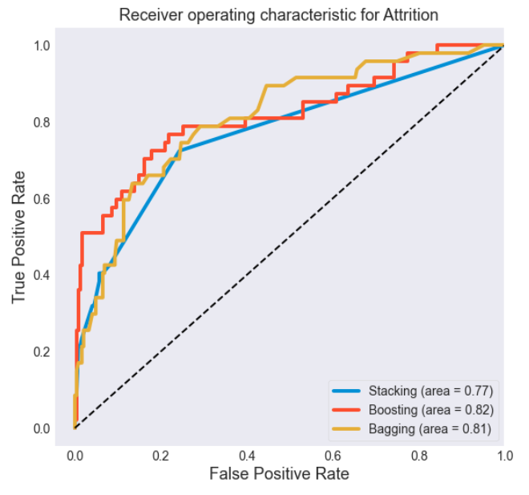
Ensemble modelling results

Slide 17
Answer
Business question
Can we predict which employees are most likely to leave an organisation?
Yes, using machine learning and ensemble models we can predict which employees are most likely to leave an organisation.

Slide 18
Answer
Data question
Which factors that can be addressed lawfully by an employer most impact employee attrition?
As the following features increase, attrition increases:
Over time
Business-related travel
As the following features increase, attrition decreases:
Environment Satisfaction
Job Satisfaction
Job Involvement
Years at Company
Stock Option Level
Years with Current Manager
Years in Current Role
Job Level

Slide 19


Recommendation #1
To address the two factors that most negatively impact attrition:
Overtime
Assess the amount of over time hours completed and determine whether additional employees are required to address the workload.
Assess the priorities of your current employees to determine why over time hours are required.
E.g., could timelines for work be extended?
Business travel
With the emergence of more digital ways of working, are there tasks that could be completed remotely?

Slide 20

Recommendation #2
To address those factors related to employee satisfaction:
Environment satisfaction
Assess which factors contribute to employee satisfaction with their environment:
The physical environment
Work/life balance
Job satisfaction
Assess the factors that contribute to an employee’s sense of satisfaction with their role:
Do they feel that their role is worthwhile to the company?
Do they have career progression opportunities?

Slide 21

Recommendation #3
There are some clear indicators that stability in the workplace contributes to employee retention.
With this information, I would recommend that an organisation look for ways to provide stability and certainty for their employees.
This could be through:
learning and development initiatives,
internal promotions,
salary increases (as appropriate),
career opportunities within an employee’s current role,
etc.

Slide 22

Recommendation #4
To ensure that an organisation reaches the desired level of 10% or less attrition (and thereby saving the taxpayer money), I would recommend undertaking:
Annual performance reviews
Annual salary reviews
Annual engagement surveys
Etc.
→ AND taking appropriate follow-up action (as discussed in recommendations 1-3)

Slide 23

limitations
A certain level of attrition is healthy (~10%), it is unreasonable for an organisation to expect to retain 100% of employees.
We are trying to predict human behaviour.
A number of factors that could influence an employees decision to stay/leave are not included in the data (e.g., organisational change, bullying/harassment, etc.).
The accuracy of the data depends on the honesty and openness of employees (for fear of recognition and retribution many employees will not offer negative views of an organisation).

Slide 24
Questions?

