Slide 1


Mixed-Reality Simulation of Quadcopter Swarms
Lukas Mäurer
Vladimir Velinov

Slide 2
Outline
Project Description
Approach
V-REP Modelling
V-REP/Lua Programming
Java Design
Java Programming
Evaluation
Conclusion
Notes:
1 min

Slide 3
Project Goal
Build a mixed-reality simulation for the FINken
Simulate multiple FINken
Couple a virtual FINken to a real one, using on-board sensors
Simulation (virtual objects) influences real FINken
Notes:
1min

Slide 4
Project Description
Let real and virtual FINken fly together
Build Simulation
Physical simulation
V-REP + Bullet
Behavior Program
V-REP+Lua
Build communication between simulation and reality
Communication
Java Program
FINken
Communication
V-REP
Java Program
Notes:
-swarmlab knows about challenges of quadcopter swarms (cost, defect probability, space
2min

Slide 5
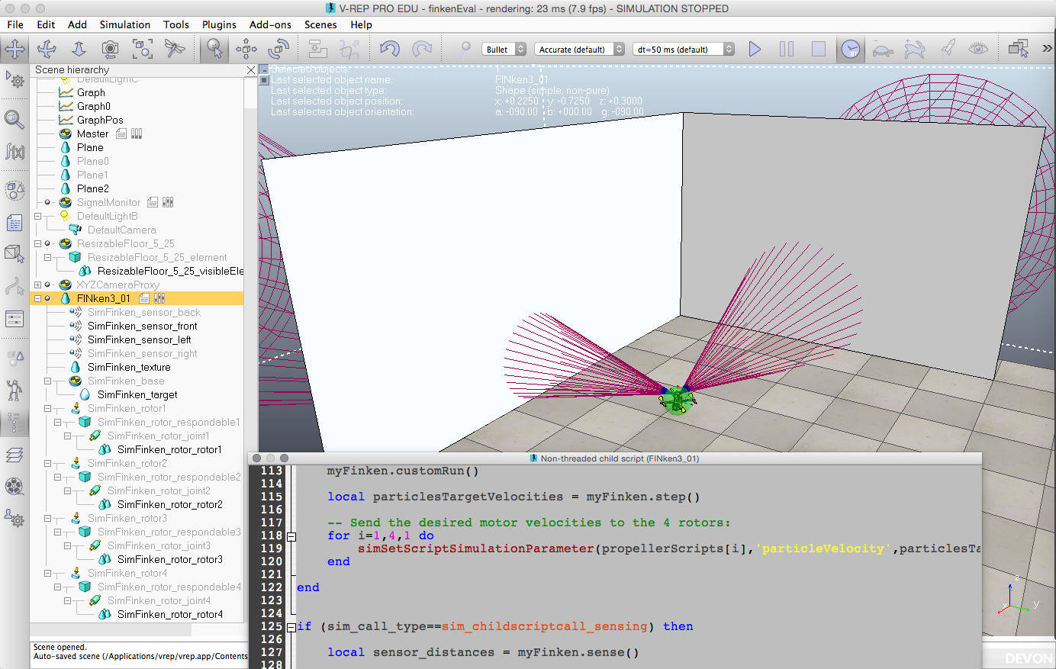
V-REP Simulation – Scene
Simulation Parameters
Rendered Scene
Objects
Attached Lua script
Notes:
Short walkthrough over the V-REP GUI

Slide 6
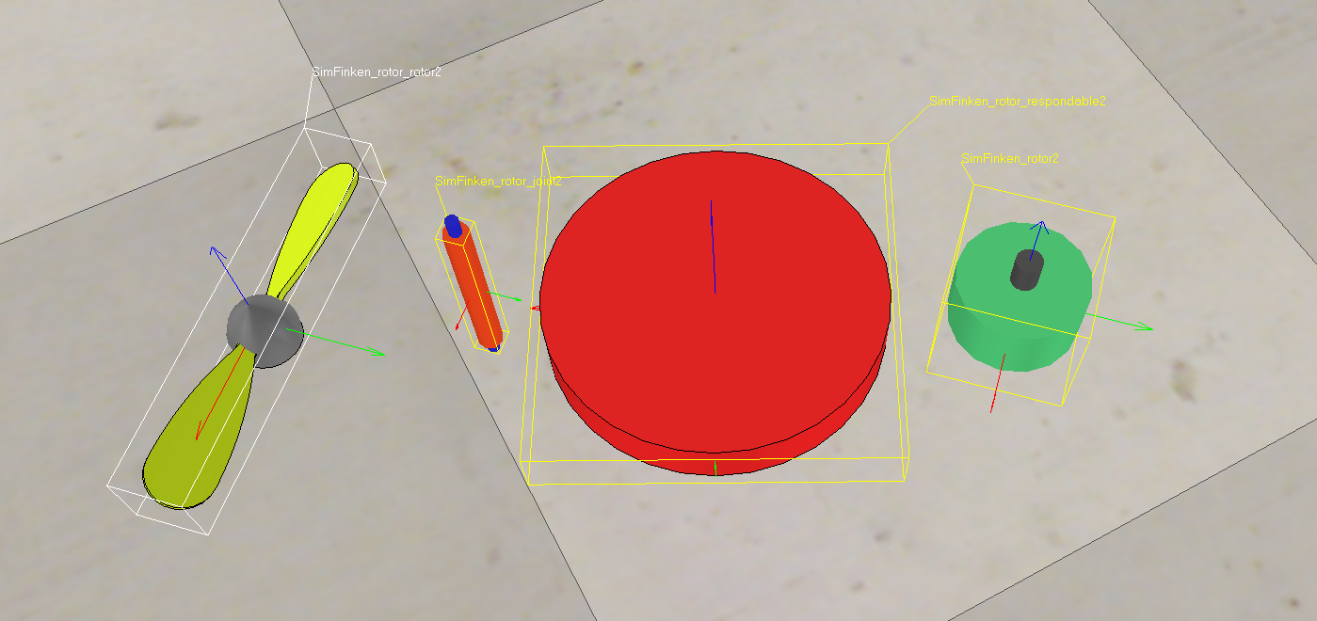
V-REP Simulation – Rotor
Dynamic objects for simulation, static objects for visualisation
Coupling via joints and force sensors
Particle simulation for the air stream created at runtime
Object structure was adopted from V-REP‘s example model
Notes:
Joints/force sensors needed to apply dynamics on static objects
Layers can be hidden
Resembls the whole model structue
Adapted from existing model

Slide 7
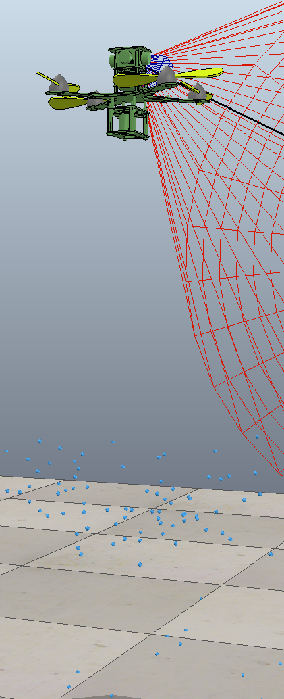
V-REP Simulation
Parameter | Value
Weight FINken | 396 g
Physics engine | Bullet
Simulation time step | 50 ms
Real time mode | enabled
Linear damping (drag) | 0.3
Notes:
Show particles
Explain damping
Explain real time

Slide 8
V-REP Simulation Control Flow
Forcing the virtual copter to the real copters orientation breaks physics
Simulated quadcopter uses PID fligth controller with real copter‘s data as input
Benefits
Stable flight during missing values (initialisation, lost messages)
Signal
finkenCore
pitch, roll, yaw
PID controller
finkenCore
pitch, roll, yaw
Thrust
For each rotor
height/throttle
height/throttle
FINken

Slide 9
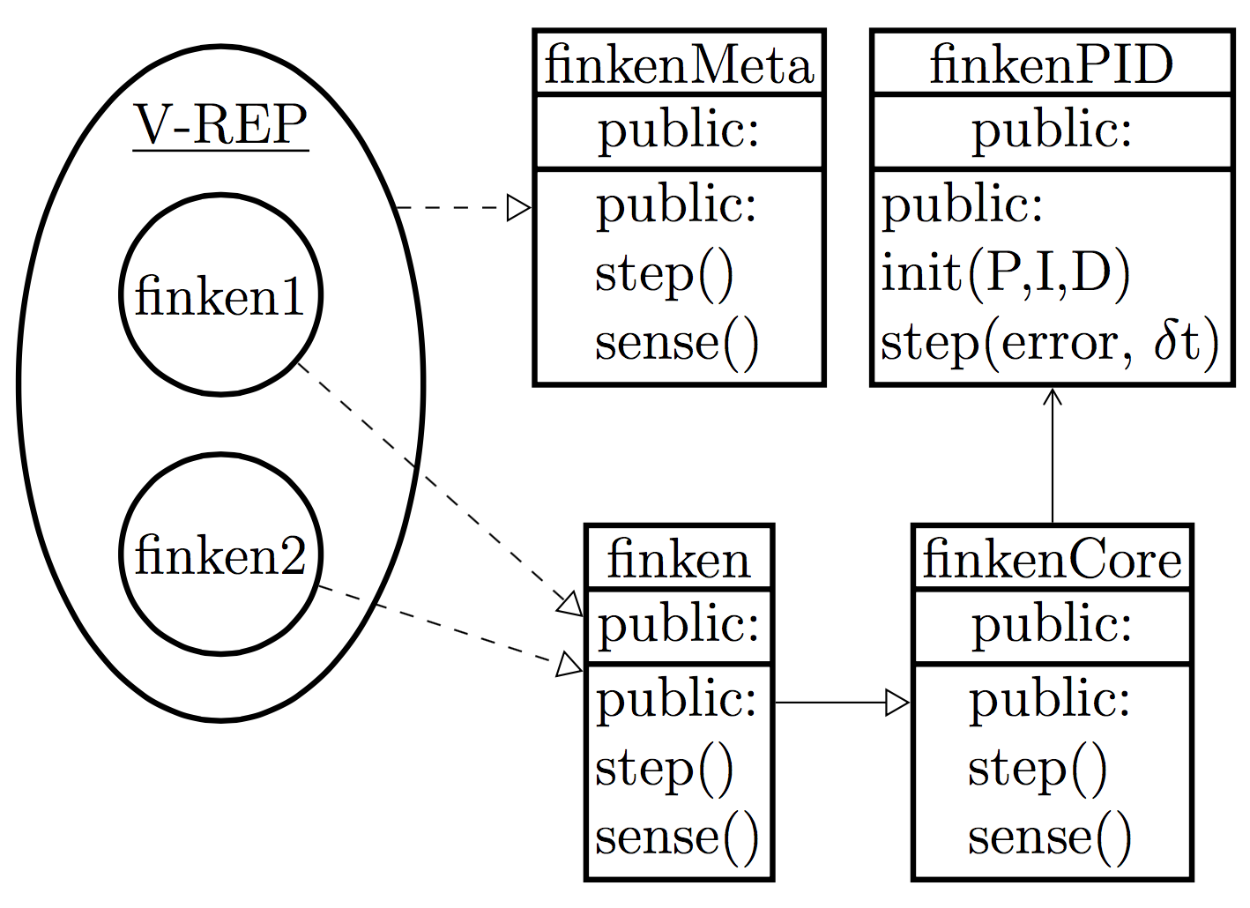
Lua Program Structure

Slide 10
Lua Program Structure
Everything runs inside a child script
Simulated FINken calls the methods of the Lua class finken
Extensions can be made externally
Good for modularity and version control
Flight control in an extra class

Slide 11
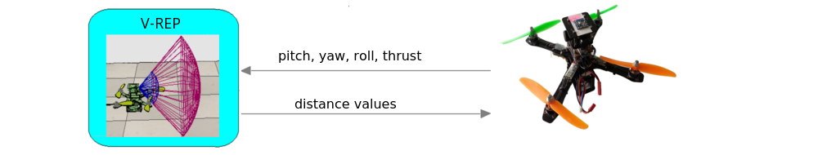
V-REP – Quadrocopters Communication
A reliable duplex communication between V-REP and quadrocopters needed.
- real quadrocopters send its pitch, yaw, roll to their coupled simulation models
- the simulation quadrocopter sends the values from its proximity sensors to the
real flying copter.

Slide 12
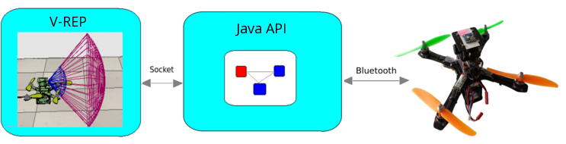
V-REP – Quadrocopters Communication
Communication is managed by an external program written in Java
- object oriented
- cross-platform
- facilitate building modular and reusable software

Slide 13
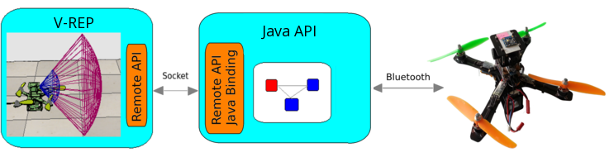
V-REP – Quadrocopters Communication
V-REP Remote API provides basic functions for getting/setting parameters
through an external program
- the control entity is external
- has Java binding which can be extended
- communication lag reduced reduced
- the control entity can control simulation and simulation objects

Slide 14

V-REP – Quadrocopters Communication
How does the external program communicate with the quadrocopter?
First idea:
Build a bluetooth communication link between the external program and
the quadrocopter.
Extra computational effort for the quadrocopter
Not scalable: many quadrocopters – low performance

Slide 15
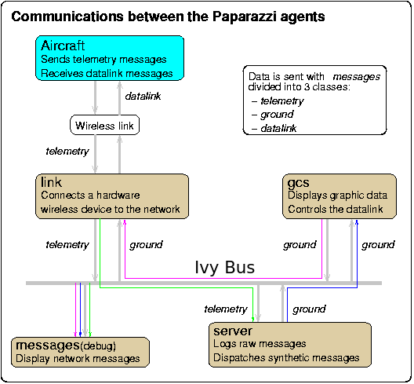
V-REP – Quadrocopters Communication
No need to build a communication channel
The quadrocopter already sends its telemetry to
the Paparazzi GS, which contain all data needed.
But how to retrieve this data?
The ground station uses Ivy-Bus for
communication between the software
components.

Slide 16

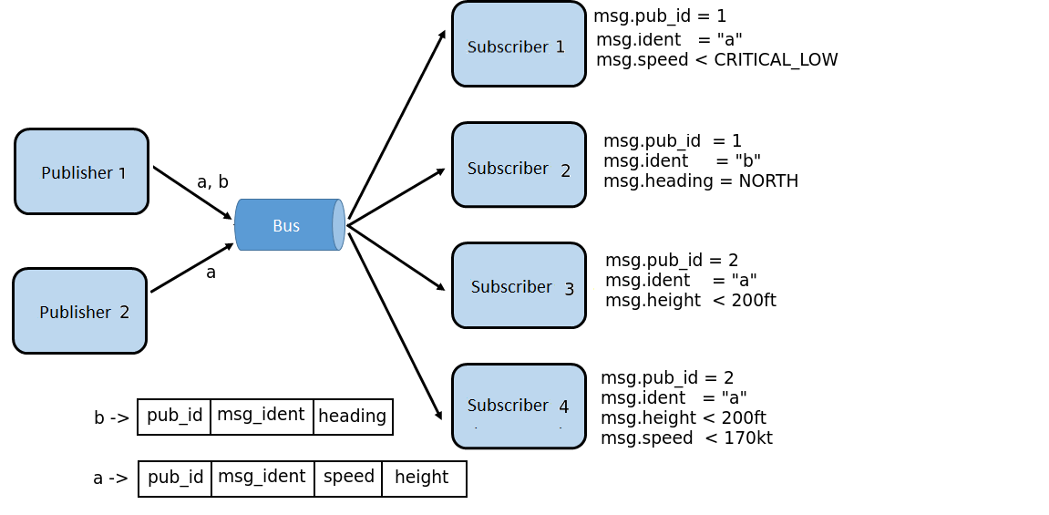
V-REP – Quadrocopters Communication
How about connecting to the Ivy-Bus and subscribe to the quadrocopter messages?
Coupling:
Space - No
Time - No
Flow - No

Slide 17

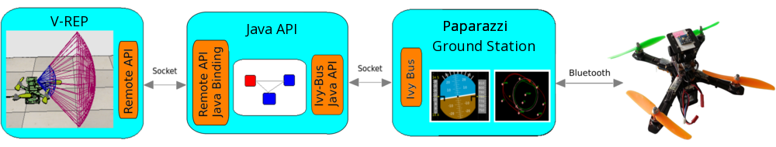
V-REP – Quadrocopters Communication
Ivy-Bus has Java binding
Filter messages by quadrocopter id
No space, time and flow coupling
Regular expression processing drops performance when bus loaded

Slide 18
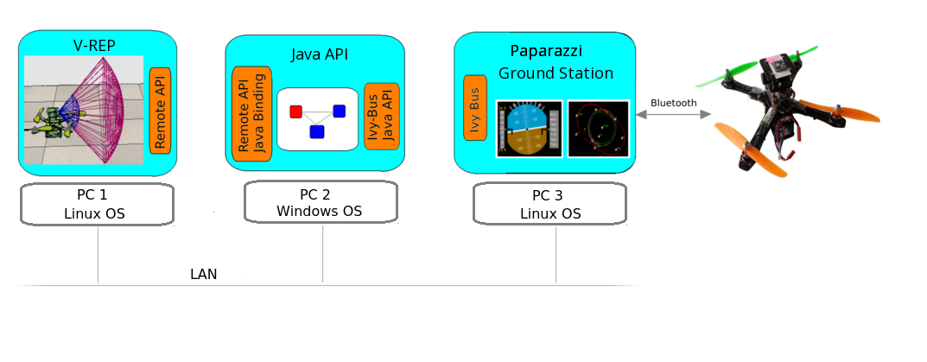
V-REP – Quadrocopters Communication
Distributed scenario
Both the V-REP Remote API and the IvyBus library use socket
communication, which allows us to distribute the application on
different machines.

Slide 19
V-REP – Quadrocopters Communication
Goals by the development of the Java API:
Consist of modules which are reusable
Easy extension for other mixed-reality scenarios.
Paparazzi compatible – use paparazzi xml configuration
Good object-oriented design:
S – Single-Responsibility
O – Open-Closed
L – Liskov substitution principle
I - Interface segregation
D – Dependency Inversion principle

Slide 20
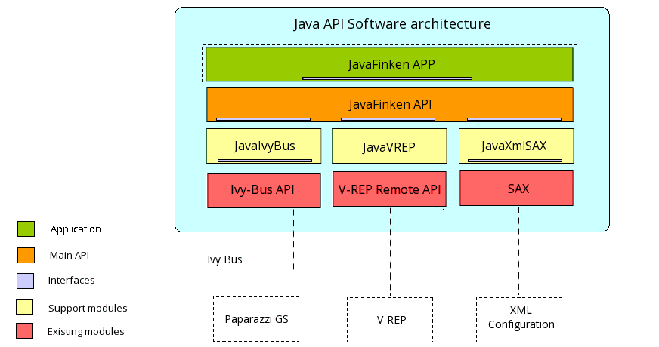
Software Architecture
JavaVREP API module:
Extends the V-REP Remote API and provides more utilities.
Provides mechanism for connecting/disconnecting to V-REP.
Fire notifications on connect/disconnect.
Encapsulates a scene object with all its properties in an abstract class.
Flexible mechanism for setting/getting object properties.
Retrieve the V-REP scene with all its object
Retrieve all virtual drones in the scene
Retrieve all real drones in the scene

Slide 21
Software Architecture
JavaIvyBus API module:
Extends the Ivy-Bus API and provides more functionality and utilities.
Define an abstract bus node class that can:
Connect/disconnect from Ivy Bus.
Subscribe to any message at runtime.
Unsubscribe from messages.
Fire notification on message receival.

Slide 22
Software Architecture
JavaXmlSax API module:
Defines an abstract XML reader, that:
Uses SAX parsing technology.
Can be extended and customized to read any XML file.

Slide 23
Software Architecture
JavaFinkenAPI module
Provides basic application logic
Define virtual and real drone classes as both V-REP object and Ivy-Bus nodes.
Management of the drones.
Attach a drone to Ivy-Bus.
Manage drone message subscription.
Manage message reception.
Calibration of sensor data.
Reading telemetry XML configuration.

Slide 24
Software Architecture
JavaFinken APP
An example GUI application build on top of the other modules.
Defines UI elements that allow to specify the IP addresses and ports where the V-REP and Paparazzi are located.
Connection/disconnection
Notification on error conditions
Monitoring and control of the quadrocopter objects .

Slide 25
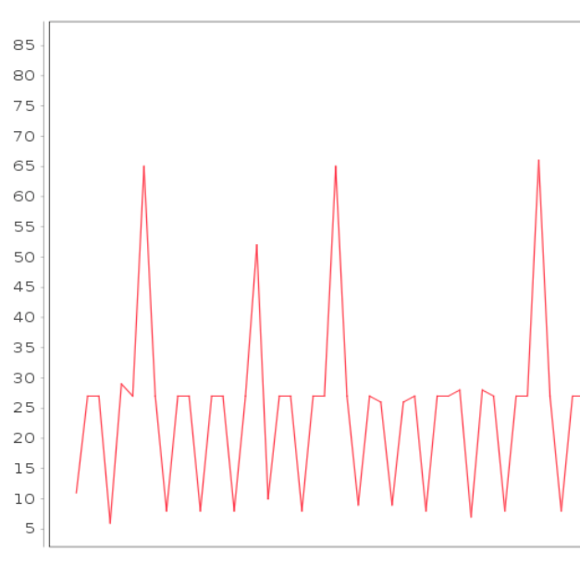
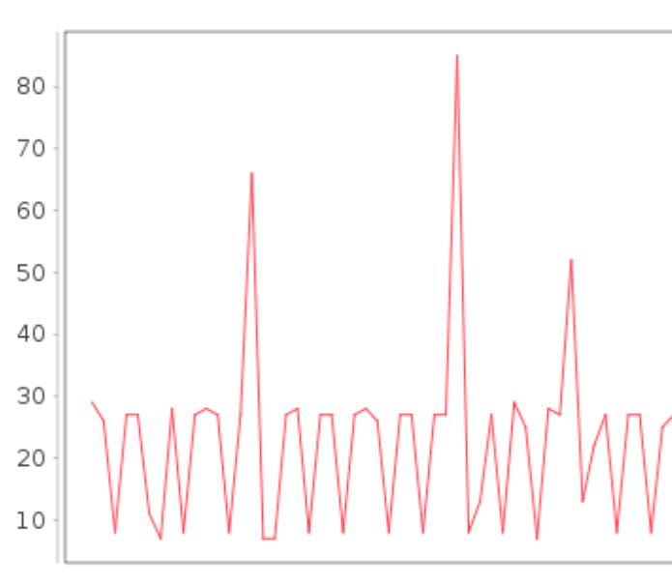
Evaluation – Communication Lag
Maximum one simulation step without new Value
Paparazzi buffering distorts message arrivals
 | Simulation Step | Configured Message time | Measured median | Measured Maximum
1 FINken | 50 ms | 22ms | 27 ms | 65 ms
2 FINken | 50 ms | 22 ms | 29 ms | 85 ms

Slide 26
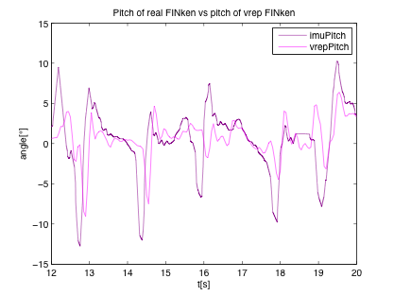
Evaluation – Movement Response
Real FINken‘s movement can be recognized in virtual FINken
Reaction delay <150ms (faster than ultrasound sensors)

Slide 27
Conclusion
Accomplishments
Running Simulation
Coupling of simulation and reality
Issues
Performance
Drift after short time
Future Work
Upscaling
Precise Model
Position correction
Module Import for real FINken’s software

Slide 28
Mixed-Reality Simulation of Quadcopter Swarms
Lukas Mäurer lukas.maeurer@st.ovgu.de
Vladimir Velinov vladimir.velinov@st.ovgu.de

