Slide 1
“The cheapest fee cost a family 324 pesos.”
ENVÍO CLARO · FINANCE TRACK · BANKING THE UNBANKED
WorldRemit · fee
$1.99 → 6,628 MXN
Finabien · fee
$2.99 → 6,952 MXN
The lower fee delivered less money. The difference was hidden in the exchange rate, and nobody shows senders that number before they pay. Envío Claro does, in Spanish, on the web, by phone, or by WhatsApp voice memo.
Source: Profeco, “Quién es Quién en el envío de dinero”, Aug 29, 2026 · $400 USD → Mexico, bank deposit
Latinos x AI Hackathon NYC · Oct 10, 2026
Notes:
[0:00–0:25] HOOK. Look at the room, not the slide.
"On August 29th, Mexico's consumer protection agency compared what families get when they send 400 dollars home. The service with the LOWER fee, a dollar ninety-nine, delivered 6,628 pesos. The one charging 2.99 delivered 6,952. The cheaper fee cost that family 324 pesos, about 19 dollars. Every month.
The fee is the part you see. The exchange rate is where the money goes, and nobody shows you that number before you pay. We built Envío Claro to show it, in Spanish, on the web, by phone, or by WhatsApp voice memo."

Slide 2
The fee is the small part; the exchange rate and a new cash tax are where the money goes
THE PROBLEM
3 costs
65–74%
~30%
Fee + a markup hidden in the exchange rate + a 1% federal tax if you pay in cash. Law requires showing the rate, not the markup.
of Honduran, Guatemalan and Salvadoran migrants have a bank account (vs 84% of Mexicans). Cash senders pay the tax, and comparison apps miss them.
of Honduras's GDP is remittances (El Salvador ~27%, Guatemala ~21%). Mexico received $61.7B in 2025.
CFPB Reg. E §1005.31 · IRC §4475 (since Jan 1, 2026)
BBVA Research via Telemundo / Crónica, 2026
UPI / Diario El Mundo 2025 · Banxico via Zeta Tijuana, Feb 2026
Who it's for on Monday: a mom in Corona, Queens who sends $300 to Honduras every month, pays cash at the bodega counter, prefers WhatsApp voice memos to apps, and has never been told what the exchange rate costs her.
Notes:
[0:25–0:55] PROBLEM.
"Every transfer has three costs: the fee, a markup hidden in the exchange rate, and since January 1st a 1% federal tax if you pay in cash, which a debit card avoids.
Who pays the most? Cash senders. Only 65 to 74% of Central American migrants have a bank account. Remittances are about 30% of Honduras's economy.
Our user is a mom in Corona sending 300 dollars to Honduras every month, paying cash at the bodega. She uses WhatsApp voice memos, not comparison apps. Nobody has ever shown her what the exchange rate costs."
(If you got interview quotes at lunch, say one here: "Today, ___ told us: '…'")

Slide 3
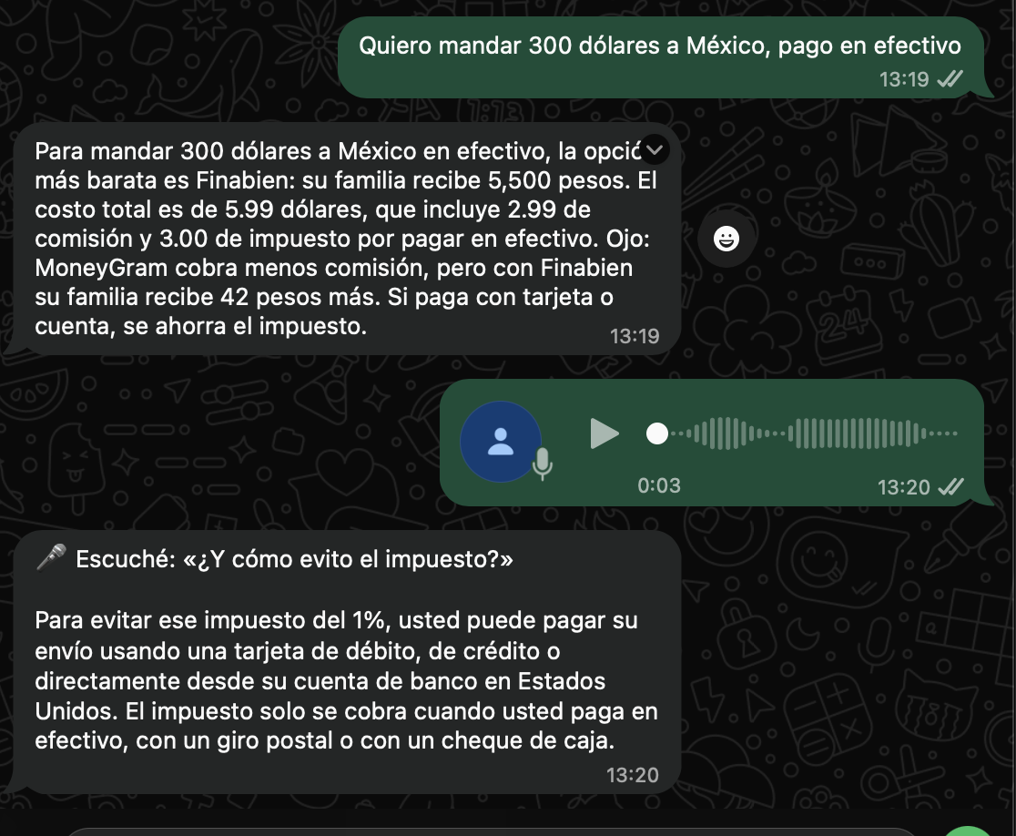
One honest answer, three ways to ask
THE PRODUCT: LIVE TODAY
WEB
envio-claro-ahora.base44.app
Amount, country, how you pay → every provider ranked by true total cost, plus alerts: fee trap, 1% cash tax, Directo a México closing, scam red flags. Read aloud in Spanish.
CALL
+1 (646) 212-2770
No smartphone, no reading needed. Say “300 dólares a Honduras, en efectivo” and hear the real cost in a Spanish voice.
CHAT
WhatsApp: text or voice memo
Ask follow-ups and get patient explanations. It replies “Escuché: …” so people know they were understood.
Same numbers on every channel: one tested cost engine. The AI explains; it never does the math.
Notes:
[0:55–2:00] LIVE DEMO (practice this; it's the moment that wins Functionality).
1) Phone on speaker: "Let me just call it." Dial +1 646 212 2770. Say: "Quiero mandar 300 dólares a Honduras, pago en efectivo." Let it answer (~5 s). Point out: it tells you the cheapest option, the hidden cost, and the 1% tax you can avoid with a debit card.
2) Web: open envio-claro-ahora.base44.app → $300 → México → Efectivo → Ver costo real. Point at the red fee-trap alert ("MoneyGram has the lowest fee, but Finabien delivers more") and the orange 1% tax alert. Tap Escuchar.
3) WhatsApp (show the screenshot or your phone): "And because our families talk in voice memos, you can just send one." Point at "Escuché…".
Backup if Wi-Fi or the call fails: use this slide's screenshot and say "here's the conversation from an hour ago."

Slide 4
Base44 is the app; every number is sourced, dated and tested
HOW IT'S BUILT
Base44
The web app families use: page, data (providers, corridors, resources, anonymous comparisons), AI Spanish summary, hosting
Daytona
Hosts the cost-engine API. Tests run inside the sandbox before every deploy; a failing test blocks the release
ElevenLabs
Spanish voice, speech-to-text for voice memos, and the WhatsApp agent that explains in depth
VAPI
Spanish phone agent. Calls our quote tool, so it repeats real numbers, never invented ones
Twilio
Phone number, WhatsApp, and a Function that receives voice memos
total_cost = fee + amount × markup + cash_tax
cash_tax = 1% × amount (only if paid in cash)
received = amount × mid_rate × (1 − markup)
Every provider row cites its source and date: Profeco, World Bank Remittance Prices Worldwide, provider sites
No referral fees from any provider. Neutrality is the product
No accounts. No names, numbers or immigration status stored
Educational information, not financial advice. Official hotlines are hardcoded, never AI-generated
Our test suite reproduces Profeco's 324-peso gap exactly. Mid-market rate: daily reference (open.er-api.com).
Notes:
[2:00–2:30] HOW IT'S BUILT (keep it fast; judges score Base44 at 20%).
"Base44 is the app families use: the page, the data with every provider's source and date, and the AI summary. The math lives in one place: a cost engine on Daytona, whose tests run inside the sandbox before every deploy. Our tests reproduce Profeco's 324-peso gap exactly.
ElevenLabs gives it a Spanish voice, transcribes voice memos and powers the WhatsApp agent. VAPI runs the phone line, Twilio connects the phone and WhatsApp.
The rule everywhere: the AI explains, it never does the math. And we take no referral fees from any provider. Neutrality is the product."

Slide 5
Comparison sites serve people already online; we serve the person in line with cash
WHY NOW · BUSINESS MODEL · NEXT
Why now
Model
Next 90 days
1% cash-remittance tax since Jan 1, 2026
Banxico's Directo a México closes Nov 20, 2026, with no announced replacement
Global average cost 6.36% vs the 3% UN target (World Bank, Q3 2025)
Free for families, always
Credit unions, consulates and community organizations license a white-label version
Never paid by providers. Monito and others take referral fees; we don't
WhatsApp Business approval (out of sandbox)
Live provider quotes + more corridors (El Salvador, Ecuador)
Pilot with a NYC Financial Empowerment Center
Try it now: envio-claro-ahora.base44.app · +1 (646) 212-2770
github.com/carltonking/envio-claro
Notes:
[2:30–3:00] WHY NOW + MODEL + CLOSE.
"Why now: the cash tax started this year, and Banxico's Directo a México program shuts down November 20th with no replacement announced.
Comparison sites like Monito exist, but they serve people already online and they're paid by the providers they rank. We're free for families and we never take a cent from providers. Credit unions, consulates and community organizations license it for their members.
Next: WhatsApp Business approval, live provider quotes, and a pilot with a NYC Financial Empowerment Center.
Try it right now: call the number on the screen. Gracias."

