Slide 1
The Five Habits of a Software Developer
From "it runs" to "it's reproducable"
Notes:
Welcome back from the history section. You've seen 80 years of the industry learning the same lessons over and over. Now let's bring it to your desk. Everything that follows uses a single example — a tumor growth analysis — that we'll improve step by step.

Slide 2
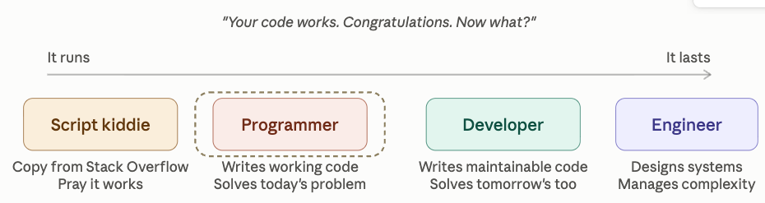
The Progression

Slide 3
Programmer vs. Software Developer
 | Programmer | Software Developer
Goal | Make it work | Make it work, readable, testable, and maintainable
Naming | `df`, `x`, `g` | `tumor_data`, `patient_measurements`, `growth_rate_mm3_per_day`
Structure | One long script | Functions, modules, clear separation
Testing | Run it. Squint at the output – “looks right to me” | Automated tests with known inputs and expected outputs
Dependencies | "It works on my machine” ¯\_(ツ)_/¯ | Pyproject.toml, Requirements.txt or environment.yml
Documentation | None or a cryptic comment from 2021 | Docstrings, README, setup instructions
Error handling | Crash and stare at the traceback | Validate inputs, informative errors. "Patient ID not found in cohort file"
Version control | Copy files or folder, append date project_backup_mar2024_old_NEW/ | Git with meaningful commits "fix: correct dose-response curve fitting"
Notes:
This isn't about job titles — it's about habits. A physicist who writes code with these habits IS a software developer. The table is deliberately provocative. Ask: "Which column sounds more like your code right now?" Most will laugh and point left.

Slide 4
The Journey
1
2
3
4
5
6
Write code that runs
→
Name things clearly
→
Modularize
→
Add tests
→
Use version control
→
Document it
Each habit builds on the last. Today we cover all five.
Notes:
This is a left-to-right progression. The key point: you don't need to do all five at once. Each one independently improves your code. But they compound — naming makes splitting easier, splitting makes testing easier, and so on. Point out that Git and documentation have their own dedicated sessions later, so today those two get a brief introduction.

Slide 5
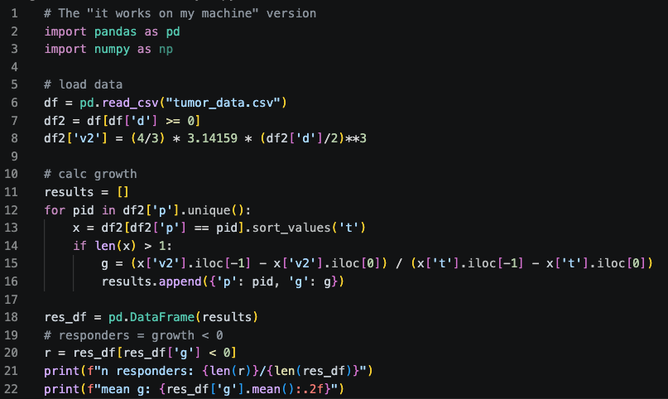
Count the Sins
Notes:
Don't explain the code. Let them read it for 30 seconds, then ask: "Show of hands — who has written code that looks like this?" (pause for laughs). Then ask someone to name a sin they see. Let THEM lead the discussion. The seven sins they should find:
1. df, df2, x, r, g — meaningless variable names
2. 3.14159 — magic number instead of math.pi
3. No units anywhere (d? v2? mm? cm³?)
4. No functions — everything in one flat block
5. No tests
6. v2 implies a v1 that doesn't exist (or got lost)
7. The comment "responders = growth < 0" documents what the next line does — the name is_responder() would have made the comment unnecessary
8. import numpy as np — imported but never used. Classic copy-paste boilerplate.
This is the "before" picture. The rest of the session transforms it step by step.

Slide 6
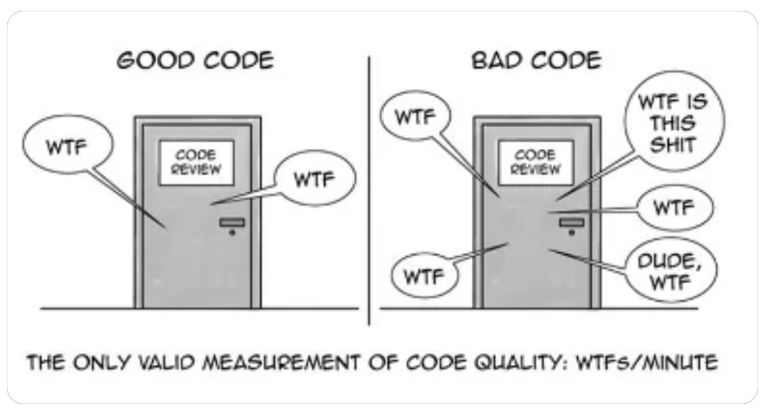
Notes:
Don't explain the code. Let them read it for 30 seconds, then ask: "Show of hands — who has written code that looks like this?" (pause for laughs). Then ask someone to name a sin they see. Let THEM lead the discussion. The seven sins they should find:
1. df, df2, x, r, g — meaningless variable names
2. 3.14159 — magic number instead of math.pi
3. No units anywhere (d? v2? mm? cm³?)
4. No functions — everything in one flat block
5. No tests
6. v2 implies a v1 that doesn't exist (or got lost)
7. The comment "responders = growth < 0" documents what the next line does — the name is_responder() would have made the comment unnecessary
8. import numpy as np — imported but never used. Classic copy-paste boilerplate.
This is the "before" picture. The rest of the session transforms it step by step.

Slide 7
Count the Sins
Meaningless variable names
3.14159 – magic number?
No units anywhere (mm, cm?)
No functions – one long script
No tests
v2 implies a v1?
Poor comments
Import numpy as np – not used
Hard-coded input data file name
No error checking on reading input data
Notes:
Don't explain the code. Let them read it for 30 seconds, then ask: "Show of hands — who has written code that looks like this?" (pause for laughs). Then ask someone to name a sin they see. Let THEM lead the discussion. The seven sins they should find:
1. df, df2, x, r, g — meaningless variable names
2. 3.14159 — magic number instead of math.pi
3. No units anywhere (d? v2? mm? cm³?)
4. No functions — everything in one flat block
5. No tests
6. v2 implies a v1 that doesn't exist (or got lost)
7. The comment "responders = growth < 0" documents what the next line does — the name is_responder() would have made the comment unnecessary
8. import numpy as np — imported but never used. Classic copy-paste boilerplate.
This is the "before" picture. The rest of the session transforms it step by step.

Slide 8
Habit 1: Name Things
Names are the primary way code communicates intent.
Code is read more than it is written.
Notes:
This is the highest-impact, lowest-effort habit. Renaming variables costs nothing and immediately makes code reviewable. Start with: "What does `g` mean? Growth? Grams? Gravity? A musical note?”
A good name tells the reader what something is or does without them having to read the implementation. In Python, the convention is simple and universal: variables are nouns, functions are verbs, everything is snake_case, constants are UPPER_SNAKE_CASE.

Slide 9
Why Name Things?
Highest-impact, lowest-effort habit.
Good names enable:
Understandability and readability of code without looking at implementation details.
Maintainability. Less fear when fixing or evolving code.
Less throw-away code that nobody wants to bother with.
Value and re-usability of code.
Notes:
The

Slide 10
Naming Rules (Python)
Variables are nouns: patient_id, tumor_volume, cohort_summary
Functions are verbs: load_measurements(), compute_growth_rate(), is_responder()
Boolean functions/variables start with is_, has_, should_: is_responder, has_baseline_scan
No single letters except loop counters in trivial loops. x, y, d, tmp are not names — they're placeholders you forgot to rename.
No magic numbers. If you see 0.0293 in code, give it a name: STANDARD_TUMOR_DENSITY_G_PER_MM3 = 0.0293.
Constants are upper snake-case and appear at the top of the file: STANDARD_TUMOR_DENSITY_G_PER_MM3 = 0.0293
Embed units in the name when they matter: diameter_mm, dose_mg_per_kg, duration_seconds
See Mars Climate Orbiter crash https://science.nasa.gov/mission/mars-climate-orbiter/
Notes:
Walk through each rule with the tumor example. The units rule is especially important for physics code — a Mars Climate Orbiter crashed because of a unit mismatch. Ask: "Has anyone ever had a bug that turned out to be a unit confusion?" Guaranteed someone has.
The function naming rule is powerful: if you can't name the function with a clear verb, you probably don't understand what it does yet. That's a design signal, not just a style issue.

Slide 11
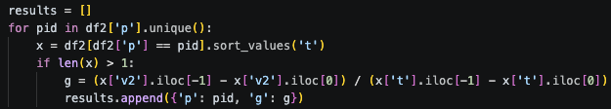
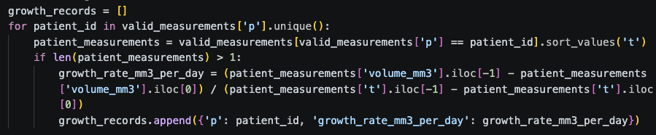
Naming: Before and After
df2['v2'] = (4/3) * 3.14159 * (df2['d']/2)**3
g = (x['v2'].iloc[-1] - x['v2'].iloc[0]) / (x['t'].iloc[-1] - x['t'].iloc[0])
Before:
import math
diameter_mm = measurements['diameter_mm']
volume_mm3 = (4/3) * math.pi * (diameter_mm / 2) ** 3
growth_rate_mm3_per_day = (
(volumes.iloc[-1] - volumes.iloc[0])
/ (days.iloc[-1] - days.iloc[0])
)
After:
Same calculation. One you can read six months later.
Notes:
Put both on screen side by side if possible. Ask: "Which one would you rather debug at 11 PM before a conference deadline?" The before version requires you to hold a mental translation table (d = diameter, v2 = volume, t = time, g = growth). The after version IS the translation table. Note: math.pi vs 3.14159 — not just cleaner, but more precise (15 decimal digits vs 5).

Slide 12
Naming: Before and After
Show bad_analysis.py vs. better_names_analysis.py side by side.
Notes:
Put both on screen side by side if possible. Ask: "Which one would you rather debug at 11 PM before a conference deadline?" The before version requires you to hold a mental translation table (d = diameter, v2 = volume, t = time, g = growth). The after version IS the translation table. Note: math.pi vs 3.14159 — not just cleaner, but more precise (15 decimal digits vs 5).

Slide 13
Habit 2: Modularity
Split into functions - One function, one job that you can reason about in isolation
Group related functions in separate files when dealing with large code base
Notes:
Transition line: "Now that we can read the names, notice the code is still one giant block. What if you need the volume calculation in a different analysis? Copy-paste it? That's how bugs breed."
Principle. A function should do one thing. A file should contain related functions. The opposite of modular code is a 2,000-line script where changing anything might break everything. The goal: write functions you can reason about in isolation.
This is Parnas from your timeline — information hiding. Each function owns a decision. You can change how a function works without changing everything that calls it, as long as you don't change what it does.

Slide 14
Why Split Into Functions?
Readability: The main script now reads like a summary - details live in the functions,
Information Hiding: Each function owns a decision, action or transformation (e.g. Parnas)
Change isolation: Limit blast-radius of changes
Testing: You can't test a 50-line script easily. You CAN test a 5-line function.
Debugging: Error in growth rate? You know exactly where to look.
Reuse: Need calculate_sphere_volume() in another analysis? Import it.
Collaboration: Two people can work on different functions without conflicts.
Notes:
The reuse argument lands well with this audience — they often have multiple analysis scripts that share calculations. Ask: "How many of you have copy-pasted a function between scripts?" Then: "What happens when you find a bug in the original — do you remember everywhere you pasted it?"

Slide 15
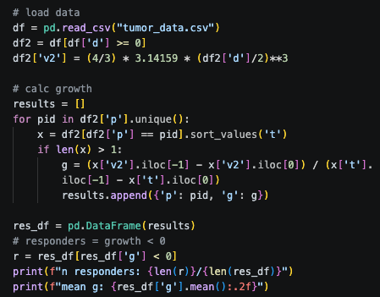
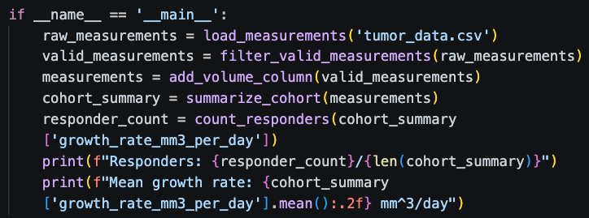
Which do you prefer?
Undisciplined code
Refactored code
Notes:
Notice he code with functions:
Reads like a summary.
The variable and functions names aid in understandability instead of hindering it
Comments are not really needed.
The functions encapsulate the implementation details, e.g. information hiding
They can be tested in isolation.

Slide 16
Writing Good Functions
Single responsibility: Do one thing
Naming: verb, describes what it does, not how
Minimize: arguments (parameters)
Limit: indentation
Pure: don’t rely on state (global variables) outside of function, don’t change state outside of function
Length: ideally 1 -30 lines, 50 lines max. Less is better. Scroll test
Group: related functions (more than a few) should live in a separate file
Notes:
Grouping function example:
Imagine loading input data could come from different sources. Such as:
.CSV file
A database
A remote API
Another function
Etc…

Slide 17
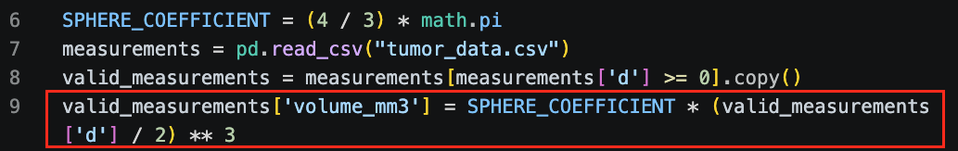
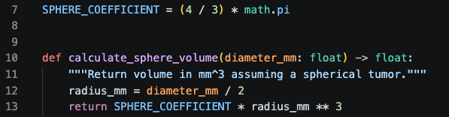
Split: A Function Emerges
From this:
To this:
Type hints tell you what goes in and what comes out.
Docstring tells you what it does in one line.
Pure function — no side effects, no global state, same input → same output.
Notes:
Walk through the anatomy: type hints on the signature (float in, float out), a one-line docstring, and a clear calculation. Point out this is testable in isolation — you don't need a CSV file or a DataFrame to verify the volume formula. You just call calculate_sphere_volume(20) and check the answer.
The phrase "pure function" is worth introducing — it means no side effects. It doesn't read files, doesn't modify global variables, doesn't print anything. Given the same diameter, it always returns the same volume. This is the gold standard for testable code.

Slide 18
Functions: Before and After
Show bad_analysis.py vs. good_analysis.py side by side.
Notes:
Put both on screen side by side if possible. Ask: "Which one would you rather debug at 11 PM before a conference deadline?" The before version requires you to hold a mental translation table (d = diameter, v2 = volume, t = time, g = growth). The after version IS the translation table. Note: math.pi vs 3.14159 — not just cleaner, but more precise (15 decimal digits vs 5).

Slide 19
Tips: Creating Functions
Two contexts to be aware of:
Extracting functions from existing code – also known as refactoring
Writing functions from the start – design of new code
Notes:
The reuse argument lands well with this audience — they often have multiple analysis scripts that share calculations. Ask: "How many of you have copy-pasted a function between scripts?" Then: "What happens when you find a bug in the original — do you remember everywhere you pasted it?"

Slide 20
Tips: Extracting Functions from Existing Code
Notice when a function is trying to emerge from your code.
Signal | What it means
You wrote a comment describing the next block | That comment is a function name
You copy-pasted code | Extract it before the copies diverge
You said "and" describing what a block does | That's two or more functions
You can't test it without running the whole script | It's trapped — extract it
You're scrolling to remember what something does | It needs a name
Notes:
The comment signal — the most reliable trigger
If you wrote a comment describing what the next block does, that comment is the function name. The code that follows is the function body.
The copy-paste signal
Any code that is copied and pasted — even with small modifications — is a function waiting to be written. If you do it twice, extract it. If you do it three times, it's a bug farm. Each copy will drift independently.
The scroll signal
If you find yourself scrolling up to remind yourself what a block of code does, it is too far from its context. It should be a function with a name that makes scrolling unnecessary.
4. The "and" signal
Read what a block of code does out loud. If the description contains the word "and", it is doing more than one thing and should be split. "This block loads the data and filters invalid rows and computes volumes" — that is three functions.
5. The testing signal
If you cannot test a piece of logic without running the entire script, it is trapped inside the script when it should be a function. This becomes the bridge back to Habit 3 (testing) — you cannot test what you cannot call.

Slide 21
Tips: Designing/writing Functions for New Code
Before diving into the implementation:
First, understand the problem or purpose of the solution - ask question, identify assumptions
What is the expected result? Define the output and what does it look like?
What is the input and what does it look like?
What are the constraints?
Work backwards from the desired or expected output to form early steps how to get there
Write functions first (even if they don’t do anything), write a test for the function, then iterate on the implementation of the function.

Slide 22
Habit 3: Write Tests
Trust, but verify — automatically
Notes:
Transition: "You've got named variables and clean functions. How do you know they're correct? You test them — not by eyeballing the output, but by writing code that checks the code."

Slide 23
Why Test?
You already test — you just do it badly.
What you do now: Run the script. Look at the output. Think "that looks about right."
What could go wrong?
What testing gives you: A machine that checks your work, every time, in seconds.
"Looks right" ≠ IS right
You can't remember what "right" looked like last month
You change one thing and silently break another
Notes:
The "you already test" framing is important — it meets them where they are rather than introducing testing as a foreign concept. They DO check their output. The habit is to automate that checking so it happens reliably. Mention: most irreproducible results in scientific computing aren't fraud — they're undetected bugs. Testing is a reproducibility tool.

Slide 24
A Test Is Just an Assert
def test_sphere_volume_known_value():
# 20mm diameter → 10mm radius → (4/3) × π × 10³
expected = (4 / 3) * math.pi * 1000
actual = calculate_sphere_volume(20)
assert math.isclose(actual, expected)
def test_sphere_volume_zero():
assert calculate_sphere_volume(0) == 0
That's it. Known input. Expected output. Assert they match.
Notes:
Demystify testing. A test is: call the function with a known input, check the output matches what you calculated by hand. The math.isclose is important for floating-point comparison — never use == with floats.
The zero test is a boundary case. What happens at the edges? Good tests check normal cases AND edge cases. Ask: "What would you test for negative diameters?" — that's a design question the test forces you to answer.

Slide 25
Testing Behavior, Not Just Math
def test_shrinking_tumor_is_responder():
measurements = pd.DataFrame({
'day': [0, 90],
'volume_mm3': [1000.0, 400.0],
})
rate = compute_growth_rate(measurements)
assert rate < 0
assert is_responder(rate)
def test_growing_tumor_is_not_responder():
measurements = pd.DataFrame({
'day': [0, 90],
'volume_mm3': [500.0, 1500.0],
})
rate = compute_growth_rate(measurements)
assert rate > 0
assert not is_responder(rate)
Notes:
Now we're testing scientific logic, not just formulas. A tumor that shrinks should be classified as a responder. A tumor that grows should not. These tests encode your scientific understanding — if someone changes the responder threshold or the growth rate formula, these tests catch it immediately.
Point out: the test creates its OWN data. It doesn't depend on a CSV file existing. That's intentional — tests should be self-contained and reproducible anywhere.

Slide 26
Running Tests
$ python -m pytest test_good_analysis.py -v
test_good_analysis.py::test_sphere_volume_known_value PASSED
test_good_analysis.py::test_sphere_volume_zero PASSED
test_good_analysis.py::test_shrinking_tumor_is_responder PASSED
test_good_analysis.py::test_growing_tumor_is_not_responder PASSED
========= 4 passed in 0.3s =========
Four tests. 0.3 seconds. Run them every time you change anything.
Notes:
Show this as a terminal screenshot if possible. The green "PASSED" is satisfying — it's immediate feedback. Mention pytest discovers tests automatically by naming convention (files starting with test_, functions starting with test_). No configuration needed. They can run this TODAY with `pip install pytest`.

Slide 27
Habit 4: Version Control
A time machine for your code
Notes:
Brief section — 4 minutes max. The goal is motivation, not tutorial. The Git session covers the mechanics later. Your line: "We've been improving this code step by step. What if you need to go back? What if a collaborator makes a change that breaks something? What if you need to prove exactly which code produced a published result?"

Slide 28
Not version control
analysis.py
analysis_v2.py
analysis_v2_fixed.py
analysis_v3_FINAL.py
analysis_v3_FINAL_really.py
analysis_v3_FINAL_use_this_one.py
analysis_backup_March.py
Notes:
The data_final_v3_REAL.py joke should land — everyone has done this. Git eliminates the need for filename-based versioning entirely. Mention: "Every version of every file, with a message explaining what changed and why. No more v2, v3, FINAL, REAL_FINAL."
Don't go deeper — just plant the seed and point them to the Git session.

Slide 29
Git in 60 Seconds
The dedicated Git session will cover the mechanics.
What it does: Records every version of every file. You can always go back.
Why it matters for: Reproducibility
Version control for:
Source code
Scripts
Configuration files
Data
Dependencies (e.g. libraries)
For now: if data_final_v3_REAL.py is in your workflow, Git replaces it.
Reproducibility — tag the exact code that produced a figure, plot or value in a paper
Collaboration — merge changes from multiple people without overwriting
Safety net — broke something? Revert to yesterday
Notes:
The data_final_v3_REAL.py joke should land — everyone has done this. Git eliminates the need for filename-based versioning entirely. Mention: "Every version of every file, with a message explaining what changed and why. No more v2, v3, FINAL, REAL_FINAL."
If your code produced a number that went into a paper, you must be able to reproduce the exact version of the code that produced it. Git is how you do that. Everything else is negotiable. "
Don't go deeper — just plant the seed and point them to the Git session.

Slide 30
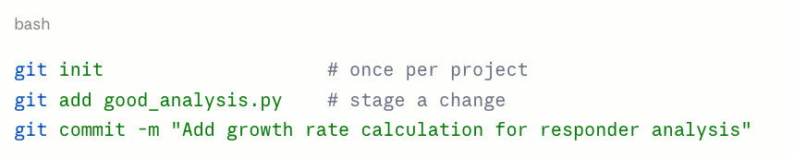
Minium Viable Git
Notes:
A good commit message completes the sentence "If applied, this commit will ___". Present tense, imperative mood. "Fix unit conversion bug in volume calculation," not "fixed stuff."

Slide 31
Habit 5: Document It
The README is for you, six months from now
Notes:
Also brief — 4 minutes. Documentation has its own session. Your line: "You think you'll remember what this code does. You won't. The person most likely to be confused by your code is future you."

Slide 32
Documentation: The Minimum
Docstrings — one line per function describes what the code does not how it does it:
def calculate_sphere_volume(diameter_mm: float) -> float:
"""Calculate sphere volume from diameter."""
README.md — one file per project:
What does this project do?
How do I run it?
What data does it need?
The dedicated documentation session will cover the details.
For now: if a function doesn't have a docstring, add one. If your project doesn't have a README, write one.
Notes:
Keep it practical and low-bar. One-line docstrings and a basic README are the floor, not the ceiling. The documentation session will cover more sophisticated approaches.
The type hints we added earlier (float → float) are themselves a form of documentation — they tell the reader what the function expects and returns without reading the body. That's "self-documenting code" in practice.

Slide 33
The Five Habits — Recap
1
Name things — nouns for variables, verbs for functions, units in names
2
Modularity — create functions with one job, group related functions in separate files/modules
3
Write tests — known input, expected output, assert they match, automate testing
4
Version control — every version recorded, always reversible *(dedicated session)*
5
Document it — docstrings + README as the floor *(dedicated session)*
Each one independently improves your code. Together they compound.
Notes:
Quick recap — no more than 60 seconds. Then: "You have the bad version and the good version in your download pack. Try the exercises in the README. The most valuable exercise: take YOUR code — the script you're working on right now — and apply Habit 1. Just rename the variables. See how it feels."
The download pack includes: bad_analysis.py, good_analysis.py, test_good_analysis.py, make_data.py, tumor_data.csv, and README.md.

Slide 34
The Code You Write Today Is the Code You Debug Tomorrow
Start with one habit. Then add another.
Download pack: bad_analysis.py, good_analysis.py, test_good_analysis.py, make_data.py, tumor_data.csv, README.md
Notes:
Final slide — leave this up during questions. The closing line is the takeaway: you don't need to adopt all five habits at once. Start with naming. Then try splitting a function out. Then write one test. The compound effect kicks in quickly.

