Slide 1
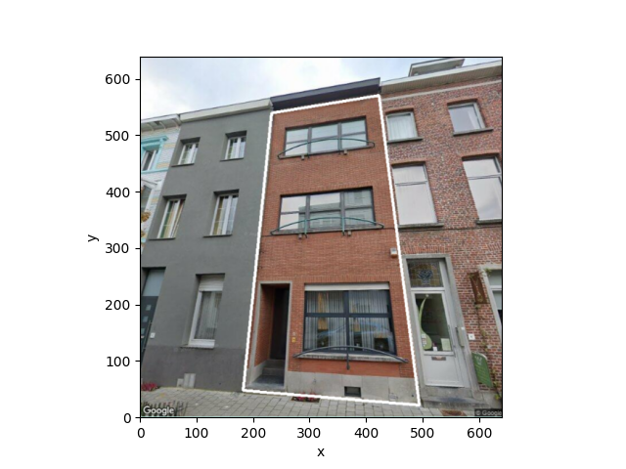
(264,562)
(454,617)
(225,111)
(530,72)

