Slide 2

What is bedtools?
Developed by the Quinlan lab at the University of Utah
“A swiss-army knife of tools for a wide-range of genomics analysis tasks”
Enables “genome arithmetic: that is, set theory on the genome”
Centered around the .bed file format
Installed on the Spec Ops Image
Command format:
bedtools [sub-command] [options]

Slide 3
The .bed file format
A tab-delimited file containing 3 required columns and 9 optional columns.
No column headers.
Annotations refer to a fasta file, but some analysis can be done without that file.
Bare minimum: BED3 file:
chr1 1 10
chr1 2 4351283
chr6 54 54
chr2 5 15
chr1 181393 198124
chromosome | start_position | end_position

Slide 4
BED4 file – with a name column:
chromosome | start_position | end_position | name
chr1 1 23 FLASH_guide_1
chr1 2 4351283 FLASH_target_1
chr6 54 54 FLASH_target_2
chr2 5 15 FLASH_target_3
chr1 181393 198124 FLASH_target_4
BED6 file – with score and strand columns:
chromosome | start_position | end_position | name | score | strand
chr1 1 23 FLASH_guide_1 1 +
chr1 2 4351283 FLASH_target_1 1 +
chr6 54 54 FLASH_target_2 1 -
chr2 5 15 FLASH_target_3 10 +
chr1 181393 198124 FLASH_target_4 10 +
BED12 file – with various graphics parameters
chromosome | start_position | end_position | name | score | strand | thickStart | thickEnd | itemRgb | blockCount | blockSizes | blockStarts

Slide 5
BEDPE file – for paired end sequencing or other disjointed features. At least 6 columns:
chrom1 | start1 | end1 | chrom2 | start2 | end2 | name | <etc.>
chr1 1 150 chr1 101 250 read_pair_1
chr1 2 151 chr1 302 451 read_pair_2
chr6 501 650 chr1 45601 45751 read_pair_3

Slide 6
Useful bedtools commands
bamtobed: bedtools bamtobed [options] -i <bam file>
Converts a bam file (reads mapped to a fasta file) to a bed file
bed file will have one line per read
“/1” or “/2” is appended to the read name to indicate read 1 or read 2
With the –bedpe flag, a .bedpe file will be generated with one line per read pair
If paired reads aren’t on the same chromosome, the alphanumerically earlier chromosome comes first
Orientation with insert size > 0 is chosen
$ bedtools bamtobed -i reads.ba -bedpe | head -3
chr7 1189650 1189651 chr7 1189700 1189701 TUPAC_0001:3:1:0:1452#0 37
chr11 765606 765656 chr11 769934 769984 TUPAC_0001:3:1:0:1472#0 37
Chr20 704674 704724 chr20 708987 709037 TUPAC_0001:3:1:1:1833#0 37

Slide 7

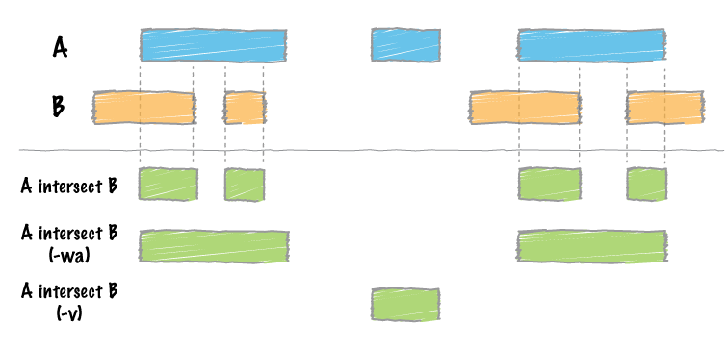
Useful bedtools commands
intersect: bedtools intersect [options] -a <file> -b <file>

