Slide 1
DASHit
Cupcakes and Coding, Amy Lyden
05/16/19

Slide 2
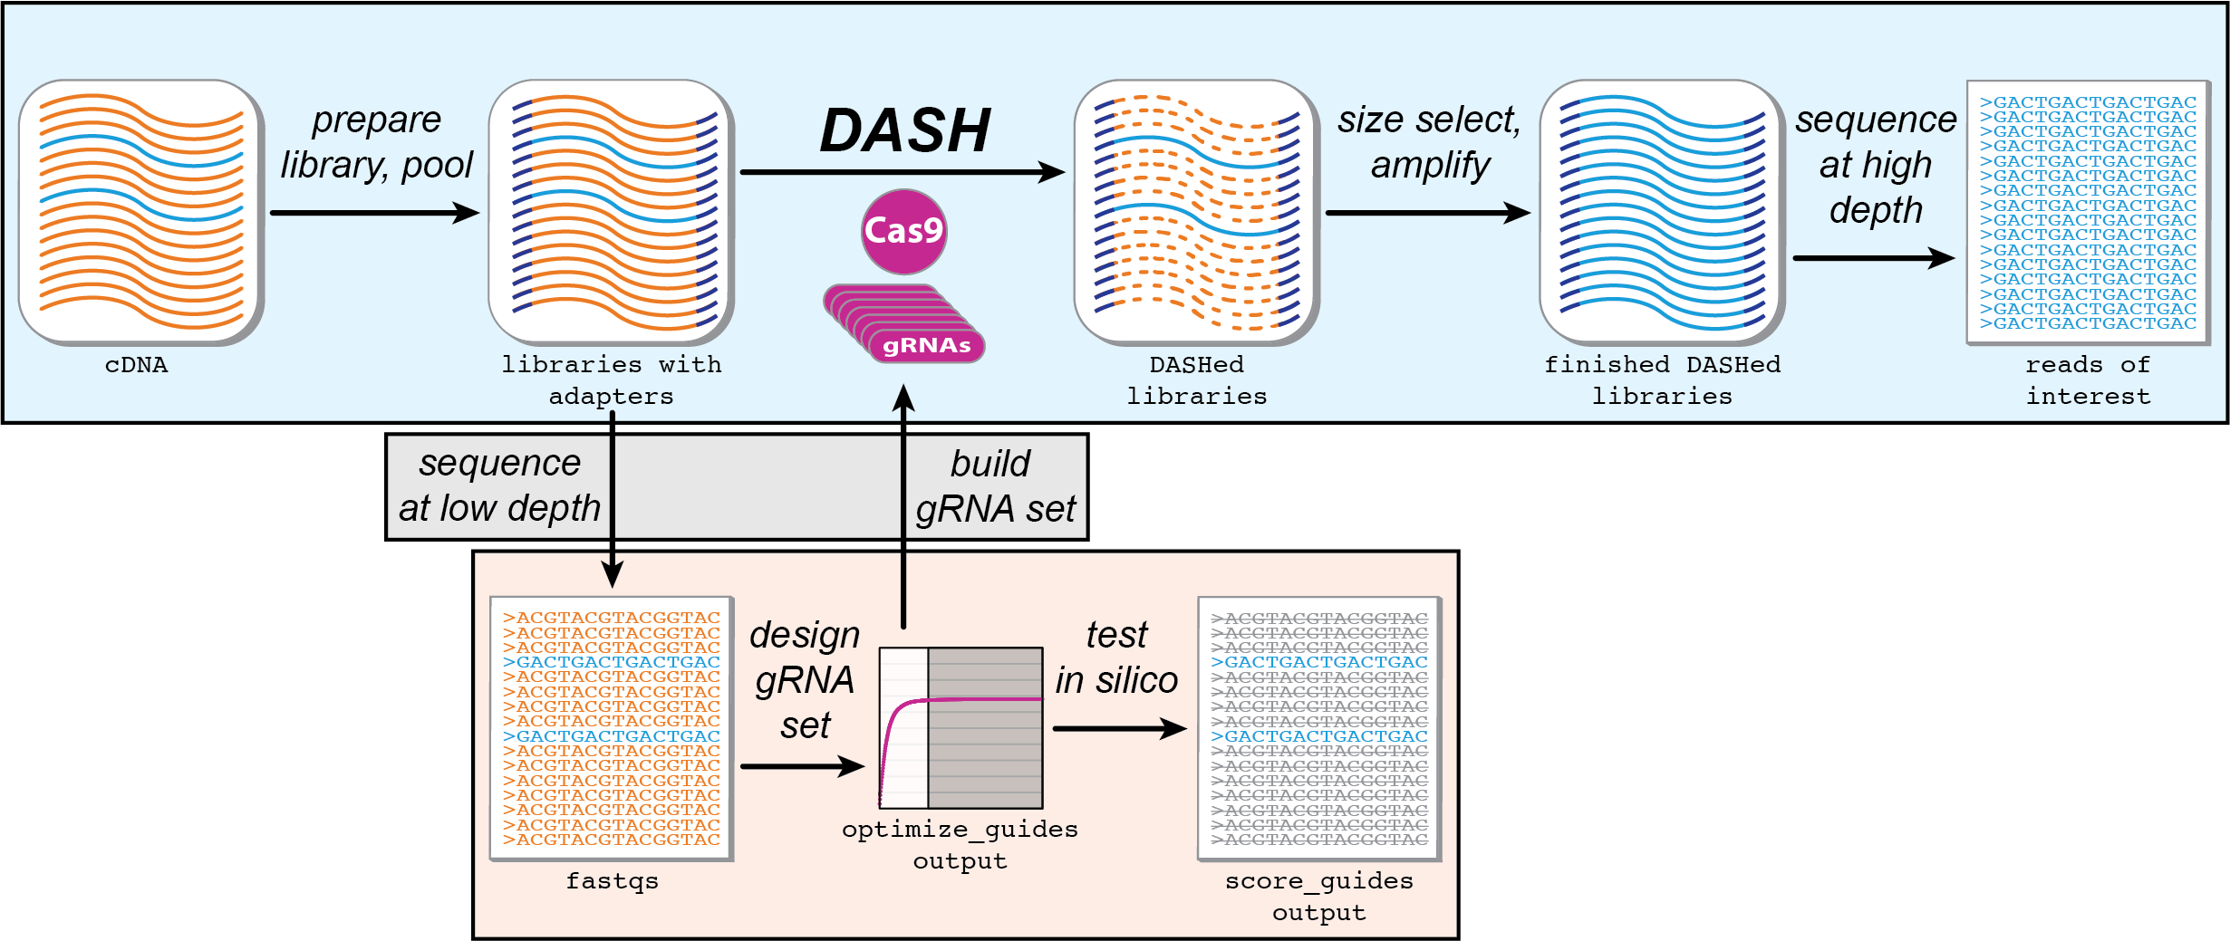
DASHit Workflow
Notes:
Got junk sequences in your sequencing fastqs? Many RNA-seq experiments are riddled with repetitive sequences which are of no value to the scientific question you are asking. Some examples include ribosomal RNA and hemoglobin. DASH is a CRISPR-cas9, NGS technology which depletes abundant sequences, increasing coverage of your sequences of interest.
In the lab, you take final NGS libraries ready for sequencing, and combine them with cas9-gRNAs which cut up your repetitive sequences into small fragments. You then size select and amplify your remaining DNA, which should contain most or only your sequences of interest. Your library can then be sequenced. For more details, see our protocol on protocols.io: dx.doi.org/10.17504/protocols.io.y9gfz3w
In order for DASH to be effective, you want to pick the fewest guides which hit the most of your repetitive sequences. The best way to know the most repetitive sequences in your sequencing is by designing guides which hit your actual reads. David has implemented a greedy algorithm to solve this set cover problem, and created a software package called DASHit to perform automated guide design for DASH experiments.
DASHit uses your reads from a preliminary, low-depth sequencing of your samples, and identifies crispr-cas9 cut sites. It has a filtering function for the guides it identifies, which allows you to specify on and off target sequences, and filter based on GC content and secondary structure. It then optimizes your guide list by giving you a set number of guides which hit the most reads.

Slide 3
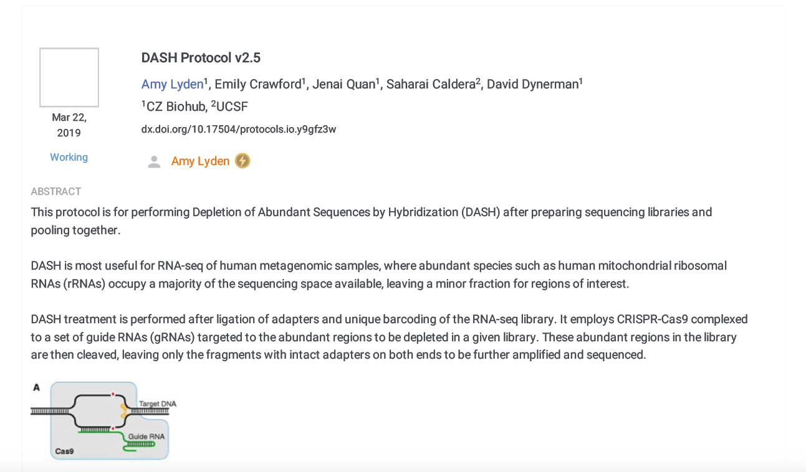
Protocols.io
dx.doi.org/10.17504/protocols.io.y9gfz3w

Slide 4
Optimizing guide number using DASHit
Notes:
DASHit also has functionality to score guides against a fasta. You can use this to test how many of your reads would be hit by a given guide set.

Slide 5
Designed mouse guides using DASHit
Notes:
Today, we will be using a set of preliminary reads on mouse tissue to design a set of 96 DASH guides. I have written a wrapper script which encompasses most of this work, which will be made available on the DASHit github repository, and remain up-to-date as a reference for anyone wishing to run this pipeline.

Slide 6
Enriching for reads of interest

