Slide 1
快樂玩雲端之 Kingston IIoT分享
講者：Carl Yang

Slide 2
Challenges
多樣化的資料來源
不一致的資料格式
網路通訊的難易度
龐大的資料量

Slide 3
Azure IoT Hub

Slide 4
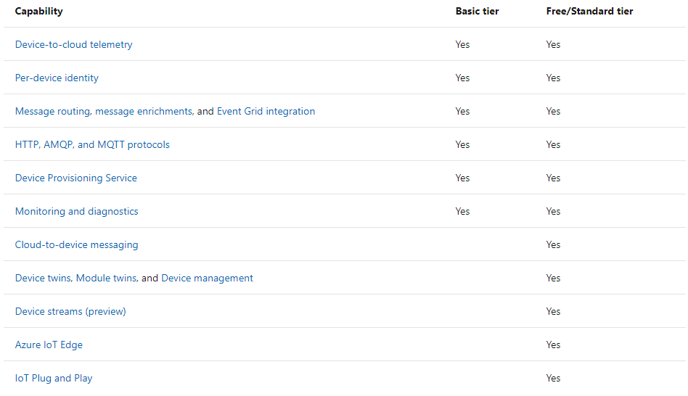
Scale
Free:
Only 1 per subscription
Basic:
Device-to-cloud
Standard:
Cloud-to-device
IoT Edge
Device Management
MQTT、AMQP
Lightweight
(Ref: https://docs.microsoft.com/en-us/azure/iot-hub/iot-hub-scaling)

Slide 5
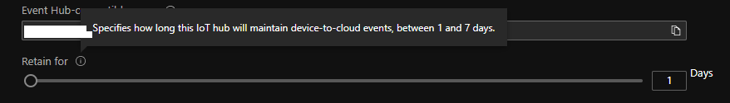
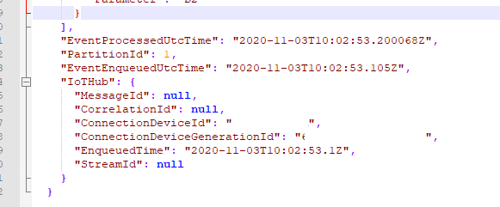
Telemetry
Cache: 1~7 days
Unified format
Unstructured
Data Centralizing
相同事件、相同時間

Slide 6

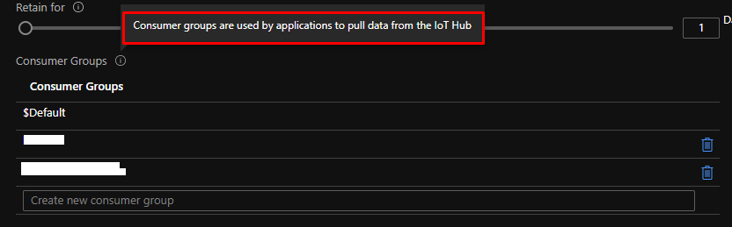
Consumer Group
Pulling data
Max. 20 consumer groups per IoT Hub
5 concurrent readers per group

Slide 7
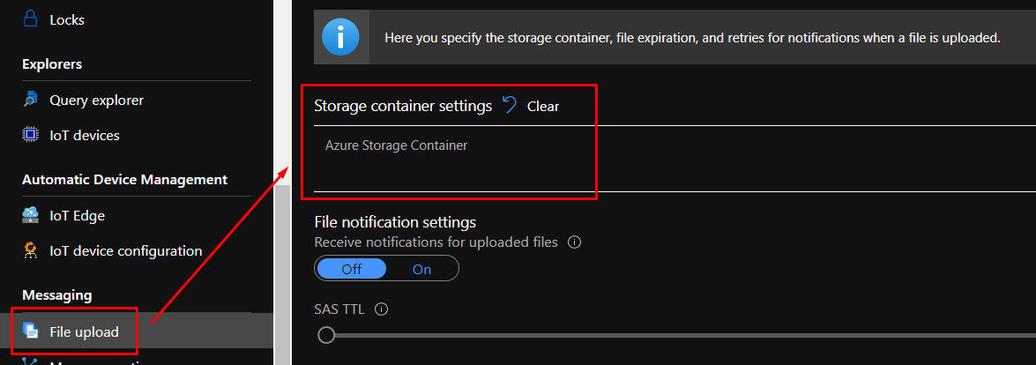
File Upload
Only Support Storage Container
Only Block blobs
10 concurrent keys in queue
同時10台裝置上傳

Slide 8
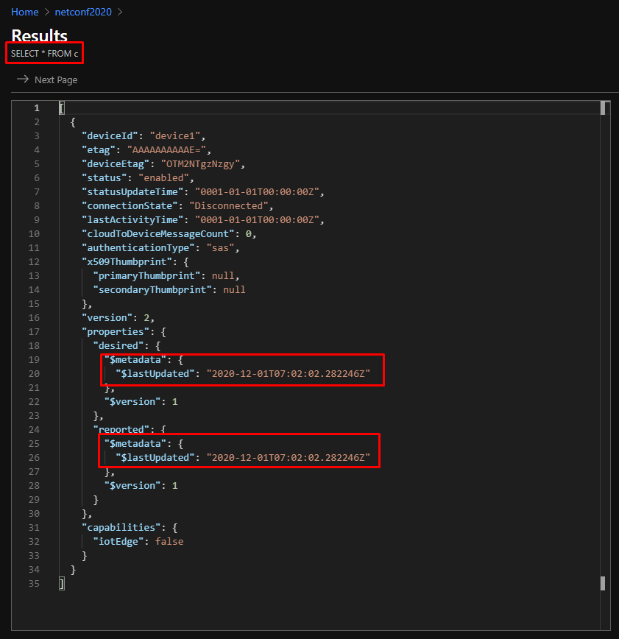
Query Explorer
Only in Standard Tier
Device Twins/Jobs
information
Help to manage devices

Slide 9
Architecture

Slide 10
Data Flow
Monitor
AuthN/AuthZ

Slide 11
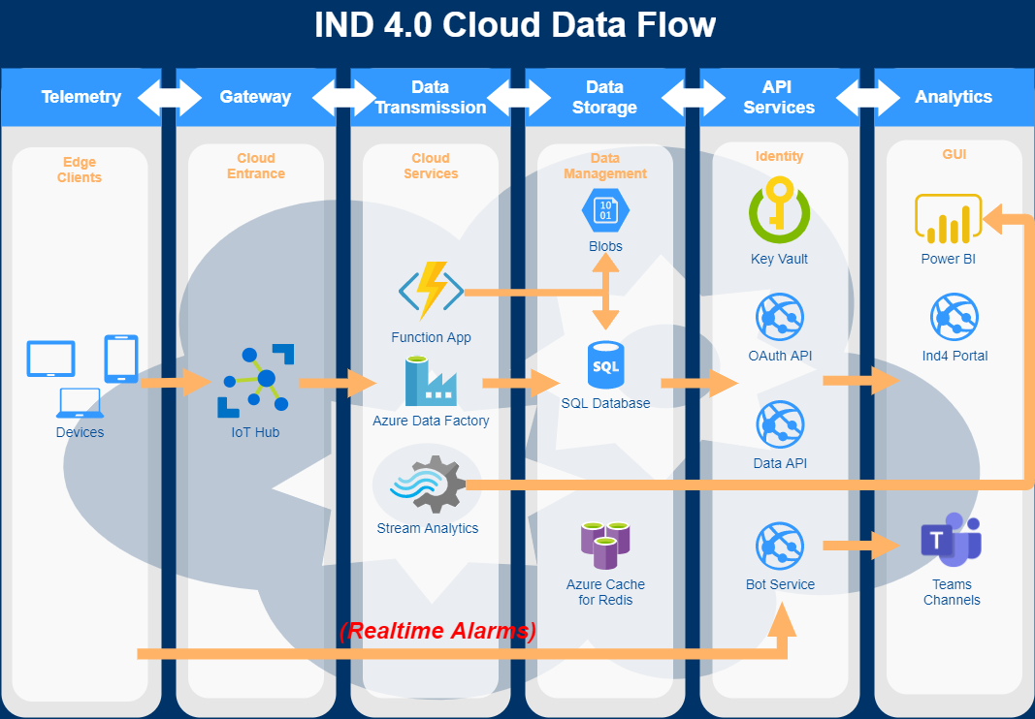
Data Flow

Slide 12
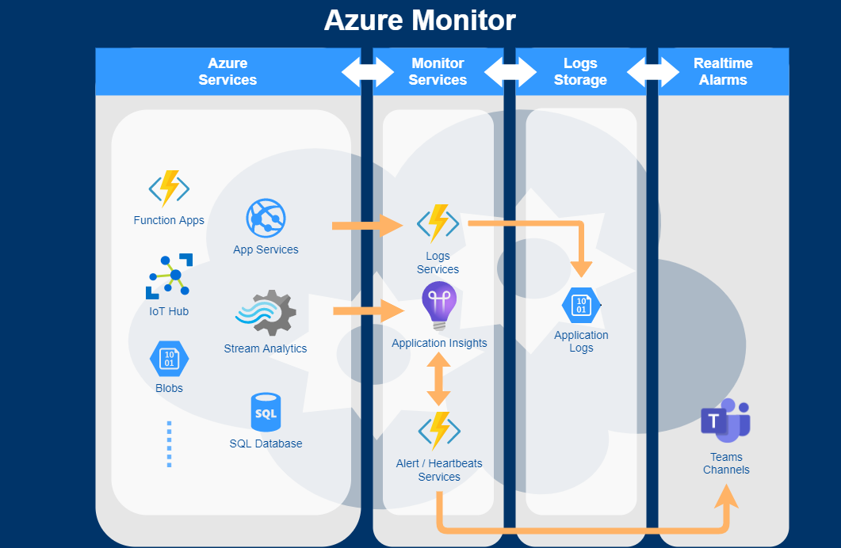
Monitor

Slide 13
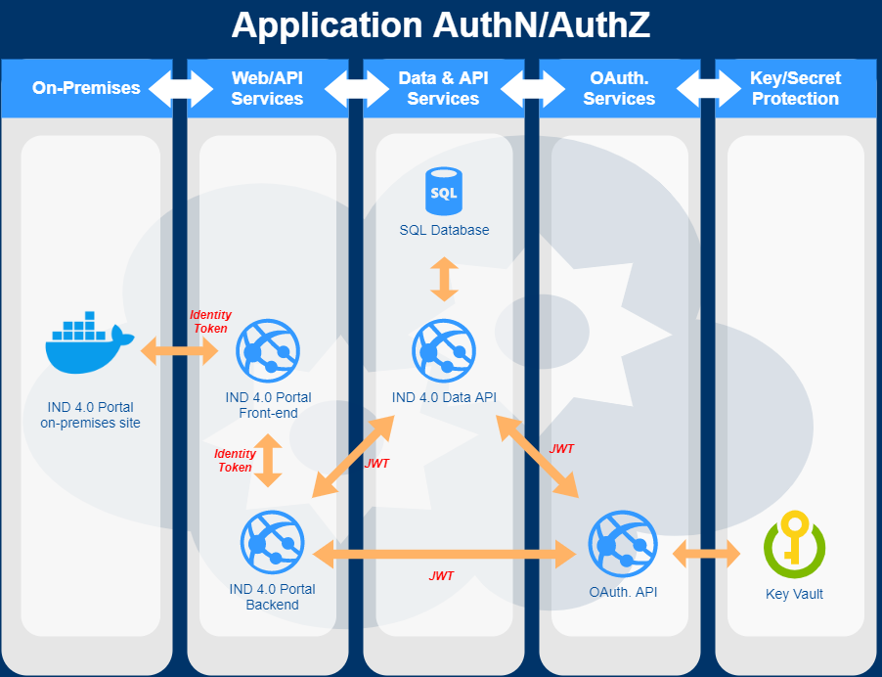
Authentication

Slide 14
Data

Slide 15
要用資料做什麼?
分析、警示、統計?

Slide 16
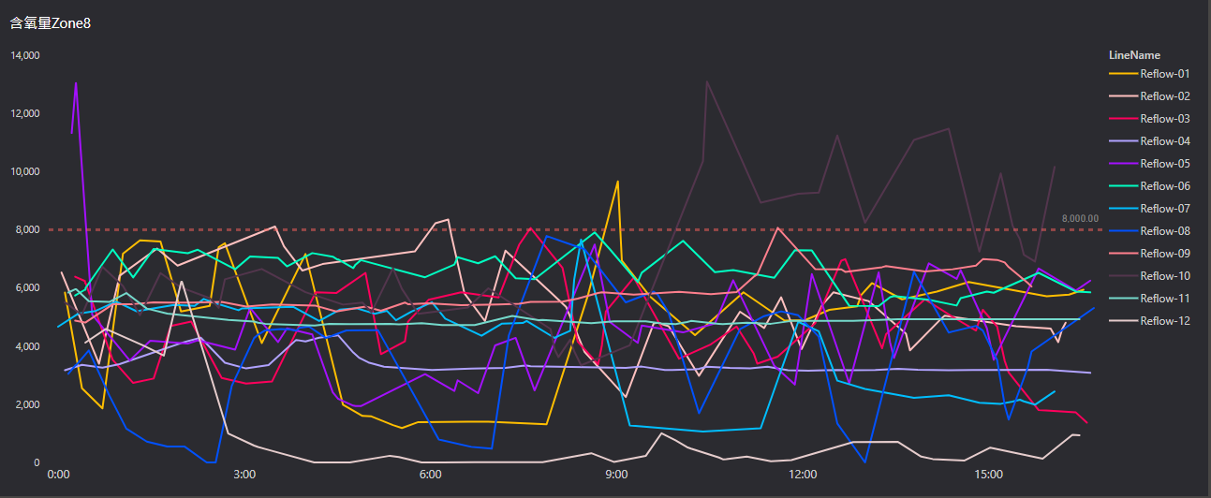
分析 – 以O2為例

Slide 17
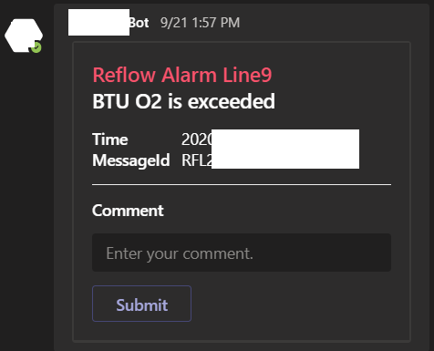
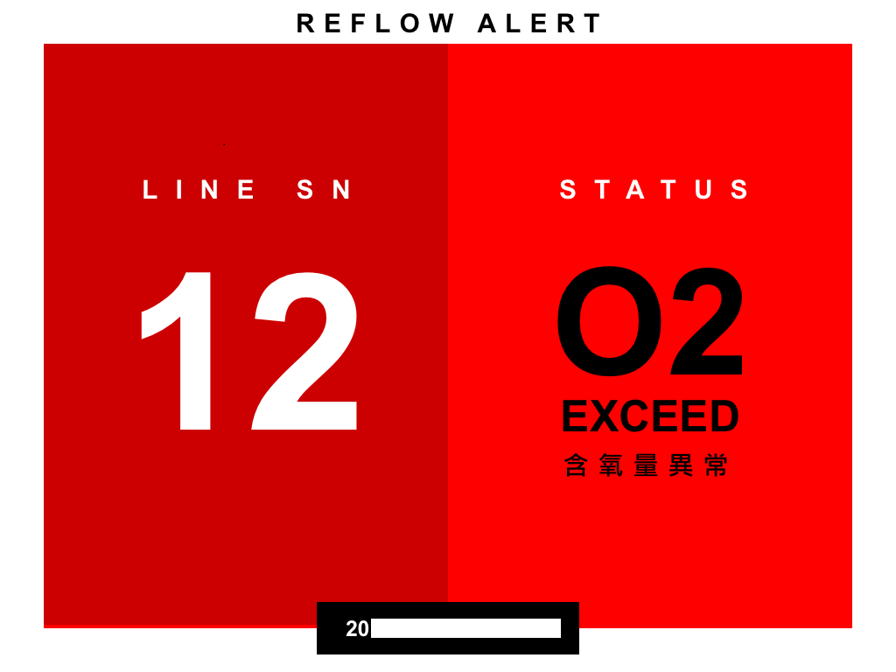
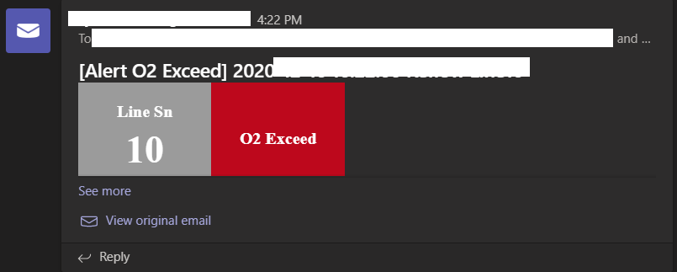
警示– 以O2為例

Slide 18
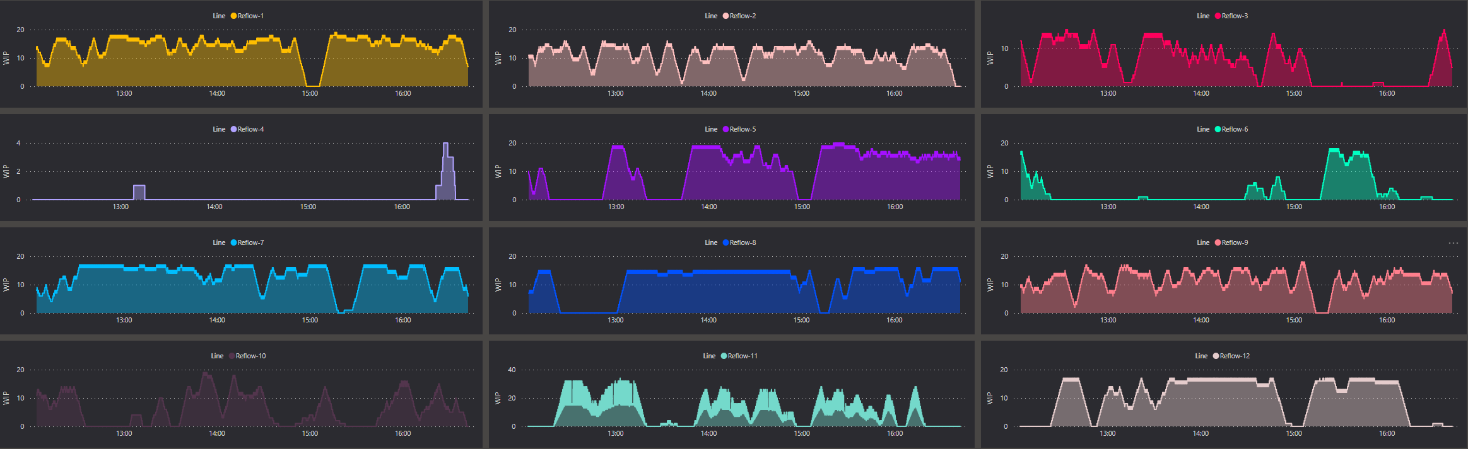
統計 – 以WIP為例

Slide 19
資料從哪裡來?
Devices、OCR?
Machine Logs!

Slide 20
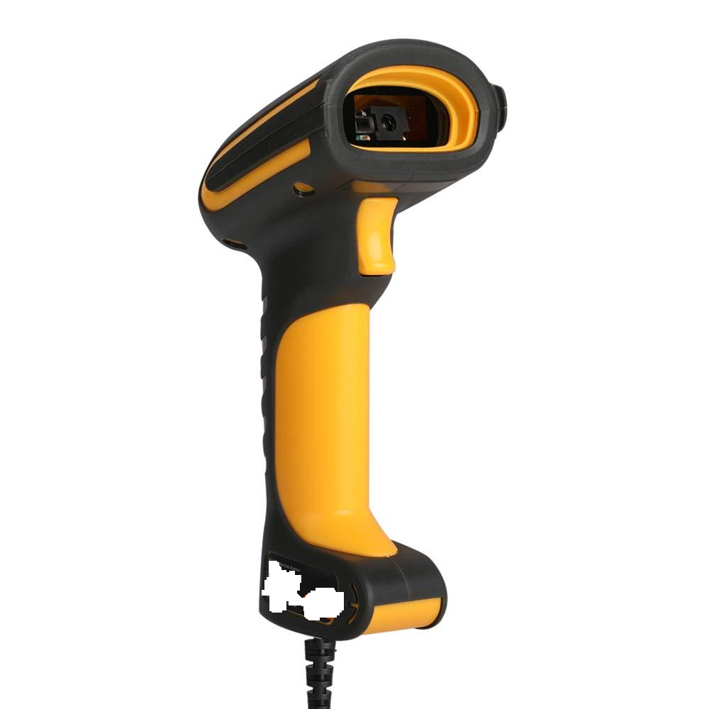
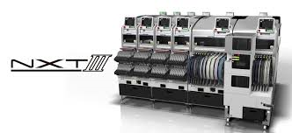
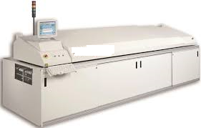
Sources
Sources:
Devices:
Devices Support
Weak Integration
OCR:
視覺辨識技術
Machine Logs:
Native Machine Software Support
Stable

Slide 21
資料如何處理?

Slide 22
Various Data Structures
Principals:
Keep useful data
Re-organize structure
Merge/Divide Values
Use CSV for collecting

Slide 23
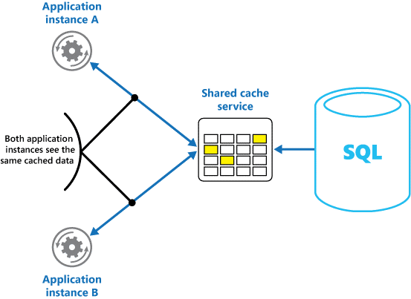
Azure Cache for Redis
Shared
Snapshot
Performance
Cache in memory
Mem Usage
maxmemory-policy
LRU(less recently used)
https://docs.microsoft.com/en-us/azure/architecture/best-practices/caching?toc=/azure/redis-cache/toc.json

Slide 24
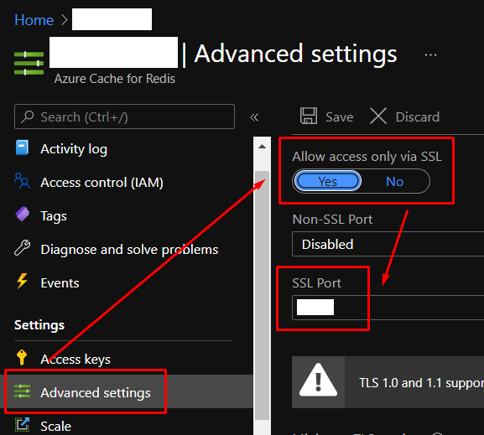
Azure Cache for Redis
SSL:
Port: 6380(default)
Non-SSL:
Port: 6379

Slide 25
Azure Cache for Redis
Shorten Key
SHA 256 to generate key
Fixed Length
Hash Keys/Fields/Values
效能較好
HMSET/HMGET、批量操作
Compression
降低傳輸耗時
降低MEM使用量
壓縮前後、差13倍以上
Split to several parts

Slide 26
資料往哪裡送?怎麼送?

Slide 27

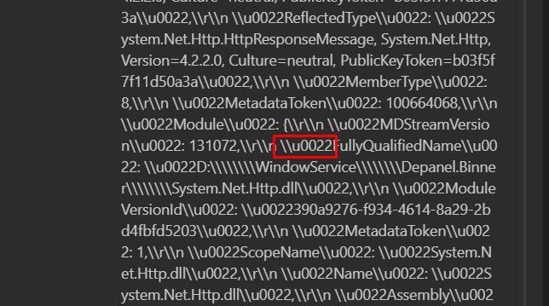

Principals for IoT Hub
256 KB per message
Make data size closed to 256 KB in each request
4 KB per unit
Reduce data size as possible, ex. \u0022
256 KB
1
256 KB
2
3
IoT Hub
128 KB

Slide 28
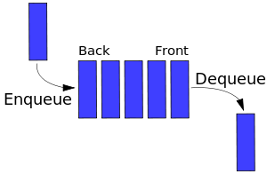
Memory Queue
Time Series
256 KB
256 KB
128 KB
IoT Hub
Latency

Slide 29
Application

Slide 30
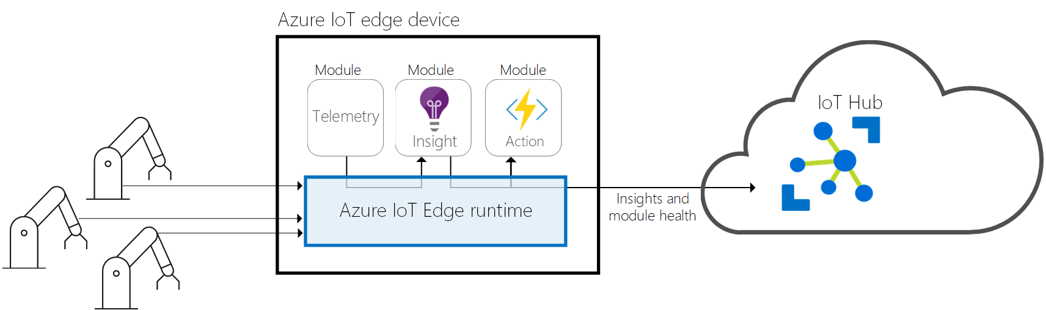
IoT Edge
最接近資料來源的機器
分散式計算
獨立運算能力
網路通訊能力

Slide 31


IoT Devices or Edge?
政策
遠端裝置管理
雙向通訊
Device Client作業環境
Device Client的網路環境

Slide 32
Win Services or Container?
Docker
Memory Process，注意使用量。
Windows環境下，盡可能不使用大量的Disk I/O處理。
Windows Services
管理不易
Debug資訊不充足
系統整合性佳

Slide 33
Cost

Slide 34
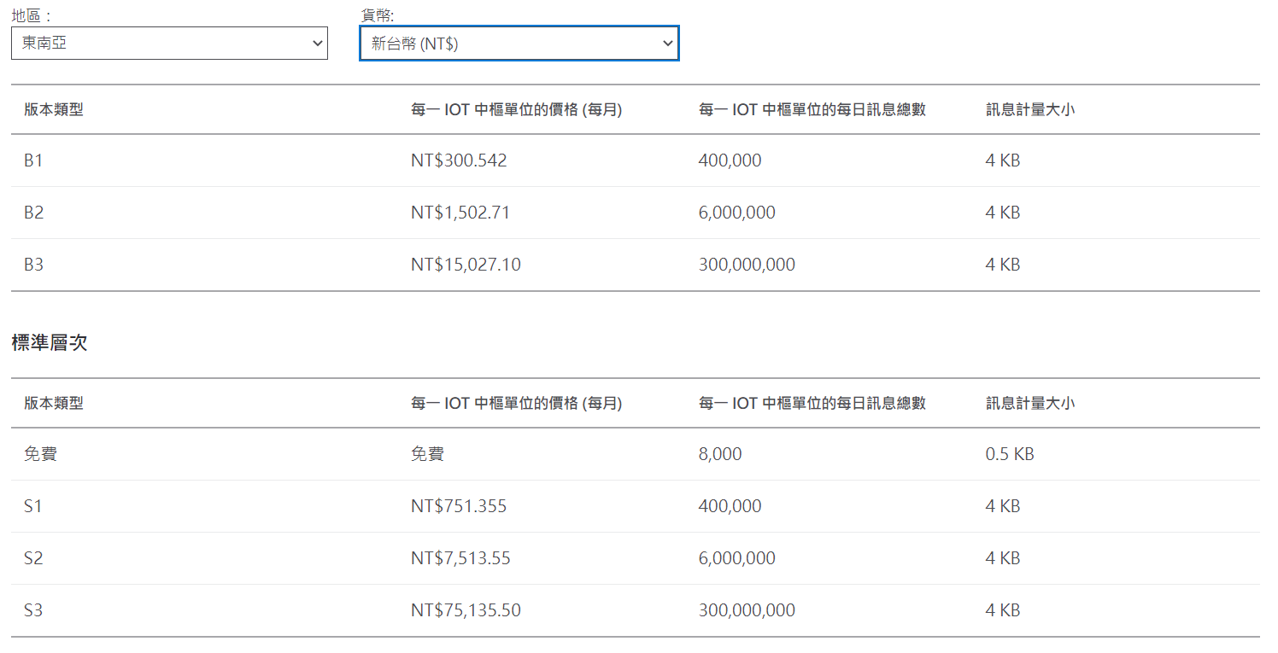
Basic or Standard tier?
(Ref:https://azure.microsoft.com/zh-tw/pricing/details/iot-hub/)

Slide 35
Azure IoT Hub Quota
Charge Unit: 4KB
Batch Daily Volume:
Type1: 0.18 KB x 60s x 60m x 24H x 12 Lines = 186,624 KB
Type2: 0.98 KB x 60/10s x 60m x 24H x 12 Lines = 101,606 KB
Total: 288,230 / 4 KB = 72,057 Units
Real-time Daily Count:
Type1: 60s x 60m x 24H x 12 Lines = 1,036,800 records
Type2: 60/10s x 60m x 24H x 12 Lines = 1,036,80 records
Total: 1,036,800 + 1,036,80 = 1,140,480 Units

Slide 36
Contact:
Carl_Yang@kingston.com.tw
PPT:
https://github.com/carlyang920/knet2021.git

Slide 37
Thanks for joining!
Notes:
Thanks for joining us! Have a great conference!

