Slide 1
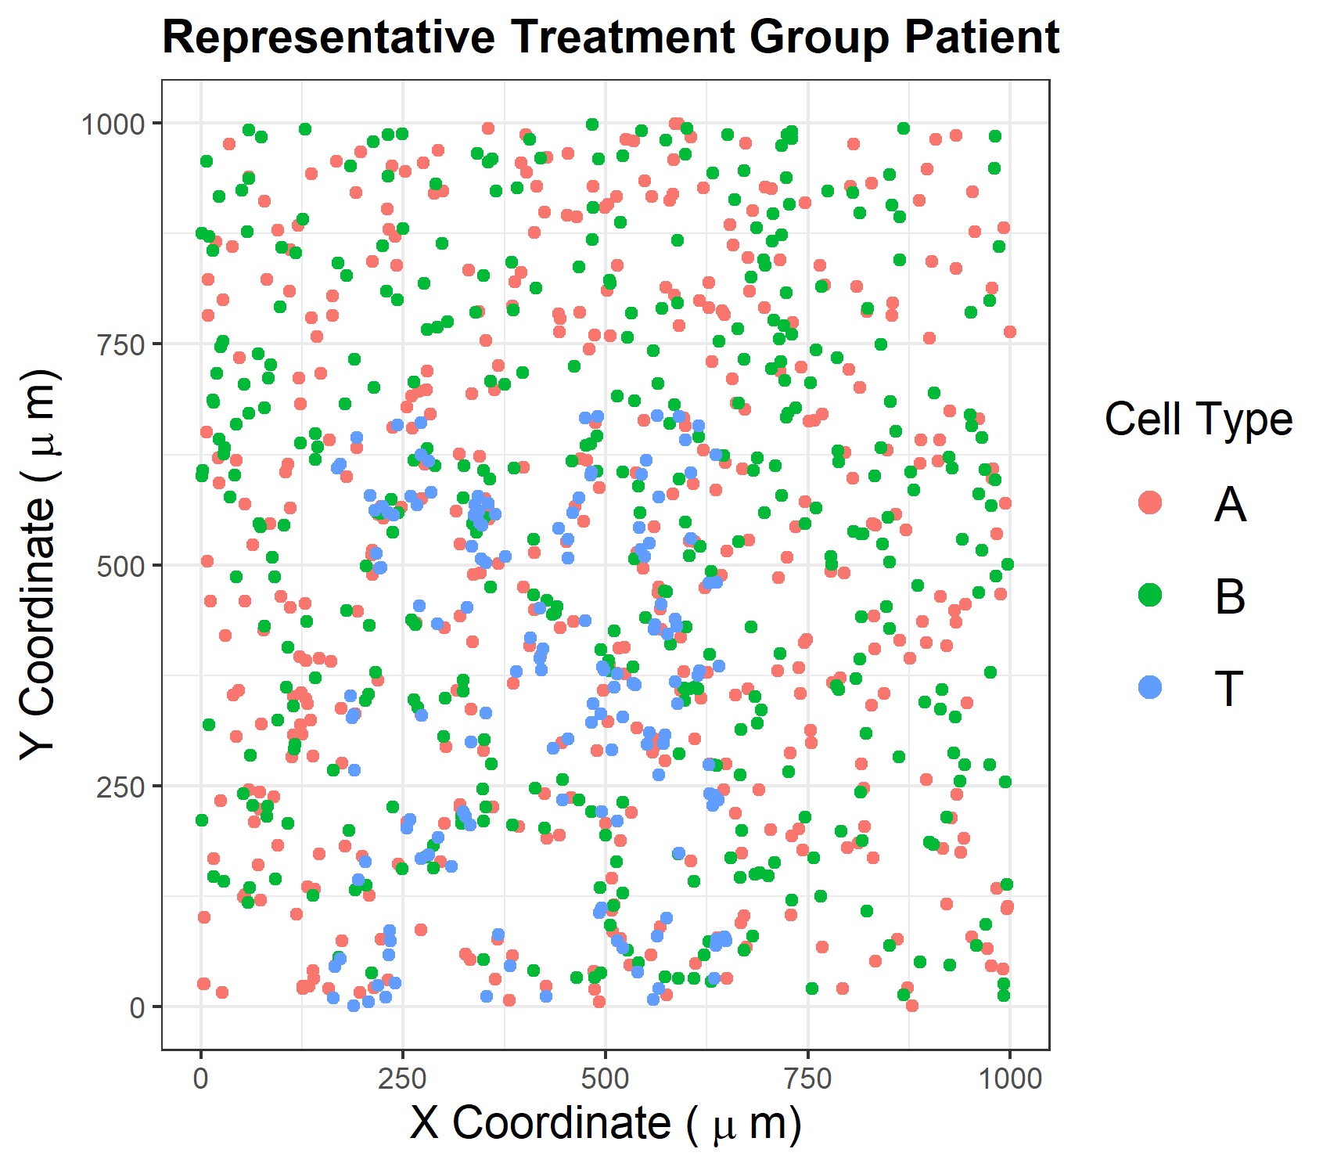
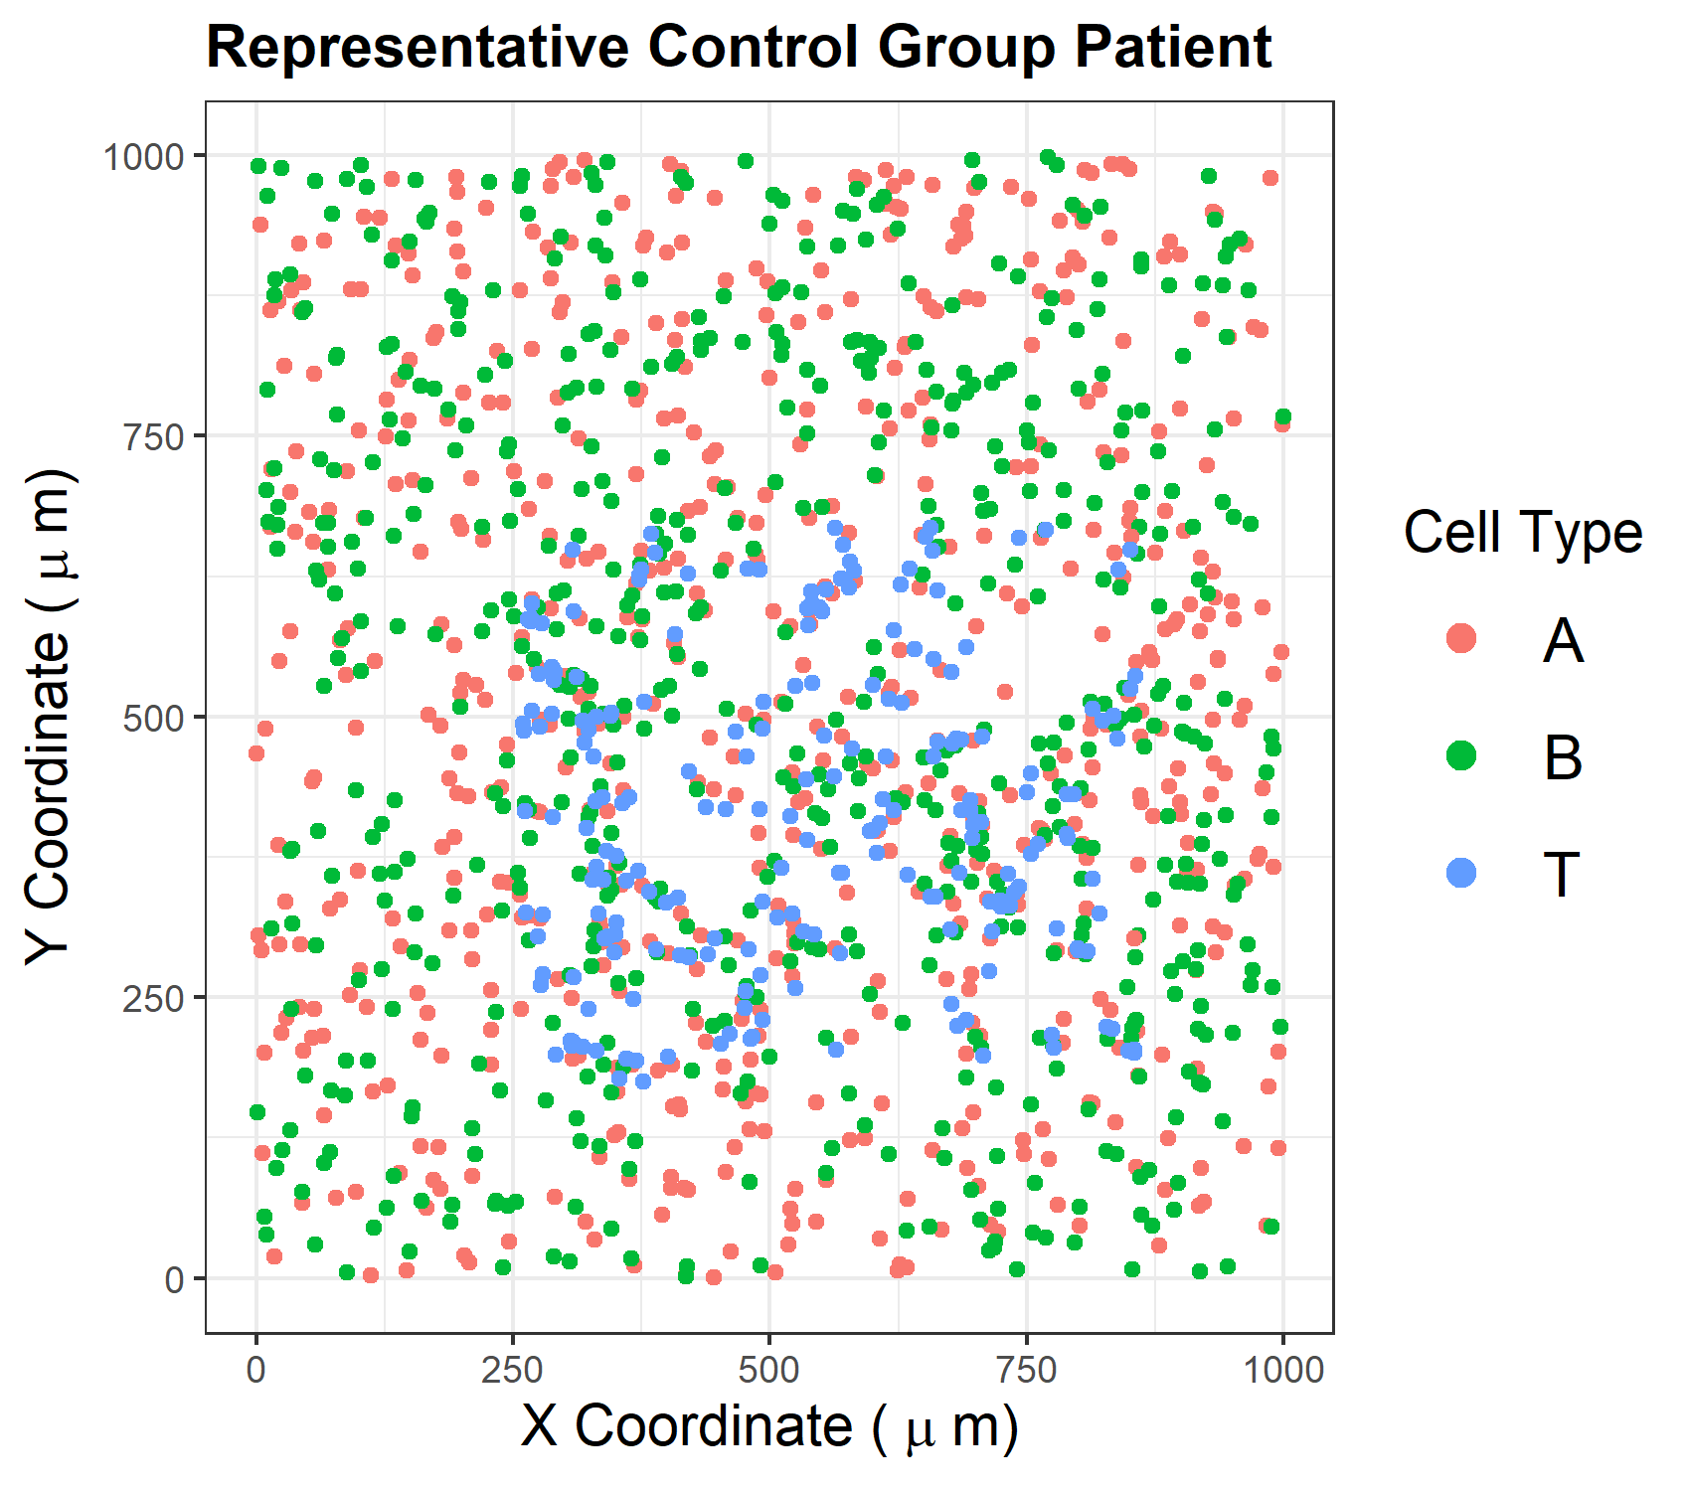
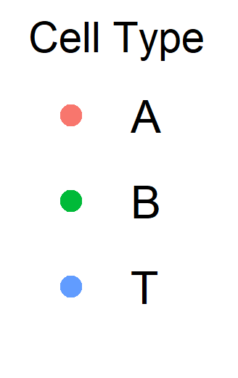
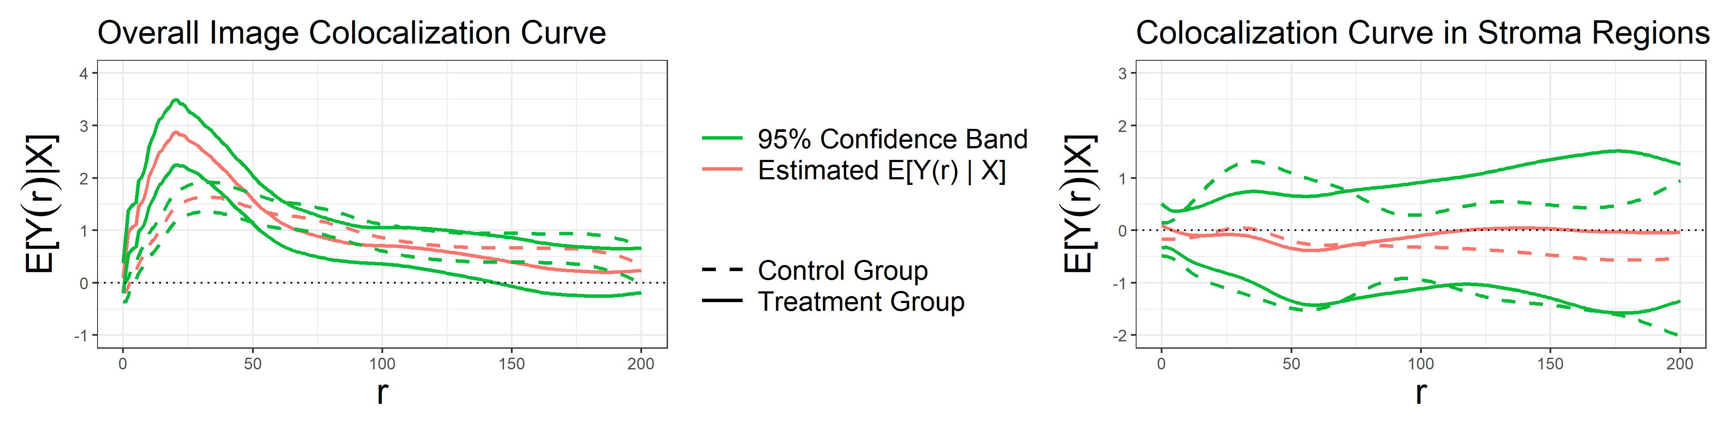
A.)
B.)
A, B random in stroma
A, B colocalized in tumor
(disc kernel radius = σ_{B} or σ_{B} + δ_{B} )
A, T colocalized in tumor
(disc kernel radius = σ_{T} )
C.)
D.)

