Slide 1
Book Inventory Management System - Project Summary
Overview of efficient book tracking and management system

Slide 2
Project Overview

Slide 3

Introduction to the Book Inventory Management System
Comprehensive Inventory Management
The system manages book inventory including categorization, authors, publishers, users, shopping carts, and purchase logging.
Modular Architecture Design
Adopts modular architecture separating entities, repositories, services, controllers, and exception handling for scalability.
RESTful APIs and Documentation
Supports RESTful APIs and integrates Swagger for real-time API documentation and testing.
Robust Unit Testing
Includes unit testing with JUnit 5 and Mockito ensuring reliability and maintainability of the system.

Slide 4
Architecture and Configuration

Slide 5
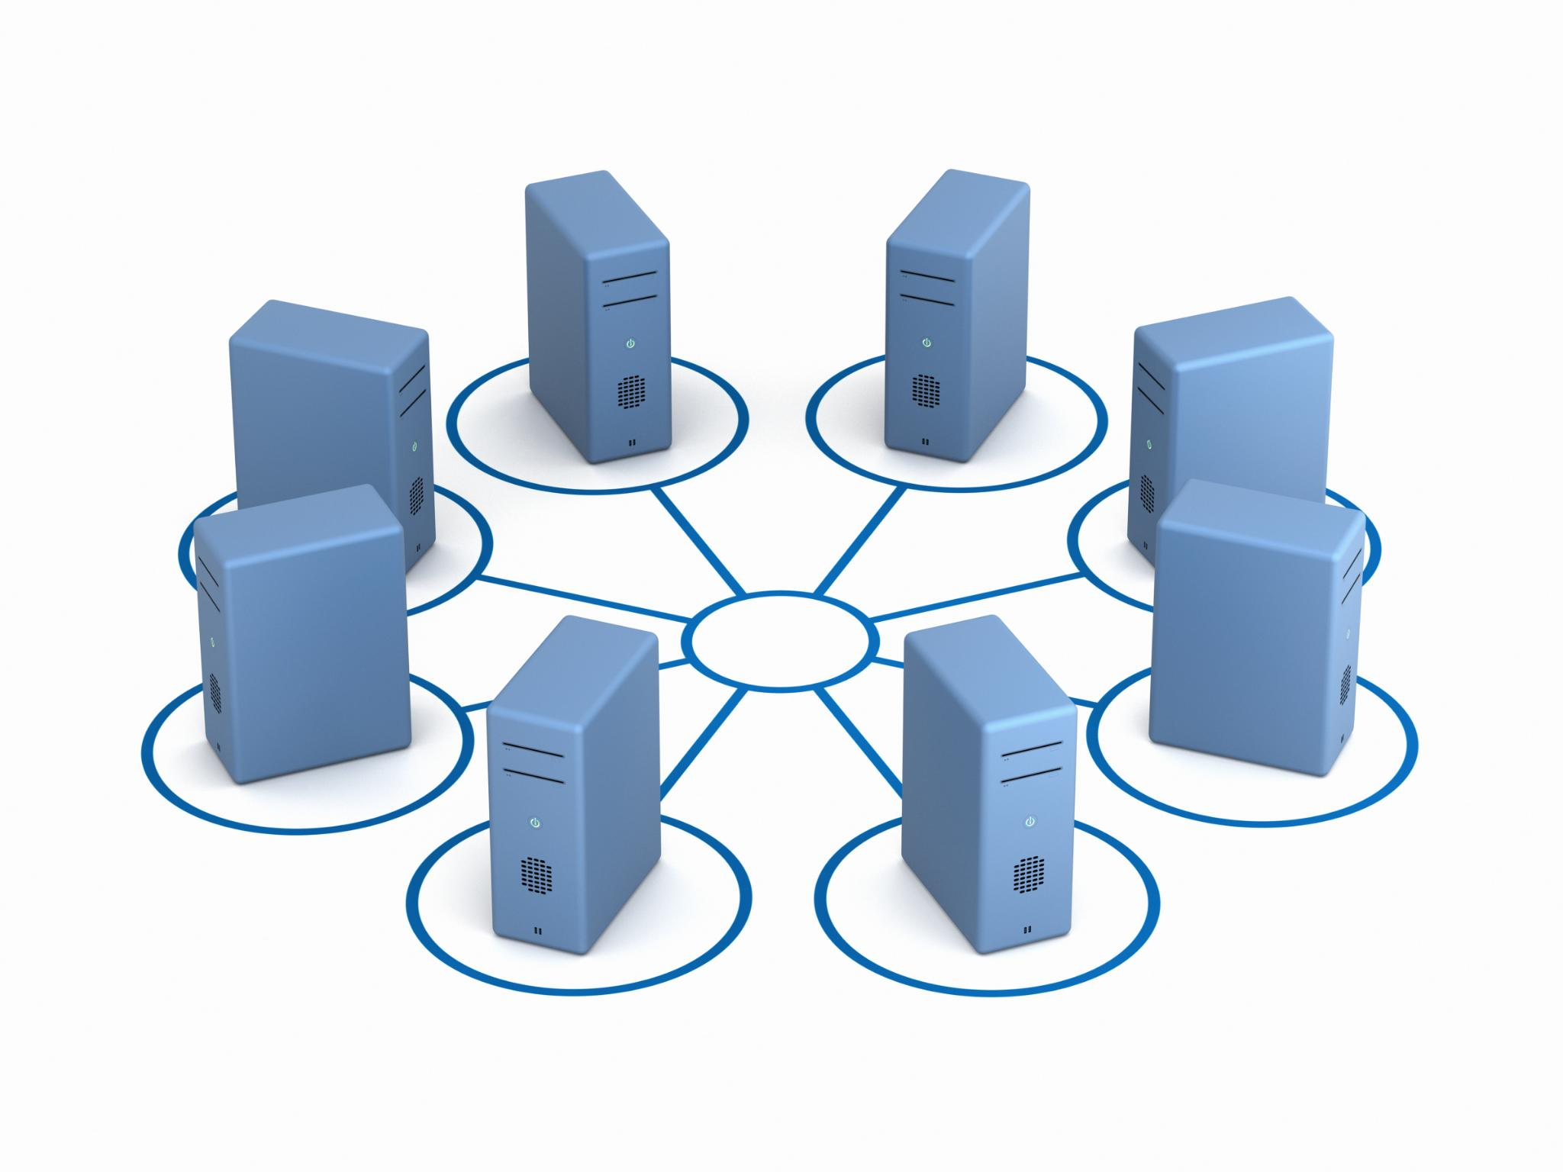
Three-layer Architecture and Configuration Updates
Three-layer Architecture
The application uses Controller, Service, and Repository layers to separate concerns and manage functionality efficiently.
Configuration Updates
Security configuration was temporarily removed, and Swagger enabled via Maven for easier deployment and functionality improvements.
Entity Relationships and Persistence
Entity mappings with OneToMany and ManyToOne refined; schema persistence adjusted from create to update mode for stability.
Centralized Exception Handling
GlobalExceptionHandler manages exceptions like DuplicateResourceException and ResourceNotFoundException effectively.

Slide 6
Testing and Documentation

Slide 7

Unit Testing and Swagger Integration
Unit Testing with JUnit 5
JUnit 5 was used to implement unit tests across multiple service classes, ensuring core functionality is reliable.
Repository Mocking Using Mockito
Mockito mocks repositories to isolate service logic tests, enabling database-independent verification of operations.
Assertions and Test Validation
Assertions like assertEquals and assertNotNull validate test outcomes, confirming correctness of save, fetch, and delete methods.
Swagger UI Integration
Swagger UI integrated via SpringDoc offers real-time API documentation and interactive endpoint testing for developers.

Slide 8
Key Learnings and Future Improvements

Slide 9

Concepts Learned and Suggested Enhancements
Backend Development Concepts
Core backend skills include Spring Boot, JPA, Hibernate ORM, REST API CRUD operations, and exception handling techniques.
Testing and Documentation
Swagger integration enhances API documentation, while JUnit 5 and Mockito support robust automated testing.
Configuration and Build Management
Application properties and Maven lifecycle management improve application configuration and build automation.
Suggested Future Enhancements
Future improvements include JWT security, role-based access, caching, cloud deployment, containerization, and CI/CD pipelines.

Slide 10
Conclusion

Slide 11
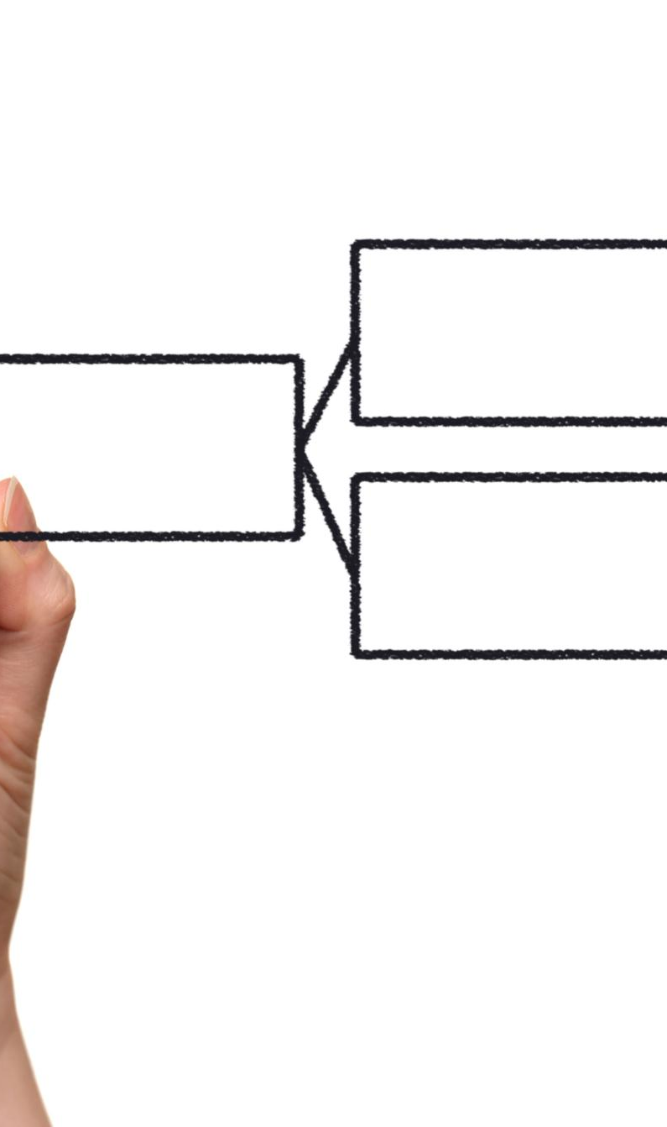
Final Thoughts and Project Impact
Scalable and Modular Design
The system is designed to be scalable and modular, supporting future enhancements and easy maintenance.
Robust Exception Handling
Robust exception handling improves system reliability and ensures smooth error management.
Comprehensive Documentation
Integrated Swagger documentation facilitates clear API understanding and professional development standards.
Effective Unit Testing
Unit tests ensure system functionality and adherence to coding standards for reliable performance.

