Slide 1
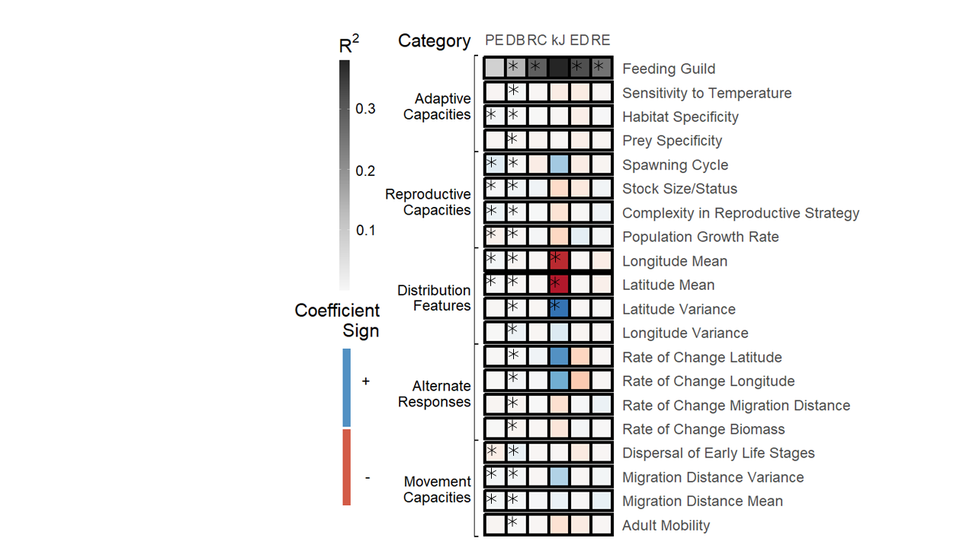
Adaptive Capacities
Reproductive Capacities
Distribution Features
Population Trends
Movement Capacities

