Slide 1
Learning JS

Slide 2
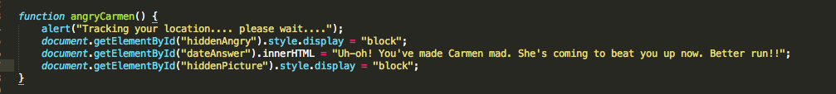
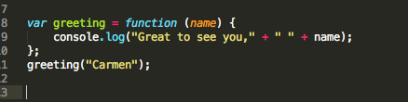

Functions
• Functions are a built-in JavaScript method.
• They can be called with the word “function” and parenthesis

Slide 3
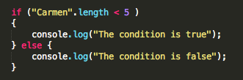
Other ways to handle user input
A single function isn’t the only way to get something done.

Slide 4
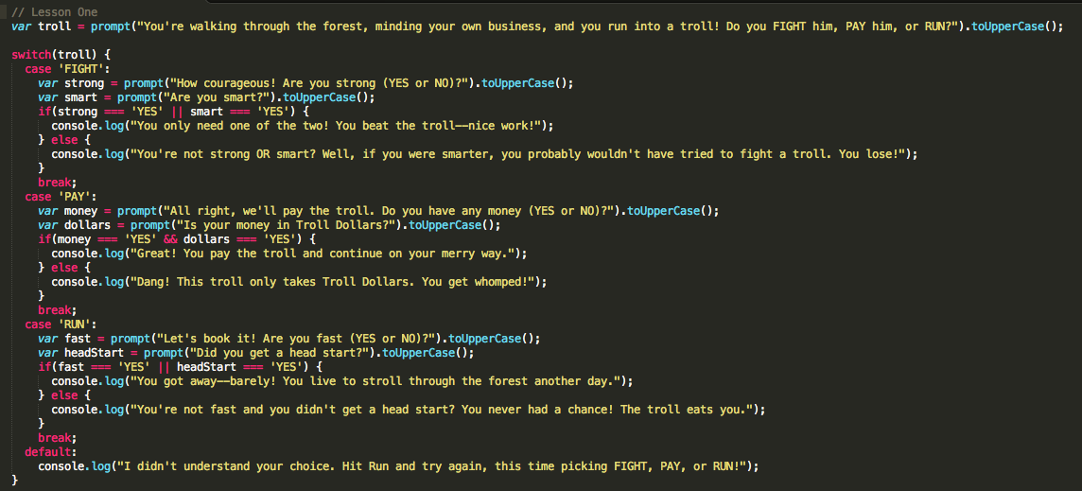
Switch statement

Slide 5
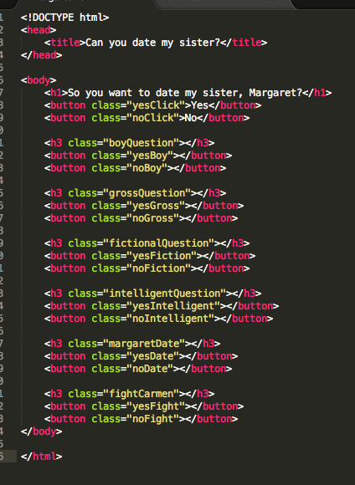
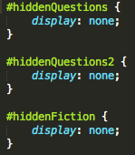
Interfacing with HTML
HTML is static by
itself… it won’t do
anything, regardless
of any attempted
user interaction.

Slide 6
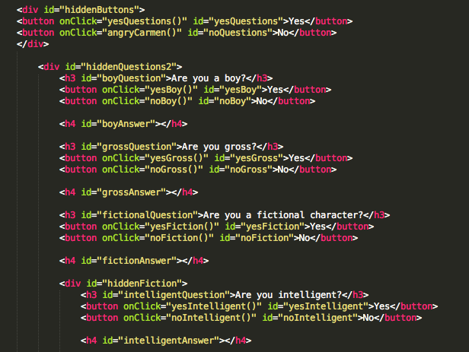

Slide 7
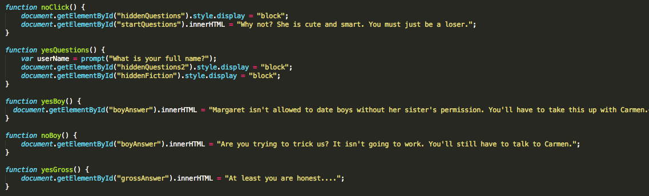
Using JS to manipulate HTML

Slide 8
Resources to learn js
https://developer.mozilla.org/en-US/docs/Web/JavaScript
http://www.codecademy.com/tracks/javascript
https://www.codeschool.com/paths/javascript
http://www.javascriptenlightenment.com/
http://Jsfiddle.net
http://labs.codecademy.com/

Slide 9
Get the code
https://github.com/carmalou/canyoudate
http://carmalou.github.io/canyoudate/

