Slide 1
Volcano: A Kubernetes Native Batch System
Department name: Cloud BU
Author’s name: Ma Da
Security Level: Public

Slide 2
Da Ma (@k82cn)
Kubernetes SIG-Scheduling Co-Leader
Kubernetes Machine Learning Working Group Co-Leader
CNCF Research User Group Tech Lead
CNCF SIG-Runtime Tech Lead
ISC/VHPC’20 Program Committee, Group Lead
Kubernetes Maintainers
Founder of Volcano/kube-batch
Expert at Huawei (now)
Ex-IBM Spectrum Symphony CE/L3 Team/Tech Lead

Slide 3
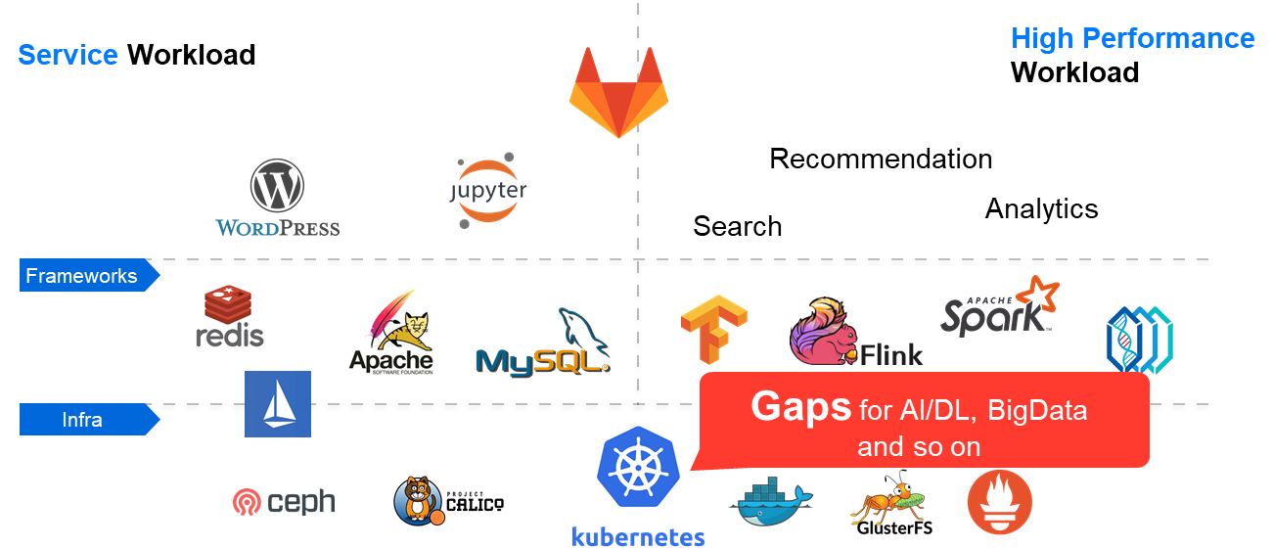

Slide 4

Volcano: A Kubernetes Native Batch System
Website: https://volcano.sh Github: http://github.com/volcano-sh/volcano Twitter: https://twitter.com/volcano_sh Slack: http://volcano-sh.slack.com Email: volcano-sh@googlegroups.com

Slide 5
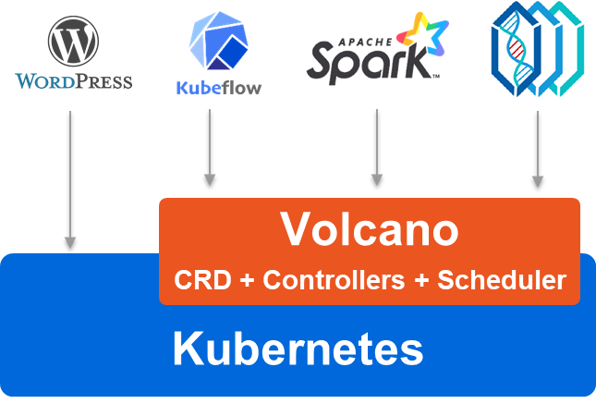
Overall Architecture
Domain frameworks:
Deployment/Installation of framework in k8s
Map framework’s terms/concepts into common concept, e.g. Job, Queue
Enable related features for frameworks, e.g. gang-scheduling for TensorFlow training
Common Service for high performance workload:
Batch scheduling, e.g. fair-share, gang-scheduling
Enhanced job management, e.g. multiple pod template, error handling
Accelerator, e.g. GPU, FPGA
kubectl plugins, e.g. show Job/Queue information

Slide 6
Volcano Architecture
vc-scheduler
(kube-batch)
singularity
topology
vc-controllers
kubelet
Kubectl creates a JobEx object in apiserver if all admission passed
JobExController create Pods based on its replicas and templates
vc-scheduler get the notification of Pod from apiserver
vc-scheduler chooses one host for the Pod of JobEx based on its policy
kubelet gets the notification of Pod from apiserver; and then start the container
2
3
4
5
1
Kubernetes
kubectl
JobEx
Queue
ETCD
vkctl
The policy in vc-scheduler is pluggable, e.g. DRF, Priority, Gang
vc-controllers includes JobExController, QueueController
Volcano handles high performance workload

Slide 7
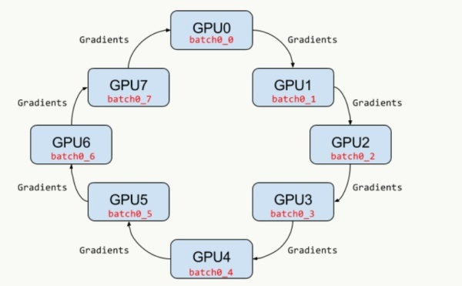
Scenarios: MPI
worker_1
mpirun
worker_2
worker_3
Multiple Pod Template
Lifecycle Policy
Gang-scheduling
ssh or kubectl
Complete job when mpirun completed
Headless service

Slide 8
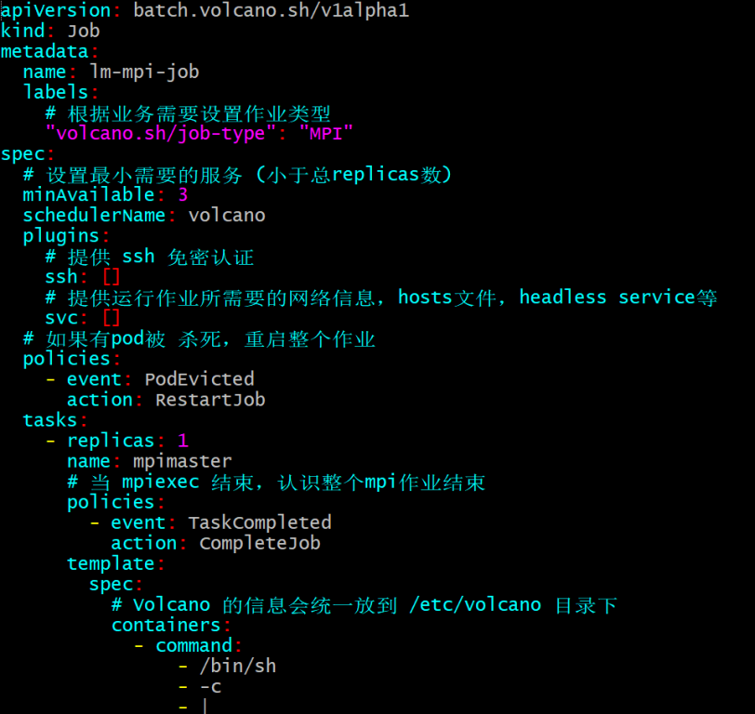
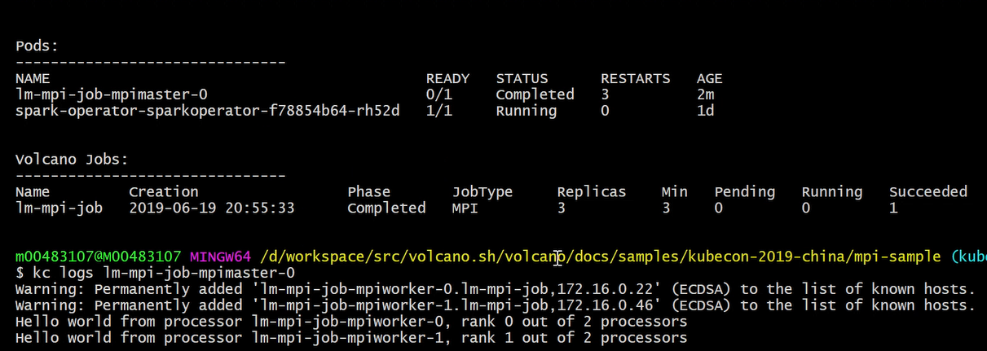
Scenarios: MPI
The workers are deleted by job controller because of sshd
The pod of mpiexec/mpirun will not be deleted for output
The pod of mpiexec/mpirun may restart few times because of network setup delay

Slide 9
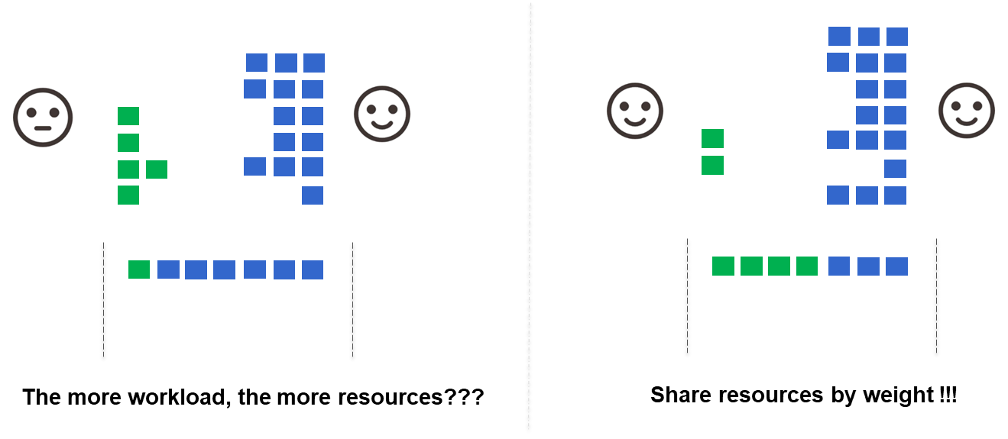
Scenarios: Fair Share

Slide 10
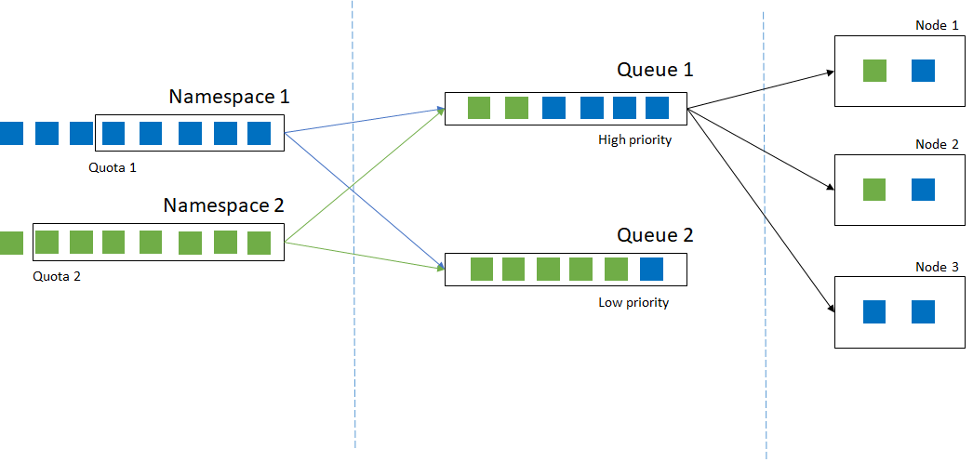
Scenarios: Queue
kube-apiserver
scheduler
nodes

Slide 11
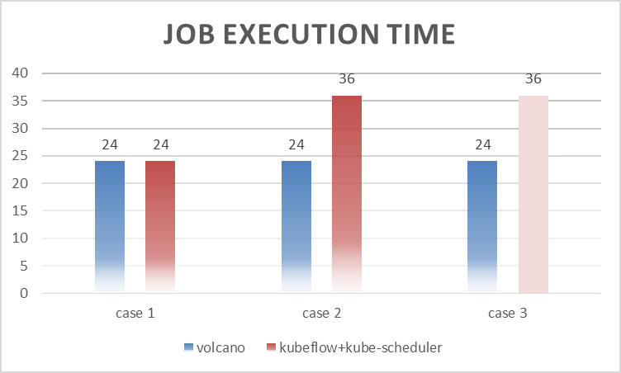
Gang-scheduling (Horovod, Tensorflow ……)
Case 1: 1 job with 2ps + 4workers
Case 2: 2 jobs with 2ps + 4workers
Case 3: 5 jobs with 2ps + 4workers
No enough resource for 2 Jobs to run concurrently; one of them wasting resources without Gang-Scheduling !
2 of 5 jobs was finished because of deadlock (+20 hours)
http://status.openlabtesting.org/builds?project=theopenlab%2Fvolcano

Slide 12
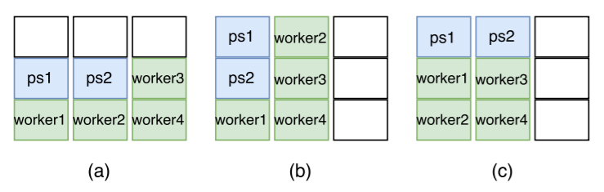
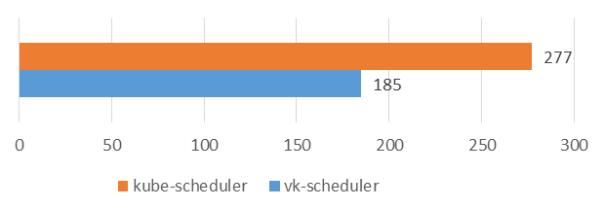
Task-Topology + Binpack (Tensorflow)
The execution time of 3 jobs in total; 2ps + 4workers for each job
The execution time is unstable when tested by default scheduler
The improvement dependent on data exchanges between pods
Task-topology within a Job also improved scheduler’s performance
Reference: “Optimus: An Efficient Dynamic Resource Scheduler for Deep Learning Clusters”

Slide 13
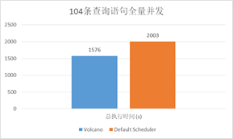
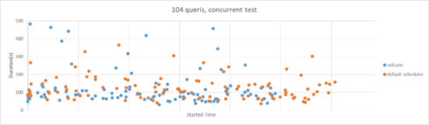
Job minResource (Spark)
Spark-sql-perf (TP-DCS, master)
104 queries concurrently
(8cpu, 64G, 1600SSD) * 4nodes
Kubernetes 1.13
Driver: 1cpu,4G; Executor: (1cpu,4G)*5
Max 26 concurrent queries if no dedicated driver nodes
~30% performance improvement because of job level reservation
Volcano (min-res): 3.3cpu, 12G
Kubernetes: 1 node for drivers

Slide 14
Community & Integration
Framework | Status | API | Notes/URLs
Horovod/MPI | Done | Volcano Job | Volcano mpi-sample
Kubeflow/tf-operator | Done | PodGroup | kubeflow/job-scheduling
Kubeflow/arena | Done | Volcano Job | kubeflow/arena#188
Spark-Operator | Done | PodGroup | spark-on-k8s-operator#599
Spark on Kubernetes | On-going | PodGroup | Huawei-cloudnative/spark-on-volcano
Cromwell | Done | Volcano Job | Cromwell/volcano
PaddlePaddle | Done | Volcano Job | Blog at InfoQ, Tutorial at PaddlePaddle community
… | … | Volcano Job, or PodGroup

Slide 15
Adopters
Organization | Contact | Environment | Description of Use
Unisound | @xieydd | Evaluation | Evaluation in ATLAS AI Platform
BIBDR | @felix5572 | Evaluation | Scientific calculations in physics, materials , biology and chemistry. molecular dynamics simulation.
caicloud | @gaocegege | Evaluation | Scheduler for Distributed DL training Jobs
Baidu | @tizhou86 | Testing | Scheduler for Deep Learning Platform to Optimize Performance
GrandOmics | @alartin | Evaluation | Infrastructure of Hanwell (Huawei Cloud backend of Cromwell which is a Broad Institute implementation of WDL)
Huawei Cloud | @tsjsdbd | Production | Scheduler & Job Management of AI Container Service and CCI
JD Retail Infrastructure Department | @yuanchen8911 | Evaluation | Spark on K8S
kt NexR | @minyk, @dieselnexr | Evaluation | spark scheduler of our next cloud native product.
QTT Bigdata Infra | @yuzhaojing | Evaluation | Spark and AI on K8S.
Vivo | @zionwu | Evaluation | Scheduler for Vtraining (deep learning training platform)
Xiaohongshu | @xiaogaozi | Evaluation | TensorFlow on K8s

Slide 16
Roadmap

