Slide 1
Customer Booking Prediction
British Airways Data Science Simulation

Slide 2
Problem Statement
Predict whether a customer will complete a booking (booking_complete).
Binary classification problem.
Goal: understand factors influencing booking behaviour.

Slide 3
Data Preparation
Handled categorical variables using One-Hot Encoding
Train-test split applied (80/20)
No scaling required (tree-based models)
Ensured consistent preprocessing using pipelines

Slide 4
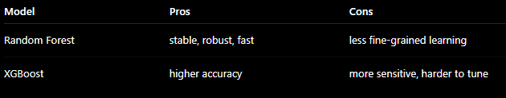
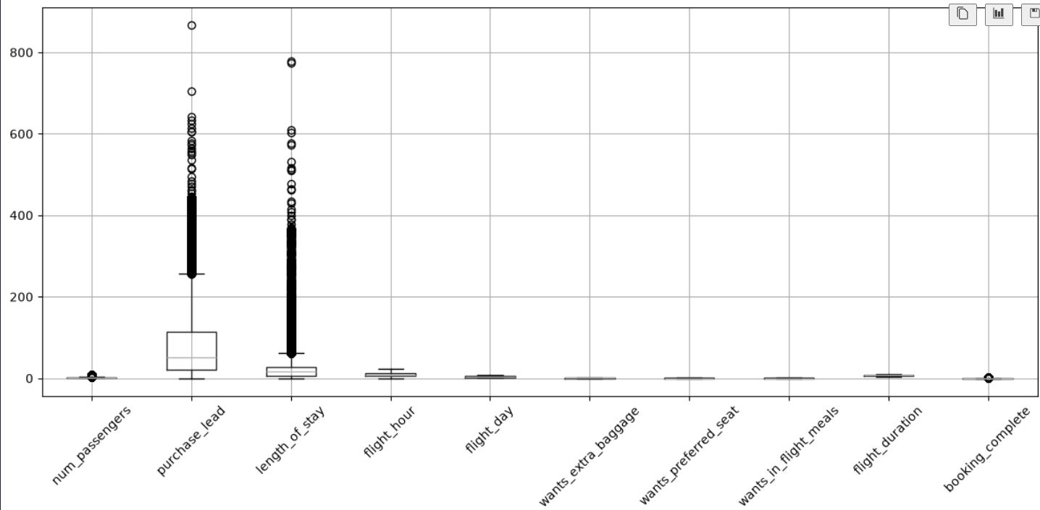
Models Used
Random Forest Classifier
XGBoost Classifier (Sensitive to Outliers, used Winsorizing to clip them instead of deleting the data)
Both models handle non-linear relationships well
Compared performance after training

Slide 5
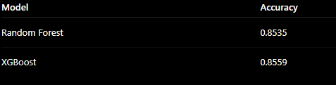
Evaluation
Accuracy used as main metric
Compared test set performance
Selected best-performing model based on validation results
XGBoost slightly outperformed Random Forest, but the difference is marginal, indicating both models capture similar patterns in the data

Slide 6
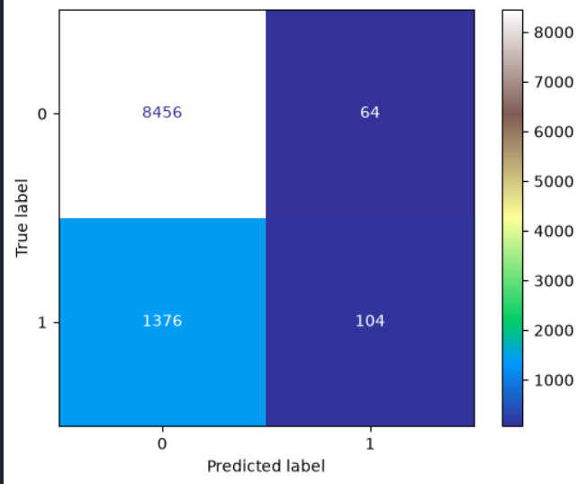
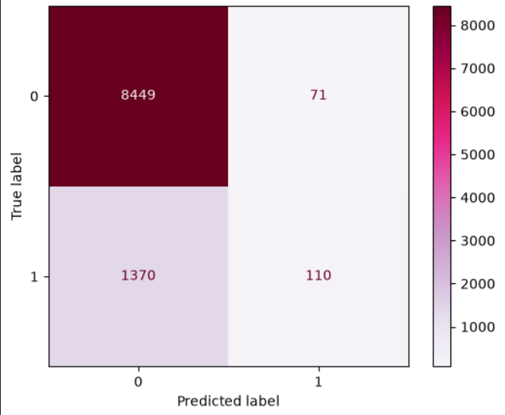
Confusion Matrix
If the business goal is to maximize detected bookings (revenue-oriented) → XGBoost
If the goal is to reduce false positives (cost control / marketing efficiency) → Random Forest
Random Forest
XGBoost

Slide 7
Business Impact
Helps identify customers likely to book
Supports marketing targeting and optimisation
Improves conversion rate strategies
Scalable model for future booking data

