Slide 1
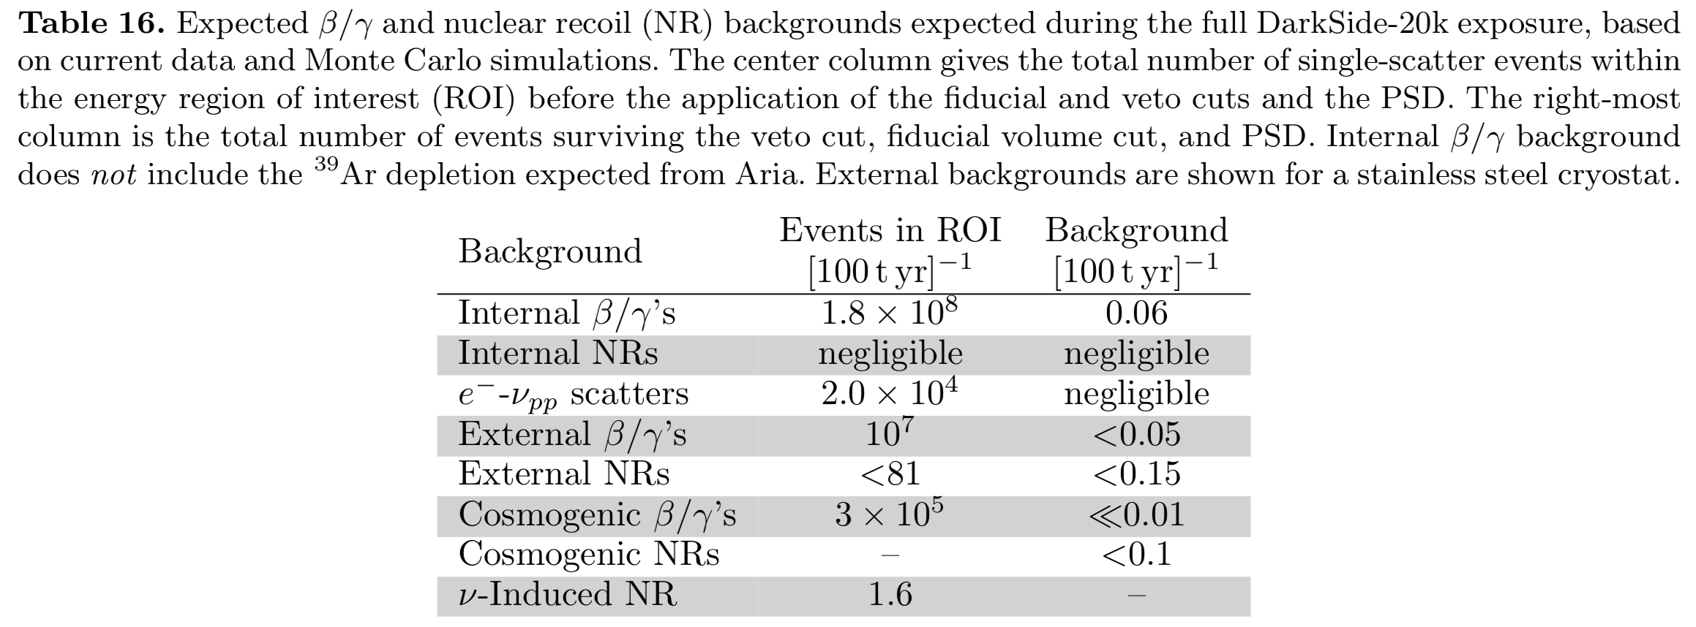
DS 20k Backgrounds
We probably want to have atleast a sentence in our paper addressing each of these backgrounds

Slide 2
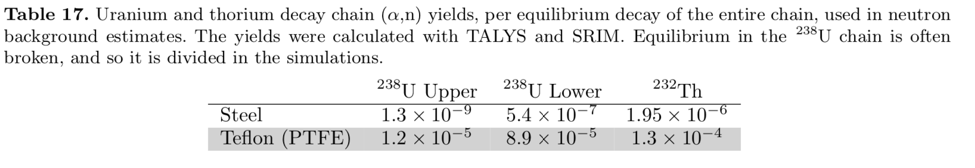
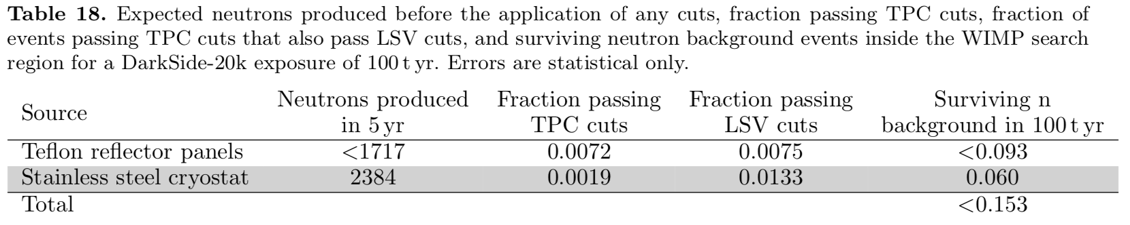
External Neutrons
Note that DS-20k (in the proposal) has a liquid scintillator veto that helps detect neutrons through capture, and also sees gammas from fission
No mention of SiPMs?

Slide 3
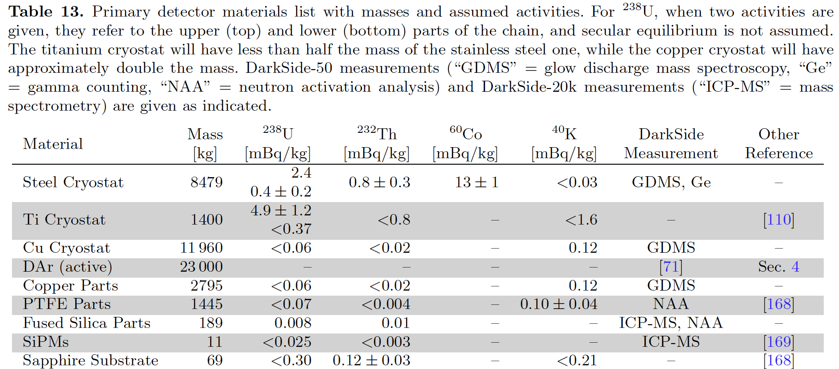
Radiopurity of Materials
SiPMs and sapphire substrate are much cleaner than stainless steel
Need to find reference for (alpha,n) on silicon, sapphire

Slide 4
 | DS-20k SS Upper | DS-20k SS Lower | DS-20k SS Total | LZ SS NIRONIT 511803 Upper | LZ SS NIRONIT 511803 Lower | DUNE SS | Eric's SS (23x cleaner than DUNE)
Mass [kg] | 8479 | 8479 | 8479 |  |  | 292000 | 292000
U [mBq/kg] | 2.4 | 0.4 | 2.8 | 1.2 | 0.27 | 3320 | 144.35
DS (alpha, n) yields/decay | 1.30E-09 | 5.40E-07 | 5.41E-07 | 1.30E-09 | 5.40E-07 | 5.41E-07 | 5.41E-07
Neutron yield/kg/sec | 3.12E-12 | 2.16E-10 | 2.19E-10 | 1.56E-12 | 1.46E-10 | 1.80E-06 | 7.81E-08
Neutron yield/cm3/sec | 2.46E-14 | 1.71E-12 | 1.73E-12 | 1.23E-14 | 1.15E-12 | 1.42E-08 | 6.17E-10
Neutron yield/yr | 8.35E-01 | 5.78E+01 | 5.86E+01 | 0.00E+00 | 0.00E+00 | 1.66E+07 | 7.20E+05
U [ppb] | 0.1944 | 0.0324 |  | 0.0972 | 0.02187 | 268.92 | 11.692
Kudryatsev (alpha, n) yields/ppb/cm3/sec | 1.47E-10 | 1.47E-10 |  | 1.47E-10 | 1.47E-10 | 1.47E-10 | 1.47E-10
Neutron yield/cm3/sec | 2.86E-11 | 4.76E-12 |  | 1.43E-11 | 3.21E-12 | 3.95E-08 | 1.72E-09
Neutron yield/yr | 9.68E+02 | 1.61E+02 |  | 0.00E+00 | 0.00E+00 | 4.61E+07 | 2.00E+06
These numbers reproduce the 2384 total number of neutrons produced in the DS20k SS per 5 yrs
58.6/yr (U) + 417/yr (Th)
 | DS-20k SS Total | LZ SS NIRONIT 511803 Upper | LZ SS NIRONIT 511803 Lower | DUNE SS | Eric's SS (23x cleaner than DUNE)
Mass [kg] | 8479 |  |  | 292000 | 292000
Th [mBq/kg] | 0.8 | 0.33 | 0.49 | 80 | 3.48
DS (alpha, n) yields/decay | 1.95E-06 | 1.95E-06 | 1.95E-06 | 1.95E-06 | 1.95E-06
Neutron yield/kg/sec | 1.56E-09 | 6.44E-10 | 9.56E-10 | 1.56E-07 | 6.78E-09
Neutron yield/cm3/sec | 1.23E-11 | 5.08E-12 | 7.55E-12 | 1.23E-09 | 5.36E-11
Neutron yield/yr | 4.17E+02 | 0.00E+00 | 0.00E+00 | 1.44E+06 | 6.25E+04
Th [ppb] | 0.1968 | 0.08118 | 0.12054 | 19.68 | 0.85565217
Kudryatsev (alpha, n) yields/ppb/cm3/sec | 4.74E-11 | 4.74E-11 | 4.74E-11 | 4.74E-11 | 4.74E-11
Neutron yield/cm3/sec | 9.33E-12 | 3.85E-12 | 5.71E-12 | 9.33E-10 | 4.06E-11
Neutron yield/yr | 3.16E+02 | 0.00E+00 | 0.00E+00 | 1.09E+06 | 4.73E+04
For Eric’s simulated SS I took a factor of 23 reduction compared to DUNE (from his slides)
This gives a total of
6.71E-10 n/cm³/sec according to DS (alpha,n) estimates or
1.76E-9 n/cm³/sec according to Kudryatsev

Slide 5
DUNE Pulse Shape Simulation (1.0 pe/keVr)
Ran f90-S1 simulation code with DUNE underground argon parameters
3000 ton x yrs
Light Collection:
1.0 p.e./keV_{r} at 500 V/cm above 57 keVr
3.12 p.e./keV_{ee} at 500 V/cm at 83mKr
3.75 p.e./keV_{ee} at 0 kV/cm
F90 curves taken from DS-50/SCENE*
Simulated Exposure: 3000 ton x yrs
Rate dominated by ³⁹Ar at 7.3x10⁻⁴ Bq/kg
We expect
0 leakage events > 80 keVr threshold
in the full 3000 ton x yr
*Used 200 V/cm ER f90 medians

