Slide 1
An introduction to Django
Maria Carmen Sorica
Afilierea : UTCN

Slide 2
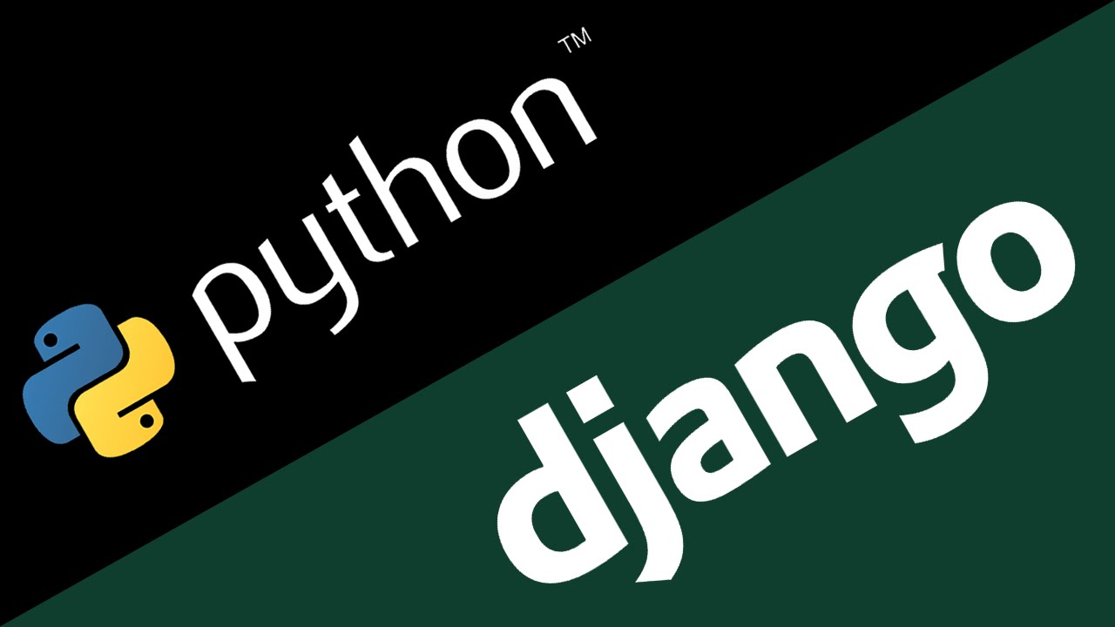
What is Django?
Django is a high-level Python Web Framework that encourages rapid development and clean, pragmatic design.
Django makes it easier to build better web applications more quickly and with less code.
Django is a "web framework for perfectionists with deadline."

Slide 3
Summary
What is Django?
Django Components - M.V.C.
Project/Site Creation- Part I
Project/Site Creation- Part II
Who uses Django?

Slide 4
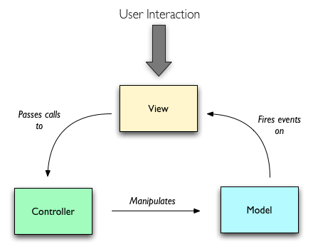
Django Components - M.V.C.
Model - is the data.
View - is how the user sees the data
Controller - handles the user's requests, such as creating a new item, and returns a view to display the result.

Slide 5
Project/Site Creation- Part I
Creating new Project:
  .django-admin.py startproject demoproject
Creating new Application:
  python manage.py startapp demoapp
Using the built-in web server:
  python manage.py runserver
Creating a superuser:
  python manage.py createsuperuser

Slide 6
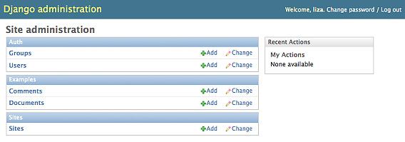
Project/Site Creation- Part II
Creating Models:
  from django.db import models
Activating Models:
  python manage.py syncdb
URLs configuration:
  from django.conf.urls.defaults import
Creating Views:
  from django.http import HttpResponse

Slide 7
Who uses Django?
In conclusion Django is a powerful framework, widely spread in the web development world.
Instagram
Mozilla
NASA
BitBucket
National Geographic, Discovery Channel
The Washington Post, NY Times, The Guardian
PBS (Public Broadcasting Service)

Slide 8

Thank you!

