Slide 1

EEP 153 PROJ 3
UGANDA FOOD & CONSUMER DEMAND DURING WET & DRY SEASONS
Team Mary Paley: Carmen Vega, Emily Wu, Mario Zhao, Jing Huang, & Rania Nasser
Notes:
Rania (1-5)
Hello—our presentation focuses on how rainfall variability in Uganda affects food demand and consumption patterns across households. Our team includes Carmen, Emily, Mario, Jing, and me—Rania.

Slide 2
PROJECT GOALS
INTERPRET HOUSEHOLD FOOD DEMAND IN UGANDA
01
ANALYZE THE EFFECT OF CLIMATE SHOCKS ON CONSUMPTION
02
IDENTIFY THE ECONOMIC DRIVERS OF FOOD INSECURITY
03
Understand how households allocate expenditures across food categories using price and income responsiveness through demand system estimation.
Evaluate how rainfall variability—particularly wet vs. dry years—impacts household food access, nutritional quality, and purchasing power.
Determine whether affordability or availability is the main constraint during drought years through empirical and inflation-adjusted analysis.
Notes:
We structured our project around three main goals:
Interpret household food demand
Analyze climate shocks
Identify drivers of food insecurity

Slide 3
WHY ARE WE INTERESTED IN RAINFALL?
Notes:
We care about rainfall because over 70% of food production in Uganda is rain-fed.

Slide 4
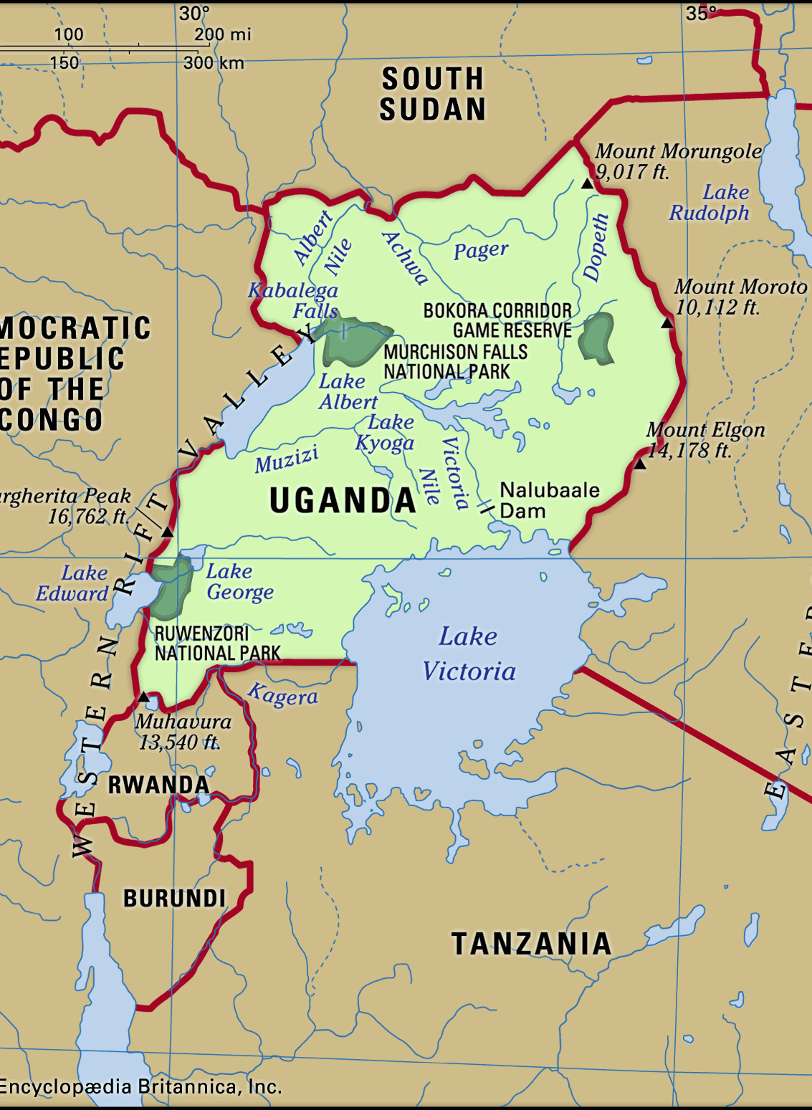
AGRICULTURE AND CLIMATE DEPENDENCE
East African Country
Uganda’s economy is heavily reliant on agriculture, which employs over 70% of the population and contributes significantly to GDP and household livelihoods.
Over 70% of Food Production is Rain-Fed
Most Ugandan households depend on seasonal rainfall for crop production, with minimal irrigation infrastructure.
Rural Households Most Vulnerable
Rural communities are especially at risk, as they face the greatest exposure to crop failures, price shocks, and food insecurity during extreme weather events.
Frequent Wet/Dry Cycles Affect Demand
Uganda experiences cycles of drought and excess rainfall, both of which disrupt food availability, impact prices, and shift household consumption patterns.
Notes:
Uganda’s economy is deeply tied to agriculture, with over 70% of the population working in the sector. Most farms rely on seasonal rain, making them vulnerable to droughts and floods. These frequent wet and dry cycles disrupt production and shift how households eat and spend.

Slide 5
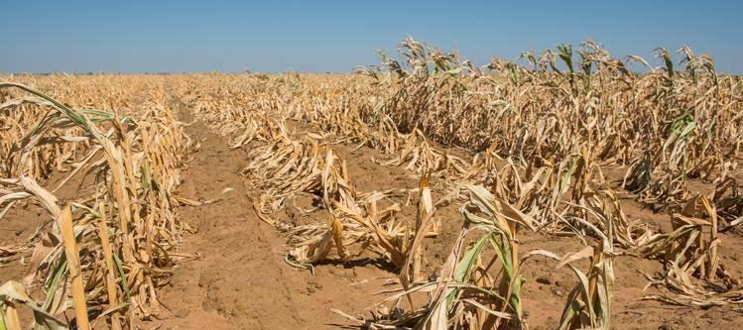
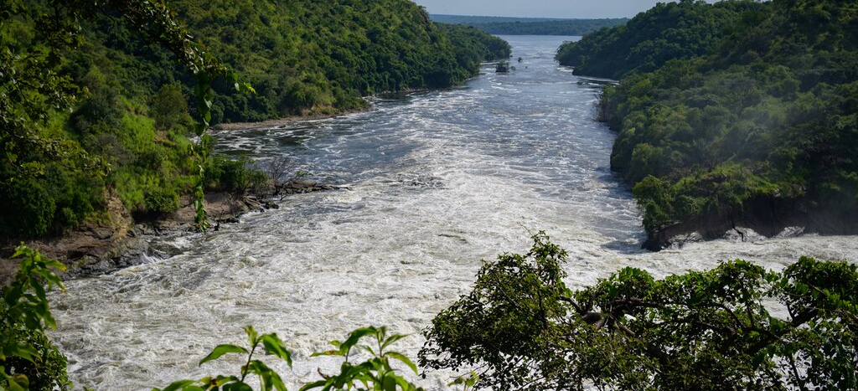
DROUGHT PERIODS
WET PERIODS
Least annual precipitation: Years 2005-06
Extreme Drought Months: Years 2010-11
Most annual precipitation: Years 2018-19
Extreme Wet Months: Years 2015-16
Notes:
Within our dataset, we identified wet and dry years in two ways: by looking at total annual rainfall and by isolating extreme months.
The driest years based on annual precipitation were 2005–06, which recorded just 1168 mm. The wettest years were 2018–19, with rainfall reaching 1443 mm.
But annual totals can miss short-term extremes—so we also examined periods like 2010–11, where multiple months fell below the long-term average, leading to an agricultural drought. That was confirmed by Uganda’s Office of the Prime Minister, which tracked crop water deficits during that time.
Meanwhile, 2015–16 marked a highly wet period, driven by the El Niño event, which tends to bring more rainfall to Eastern Africa.

Slide 6
INTERPRETING FOOD DEMAND SYSTEM
Notes:
Carmen 6-7
To characterize the household food demand climate in Uganda, we estimated a food demand system for our population.

Slide 7
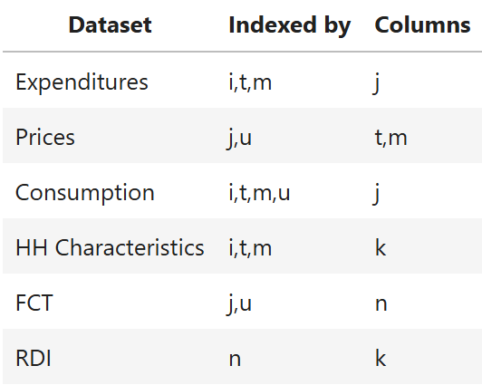
GATHERING DATA
i: household index
t: time periods (years)
m: market/region
j: good/food name
k: household characteristic/demographic
u: unit (for goods)
n: nutrients
Years:
2005-06, 2009-10, 2010-11, 2011-12, 2013-14, 2015-16, 2018-19, 2019-20
Notes:
CARMEN:
To begin our data analysis, we first needed to obtain data in several different formats. We imported Ugandan data from Google sheets by downloading each sheet as a csv file and then importing the sheets as pandas dataframes on Datahub. In total, we created six different datasets: one for expenditures, food prices, consumption, household characteristics, a food conversion table, and a recommended daily intakes table. In order to format our data in a way in which we could perform our analysis, we indexed each table by specific parameters using the pivot table function. Our parameters included a unique household index, time periods, markets, food names, household characteristics, units, nutrients. All of this data was obtained for the following years in Uganda. While there are some year gaps where we did not have data, we still attempted to draw conclusions from the data we could work with.

Slide 8
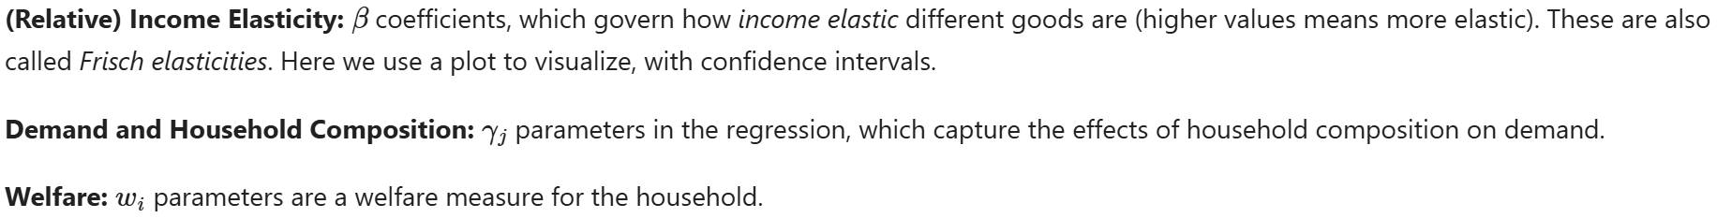
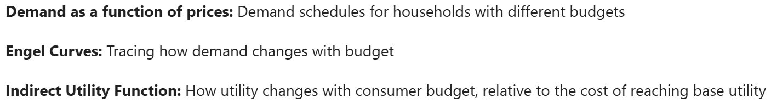
UNDERSTANDING FOOD DEMAND SYSTEMS
The Food Demand Climate in Uganda can be interpreted through extracting the parameters of an estimated regression:
We already have these parameters:
y : log expenditures
d : household characteristics
Parameters we’re estimating:
Interpretation of demand system through:
Notes:
CARMEN:
In order to understand how households allocated expenditures across food categories, we designed an estimate demand system. In our regression model, we began with two known parameters: the log expenditures for each household, and individual household characteristics. Using the cfe module, we designed a regression based on our dataframes. After confirming the validity of our regression by graphing our predicted and expected y-values, as well as ensuring a high R-squared value, we then estimated the unknown parameters of our model. The parameters we estimated were relative income elasticity, demand and household composition, and welfare. Finally, we interpreted our demand system by visualizing demand as a function of prices, engel curves, and an indirect utility function. We performed this estimation across all the years we had data for.

Slide 9
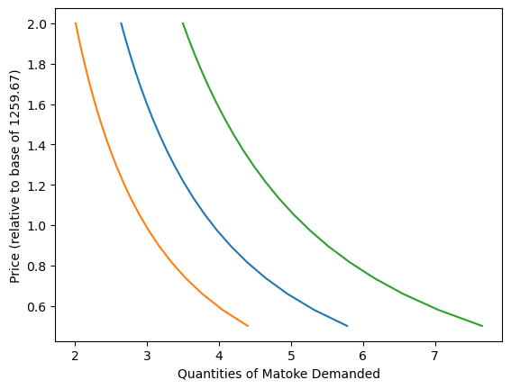
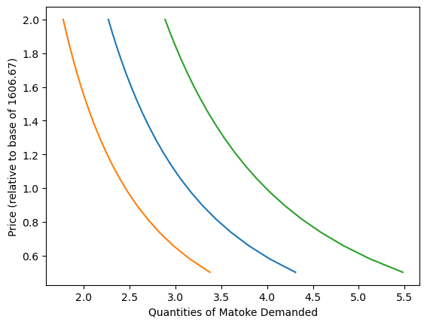
DEMAND AND PRICES
Dry: 2005-2006
Wet: 2018-2019
Things to note:
Price-demand relationship is similar in both dry and wet years
2018-2019 wet year: smaller range in quantities demanded and steeper slope of curves
Notes:
Emily 8-11
We looked into the demand and price curves because comparing demand across different household budgets showed us how price sensitivity varies. The curves shows that climate conditions may affect the overall consumption range of Matoke in Uganda, but the fundamental price-demand relationship maintains a similar structure. The narrower quantity range (or the x-axis) in the 2018-2019 wet year reflects either changes in agricultural production capacity, shifts in consumer preferences, or market size. In 2018-2019, the slope of the lines are also a bit steeper indicating greater consumer sensitivity to Matoke.

Slide 10
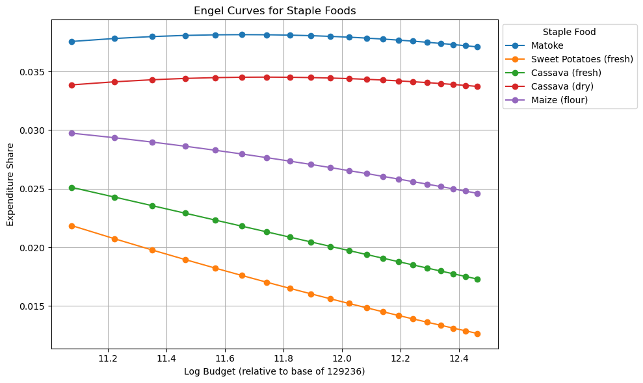
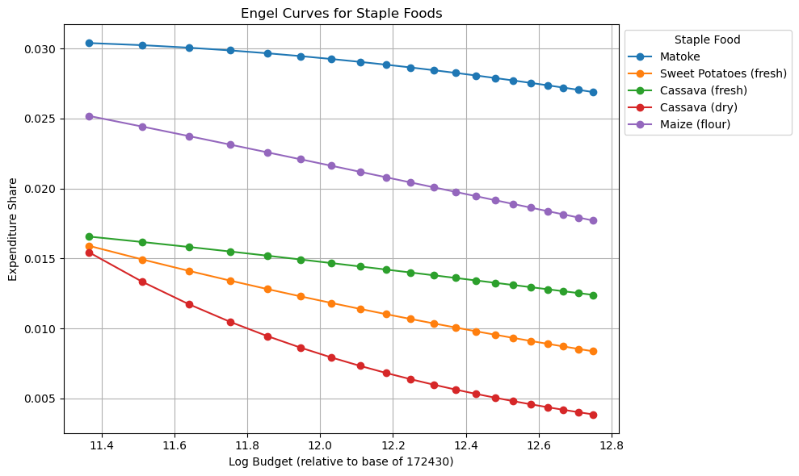
ENGEL CURVES
Dry: 2005-2006
Wet: 2018-2019
Things to note:
Engel curves illustrate how households allocate their budget shares to specific goods based on income changes
Wet year: lower expenditure shares→ better agricultural yields or increased food diversity
Rightward shift in budget range suggest income growth over time
Dry cassava reflects a “climate-responsive” staple
Notes:
Engel curves illustrate how households allocate their budget shares to specific goods as their income changes. Matoke consistently maintains the highest expenditure share among all staple foods in both the dry period (2005-2006) and wet period (2018-2019), emphasising its cultural and dietary significance.
During the wet period (2018-2019), the overall expenditure shares for most foods are lower compared to the dry period, suggesting better agricultural yields or increased food diversity. The negative slopes of all curves indicate these are necessity goods: expenditure share decreases as income rises which is often seen for staple foods.
The rightward shift in budget range (from approximately 11.1-12.5 to 11.3-12.8) suggests income growth over the 13-year span, and can also indicate inflation. Simultaneously, the y-axis scale shows reduced expenditure shares in 2018-2019, potentially indicating increased spending on non-staple foods as households diversify their diets.
Dry cassava appears to function as a "climate-responsive" staple, with households relying on it more heavily during dry periods. The shift from a nearly linear curve to a strongly concave one indicates a fundamental change in cassava's role in the Ugandan diet – indicating a transition from being a regular staple across income levels to functioning primarily as a coping food for lower-income households.

Slide 11
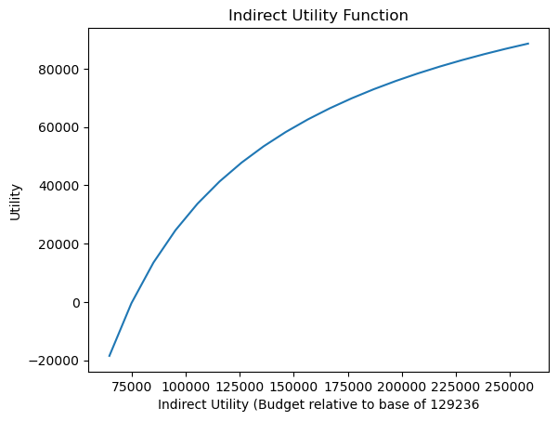
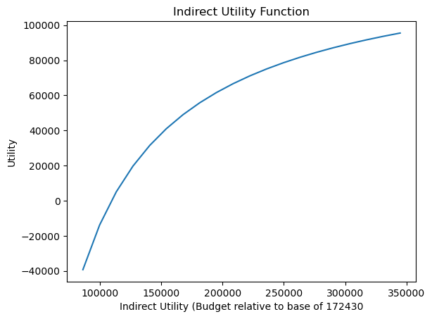
INDIRECT UTILITY FUNCTION
Dry: 2005-2006
Wet: 2018-2019
Things to note:
Indirect utility functions map household budget levels to corresponding utility levels
Budget range increased from 2005-2006 to 2018-2019: economic growth & expanded income possibilities
Wider utility range in 2018-2019: deeper potential welfare losses at low incomes & slightly higher potential welfare gains at high income
Notes:
The indirect utility functions map household budget levels (x-axis) to corresponding utility levels (y-axis), which provides us with valuable insights into welfare changes over time in Uganda.
The budget range has increased from approximately 75,000-250,000 (2005-2006) to 75,000-350,000 (2018-2019), also further suggesting economic growth and expanded income possibilities for Ugandan households. The wider utility range in 2018-2019 indicates both deeper potential welfare losses at low incomes and slightly higher potential welfare gains at high incomes.
This analysis aligns with the earlier findings on Engel curves, collectively suggesting that Uganda has experienced economic growth with changing consumption patterns, but potentially with increased vulnerability for lower-income households.

Slide 12
CONSUMPTION, EXPENDITURE , AND NUTRITIONAL ADEQUACY
Notes:
Jing 13-15

Slide 13
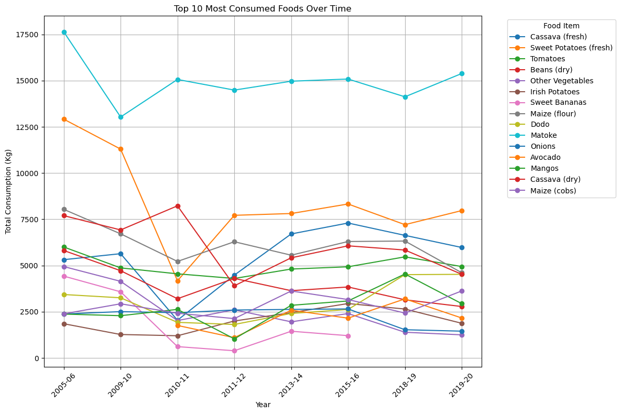
TOP 10 MOST CONSUMED FOODS
Notes:
Looking at the top 10 most consumed foods in Uganda, the data suggests a gradual diversification of the Ugandan diet over time. The gap between matoke and other foods narrowed somewhat after 2010, and there appears to be more clustering of multiple food types in the middle consumption range
Some of the consumption patterns might correlate with known drought periods (e.g., 2010-2011) and economic changes in Uganda. The recovery and relative stabilization after 2011-12 could reflect improved agricultural conditions or economic growth allowing for more consistent food access.

Slide 14
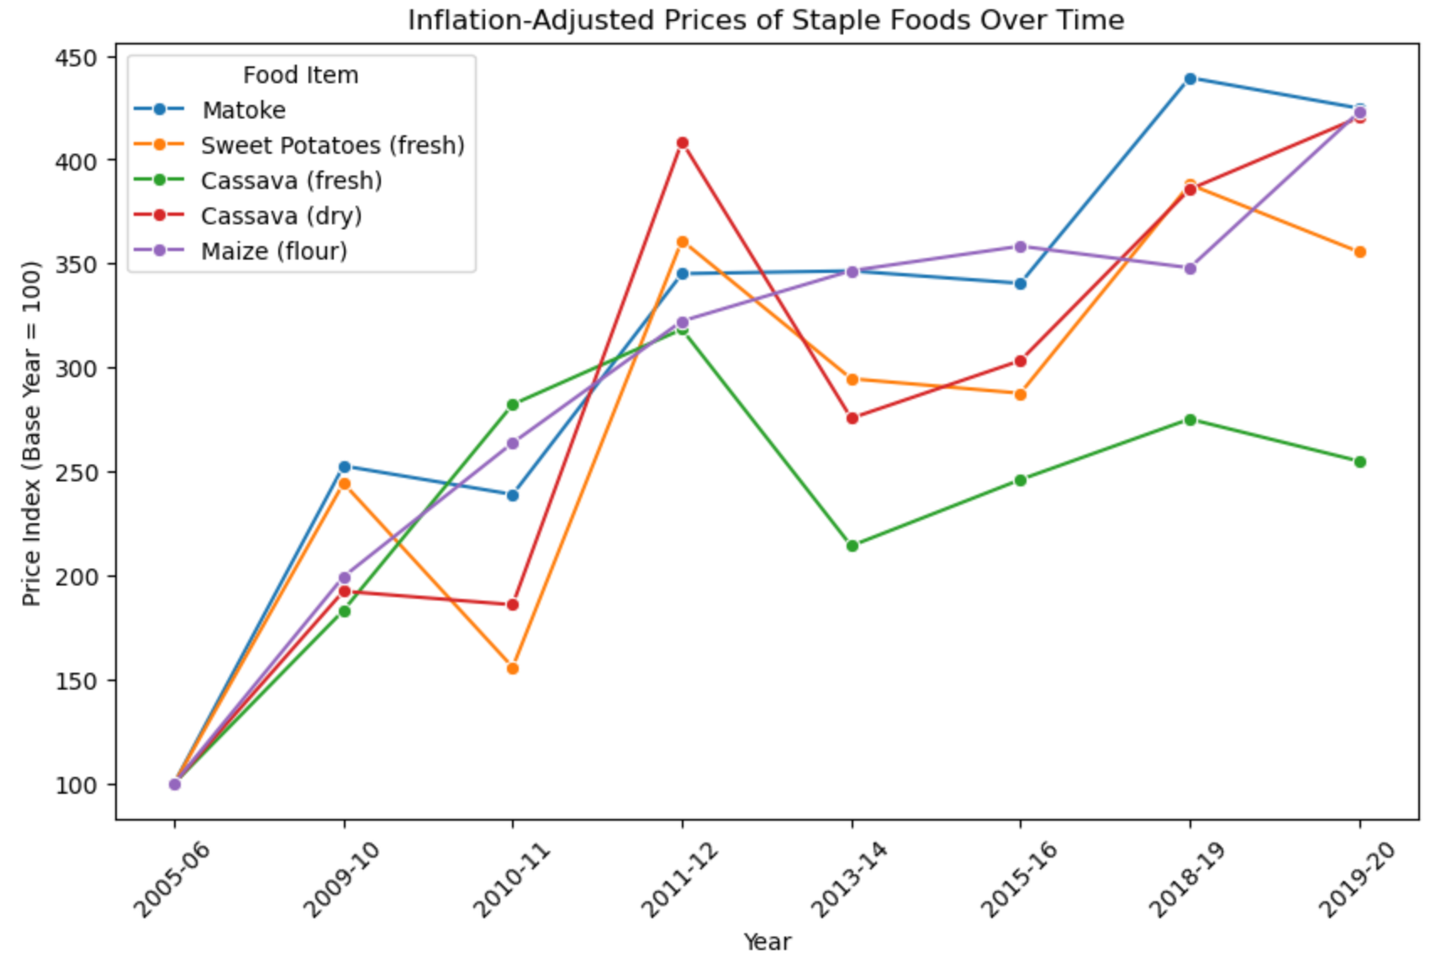
FOOD PRICES
Notes:
From the graph of the Food Prices, it shows the inflation-adjusted prices of key staple foods over time. Most items show a steady upward trend, reflecting both general inflation and periodic supply shocks. Noticeable spikes in certain years—especially around 2010–2011—suggest that climatic factors or market disruptions may have pushed prices higher.

Slide 15
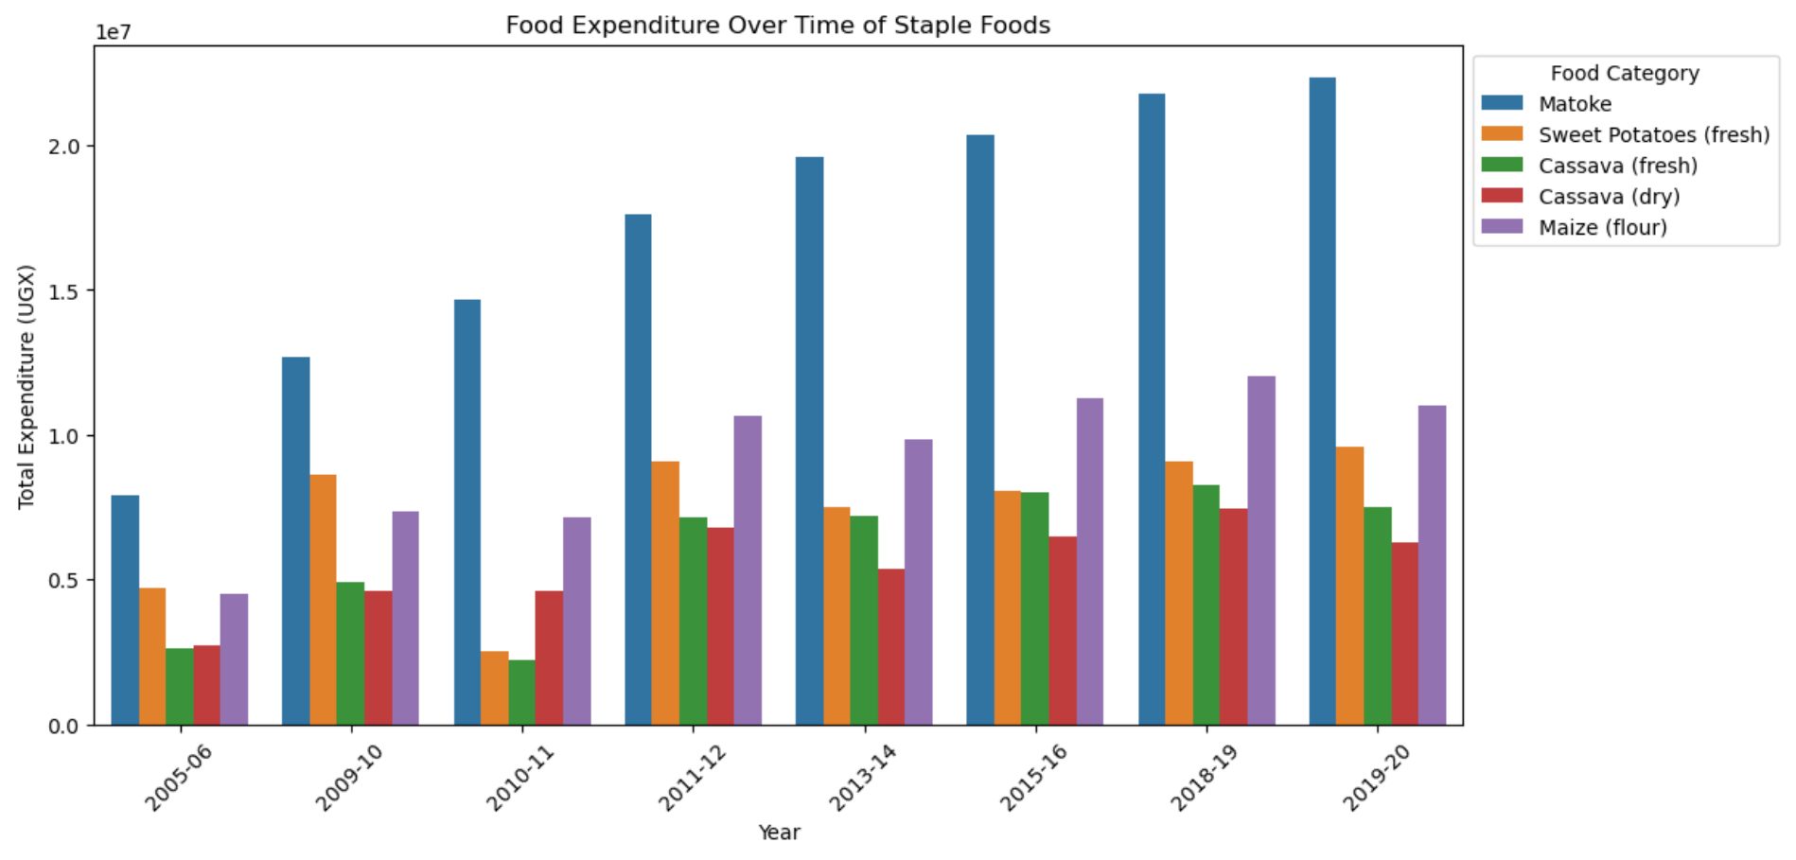
EXPENDITURE PATTERNS
Notes:
NOTE MATOKE IS MOST CONSUMED FOOD!!!
Typically increases over time…
But:
Sweet potatoes decrease significantly in 2010-11
Cassava (fresh) decrease in 2010-11
Then, We observe a general increase in spending on all staples, indicative of growing demand and possibly rising prices.Such as MATOKE IS MOST CONSUMED FOOD. However, certain items, such as sweet potatoes or fresh cassava, exhibit dips during specific periods—most notably around 2010–2011—which may reflect shifts in consumer preferences, supply constraints, or economic pressures.

Slide 16
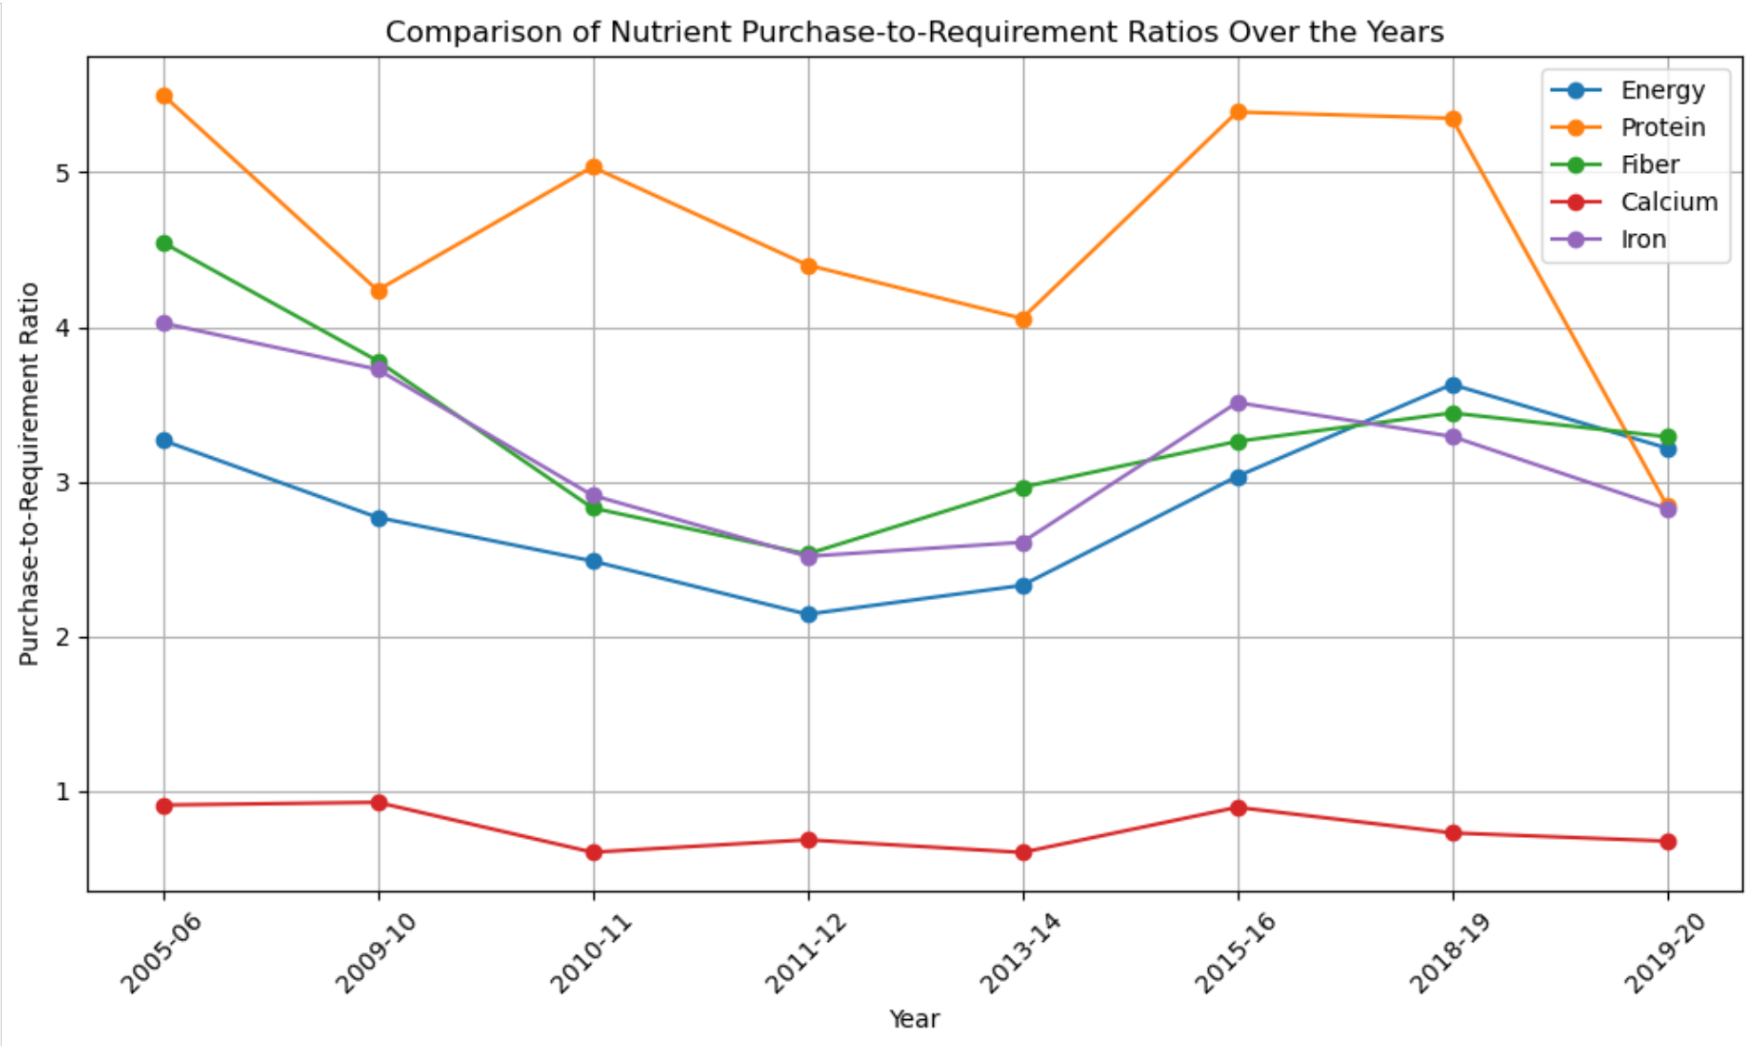
NUTRITIONAL ADEQUACY
Notes:
Decrease (generally) 2005-6 to 2011-12
After that, increases
Protein kinda crazy lol
Here, we compare the purchase-to-requirement ratios for various nutrients—such as energy, protein, and micronutrients—over several years. From around 2005–2006 to 2011–2012, there’s a noticeable decline in most nutrients, suggesting that households faced greater challenges in meeting recommended dietary needs.

Slide 17
EVALUATING RAINFALL SHOCK
Notes:
Carmen 17-19
Our group was particularly interested in analyzing the effect of rainfall shocks on expenditure and consumption patterns.

Slide 18
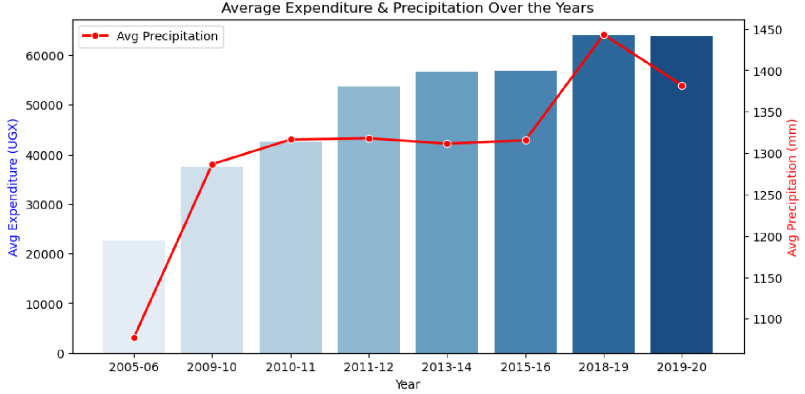
GAS PIPELINES
TUNNEL WORKS
WATER TREATMENT PLANTS
EXPENDITURE & PRECIPITATION
Yes, Saturn is the ringed one. This planet is a gas giant, and it’s composed mostly of hydrogen and helium
Jupiter is a gas giant and the biggest planet in our Solar System. It’s the fourth-brightest object in the sky
Despite being red, Mars is a cold place, not hot. It’s full of iron oxide dust, which gives the planet its reddish cast
Notes:
To begin this analysis, we first visualized how the average expenditure varied in comparison to the variance in average rainfall over time. This graph suggested that perhaps there is some correlation between the two variables, with several increases in rainfall aligning with an increase in average expenditure on goods. However, this pattern doesn’t exactly hold for years with a small change in average precipitation. From this graph, an exact conclusion isn’t clear, as so we did further analysis into specific parameters.

Slide 19
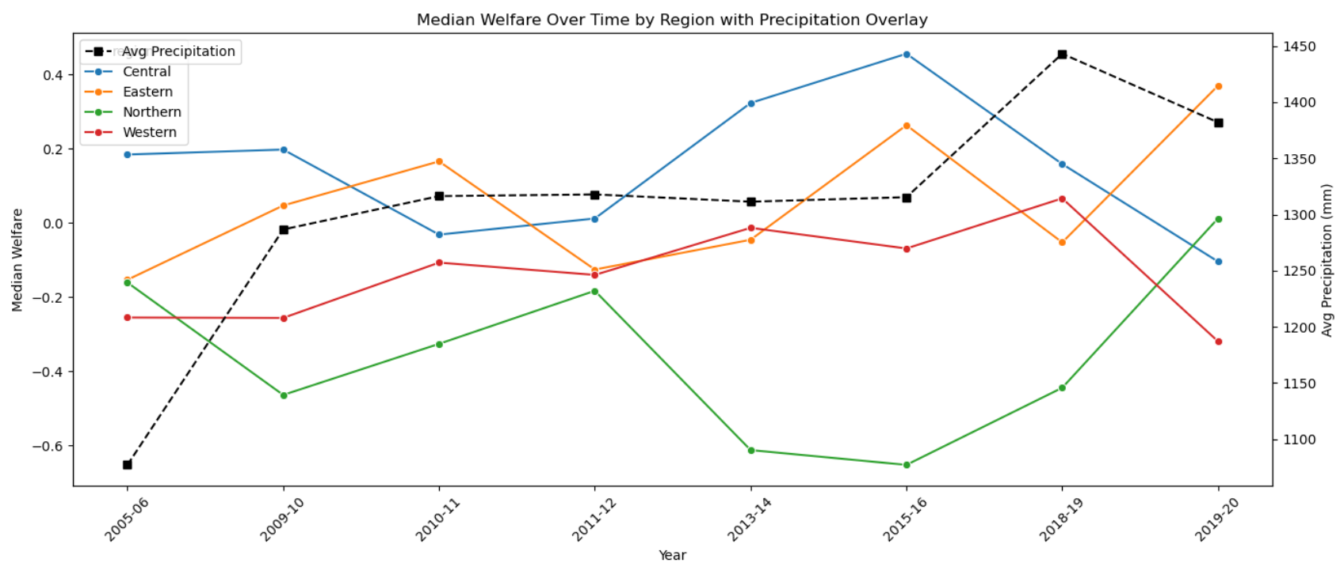
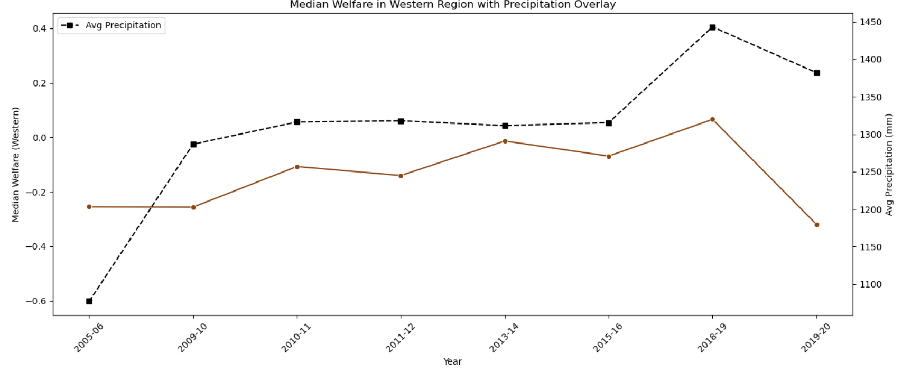
WELFARE IMPACT
← All Regions
Only Western Region →
Notes:
Here we analyzed our welfare parameter, which serves as a measure of the health and happiness of a household. This was the only parameter we estimated that’s data suggested a correlation to average precipitation when analyzing across all years. In the top graph, we see that when dividing our welfare data amongst the regions (aka markets) of Uganda, there doesn’t seem to be a correlation for all regions. However, if we single out our data from the Western region of Uganda, as shown on the lower graph, we can see that indication of a correlation between precipitation and welfare.

Slide 20
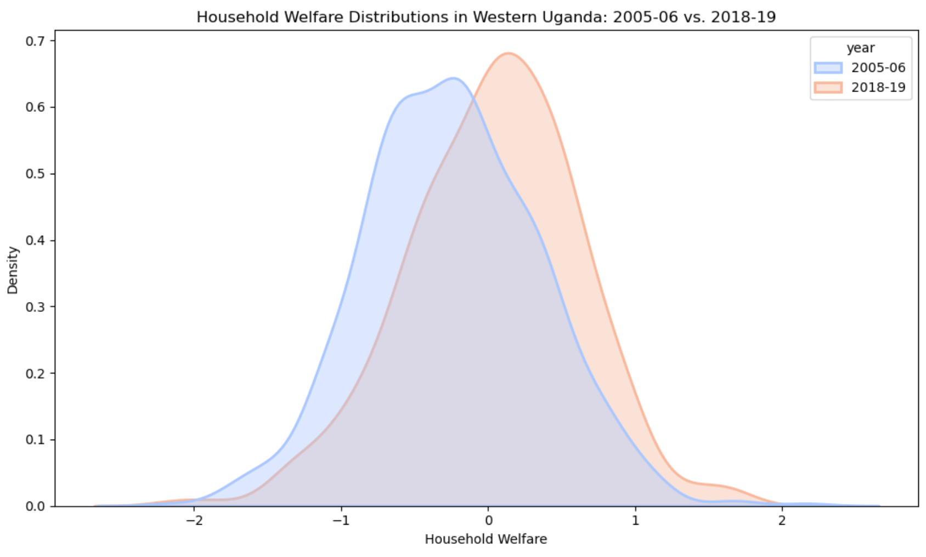
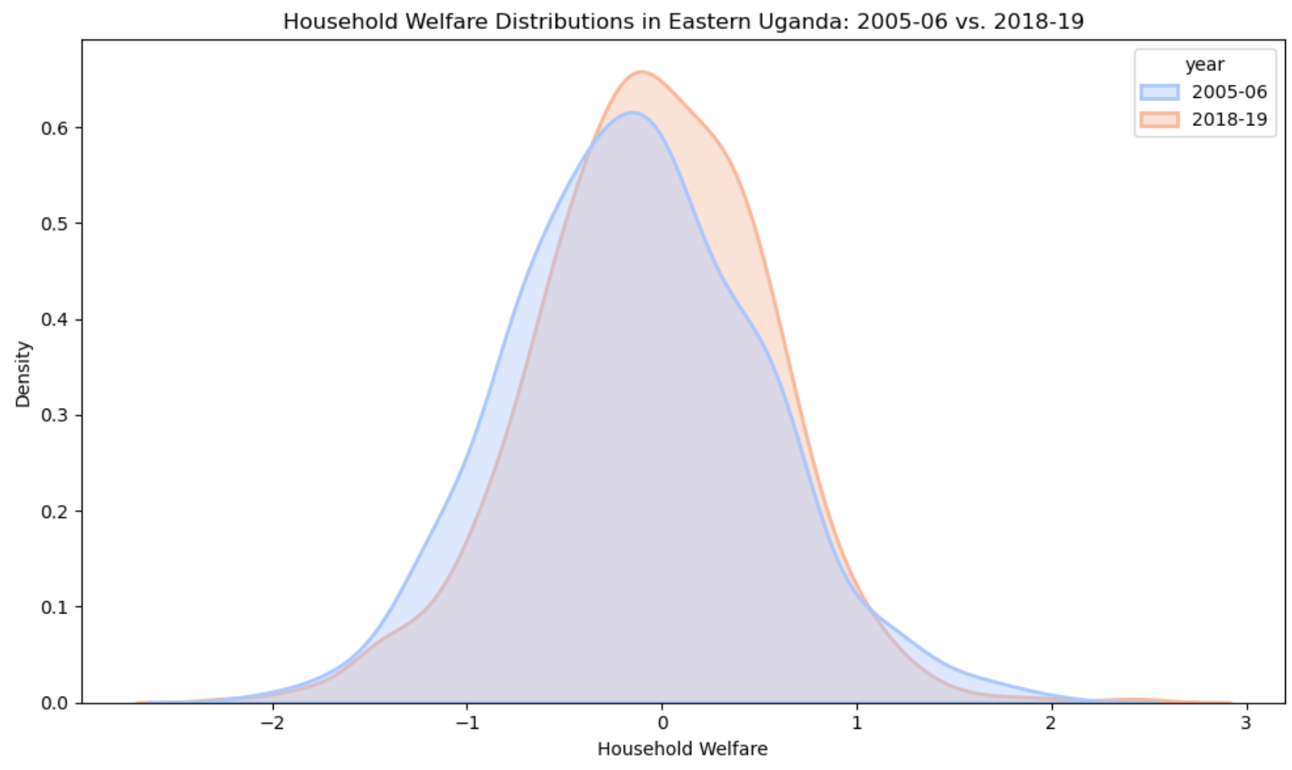
WELFARE KDE
Notes:
To further understand differences in welfare in comparison to rainfall data, we looked at the two periods with the least and most annual precipitation: being 2005-06 and 2018-19 respectively. Again, we focused on any significance pertaining to the Western region. When comparing kernel density estimates of welfare distributions for Western Uganda (on the left) vs Eastern Uganda (on the right), we can see that indeed Western Uganda shows a difference between the wet and dry years, whereas Eastern Uganda does not. From this, we can infer that the welfare of the Western region of Uganda is disproportionately affected by the amount of rainfall in a given year.

Slide 21

WESTERN UGANDA CHARACTERISTICS
The Western region can be distinguished from others on the basis of its economic dependence on rain-fed agriculture. Specifically: Bananas! (aka Matoke) The Western region produces over double the amount of bananas as any other region.
 | Production [Metric tons]
Crop | Central | Eastern | Northern | Western
Banana (Food type) | 929,534 | 333,851 | 26,015 | 2,728,587
Banana (Sweet type) | 11,319 | 3,117 | 4,630 | 17,447
Banana (Beer type) | 98,984 | 5,266 | 981 | 137,614
Notes:
As we did research to try and understand why Western Ugandan welfare was so susceptible to rainfall, we found a significant characterization of the region. The West can be distinguished from other regions on the basis of its economic dependence on rain-fed agriculture. Most significantly, the west produced over double the amount of bananas as any other region, according to data from the Global Yield Gap Atlas. As we saw in our analysis of consumption and expenditure in Uganda, matoke, which is another name for bananas, was by far the most consumed and purchased food. Being such a significant food, and having a significant production within the Western region, it makes sense for the welfare of households in the West to be impacted by rainfall changes.
https://www.yieldgap.org/uganda

Slide 22
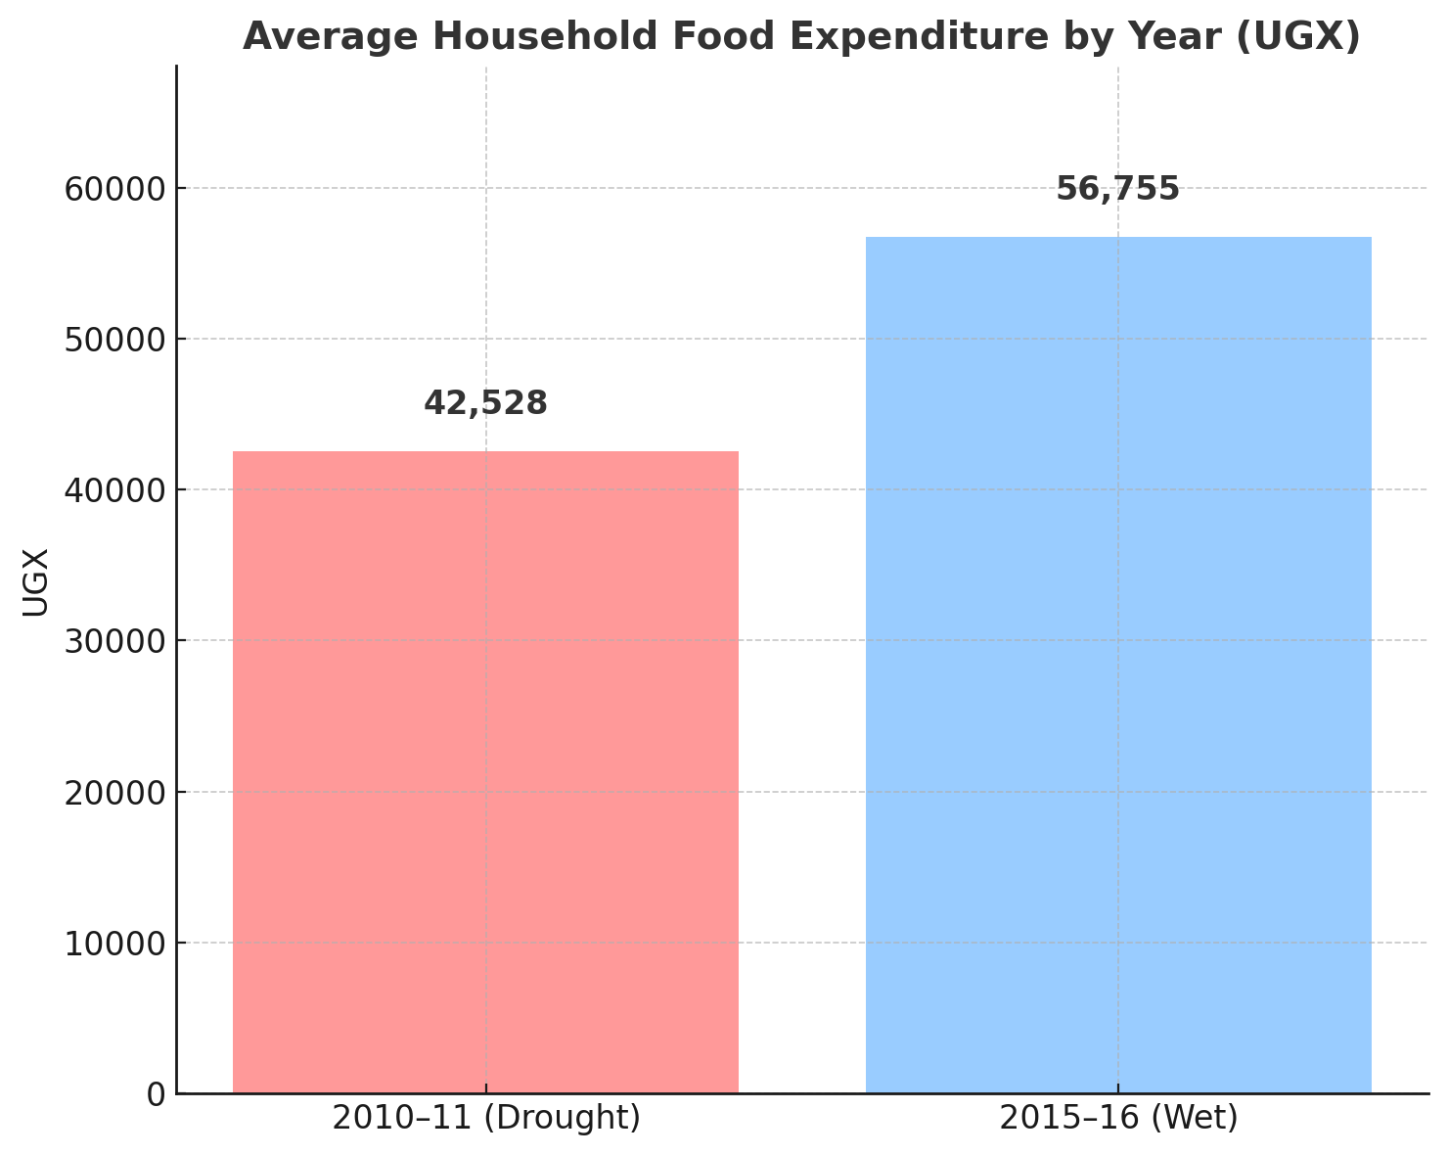
CONSUMPTION & PRECIPITATION
📉 Food spending dropped 25% during the 2010–11 drought
🌧️ Rainfall shortages reduced crop yields and market supply
⚠️ Households adjusted by spending less and eating cheaper staples
Notes:
Mario 20-21
For our consumption and precipitation slide we highlights how food consumption was affected during Uganda’s 2010–11 drought. On average, household food expenditure during the drought year dropped by more than 25% compared to the wet year of 2015–16. This decline wasn’t just about household choices — it reflects a real supply shock caused by rainfall failure. When crops fail, markets tighten, and food becomes more expensive. In response, families spent less, not necessarily by choice, but because they were forced to shift toward cheaper, lower-quality foods. So while consumption may look stable on the surface, this drop in expenditure shows how climate stress directly impacted what people could actually afford to eat.

Slide 23
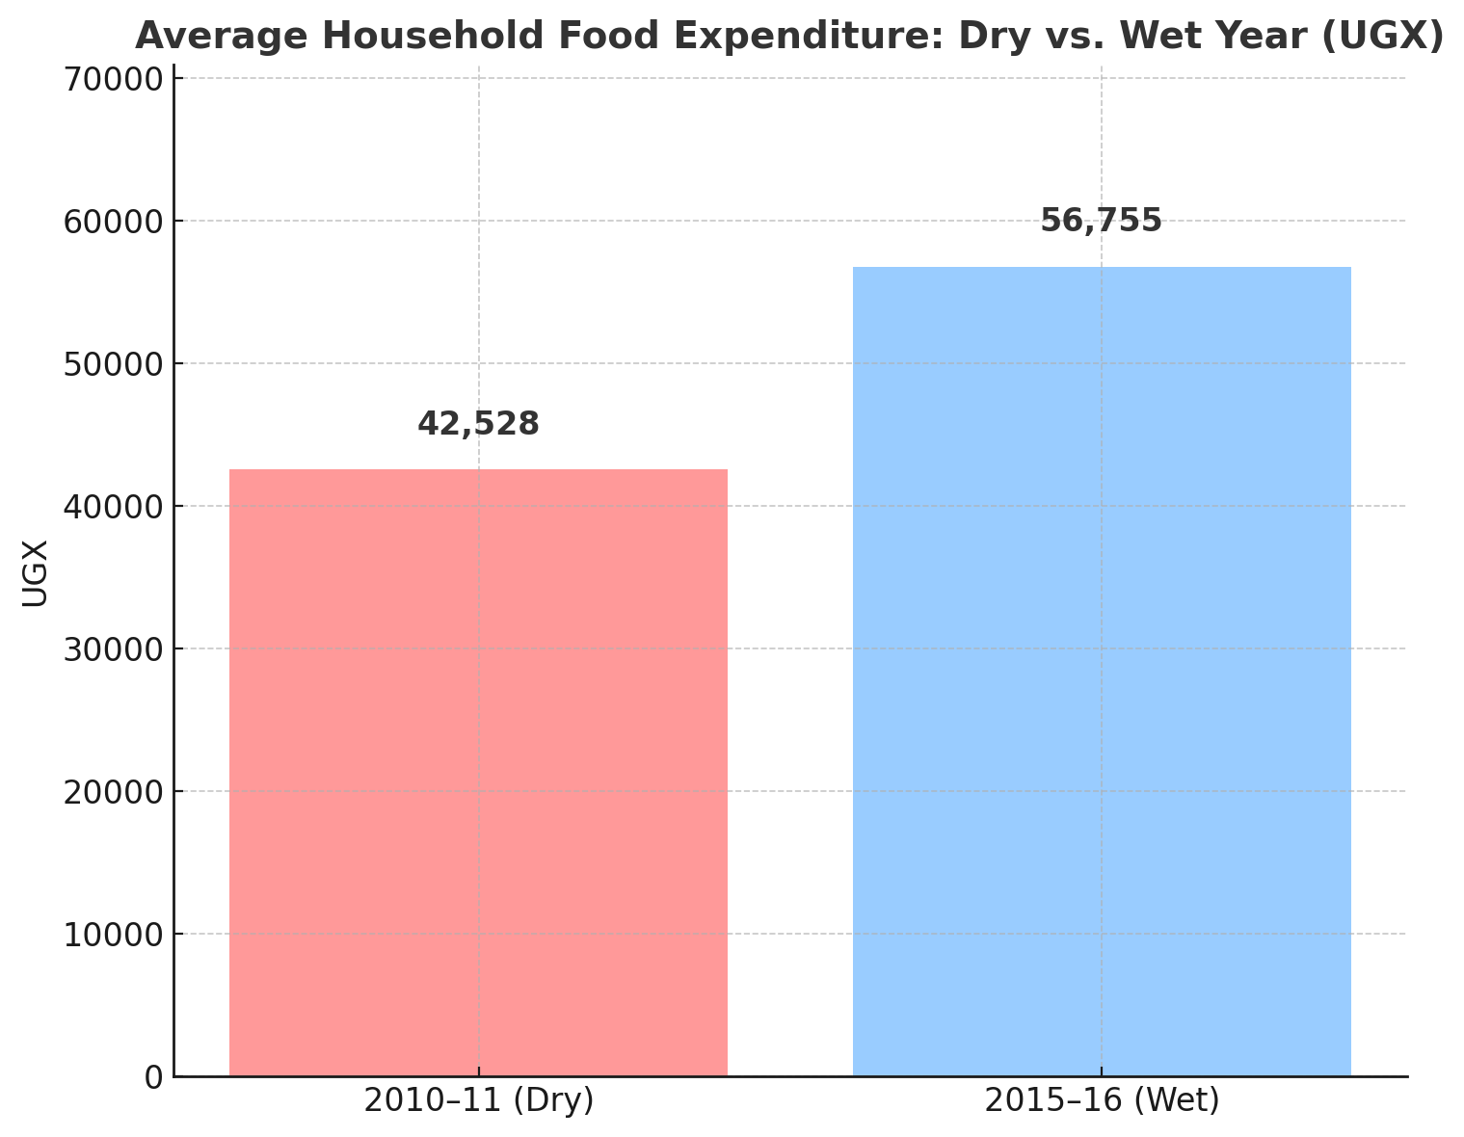
DRY AND WET YEARS
“Households Consumed More in Wet Years with Stable Food Supply”
💧 2010–11 Drought Year → Avg. household food spending: UGX 42,529
🌿 2015–16 Wet Year → Avg. spending rose to UGX 56,756 (+33%)
📉 Reflects reduced food access and affordability during drought
Notes:
We compares household food consumption across two key periods in Uganda: the 2010–11 drought year and the 2015–16 wet year.
To create this, we used food expenditure data from the Uganda LSMS, specifically the Food Expenditures sheets for both years. We grouped the data by household and calculated total food spending for each household over the survey period.
Then we computed the average food expenditure per household.
What we found is that during the drought year of 2010–11, the average household spent about UGX 42,500 on food. In contrast, during the wet year of 2015–16, average food spending rose to nearly UGX 56,800.
That’s a 33% increase, and it shows how rainfall patterns directly affect not just supply — but actual household consumption.
This difference suggests that in dry years, households may either cut back on food, switch to cheaper options, or simply be priced out of more nutritious choices.
It’s not just about what’s available in the market — it’s about what people can afford to put on their plate."

Slide 24
CONCLUSIONS
Notes:
Emily 22-23

Slide 25
FROM OUR DATA + RESEARCH…
Ugandan agriculture and food consumption is both impacted by annual rainfall totals and monthly levels throughout the year
Western Uganda was more receptive to welfare changes due to rainfall, likely due to their high production of matoke
Drought conditions significantly reduce household food spending and dietary resilience, highlighting the vulnerability of food access to climatic pressures
Further analysis: Look into data on specific crops, or data on variation of imports in correspondence to rainfall patterns

