Slide 1
How Machine Learning is Reshaping Price Optimization

Slide 2



Traditional price optimization and its limitations
Manual analysis
Massive data
Complex market conditions

Slide 3
How does machine learning-based pricing work?
Data Collection
Training of the Machine Learning Model
Optimization based on price elasticity predictions

Slide 4
Dataset Information
Source
https://www.kaggle.com/datasets/vijayuv/onlineretail
Data Type
Transactional data set for a UK-based online retail
Industry
Online retail where the company mainly sells unique all occasion gifts.

Slide 5
Exploratory Data Analysis (EDA)
a) Description
b) Quantity
c) Price
a) Missing values
b) Outliers
c) Data type
a) Trend analysis
b) Validation of
assumptions &
hypothesis
Visualizations
Understand the variables
Clean the datasets

Slide 6
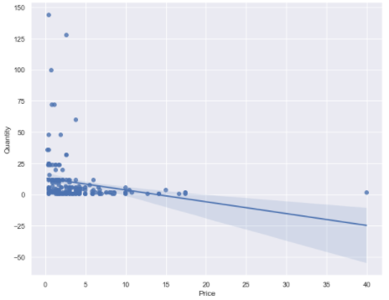
Exploratory Data Analysis (EDA)
Visualizations: Demand Curve expectation
Assumptions and hypothesis validated
price
demand

Slide 7


Let’s build the Model Model type
What model?
Linear Regression model
Why this model?
The scatterplot is in a linear trend
Predicts the relationship between 2 variables
Quantity & Price

Slide 8
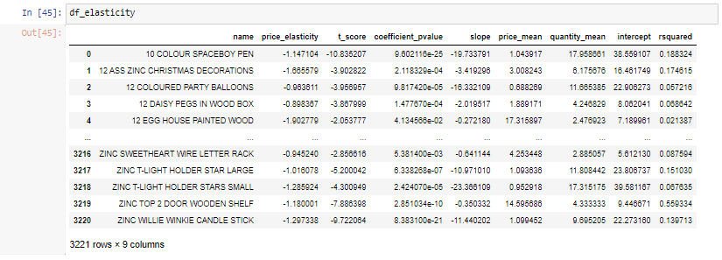
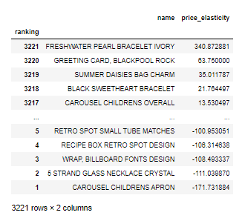
Let’s build the Model Final Data Frame Metrics

Slide 9







Let’s build the Model Metrics Interpretation
<1 demand is
insensitive
to price
>1 demand is
sensitive
to price
1 Revenue
maximized
R
2
Price Elasticity
Slope
Intercept
R-Squared

Slide 10
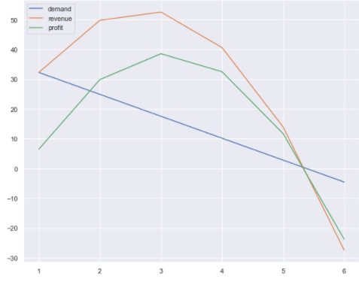

Let’s build the Model Metrics Interpretation by Product
Elasticity
Elasticity is 1.4
Slope
Every 1 dollar change in price
Intercept
Business can still sell 39 units with no price change
Product is sensitive to price change
R-Squared
Though is low at 1.4%, based on scatterplot, it still indicates linear relationship between Quantity & Price
Demand will change by 7 units

Slide 11


Key takeaways
Benefits of machine learning-based pricing work
Huge & Complex data sets
No more price reductions at the expense of profit
Improved calculation of willingness to buy

Slide 12
~Thank you~

