Slide 1
Using Interactive Visualization to Enhance Understanding of a Fisheries Model
Carmen St. Jean
Master’s Thesis Proposal
December 13, 2013

Slide 2
Thesis Goals
Build an interactive visualization interface to the MS-PROD model
Help fisherman, fishery managers, and other stakeholders understand
Implications of the model
The model itself
Evaluate alternative portrayal methods for their effectiveness

Slide 3
Fisheries Management
Sustainable exploitation
Managers control fishing effort
Bottom trawls (demersal)
Mid-water trawls (pelagic)
Others (e.g., long lines)

Slide 4
Ecosystem Models
Abstract model representing an ecosystem
Predict number (or biomass) of species
Leads to better understanding of ecosystem

Slide 5
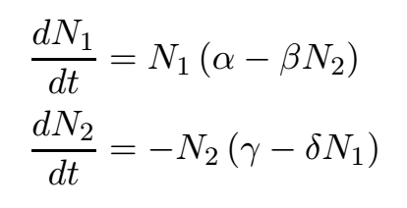
Lotka-Volterra Equations (1926)
Models predation between two species
N₁: number of prey
N₂: number of predator
t: time
α: prey’s growth rate
β: rate at which the predator destroys the prey
γ: predator’s death rate
δ: rate at which the predator increases from consuming the prey

Slide 6
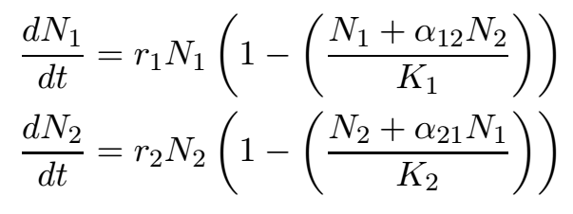
Rosenzweig-MacArthur (1963) /Leslie-Gower (1960)
Models competition between two species
N_{i}: number of species i
r_{i}: growth rate for species i
K_{i}: carrying capacity for species i
α_{ij}: effect species j has on species i

Slide 7
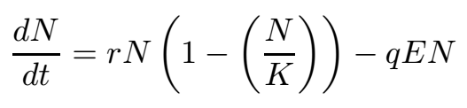
Schaefer Model (1957)
Models effect of harvest on a species
N: biomass of species
t: time
r: growth rate of species
K: carrying capacity of species
q: catchability of species
E: harvest effort

Slide 8
Ecosystem-Based Fishery Management
Considers many ecological factors
Predation
Competition
Humans
Climate
Closer to reality
Highly recommended, but seldom used
Pop_{t} = Pop_{t-1} *(1 + Growth) – Pred_{t-1} – Comp_{t-1} - Harv_{t-1}

Slide 9
MS-PROD (Multispecies Production) Model
Gamble and Link (NOAA National Marine Fisheries Service)
Uses ecosystem-based management approach
Predation
Interaction
Harvest
10 significant species
4 functional groups
30 year forecasts

Slide 10
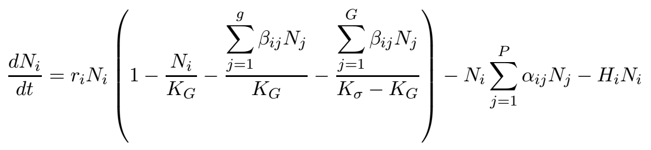
MS-PROD
Growth rate
Carrying capacity
Competition
Predation
Harvest
Prevents indefinite growth
N_{i}: number (or biomass) of species i
t: time
r_{i}: growth rate for species i
α_{ij}: predation of species j on i
β_{ij}: interaction of species j on i
H_{i}: harvest rate on species i
K_{G}: carrying capacity of i’s functional group
K_{σ}: carrying capacity of entire system
g: number of species in species i’s group
G: number of groups
P: number of predators

Slide 11
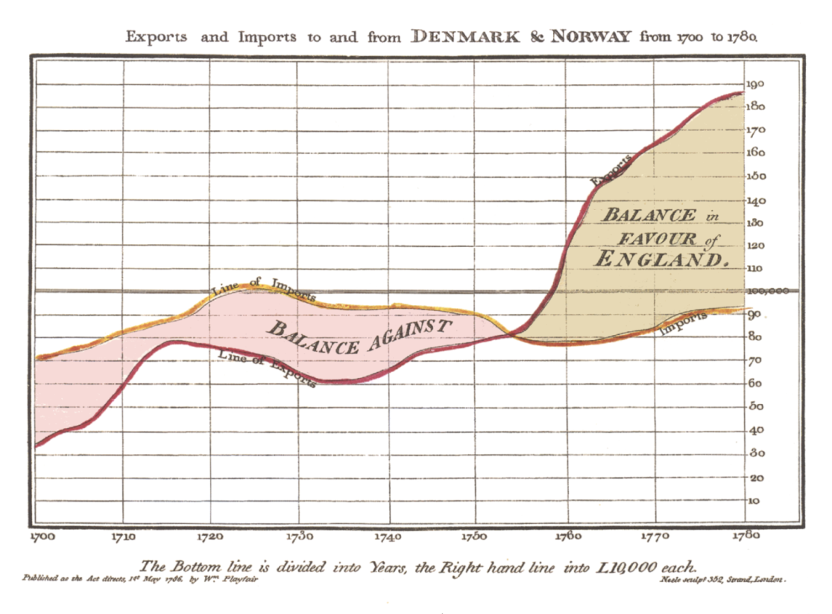
Representing Changes over Time
As a consequence of management actions
Trade balance time series (Playfair 1786)

Slide 12

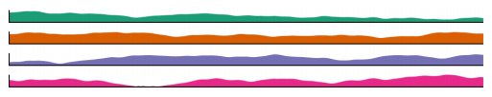
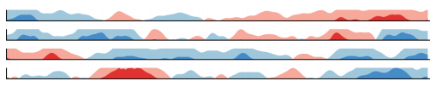

Multiple Time Series (Javed et al. 2010)
Simple Line Chart
Small Multiples
Horizon Graphs
Braided Graph

Slide 13
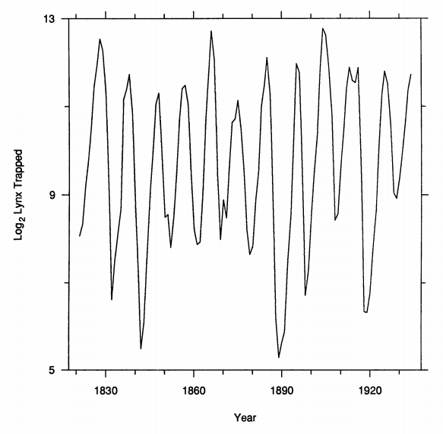
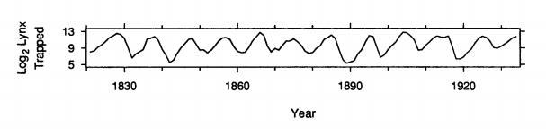
Chart Shape (Cleveland et al. 1988)
shape = h / w = 1.0
shape = h / w = 0.074

Slide 14
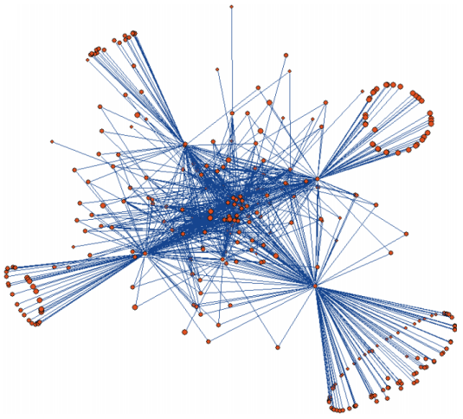
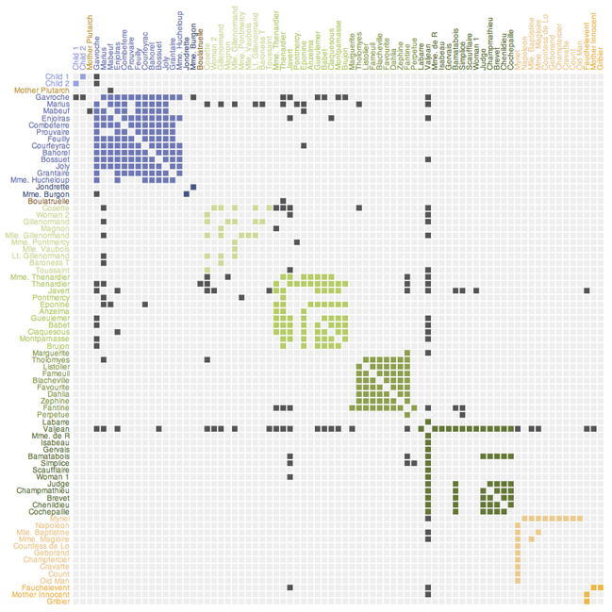
Representing Species Relationships
Force-Directed Layout
Matrix Representation
Gulf of Alaska food web (Gaichas and Francis 2008)
Les Misérables character interaction (Knuth 1993)

Slide 15
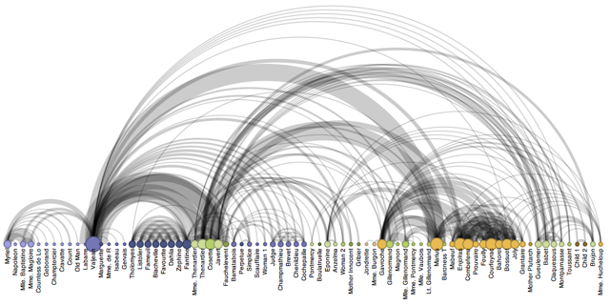
Arc Diagrams
Les Misérables character interaction (Knuth 1993)

Slide 16
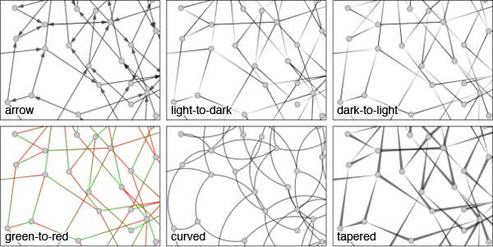
Directed Edges
Holten and van Wijk 2009

Slide 17
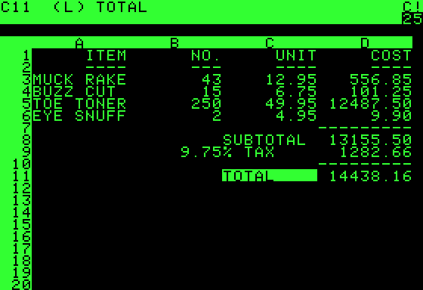
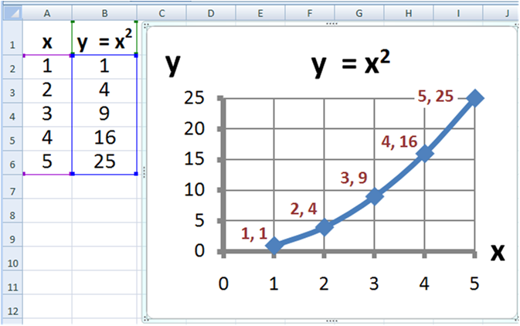
Interaction with Models
VisiCalc
Microsoft Excel

Slide 18
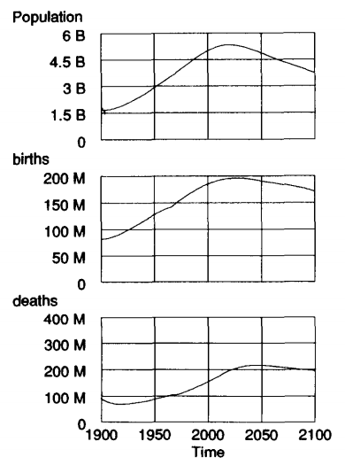
Vensim (Eberlein and Peterson 1992)
Interactive changing of parameters
Instantaneous change in forecast
Unskilled and skilled users

Slide 19
MS-PROD Visualization Design Requirements
Show predicted biomass as a time series
Show changes in predicted biomass as a result of changes in fishing effort
Show relationships between species (i.e., causal effects in the model)
Show uncertainty in the model

Slide 20
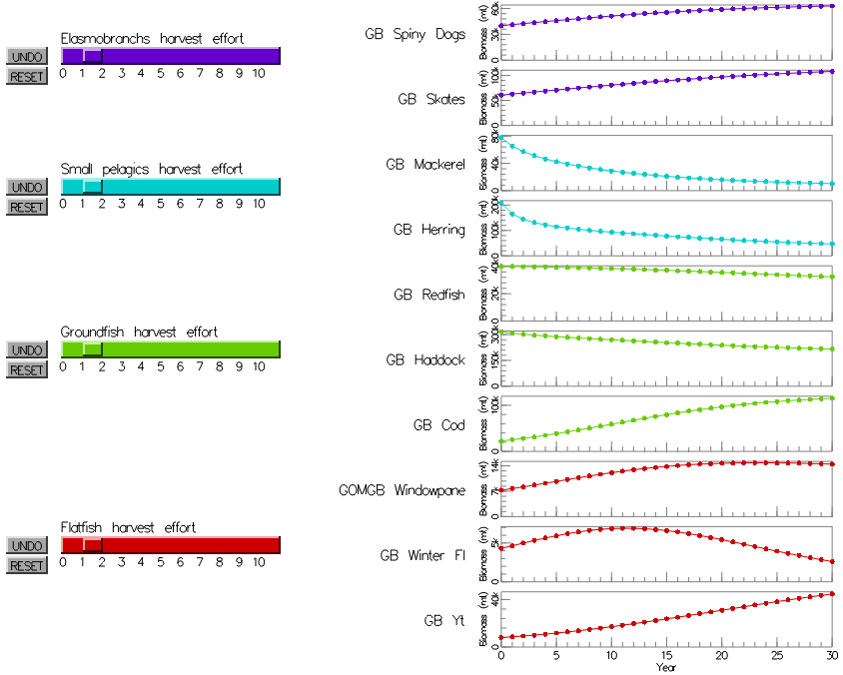
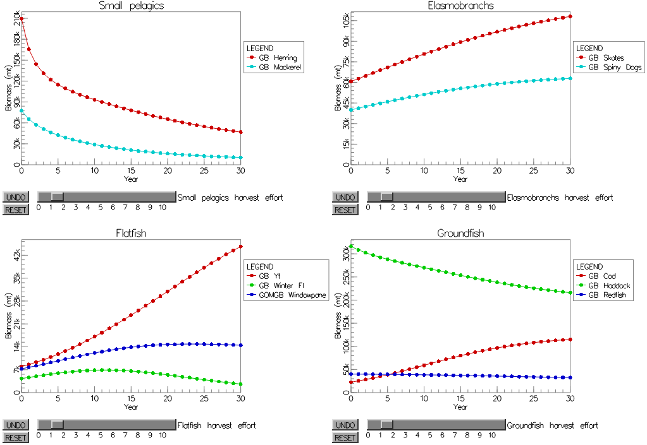
Alternative Screen Layouts
Four panel view
Small multiples view

Slide 21
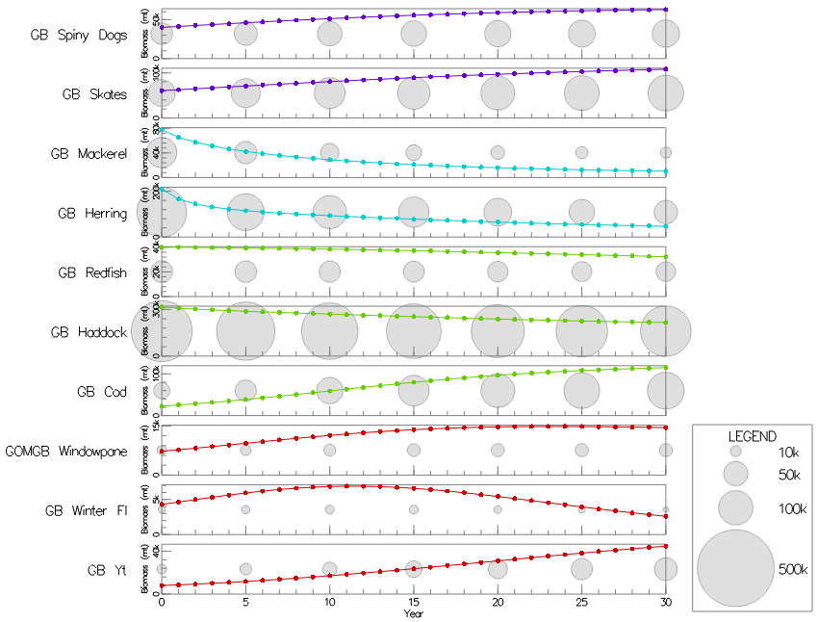
Absolute Biomass Indicators

Slide 22



Visualization of Change
Saving of baseline effort values to compare baseline forecast with current forecast
Instantaneous change (like Vensim)
Baseline as dotted line
Blended area between baseline and current

Slide 23
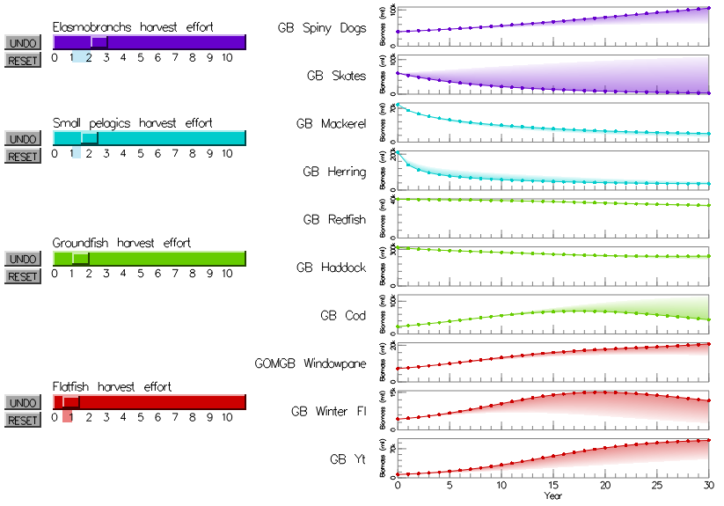
Example of Baseline Comparison

Slide 24
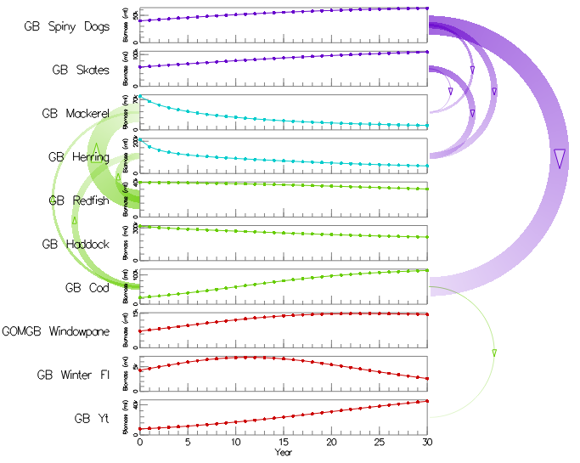
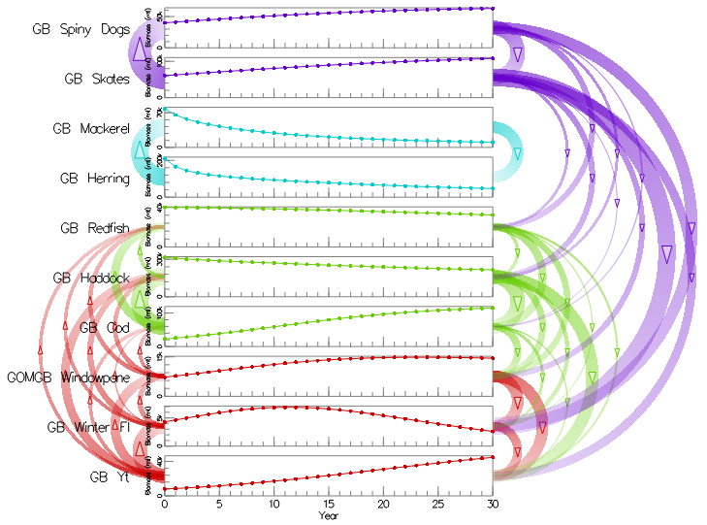
Visualization of Relationships
Predation
Interaction

Slide 25
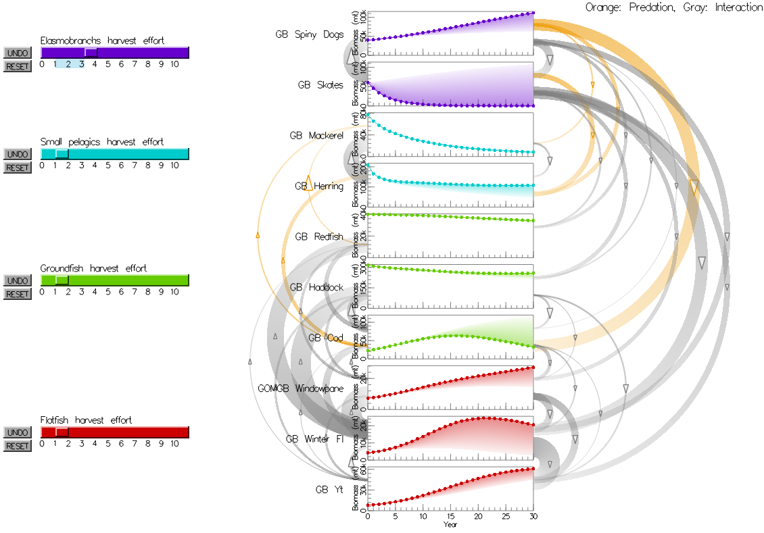
Visualizing Both Relationships

Slide 26
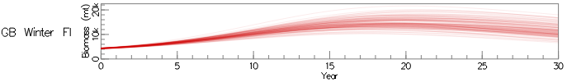

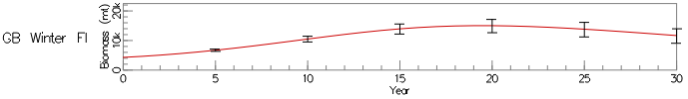
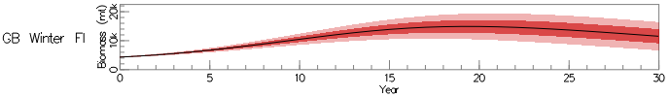
Visualizing Uncertainty
Monte Carlo simulations, randomly jittered the non-zero parameter values ±10%
Multi-Line
Box Plots
Error Bars
Error Bands

Slide 27
Demo

Slide 28
Work to be Completed
User evaluation
Alternative portrayal methods
Participants: model authors, fishery managers, scientists
Goal: rank or rate the alternative features
E.g., “Is this feature useful?”
Model understanding
Participants: undergraduate/graduate students
Goal: how well arc and change representations facilitate understanding of model
E.g., “What happens to X if we increase catch on Y?”
Finalize interactive interface

