Slide 1
Using Interactive Visualization to Enhance Understanding of a Fisheries Model
Carmen St. Jean
Master’s Thesis
May 28, 2014

Slide 2
Thesis Goals
Build an interactive visualization interface to the MS-PROD model
Help fisherman, fishery managers, and other stakeholders understand
Implications of the model
The model itself
Evaluate alternative portrayal methods for causal relationships

Slide 3
Fisheries Management
Sustainable exploitation
Managers control fishing effort
Bottom trawls (demersal)
Mid-water trawls (pelagic)
Others (e.g., long lines)

Slide 4
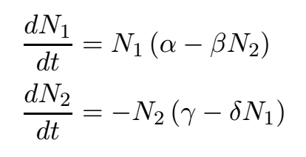
Ecosystem Models
Abstract model representing an ecosystem
Predict number (or biomass) of species
Leads to better understanding of ecosystem
Lokta-Volterra Equations (1926)
Models predation between two species
N₁: number of prey
N₂: number of predator
t: time
α: prey’s growth rate
β: rate at which the predator destroys the prey
γ: predator’s death rate
δ: rate at which the predator increases from consuming the prey

Slide 5
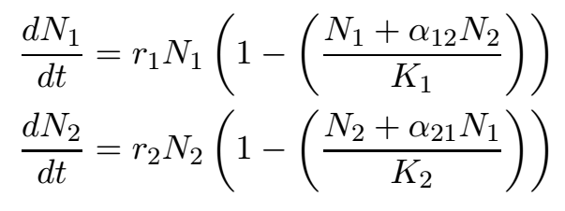
Rosenzweig-MacArthur (1963) /Leslie-Gower (1960)
Models competition between two species
N_{i}: number of species i
r_{i}: growth rate for species i
K_{i}: carrying capacity for species i
α_{ij}: effect species j has on species i

Slide 6
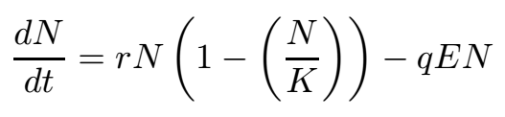
Schaefer Model (1957)
Models effect of harvest on a species
N: biomass of species
t: time
r: growth rate of species
K: carrying capacity of species
q: catchability of species
E: harvest effort

Slide 7
Ecosystem-Based Fishery Management
Considers many ecological factors
Predation
Competition
Humans
Climate
Closer to reality
Highly recommended, but seldom used
Pop_{t} = Pop_{t-1} *(1 + Growth) – Pred_{t-1} – Comp_{t-1} - Harv_{t-1}

Slide 8
MS-PROD (Multispecies Production) Model
Gamble and Link (NOAA National Marine Fisheries Service)
Uses ecosystem-based management approach
Predation
Competition
Harvest
10 significant species
4 functional groups
30 year forecasts

Slide 9
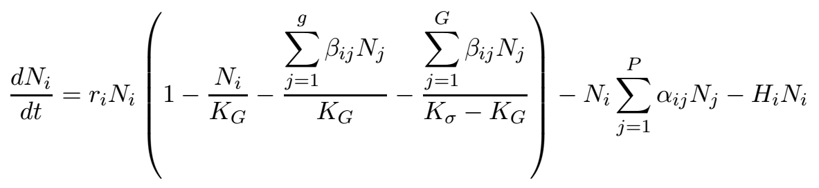
MS-PROD
Growth rate
Carrying capacity
Competition
Predation
Harvest
Prevents indefinite growth
N_{i}: number (or biomass) of species i
t: time
r_{i}: growth rate for species i
α_{ij}: predation of species j on i
β_{ij}: interaction of species j on i
H_{i}: harvest rate on species i
K_{G}: carrying capacity of i’s functional group
K_{σ}: carrying capacity of entire system
g: number of species in species i’s group
G: number of groups
P: number of predators

Slide 10
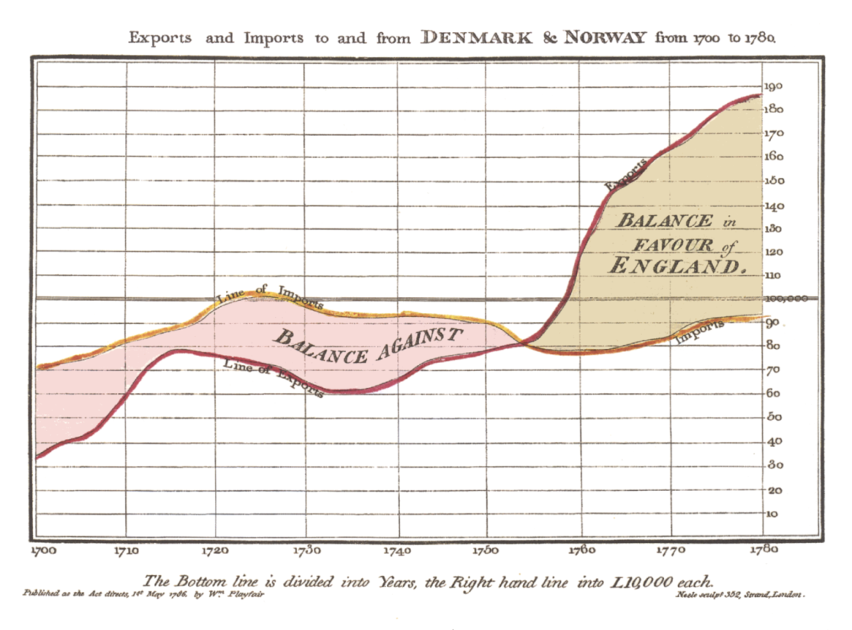
Representing Changes over Time
As a consequence of management actions
Trade balance time series (Playfair 1786)

Slide 11
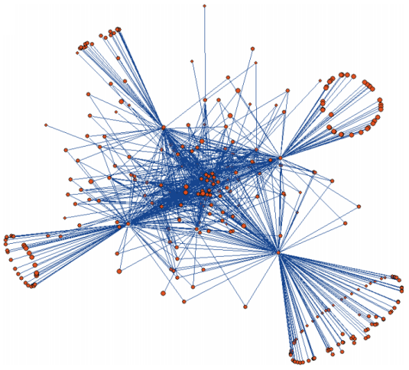
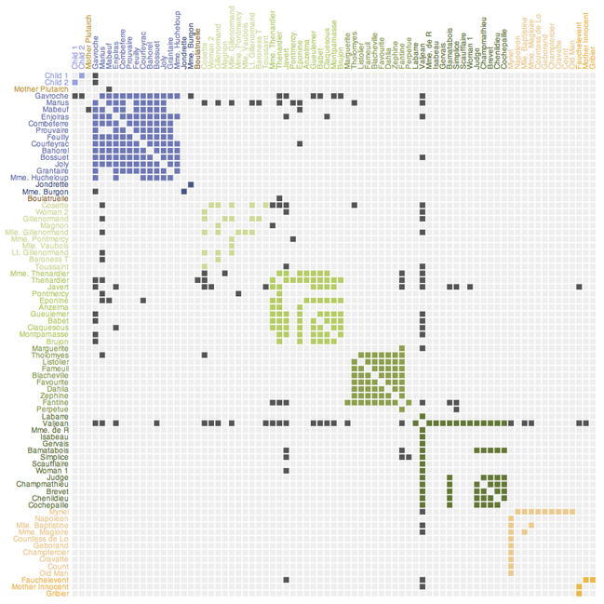
Representing Species Relationships
Force-Directed Layout
Matrix Representation
Gulf of Alaska food web (Gaichas and Francis 2008)
Les Misérables character interaction (Knuth 1993)

Slide 12
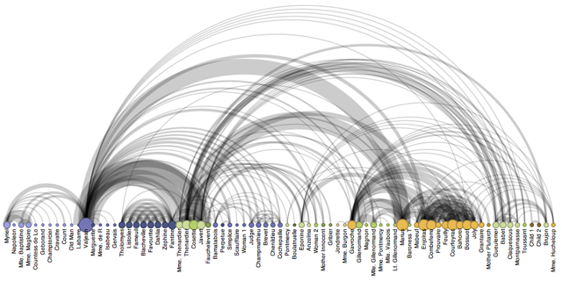
Arc Diagrams
Les Misérables character interaction (Knuth 1993)

Slide 13
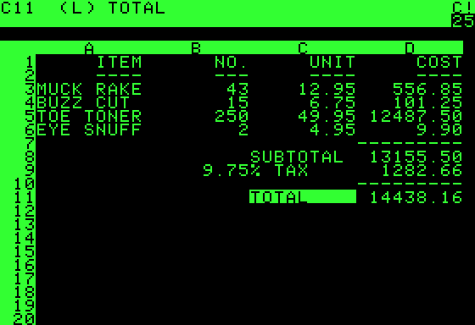
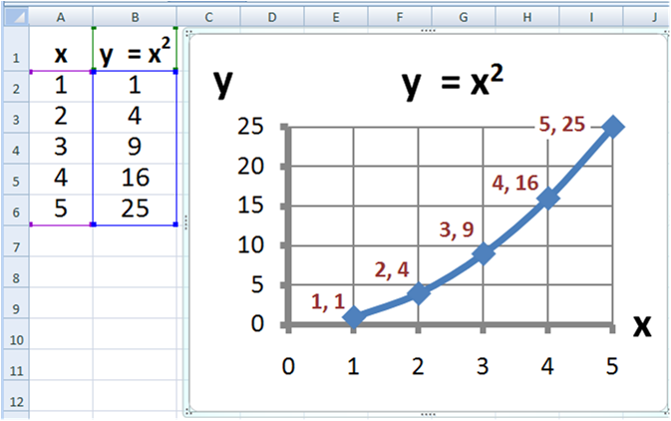
Interaction with Models
VisiCalc
Microsoft Excel

Slide 14
MS-PROD Visualization Design Requirements
Show predicted biomass as a time series
Show changes in predicted biomass as a result of changes in fishing effort
Show relationships between species (i.e., causal effects in the model)
Show uncertainty in the model

Slide 15
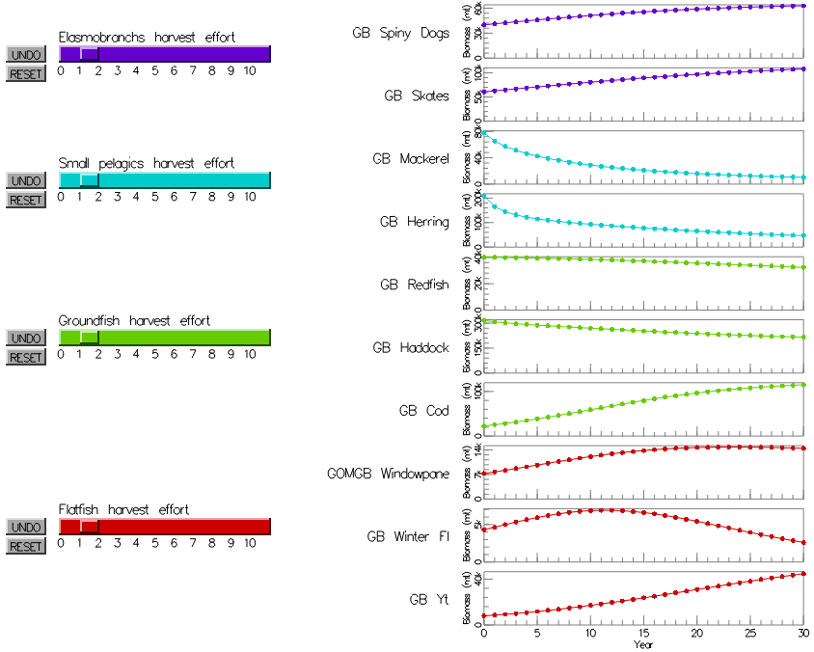
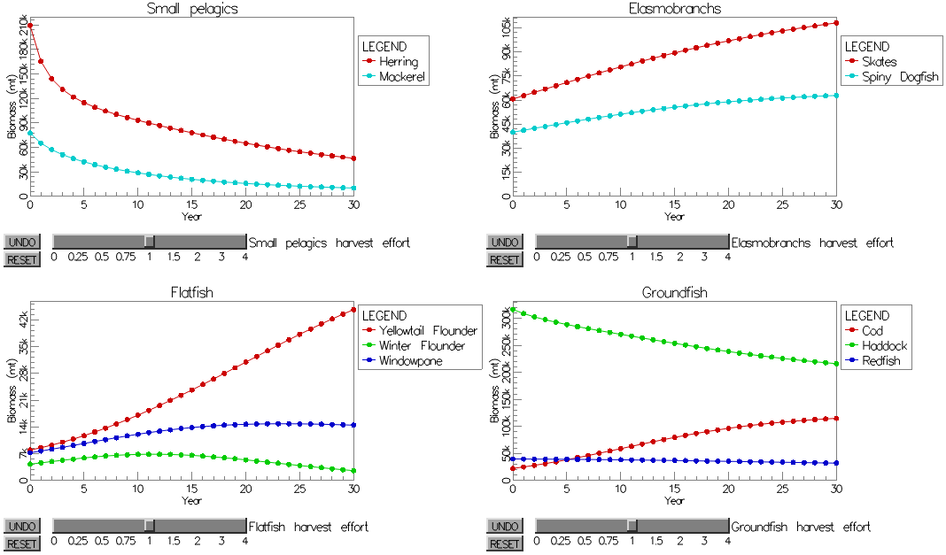
Alternative Screen Layouts
Four panel view
Small multiples view

Slide 16
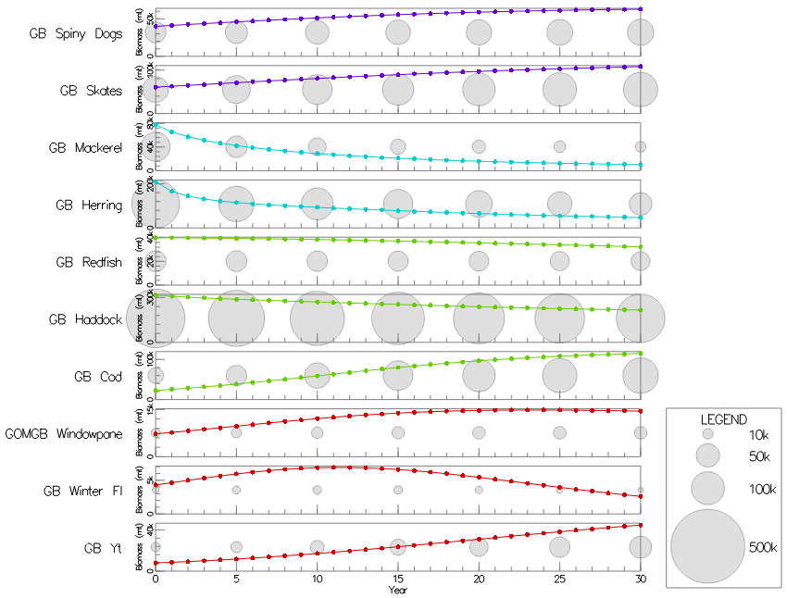
Absolute Biomass Indicators

Slide 17



Visualization of Change
Saving of baseline effort values to compare baseline forecast with current forecast
Instantaneous change
Baseline as dotted line
Blended area between baseline and current

Slide 18
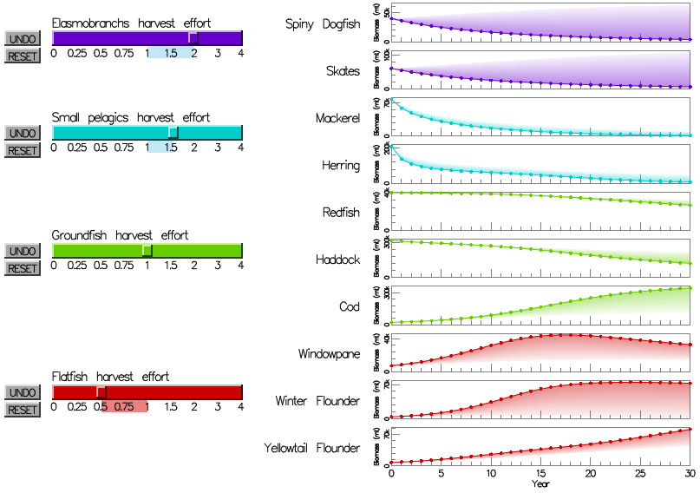
Example of Baseline Comparison

Slide 19
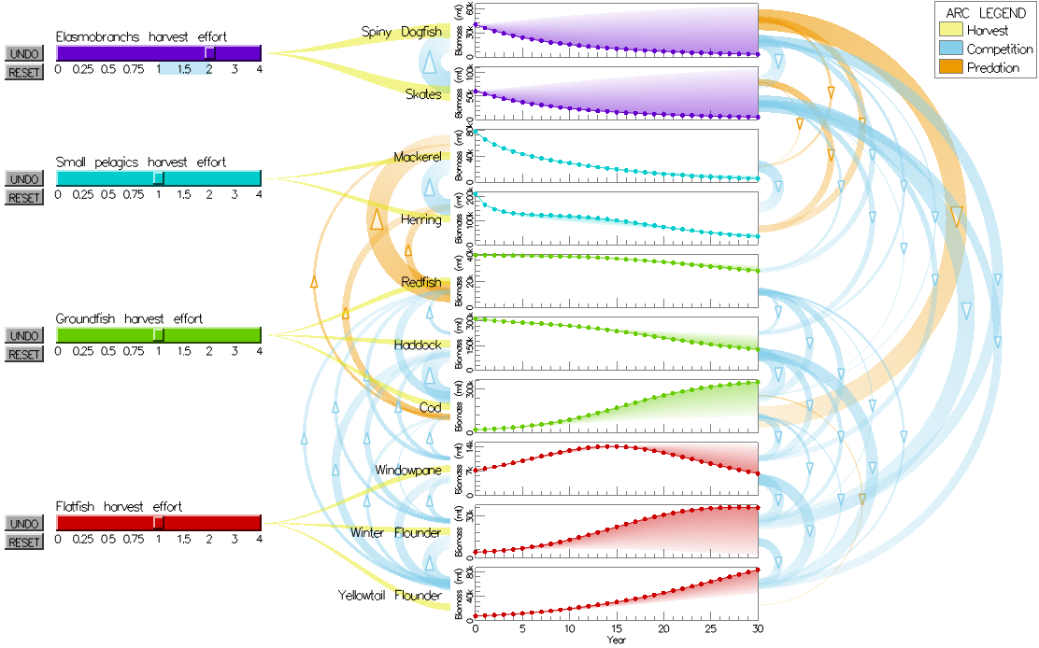
Visualization of Relationships

Slide 20

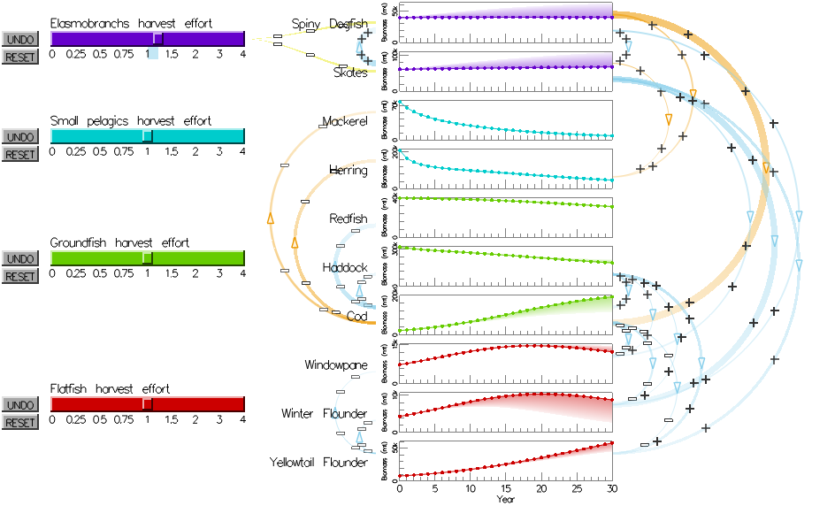
Dynamic Arcs

Slide 21
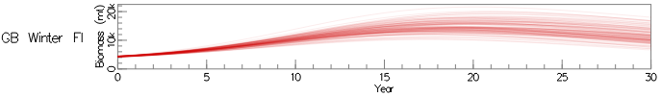

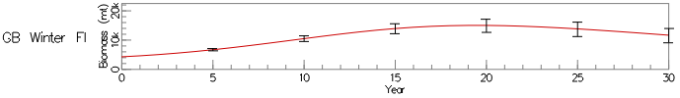
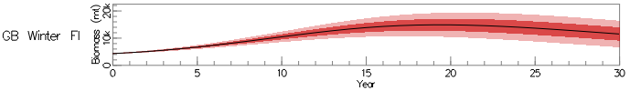
Visualizing Uncertainty
Monte Carlo simulations, randomly varied the non-zero parameter values ±10% using normal distribution (stdev = 5%)
Multi-Line
Box Plots
Error Bars
Error Bands

Slide 22
Demo

Slide 23
Evaluations
Formal evaluation
80 student participants
Comparison of different methods for depicting inter-species relationships
Informal evaluation
3 expert users
Casual interviews to learn preference

Slide 24
Formal Evaluation
80 participants, recruited randomly at the MUB
Conditions:
No arcs
Static arcs
Dynamic arcs without animation
Dynamic arcs with animation
Task:
Follow instruction to change fishing effort
Explain what happened to a specific fish
Explain why that happened to that fish

Slide 25
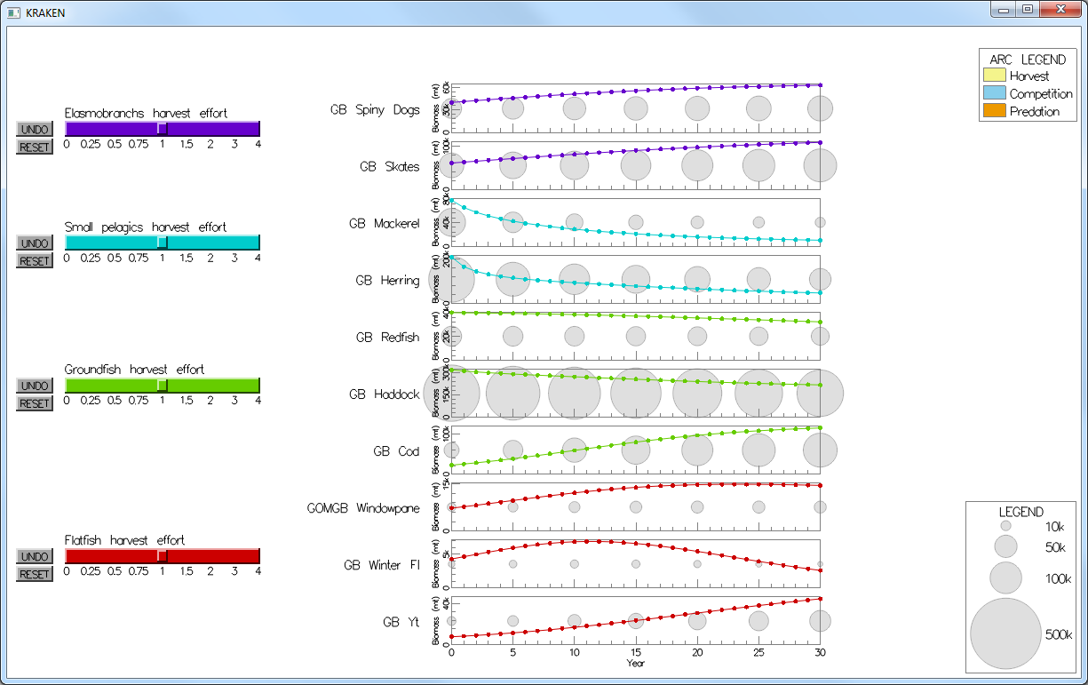
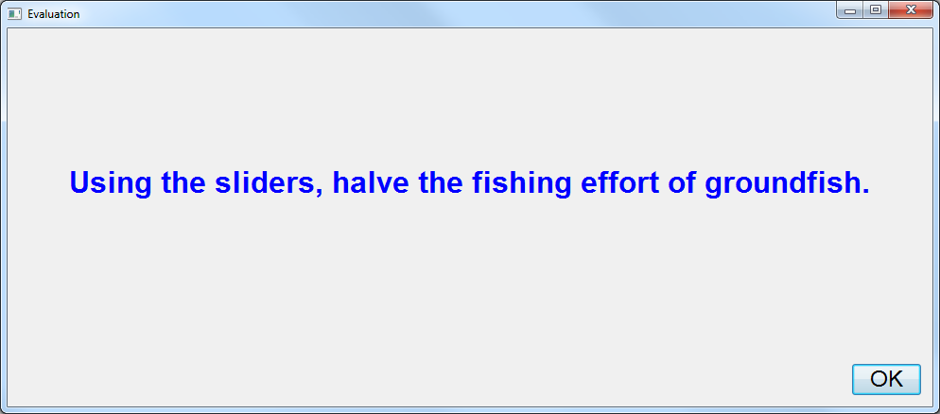
Formal Evaluation Task

Slide 26
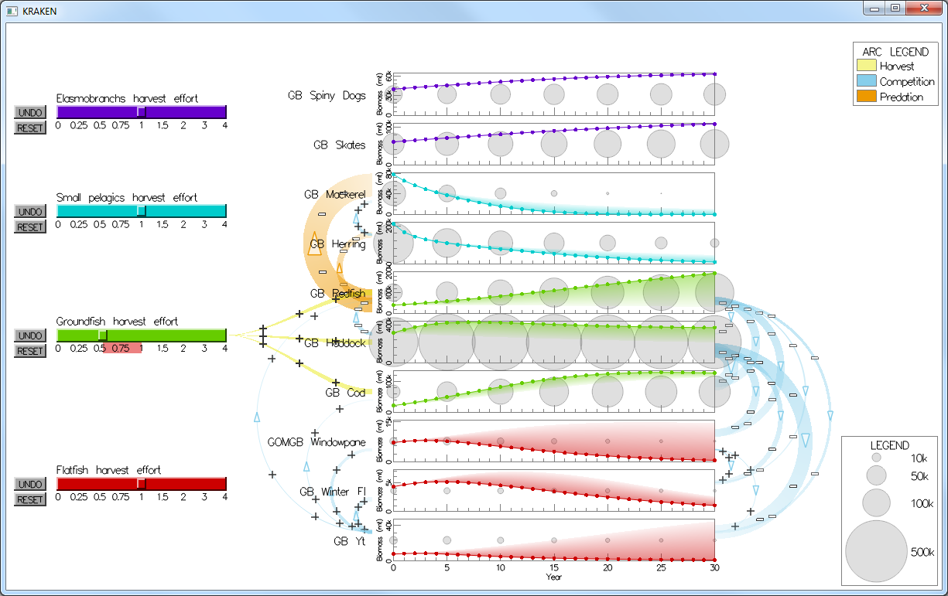
Formal Evaluation Task

Slide 27
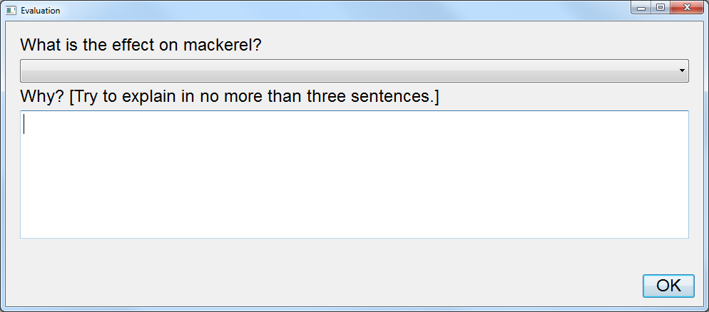
Formal Evaluation Task

Slide 28
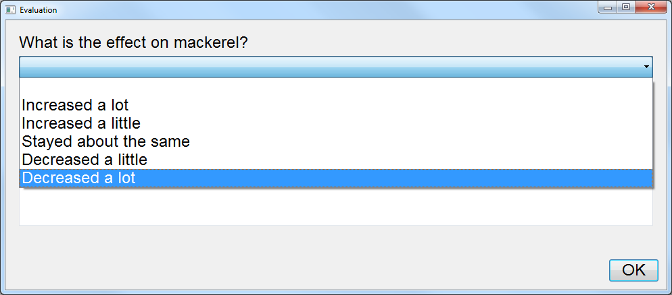
Formal Evaluation Task

Slide 29
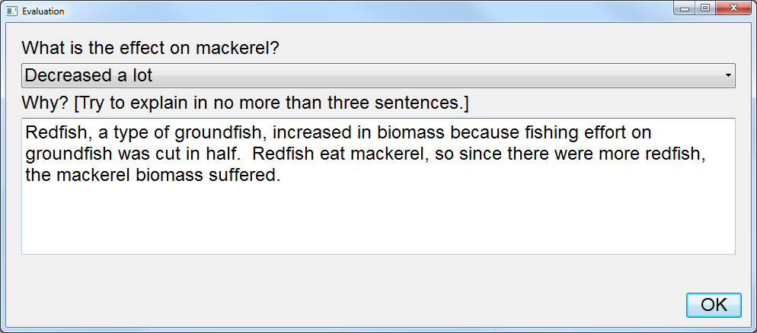
Formal Evaluation Task

Slide 30
Formal Evaluation Questions
Varied in difficulty:
“What happened to ___?” questions (7)
Easiest
Simple reading of the time series
First-order “Why?” questions (3)
Harder
Involved a species directly effected by fishing effort change
Higher-order “Why?” questions (4)
Hardest
Involved a species indirectly effected by fishing effort change

Slide 31
Formal Evaluation Grading
0 to 3 scale
Two undergraduates, correlation coefficient (Pearson’s r) of graders’ scores: 0.744

Slide 32
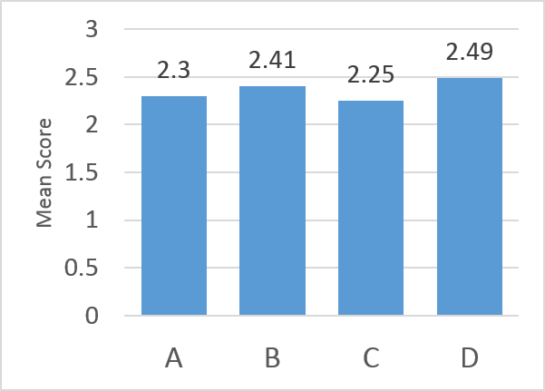
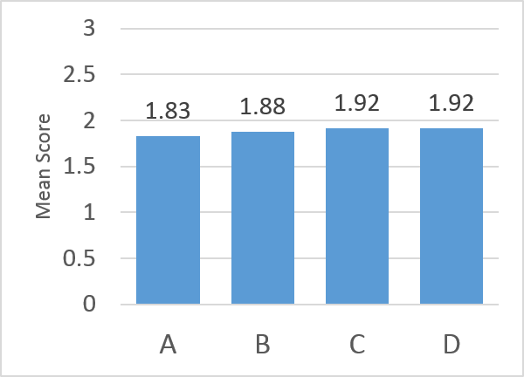
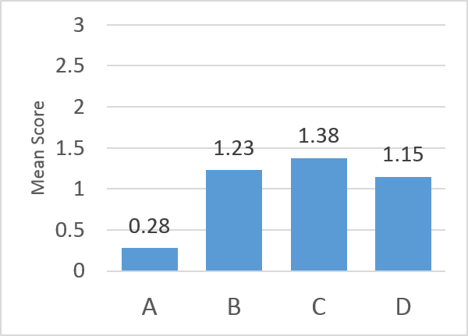
Formal Evaluation Results cont’d
“What…?” mean scores
First-order “Why?” mean scores
Higher-order “Why?” mean scores
No significant differences between conditions:
“What…?” questions
First-order “Why?” questions
ANOVA (F[1, 76] = 12.6; p < 0.001) and HSD test showed significant effect for higher-order “Why?” questions
No significant effect for gender

Slide 33
Formal Evaluation Discussion
“What…?” mean scores
First-order “Why?” mean scores
Higher-order “Why?” mean scores
Static or dynamic arcs are better than no arcs for difficult questions

Slide 34
Quantitative Level
Pseudo quantitative category based on college:
“Low quantitative” – COLA
“High quantitative” – every other college
Approached significance (F[1, 3] = 5.26; p = 0.1)

Slide 35
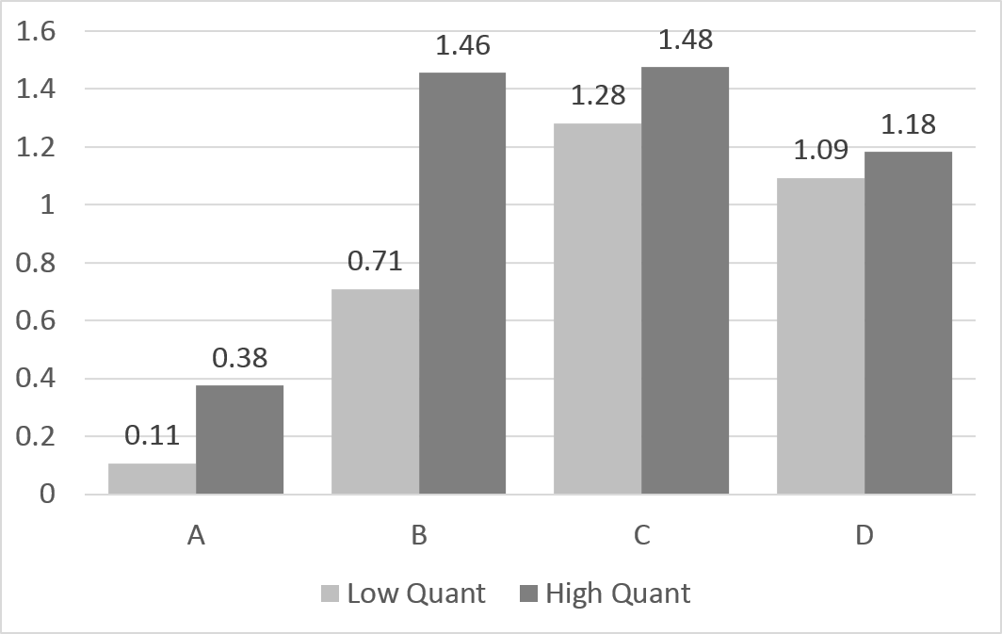
Effect of Quantitative Level
High quant students performed better than low quant students with no arcs or static arcs
Gap between quantitative levels narrowed with dynamic arcs

Slide 36
Informal Evaluation
Michael Fogarty and Robert Gamble
Authors of the MS-PROD model
NOAA’s National Marine Fisheries Services
David Goethel
Biologist, fisherman, former advisor to New England Fishery Management Council
Overall positive reactions

Slide 37
Michael Fogarty & Robert Gamble
Different views useful for different tasks
Ability to compare forecasts a powerful tool
Dynamic arcs help explain effects even they find confusing
Future directions
Could help to persuade fishery managers to use MS-PROD
New versions of MS-PROD
Web-based version

Slide 38
David Goethel
Liked having options for uncertainty visualization
Preferred the blended, shaded area between forecasts
Preferred dynamic over static arcs
“follow the flow of the relationships”

Slide 39
Conclusion
Arcs help to explain complex, underlying relationships between fish
Novel combination
Time series
Network diagram
User interactions
Ecological model
Might aid the model authors, scientists, fishery managers, fishermen, etc.
Could be expanded, generalized
Might be applicable to models in other fields

Slide 40
Thank you
Questions?

Slide 41
Future Directions
Larger evaluation (find significance for quantitative skills)
Unexplored alternatives
Dynamic arc width calculation
Drawing styles for arcs
Generalization
Scalability
Require zooming, filtering, fisheye, etc.
Web-based version of the application

