Slide 1


What Luke Can Do-
What Luke Did Yesterday
Atlantis Learning Archives | A project by Carmen Khoury | © 2026

Slide 2
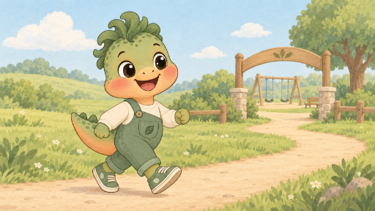
Luke can walk.
So, he walked to the park.

Slide 3
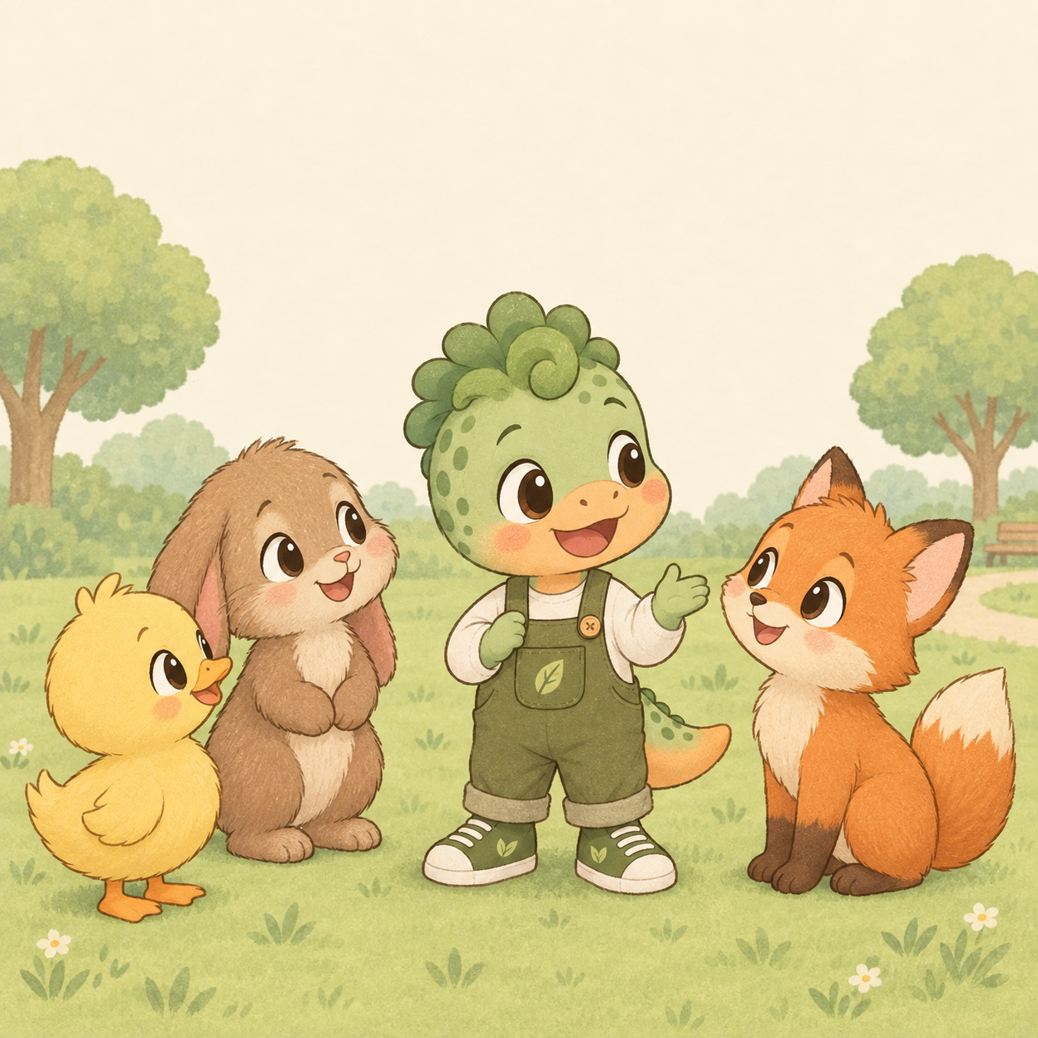
Luke can talk.
So, he talked with his pals.

Slide 4

Luke can jump.
So, he jumped in the air.

Slide 5
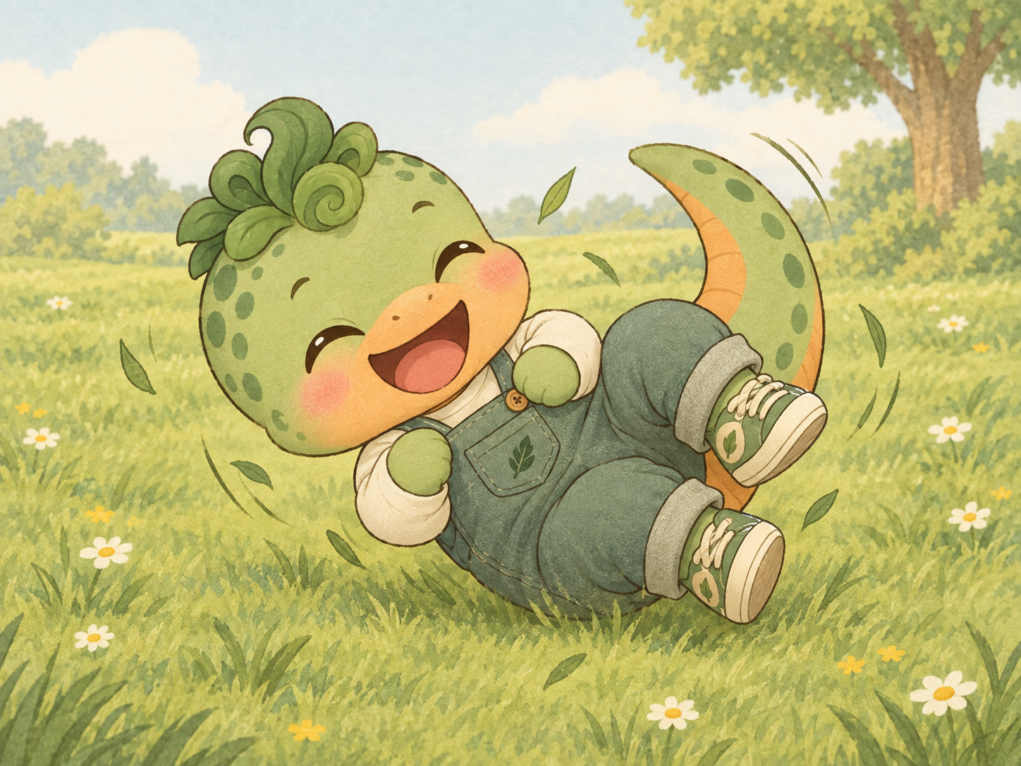
Luke can roll.
So, he rolled in the grass.

Slide 6
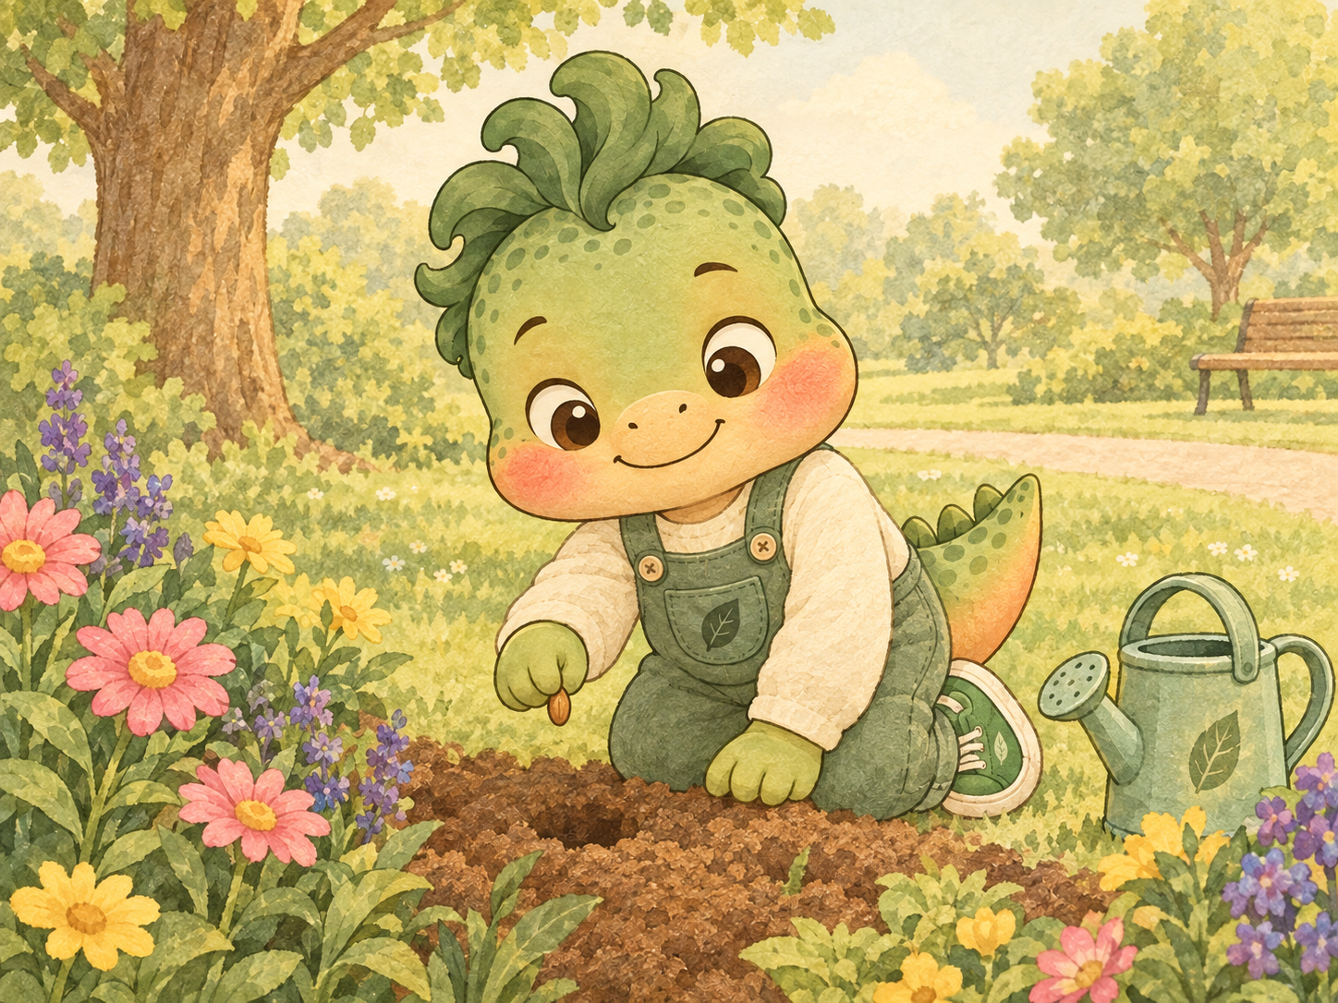
Luke can plant.
So, he planted a seed.

Slide 7
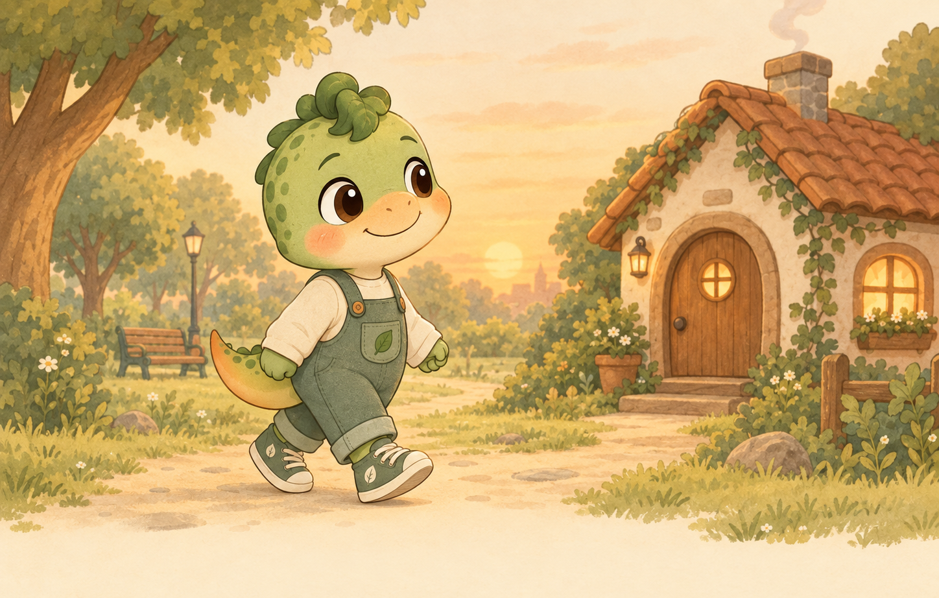
Luke can walk.
So, he walked home.

Slide 8
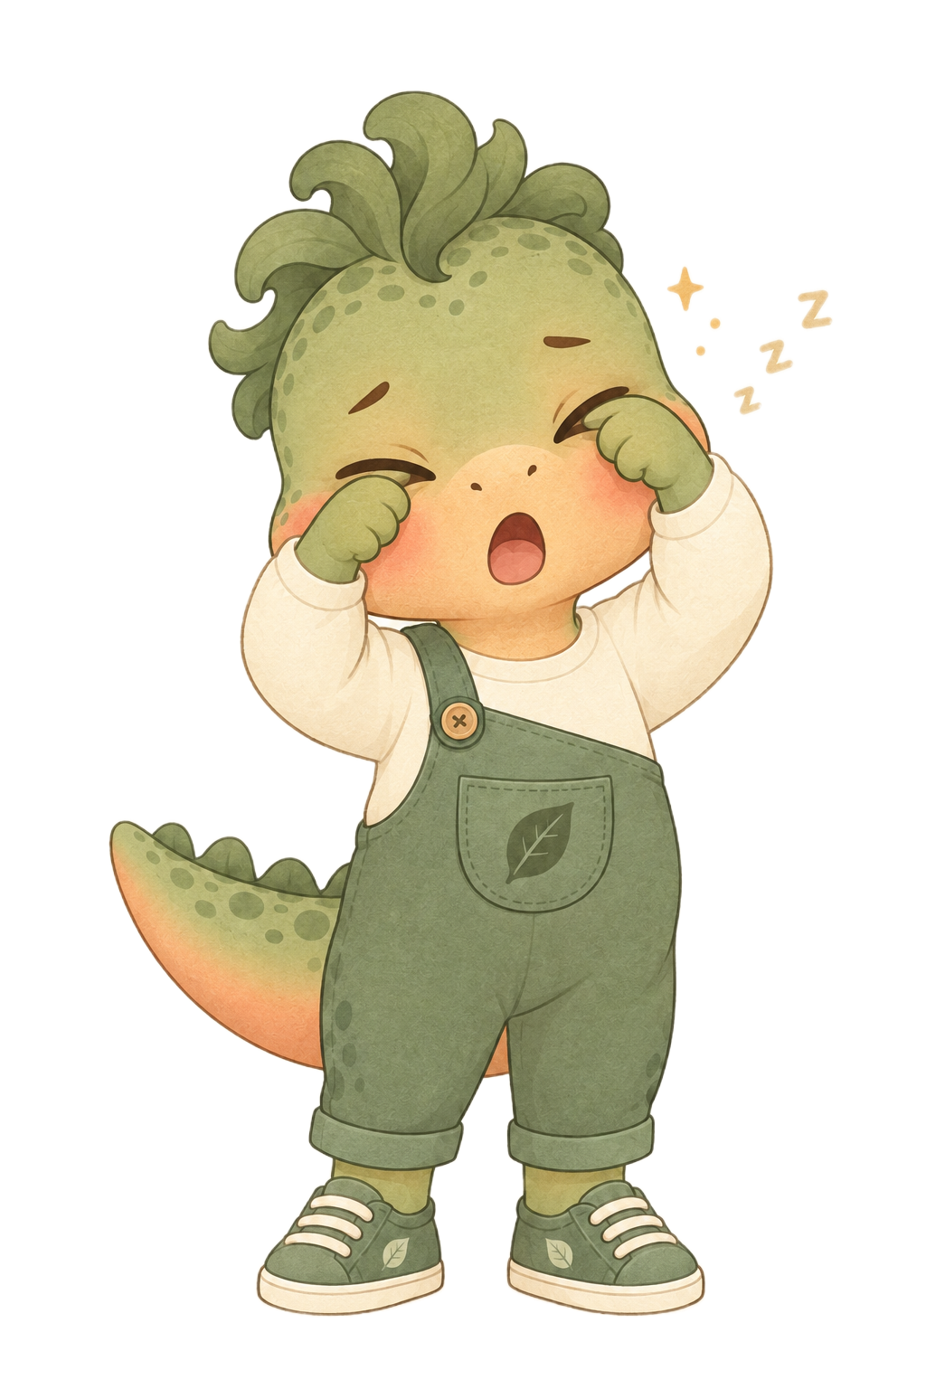
Luke can rub.
So, he rubbed his eyes.

Slide 9
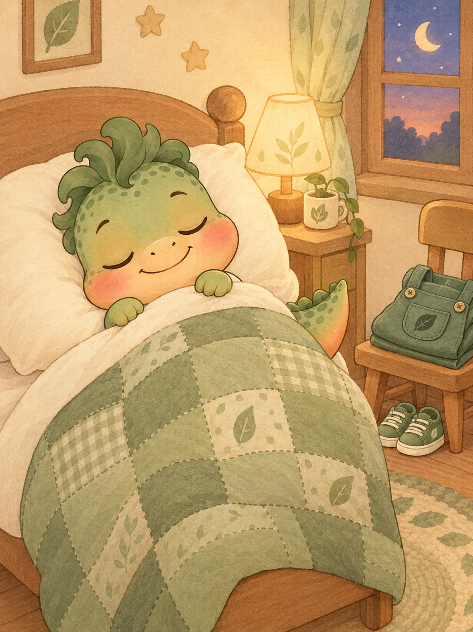
Luke can rest.
So, he rested in his bed.

Slide 10
The End
Atlantis Learning Archives | A project by Carmen Khoury | © 2026

