Slide 1

NETWORK TRAFFIC EMULATION PROJECT
OON
Open Optical Networks
Carmen Moncada s296675

Slide 2

INDEX
Scenarios Evaluated
- Single Matrix Scenario
1. Network
2. Full_Network
3. Not_Full_Network
- Congestion Scenario
1. Network
2. Full_Network
3. Not_Full_Network
Considerations
Transceiver Strategies
Results
Single Matrix Scenario
Congestion Scenario
Recommendations for future tests.

Slide 3

SCENARIOS EVALUATED
OON
Single Matrix Scenario
For a given value of M, fix the number of Monte Carlo runs for which the distributions of the metrics are stable (executing other Monte Carlo runs, the distribution does not change).
Congestion Scenario
In this scenario, the traffic generated by the matrix will increase by an integer M. Therefore, the bit rate requested by each pair of nodes is given by M*100 Gbps.

Slide 4
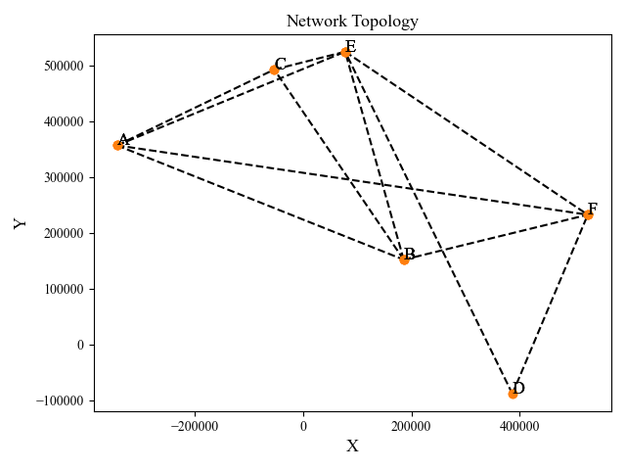
NETWORK CHARACTERISTICS
OON
OON
These scenarios has been applied to 3 different network definitions, which are presented in the following json files.
Networks.json
- Connected Nodes
- Position of nodes
Full_Network.json
Connected Nodes
Position of nodes
Switching matrix with all channels available
Non_full_network.json
Connected Nodes
Position of nodes
Switching matrix under limited channel availability
Y [m]
X [m]
Network Topology

Slide 5

CONSIDERATIONS
SINGLE TRAFFIC MATRIX SCENARIO
OON
A factor of M=4 was set to initialize the traffic matrix of each pair of nodes.
A total of 50 Monte Carlo runs were conducted to estimate each parameter evaluated in the network.
As the file Networks.json lacked the switching matrix, the emulator (code) proceeded to create one for each mode. For the cases of full_netwrok.json and not_full_network.json files, the switching matrix was already pre-defined, therefore, the emulator operated on it.
The number of completed connections was set to 30. This means that the connection between each pair of nodes in the Traffic Matrix has to be saturated.
NOTE: Completed connections $≠$ Accepted connections
FILES | NUMBER OF CHANNELS | TRANSCEIVERS STRATEGIES
Network.py | 10 | Fixed Rate Flexible Rate Shannon Rate
Full_network.py | 6 | Fixed Rate Flexible Rate Shannon Rate
Not_full_network.py | 6 | Fixed Rate Flexible Rate Shannon Rate

Slide 6

TRANSMISSION RATE ($R_{b}$) given a ${BER }_{t}={10}^{−3}$
1. Fixed-Rate Transceiver Strategy (PM-QPSK Modulation)
$R_{b}=\left\{\begin{aligned}100 Gbps if GSNR≥2 {erfcinv}^{2}\left(2 BER\right)\frac{R_{s}}{B_{n}} Gbps \\ 0 Gbps otherwise \end{aligned}\right.$
2. Flex-Rate Transceiver Strategy (PM-QPSK, PM-8-QAM, PM-16QAM Modulations)
$$R_{b}=\left\{\begin{aligned}0 Gbps if GSNR ≤2 {erfcinv}^{2}\left(2 BER\right)\frac{R_{s}}{B_{n}} \\ 100 Gbps if 2 {erfcinv}^{2}\left(2{BER}_{t}\right)\frac{R_{s}}{B_{n}} ≤GSNR <\frac{14}{3}{erfcinv}^{2}\left(\frac{3}{2}{BER}_{t}\right)\frac{R_{s}}{B_{n}} \\ 200 Gbps if\frac{14}{3}{erfcinv}^{2}\left(\frac{3}{2}{BER}_{t}\right)\frac{R_{s}}{B_{n}} ≤GSNR<10 {erfcinv}^{2}\left(\frac{8}{3}{BER}_{t}\right)\frac{R_{s}}{B_{n}} \\ 400 Gbps if GSNR>10 {erfcinv}^{2}\left(\frac{8}{3}{BER}_{t}\right)\frac{R_{s}}{B_{n}}\end{aligned}\right.$$
3. Maximum Theoretical Shannon Rate (Ideal Gaussian Modulation)
$R_{b}=2R_{s}\log_{2}\left(1+\frac{GSNR {. R}_{s}}{B_{n}}\right) Gbp$s
​
PM-QPSK
PM-8-QAM
PM-16-QAM

Slide 7
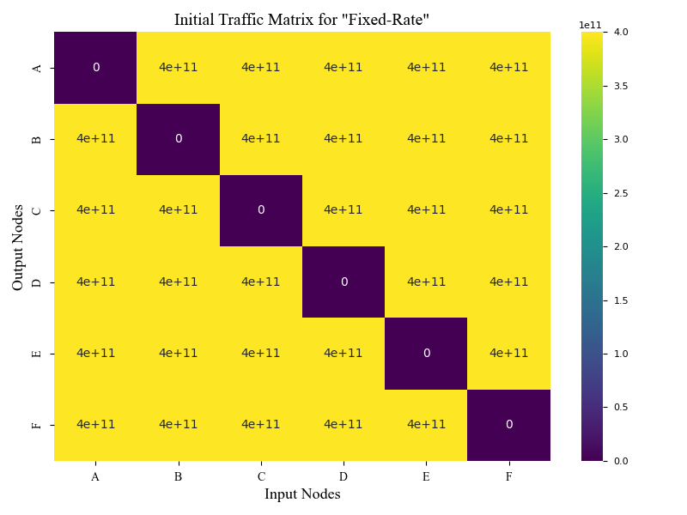
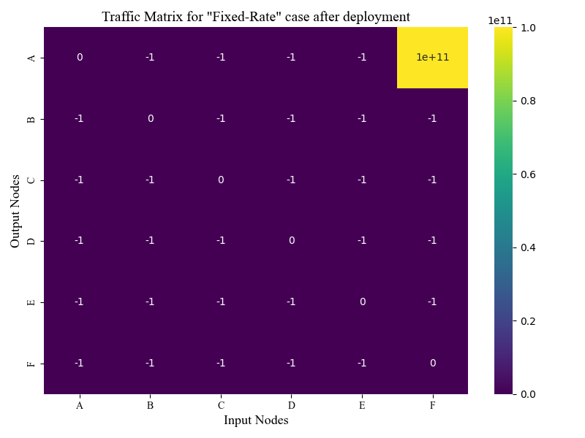
SINGLE TRAFFIC MATRIX SCENARIO RESULTS
USING NETWORK FILE
Fixed Rate - Traffic Matrix for a single Monte Carlos run

Slide 8

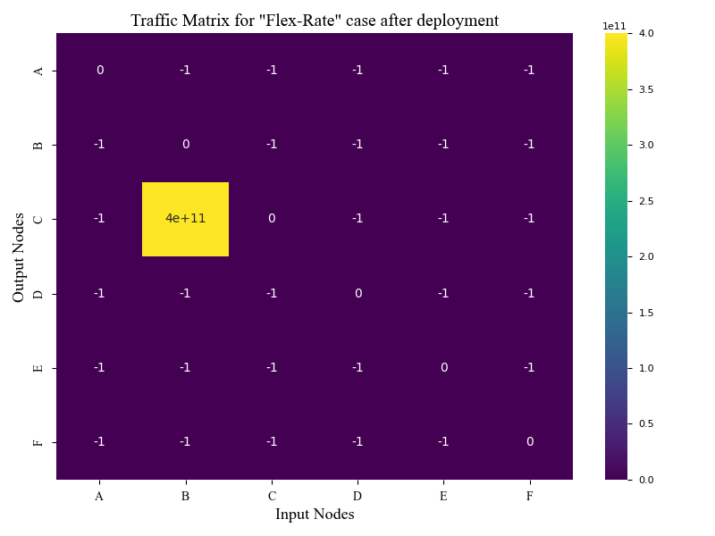
SINGLE TRAFFIC MATRIX SCENARIO RESULTS
USING NETWORK FILE
Flexible Rate - Traffic Matrix for a single Monte Carlos run

Slide 9
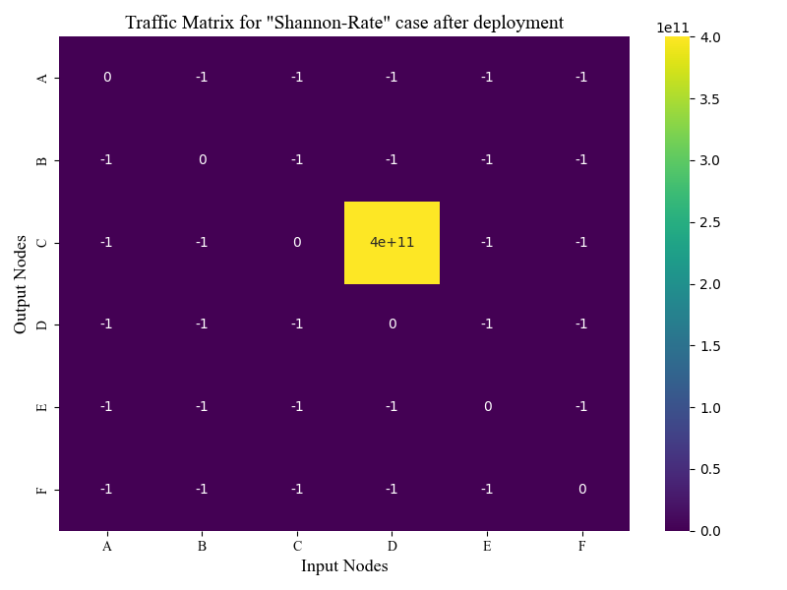
SINGLE TRAFFIC MATRIX SCENARIO RESULTS
USING NETWORK FILE
Shannon (Theoretical) Rate - Traffic Matrix for a single Monte Carlos run

Slide 10
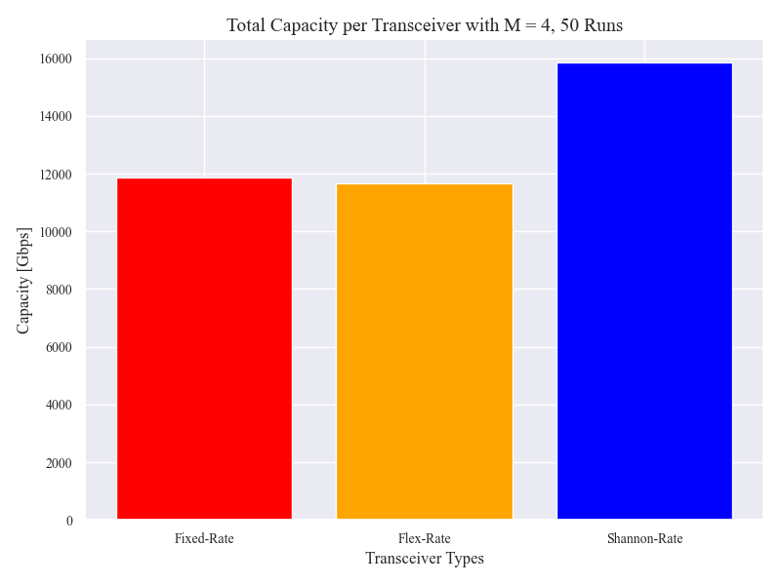
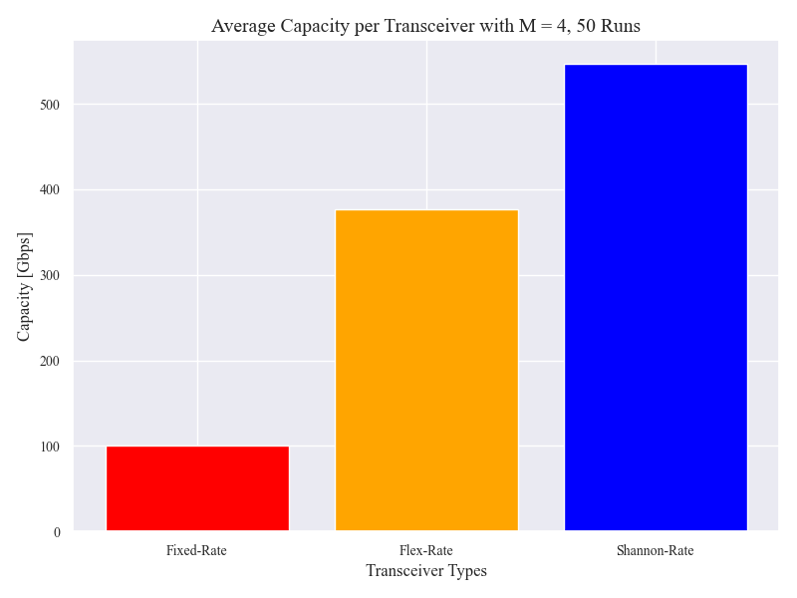
SINGLE TRAFFIC MATRIX SCENARIO RESULTS
NETWORK.py definition
1600
545
1183
1163
375

Slide 11
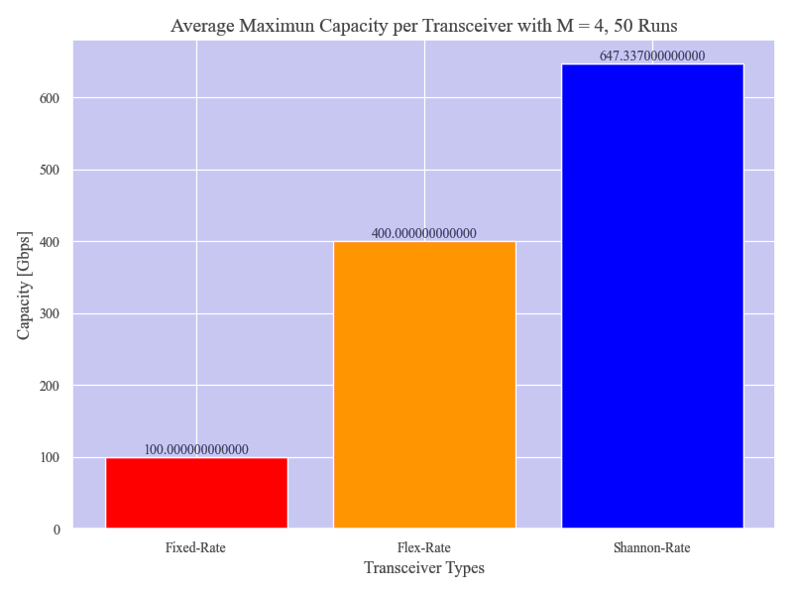
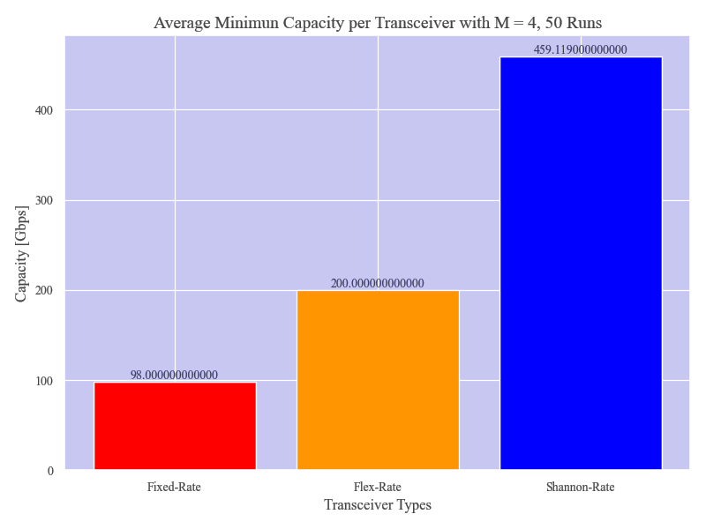
MIN AND MAXIMUN CAPACITY
OON

Slide 12
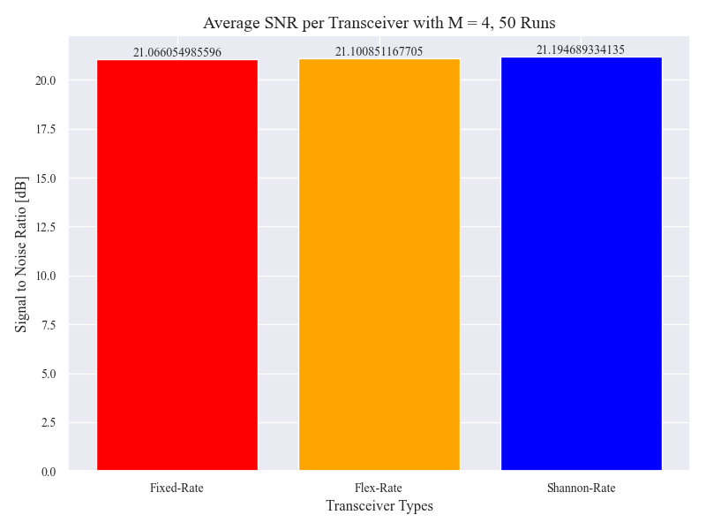
SIGNAL TO NOISE RATIO (SNR)

Slide 13
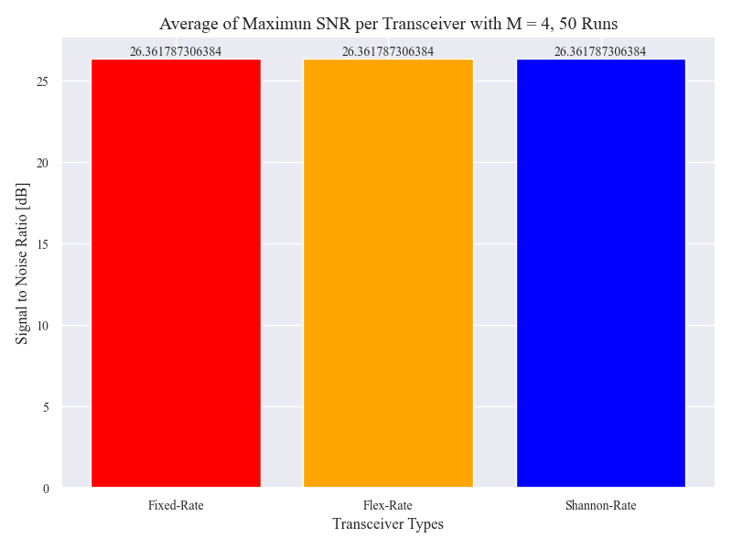
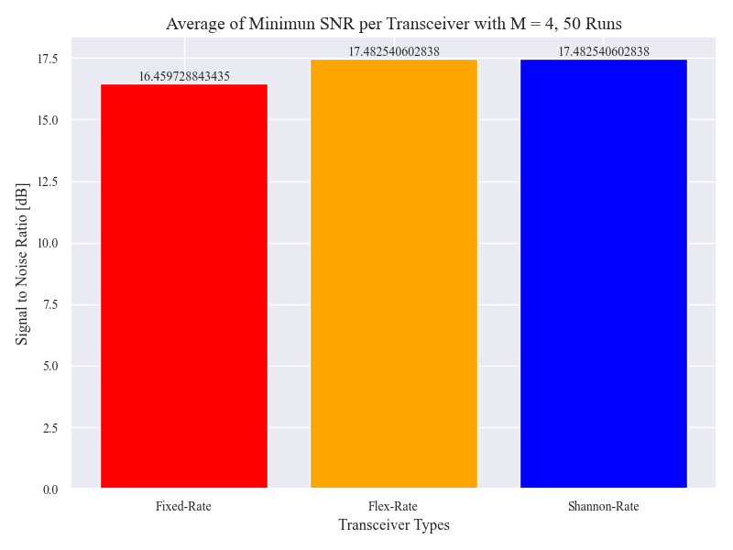
MAXIMUN AND MINIMUN SNR
Comentarios e instrucciones de edición de plantilla

Slide 14
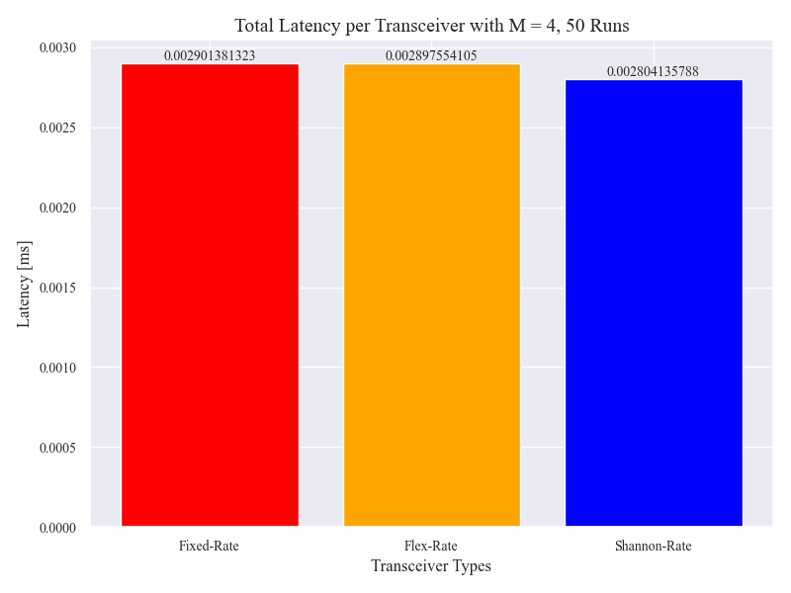
LATENCY
Comentarios e instrucciones de edición de plantilla

Slide 15
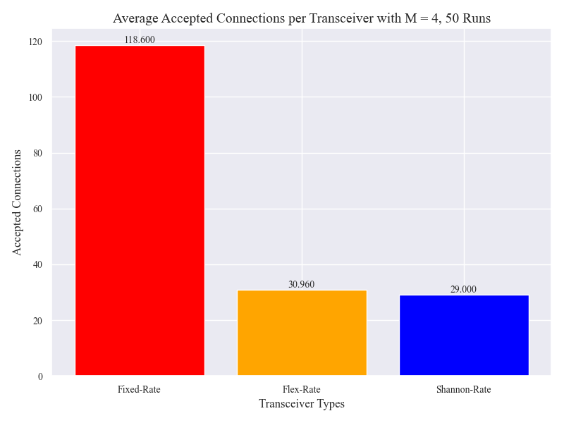
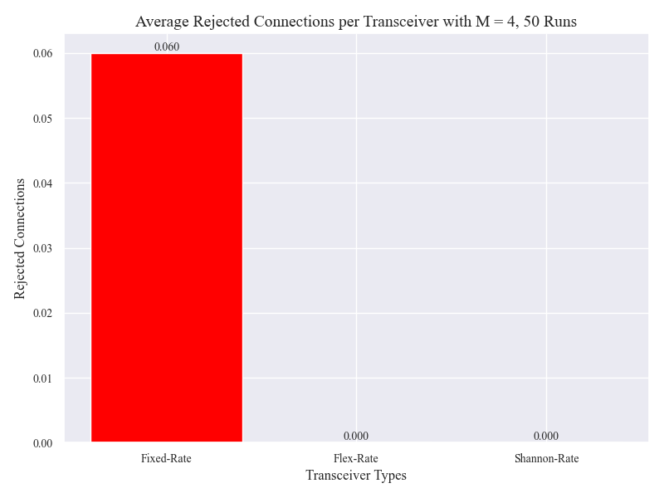
ACCEPTED AND REJECTED CONNECTIONS
Comentarios e instrucciones de edición de plantilla
Connections were rejected because no path was available or the bit rate was 0.

Slide 16
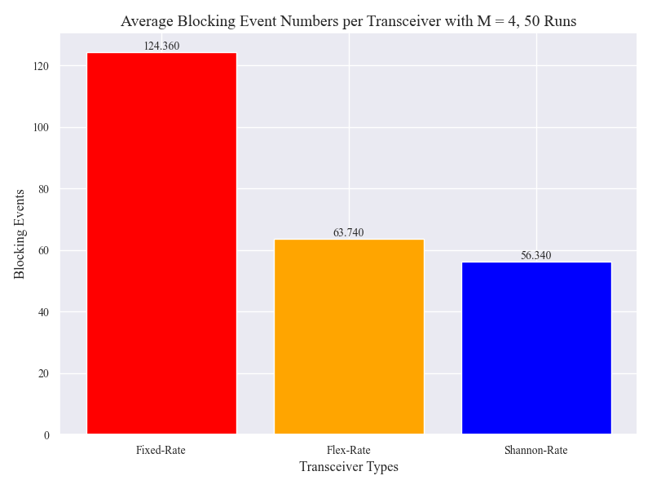
BLOCKING EVENTS
Not Traffic Matrix Assignment due to:
Matrix saturation
It was not possible to assign a suitable path for the connection

Slide 17
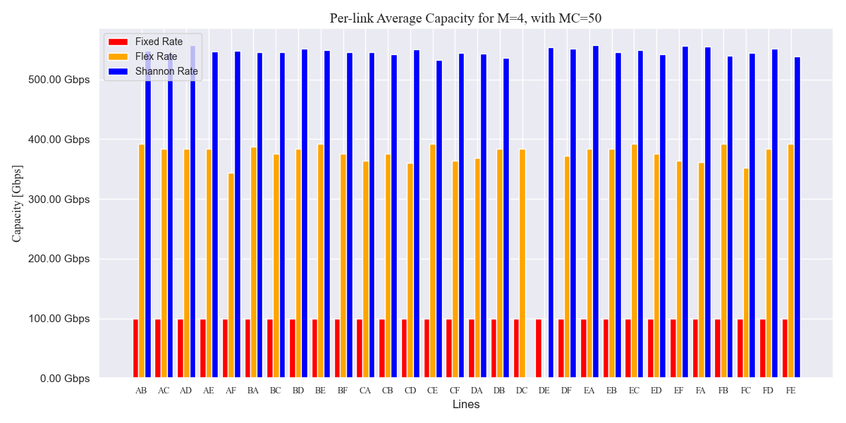
PER- LINK CAPACITY

Slide 18
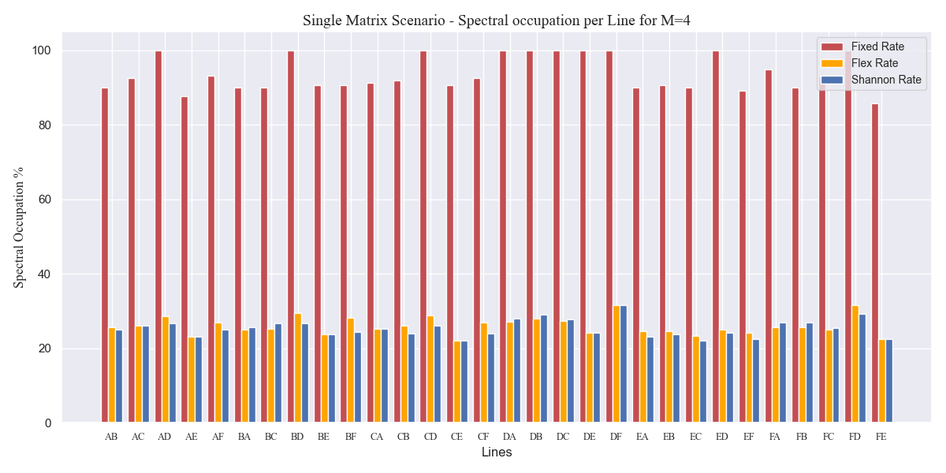
SPECTRAL OCCUPATION PER LINE

Slide 19
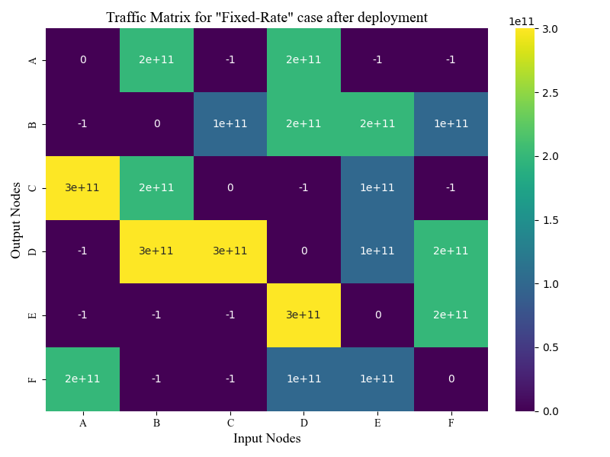
SINGLE TRAFFIC MATRIX SCENARIO RESULTS
USING FULL_NETWORK FILE
Fixed Rate -Traffic Matrix for a single Monte Carlo run

Slide 20
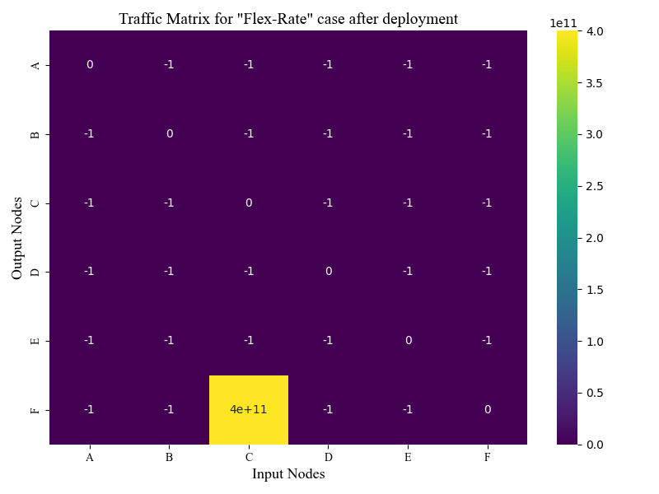
SINGLE TRAFFIC MATRIX SCENARIO RESULTS
USING FULL_NETWORK FILE
Flexible Rate - Traffic Matrix for a single Monte Carlo run

Slide 21
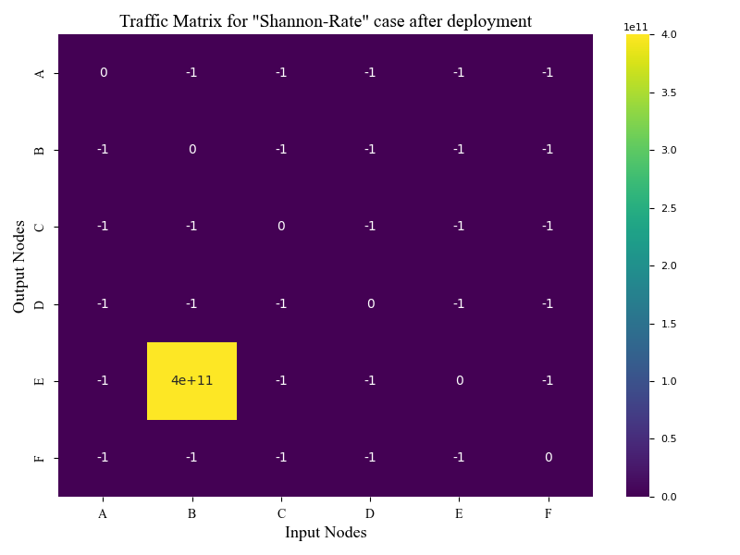
SINGLE TRAFFIC MATRIX SCENARIO RESULTS
USING FULL_NETWORK FILE
Shannon (Theoretical) Rate - Traffic Matrix for a single Monte Carlo run

Slide 22
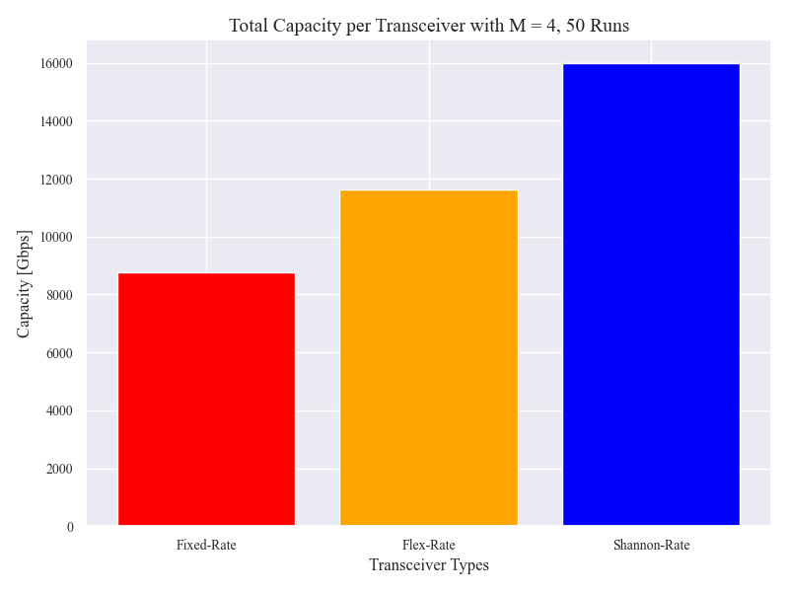
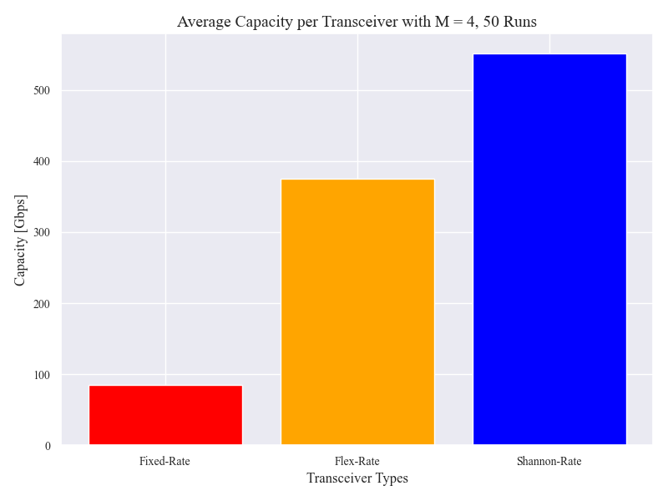
TOTAL AND AVERAGE CAPACITY
16.00
550
11.62
374
8.759
84

Slide 23
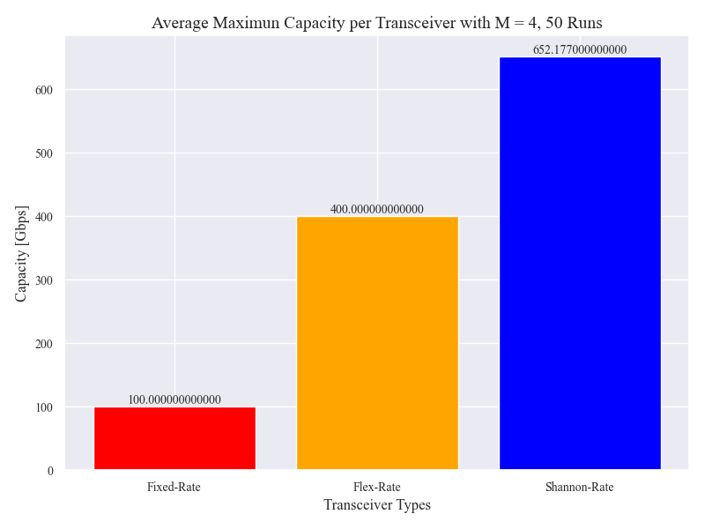
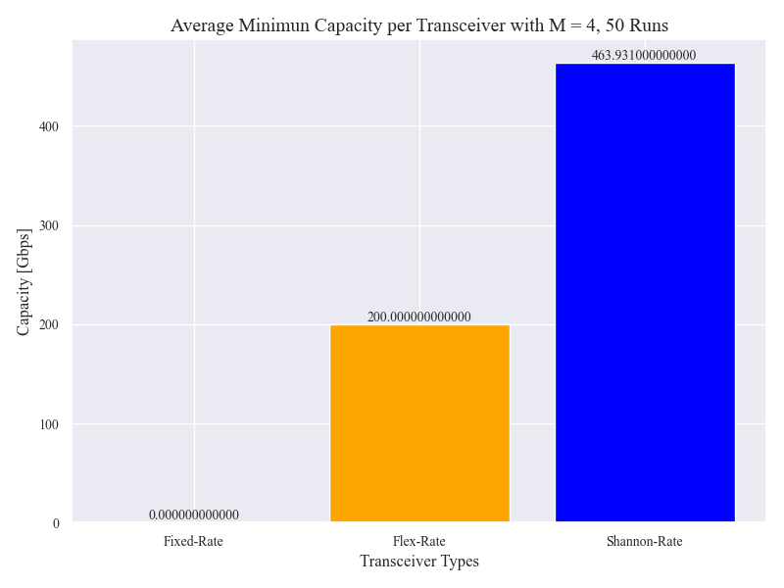
MIN AND MAXIMUN CAPACITY
OON

Slide 24
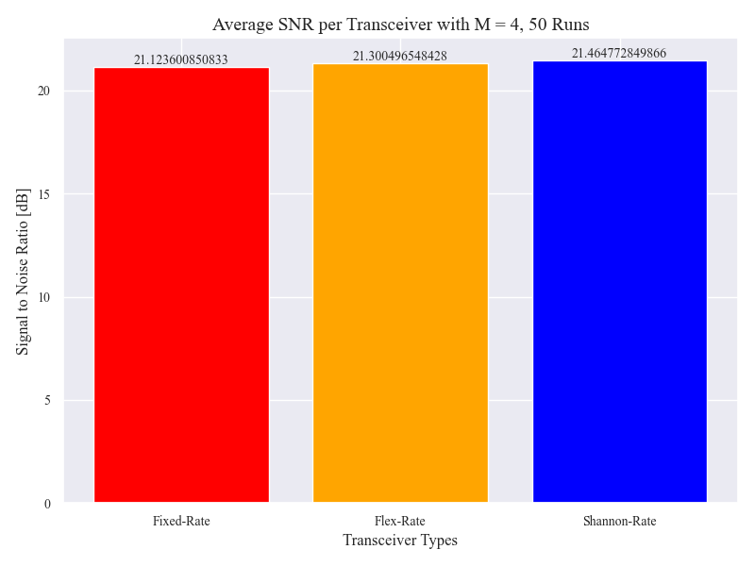
SIGNAL TO NOISE RATIO (SNR)

Slide 25

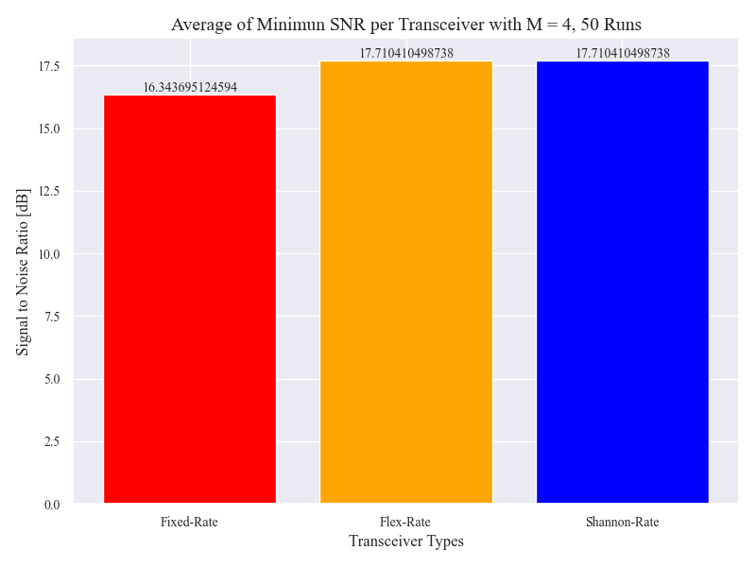
MAXIMUN AND MINIMUN SNR
Comentarios e instrucciones de edición de plantilla

Slide 26
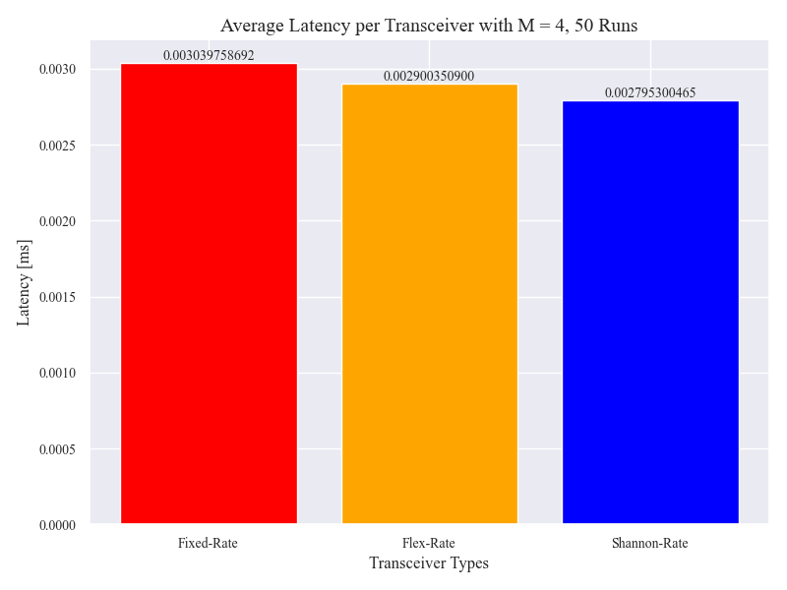
LATENCY
Comentarios e instrucciones de edición de plantilla

Slide 27
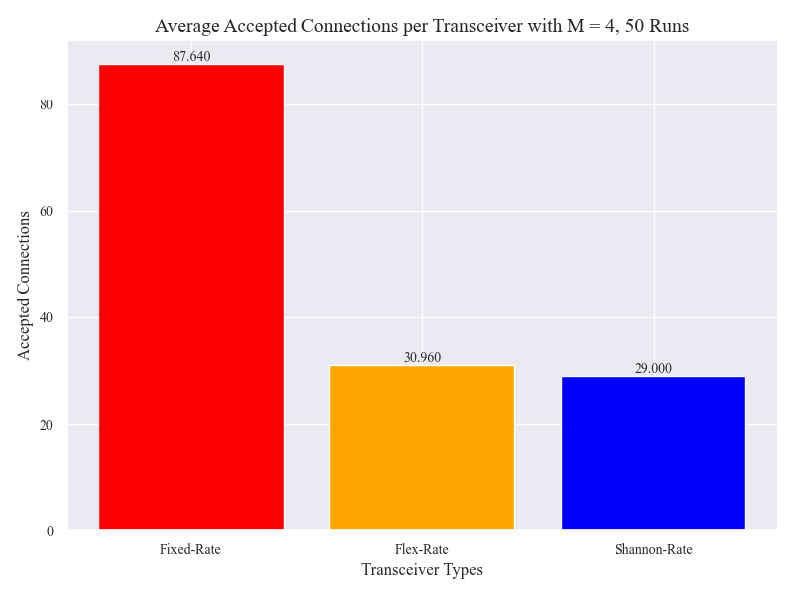
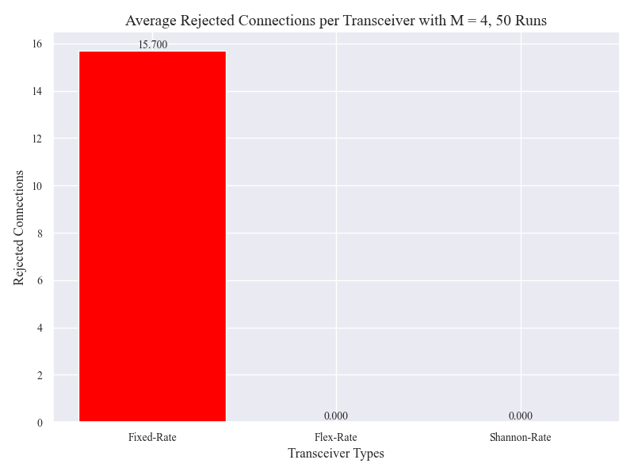
ACCEPTED AND REJECTED CONNECTIONS
Comentarios e instrucciones de edición de plantilla
Connections were rejected because no path was available or the bit rate was 0.

Slide 28
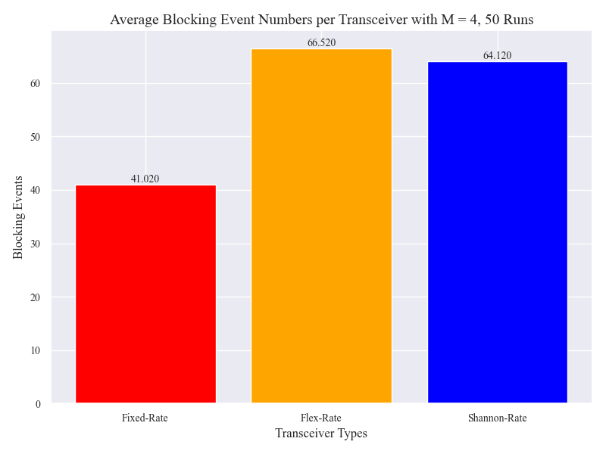
BLOCKING EVENTS
Not Traffic Matrix Assignment due to:
Matrix saturation
It was not possible to assign a suitable path for the connection

Slide 29
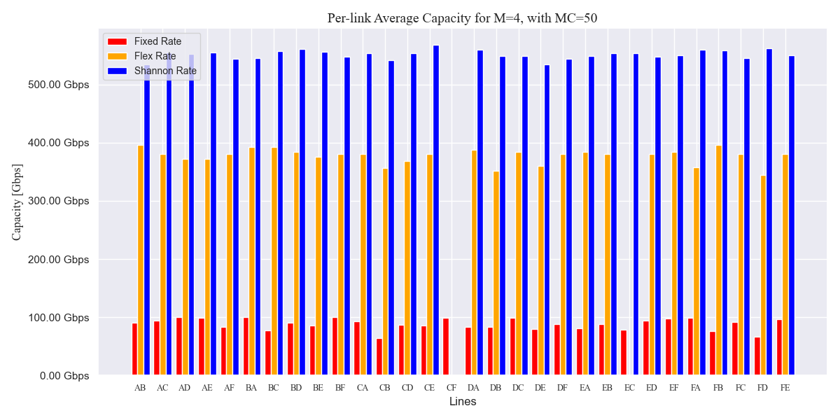
PER- LINK CAPACITY

Slide 30
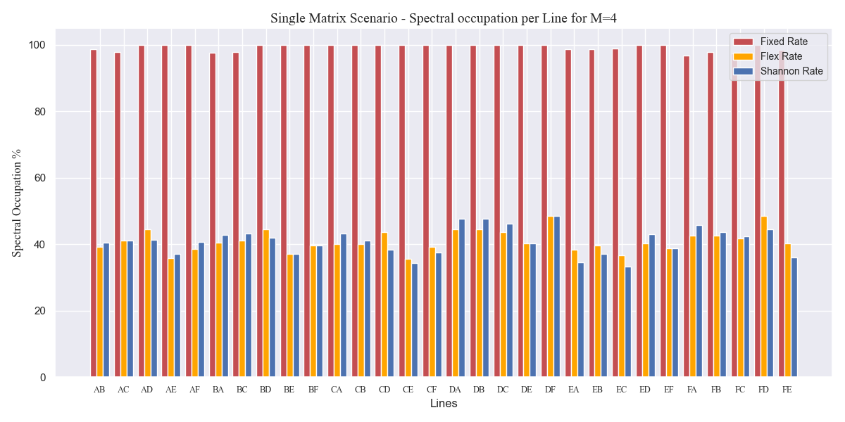
SPECTRAL OCCUPATION PER LINE

Slide 31
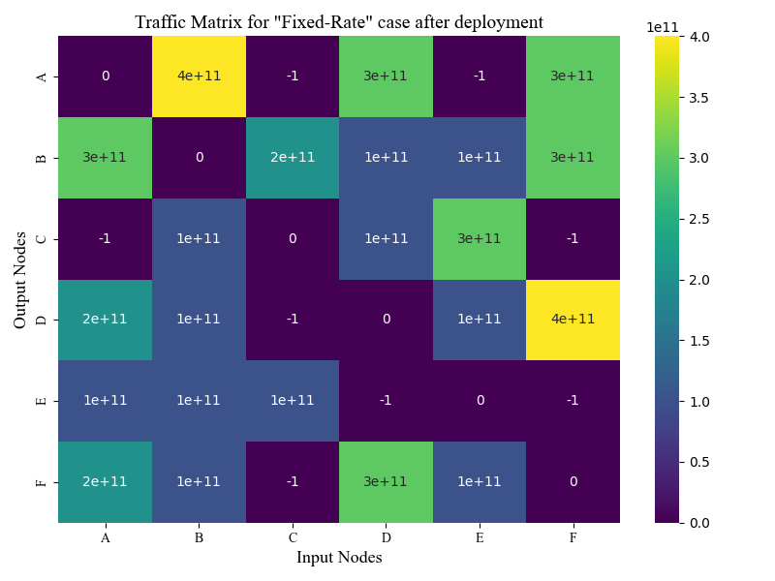
SINGLE TRAFFIC MATRIX SCENARIO RESULTS
USING NOT_FULL_NETWORK FILE
Fixed Rate - Traffic Matrix for a single Monte Carlos run

Slide 32
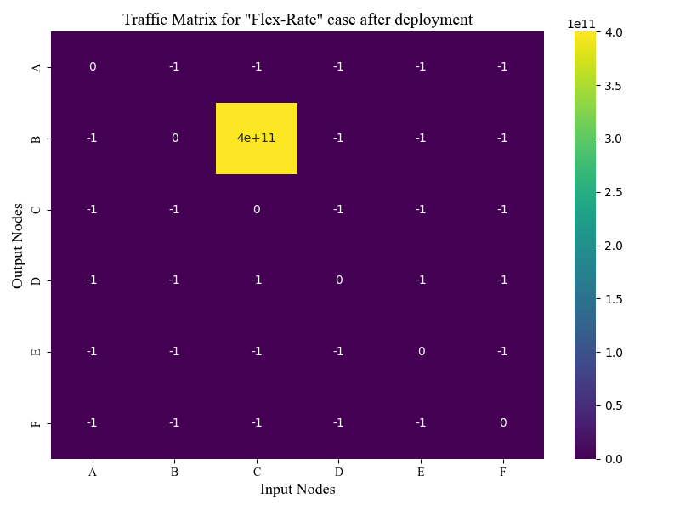
SINGLE TRAFFIC MATRIX SCENARIO RESULTS
USING NOT_FULL_NETWORK FILE
Flexible Rate - Traffic Matrix for a single Monte Carlos run

Slide 33

SINGLE TRAFFIC MATRIX SCENARIO RESULTS
USING NOT_FULL_NETWORK FILE
Shannon (Theoretical) Rate - Traffic Matrix for a single Monte Carlos run

Slide 34
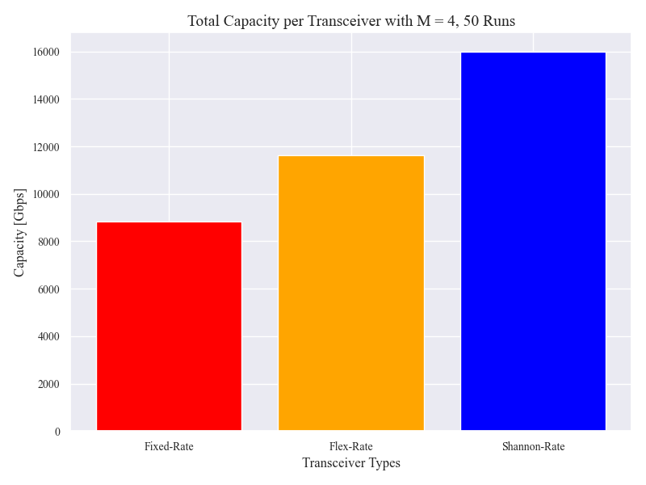

TOTAL AND AVERAGE CAPACITY
16.000
550
11.672
375
8.825
84

Slide 35
MIN AND MAXIMUN CAPACITY
OON

Slide 36
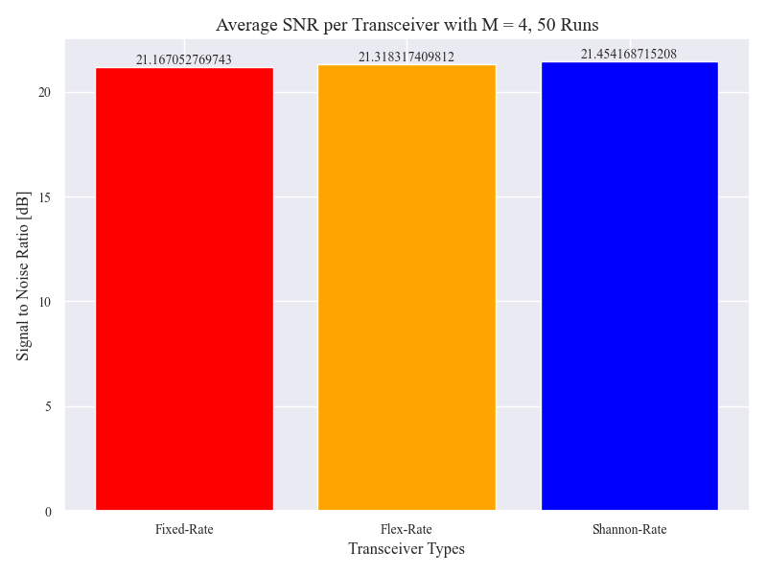
SIGNAL TO NOISE RATIO (SNR)

Slide 37

MAXIMUN AND MINIMUN SNR
Comentarios e instrucciones de edición de plantilla

Slide 38

LATENCY
Comentarios e instrucciones de edición de plantilla

Slide 39
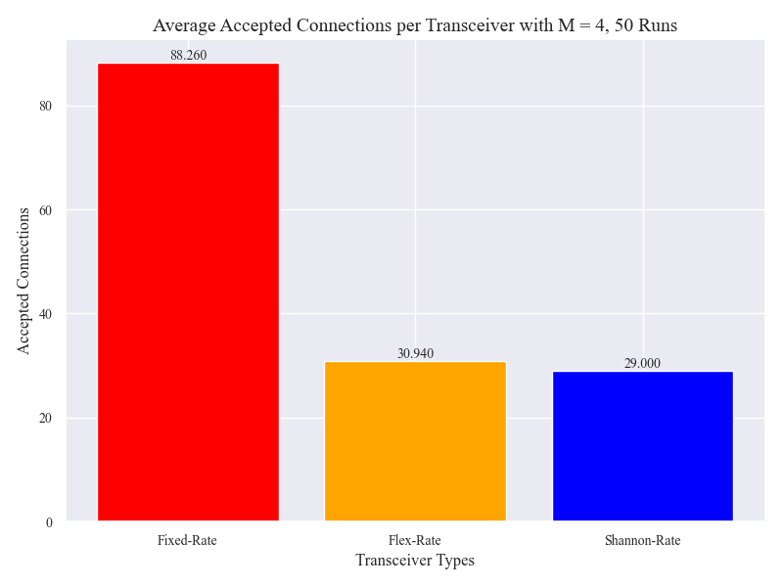

ACCEPTED AND REJECTED CONNECTIONS
Comentarios e instrucciones de edición de plantilla
Connections were rejected because no path was available or the bit rate was 0.

Slide 40
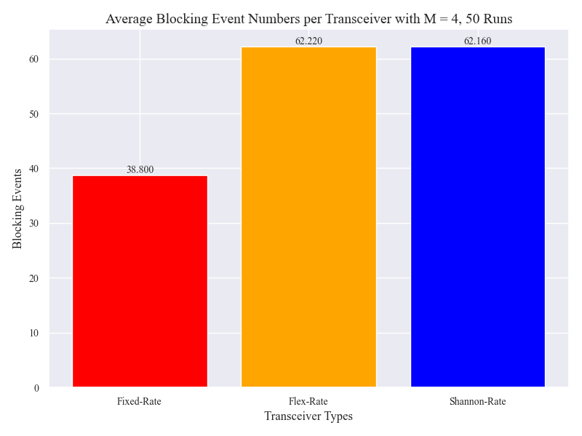
BLOCKING EVENTS
Not Traffic Matrix Assignment due to:
Matrix saturation
It was not possible to assign a suitable path for the connection

Slide 41
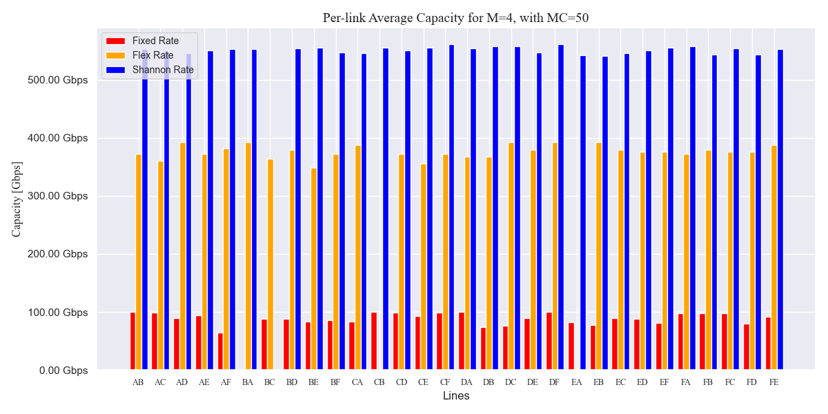
PER- LINK CAPACITY

Slide 42
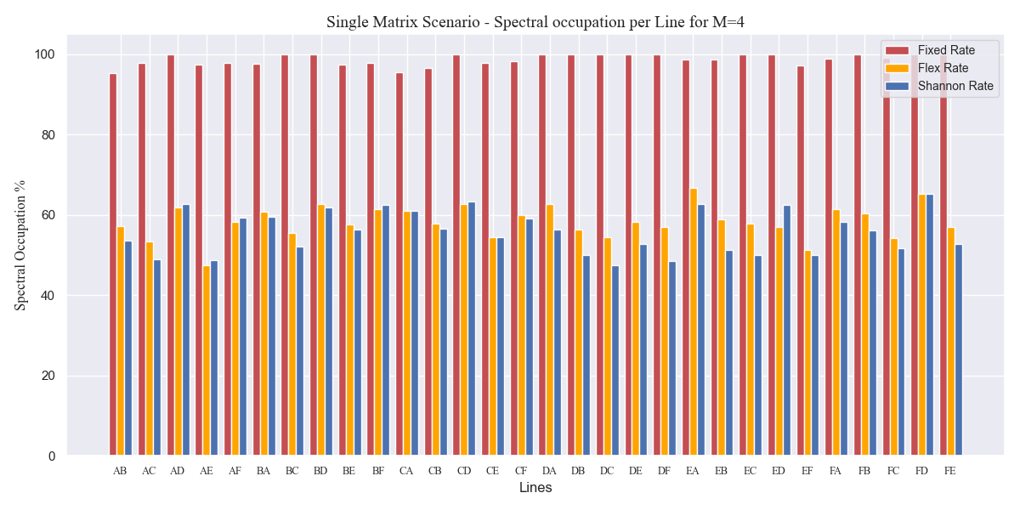
SPECTRAL OCCUPATION PER LINE

Slide 43
CONSIDERATIONS
CONGESTION SCENARIO
In order to evaluate the impact of congestion on the network, the value of the M factor was assessed at 10 discrete values, ranging from 1 to 10. Each test was conducted 10 times, with the aim of estimating the metric at the conclusion of the test.
The json files evaluated were once again Network, full_network, and not_full_network.
The number of completed connections was set to 30. This means that the connection between each pair of nodes in the Traffic Matrix is saturated.

Slide 44
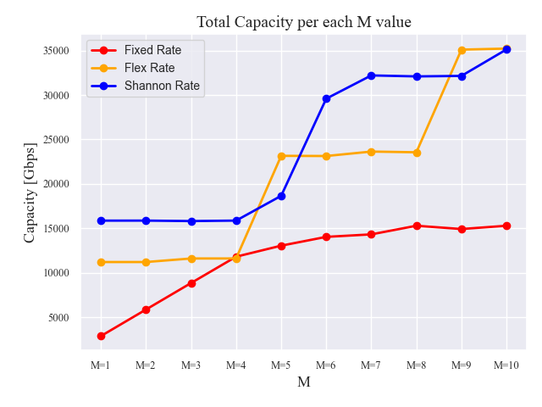
Network

Slide 45
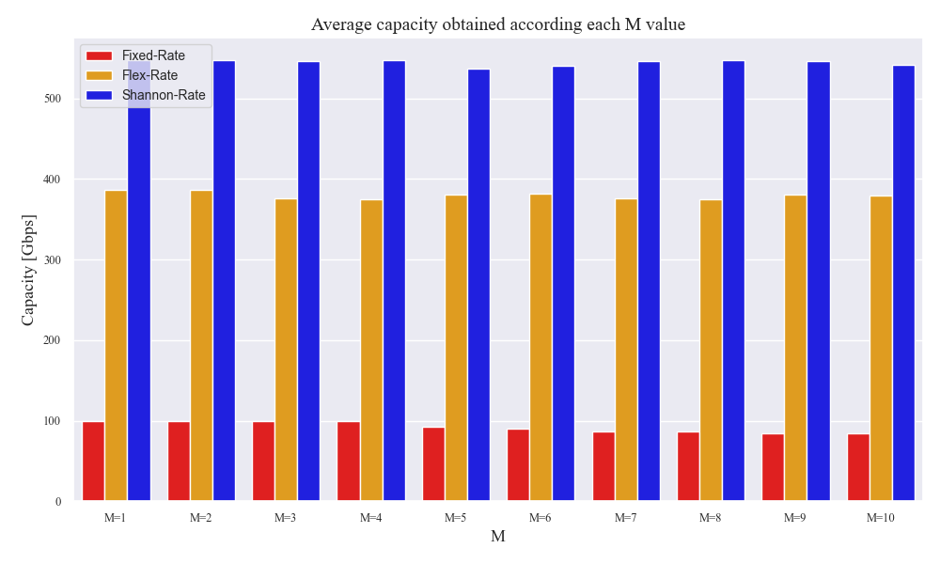
Network
540
378
82

Slide 46
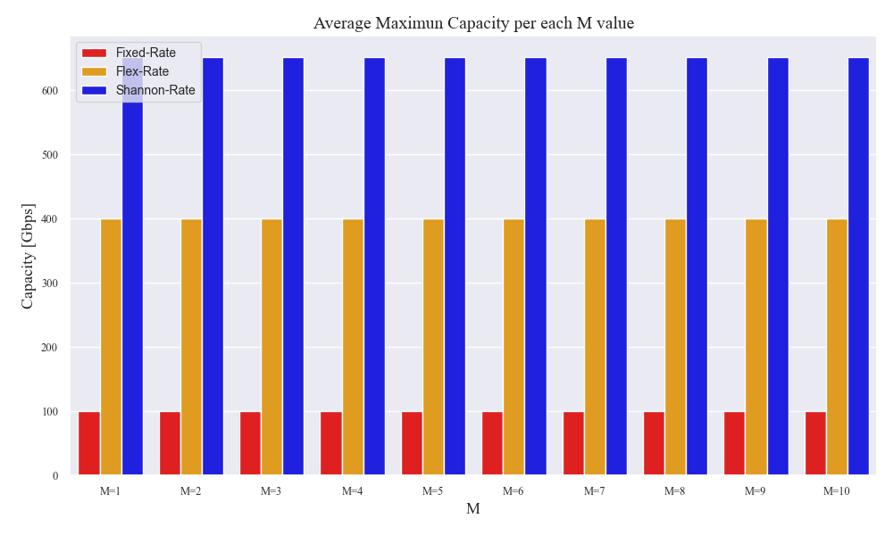
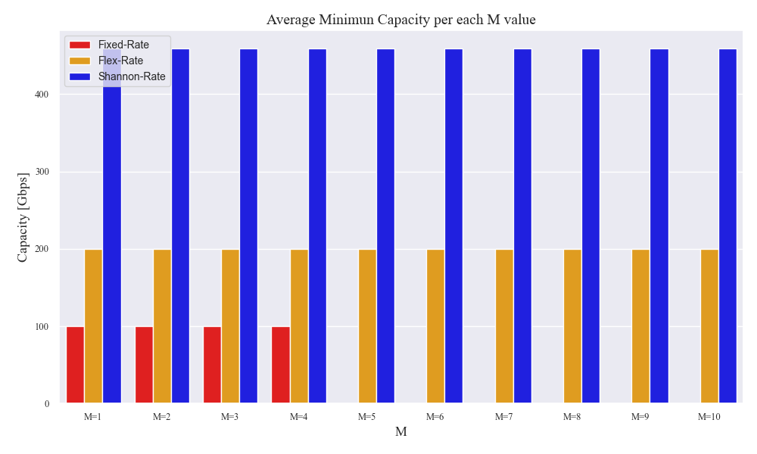
646
Average Minimum Capacity
458
Average Maximum Capacity

Slide 47
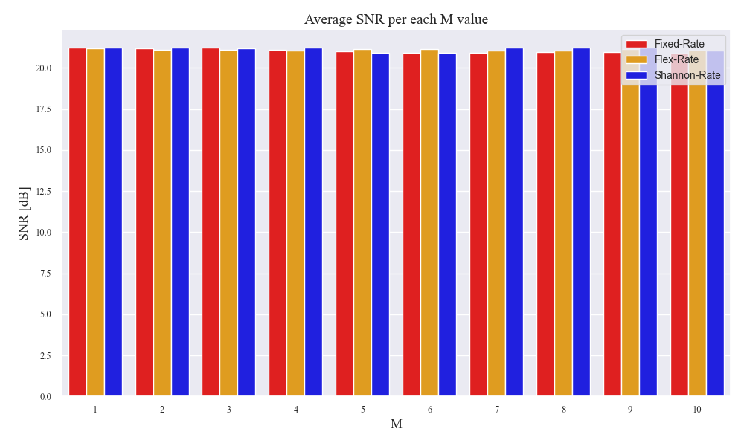
Network

Slide 48
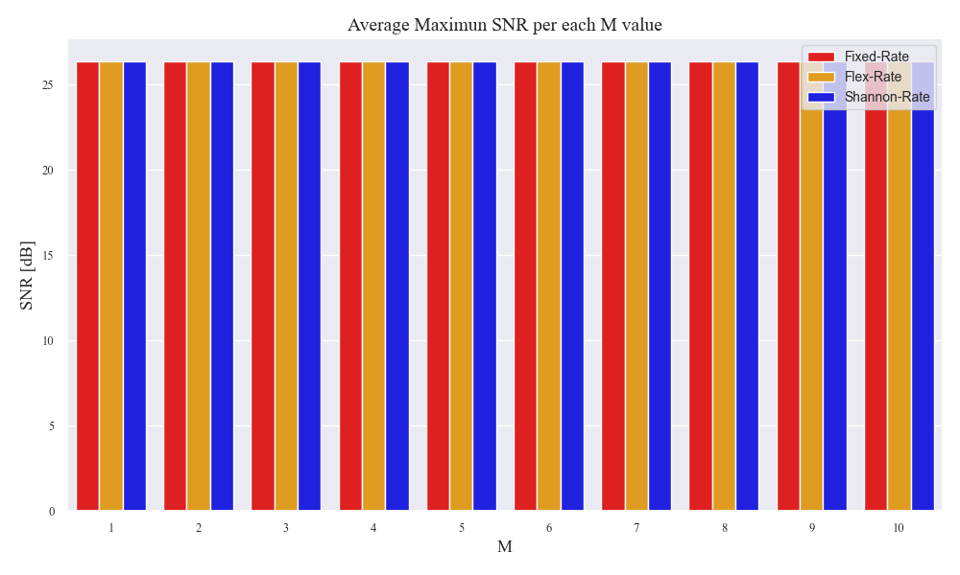
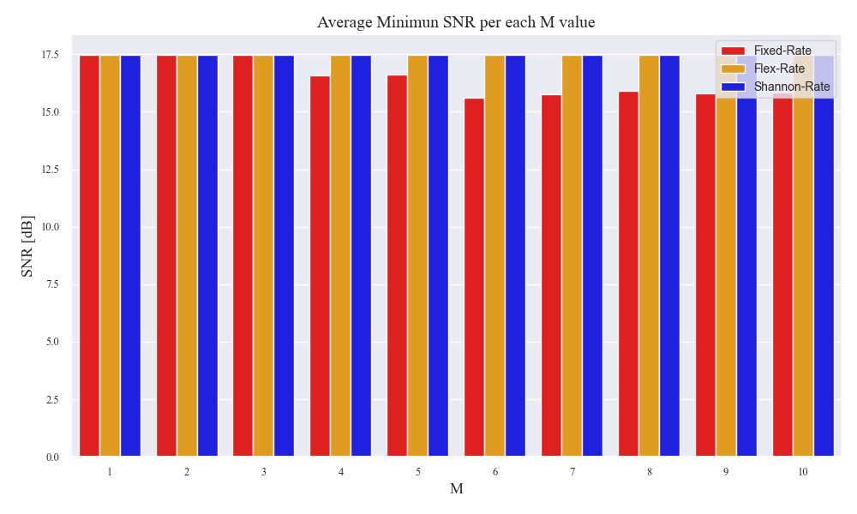
26.29
Average Minimum SNR
Average Maximum SNR

Slide 49


Slide 50


Average Rejected Connection
Average Accepted Connection

Slide 51

Network
BLOCKING EVENTS
Not Traffic Matrix Assignment due to:
Matrix saturation.
It was not possible to assign a suitable path for the connection.

Slide 52

Network

Slide 53

Network

Slide 54




Slide 55

Full Network
Full Network

Slide 56

Full Network
546
344
74

Slide 57

651
Average Minimum Capacity
454.8
Average Maximum Capacity

Slide 58

Full Network
21.39

Slide 59


26.52
Average Minimum SNR
17.5
Average Maximum SNR

Slide 60


Slide 61


93.3
62.5
58.5
Average Rejected Connection
28.93
Average Accepted Connection
8.36

Slide 62

Full Network
BLOCKING EVENTS
Not Traffic Matrix Assignment due to:
Matrix saturation.
It was not possible to assign a suitable path for the connection.

Slide 63

Full Network

Slide 64

Full Network

Slide 65



Slide 66

Not Full Network

Slide 67

Not Full Network
545
345
73

Slide 68


Average Minimum Capacity
Average Maximum Capacity

Slide 69

Not Full Network
21.05
21.28
21.37

Slide 70


26.58
Average Minimum SNR
17.63
15.93
Average Maximum SNR

Slide 71


92.2
81.7
62.3
28.86
28.93
7.74
7.24

Slide 72

Not Full Network
BLOCKING EVENTS
Not Traffic Matrix Assignment due to:
Matrix saturation
It was not possible to assign a suitable path for the connection

Slide 73

Not Full Network

Slide 74

Not Full Network

Slide 75



Slide 76
Recommendations for Future Tests
In the context of the Congestion Scenario.
To observe more pronounced alterations in the graphs between the different transceiver strategies, it is recommended to increase M by 5. This will result in a more noticeable change in the graphs between the different transceiver strategies.
In the case of the Single Matrix Scenario.
An increase in M signifies an increase in the number of Monte Carlo runs to be conducted. In order to achieve the same distribution in the traffic matrix with an M=16, for instance, it may be necessary to perform 100 or more runs.

Slide 77
Thank you for your attention
OON
Open Optical Networks

