Slide 1
QuEra & MOODY'S Challenge
Team: 2Q-4U
Nessim Dridi, David Schrago, Constantin Schuchardt

Slide 2
We start with theory …

Slide 3
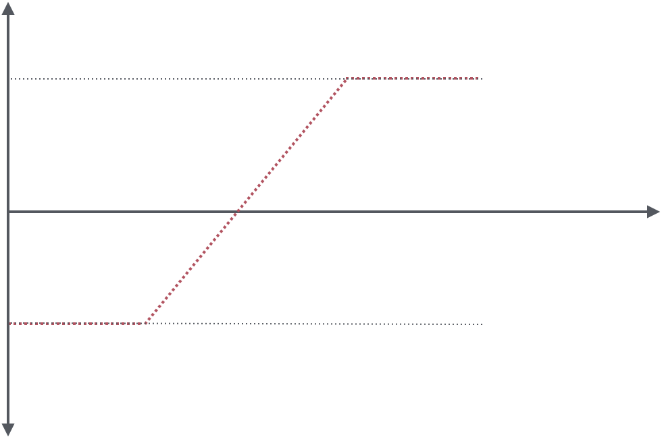

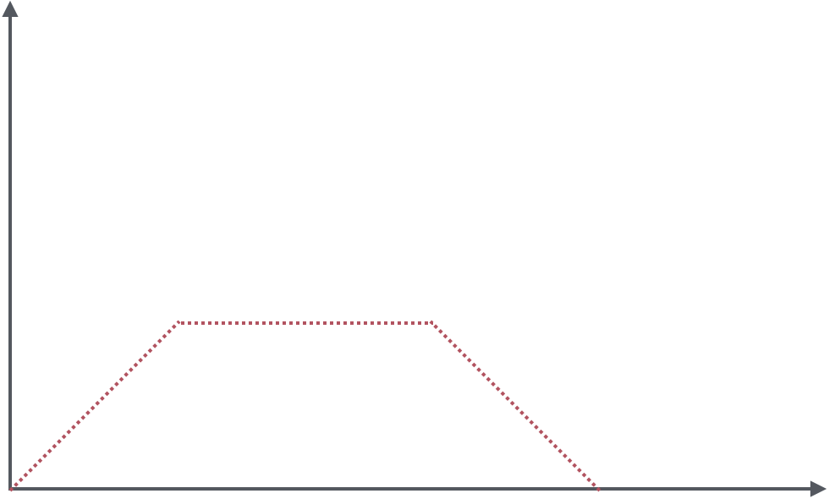




Intuition:
-
‘Adiabatic theorem’
# of ‘neighbors’

Slide 4









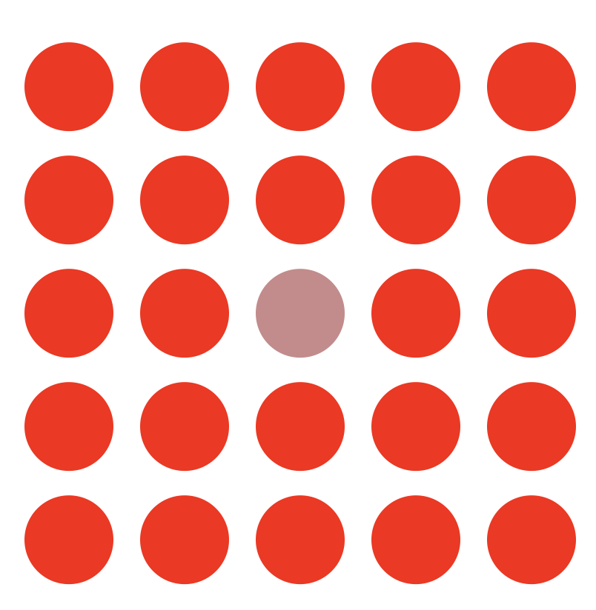
Neighbors vs. radius
# = 4
# = 8
# = 12
# = 20
# = 25
JP Morgan : “Only this is difficult enough”

Slide 5
>>> print(results)

Slide 6
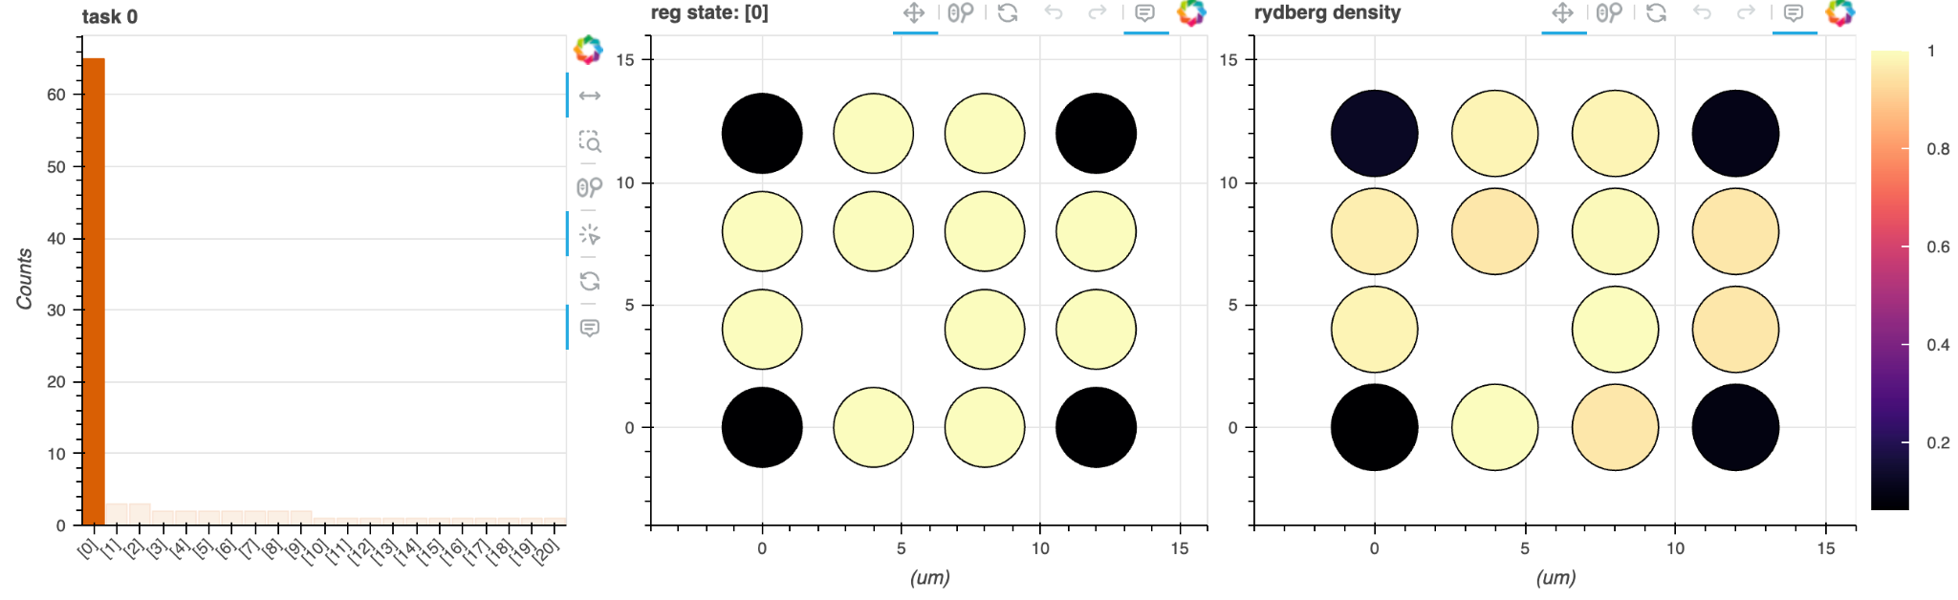
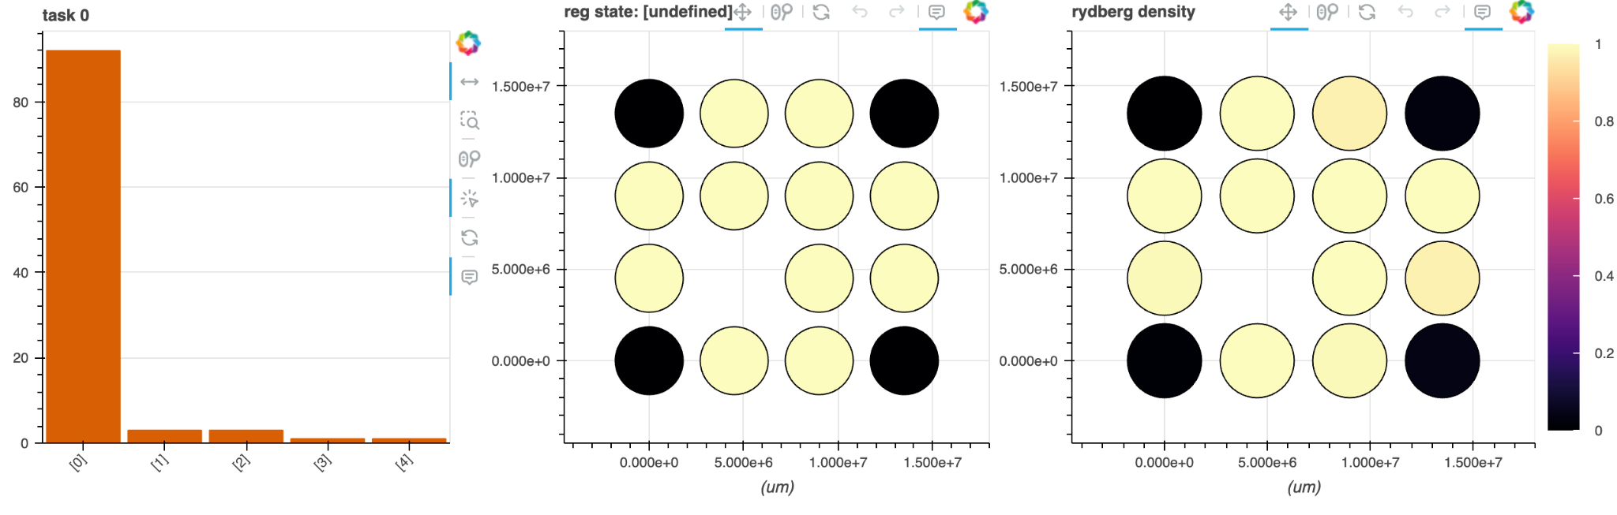
King’s 4x4 comparison
Quantum Simulation
More than 60% optimal case
Far more possible final states
Classical Emulation
Roughly 90% optimal case
No wrong sets
Notes:
Issue with scaling up. No classical emulation greater than 5x5 possible. Classica computer outperforms QPU in this regime

Slide 7
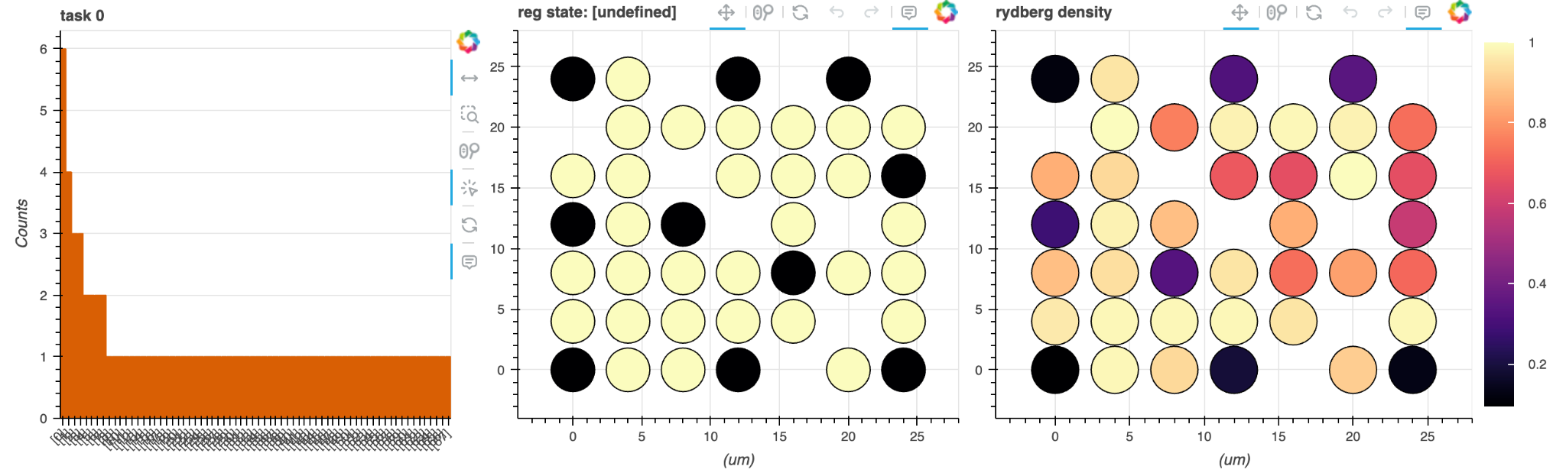
Two neighbors
hardness parameter: HP = 2.638
Notes:
Largest system we managed to make work

Slide 8
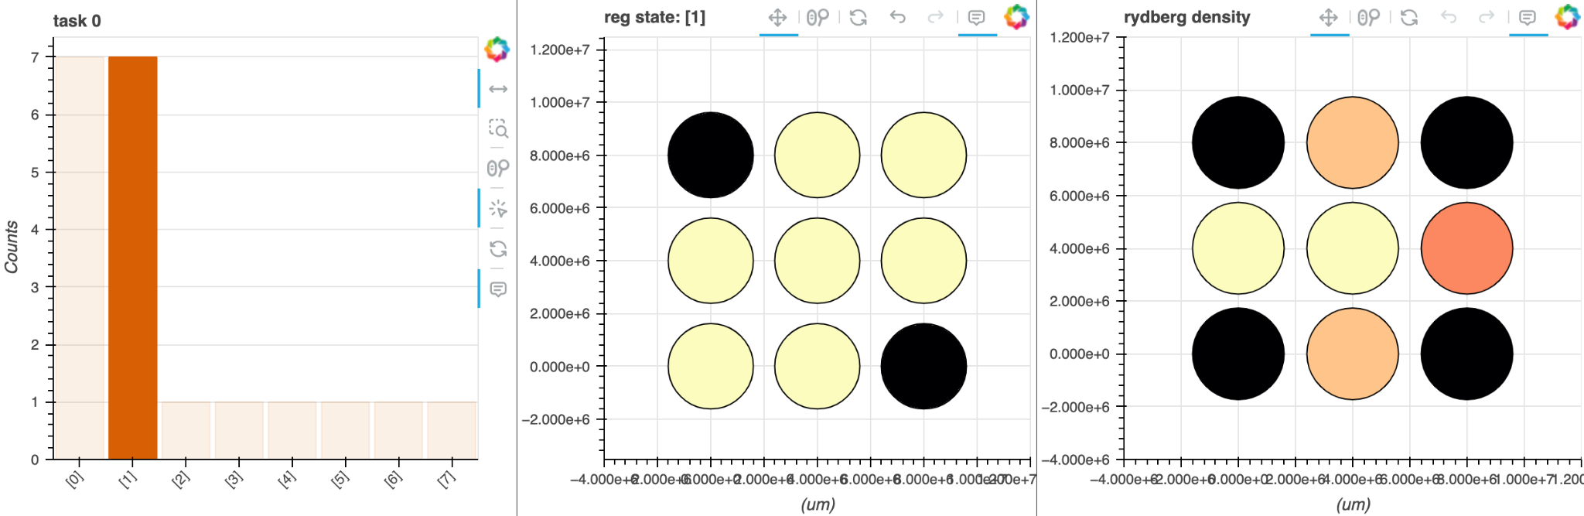
sqrt(5) neighbors
Classical Simulation
14/20 rate of MIS results
Notes:
Largest system we managed to make work

Slide 9
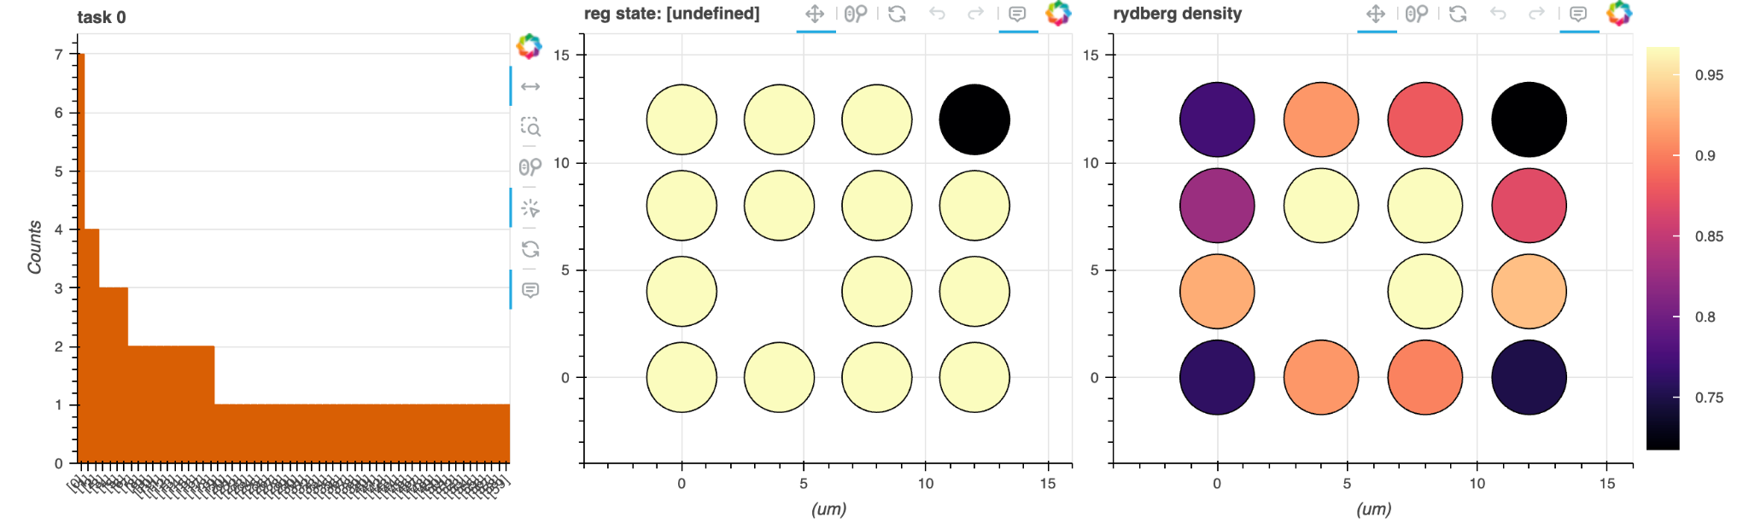
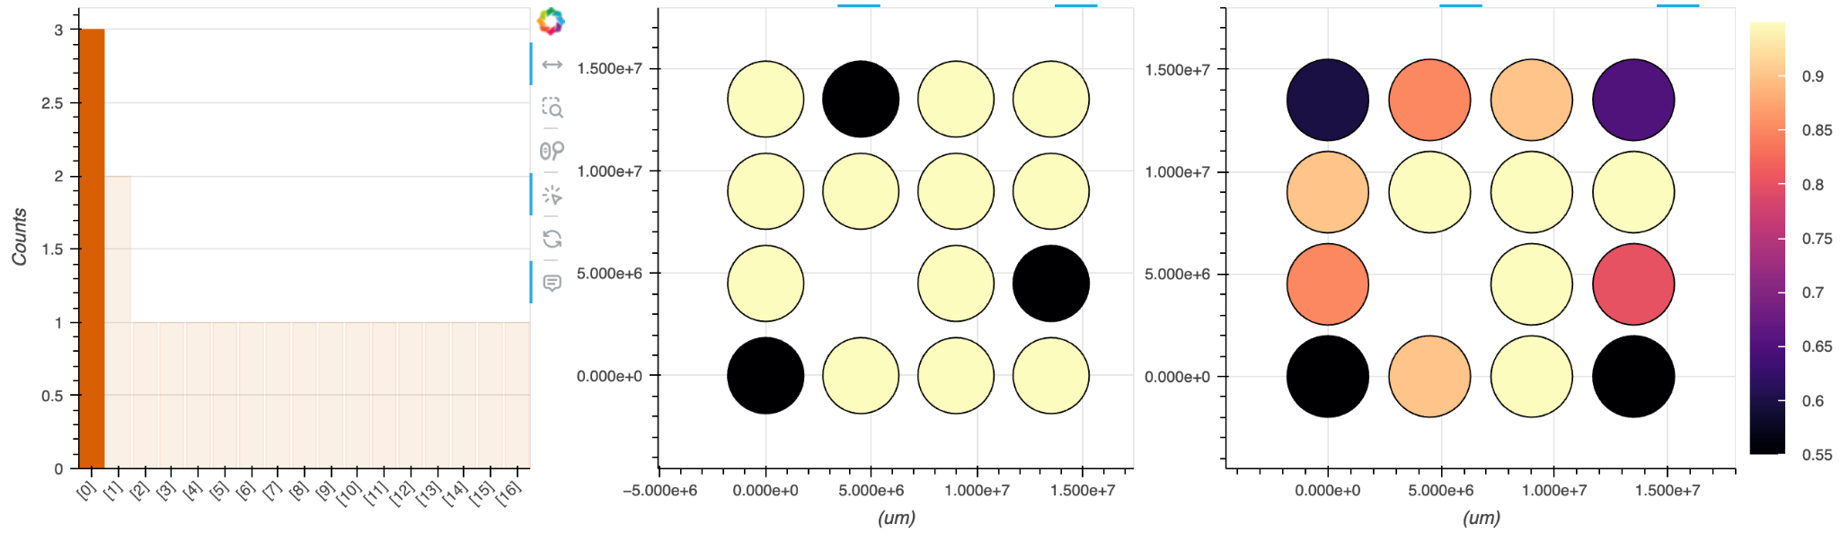
Three neighbors
Quantum Simulation
No clear correspondence with classical simulation
Classical Simulation
Roughly 33% rate of MIS’s

Slide 10
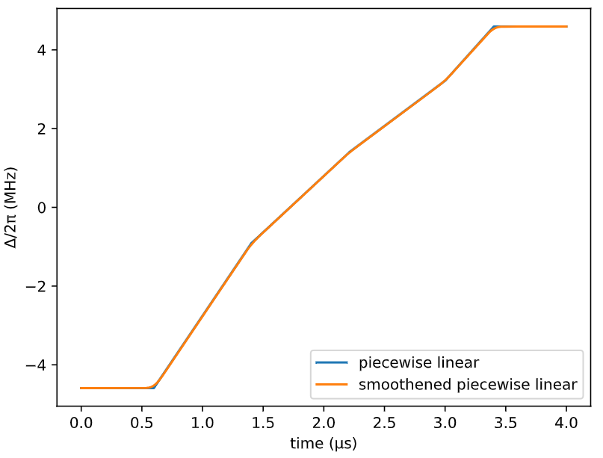
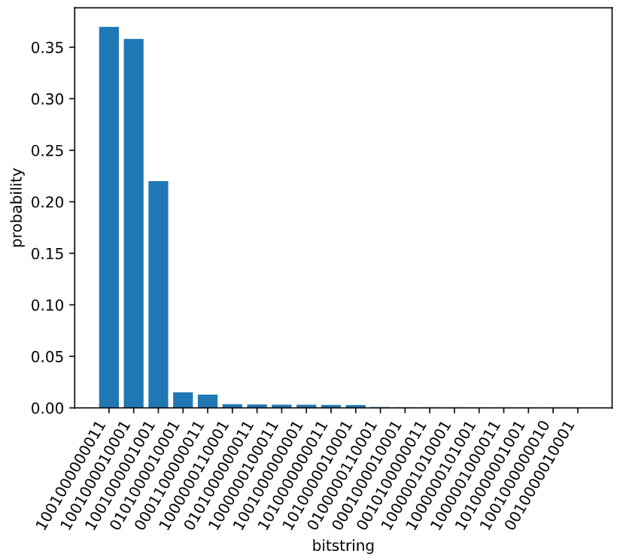
Optimization

Slide 11
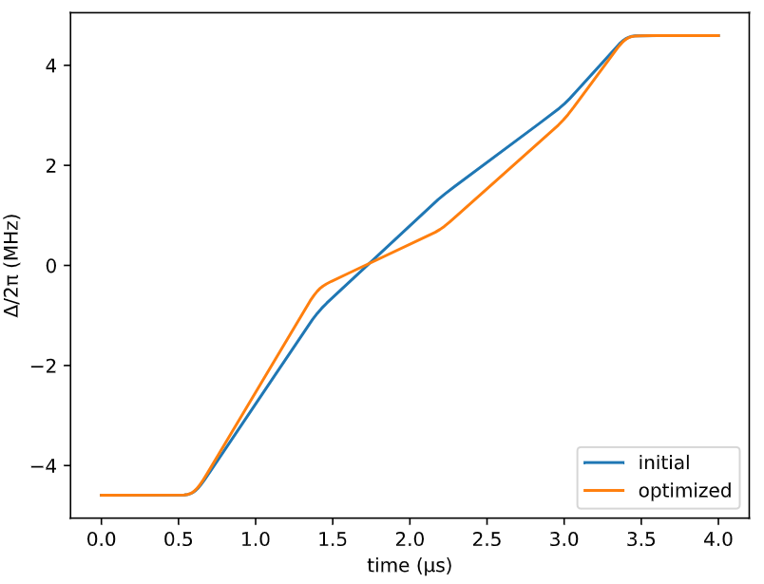
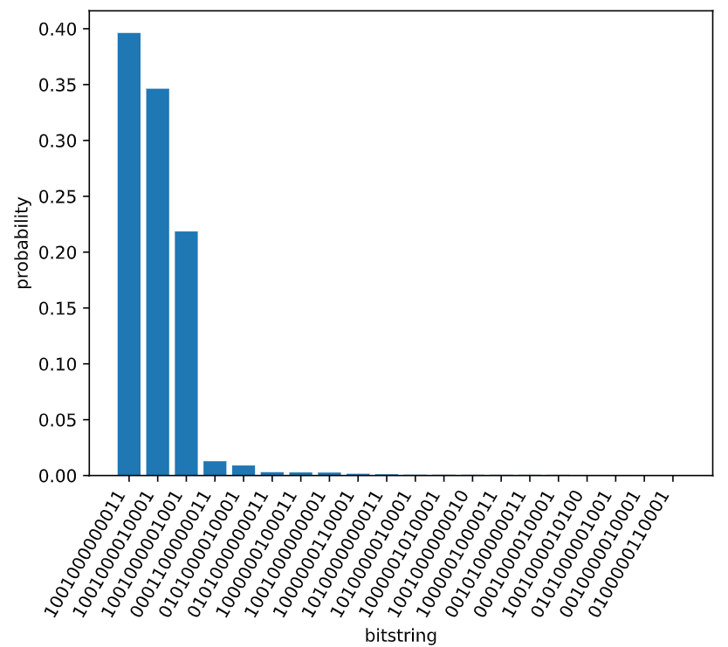
Optimization

Slide 12
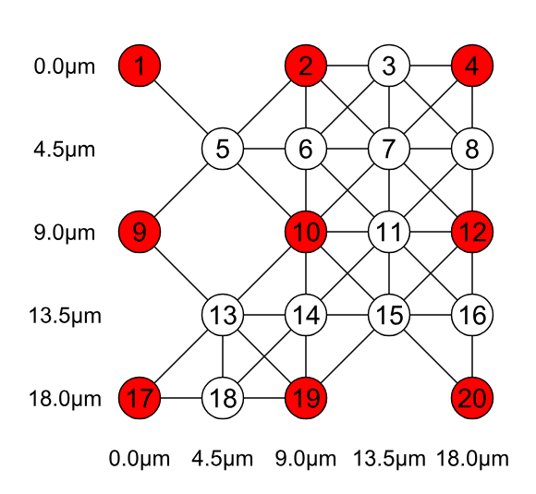

Classical Simulation

Slide 13

How hard is it to find MIS on a given graph?
hardness parameter
degeneracy of the MIS with |MIS| - 1 nodes
number of nodes
degeneracy of the MIS with |MIS| nodes
S. Ebadi et al. (10.48550/arXiv.2202.09372)

Slide 14
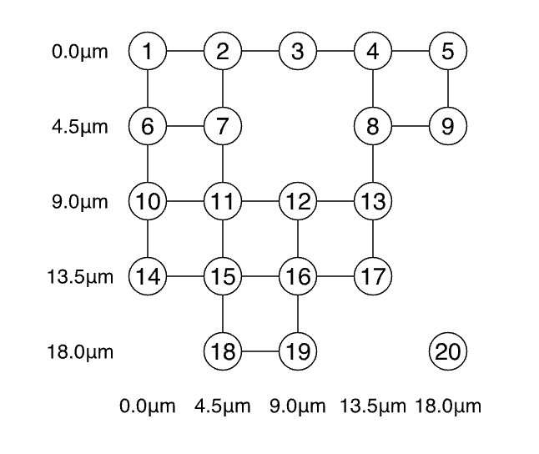
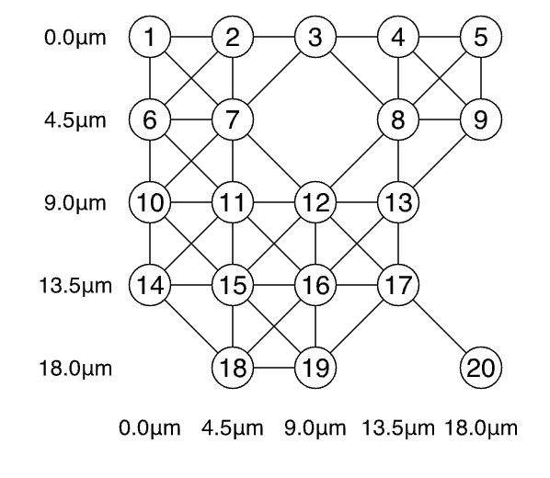
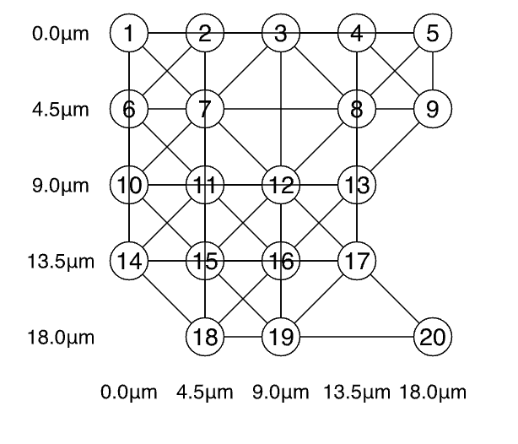
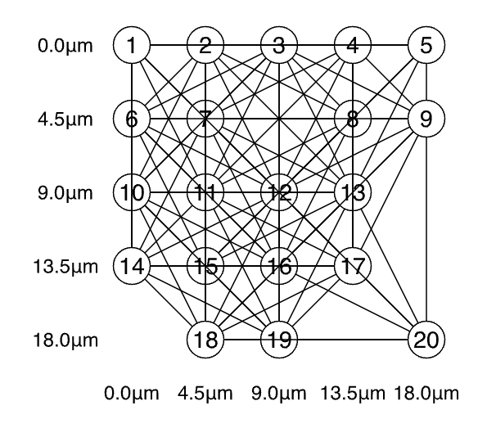
Hardness for varying blockade radius:
R_b / a | 1 | sqrt(2 * sqrt(2)) | 2 | 3
edges | 26 | 48 | 66 | 123
HP | 1.54 | 1.28 | 8.16 | 10.00

Slide 15
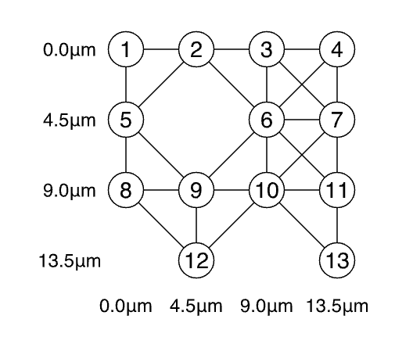
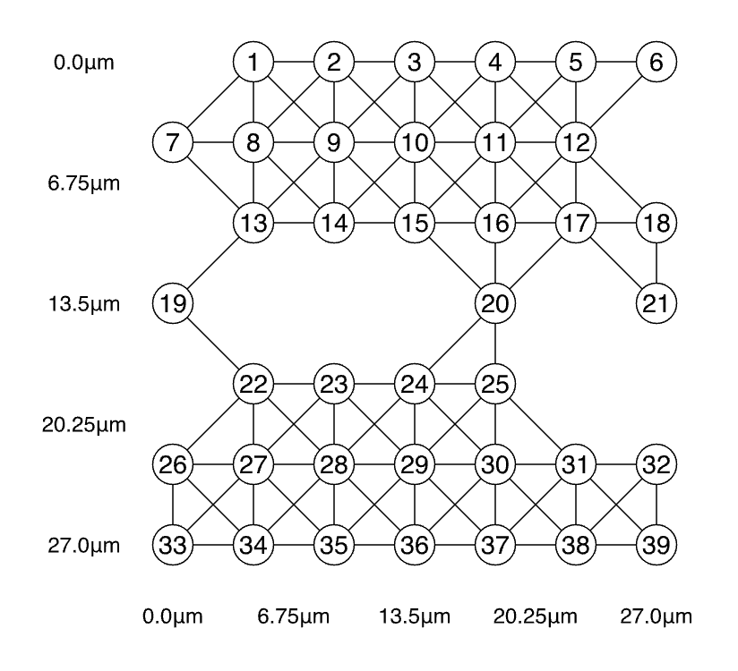
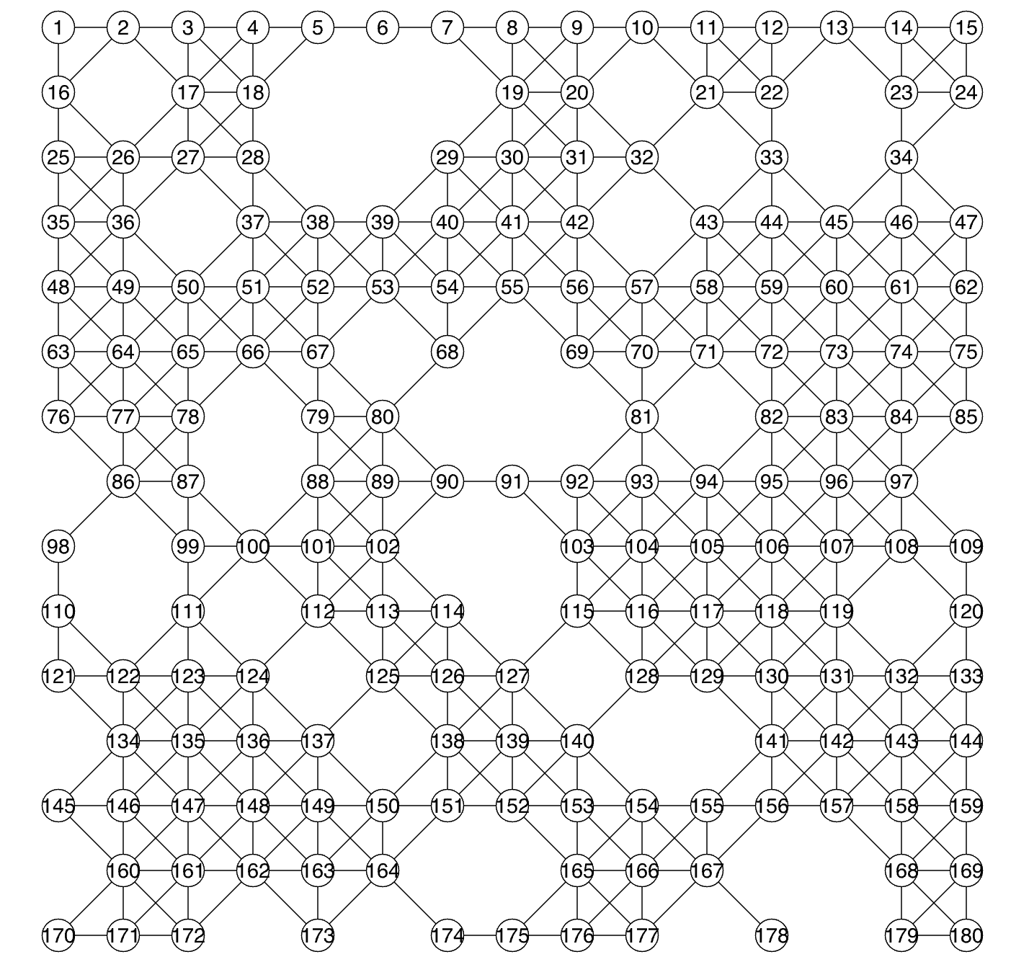
Hardness for varying number of nodes:
nodes | 13 | 39 | 180
edges | 26 | 100 | 513
hardness | 0.54 | 2.41 | 3.27

Slide 16
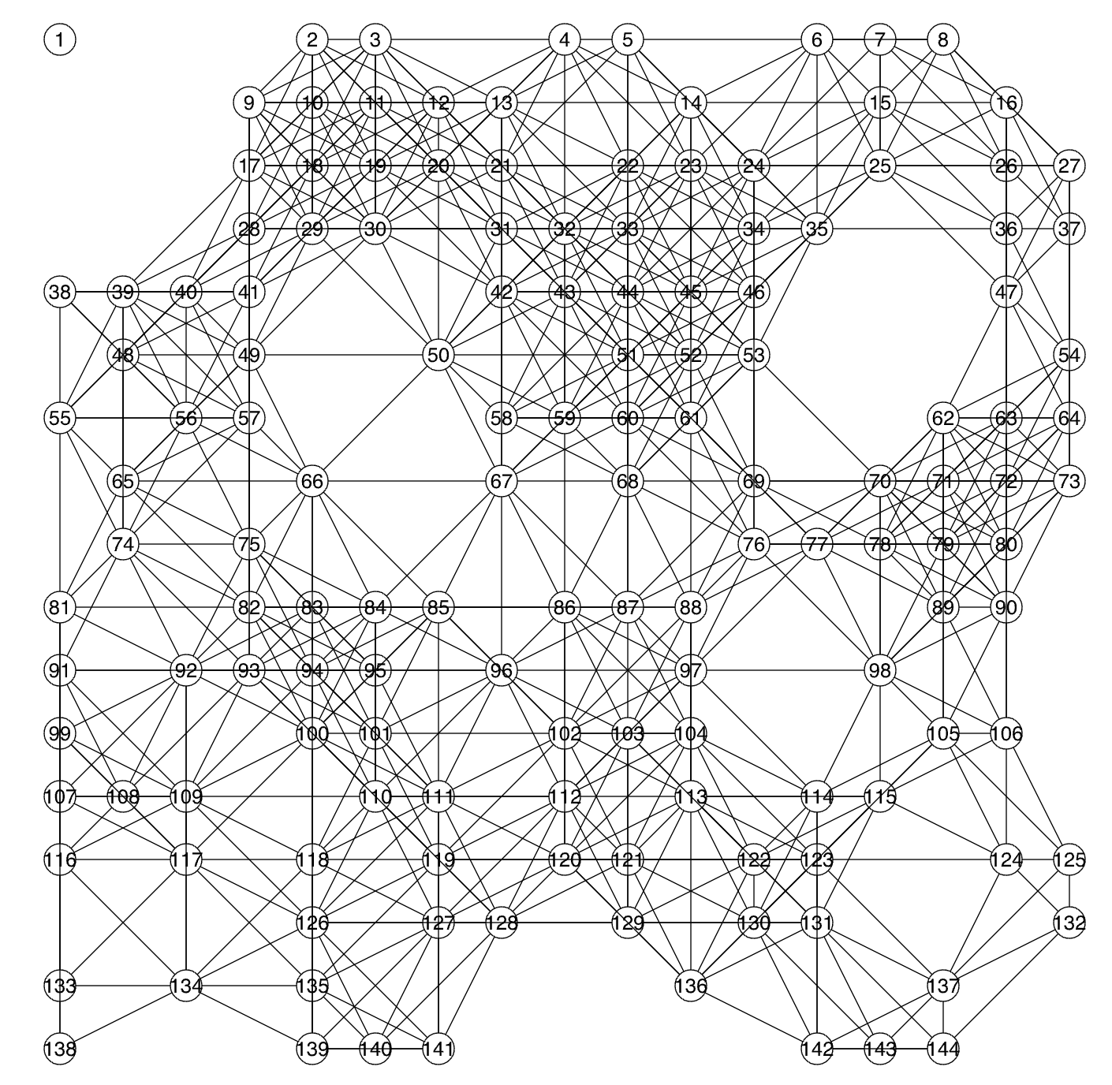
hard-graph.png
HP = 120.97

Slide 17
Let’s talk business!

Slide 18
Two business ideas:
Toy model: geographic portfolio diversification
01.
General approach to portfolio optimization
02.
What can we do with more time?
What can we do right now?
Notes:
Consti;

Slide 19
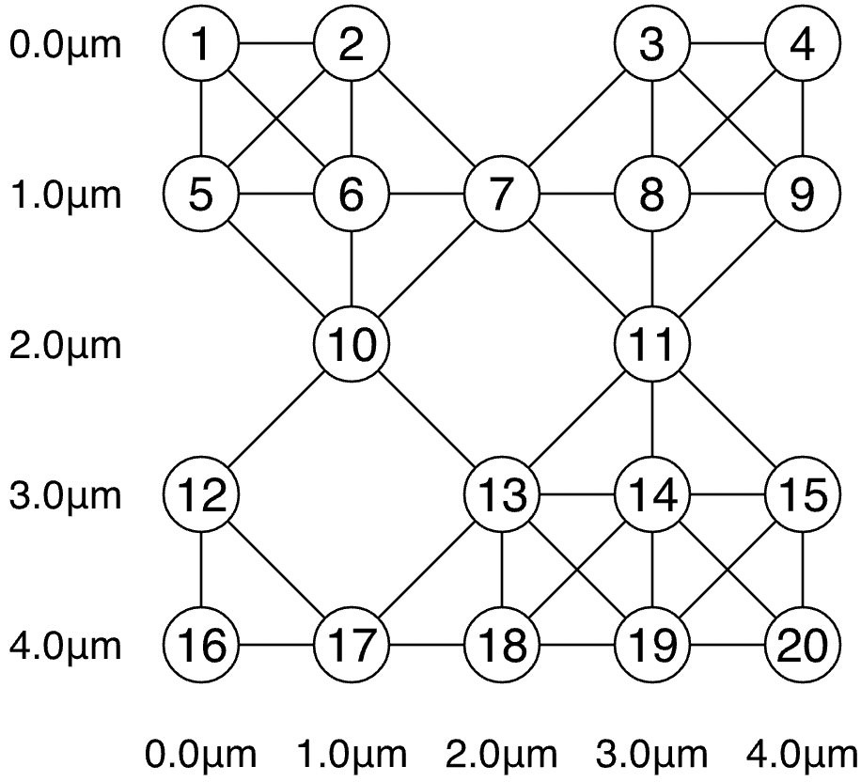
General Idea
Use the MIS of a 2D graph of correlated stocks to maximally diversify a portfolio
Customers can be ensured of lowest possible risk exposure with highest spread of investment
Each qubit corresponds to a stock and each vertex to a connectivity between the stocks, implying similar risk.
Notes:
Example idea: S&P 500, tech companies ;;; Consti

Slide 20
This has been done before (but not Quantum)
Correlation-diversified portfolio, assisted with a quantum algorithm and using MIS
Historical correlation => current correlation statistically (values between -1 and 1)
Stocks are connected if correlation exceeds a value 𝛉
https://arxiv.org/pdf/2308.04769, Hidaka et al, 2023.
Notes:
Consti

Slide 21
Quantum Process
Comparing the Two Approaches
Limitation
Quantum Advantage
Use a 2D map placing correlated stocks close to each other
Map onto square grid (with degeneracy)
Use QPU MIS process
MIS is NP hard to solve classically
MIS is solvable using a QPU

Slide 22
How could we try make it near future?
Issue: More than a few hundred stocks exist
Solution: Divide and Conquer
From: one iteration over a quadratic number of qubits
To: linear number of iterations over a linear number of qubits
Example:
100x100 qubit system
Do one hundred 10x10 qubit iterations
Merge together at the edges, `hope` for small errors there
‘Hope’: Putting together the edges via Minimum independence cut?
Notes:
Future outlook for other projects

Slide 23
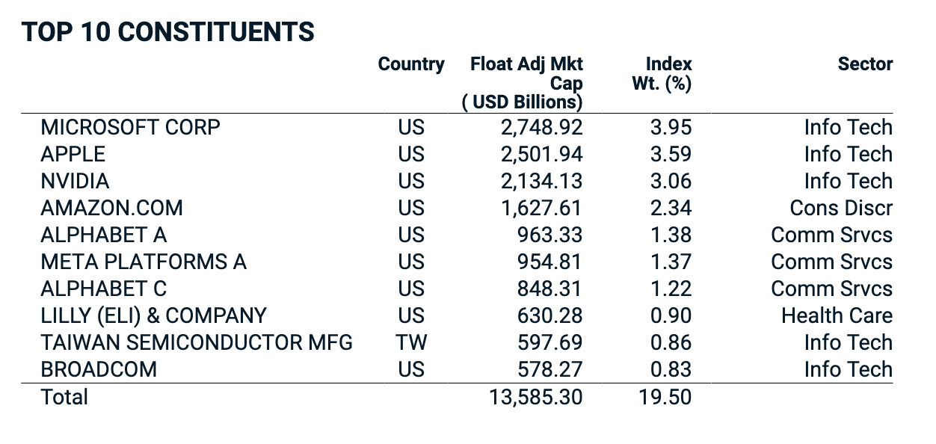
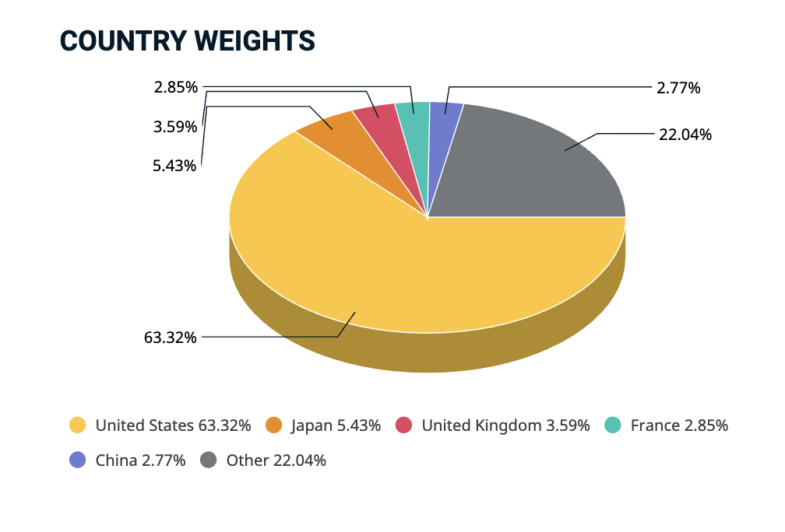
Problem: Geographic Portfolio Diversification
MSCI ACWI Index

Slide 24
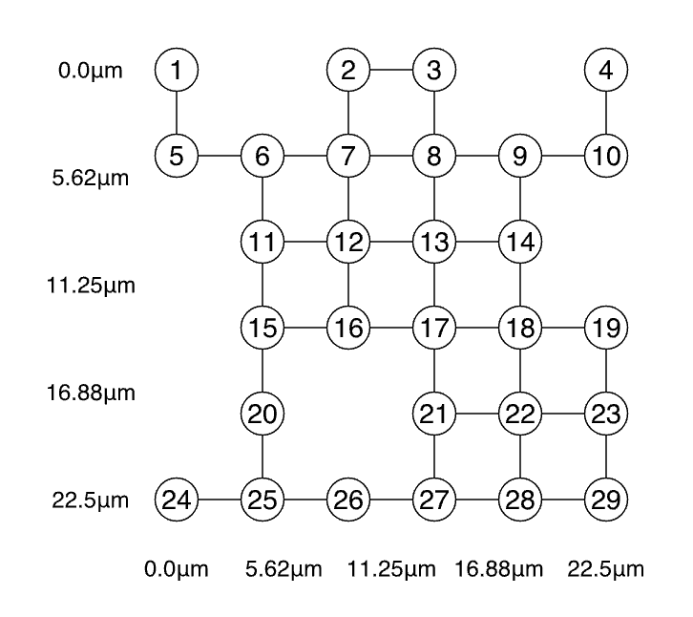
Idea: Geographic Portfolio Diversification
asset at location (x, y) on earth
Y
X

Slide 25
Idea: Geographic Portfolio Diversification
Belgium
asset at location (x, y) on earth
Y
Germany
France
Switzerland
X

Slide 26
Use case: Geographic-Portfolio Diversification
Description
Advantage & Impact
Short term
OU: Funds & Asset Management group
Problem: geographic diversification of assets
Product:
map asset location to grid position of neutral atoms
solving the MIS problem on quantum computer to resolve geographic clustering of assets
first optimizations already possible with near-term number of qubits
at most hundreds of qubits required
Impact:
benchmarking geographic diversification
lowering risk for national influences on assets (i.e. war, spread of diseases, politics)
Flexible:
the approach is not limited to the location of the assets
you decide what the position of the atoms encode (e. g. Industry, sector)
Notes:
General diversification across different asset classes is also possible, but in this case we want to focus on stocks, specifically.

Slide 27
Thanks!
Any questions?

