Slide 1
7/28/14 Topics:
Inheritance (continued)
Interfaces

Slide 2
Inheritance
• In OO langs a new class can extend an existing class.
• Every class that doesn’t explicitly extend some other
class will still extend Object.
• The existing class is called the base or super class.
• The new (typically called the derived or sub) class will
inherit the static and instance variables and methods
from the base.
• However, it might not have direct access to some of
the things it inherits!

Slide 3
Inheritance
The final keyword restricts inheritance in two ways.
If a class is final, it cannot be extended
If a method is final, it cannot be overriden

Slide 4
Inheritance
Some methods Object gives you…
boolean equals(Object);
Class getClass();
int hashCode();
String toString();
(If a class implements any of these, it will override Object’s version of them)

Slide 5
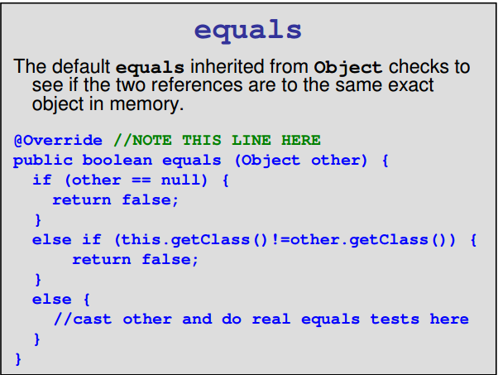
Inheritance

Slide 6
Inheritance: The ‘super’ keyword
If your method overrides one of its superclass's methods, you can invoke the overridden method through the use of the keyword super.

Slide 7
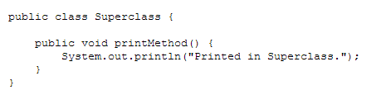
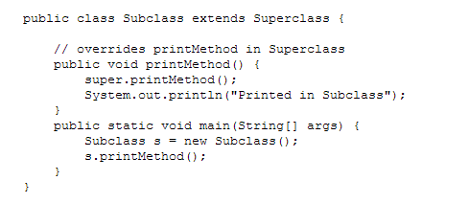
Inheritance: The ‘super’ keyword

Slide 8
Inheritance: The ‘super’ keyword
One thing to be aware of is the names of any variables declared in the base class.
• If you declare a variable with the same name
in the derived class then that is the one that
is seen by default
• Within a method of the derived class (but not
in places in the rest of the project) you can
access the base's version by using super.
to refer to the variable from the superclass.

Slide 9
Inheritance: Constructors
When a derived object's constructor is called, the regular no-parameter version of the base class' constructor will be called before the body of the derived object’s constructor is executed unless it explicitly calls a different constructor in the base class using the super(…) syntax.

Slide 10
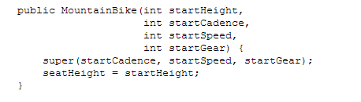
Inheritance: Constructors
Constructors are NOT inherited by subclasses. To access the superclass constructor, use super().

Slide 11
Multiple Inheritance
Java does not allow for a class to extend more than one class at a time.
BUT, java allows a class to extend more than one interface.

Slide 12
Interfaces
In Java, an interface establishes (for example)
a set of public methods that any class which
implements that interface must contain.
If we implement several classes which implement
the same interface, we get an added ability; we
can create a reference using the interface's
name and have it point to any of the classes
that implement that interface.

Slide 13
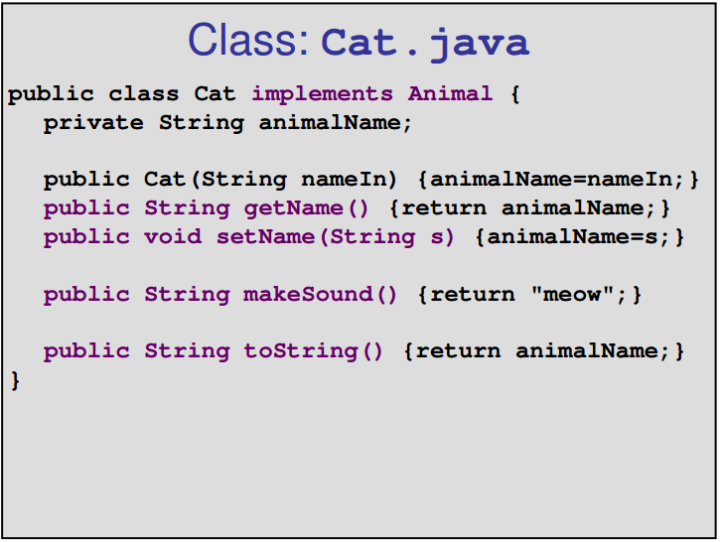
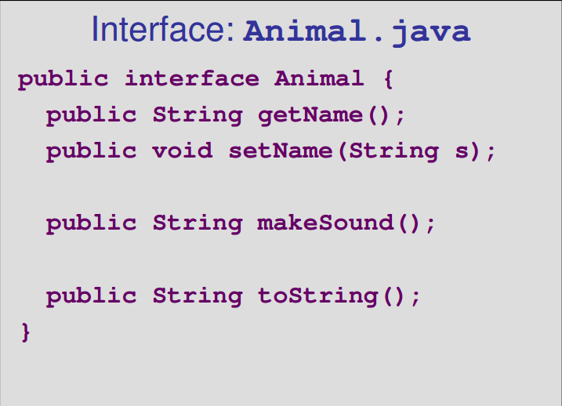
Interfaces

Slide 14
Interfaces
A Heterogeneous Array
Cats and Dogs, living together?
Yes, if we create an array of Animal references and then allocate a Cat
object or a Dog object as desired.

Slide 15
Interfaces
You cannot call “new” on an Interface since an interface cannot be instantiated.
In addition to method signatures, interface definitions can contain public static constants (note: you don’t actually use the words final or static in the interface definition).

Slide 16
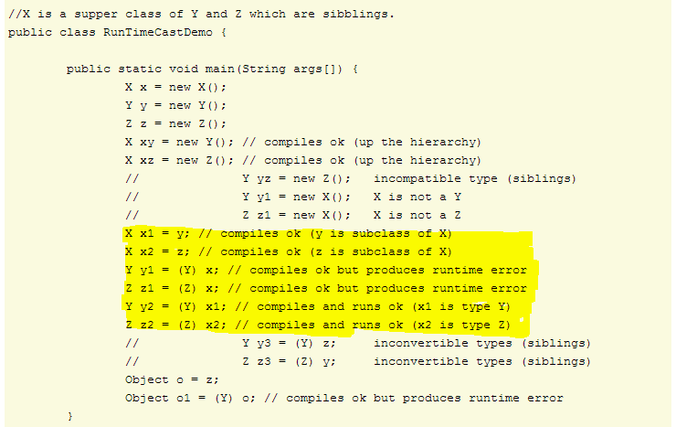
Casting

Slide 17
Casting
Before casting, you might want to test to make sure you are correct about the type.
if (objectRef instanceof DerivedName) {
((DerivedName)objectRef).funInDer();
}

