Slide 1
NXProject
Intelligent planning integrated with Azure DevOps
From estimates to schedule — without leaving the technical backlog behind.
Nexus XData Tecnologia • nexusxdata.com.br

Slide 2
The problem NXProject solves
📋 Rich backlog, missing schedule
The technical team works in Azure DevOps, but management cannot see dates, dependencies and allocation in one consolidated view.
⚠️ Rework and parallel spreadsheets
Managers maintain Excel sheets manually, out of sync with what the team is actually doing in the backlog.
🔗 Lack of traceability between planning and execution
There is no direct link between the manager's estimate and the developer's work item — every change requires double updates.
📅 Hard to replan quickly
When a sprint slips, recalculating all dependencies and dates manually is slow and error-prone.

Slide 3
What NXProject is
A planning layer on top of Azure DevOps that turns the technical backlog into a manageable schedule — with dates, dependencies, Gantt, resource allocation and bidirectional traceability — without changing the technical team's workflow.
🗓️
🔗
📊
🗂️
👥
🤖
Automatic schedule
Bidirectional integration
Interactive Gantt
Execution TaskBoard
Resource management
Local or cloud AI
Dates calculated from duration, work calendar, holidays and predecessors.
Imports and syncs with Azure DevOps: work items, sprints, owners and estimates.
Bars, dependencies, milestones, critical path and baseline, with adjustable zoom.
Sprint Tasks by person and state; the team runs the day and the board writes to DevOps.
Allocation by person, overload detection, allocation map and cost per resource.
Suggests task structures; the local model runs on your machine, sending no data out.

Slide 4
Planning philosophy: degrees of freedom
NXProject plans down to the Story level. Tasks can be pulled into the schedule, but the intent is for the team to detail and create them during execution, supported by the TaskBoard — which brings more agility to the project.
Inspired by the mathematical concept of degrees of freedom: define the boundaries of the system without constraining the movement inside them.
Management sets the boundaries
The team moves inside them
Both sides see the same thing
Dates, resources, dependencies and priority — at Epic, Feature and Story level. That is what holds deadline, capacity and risk together.
Tasks are born in execution, with the people doing the work: breakdown, sequence and fine tuning happen in the TaskBoard, with no replanning round trip.
The Task created by the team rolls up to the Story in the schedule; managers see progress and blockers without chasing status manually.

Slide 5
Key features
Azure DevOps import
Smart schedule
Gantt chart
TaskBoard
• Project → Epic → Feature → Story hierarchy • Optional Task level (Load Task ToDo) • Estimates, dates, sprints and owners • Predecessors and blockers (Block tag)
• Automatic predecessor cascade • Virtual predecessor by resource • Calendar with holidays and working hours • %Daily column: expected pace by today
• Bars, milestones and dependency arrows • Critical path (CPM) and baseline • Zoom: Day, Week, Sprint, Month, Quarter • Drag to visually replan
• Project & Story and Person & Task views • Drag to change state; batched write-back • Doing/Done and WIP limit per person • Alert for Stories out of sync
Task Plan (Excel)
Resources and costs
Bidirectional sync
Health Check
• Breaks the Story down into Tasks • AI suggestions and Tech Lead review • Applies to the schedule and syncs back • Automatic backup on every save
• Allocation by person and sprint • Allocation map by project and month • Cost per resource (hourly or monthly) • Overload alert (>100%)
• Dates, hours, state, sprint, tags and predecessors • Creates new work items in DevOps • Concurrency control across users • Project admin group (Adm_NX)
• Late activities (Finish < today and % < 100) • %Daily vs reported % deviation • Items without owner and circular dependencies

Slide 6
Strategic benefits for Management
🎯 Real visibility into IT projects
A consolidated schedule with dates, dependencies and completion percentage — without relying on manual team reports.
⚡ Zero impact on technical workflow
The team continues using Azure DevOps as before. NXProject is a reading and planning layer — no process change required.
💰 Less rework and hidden cost
Eliminates parallel spreadsheets, long status meetings and the cost of delays detected too late.
📈 Data-driven decisions
Automatic Health Check, resource allocation and proactive delay alerts give management precise information for fast decisions.
🔒 Security and control
Azure DevOps credentials protected by DPAPI (Windows per-user encryption). Project data stays in a local file — no mandatory cloud. Local AI runs the model on your own machine, sending no project data out.
📦 Simple deployment
Desktop application with its own installer: no server, no database and no extra infrastructure. Ready in minutes.

Slide 7
How it works — workflow
1
2
3
4
5
6
Import
Plan
Visualize
Execute
Sync
Monitor
Connect to Azure DevOps and import the work item hierarchy
→
Adjust dates, duration, resources and dependencies in the schedule
→
Track dates, milestones and resource allocation in the Gantt
→
The team details the Tasks and runs the day to day in the TaskBoard
→
Send dates, hours, states and new work items back to DevOps
→
Automatic Health Check alerts delays, blockers and overloads

Slide 8
Who NXProject is for
🧑‍💼
🔄
💻
📊
Project Manager
Scrum Master / RTE
Tech Lead
Management / PMO
Schedule integrated with the backlog, delay alerts, dependency view and negotiated dates.
Sprint capacity, allocation conflicts, change impact and automatic cascade.
Feature and Story view with predecessors, hour estimates and traceability.
Consolidated portfolio view, export to MS Project/Excel and executive Health Check.

Slide 9
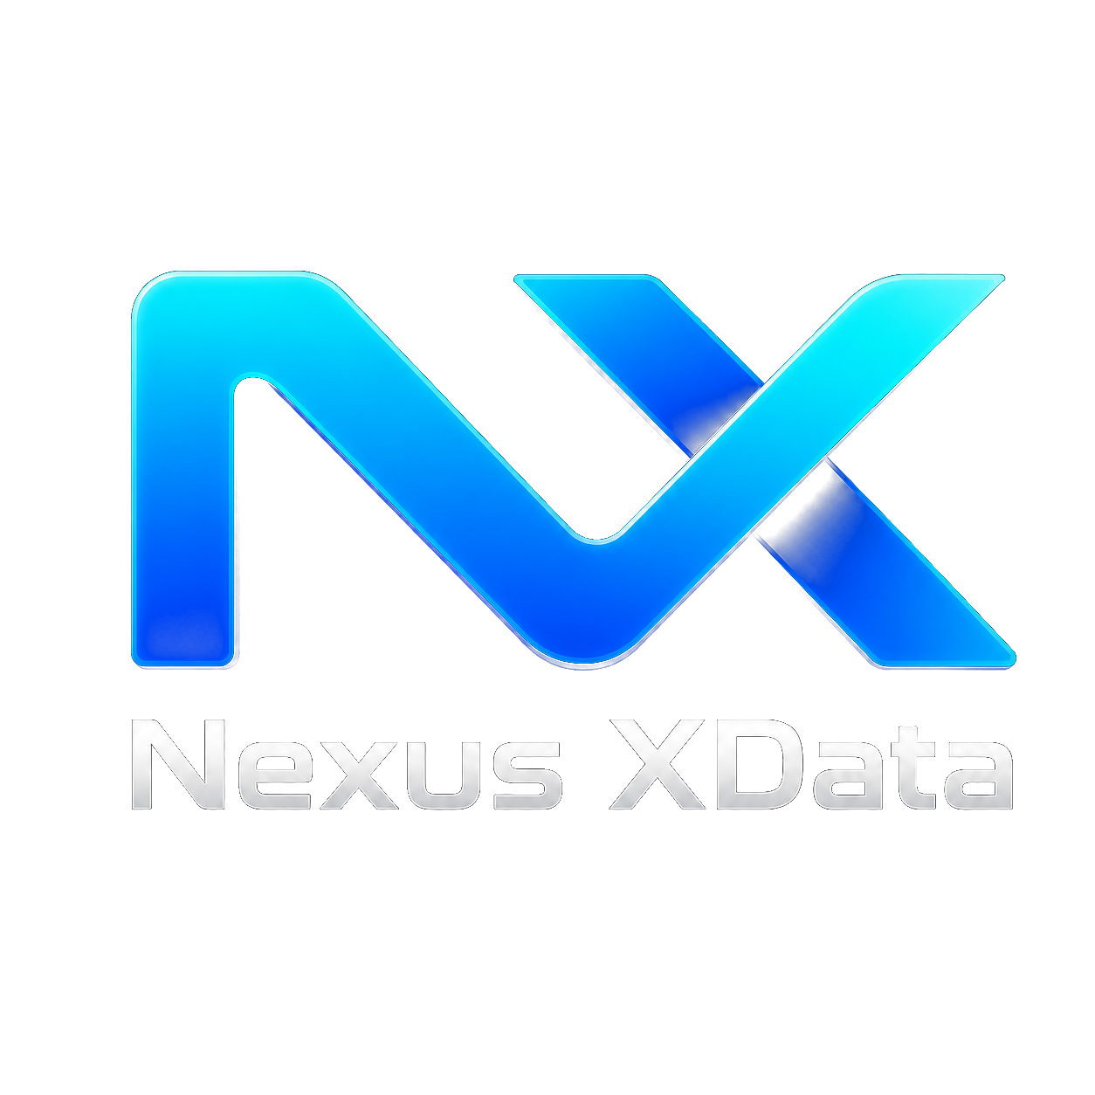
Turn your DevOps backlog into a manageable schedule.
NXProject connects management and development — with transparency, automation and traceability — without changing the technical process.
Request a demo
comercial.nexus.xdata@gmail.com • nexusxdata.com.br

