Slide 1
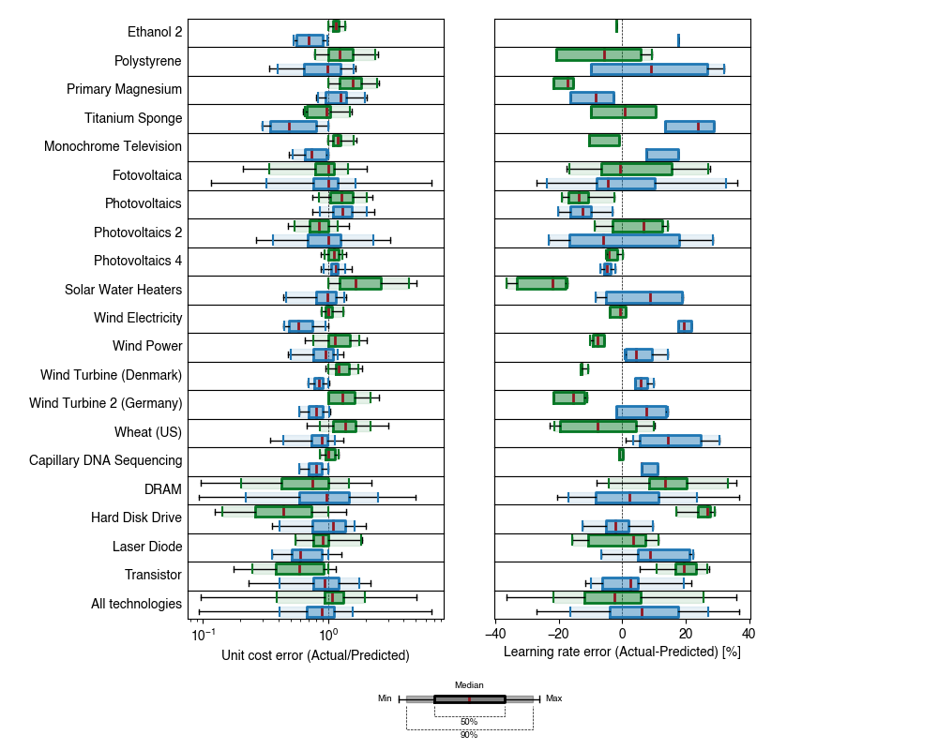
Chemicals
Consumer goods
Energy
Food
Genomics
Hardware

