Slide 1
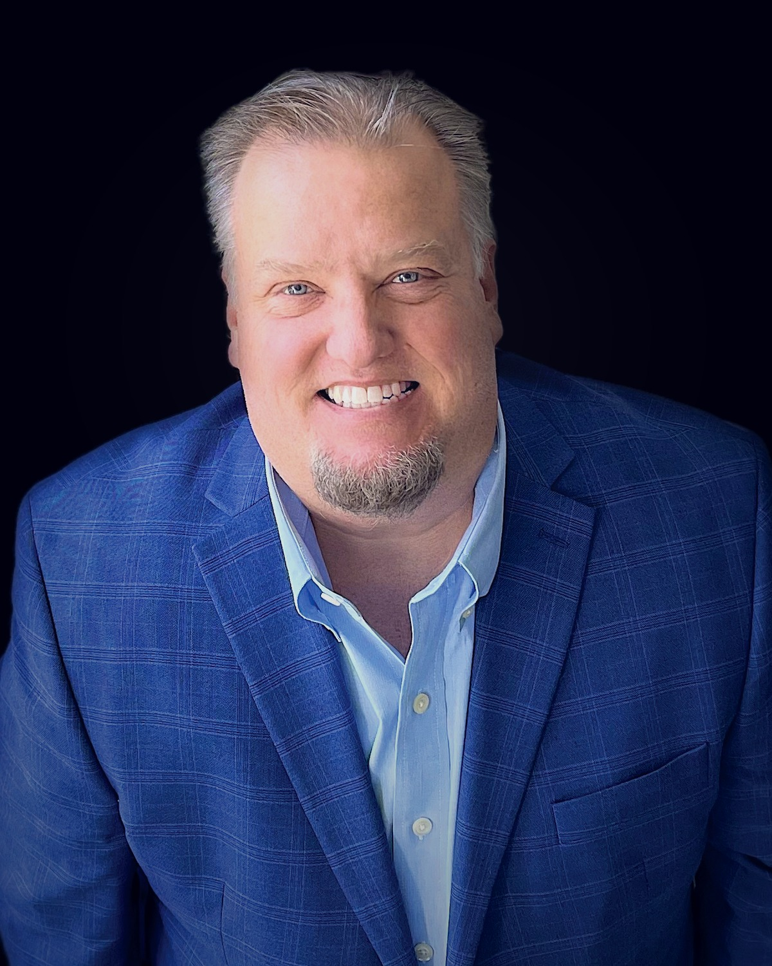
carney
.wiki
AI-Era Growth Proposal
A reusable client proposal and pitch narrative for technical B2B companies that need sharper positioning, stronger proof, and practical pipeline motion.
01
02
03
CLARIFY THE STORY
BUILD THE PROOF
MOVE THE MARKET
Proposal template | Prepared by Bill Carney
01

Slide 2
BUYER REALITY
The old funnel is too fragile for AI-era buying.
Buyers, committees, and AI systems compress weak positioning into generic summaries. The proposal has to show how the client becomes easier to understand, verify, and choose.
VAGUE STORY
Buyers cannot repeat why the company matters now.
MISSING PROOF
Claims do not connect to evidence, objections, or use cases.
STALLED MOTION
Campaigns and sales conversations do not create safer next steps.
carney.wiki | Strategy. Clarity. Results.
02

Slide 3
ENGAGEMENT FRAME
The work tightens three operating systems.
01
02
03
POSITIONING
PROOF OPS
PIPELINE MOTION
Turn technical capability into a buyer situation, category frame, and defensible value claim.
Map evidence to claims, buying stages, use cases, objections, and sales moments.
Convert story and proof into offer paths, campaigns, assets, and operating rhythms.
Each workstream produces reusable client artifacts, not abstract strategy theatre.
carney.wiki | Strategy. Clarity. Results.
03

Slide 4
PROOF SYSTEM
Proof should move like inventory, not decoration.
CLAIMS
EVIDENCE
PLACEMENT
USAGE
What we need buyers to believe
Customer, product, security, and implementation proof
Homepage, sales deck, trust center, campaigns
Which proof is reused in active deals
Proposal deliverable: proof inventory + proof matrix + placement plan
carney.wiki | Strategy. Clarity. Results.
04

Slide 5
GROWTH LOOP
The proposal turns the story into repeatable market motion.
CLARIFY
PACKAGE
ACTIVATE
LEARN
Buyer situation and differentiated claim
Proof and assets buyers can forward
Offers, campaigns, and sales enablement
Signals that refine proof and messaging
The final roadmap makes the loop operational: owner, cadence, asset backlog, and priority plays.
carney.wiki | Strategy. Clarity. Results.
05

Slide 6
TIMELINE
Six weeks is enough to move from diagnosis to operating rhythm.
WEEK 1
WEEKS 2-3
WEEKS 4-5
WEEK 6
Audit + context
Architecture
Build
Handoff
Current story, buyer friction, proof gaps
Positioning, claims, proof map
Assets, offers, campaign plays
30/60/90 roadmap and owner model
carney.wiki | Strategy. Clarity. Results.
06

Slide 7
COMMERCIAL OPTIONS
Choose the path that matches urgency and evidence gaps.
AUDIT
$5K
Fast diagnosis and priority fixes
PROOF OPS
$10K-$20K
Proof matrix, library, placement plan
CONTENT ENGINE
$5K/mo
Recurring POV, proof, and site improvements
Custom growth system scoped after diagnostic when the client needs broader GTM reset or implementation support.
carney.wiki | Strategy. Clarity. Results.
07

Slide 8
NEXT STEP
Start with the fastest path to clarity, then build from evidence.
carney.wiki
The proposal should make the buyer feel less risk, not more work. The next conversation confirms where clarity is missing, which proof matters, and which commercial path creates momentum soonest.
Ideas into impact.
Strategy. Clarity. Results.
1
Confirm client owner and decision date
Use this deck alongside the proposal document as the meeting narrative, then tailor client-specific proof, scope, and pricing before sending.
2
Share site, sales, proof, and performance materials
3
Schedule kickoff and diagnostic readout
carney.wiki | Strategy. Clarity. Results.
08

