Slide 1
Intro to Audio Engineering
Week 0 – Project Introduction

Slide 2
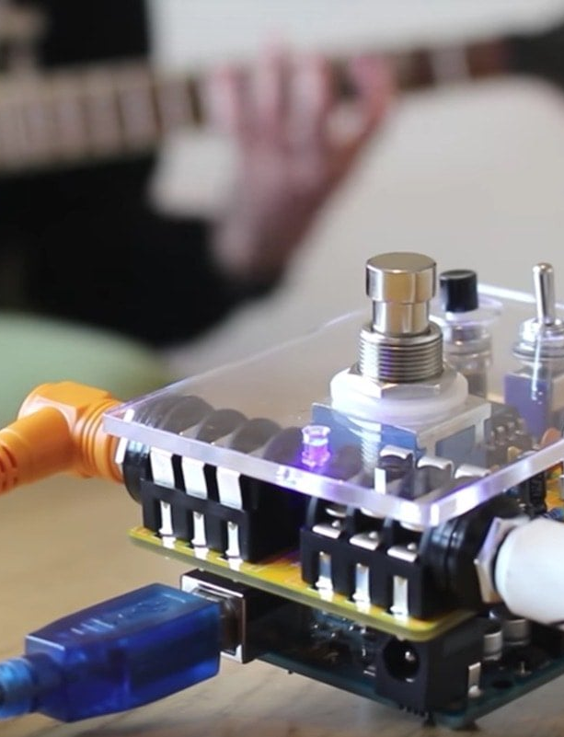
Guiding Questions
How to do “audio engineering”?
  How is the audio represented?
  How do we want it to come out?
  What tools do we use to do stuff to it?
Ways to engineer audio
  What are the types of changes we can make?
  What will it sound like when it has been changed?

Slide 3
Meeting Structure
Project Demo:
Show off what you made & how it was done
Presentation:
Introduce topics, example demos, overview of tutorial
Work Time:
Follow tutorial, implement your own stuff, (you can take home the hardware)
1
2
3

Slide 4
Software/Digital
Hardware/Analog
Breadboard
Oscilloscope
Digital to Analog Conversion
Filters
Amplifiers
Speakers
Arduino/C++
Time-Domain Effects
Frequency-Domain Effects
MIDI messaging

Slide 5
Final Project:
Audio Processing Device
Read audio data from SD card
Do digital processing on it
Do analog processing on it
Be able to explain what’s happening
You pick the digital effects
You pick the hardware controls
You can present at design day

Slide 6
Relevance to Club Projects

Slide 7
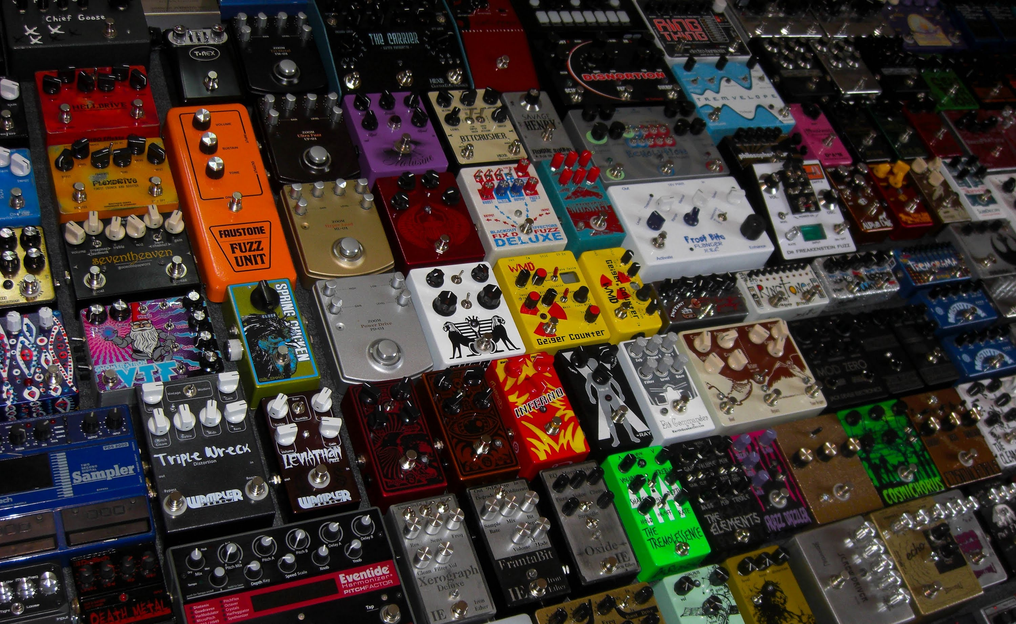
Guitar Pedals
Just a bunch of analog circuits
If we want out input signal to turn into a certain output signal, what types of filters do we implement?

Slide 8
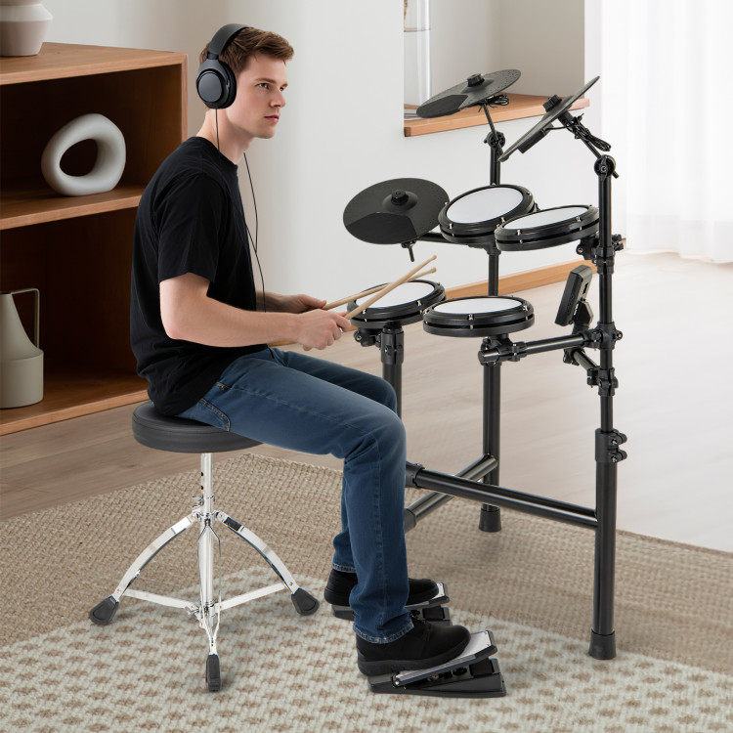
MIDI Drum Kit
What kind of sensors do we use to get the most relevant info?
How do we receive information from the drumpad sensors?
How do we translate that information into values that describe sound?
How do we send MIDI signals?

Slide 9
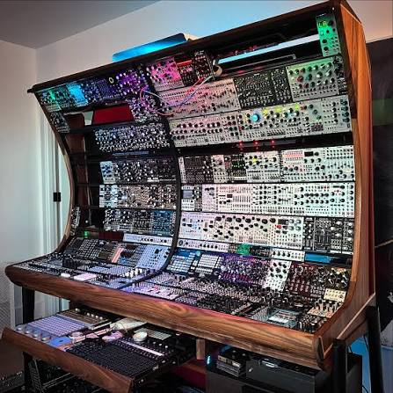
Modular Synthesizer
What kind of sounds are being synthesized?
What do we wanna do to it?
MIDI signal comes in → how to translate it into controls?
How does the analog circuitry receive control signals & change the waveform?
How does the circuit create waveforms to manipulate?
How to construct modules?

Slide 10
Project Timeline
Week 1 | Week 2 | Week 3 | Week 4
Microcontroller basics | Audio data formats | Time domain effects | Frequency domain effects
Buzzer synth | Music player | Speed control | Equalizer
Week 5 | Week 6 | Week 7 | Week 8
Digital-to-analog | Amplifiers | Analog Filters | D Day
RC DAC | Op-Amp circuit | Tone control | Your design!

Slide 11
Meeting Info
Tuesday 6-7pm room 2400 (unless general meeting, then we will do it after the general meeting or another week)
Email me at huang244@msu.edu

