Slide 1
Intro to Audio Engineering
Week 1 – Microcontrollers

Slide 2
Microcontrollers

Slide 3
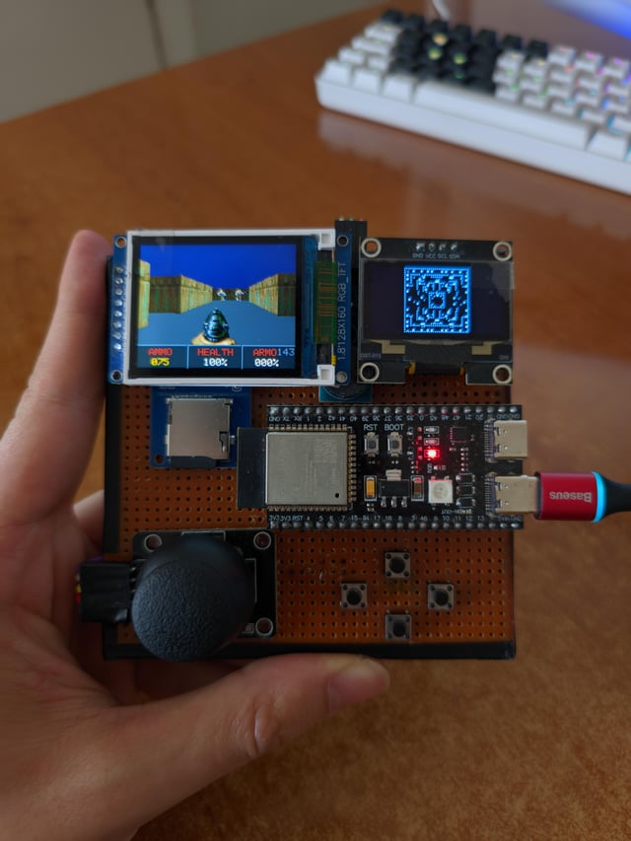
What is a Microcontroller?
A microcontroller is a programable computer which can interact with the outside world
Write code → flash it onto microcontroller → microprocessor on microcontroller executes instructions from code → interact with hardware connected to the microcontroller
Take in (software or hardware) inputs, translate into (software or hardware) outputs

Slide 4
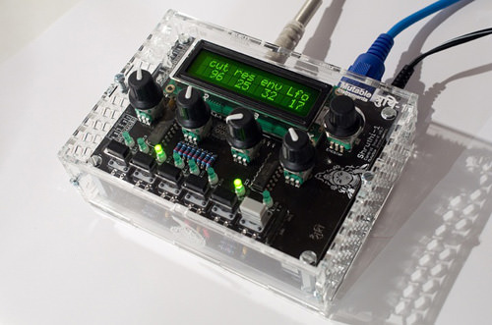
Example Usage: Digital Synthesizer
Inputs: buttons, knobs
Outputs: speakers, MIDI signals to computer
In between: detect hardware inputs, translate them into MIDI messages in software, produce sound using hardware.

Slide 5
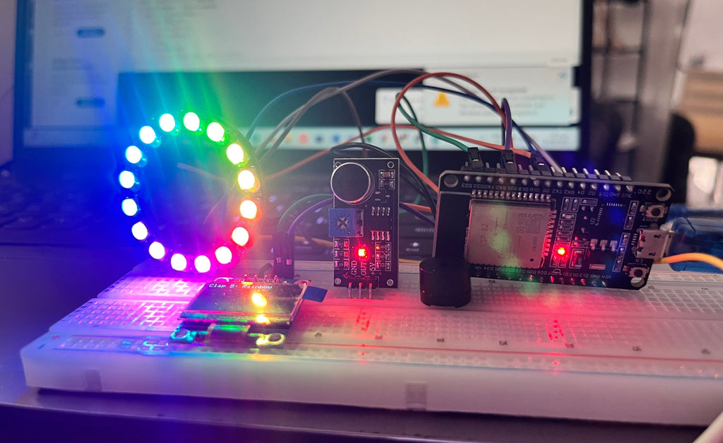
Example Usage: Sound Reactive LEDs
Inputs: microphone
Outputs: LEDs
In between: translate & interpret microphone data into audio features like volume, pitch, beat detection. Manipulate LED ring to respond to events.

Slide 6
Week 1 Project

Slide 7
Week 1 Project: LED & Buzzer Synth
Inputs: buttons
Outputs: LEDs, buzzer
In between: detect button press, decide which LED to turn on, decide which sound to play.

Slide 8
Project Modification Ideas
Add volume control buttons
Add shift pitch up/down buttons
Change the LED display to do something cool, add more LEDs

Slide 9
Software Basics

Slide 10
Variables
Declaration & Assignment: [variable type] [variable name] = [variable value];
Declaration: [variable type] [variable name];
Assignment: [variable name] = [variable value];

Slide 11
Loops
while(condition; con

Slide 12
Conditionals

Slide 13
Functions

Slide 14
Libraries

Slide 15
Header & Implementation Files

Slide 16
Hardware Basics

Slide 17
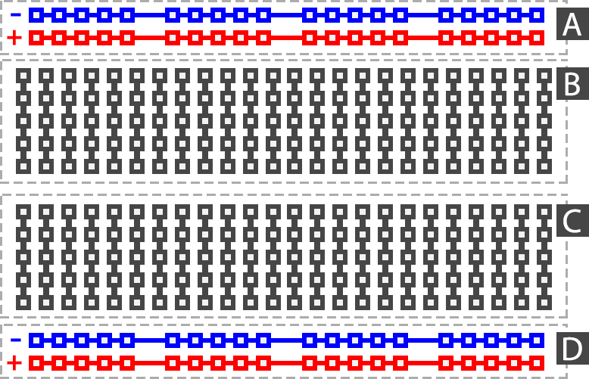
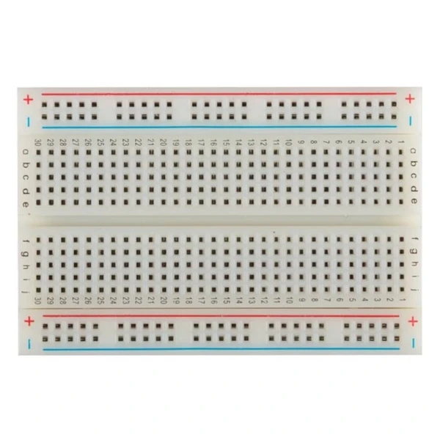
Breadboard Layout

Slide 18
Ground & Power Rails

Slide 19
Arduino Basics

Slide 20
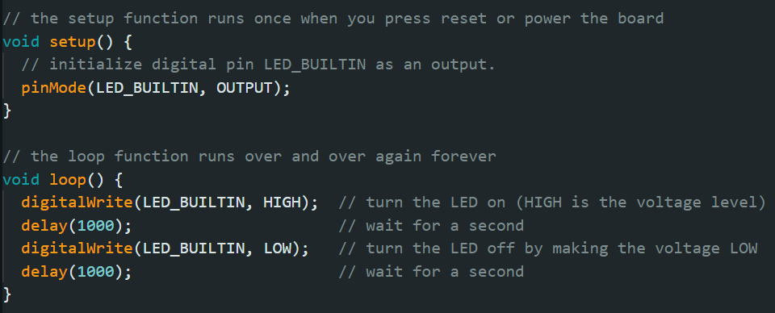
Blink.ino Walkthrough

Slide 21
Serial Monitor
Serial.begin(<baudrate>); ← this goes in the setup function
Serial.print(“hello”); ← print text
Serial.println(“hello”): ← print new line
Tools → Serial Monitor to view output

Slide 22
Input Pins

Slide 23
Outputs

Slide 24
Example: Button Input

Slide 25
Outputs

Slide 26
Example: LED Output

Slide 27
Outputs

