Slide 1


SILVERLINEAD.COM ↗
COMPANY PROFILE
SILVERLINE
ADVERTISING LLC
Designed to craft your presence.
BRANDING SOLUTIONS | PROMOTIONAL STANDS | BANNERS | SIGNAGE
DUBAI, UAE

Slide 2

02 / 07
ABOUT US
YOUR VISION REDEFINED
Silverline Advertising LLC is a UAE-based branding solutions company. Our in-house design team, production and global supplier network cover signage, promotional and exhibition stands, banners, branding installations, promotional items and print, so you brief one partner instead of five.
We turn your brand vision into tangible, high-impact presence that people see, touch and remember, delivered to the right place at the right time.
01 VISION
02 CRAFT
03 IMPACT
04 PRECISION
BRANDING SOLUTIONS | PROMOTIONAL STANDS | BANNERS | SIGNAGE
SILVERLINEAD.COM

Slide 3









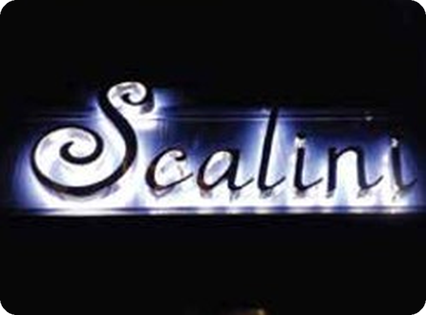
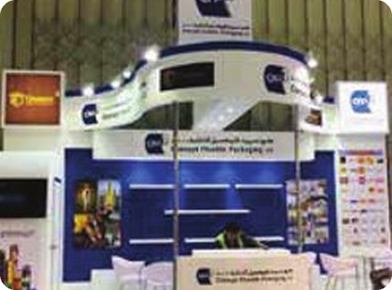
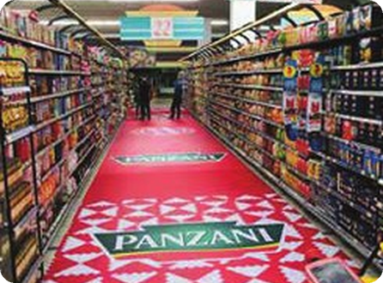

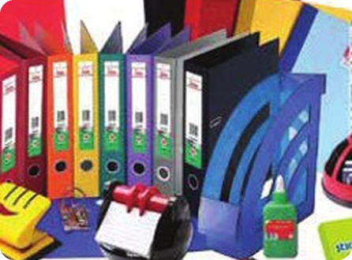
03 / 07
MAKE YOUR BRAND UNMISSABLE
BRANDING SOLUTIONS
Signage
Directional, informational and brand signage that communicates clearly and complements your space.
Promotional Stands
Eye-catching stands designed to stop foot traffic and drive engagement at events, expos and activations.
Exhibition Displays
Complete booth systems and bespoke installations that showcase your brand at trade shows and exhibitions.
Branding Installations
Custom environmental branding that transforms interiors and exteriors into brand experiences.
/01
/02
/03
/04
Retail Displays
Point-of-sale fixtures and product displays that enhance the shopping experience and drive sales.
Promotions & Gifts
Branded merchandise, promotional items and gifts that extend your brand presence beyond the display.
Design & Print
End-to-end design and large-format printing services for all your branding and promotional needs.
Banners & Large Format
High-impact printed graphics and banners tailored to your campaign. Indoor and outdoor options.
/05
/06
/07
/08
BRANDING SOLUTIONS | PROMOTIONAL STANDS | BANNERS | SIGNAGE
SILVERLINEAD.COM

Slide 4
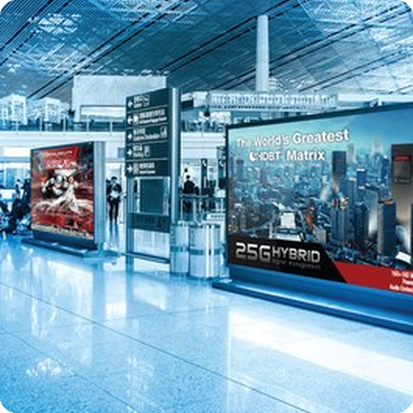
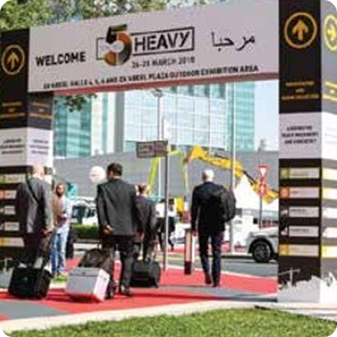
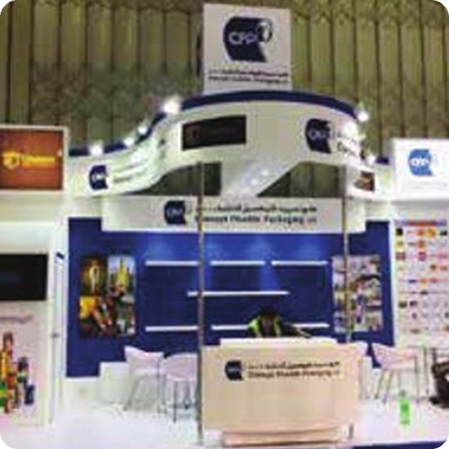
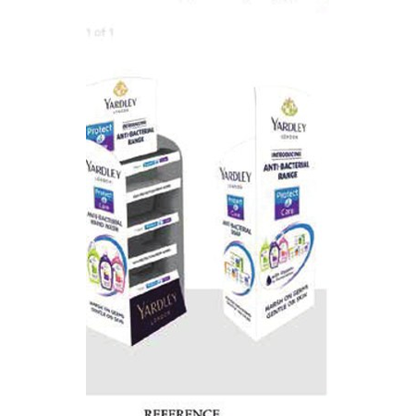
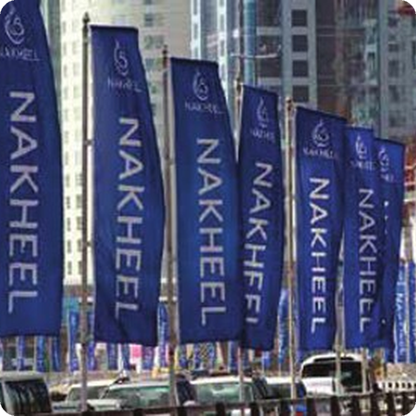
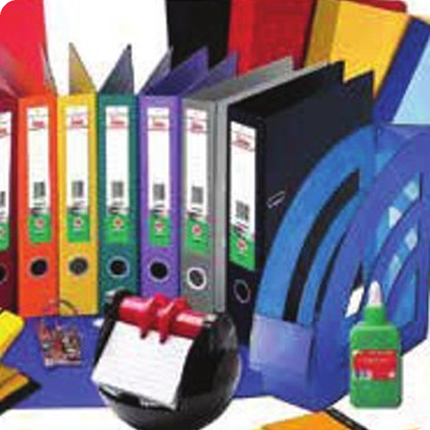
04 / 07
SELECTED WORK
FEATURED PROJECTS
INDOOR SIGNAGE
OUTDOOR SIGNAGE
EXHIBITION STANDS
RETAIL & CORPORATE BRANDING
PROMOTIONS & GIFTS
DESIGN & PRINT
BRANDING SOLUTIONS | PROMOTIONAL STANDS | BANNERS | SIGNAGE
SILVERLINEAD.COM

Slide 5




05 / 07
HOW WE WORK
FROM BRIEF TO BRAND
PRESENCE IN FOUR STEPS.
STEP 1
STEP 2
STEP 3
STEP 4
BRIEF
DESIGN
PRODUCE
DELIVER & INSTALL
We listen first: your goals, your space, your timeline and your budget.
Our in-house design team turns your vision into visuals you can review and approve.
Produced to the approved design through our production and global supplier network, checked before it ships.
Delivered and installed on site through our supply and distribution network.
BRANDING SOLUTIONS | PROMOTIONAL STANDS | BANNERS | SIGNAGE
SILVERLINEAD.COM

Slide 6




06 / 07
WHY SILVERLINE
ONE PARTNER.
From the first brief to final installation, Silverline manages every stage of your brand presence, so you get one point of contact, one consistent look and one timeline instead of coordinating five suppliers.
ONE PARTNER, ONE BRIEF
DESIGN IN-HOUSE
Signage, stands, banners, branding, gifts and print from a single partner.
Our in-house design team turns your ideas into visuals, then into finished brand presence.
UAE-based team with in-house design and production
Custom to your space, brief and budget
Checked before it ships, installed on site
TELL US WHERE YOUR BRAND NEEDS TO BE.
GLOBAL SUPPLIER NETWORK
RIGHT PLACE, RIGHT TIME
Promotional items sourced through our established supplier network.
A dedicated supply and distribution network keeps projects on schedule.
LET'S CONNECT ↗
BRANDING SOLUTIONS | PROMOTIONAL STANDS | BANNERS | SIGNAGE
SILVERLINEAD.COM

Slide 7



07 / 07
GET IN TOUCH
PHONE
+971 52 259 6385
LET'S MAKE YOUR
BRAND UNMISSABLE.
EMAIL
info@silverlinead.com
WEBSITE
Send us a brief and we'll come back with ideas and a quote.
www.silverlinead.com
OFFICE
Dubai, United Arab Emirates
Silverline Advertising LLC
BRANDING SOLUTIONS | PROMOTIONAL STANDS | BANNERS | SIGNAGE
SILVERLINEAD.COM

