Slide 1
Text Processing and REGEX
Python and Regex

Slide 2
Import and compile
First, import the library re
Compile
The purpose of the compile method is to compile the regex pattern which will be used for matching later. It's advisable to compile regex when it'll be used several times in your program. Resaving the resulting regular expression object for reuse, which re.compile does, is more efficient.
pattern = re.compile(r"")

Slide 3
Special Sequences
They are simply a sequence of characters that have a backslash \ character. For instance, \d is a match for one digit [0-9] \w is a match for one alphanumeric character. This means any ASCII character that's either a letter or a number [a-z A-Z 0-9]

Slide 4
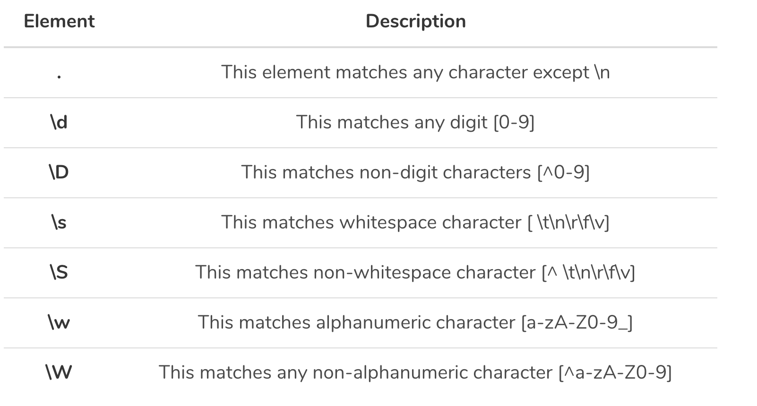
Special Sequences
Points to note:
[0-9] is the same as [0123456789]
\d is short for [0-9]
\w is short for [a-zA-Z0-9]
[7-9] is the same as [789]

Slide 5
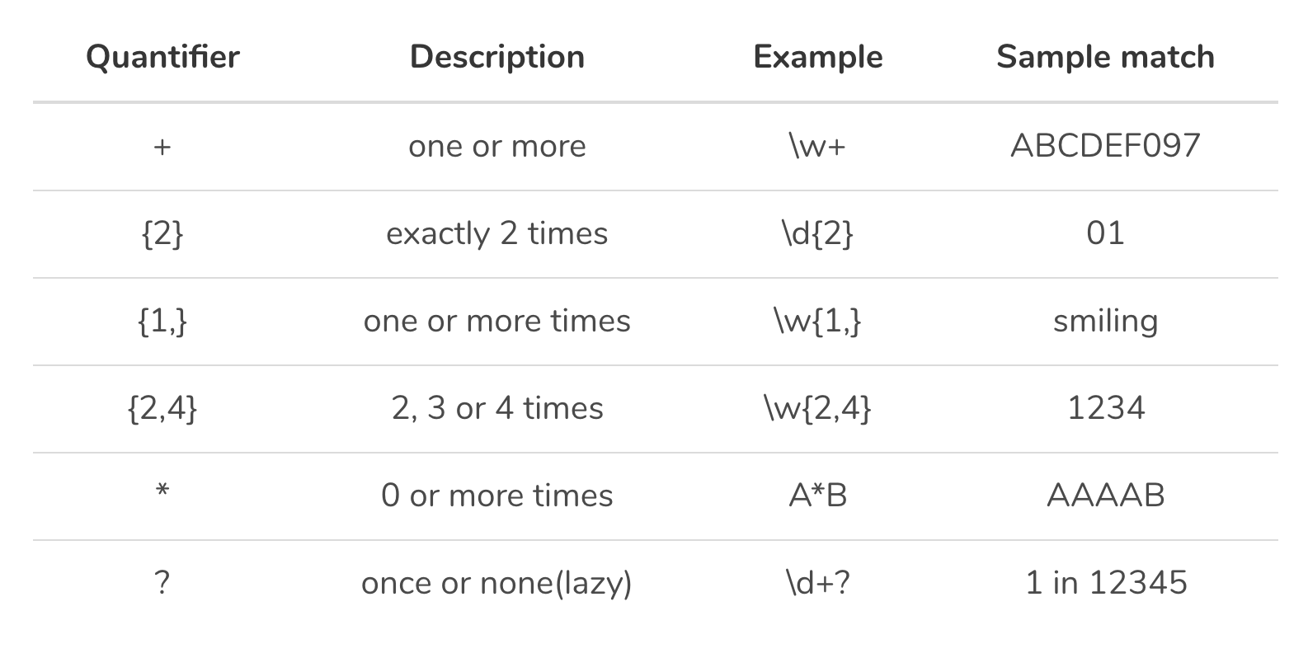
Quantifiers
Quantifiers simply specify the quantity of characters to match.

Slide 6
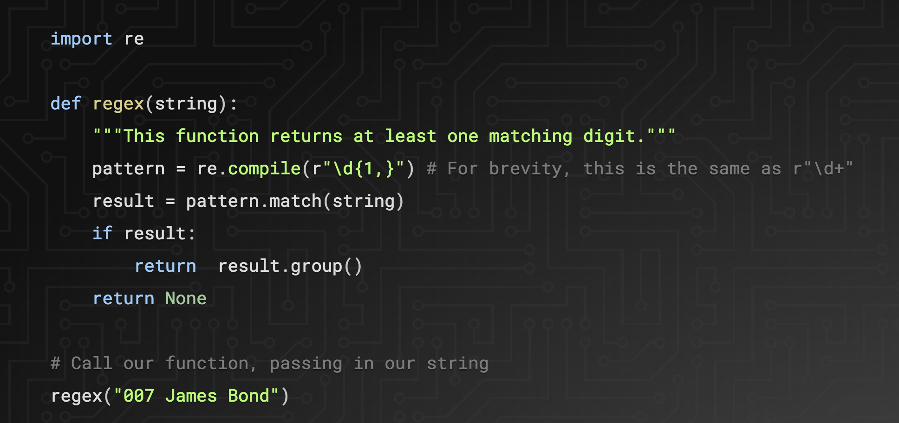
Example
Output:
007

Slide 7
What are ^ and $ ?
These are the boundaries or anchors
^ marks the start, while $ marks the end of a regular expression.

Slide 8
Matching vs Searching
Matching only check for matches at the beginning of a string
Searching checks the entire string

Slide 9
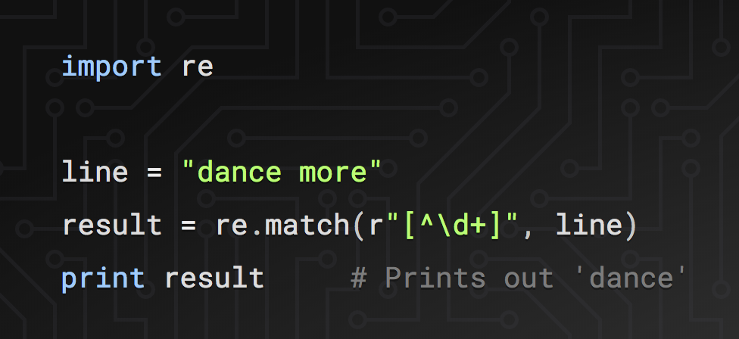
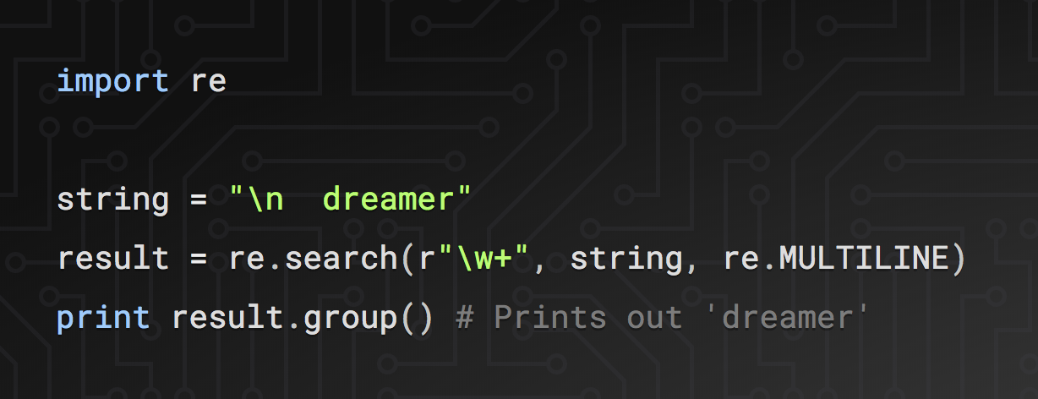
Matching vs Searching
Note: no compile because only used once.
re.MULTILINE simply tells our method to search on multiple lines that have been separated by the new line space character if any.

Slide 10
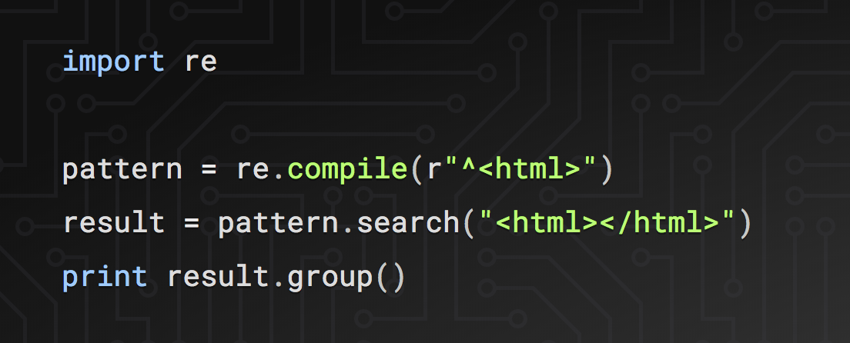
What will this print?

Slide 11
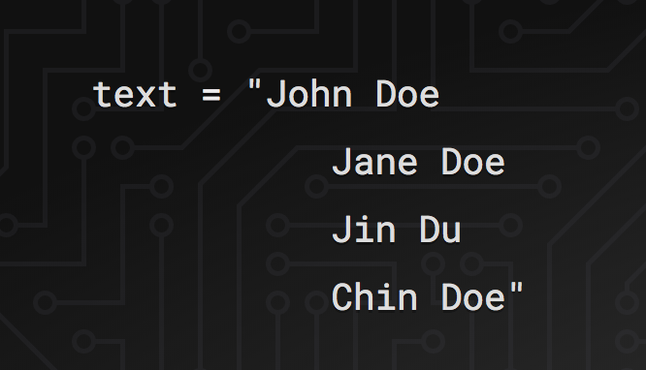
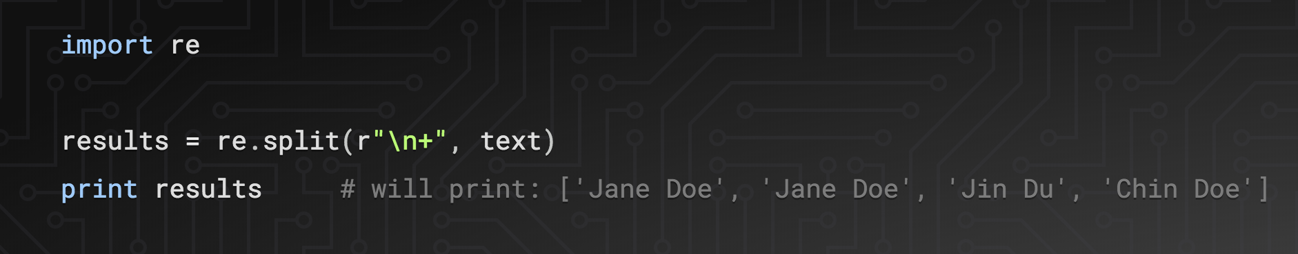
Splitting
re.split() splits a string into a list delimited by the passed pattern. For example, consider having names read from a file that we want to put in an list:

Slide 12
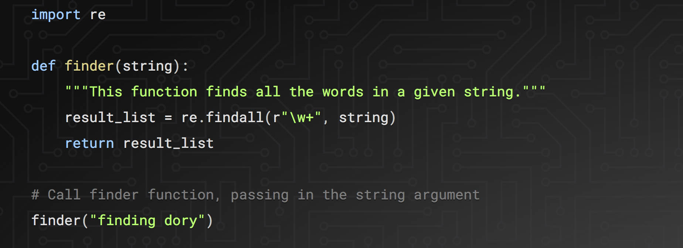
Find All
['finding', 'dory']
re.findall() finds all the matches of all occurrences of a pattern, not just the first one as re.search() does. Unlike search which returns a match object, findall returns a list of matches.

Slide 13
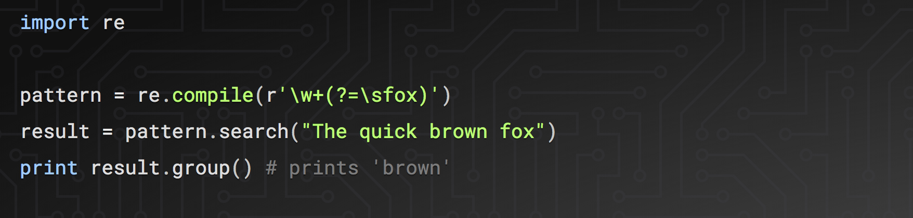
Look Ahead
(?=)
This syntax is defines a look ahead. Instead of matching from the start of the string, match an entity that's followed by the pattern. For instance, r"a (?=b)" will return a match a only if it's followed by b.

Slide 14
Other tools
.replace('"', '')
.split(’.')
[“left of the dot”, “right of the “]
“steventking.com”.split(‘.’)
[“steventking”, “com”]
.join()
commas = ','.join(colonized)

Slide 15
Example
["{ type: 'stats', rp_id: 9450, path: 'baseball', year: 2017, player_id: 3759 }", "{ type: 'related', rp_id: 9450, player_id: 3759 }"]
["{ type: 'stats', rp_id: 9450, path: 'baseball', year: 2017, player_id: 3759 }", "{ type: 'related', rp_id: 9450, player_id: 3759 }"]
[{'path': 'baseball', 'player_id': '3759', 'rp_id': '9450', 'type': 'stats', 'year': '2017'}]

Slide 16
Search It, write it, test it.
https://regex101.com/

