Slide 1
NumPy + Pandas
Python Data Processing

Slide 2
Python
db
data
Pandas
Web Data
viz
or
json
NumPy

Slide 3
Backup: Python Variables
In Python, variables are like labels of values rather than containers waiting to hold data.
Therefore:
You can have more than one name pointing to the same object.
In MOST cases, this is very efficient and fast.
But this might not be as efficient when dealing with huge numbers.

Slide 4
What is NumPy
NumPy is the fundamental package for scientific computing in Python. It is a Python library that provides a multidimensional array object, various derived objects (such as masked arrays and matrices), and an assortment of routines for fast operations on arrays, including mathematical, logical, shape manipulation, sorting, selecting, I/O, discrete Fourier transforms, basic linear algebra, basic statistical operations, random simulation and much more.

Slide 5
What is Pandas
pandas is a Python package providing fast, flexible, and expressive data structures designed to make working with “relational” or “labeled” data both easy and intuitive. It aims to be the fundamental high-level building block for doing practical, real world data analysis in Python. Additionally, it is becoming the most powerful and flexible open source data analysis / manipulation tool available in any language.
NOTE: Pandas leverages NumPy
“It’s the user-friendly API for NumPy”

Slide 6
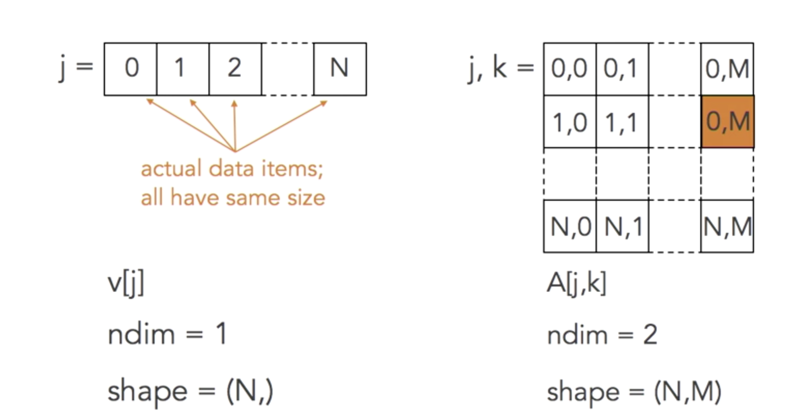
NumPy Array
You might want to reserve a space in memory and lay down all those values side-by-side

