Slide 1
NumPy + Pandas
Python Data Processing

Slide 2
Python
db
data
Pandas
Web Data
viz
or
json
NumPy

Slide 3
Backup: Python Variables
In Python, variables are like labels of values rather than containers waiting to hold data.
Therefore:
You can have more than one name pointing to the same object.
In MOST cases, this is very efficient and fast.
But this might not be as efficient when dealing with huge numbers.

Slide 4
What is NumPy
NumPy is the fundamental package for scientific computing in Python. It is a Python library that provides a multidimensional array object, various derived objects (such as masked arrays and matrices), and an assortment of routines for fast operations on arrays, including mathematical, logical, shape manipulation, sorting, selecting, I/O, discrete Fourier transforms, basic linear algebra, basic statistical operations, random simulation and much more.

Slide 5
What is Pandas
pandas is a Python package providing fast, flexible, and expressive data structures designed to make working with “relational” or “labeled” data both easy and intuitive. It aims to be the fundamental high-level building block for doing practical, real world data analysis in Python. Additionally, it is becoming the most powerful and flexible open source data analysis / manipulation tool available in any language.
NOTE: Pandas leverages NumPy
“It’s the user-friendly API for NumPy”

Slide 6
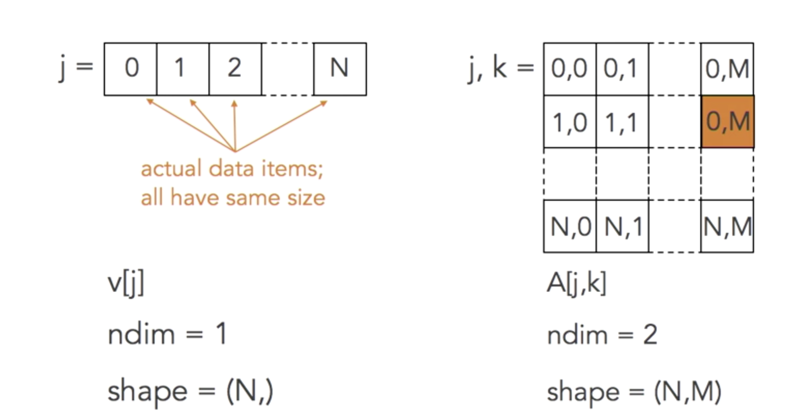
NumPy Array
You might want to reserve a space in memory and lay down all those values side-by-side

Slide 7
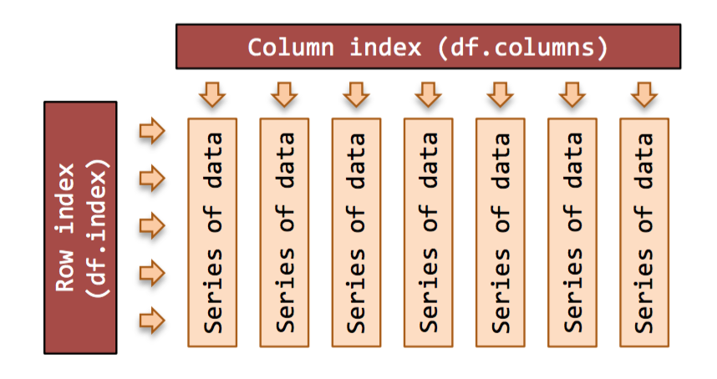
Storage/Index in NumPy/pandas

Slide 8
NumPy
Fast Math
Advanced Math
Great for SciPy

Slide 9
Pandas
Easy way to use most functions of NumPy
Great for getting overviews of data
Great for cleaning the data

Slide 10
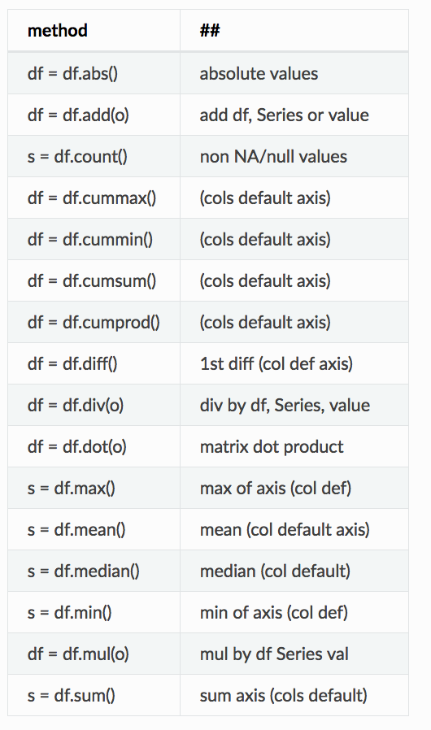
Comon Math functions

Slide 11
How many ways can you write UNC?

Slide 12
How many ways can you write UNC?
UNC
UNC Chapel Hill
UNC-CH
UNCCH
The University of North Carolina at Chapel Hill
The University of North Carolina Chapel Hill
North Carolina
N. Carolina
Carolina
N.C.
NC
North Carolina Chapel Hill
North Carolina Tarheels
North Carolina Tar Heels
I got 14

Slide 13
Common Panda Concepts
dataFrame
Data Structure
Series
passing a list of values, letting pandas create a default integer index
dtype
Data type

Slide 14
Pandas Info and Helpful functions
df.describe()
Get info
df.head()
First 5
df.tail()
Last 5
Df.tail(23)
Last 23
df.index()
df.T
Transpose data (switch columns and rows)

Slide 15
Pandas Selection
df.sort_values(by='B')
Sorting by columns
df[‘column’]
Select a single column
Df.loc[lablename[0]]

