Slide 1
Continued Improvement on the Contactor Line
100-c contactor built in Switzerland plant
Partially automated process
MKE showcase project initiated
Design & virtual commissioning with E3D
Fully automated line launched
Footprint optimization
MES integrated with controls
70% labor reduction
Digital foundation: IIoT data integration
Smart objects
FT Edge Gateway
ThingWorx
FT View Heat Map
Digital evolution: Preventive maintenance & spare parts management
Fiix CMMS deployed
Digital evolution: OEE Monitoring
Enhanced smart objects
Detailed fault/OEE reporting
Improvement actions driven by insights
Digital evolution: OEE Proactive Optimization
DataMosaix Energy Manager
Feeder monitoring
Vision AI deployment
Digital evolution: ?
Scaling Vision AI
DataMosaix advanced analytics and agentic AI
What’s next
2025
2023-24
2022
2021
2020
2019
2018
Notes:
Alternative timeline: Contactor Line Evolution Timeline

Slide 2


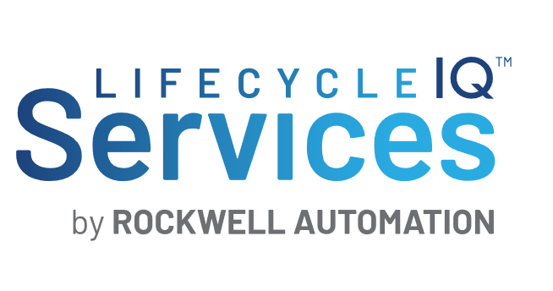
OUR VISION・LIFECYCLE SERVICES
Transforming How Work is Done
We are the industry’s trusted advisor in creating the future of industrial operations,
simplifying the way products are brought to life by transforming how work is done.
Through co-innovation, we solve our customers’ most difficult challenges
and speed their time to value.
Innovate
Design
Maintain
Operate
Consulting | Design & Engineering | Development | Deployment | Integration | Onsite Support | Remote Support | Monitoring & Management
Notes:
Presentation Map Slide Name - LCS Vision
While many companies have initiatives to achieve their outcomes, they also struggle with having the right experience and expertise to see them through or scale them appropriately. That’s where a partner like Lifecycle Services can help you take the right approach.
Our vision is to be the industry’s trusted advisor in creating the future of industrial operations, simplifying the way products are brought to life by transforming how work is done.
Through co-innovation, we solve your most difficult challenges and speed time to value.
Presentation Map Slide Name - LCS Logo Slide
Our full suite of services transforms how work is done across the manufacturing lifecycle with:
Professional services (project based) and include consulting, design and engineering, development, deployment and integration.
Managed and support services (contract based) and include onsite and field support, remote support, and monitoring and management.
Our flexible, scalable approach meets you where you are to innovate, design, operate, and maintain solutions that deliver rapid value and ROI. This looks like:
Innovating to improve outcomes and create new value streams
Designing integrated, intelligent, scalable and secure solutions
Implementing, operating and scaling solutions that speed time to value
Maintaining and optimizing performance for continuous improvement
We begin every engagement with the outcome in mind, bringing together the people, processes and technology required to achieve it.

Slide 3
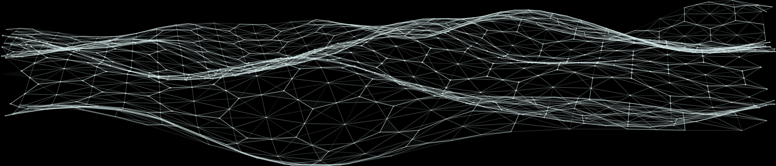

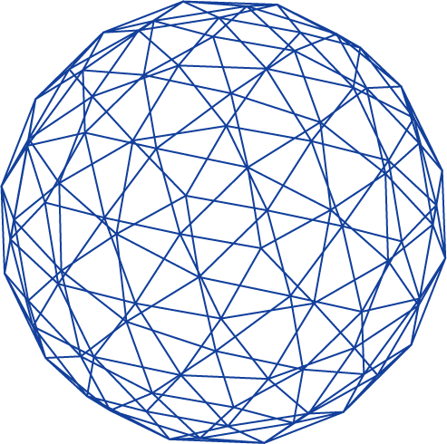
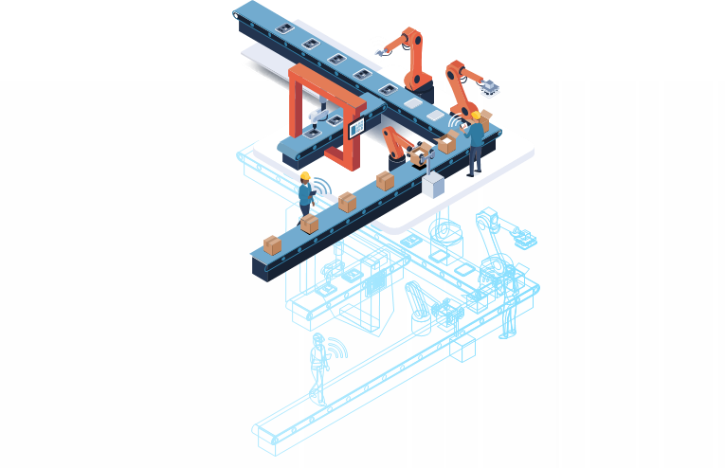




Digital can unite data from disparate systems, put it in the right context, and use it to generate insight that drives optimal decisions and actions.
This is powerful – transforming value chain operations, from what products are made to how they come to life – but difficult to achieve.
DISCOVER
CREATE
MAKE
SELL
OBSERVE
INFER
DECIDE
ACT
Digital thread throughout the business (IT) and (OT) sides of the enterprise increases connectivity and enables information and data to flow freely across the value chain.
Autonomous operations through AI and machine learning enable systems to operate independently and improve themselves continuously.
Notes:
The value of
Digital is that it can unite data from disparate systems across business and operational systems - so, across IT and OT technologies, put it in the right context, and use it to generate insights that drive optimal decisions and actions.
This is powerful as it transforms value chain operations, from decisions on what products to make to how they come to life and knowing real-time how production aligns to demand, forecast and customer expectations – but difficult to achieve.
----------------------------------------------------------------------
Digital thread is not a new concept but the technologies to enable it are more powerful and continue to evolve to where it’s easier to enable it.
Achieving autonomy is more attainable than ever due to the rapidly evolving and widely available AI and machine learning capabilities.

Slide 4

The Lifecycle Services Difference
1
2
3
4
Consultative
approach
Manufacturing
value chain expertise
IT/OT
integration
Scalable
innovation
Enabled by 7,000+ experts and innovators around the world
24
Discrete, hybrid and process industries
Supporting
Rockwell Automation
and third-party
platforms
100+
countries
24x7x365
Support Centers
Notes:
Presentation Map Slide Name – LCS Difference
What makes Lifecycle Services qualified to be your trusted advisor is more than just our size and scale – it’s:
A consultative approach to truly understand your challenges, meet you where you are, and put our collective expertise to work to achieve your business outcomes. We call this the Lifecycle Value Promise
Manufacturing value chain expertise in all aspects of the manufacturing process, including design, engineering, value chain, production and logistics, to fundamentally change how your products are brought to life
IT/OT integration into a single, unified, converged architecture, navigating a complex multi-vendor landscape to create data with context
Innovation in a scalable, repeatable way that delivers value quickly – not just for one customer, but to pull the entire industry forward
All of this is enabled by 7,000 Lifecycle Services experts and innovators in over 100 countries with deep industry and domain expertise. We serve clients and customers onsite as well as through our 19 state-of-the art remote support centers, in any industry, and on Rockwell Automation and third-party platforms.

Slide 5
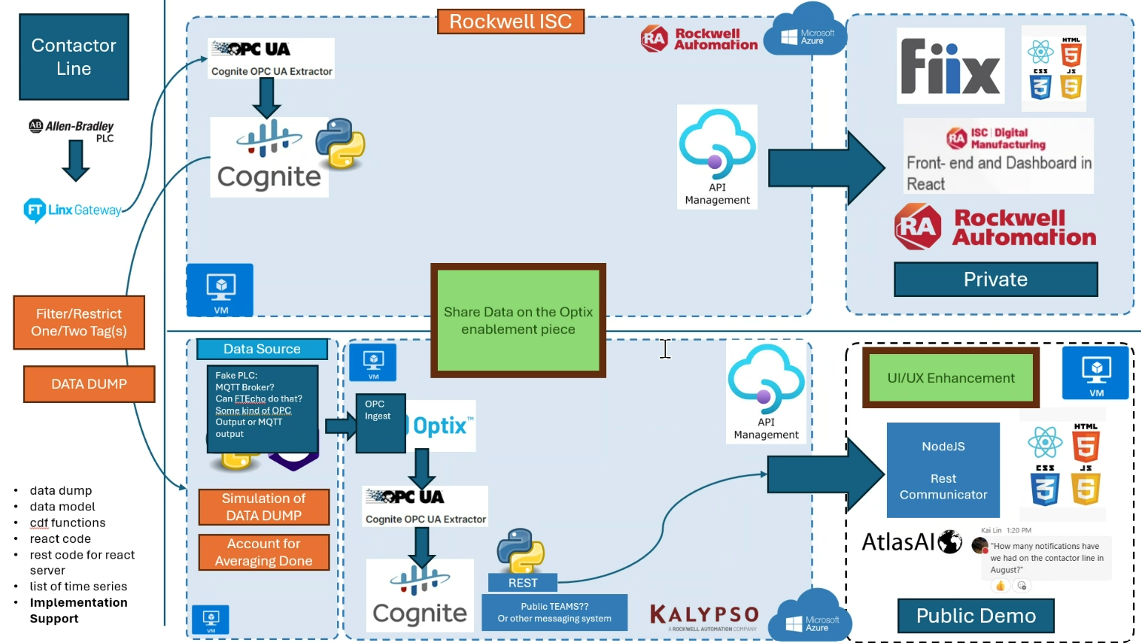
Reference Architecture

Slide 6
Continued Improvement on the Contactor Line
100-c contactor built in Switzerland plant
Partially automated process
MKE showcase project initiated
Design & virtual commissioning with E3D
Fully automated line launched
Footprint optimization
MES integrated with controls
70% labor reduction
Digital foundation: IIoT data integration
Smart objects
FT Edge Gateway
ThingWorx
FT View Heat Map
Digital evolution: Preventive maintenance & spare parts management
Fiix CMMS deployed
Digital evolution: OEE Monitoring
Enhanced smart objects
Detailed fault/OEE reporting
Improvement actions driven by insights
Digital evolution: OEE Proactive Optimization
DataMosaix Energy Manager
Feeder monitoring
Vision AI deployment
Digital evolution: ?
Scaling Vision AI
DataMosaix advanced analytics and agentic AI

Slide 7
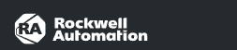

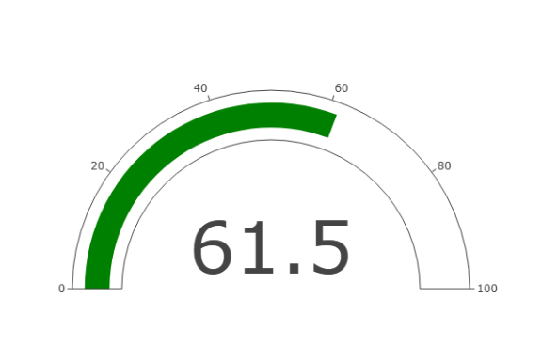
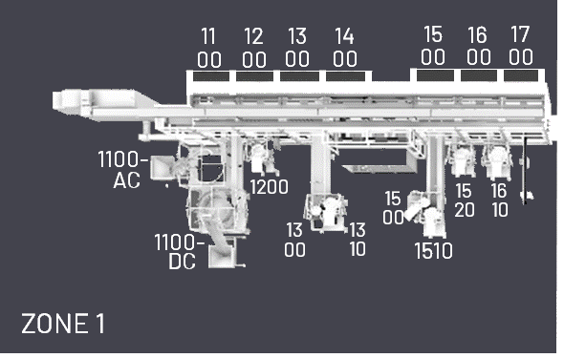




OEE FOR LINE
OEE FOR ZONE
Line: 100C
Last Update: DATE
Zone: 1
Base Assm
Last Update: DATE
Availability | 99.2%
Quality | 100%
Performance | 70.0%
Availability | 99.2%
Quality | 100%
Performance | 70.0%
Station: 1100
Last Update:
Nov 17, 2025 06:00:20
Station: 1100 AC
Last Update:
Nov 17, 2025 06:00:20
Station: 1100 DC
Last Update:
Nov 17, 2025 06:00:20
Availability | 99.2%
Quality | 100%
Performance | 70.0%
Availability | 99.2%
Quality | 100%
Performance | 70.0%
Availability | 99.2%
Quality | 100%
Performance | 70.0%
Station: 1200
Last Update:
Nov 17, 2025 06:00:20
Station: 1300
Last Update:
Nov 17, 2025 06:00:20
Station: 1400
Last Update:
Nov 17, 2025 06:00:20
Availability | 99.2%
Quality | 100%
Performance | 70.0%
Availability | 99.2%
Quality | 100%
Performance | 70.0%
Availability | 99.2%
Quality | 100%
Performance | 70.0%
Station: 1500
Last Update:
Nov 17, 2025 06:00:20
Station: 1600
Last Update:
Nov 17, 2025 06:00:20
Station: 1700
Last Update:
Nov 17, 2025 06:00:20
Availability | 99.2%
Quality | 100%
Performance | 70.0%
Availability | 99.2%
Quality | 100%
Performance | 70.0%
Availability | 99.2%
Quality | 100%
Performance | 70.0%

Slide 8
Create What’s Next on the Contactor Line
Turning data into action to unlock actionable insights that improve OEE and accelerate innovation.
After achieving flexible automated manufacturing for multiple contactor deviations, the team invested in a program to advance digital capabilities and boldly create what’s next.
Program combines functional and operational excellence with digital solutions like station- and role-based production monitoring dashboards
STEP 1:
STEP 2:
STEP 3:
STEP 4:
Enable data at the edge – capturing critical production insights in real-time
Aggregate and contextualize OT + IT data – enhancing user experience and proactively suggesting insights with GenAI
Turn data into action with station-based dashboards – e.g., engineers resolve feeder maintenance proactively with Fiix CMMS instead of over-maintaining
Monitor and improve OEE holistically – dashboards + Digital Twin simulations + AI/ML enable proactive decisions; virtual-first testing allows faster PLC code deployment from E3D to the line
Notes:
Narrative:
Intro
After achieving flexible automated manufacturing for multiple contactor deviations, leadership made strategic investments to evolve digital capabilities and create what’s next. This vision turned the contactor line into a showcase for innovation – demonstrating how data, advanced technology, and operational excellence can transform performance and unlock sustainable growth.
Transformation
By converging IT and OT and applying Industrial AI (digital twins, generative AI and more), the team enabled data from the edge and across the value chain to power actionable insights that improve OEE, accelerate innovation, and give engineers the tools to make smarter, faster decisions. From predictive maintenance to virtual commissioning, station-based dashboards, and AI-enabled simulations, the contactor line demonstrates how turning data into action delivers measurable results today while building resilience for tomorrow.
Timeline Callout
This journey has unfolded year by year, starting with partial automation in 2018 and evolving into a fully digitalized line with MES, IIoT, Fiix CMMS, and now AI-driven optimization. Today, we continue to advance the contactor line with Vision AI, DataMosaix, and agentic AI – showcasing how strategic investment and innovation
continually prepare the business to create what’s next.

Slide 9

DIGITAL EVOLUTION
What’s next
2025
DIGITAL FOUNDATION
2023 - 2024
NAME?
Scaling Vision AI
DataMosaix advanced analytics and agentic AI
2021 - 2022
OEE Proactive Optimization
Feeder monitoring
Vision AI deployment
2019 - 2020
OEE Monitoring
Enhanced smart objects
Detailed fault/OEE reporting
Improvement actions driven by insights
2018
Smart objects
FT Edge Gateway
ThingWorx
FT View Heat Map
Preventive maintenance & spare parts management
Fiix CMMS deployed
MKE showcase project initiated
Design & virtual commissioning with E3D
Fully automated line launched
Footprint optimization
MES integrated with controls
70% labor reduction
100-c contactor built in Switzerland plant
Partially automated process
Notes:
Alternative timeline: Contactor Line Evolution Timeline

Slide 10
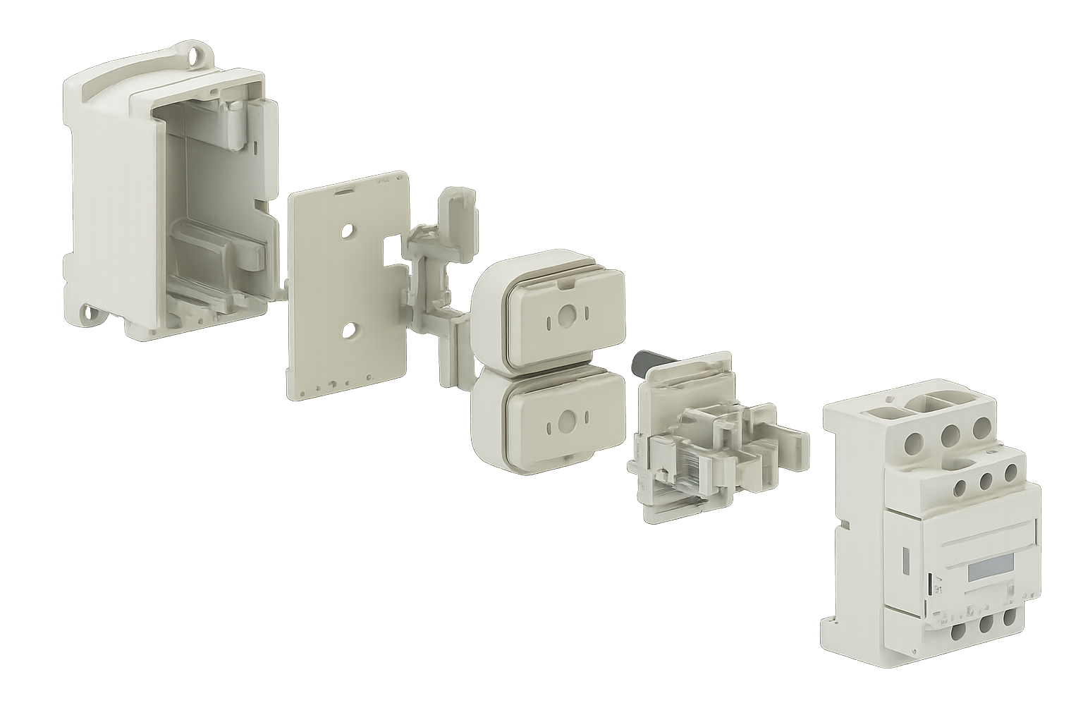

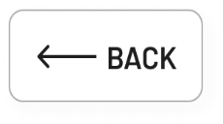
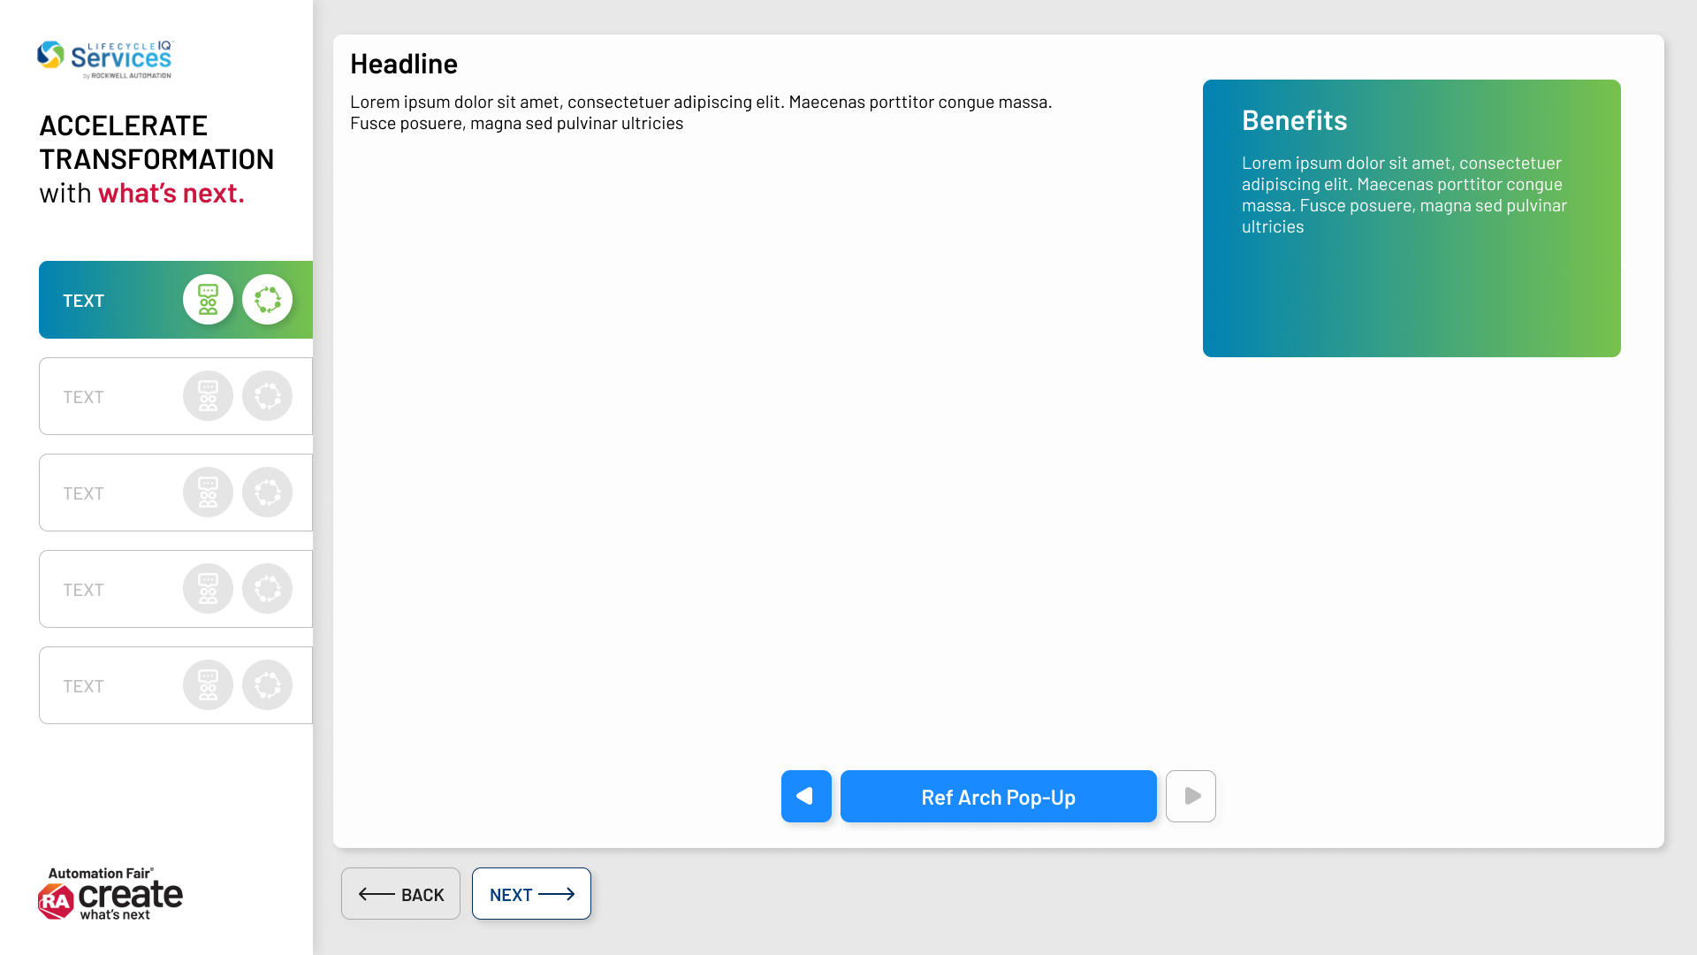
CREATE what’s next
by turning data into action.
Station Based Digital Solutions
After achieving flexible automated manufacturing for the multiple contactor deviations, leadership was ready to invest in a program that accelerated digital transformation with what’s next.
IT and OT convergence, Digital Twins and Industrial AI optimize production, drive sustainable growth and enable data-driven decision making, starting from the edge and across the value chain.
OVERVIEW
1
ENABLE DATA
Industrial
IoT
Digital Twin
Data Science
Industrial AI
2
CONTEXTUALIZE DATA
What’s next for this Line
+
+
+
+
+
3
MONITOR PRODUCTION
Results:
4
We now have our line data connected and contextualized and available for future work.
..
..
..
OPTIMIZE PRODUCTION
CLOSE
ARCHITECTURE
APPROACH
Notes:
Here we are going to start of the conversation of the how the world is working with Data Science, robotics and AI
ORIGINAL
After achieving flexible automated manufacturing for the multiple contactor deviations, leadership was ready to invest in a program that accelerated digital transformation with what’s next.
IT and OT convergence, Digital Twins and Industrial AI optimize production, drive sustainable growth and enable data-driven decision making, starting from the edge and across the value chain.
-----------------------------
PROPOSED REVISION to lean more to the “create what’s next” part of the theme vs. “prepare for what’s next” – more proactive, aspirational, aligns to the event theme.
After achieving flexible automated manufacturing for multiple contactor deviations, leadership was ready to invest in a program to accelerate digital transformation and boldly create what’s next.
By converging IT and OT, leveraging Digital Twins, and applying Industrial AI, data from the edge and across the value chain powers data-driven decisions that improve and elevate performance ensuring a competitve edge (drive sustainable growth).
By converging IT and OT, leveraging Digital Twins, and applying Industrial AI, data from the edge and across the value chain powers data-driven decisions that elevate/drive performance and ensure a competitive edge.
After achieving flexible automated manufacturing for multiple contactor deviations, leadership was ready to invest in a program to accelerate digital transformation and boldly create what’s next.
After achieving flexible automated manufacturing for multiple contactor deviations, leadership was ready to invest in a program to increase/evolve digital capabilities and boldly create what’s next.
After achieving flexible automated manufacturing for multiple contactor deviations, leadership was ready was ready to drive digital innovation and boldly create what’s next.
---FINAL---
After achieving flexible automated manufacturing for multiple contactor deviations, leadership was ready to invest in digital capabilities and boldly create what’s next.
By converging IT and OT, leveraging Digital Twins, and applying Industrial AI, data from the edge and across the value chain powers data-driven decisions that optimize performance and ensure a competitive edge.

Slide 11
CREATE what’s next
by turning data into action.

