Slide 1
Introdução a Sistemática Filogenética
Carolina M. Siniscalchi
Outubro 2026

Slide 2
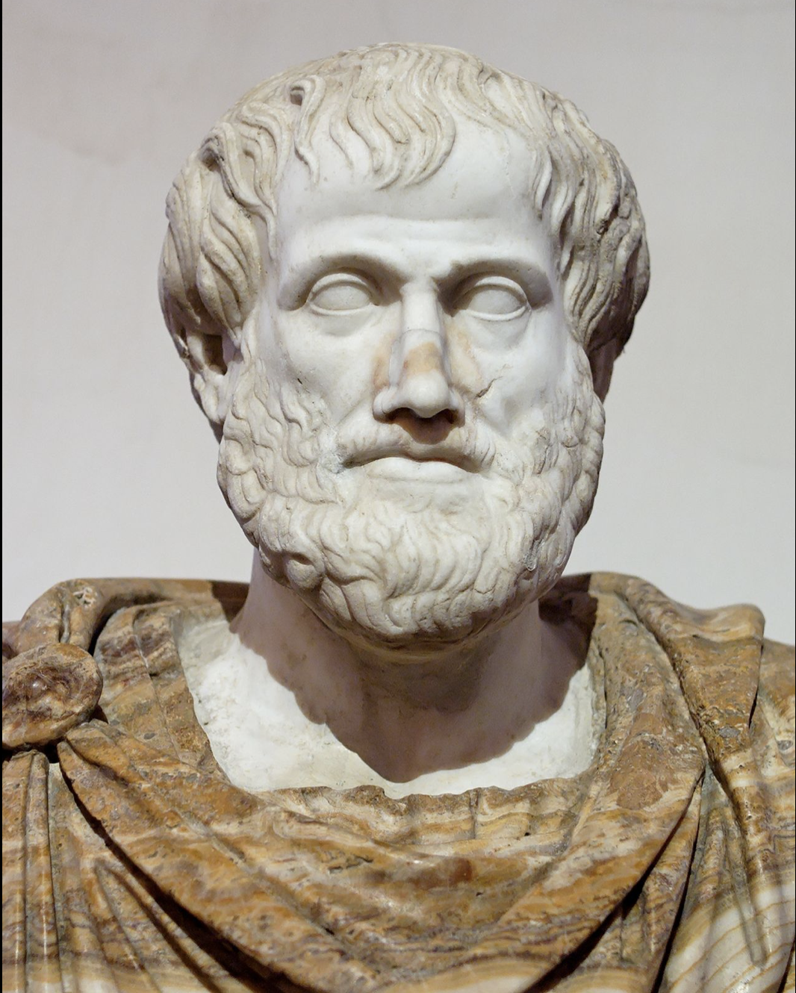
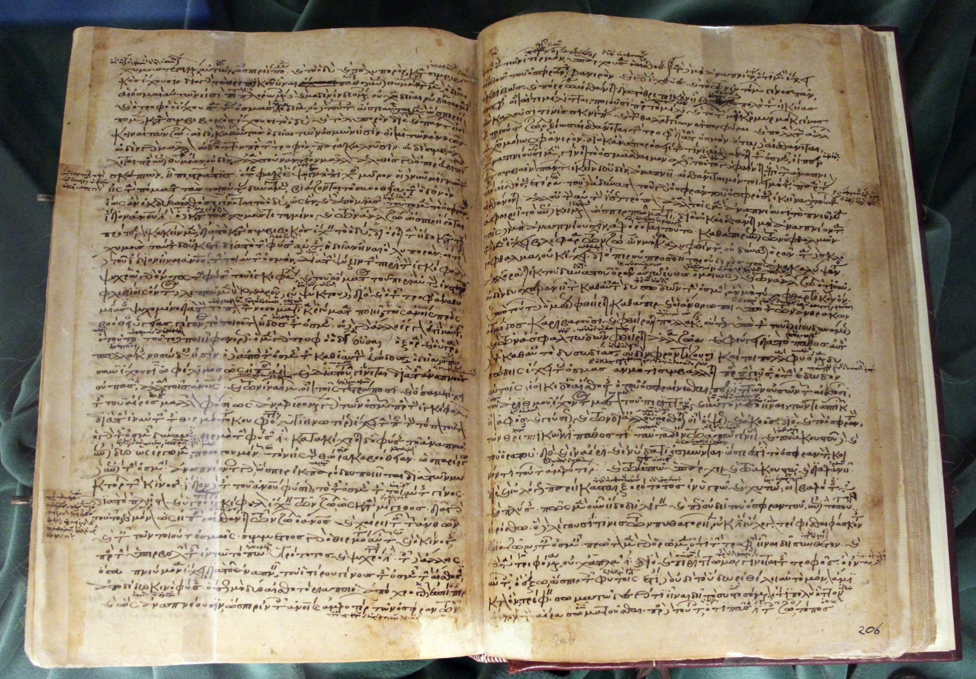
Histórico
Seres humanos gostam de classificar e agrupar coisas
Primeiras classificações datam da época de Aristóteles (384–322 BC)
A maioria das classificações agrupam organismos com base em afinidades morfológicas

Slide 3
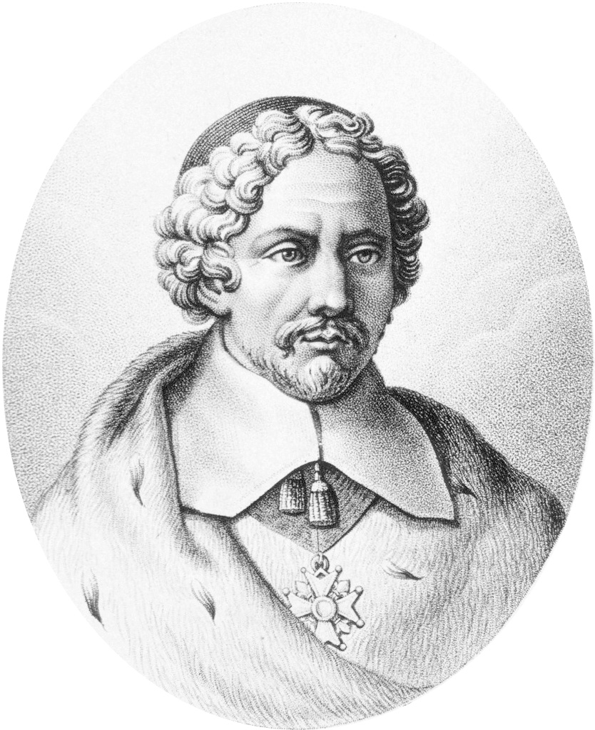
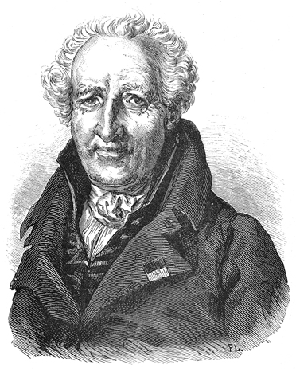
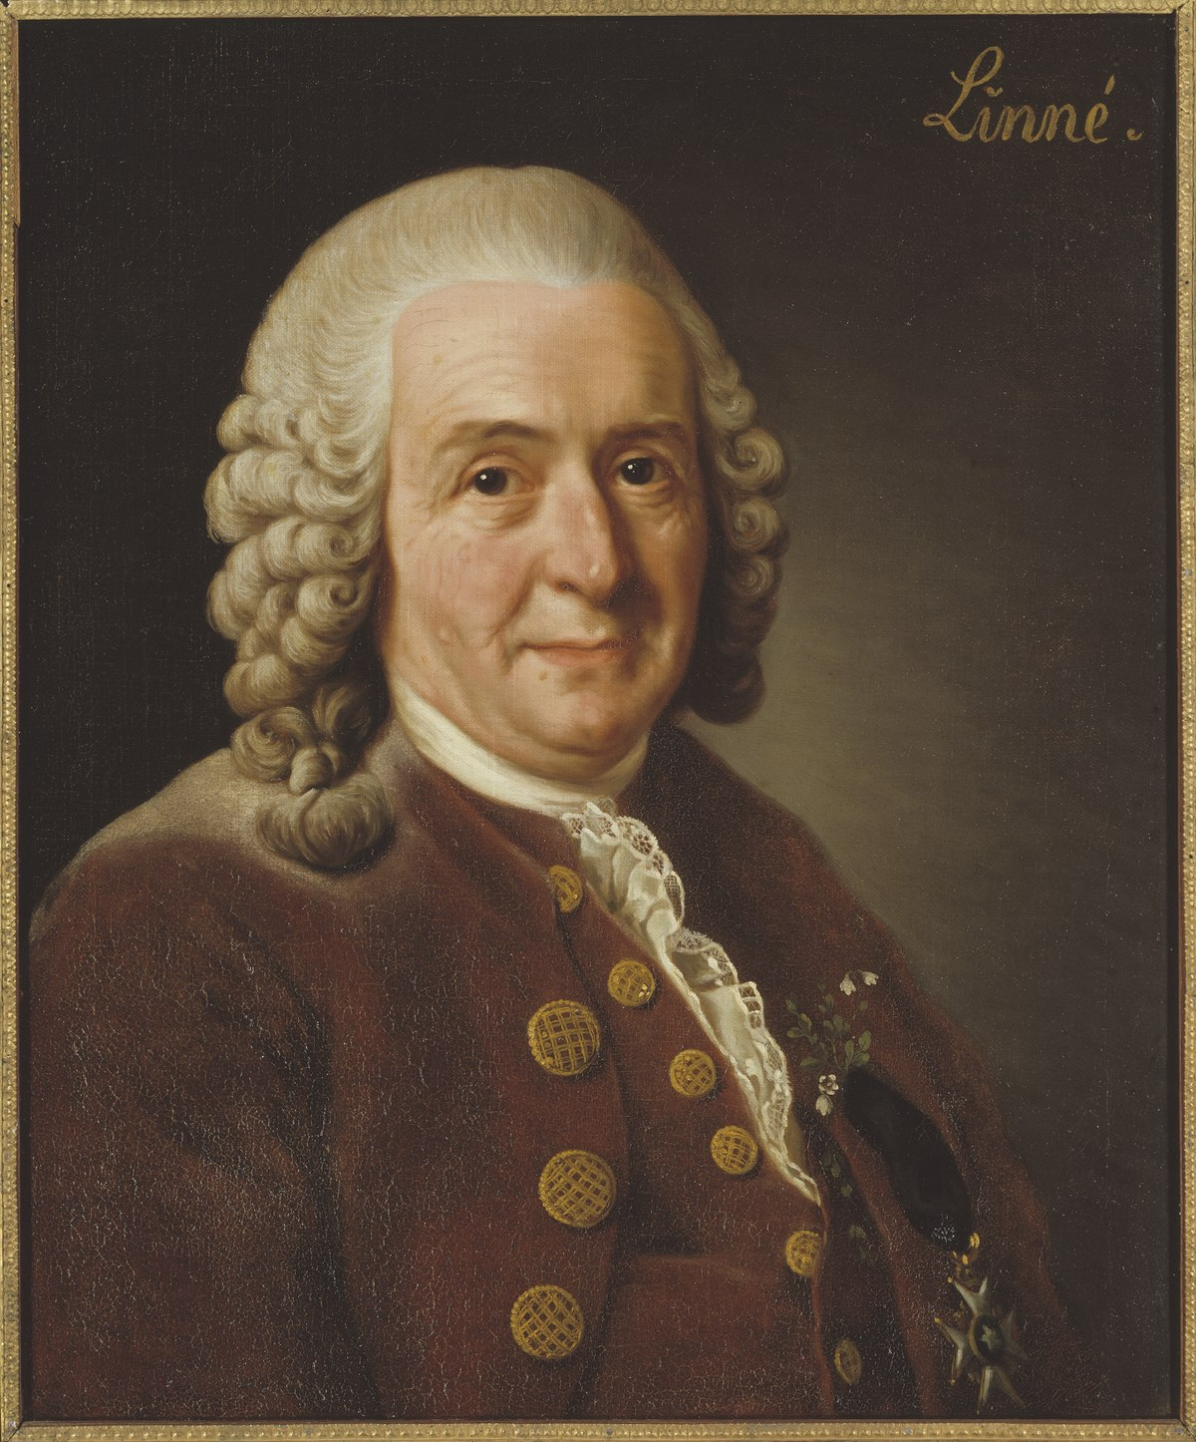
Brief History
18th century: the search for natural groups
What is natural?
Synthetic classifications: used one or few characters to successively divide groups
Linnaeus – Systema Naturae (1735): establishes the hierarchical classification system still in use today
Tournefort
Jussieu
Linnaeus

Slide 4
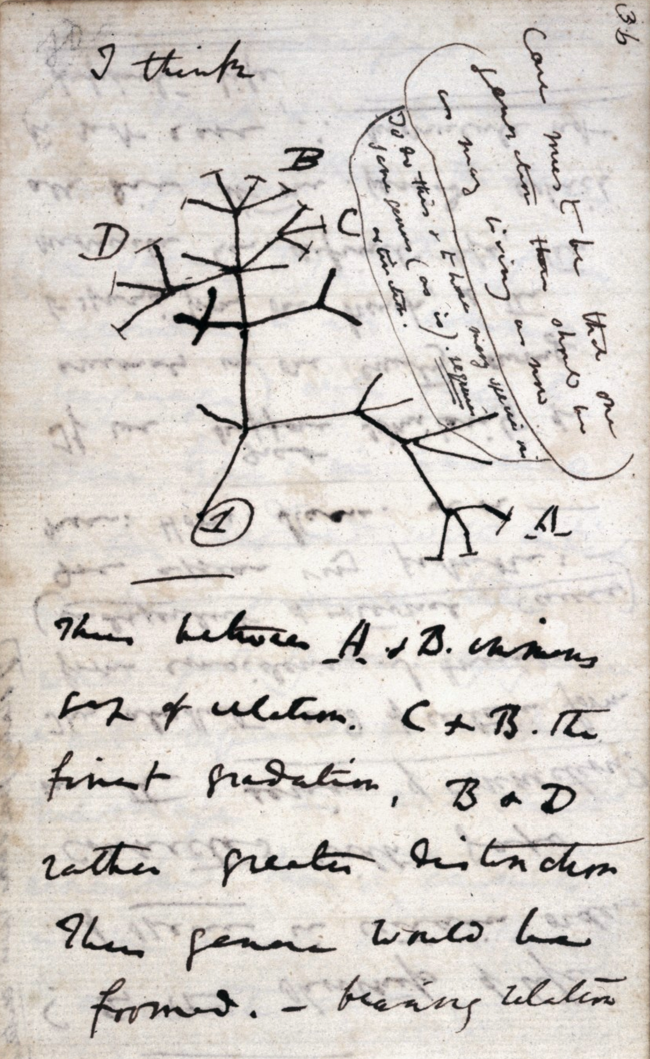
Brief History
Darwin – On the Origin of the Species (1859): evolutionary relationships
First depiction of an evolutionary tree (1837)
The idea of “relationships” among groups becomes more evident in classifications

Slide 5
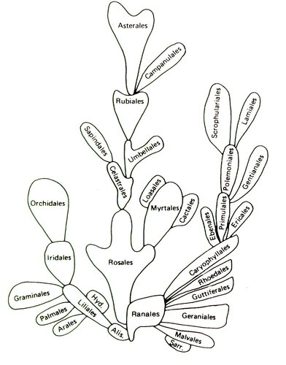
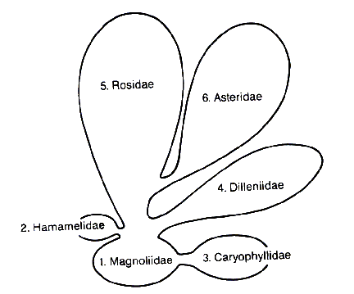
Brief History
Tree-like diagrams start to appear
No real inference of evolutionary relationships, still based on assumptions of morphological similarity
Bessey 1915
Cronquist 1988

Slide 6
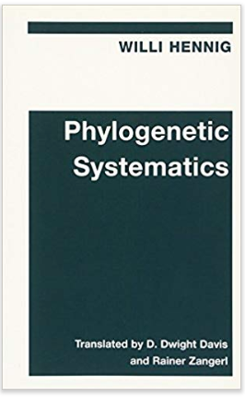
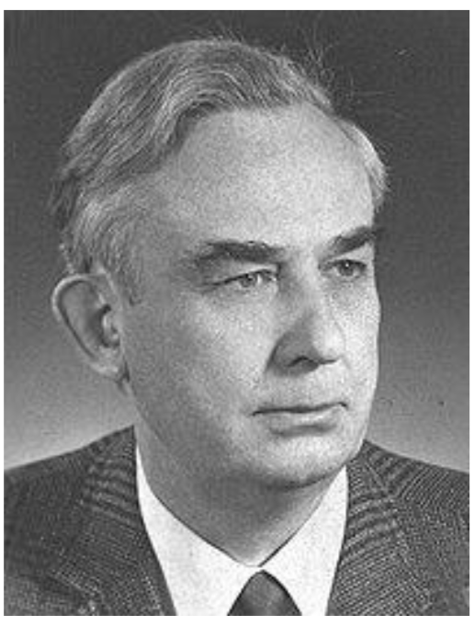
Brief History – Phylogenetic Systematics
Willi Hennig – Phylogenetic Systematics (1950)
Three questions:
  What is a phylogenetic relationship?
  How are phylogenetic relationships established?
  How can one express these relationships?

Slide 7
Brief History – Phylogenetic Systematics
  What is a phylogenetic relationship?
  Phylogenetic relationships are expressed as a series of nested relationships were 2 taxa are more closely (sister-taxa) related among themselves than to a 3rd taxon
Sister-groups
🥑
🍍
🍐
🍎

Slide 8
Brief History – Phylogenetic Systematics
  How are phylogenetic relationships established?
    Sister group relationships are established by the presence of a derived similarity (synapomorphy), shared by the sister taxa but absent in the others.
Sister-groups
🥑
🍍
🍐
🍎
synapomorphy

Slide 9
Brief History – Phylogenetic Systematics
  How can one express these relationships?
    They can be represented in a branched diagram that summarizes sister-group relationships – a cladogram.
Sister-groups
🥑
🍍
🍐
🍎
Cladograms do not represent ancestor-descendant relationships
Cladograms present sister-group relationships
synapomorphy

Slide 10
Brief History
Brief History – Phylogenetic Systematics
A diagram with ancestor-descendant relationships
A cladogram with sister-group relationships
🍎
🥑
🍍
🍐
🍎
🍐
🍍
Common hypothetical ancestors
🥑

Slide 11
Brief History – Phylogenetic Systematics
Precise definition of kinship:
Apples are more closely related to pears because they share a more recent common hypothetical ancestor (“x” in the cladogram) than apples and pineapples (“y”).
Pineapples are more closely related to pears and apples than to avocados because they share a more recent common ancestor.
🥑
🍍
🍐
🍎
x
y
z

Slide 12
Homology
Not all morphological similarities among different organisms are informative to discover kinship

Slide 13
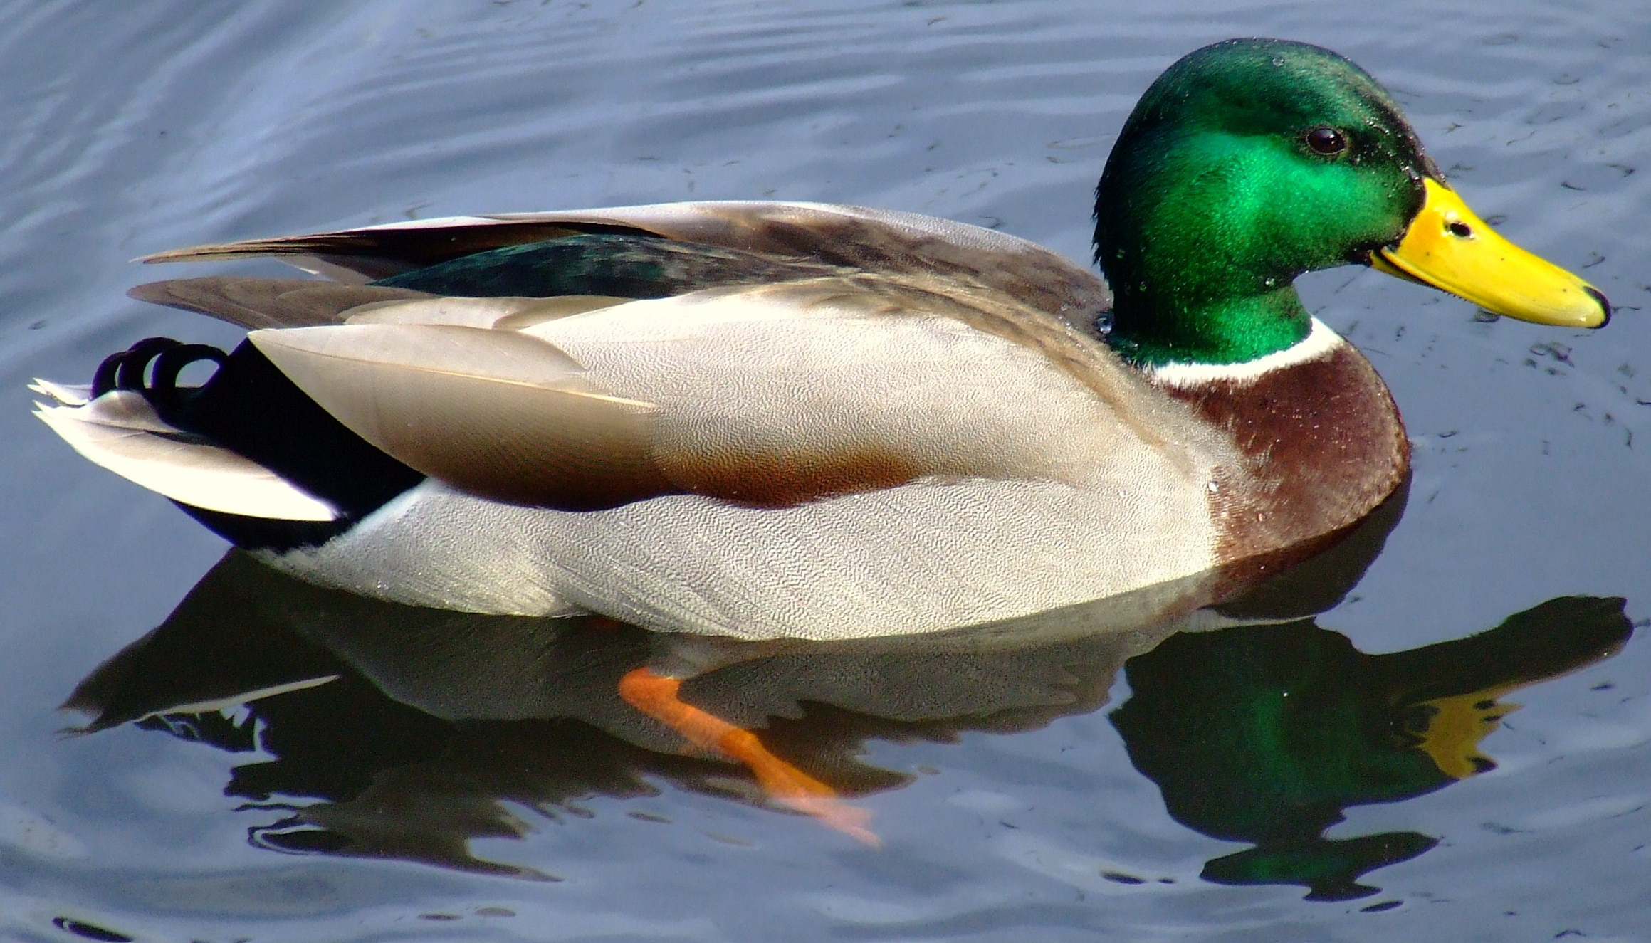
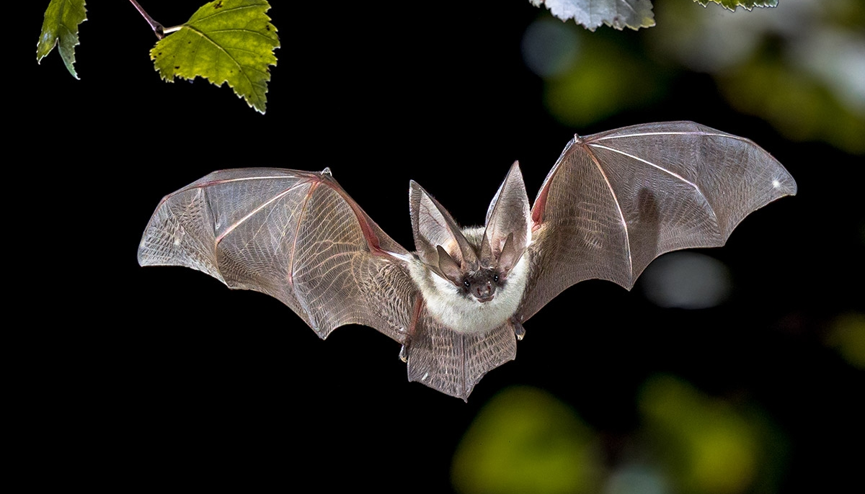
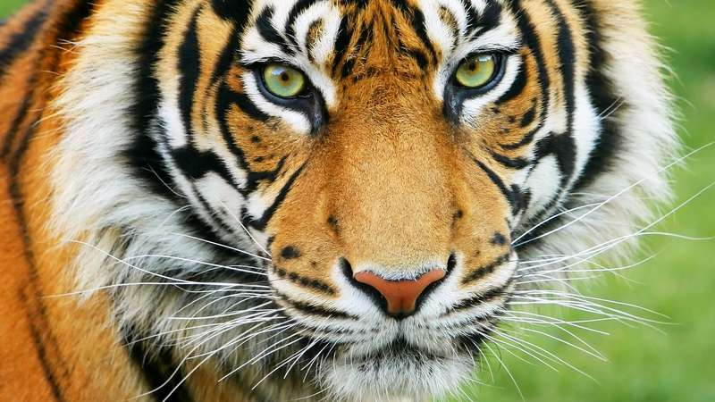
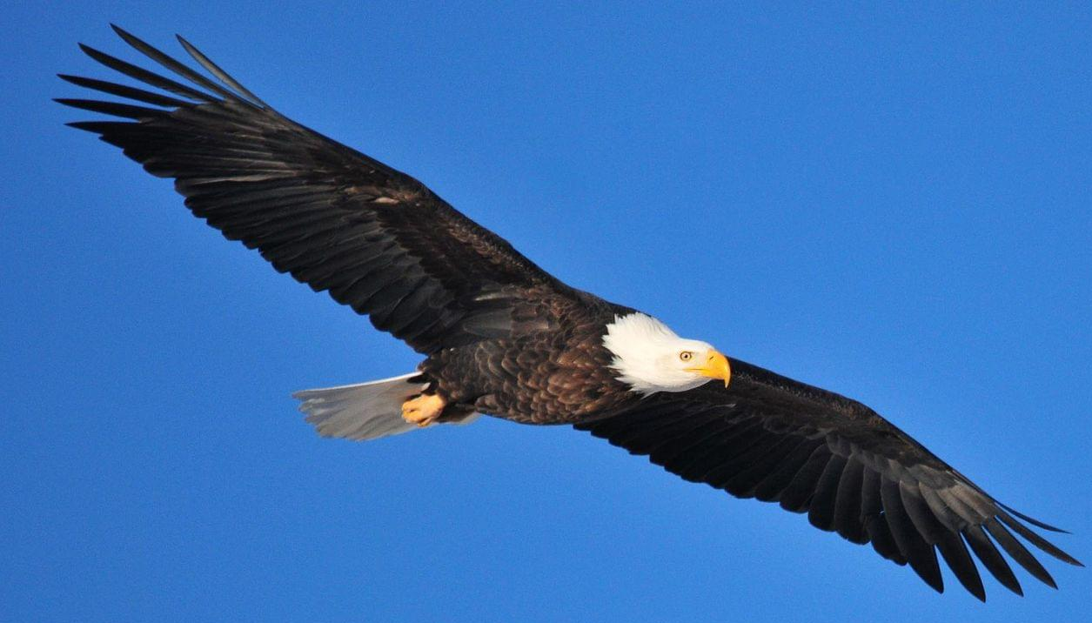
Homology
🐅
🦅
🦆
🦇

Slide 14
Homology
🐅
🦇
🦆
wings
🦅

Slide 15
Homology
hairs
mammary glands
🐅
🦇
🦆
feathers
bone fusions
🦅

Slide 16
Homology
Synapomorphy = homology
Homology = similarity due to shared evolutionary origin
hairs
mammary glands
🐅
🦇
🦆
feathers
bone fusions
🦅

Slide 17
Homology
hairs
mammary glands
🐅
wings
🦇
🦆
feathers
bone fusions
🦅
wings

Slide 18
Homology
hairs
mammary glands
🐅
wings
🦇
Wings = not homologous!
2 independent evolutionary origins
🦆
feathers
bone fusions
🦅
wings

Slide 19
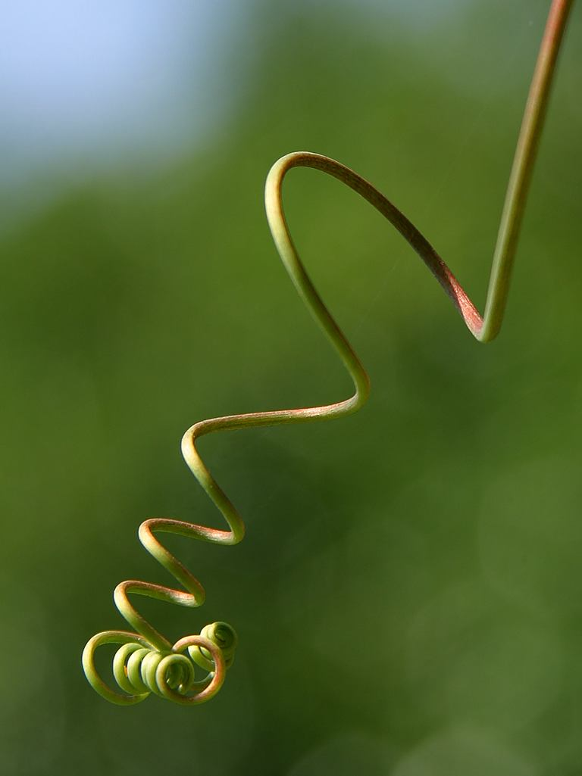
Homology
Tendril
Structure that helps plants climb over stuff

Slide 20
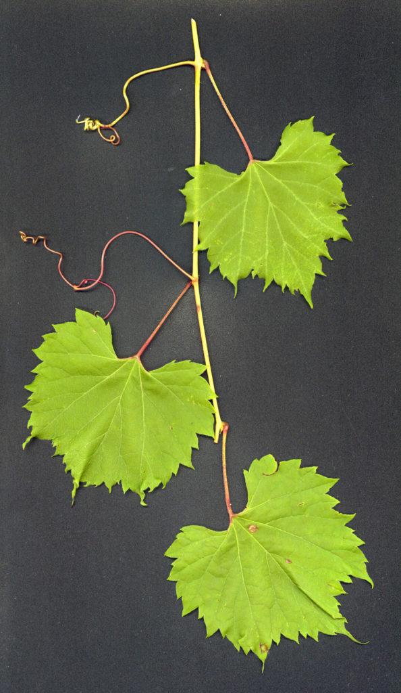
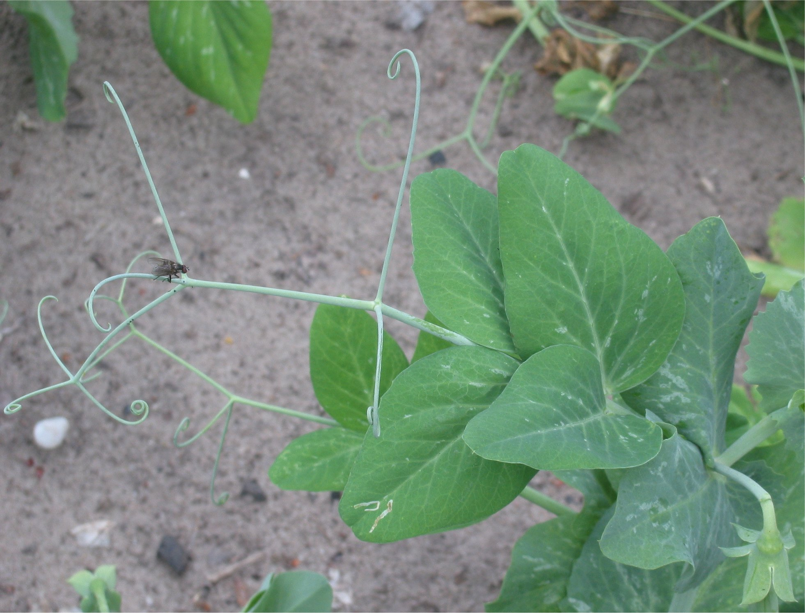
Homology
Garden pea– Pisum sativum
Wild grape – Vitis sp

Slide 21
Homology
Same function?
YES!
Garden pea– Pisum sativum
Wild grape – Vitis sp

Slide 22
Homology
Same function?
YES!
Same evolutionary origin?
Garden pea– Pisum sativum
Wild grape – Vitis sp

Slide 23
Homology
Position
Opposite to leaves
Garden pea– Pisum sativum
In a branch (?) after leaves
Wild grape – Vitis sp

Slide 24
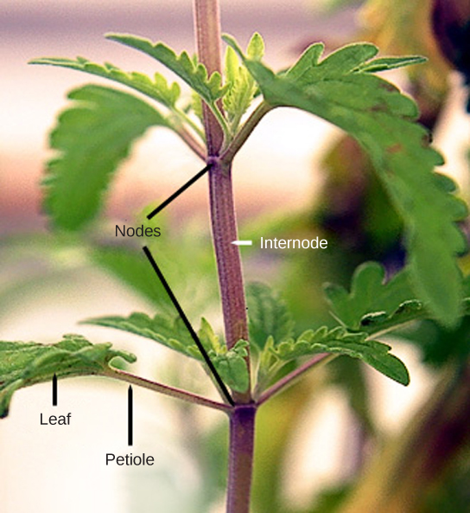
Homology
Opposite to leaves
- Emerging from the same region were axillary buds are found
- Axillary buds have dormant organogenic potential
- Tendrils = modified branch
Wild grape – Vitis sp

Slide 25
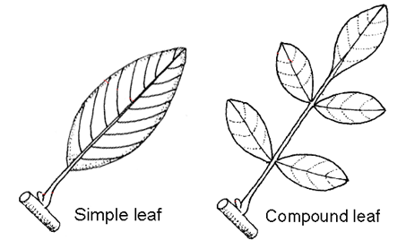
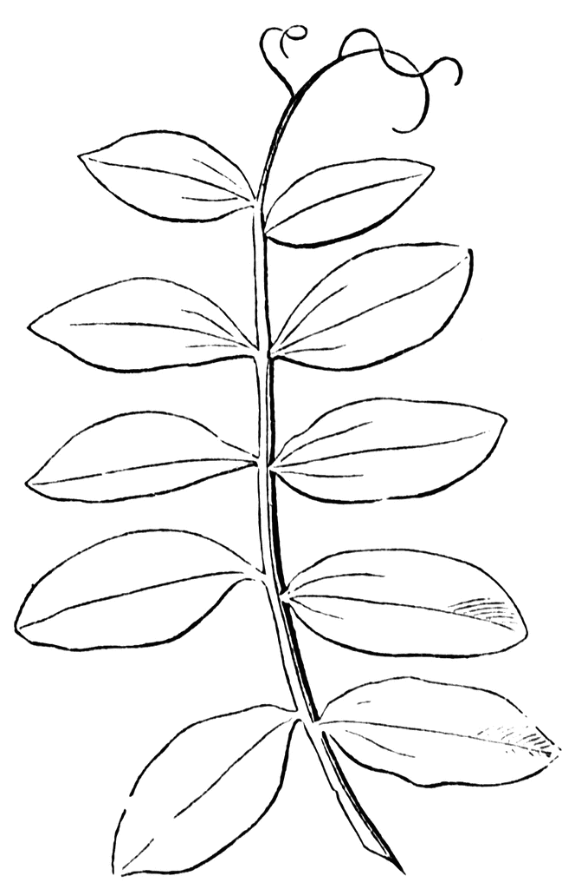
Homology
In a branch (?) after leaves
Compound leaves might have a terminal leaflet
Tendril = modified leaflet
Garden pea– Pisum sativum

Slide 26
Homology
Same function
Different morphological origin
We are not comparing the same structure!!
HOMOPLASY
- convergence
- parallelism
Garden pea– Pisum sativum
Modified leaflet
Wild grape – Vitis sp
Modified branch

Slide 27
Homology
Making sure your characters are homologous (have the same EVOLUTIONARY ORIGIN) is a FUNDAMENTAL PREMISE of phylogenetics

Slide 28
Parsimony
🌿
🌼
🌼
🌼
🌼
A
B
C
D
Three characters:
Shape
Color
Leaf 🚫 🌿

Slide 29
Parsimony
🌿
🌼
🌼
🌼
🌼
A
B
C
D
Three characters:
Shape
Color
Leaf 🚫 🌿
Transforming the characters into binary:
Shape: 0 – square / 1 – round
Color: 0 – purple / 1 – red
Leaf: 0 – absent / 1 – present

Slide 30
Parsimony
🌿
🌼
🌼
🌼
🌼
A
B
C
D
Binary:
Shape: 0 – square / 1 – round
Color: 0 – purple / 1 – red
Leaf: 0 – absent / 1 – present
 | Shape | Color | Leaf
A | 0 | 1 | 0
B | 1 | 1 | 0
C | 0 | 0 | 0
D | 1 | 1 | 1

Slide 31
Parsimony
🌿
🌼
🌼
🌼
🌼
A
B
C
D
C
A
B
D
 | Shape | Color | Leaf
A | 0 | 1 | 0
B | 1 | 1 | 0
C | 0 | 0 | 0
D | 1 | 1 | 1
C(A, B, D)

Slide 32
Parsimony
🌿
🌼
🌼
🌼
🌼
A
B
C
D
C
A
B
D
 | Shape | Color | Leaf
A | 0 | 1 | 0
B | 1 | 1 | 0
C | 0 | 0 | 0
D | 1 | 1 | 1
C(A (B, D)

Slide 33
Parsimony
🌿
🌼
🌼
🌼
🌼
A
B
C
D
C
A
B
D
 | Shape | Color | Leaf
A | 0 | 1 | 0
B | 1 | 1 | 0
C | 0 | 0 | 0
D | 1 | 1 | 1
🌿
C(A (B, D)

Slide 34
Parsimony
🌿
🌼
🌼
🌼
🌼
A
B
C
D
3 character transformations
4 character transformations
C
A
B
D
C
A
B
D
🌿
🌿

Slide 35
Parsimony
3 character transformations
4 character transformations
C
A
B
D
C
A
B
D
🌿
🌿
Law of Parsimony
Occam's Razor:
the principle that entities should not be multiplied needlessly;
the simplest of two competing theories is to be preferred

Slide 36
Parsimony
3 character transformations
4 character transformations
C
A
B
D
C
A
B
D
🌿
🌿
Law of Parsimony
Occam's Razor:
the principle that entities should not be multiplied needlessly;
the simplest of two competing theories is to be preferred

Slide 37
Parsimony
Law of Parsimony
Occam's Razor:
the principle that entities should not be multiplied needlessly;
the simplest of two competing theories is to be preferred
In phylogenetics, the parsimony analysis is the hierarchical ordination of synapomorphies by choosing the taxa arrangement that explains the highest number of characters in the simplest way
Parsimony is the universal criterion to choose between alternative hypothesis of character distributions

Slide 38
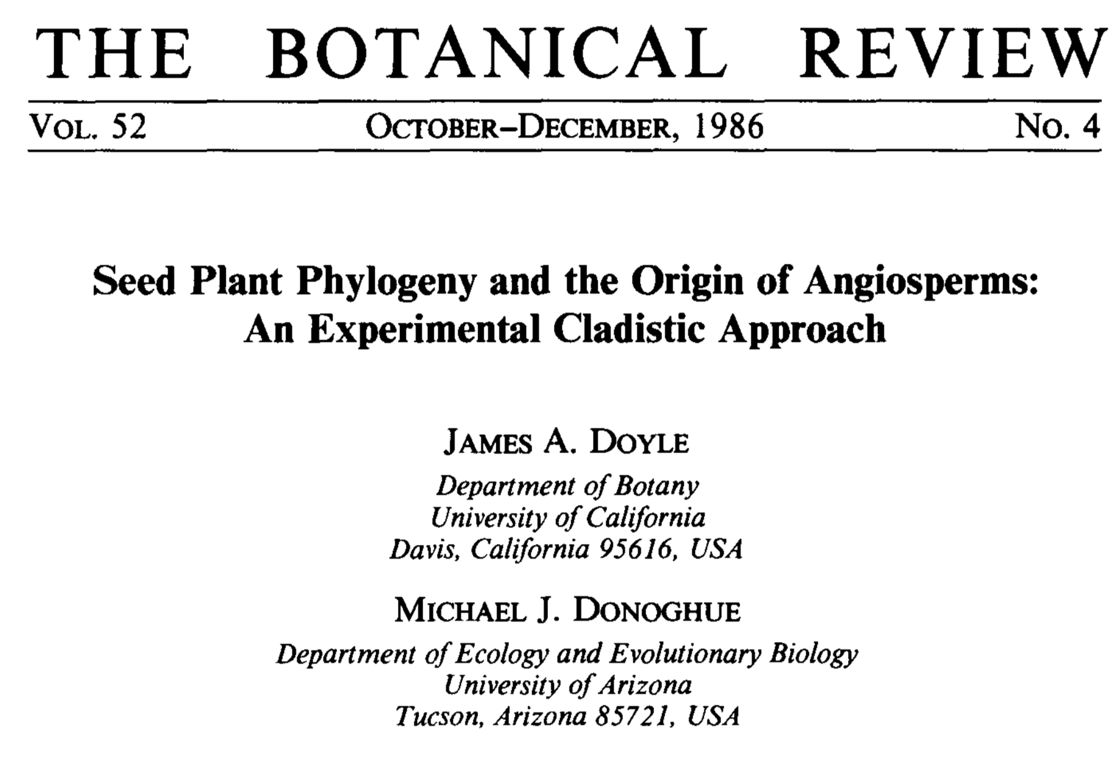

Slide 39
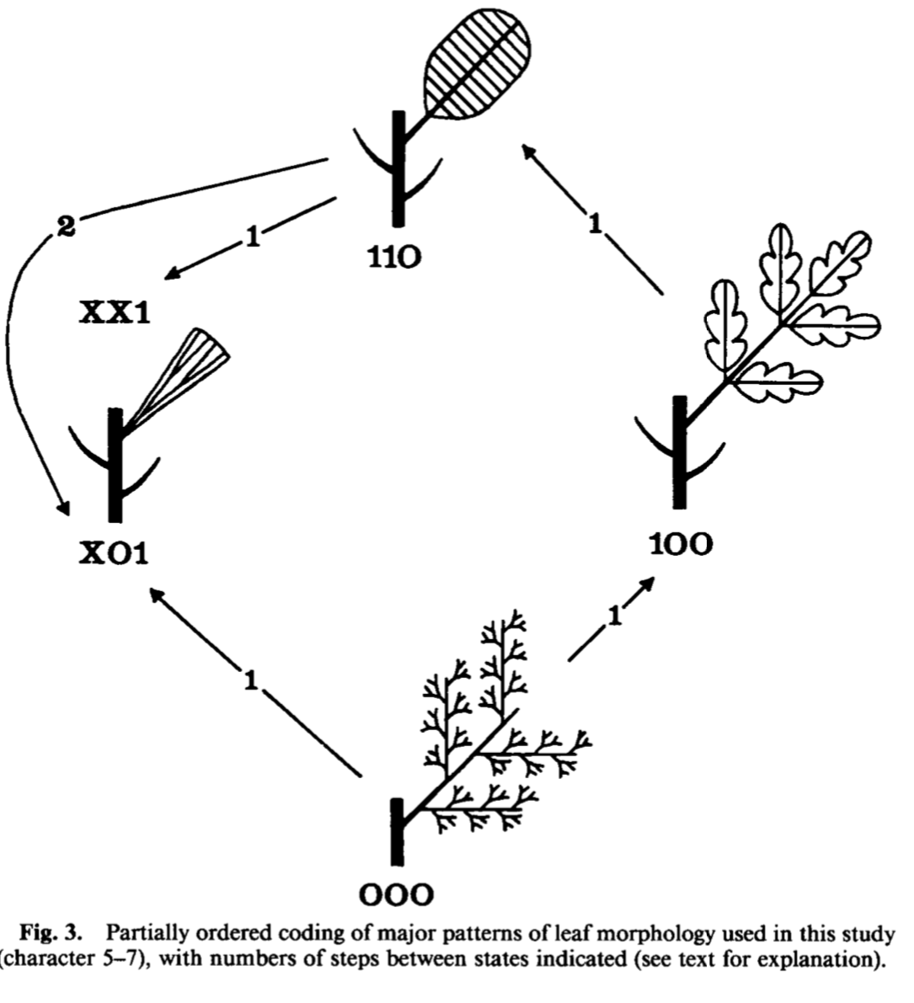
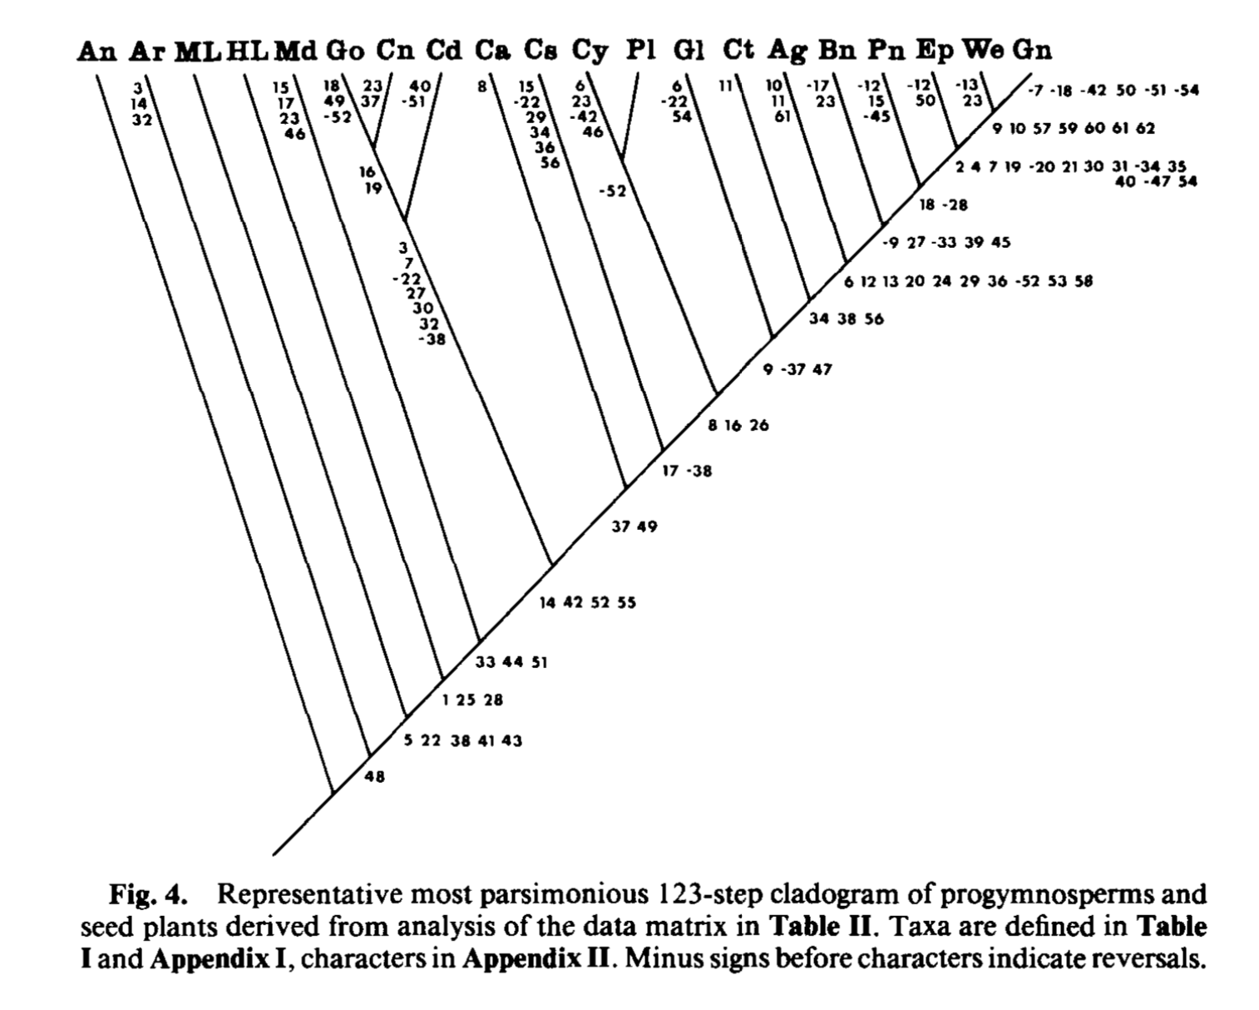
Doyle & Donoghue 1986

Slide 40
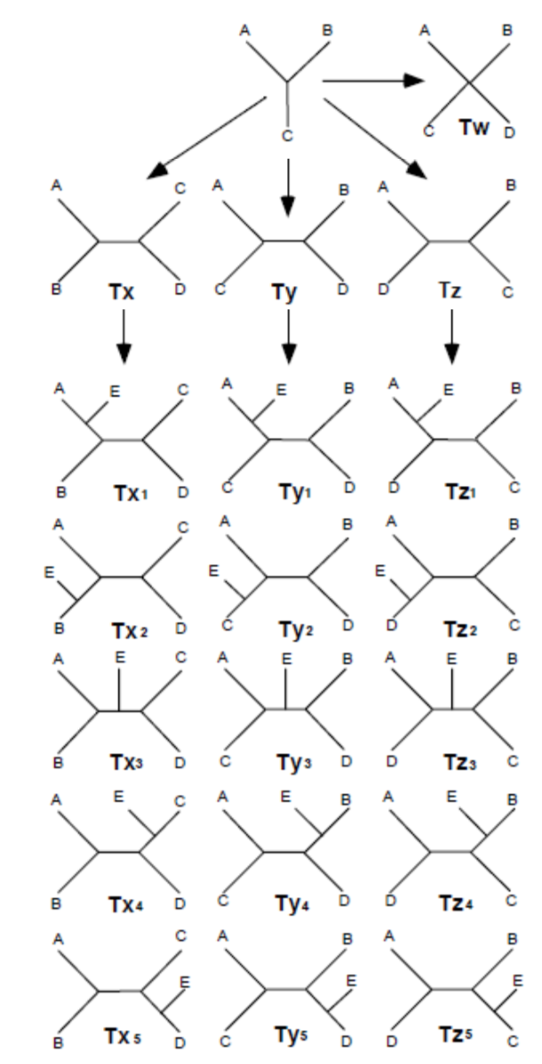
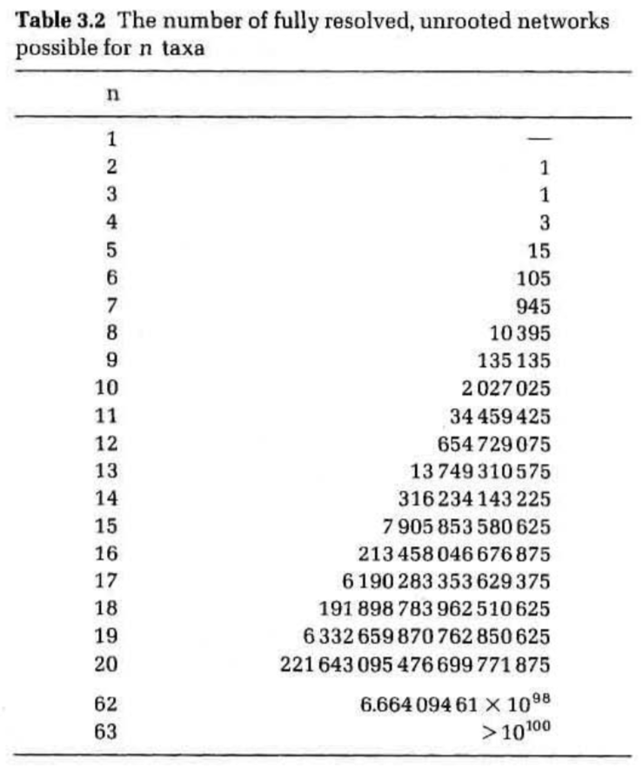
Parsimony
With the addition of taxa, the number of possible resolved networks increases very fast, regardless of the number of characters.
Computational shortcuts allow to speed up the process, but usually restrict the search to a set of possible trees, so they will only find the local optimum.
Kitching et al. 1998, Darlu & Tassy 1993

Slide 41
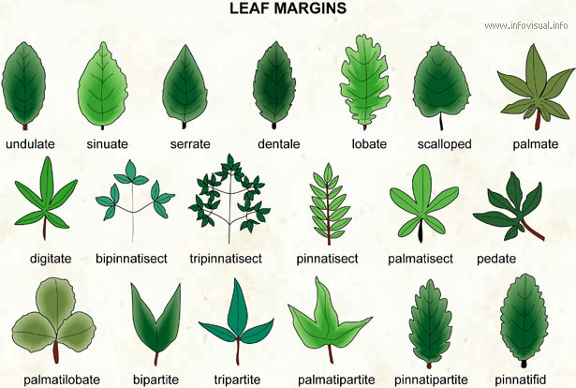
Morphological characters
Ordering morphological characters: based on observations, ontogeny studies, etc
Order influences how the characters will be used to build the cladogram
Character: leaf blade division
States: 0 – simple
1 – pinnate
2 – bipinnate
3 – tripinnate
0
1
2
3

Slide 42
🐉
🧟‍♂️
🧚🏻‍♀️
🧜🏽‍♀️
🦄
Zombies are more closely related to _________
Mermaids are more closely related to __________

Slide 43
🐉
🧟‍♂️
🧚🏻‍♀️
🧜🏽‍♀️
🦄
Zombies are more closely related to FAIRIES
Mermaids are more closely related to UNICORNS+ZOMBIES+FAIRIES

Slide 44
🐉
🧟‍♂️
🧚🏻‍♀️
🧜🏽‍♀️
🦄
Mermaids are more closely related to __________
Unicorns are more closely related to __________

Slide 45
🐉
🧟‍♂️
🧚🏻‍♀️
🧜🏽‍♀️
🦄
Mermaids are more closely related to DRAGONS
Unicorns are more closely related to ZOMBIES+FAIRIES

Slide 46
🐉
🧟‍♂️
🧜🏽‍♀️
🧚🏻‍♀️
🦄
Zombies are more closely related to _________

Slide 47
🐉
🧟‍♂️
🧜🏽‍♀️
🧚🏻‍♀️
🦄
Zombies are more closely related to FAIRIES

Slide 48
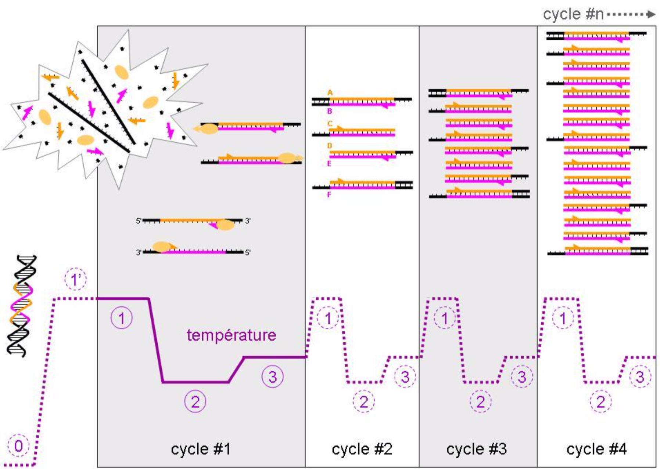
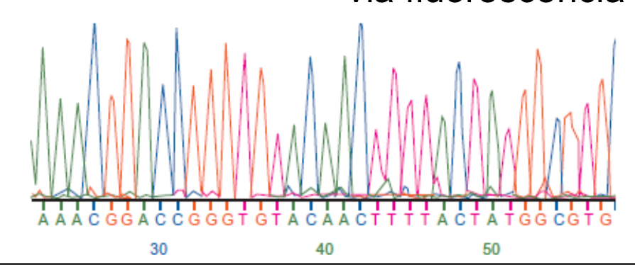
Molecular characters
1977 to 1985:
development of molecular biology methods such as DNA sequencing and PCR

Slide 49
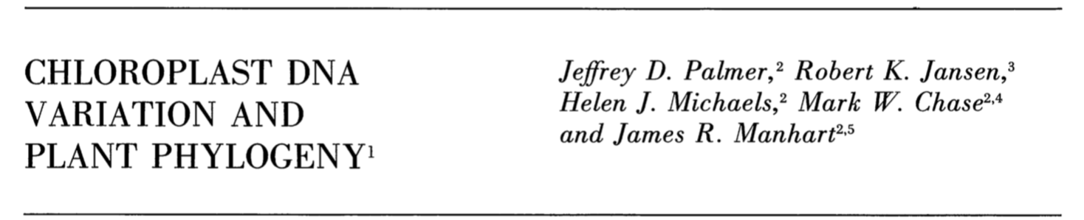
Molecular characters
1977 to 1985:
development of molecular biology methods such as DNA sequencing and PCR
~1980s:
DNA markers (in the form of sequences) start to be used for phylogenetic analysis

Slide 50
Molecular characters
What are the characters and character states in DNA data?

Slide 51
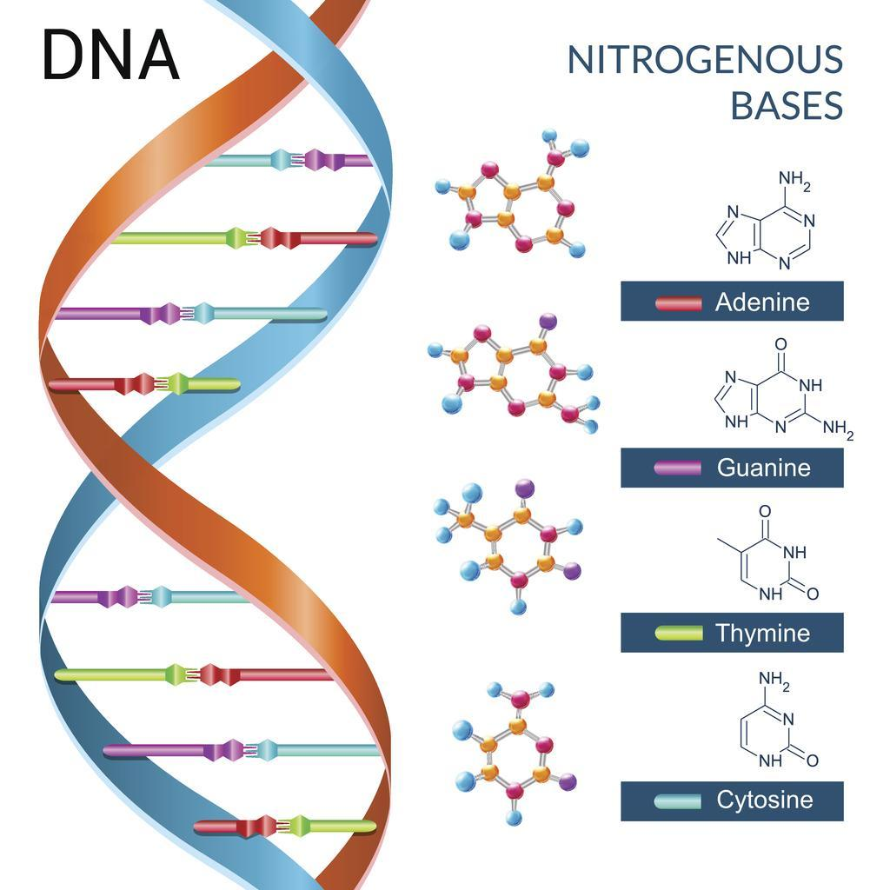
Molecular characters
What are the characters and character states in DNA data?
The base (A, T, C, G) that occupies that specific position will be the character state
Nucleotide positions in the DNA sequence are the characters

Slide 52
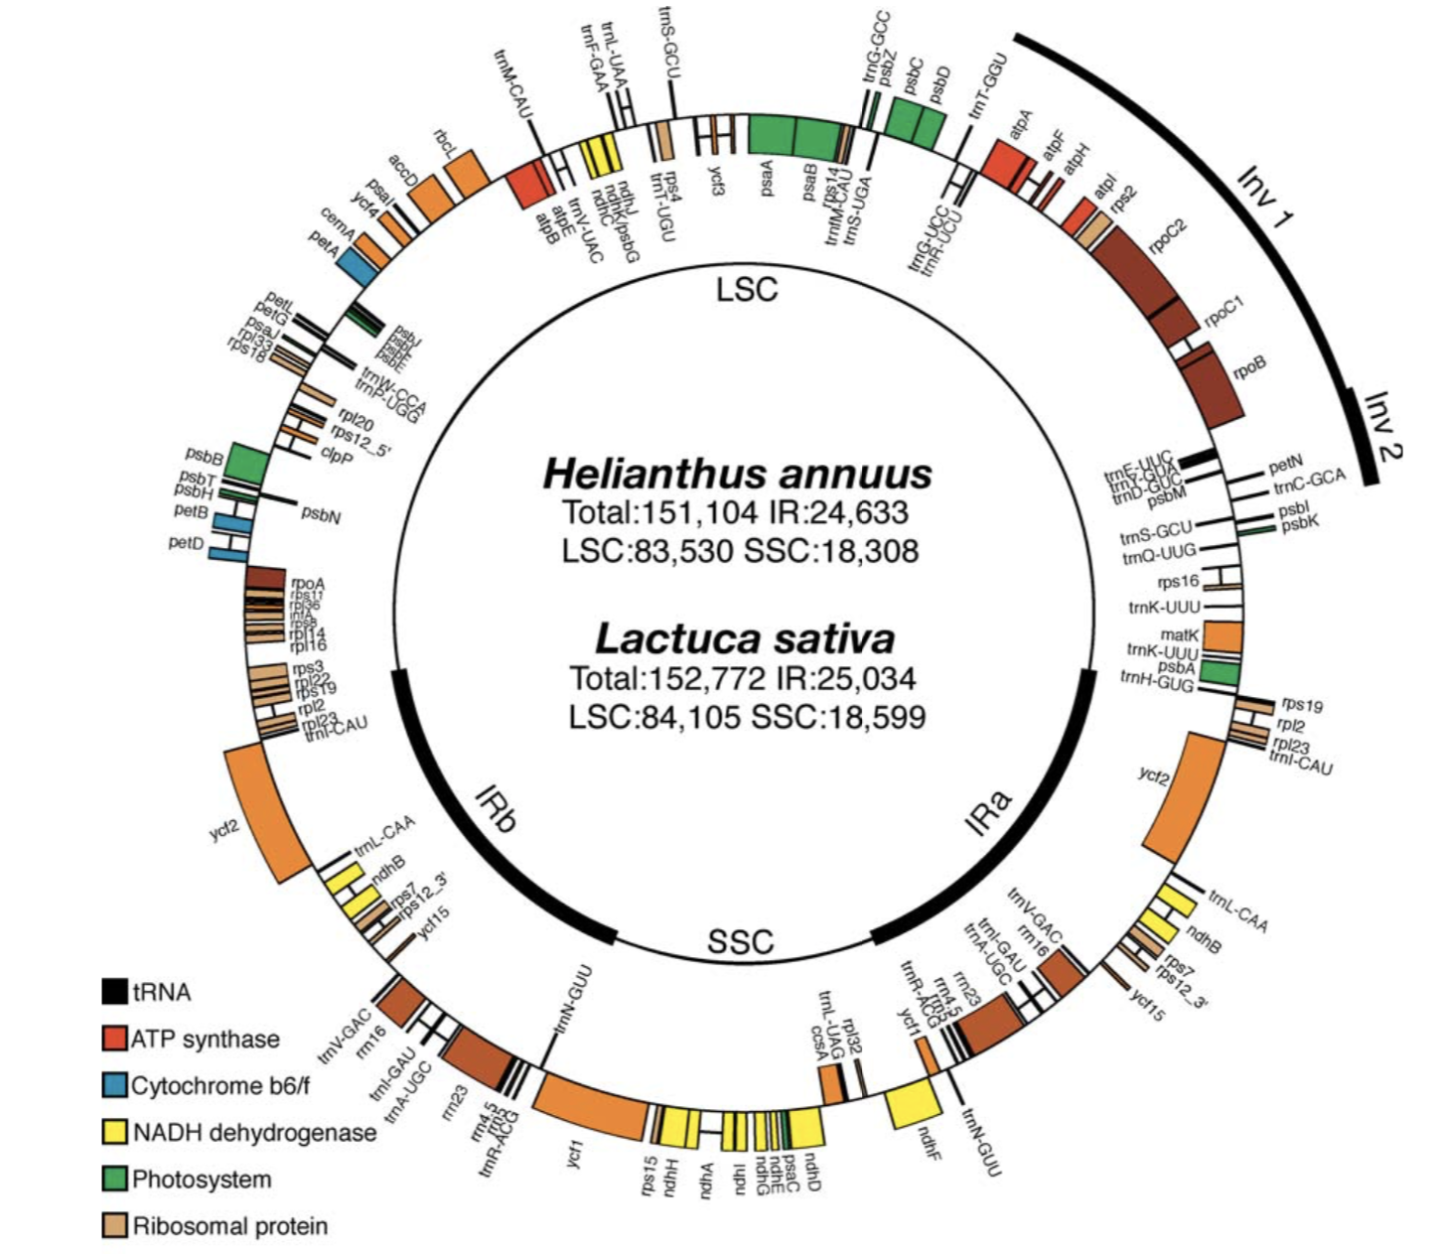
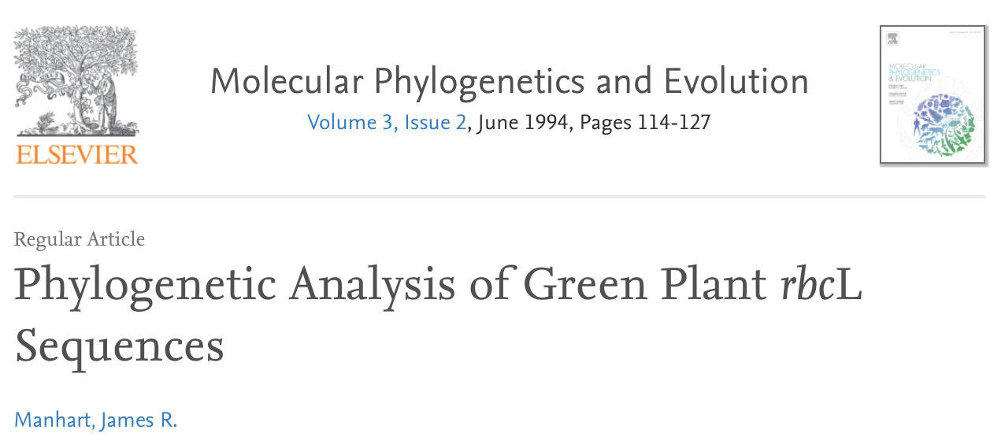
Molecular characters
How do we guarantee homology between characters?
We make sure we are comparing the same DNA region among different taxa
E.g.: the same gene, the same intergenic region, etc
rbcL is a chloroplast gene that encodes the large subunit of the enzyme Rubisco. It has been widely used for phylogenies

Slide 53
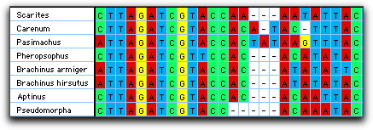
Molecular characters
How do we guarantee homology between characters?
Besides, we need to ensure we are comparing the same nucleotide positions in each taxon
To do that, we align the sequences: stack them based on their overall similarity or using the position of specific codons, for example.

Slide 54
Molecular characters
How do character state transitions happen with molecular characters?
What happened here?

Slide 55
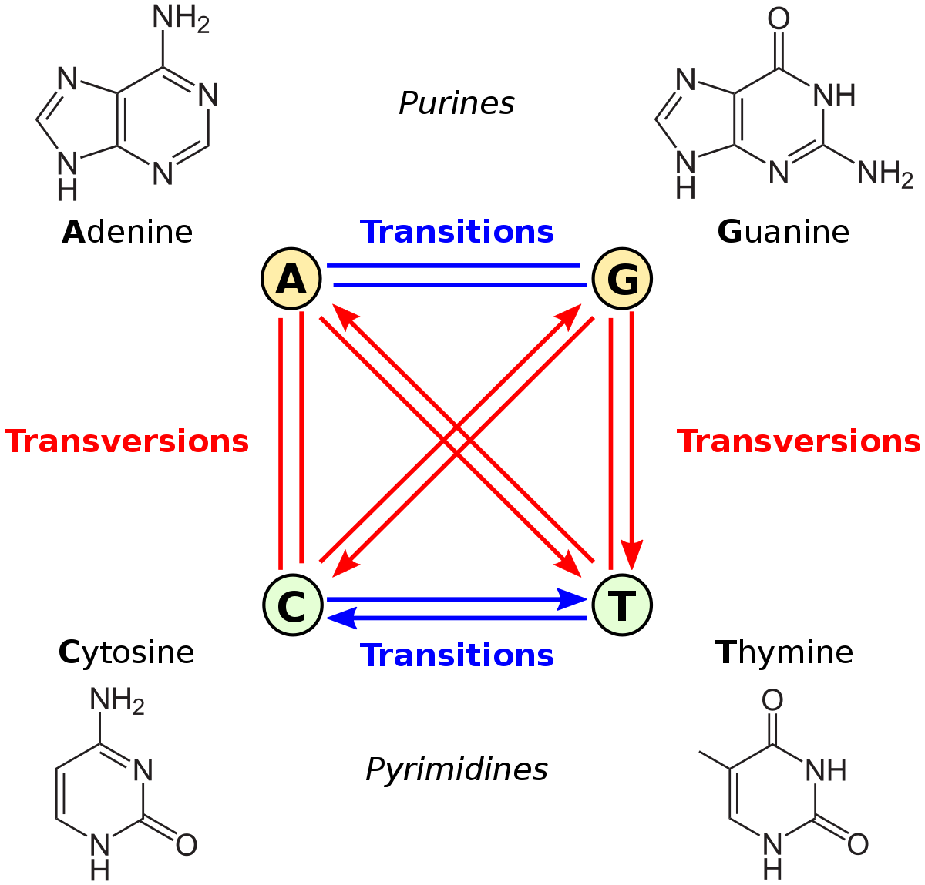
Molecular characters
How do character state transitions happen with molecular characters?
Nitrogenous bases

Slide 56
Molecular characters
How do character state transitions happen with molecular characters?
Transitions are more common than transversions

Slide 57
Molecular characters
Transitions are more common than transversions
μ
Mutation rates (μ) can be different between different types of character change
μ/2
μ/2
Increased complexity for phylogenetic analysis
μ

Slide 58
Statistical Inference Methods
The increased complexity resulting from molecular markers led to a shift from parsimony to model-based statistical inference methods, that allow including these uncertainties in the analysis
μ
μ/2
μ/2
μ

Slide 59
Statistical Inference Methods
Maximum Likelihood
Bayesian Analysis
Frequentist (objective) vision of probability
Subjective vision of probability

Slide 60
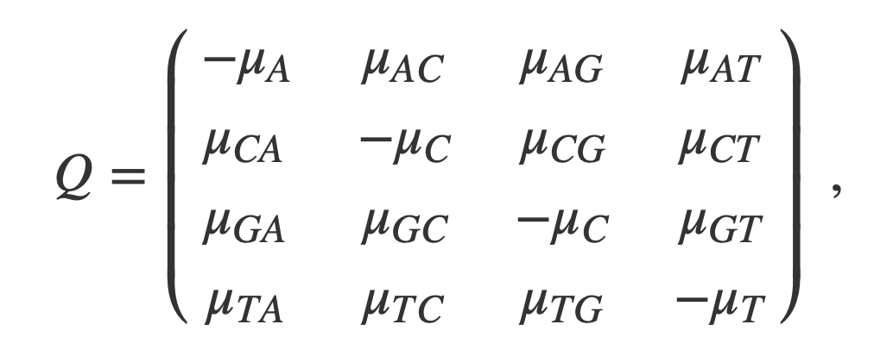
Statistical Inference Methods
Both depend on molecular substitution models
Where µ is the instantaneous rate of substitution from one state to the other
Character states = different nitrogenous bases
4 character states = 16 substitutions rates

Slide 61
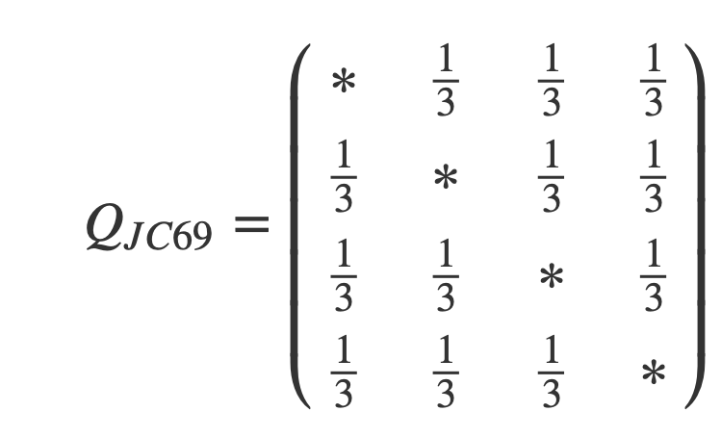
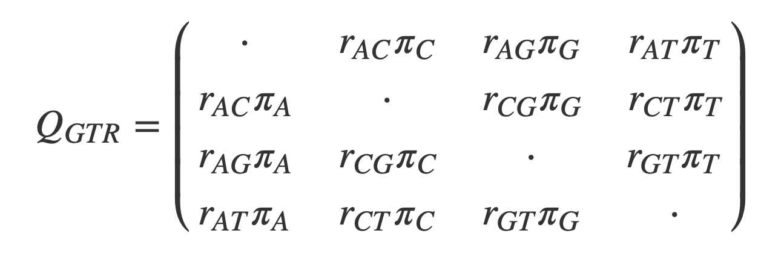
Statistical Inference Methods
Both depend on molecular substitution models
They go from simple matrices with equal rates for all transitions
To complex transition matrices, where the stationary frequency of each nucleotide (𝝅) and the exchangeability rate between different states (𝒓) can both vary
Jukes & Cantor 1969
Tavaré 1986

Slide 62
Statistical Inference Methods
Maximum Likelihood
Likelihood = it is the idea that something is likely to happen or to have happened
Its application in phylogenetic reconstruction implies in the search for the tree that has the highest probability of having originated the observed data (DNA matrix).

Slide 63
Statistical Inference Methods
Maximum Likelihood
P(Ei|D)
D: data (DNA matrix)
Ei: the specific tree in the context of a nucleotide substitution model
Probability of the observed tree given the data
We search for the tree that maximizes P(Ei|D)

Slide 64
Statistical Inference Methods
Maximum Likelihood
Frequentist statistics = relative frequency of the results over repeated executions of the experiment
Calculate the probability of a tree involves calculating the occurrence probability of all possible ancestral states in the internal nodes of the trees
This means calculating the possibility of each nucleotide having occurred in each internal node

Slide 65
Statistical Inference Methods
Maximum Likelihood
The ML analysis does not estimate the topology of the tree itself, but the branch lengths of all branches of the tree
At each iteration, the branch lengths vary and the likelihood of each particular topology is calculated
The topology with the better likelihood is then chosen!

Slide 66
Statistical Inference Methods
Maximum Likelihood
A
Support values in a ML tree are bootstrap values
The bootstrap procedure resamples all the characters in a matrix to reassembled a new matrix of the same size, allowing reposition
Evaluates how the hypothesis holds up at each new iteration
100
B
C
95
D

Slide 67
Statistical Inference Methods
Bayesian Analysis
Subjective vision of probability: derived from the individual’s judgement or experience about the likelihood of an event to occur
P(H|D) = P(D|H) . P(H)
P(D)

Slide 68
Statistical Inference Methods
Bayesian Analysis
Likelihood function
Prior probability (judgment without knowing the data)
P(H|D) = P(D|H) . P(H)
P(D)
Posterior probability
Marginal probability of the data

Slide 69
Statistical Inference Methods
Bayesian Analysis
P(H|D) = P(D|H) . P(H)
P(D)
When testing scientific hypothesis, we look to know the probability of a hypothesis considering that our data is true [P(H|D)]

Slide 70
Statistical Inference Methods
Bayesian Analysis
P(H|D) = P(D|H) . P(H)
P(D)
Once we calculate P(H|D), we have a new knowledge about the hypothesis
We can then update the prior probability [P(H)]

Slide 71
Statistical Inference Methods
Bayesian Analysis
P(H|D)
A
In a Bayesian tree, the posterior probability value in each node represents the probability of that clade considering our data as true
1.00
B
C
0.95
D
P(H|D)

Slide 72
Current Trends

Slide 73
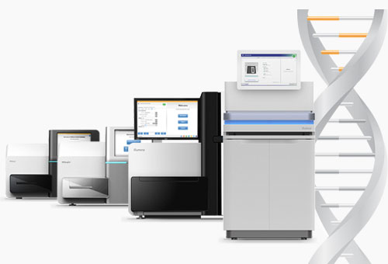
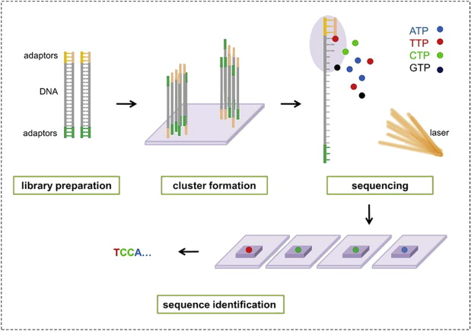
Current Trends
2010s: New DNA sequencing revolution – phylogenetics goes big data
High-throughput methods now allow us to sequence hundreds of genes, generating matrices with hundreds of thousands of characters for each taxa
Big data generates new issues for data analysis: speed, computational power

Slide 74
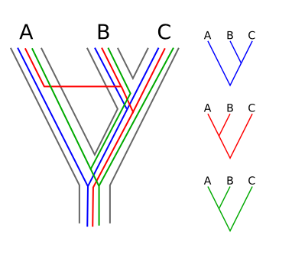
Current Trends
Most phylogenetic methods were developed considering a few genes or markers as input data
With the increase in number of genes in a phylogenetic analysis, we need to worry about genes having different evolutionary histories, different from the species history

Slide 75
Current Trends
The biggest change has been the development of the multispecies coalescent.
Based on the coalescent theory: a model of how alleles of a gene sampled from a population may have originated from a common ancestor.
The multispecies coalescent accounts for ancestral polymorphism and gene tree/species tree conflict.

Slide 76
Current Trends
In the way that the multispecies coalescent is currently applied, maximum likelihood and Bayesian analysis are still used to obtain gene trees for each one of the genes in the analysis.
The multispecies coalescent is used to summarize all the gene trees and obtain a species tree.

Slide 77
Summarizing
🐅
🥑
🍍
🍐
🍎
🦇
🦆
🦅
Establishing homology of the characters is essential!
Always compare things that have the same evolutionary origin!
Evolution and kinship relations as an idea
A graphical representation of kinship, with hypothetical ancestors being a key idea
Big data and methods that account for different evolutionary origins of genes
P(Ei|D)
DNA sequencing changed how we obtain characters and how we analyze them
Complex statistical models that account for different transition rates

Slide 78
