Slide 1

Data wrangling and visualization with R
Carolina M. Siniscalchi
Data science coordinator

Slide 2

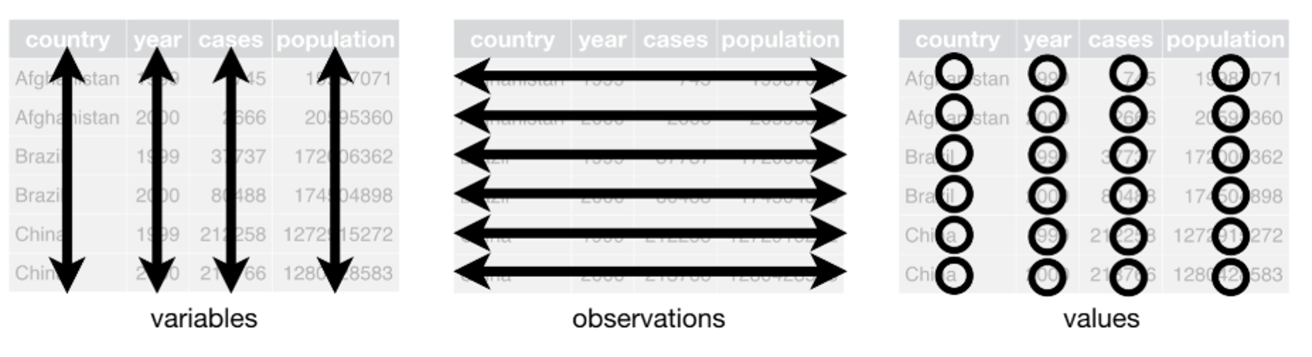
The tidyverse
A collection of packages for data science that share an underlying design philosophy, grammar, and data structures
Based on the principle of tidy data:
  One variable per column
  One observation per row
  One value per cell

Slide 3
Data wrangling
Data wrangling is the process of getting your data into a useful form for visualization, summary, and modeling
Most of the times, data won’t come exactly in the format you need (or it’ll be messy), that’s why we need wrangling
In the tidyverse, we use functions (or verbs) for specific actions
These verbs can be chained together using the pipe %>%
Six main verbs: summarize, group_by, mutate, filter, select and arrange

Slide 4
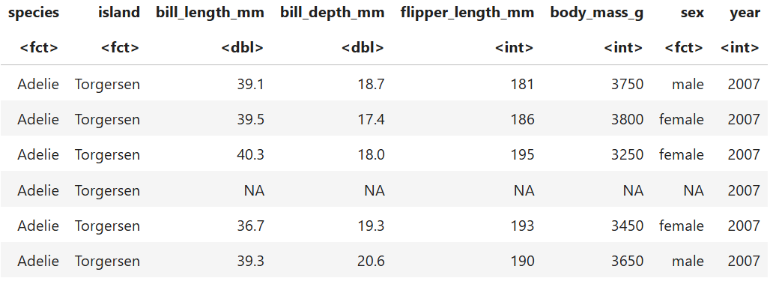
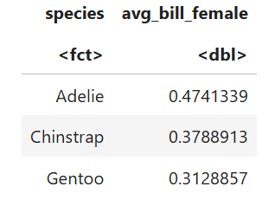
Data wrangling
penguins %>%
drop_na() %>%
filter(sex == "female") %>%
select(species, bill_length_mm, bill_depth_mm) %>%
group_by(species) %>%
mutate(bill_ratio = bill_depth_mm/bill_length_mm) %>%
summarize(avg_bill_female = mean(bill_ratio))

Slide 5
The Grammar of Graphics
- A way of thinking about how graphs are constructed
In language grammar, sentences have different structures or components that are layered together
  Nouns, verbs, pronouns, conjunctions, propositions, etc
  This is the same idea behind the grammar of graphs, a series of structures that together form the graph
  This creates a highly customizable and powerful system
  Why use code to create a figure? Reproducibility!

Slide 6
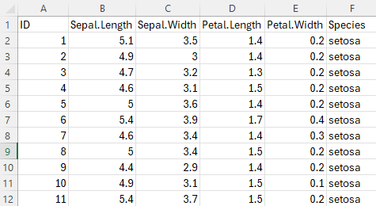
The Grammar of Graphics
Ggplot2 graphs have 3 required layers (or structures) for any type of plot
  Data: a data frame (table) that contain the observations and variables we want to plot
ggplot(iris,

Slide 7
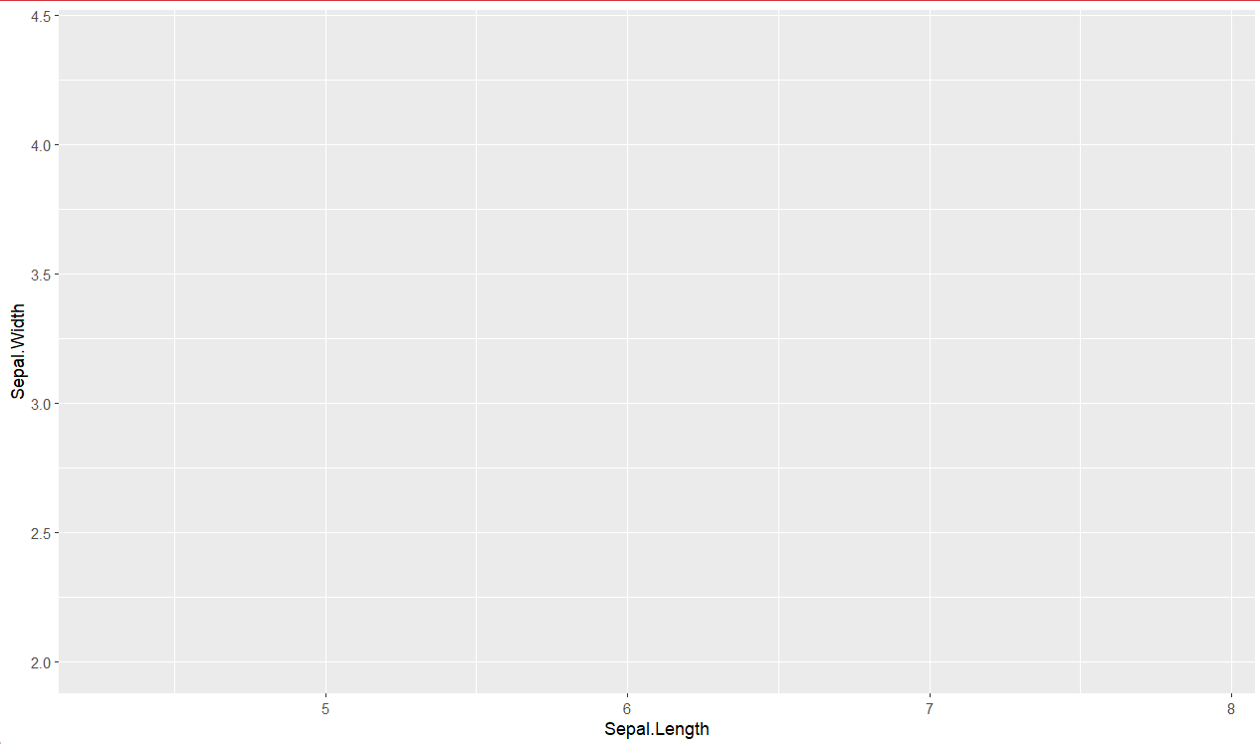
The Grammar of Graphics
Ggplot2 graphs have 3 required layers (or structures) for any type of plot
  Data: a data frame (table) that contain the observations and variables we want to plot
  Aesthetic: the mapping of our variables of interest (the x and y axis, for example)
ggplot(iris, aes(x = Sepal.Length, y = Sepal.Width))

Slide 8
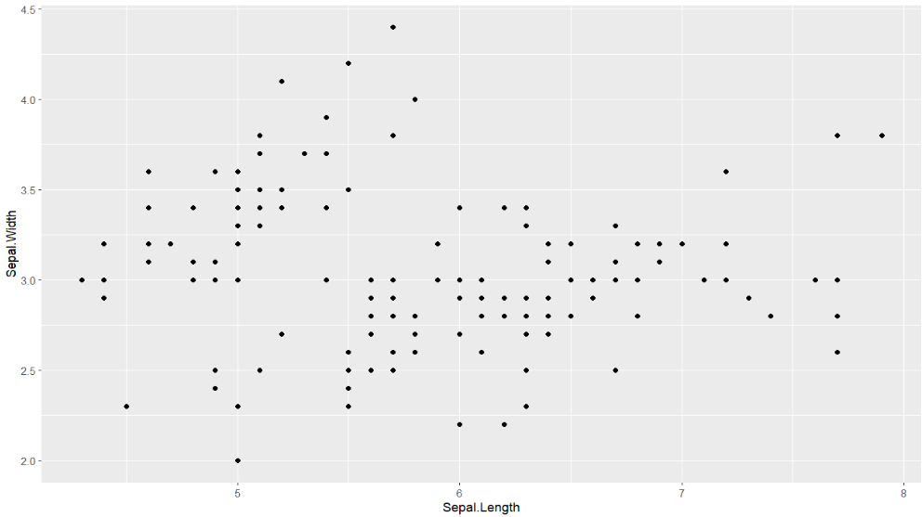
The Grammar of Graphics
Ggplot2 graphs have 3 required layers (or structures) for any type of plot
  Data: a data frame (table) that contain the observations and variables we want to plot
  Aesthetic: the mapping of our variables of interest (the x and y axis, for example)
  Geometry: the type or shape of the visual elements of the graph (for example, bars or points)
ggplot(iris, aes(x = Sepal.Length, y = Sepal.Width)) +
geom_point( )

Slide 9
The Grammar of Graphics
Ggplot2 graphs have 3 required layers (or structures) for any type of plot
  Data: a data frame (table) that contain the observations and variables we want to plot
  Aesthetic: the mapping of our variables of interest (the x and y axis, for example)
  Geometry: the type or shape of the visual elements of the graph (for example, bars or points)
ggplot(iris, aes(x = Sepal.Length, y = Sepal.Width))+
geom_point( )

Slide 10
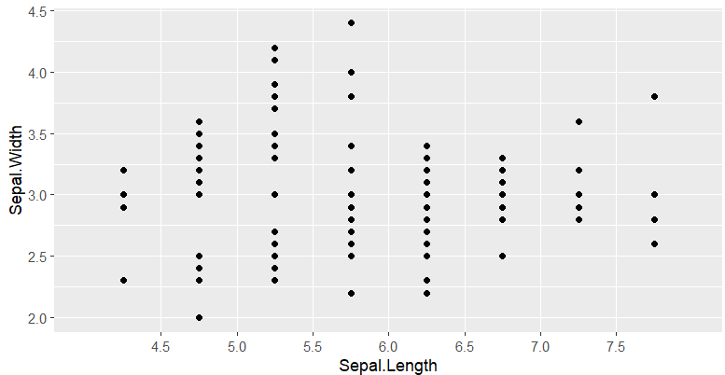
The Grammar of Graphics
- There are other elements that can be added to make modifications to how data or other elements appear in the plot
  Scales: can be used to adjust axis coordinates, add color to geometry structures, etc.
ggplot(iris, aes(x = Sepal.Length, y = Sepal.Width))+
geom_point( ) +
scale_x_binned( )

Slide 11
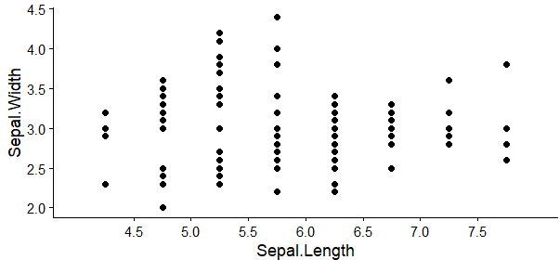
The Grammar of Graphics
- There are other elements that can be added to make modifications to how data or other elements appear in the plot
  Scales: can be used to adjust axis coordinates, add color to geometry structures, etc.
  Themes: change and control non-data display elements
ggplot(iris, aes(x = Sepal.Length, y = Sepal.Width))+
geom_point( ) +
scale_x_binned( ) +
theme_classic( )

Slide 12
Workshop
Here we will use RStudio for interfacing with R
We will use the “penguins” dataset from the palmerpenguins package. It has continuous and categorical variables.
We will learn how to make scatter plots, histograms, bar plots, and box plots.
We will also learn how to change different aspects of our plots.

Slide 13
Useful Resources
R install: https://cran.r-project.org/
RStudio install: https://posit.co/download/rstudio-desktop/
The R Graph Gallery: https://r-graph-gallery.com/
Data to Viz: https://www.data-to-viz.com/
ggplot vignettes: https://ggplot2.tidyverse.org/articles/ggplot2.html
ggplot cheat sheet: https://posit.co/wp-content/uploads/2022/10/data-visualization-1.pdf
R for Data Science: https://r4ds.hadley.nz/
Data Visualization: A Practical Introduction https://socviz.co/

