Slide 1
CodaMOSA: Escaping Coverage Plateaus in Test Generation with Large Language Models
Caroline Lemieux
University of British Columbia
Jeevana Priya Inala
Microsoft Research
Shuvendu K. Lahiri
Microsoft Research
Siddhartha Sen
Microsoft Research
To be presented at 45th IEEE/ACM International Conference on Software Engineering (ICSE’23), Melbourne, Australia

Slide 2
Automated Test Suite Generation
Goal: generate test suites for a given program under test
Test suite should cover diverse behaviors of PUT
State-of-the-art solutions are search-based

Slide 3
Test Input Generation
Generate inputs to a parameterized test function
Parameterized Test Function
def test_insert(tree, to_add):
assume(is_BST(tree))
BST_insert(tree, to_add)
assert(is_BST(tree))
2
2
2
0
7
1
5
3

Slide 4
Test Suite Generation
Generate test cases for a file (e.g., python module, java class) under test
Module Under test
def BST_insert(tree, to_add):
# Insert to_add into tree
<...>
def BST_search(tree, to_search):
# Search tree for to_search
<...>
def BST_delete(tree, to_delete):
# Delete to_delete from tree
<...>
def test_BST_insert():
tree = None
tree = BST_insert(tree, 5)
tree = BST_insert(tree, 3)
tree = BST_insert(tree, 7)
assert tree.value == 5
assert tree.left.value == 3
assert tree.right.value == 7
def test_BST_search():
tree = Node(5)
tree.left = Node(3)
tree.left.left = Node(1)
res = BST_search(tree, 3)
assert res == tree.left
def test_BST_delete():
tree = Node(5)
tree.left = Node(3)
tree.left.left = Node(1)
tree.left.right = Node(4)
BST_delete(tree, 4)
assert tree.left.right is None

Slide 5
Search-Based Test Suite Generation (High-level view)
Test Case Population

Slide 6
Search-Based Test Suite Generation (High-level view)
Test Case Population
(usually, generate randomly)

Slide 7
Search-Based Test Suite Generation (High-level view)
Mutate test cases
Test Case Population
Evolved Test Cases

Slide 8
Search-Based Test Suite Generation (High-level view)
Mutate test cases
Test Case Population
Evolved Test Cases
Fitness (Coverage) Feedback
Evaluate test cases on test program

Slide 9
Search-Based Test Suite Generation (High-level view)
Mutate test cases
Test Case Population
Evolved Test Cases
Fitness (Coverage) Feedback
Evaluate test cases on test program
Update population

Slide 10
Search-Based Test Suite Generation (High-level view)
Mutate test cases
Test Case Population
Evolved Test Cases
Fitness (Coverage) Feedback
Evaluate test cases on test program
Update population

Slide 11
Search-Based Test Suite Generation (High-level view)
Mutate test cases
Test Case Population
Evolved Test Cases
Repeat until full coverage,
or time limit reached
Fitness (Coverage) Feedback
Evaluate test cases on test program
Update population

Slide 12
Search-Based Test Suite Generation (High-level view)
Mutate test cases
Test Case Population
Evolved Test Cases
Fitness (Coverage) Feedback
Evaluate test cases on test program
Update population

Slide 13
Concrete Example
Mutate test cases
Test Case Population
Evolved Test Cases
<...omitted code...>
def _build_version_bump_position(pos: int) -> int:
pos_min = -3
pos_max = 2
if (pos_min <= pos <= pos_max) is False:
raise ValueError("Invalid position")
# Turn position into a positive number
if pos < 0:
pos_max += 1
return pos_max + pos
return pos
<...omitted code...>
def bump_version(version: str, pos: int = 2,
pre_release: Optional[str]= None) -> str:
ver_info = _build_version_info(version)
pos = _build_version_bump_position(pos)
bump_type = _build_version_bump_type(pos, pre_release)
<...omitted code...>
return out
Module under Test
Update population
Evaluate test cases on test program

Slide 14
Concrete Example
Mutate test cases
Test Case Population
Evolved Test Cases
<...omitted code...>
def _build_version_bump_position(pos: int) -> int:
pos_min = -3
pos_max = 2
if (pos_min <= pos <= pos_max) is False:
raise ValueError("Invalid position")
# Turn position into a positive number
if pos < 0:
pos_max += 1
return pos_max + pos
return pos
<...omitted code...>
def bump_version(version: str, pos: int = 2,
pre_release: Optional[str]= None) -> str:
ver_info = _build_version_info(version)
pos = _build_version_bump_position(pos)
bump_type = _build_version_bump_type(pos, pre_release)
<...omitted code...>
return out
Module under Test
bump_version(‘0.0.0’) → ‘0.0.1'
bump_version(‘0.0.0’, 1) → ‘0.1.0'
bump_version(‘0.0.0’, 1, ‘a’) → ‘0.1.0a'
Update population
Evaluate test cases on test program

Slide 15
Concrete Example
Mutate test cases
Test Case Population
Evolved Test Cases
def test_case_1():
str_0 = 'a\t!sUo~AU'
str_1 = bump_version(
str_0)
<...omitted code...>
def _build_version_bump_position(pos: int) -> int:
pos_min = -3
pos_max = 2
if (pos_min <= pos <= pos_max) is False:
raise ValueError("Invalid position")
# Turn position into a positive number
if pos < 0:
pos_max += 1
return pos_max + pos
return pos
<...omitted code...>
def bump_version(version: str, pos: int = 2,
pre_release: Optional[str]= None) -> str:
ver_info = _build_version_info(version)
pos = _build_version_bump_position(pos)
bump_type = _build_version_bump_type(pos, pre_release)
<...omitted code...>
return out
Module under Test
def test_case_2():
str_0 = None
int_0 = 1431
str_1 = bump_version(
str_0, int_0)
Update population
Evaluate test cases on test program

Slide 16
Current Population has Low Coverage
Mutate test cases
Test Case Population
Evolved Test Cases
def test_case_1():
str_0 = 'a\t!sUo~AU'
str_1 = bump_version(
str_0)
<...omitted code...>
def _build_version_bump_position(pos: int) -> int:
pos_min = -3
pos_max = 2
if (pos_min <= pos <= pos_max) is False:
raise ValueError("Invalid position")
# Turn position into a positive number
if pos < 0:
pos_max += 1
return pos_max + pos
return pos
<...omitted code...>
def bump_version(version: str, pos: int = 2,
pre_release: Optional[str]= None) -> str:
ver_info = _build_version_info(version)
pos = _build_version_bump_position(pos)
bump_type = _build_version_bump_type(pos, pre_release)
<...omitted code...>
return out
Module under Test
def test_case_2():
str_0 = None
int_0 = 1431
str_1 = bump_version(
str_0, int_0)
Update population
Evaluate test cases on test program

Slide 17
Create New Test Cases via Mutation
Mutate test cases
Test Case Population
Evolved Test Cases
def test_case_1():
str_0 = 'a\t!sUo~AU'
str_1 = bump_version(
str_0)
def test_case_1m():
str_0 = 'a\t!sUo~AUUUU'
str_1 = bump_version(
str_0)
<...omitted code...>
def _build_version_bump_position(pos: int) -> int:
pos_min = -3
pos_max = 2
if (pos_min <= pos <= pos_max) is False:
raise ValueError("Invalid position")
# Turn position into a positive number
if pos < 0:
pos_max += 1
return pos_max + pos
return pos
<...omitted code...>
def bump_version(version: str, pos: int = 2,
pre_release: Optional[str]= None) -> str:
ver_info = _build_version_info(version)
pos = _build_version_bump_position(pos)
bump_type = _build_version_bump_type(pos, pre_release)
<...omitted code...>
return out
Module under Test
def test_case_2():
str_0 = None
int_0 = 1431
str_1 = bump_version(
str_0, int_0)
def test_case_2p():
str_0 = None
int_0 = 1431
str_1 = bump_version(
str_0, int_0)
int_1 = 1
str_1 = bump_version(
str_0, int_1)
Update population
Evaluate test cases on test program

Slide 18
Mutation Unable to Increase Coverage
Mutate test cases
Test Case Population
Evolved Test Cases
def test_case_1():
str_0 = 'a\t!sUo~AU'
str_1 = bump_version(
str_0)
def test_case_1m():
str_0 = 'a\t!sUo~AUUUU'
str_1 = bump_version(
str_0)
<...omitted code...>
def _build_version_bump_position(pos: int) -> int:
pos_min = -3
pos_max = 2
if (pos_min <= pos <= pos_max) is False:
raise ValueError("Invalid position")
# Turn position into a positive number
if pos < 0:
pos_max += 1
return pos_max + pos
return pos
<...omitted code...>
def bump_version(version: str, pos: int = 2,
pre_release: Optional[str]= None) -> str:
ver_info = _build_version_info(version)
pos = _build_version_bump_position(pos)
bump_type = _build_version_bump_type(pos, pre_release)
<...omitted code...>
return out
Module under Test
def test_case_2():
str_0 = None
int_0 = 1431
str_1 = bump_version(
str_0, int_0)
def test_case_2p():
str_0 = None
int_0 = 1431
str_1 = bump_version(
str_0, int_0)
int_1 = 1
str_1 = bump_version(
str_0, int_1)
✗
Update population
Evaluate test cases on test program

Slide 19
Search stalled. What to do now?
Mutate test cases
Test Case Population
Evolved Test Cases
def test_case_1():
str_0 = 'a\t!sUo~AU'
str_1 = bump_version(
str_0)
def test_case_1m():
str_0 = 'a\t!sUo~AUUUU'
str_1 = bump_version(
str_0)
<...omitted code...>
def _build_version_bump_position(pos: int) -> int:
pos_min = -3
pos_max = 2
if (pos_min <= pos <= pos_max) is False:
raise ValueError("Invalid position")
# Turn position into a positive number
if pos < 0:
pos_max += 1
return pos_max + pos
return pos
<...omitted code...>
def bump_version(version: str, pos: int = 2,
pre_release: Optional[str]= None) -> str:
ver_info = _build_version_info(version)
pos = _build_version_bump_position(pos)
bump_type = _build_version_bump_type(pos, pre_release)
<...omitted code...>
return out
Module under Test
def test_case_2():
str_0 = None
int_0 = 1431
str_1 = bump_version(
str_0, int_0)
def test_case_2p():
str_0 = None
int_0 = 1431
str_1 = bump_version(
str_0, int_0)
int_1 = 1
str_1 = bump_version(
str_0, int_1)
✗
Update population
Evaluate test cases on test program

Slide 20
Core Approach
Evaluation Highlights
Remaining Challenges

Slide 21
Core Approach
Evaluation Highlights
Remaining Challenges

Slide 22
Search-Based Test Suite Generation (High-level view)
Mutate test cases
Test Case Population
Evolved Test Cases
Fitness (Coverage) Feedback
Evaluate test cases on test program
Update population

Slide 23
CodaMOSA Approach
Mutate test cases
Test Case Population
Evolved Test Cases
Fitness (Coverage) Feedback
Evaluate test cases on test program
Update population

Slide 24
Check for Coverage Stalls
Coverage Stalled?
Test Case Population
Evolved Test Cases
Fitness (Coverage) Feedback
Evaluate test cases on test program
Update population

Slide 25
Check for Coverage Stalls
Coverage Stalled?
Test Case Population
Evolved Test Cases
Coverage stall : N iterations without increasing coverage of program under test
Fitness (Coverage) Feedback
Evaluate test cases on test program
Update population

Slide 26
Check for Coverage Stalls
Coverage Stalled?
Test Case Population
Evolved Test Cases
Coverage stall : N iterations without increasing coverage of program under test
We use N=25 in our experiments
Fitness (Coverage) Feedback
Evaluate test cases on test program
Update population

Slide 27
Check for Coverage Stalls
Coverage Stalled?
Test Case Population
Evolved Test Cases
Fitness (Coverage) Feedback
Evaluate test cases on test program
Update population

Slide 28
Check for Coverage Stalls No stalls: proceed as usual
Coverage Stalled?
No, mutate test cases
Test Case Population
Evolved Test Cases
Fitness (Coverage) Feedback
Evaluate test cases on test program
Update population

Slide 29
Check for Coverage Stalls Stall: Invoke Codex for a Hint
Coverage Stalled?
No, mutate test cases
Test Case Population
Evolved Test Cases
Fitness (Coverage) Feedback
Evaluate test cases on test program
Update population

Slide 30
Check for Coverage Stalls Stall: Invoke Codex for a Hint
Coverage Stalled?
Yes, ask for a hint
Prompt to create low-coverage functions tests
No, mutate test cases
Test Case Population
Evolved Test Cases
Fitness (Coverage) Feedback
Evaluate test cases on test program
Update population

Slide 31
Codex Returns Prompt Completions
Coverage Stalled?
Yes, ask for a hint
Prompt to create low-coverage functions tests
Ask Codex
No, mutate test cases
Test Case Population
Evolved Test Cases
Raw Model Output (“natural” code)
def test_case_0():
res = foo.bar(5)
assert res== 7
def test_case_2():
f = foo.Foo()
f.add(4)
f.remove(5)
assert len(f) == 1
def test_case_1():
res = foo.bar(5)
res2 = bax.Bax(6)
assert res== res2
Fitness (Coverage) Feedback
Evaluate test cases on test program
Update population

Slide 32
Extract Test Cases from Completions
Coverage Stalled?
Yes, ask for a hint
Prompt to create low-coverage functions tests
Ask Codex
No, mutate test cases
Test Case Population
Evolved Test Cases
Raw Model Output (“natural” code)
def test_case_0():
res = foo.bar(5)
assert res== 7
def test_case_2():
f = foo.Foo()
f.add(4)
f.remove(5)
assert len(f) == 1
def test_case_1():
res = foo.bar(5)
res2 = bax.Bax(6)
assert res== res2
Fitness (Coverage) Feedback
Evaluate test cases on test program
Extracted Test Cases
Deserialize to mutatable format
Update population

Slide 33
Evaluate Generated Tests
Coverage Stalled?
Yes, ask for a hint
Prompt to create low-coverage functions tests
Ask Codex
No, mutate test cases
Test Case Population
Evolved Test Cases
Raw Model Output (“natural” code)
def test_case_0():
res = foo.bar(5)
assert res== 7
def test_case_2():
f = foo.Foo()
f.add(4)
f.remove(5)
assert len(f) == 1
def test_case_1():
res = foo.bar(5)
res2 = bax.Bax(6)
assert res== res2
Fitness (Coverage) Feedback
Evaluate test cases on test program
Extracted Test Cases
Deserialize to mutatable format
Update population

Slide 34
Codex-Generated Tests Can be Mutated Synergy between LLM and Search
Coverage Stalled?
Yes, ask for a hint
Prompt to create low-coverage functions tests
Ask Codex
No, mutate test cases
Test Case Population
Evolved Test Cases
Raw Model Output (“natural” code)
def test_case_0():
res = foo.bar(5)
assert res== 7
def test_case_2():
f = foo.Foo()
f.add(4)
f.remove(5)
assert len(f) == 1
def test_case_1():
res = foo.bar(5)
res2 = bax.Bax(6)
assert res== res2
Fitness (Coverage) Feedback
Evaluate test cases on test program
Extracted Test Cases
Deserialize to mutatable format
Update population

Slide 35
Codex-Generated Tests Can be Mutated Synergy between LLM and Search
Coverage Stalled?
Yes, ask for a hint
Prompt to create low-coverage functions tests
Ask Codex
No, mutate test cases
Test Case Population
Evolved Test Cases
Raw Model Output (“natural” code)
def test_case_0():
res = foo.bar(5)
assert res== 7
def test_case_2():
f = foo.Foo()
f.add(4)
f.remove(5)
assert len(f) == 1
def test_case_1():
res = foo.bar(5)
res2 = bax.Bax(6)
assert res== res2
Fitness (Coverage) Feedback
Evaluate test cases on test program
Extracted Test Cases
Deserialize to mutatable format
Update population

Slide 36
Codex-Generated Tests Can be Mutated Synergy between LLM and Search
Coverage Stalled?
Yes, ask for a hint
Prompt to create low-coverage functions tests
Ask Codex
No, mutate test cases
Test Case Population
Evolved Test Cases
Raw Model Output (“natural” code)
def test_case_0():
res = foo.bar(5)
assert res== 7
def test_case_2():
f = foo.Foo()
f.add(4)
f.remove(5)
assert len(f) == 1
def test_case_1():
res = foo.bar(5)
res2 = bax.Bax(6)
assert res== res2
Fitness (Coverage) Feedback
Evaluate test cases on test program
Extracted Test Cases
Deserialize to mutatable format
Update population

Slide 37
Codex-Generated Tests Can be Mutated Synergy between LLM and Search
Coverage Stalled?
Yes, ask for a hint
Prompt to create low-coverage functions tests
Ask Codex
No, mutate test cases
Test Case Population
Evolved Test Cases
Raw Model Output (“natural” code)
def test_case_0():
res = foo.bar(5)
assert res== 7
def test_case_2():
f = foo.Foo()
f.add(4)
f.remove(5)
assert len(f) == 1
def test_case_1():
res = foo.bar(5)
res2 = bax.Bax(6)
assert res== res2
Fitness (Coverage) Feedback
Evaluate test cases on test program
Extracted Test Cases
Deserialize to mutatable format
Update population

Slide 38
Recall Concrete Example
Coverage Stalled?
Yes, ask for a hint
Prompt to create low-coverage functions tests
Ask Codex
No, mutate test cases
Test Case Population
Evolved Test Cases
Raw Model Output (“natural” code)
def test_case_0():
res = foo.bar(5)
assert res== 7
def test_case_2():
f = foo.Foo()
f.add(4)
f.remove(5)
assert len(f) == 1
def test_case_1():
res = foo.bar(5)
res2 = bax.Bax(6)
assert res== res2
Fitness (Coverage) Feedback
Evaluate test cases on test program
Extracted Test Cases
Deserialize to mutatable format
Update population

Slide 39
Recall Concrete Example
Coverage Stalled?
Yes, ask for a hint
Prompt to create low-coverage functions tests
No, mutate test cases
Test Case Population
Evolved Test Cases
Ask Codex
def test_case_1():
str_0 = 'a\t!sUo~AU'
str_1 = bump_version(
str_0)
def test_case_1m():
str_0 = 'a\t!sUo~AUUUU'
str_1 = bump_version(
str_0)
<...omitted code...>
def _build_version_bump_position(pos: int) -> int:
pos_min = -3
pos_max = 2
if (pos_min <= pos <= pos_max) is False:
raise ValueError("Invalid position")
# Turn position into a positive number
if pos < 0:
pos_max += 1
return pos_max + pos
return pos
<...omitted code...>
def bump_version(version: str, pos: int = 2,
pre_release: Optional[str]= None) -> str:
ver_info = _build_version_info(version)
pos = _build_version_bump_position(pos)
bump_type = _build_version_bump_type(pos, pre_release)
<...omitted code...>
return out
def test_case_2():
str_0 = None
int_0 = 1431
str_1 = bump_version(
str_0, int_0)
def test_case_2p():
str_0 = None
int_0 = 1431
str_1 = bump_version(
str_0, int_0)
int_1 = 1
str_1 = bump_version(
str_0, int_1)
Raw Model Output (“natural” code)
def test_case_0():
res = foo.bar(5)
assert res== 7
def test_case_2():
f = foo.Foo()
f.add(4)
f.remove(5)
assert len(f) == 1
def test_case_1():
res = foo.bar(5)
res2 = bax.Bax(6)
assert res== res2
Evaluate test cases on test program
Extracted Test Cases
Deserialize to mutatable format
Update population

Slide 40
Search Stalled
Coverage Stalled?
Yes, ask for a hint
Prompt to create low-coverage functions tests
No, mutate test cases
Test Case Population
Evolved Test Cases
Ask Codex
def test_case_1():
str_0 = 'a\t!sUo~AU'
str_1 = bump_version(
str_0)
def test_case_1m():
str_0 = 'a\t!sUo~AUUUU'
str_1 = bump_version(
str_0)
<...omitted code...>
def _build_version_bump_position(pos: int) -> int:
pos_min = -3
pos_max = 2
if (pos_min <= pos <= pos_max) is False:
raise ValueError("Invalid position")
# Turn position into a positive number
if pos < 0:
pos_max += 1
return pos_max + pos
return pos
<...omitted code...>
def bump_version(version: str, pos: int = 2,
pre_release: Optional[str]= None) -> str:
ver_info = _build_version_info(version)
pos = _build_version_bump_position(pos)
bump_type = _build_version_bump_type(pos, pre_release)
<...omitted code...>
return out
def test_case_2():
str_0 = None
int_0 = 1431
str_1 = bump_version(
str_0, int_0)
def test_case_2p():
str_0 = None
int_0 = 1431
str_1 = bump_version(
str_0, int_0)
int_1 = 1
str_1 = bump_version(
str_0, int_1)
Raw Model Output (“natural” code)
def test_case_0():
res = foo.bar(5)
assert res== 7
def test_case_2():
f = foo.Foo()
f.add(4)
f.remove(5)
assert len(f) == 1
def test_case_1():
res = foo.bar(5)
res2 = bax.Bax(6)
assert res== res2
Evaluate test cases on test program
Extracted Test Cases
Deserialize to mutatable format
Update population

Slide 41
Time to Ask for a Hint
Yes, ask for a hint
Coverage Stalled?
Prompt to create low-coverage functions tests
Ask Codex
No, mutate test cases
Test Case Population
Raw Model Output (“natural” code)
<...omitted code...>
def _build_version_bump_position(pos: int) -> int:
pos_min = -3
pos_max = 2
if (pos_min <= pos <= pos_max) is False:
raise ValueError("Invalid position")
# Turn position into a positive number
if pos < 0:
pos_max += 1
return pos_max + pos
return pos
<...omitted code...>
def bump_version(version: str, pos: int = 2,
pre_release: Optional[str]= None) -> str:
ver_info = _build_version_info(version)
pos = _build_version_bump_position(pos)
bump_type = _build_version_bump_type(pos, pre_release)
<...omitted code...>
return out
Evolved Test Cases
test_case_1
test_case_2
def test_case_0():
res = foo.bar(5)
assert res== 7
def test_case_2():
f = foo.Foo()
f.add(4)
f.remove(5)
assert len(f) == 1
def test_case_1():
res = foo.bar(5)
res2 = bax.Bax(6)
assert res== res2
Evaluate test cases on test program
Extracted Test Cases
Deserialize to mutatable format
Update
population

Slide 42
Time to Ask for a Hint
Yes, ask for a hint
Coverage Stalled?
Prompt to create low-coverage functions tests
Ask Codex
No, mutate test cases
Test Case Population
Raw Model Output (“natural” code)
<...omitted code...>
def _build_version_bump_position(pos: int) -> int:
pos_min = -3
pos_max = 2
if (pos_min <= pos <= pos_max) is False:
raise ValueError("Invalid position")
# Turn position into a positive number
if pos < 0:
pos_max += 1
return pos_max + pos
return pos
<...omitted code...>
def bump_version(version: str, pos: int = 2,
pre_release: Optional[str]= None) -> str:
ver_info = _build_version_info(version)
pos = _build_version_bump_position(pos)
bump_type = _build_version_bump_type(pos, pre_release)
<...omitted code...>
return out
Evolved Test Cases
test_case_1
def test_bump_version():
assert bump_version(‘0.0.0') == ‘1.0.0'
assert bump_version(‘0.0.0’, 1) == ‘0.1.0'
test_case_2
Evaluate test cases on test program
Extracted Test Cases
def test_case():
str_0 = ‘0.0.0’
str_1 = bump_version(str_0)
int_0 = 1
str_2 = bump_version(str_0, int_0)
Update
population

Slide 43
Suggested Test Case Increases Coverage
Yes, ask for a hint
Coverage Stalled?
Prompt to create low-coverage functions tests
Ask Codex
No, mutate test cases
Test Case Population
Raw Model Output (“natural” code)
<...omitted code...>
def _build_version_bump_position(pos: int) -> int:
pos_min = -3
pos_max = 2
if (pos_min <= pos <= pos_max) is False:
raise ValueError("Invalid position")
# Turn position into a positive number
if pos < 0:
pos_max += 1
return pos_max + pos
return pos
<...omitted code...>
def bump_version(version: str, pos: int = 2,
pre_release: Optional[str]= None) -> str:
ver_info = _build_version_info(version)
pos = _build_version_bump_position(pos)
bump_type = _build_version_bump_type(pos, pre_release)
<...omitted code...>
return out
Evolved Test Cases
test_case_1
def test_bump_version():
assert bump_version(‘0.0.0') == ‘1.0.0'
assert bump_version(‘0.0.0’, 1) == ‘0.1.0'
test_case_2
Evaluate test cases on test program
Extracted Test Cases
def test_case():
str_0 = ‘0.0.0’
str_1 = bump_version(str_0)
int_0 = 1
str_2 = bump_version(str_0, int_0)
Update
population

Slide 44
Update Population
Yes, ask for a hint
Coverage Stalled?
Prompt to create low-coverage functions tests
Ask Codex
No, mutate test cases
Test Case Population
Raw Model Output (“natural” code)
def test_case():
...
<...omitted code...>
def _build_version_bump_position(pos: int) -> int:
pos_min = -3
pos_max = 2
if (pos_min <= pos <= pos_max) is False:
raise ValueError("Invalid position")
# Turn position into a positive number
if pos < 0:
pos_max += 1
return pos_max + pos
return pos
<...omitted code...>
def bump_version(version: str, pos: int = 2,
pre_release: Optional[str]= None) -> str:
ver_info = _build_version_info(version)
pos = _build_version_bump_position(pos)
bump_type = _build_version_bump_type(pos, pre_release)
<...omitted code...>
return out
Evolved Test Cases
def test_bump_version():
assert bump_version(‘0.0.0') == ‘1.0.0'
assert bump_version(‘0.0.0’, 1) == ‘0.1.0'
test_case_2
Evaluate test cases on test program
Extracted Test Cases
def test_case():
str_0 = ‘0.0.0’
str_1 = bump_version(str_0)
int_0 = 1
str_2 = bump_version(str_0, int_0)
Update
population

Slide 45
Search No Longer Stalled
Yes, ask for a hint
Coverage Stalled?
Prompt to create low-coverage functions tests
Ask Codex
No, mutate test cases
Test Case Population
Raw Model Output (“natural” code)
def test_case():
...
<...omitted code...>
def _build_version_bump_position(pos: int) -> int:
pos_min = -3
pos_max = 2
if (pos_min <= pos <= pos_max) is False:
raise ValueError("Invalid position")
# Turn position into a positive number
if pos < 0:
pos_max += 1
return pos_max + pos
return pos
<...omitted code...>
def bump_version(version: str, pos: int = 2,
pre_release: Optional[str]= None) -> str:
ver_info = _build_version_info(version)
pos = _build_version_bump_position(pos)
bump_type = _build_version_bump_type(pos, pre_release)
<...omitted code...>
return out
Evolved Test Cases
def test_bump_version():
assert bump_version(‘0.0.0') == ‘1.0.0'
assert bump_version(‘0.0.0’, 1) == ‘0.1.0'
test_case_2
Evaluate test cases on test program
Extracted Test Cases
def test_case():
str_0 = ‘0.0.0’
str_1 = bump_version(str_0)
int_0 = 1
str_2 = bump_version(str_0, int_0)
Update
population

Slide 46
Search No Longer Stalled
Yes, ask for a hint
Prompt to create low-coverage functions tests
Coverage Stalled?
Ask Codex
No, mutate test cases
Evolved Test Cases
Test Case Population
def test_case_mutant_0():
str_0 = ‘0.0.0'
str_1 = bump_version(
str_0)
int_0 = -1
str_2 = bump_version(
str_0, int_0)
Raw Model Output (“natural” code)
def test_case():
...
<...omitted code...>
def _build_version_bump_position(pos: int) -> int:
pos_min = -3
pos_max = 2
if (pos_min <= pos <= pos_max) is False:
raise ValueError("Invalid position")
# Turn position into a positive number
if pos < 0:
pos_max += 1
return pos_max + pos
return pos
<...omitted code...>
def bump_version(version: str, pos: int = 2,
pre_release: Optional[str]= None) -> str:
ver_info = _build_version_info(version)
pos = _build_version_bump_position(pos)
bump_type = _build_version_bump_type(pos, pre_release)
<...omitted code...>
return out
def test_case_mutant_n():
str_0 = ‘0.0.0'
str_1 = bump_version(
str_0)
int_0 = -2687
str_2 = bump_version(
str_0, int_0)
def test_bump_version():
assert bump_version(‘0.0.0') == ‘1.0.0'
assert bump_version(‘0.0.0’, 1) == ‘0.1.0'
test_case_2
Evaluate test cases on test program
Extracted Test Cases
def test_case():
str_0 = ‘0.0.0’
str_1 = bump_version(str_0)
int_0 = 1
str_2 = bump_version(str_0, int_0)
Update
population

Slide 47
Search No Longer Stalled
Yes, ask for a hint
Prompt to create low-coverage functions tests
Coverage Stalled?
Ask Codex
No, mutate test cases
Evolved Test Cases
Test Case Population
def test_case_mutant_0():
str_0 = ‘0.0.0'
str_1 = bump_version(
str_0)
int_0 = -1
str_2 = bump_version(
str_0, int_0)
Raw Model Output (“natural” code)
def test_case():
...
<...omitted code...>
def _build_version_bump_position(pos: int) -> int:
pos_min = -3
pos_max = 2
if (pos_min <= pos <= pos_max) is False:
raise ValueError("Invalid position")
# Turn position into a positive number
if pos < 0:
pos_max += 1
return pos_max + pos
return pos
<...omitted code...>
def bump_version(version: str, pos: int = 2,
pre_release: Optional[str]= None) -> str:
ver_info = _build_version_info(version)
pos = _build_version_bump_position(pos)
bump_type = _build_version_bump_type(pos, pre_release)
<...omitted code...>
return out
def test_case_mutant_n():
str_0 = ‘0.0.0'
str_1 = bump_version(
str_0)
int_0 = -2687
str_2 = bump_version(
str_0, int_0)
def test_bump_version():
assert bump_version(‘0.0.0') == ‘1.0.0'
assert bump_version(‘0.0.0’, 1) == ‘0.1.0'
test_case_2
Evaluate test cases on test program
Extracted Test Cases
def test_case():
str_0 = ‘0.0.0’
str_1 = bump_version(str_0)
int_0 = 1
str_2 = bump_version(str_0, int_0)
Update
population

Slide 48
Search No Longer Stalled
Yes, ask for a hint
Prompt to create low-coverage functions tests
Coverage Stalled?
Ask Codex
No, mutate test cases
Evolved Test Cases
Test Case Population
def test_case_mutant_0():
str_0 = ‘0.0.0'
str_1 = bump_version(
str_0)
int_0 = -1
str_2 = bump_version(
str_0, int_0)
Raw Model Output (“natural” code)
def test_case():
...
<...omitted code...>
def _build_version_bump_position(pos: int) -> int:
pos_min = -3
pos_max = 2
if (pos_min <= pos <= pos_max) is False:
raise ValueError("Invalid position")
# Turn position into a positive number
if pos < 0:
pos_max += 1
return pos_max + pos
return pos
<...omitted code...>
def bump_version(version: str, pos: int = 2,
pre_release: Optional[str]= None) -> str:
ver_info = _build_version_info(version)
pos = _build_version_bump_position(pos)
bump_type = _build_version_bump_type(pos, pre_release)
<...omitted code...>
return out
def test_case_mutant_n():
str_0 = ‘0.0.0'
str_1 = bump_version(
str_0)
int_0 = -2687
str_2 = bump_version(
str_0, int_0)
def test_bump_version():
assert bump_version(‘0.0.0') == ‘1.0.0'
assert bump_version(‘0.0.0’, 1) == ‘0.1.0'
test_case_2
Evaluate test cases on test program
Extracted Test Cases
def test_case():
str_0 = ‘0.0.0’
str_1 = bump_version(str_0)
int_0 = 1
str_2 = bump_version(str_0, int_0)
Update
population

Slide 49
Search No Longer Stalled
Yes, ask for a hint
Prompt to create low-coverage functions tests
Coverage Stalled?
Ask Codex
No, mutate test cases
Evolved Test Cases
Test Case Population
def test_case_mutant_0():
str_0 = ‘0.0.0'
str_1 = bump_version(
str_0)
int_0 = -1
str_2 = bump_version(
str_0, int_0)
Raw Model Output (“natural” code)
def test_case():
...
<...omitted code...>
def _build_version_bump_position(pos: int) -> int:
pos_min = -3
pos_max = 2
if (pos_min <= pos <= pos_max) is False:
raise ValueError("Invalid position")
# Turn position into a positive number
if pos < 0:
pos_max += 1
return pos_max + pos
return pos
<...omitted code...>
def bump_version(version: str, pos: int = 2,
pre_release: Optional[str]= None) -> str:
ver_info = _build_version_info(version)
pos = _build_version_bump_position(pos)
bump_type = _build_version_bump_type(pos, pre_release)
<...omitted code...>
return out
def test_case_mutant_n():
str_0 = ‘0.0.0'
str_1 = bump_version(
str_0)
int_0 = -2687
str_2 = bump_version(
str_0, int_0)
test_case_mutant_0
def test_bump_version():
assert bump_version(‘0.0.0') == ‘1.0.0'
assert bump_version(‘0.0.0’, 1) == ‘0.1.0'
test_case_2
test_case_mutant_n
Evaluate test cases on test program
Extracted Test Cases
def test_case():
str_0 = ‘0.0.0’
str_1 = bump_version(str_0)
int_0 = 1
str_2 = bump_version(str_0, int_0)
Update
population

Slide 50
Spoiler: Results on this Benchmark
Yes, ask for a hint
Prompt to create low-coverage functions tests
Coverage Stalled?
Ask Codex
No, mutate test cases
Evolved Test Cases
Test Case Population
SBST-only approach: 18.4% Coverage
Codex-only approach: 64.5% Coverage
Our approach: 91.8% Coverage
(better than the sum of its parts!)
def test_case_mutant_0():
str_0 = ‘0.0.0'
str_1 = bump_version(
str_0)
int_0 = -1
str_2 = bump_version(
str_0, int_0)
Raw Model Output (“natural” code)
def test_case():
...
<...omitted code...>
def _build_version_bump_position(pos: int) -> int:
pos_min = -3
pos_max = 2
if (pos_min <= pos <= pos_max) is False:
raise ValueError("Invalid position")
# Turn position into a positive number
if pos < 0:
pos_max += 1
return pos_max + pos
return pos
<...omitted code...>
def bump_version(version: str, pos: int = 2,
pre_release: Optional[str]= None) -> str:
ver_info = _build_version_info(version)
pos = _build_version_bump_position(pos)
bump_type = _build_version_bump_type(pos, pre_release)
<...omitted code...>
return out
def test_case_mutant_n():
str_0 = ‘0.0.0'
str_1 = bump_version(
str_0)
int_0 = -2687
str_2 = bump_version(
str_0, int_0)
test_case_mutant_0
def test_bump_version():
assert bump_version(‘0.0.0') == ‘1.0.0'
assert bump_version(‘0.0.0’, 1) == ‘0.1.0'
test_case_2
test_case_mutant_n
Evaluate test cases on test program
Extracted Test Cases
def test_case():
str_0 = ‘0.0.0’
str_1 = bump_version(str_0)
int_0 = 1
str_2 = bump_version(str_0, int_0)
Update
population

Slide 51
CodaMOSA Approach
Coverage Stalled?
Yes, ask for a hint
Prompt to create low-coverage functions tests
Ask Codex
No, mutate test cases
Test Case Population
Evolved Test Cases
Raw Model Output (“natural” code)
def test_case_0():
res = foo.bar(5)
assert res== 7
def test_case_2():
f = foo.Foo()
f.add(4)
f.remove(5)
assert len(f) == 1
def test_case_1():
res = foo.bar(5)
res2 = bax.Bax(6)
assert res== res2
Fitness (Coverage) Feedback
Evaluate test cases on test program
Extracted Test Cases
Deserialize to mutatable format
Update population

Slide 52
Challenge: When to ask for a hint?
Coverage Stalled?
Yes, ask for a hint
Prompt to create low-coverage functions tests
Ask Codex
No, mutate test cases
Test Case Population
Evolved Test Cases
Raw Model Output (“natural” code)
def test_case_0():
res = foo.bar(5)
assert res== 7
def test_case_2():
f = foo.Foo()
f.add(4)
f.remove(5)
assert len(f) == 1
def test_case_1():
res = foo.bar(5)
res2 = bax.Bax(6)
assert res== res2
Fitness (Coverage) Feedback
Evaluate test cases on test program
Extracted Test Cases
Deserialize to mutatable format
Update population

Slide 53
Challenge: How to ask for a hint?
Coverage Stalled?
Yes, ask for a hint
Prompt to create low-coverage functions tests
Ask Codex
No, mutate test cases
Test Case Population
Evolved Test Cases
Raw Model Output (“natural” code)
def test_case_0():
res = foo.bar(5)
assert res== 7
def test_case_2():
f = foo.Foo()
f.add(4)
f.remove(5)
assert len(f) == 1
def test_case_1():
res = foo.bar(5)
res2 = bax.Bax(6)
assert res== res2
Fitness (Coverage) Feedback
Evaluate test cases on test program
Extracted Test Cases
Deserialize to mutatable format
Update population

Slide 54
Challenge: How to handle (potentially) arbitrary output from Codex?
Coverage Stalled?
Yes, ask for a hint
Prompt to create low-coverage functions tests
Ask Codex
No, mutate test cases
Test Case Population
Evolved Test Cases
Raw Model Output (“natural” code)
def test_case_0():
res = foo.bar(5)
assert res== 7
def test_case_2():
f = foo.Foo()
f.add(4)
f.remove(5)
assert len(f) == 1
def test_case_1():
res = foo.bar(5)
res2 = bax.Bax(6)
assert res== res2
Fitness (Coverage) Feedback
Evaluate test cases on test program
Extracted Test Cases
Deserialize to mutatable format
Update population

Slide 55
Solutions Discussed Further in Paper
Coverage Stalled?
Yes, ask for a hint
Prompt to create low-coverage functions tests
Ask Codex
No, mutate test cases
When to ask for a hint? After stall, back off when hints not helpful
How to ask for a hint? Prompt with implementation + fn header
How to handle arbitrary output? Add support for importing new functions, arbitrary syntax generated by Codex
Test Case Population
Evolved Test Cases
Raw Model Output (“natural” code)
def test_case_0():
res = foo.bar(5)
assert res== 7
def test_case_2():
f = foo.Foo()
f.add(4)
f.remove(5)
assert len(f) == 1
def test_case_1():
res = foo.bar(5)
res2 = bax.Bax(6)
assert res== res2
Fitness (Coverage) Feedback
Evaluate test cases on test program
Extracted Test Cases
Deserialize to mutatable format
Update population

Slide 56
Core Approach
Evaluation Highlights
Remaining Challenges

Slide 57
Core Approach
Evaluation Highlights
Remaining Challenges

Slide 58
Evaluation Setup
486 Modules from 27 Python Projects
Run each technique 16 times, 600s each
Compare to baselines:
MOSA (no Codex hints)
CodexOnly (no mutative search)
Paper: evaluate CodaMOSA design decisions

Slide 59
Final Coverage Comparison
Measure coverage of techniques at search end time (600s)
Average over all runs presented
Statistical significance test using Mann-Whitney U-Test, p=0.05

Slide 60
Final Coverage Comparison

Slide 61
On Some Benchmarks, No Significant Difference in Achieved Coverage
Statistical significance test using Mann-Whitney U-Test, p=0.05

Slide 62
On Few Benchmarks, Baseline Achieved Higher Coverage

Slide 63
On Many More Benchmarks, CodaMOSA Outperforms Baselines

Slide 64
Common Causes for Improvements
Manually analyze 20 benchmarks w/ biggest coverage increases
15/20 benchmarks: “special strings”
bump_version(‘0.0.0')
7/20 benchmarks: construct data correctly w/o Type Hints
str_0 = ‘devbox01'
host_0 = module_2.Host(str_0)
group_0 = module_0.Group(str_0)
var_0 = [host_0, host_0, host_0, group_0, group_0, group_0]
vars_module_0 = module_1.VarsModule()
var_1 = vars_module_0.get_vars(str_0, str_0, var_0)
5/20 benchmarks: introduce new syntactical constructs
str_0 = ‘c'
var_0 = module_0.join_each(str_0, str_0)
var_1 = list(var_0)

Slide 65
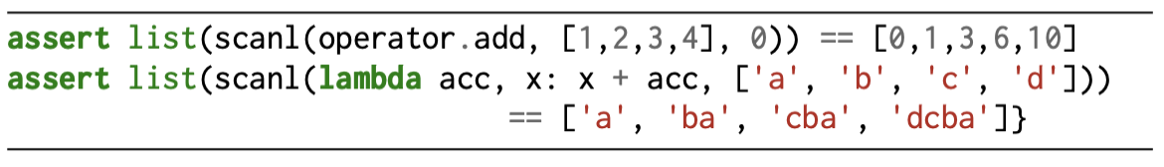
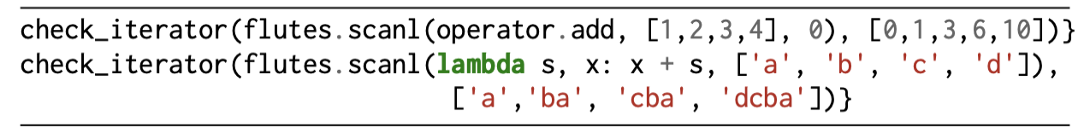
Is Codex Just Copying Existing Tests?
Example with high similarity (0.713)
Codex generation:
Function in other part of code base (out of prompt):

Slide 66
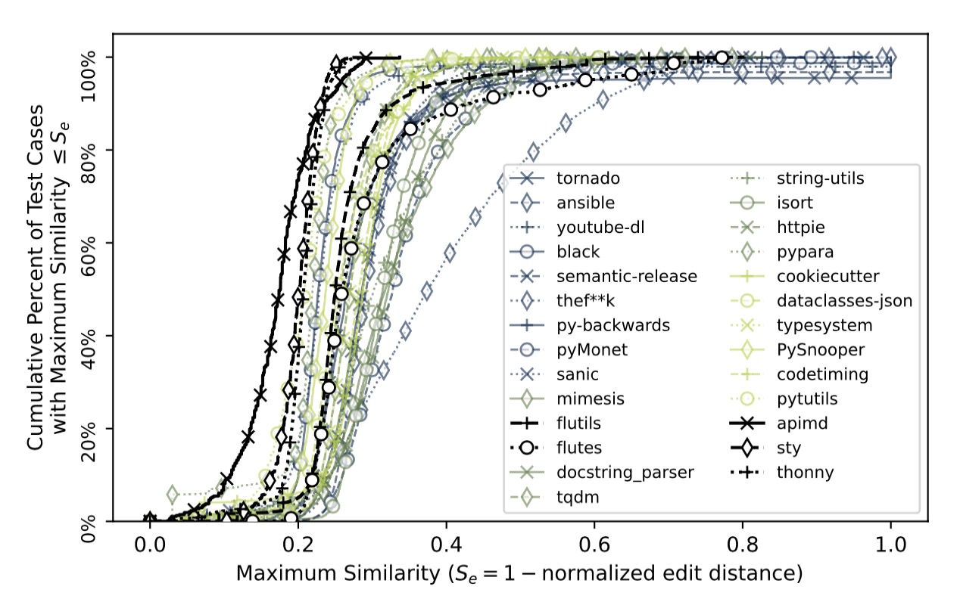
Most Generated Tests Not Too Similar
y-axis: cumulative # of Codex-generated tests with max. similarity <= x-axis

Slide 67
Most Generated Tests Not Too Similar
Similarity from last example
y-axis: cumulative # of Codex-generated tests with max. similarity <= x-axis

Slide 68
Most Generated Tests Not Too Similar
Similarity from last example
y-axis: cumulative # of Codex-generated tests with max. similarity <= x-axis
Most tests have similarity < 0.4

Slide 69
Core Approach
Evaluation Highlights
Remaining Challenges

Slide 70
Core Approach
Evaluation Highlights
Remaining Challenges

Slide 71
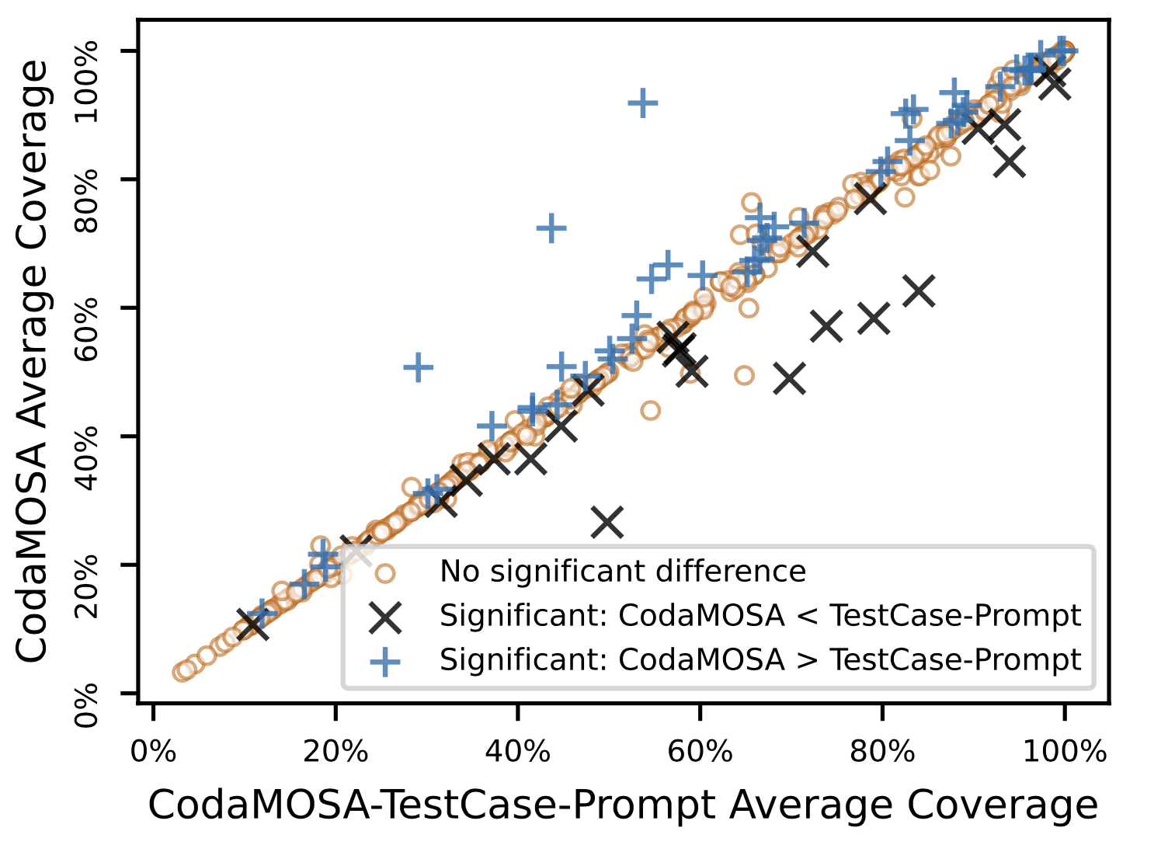
Prompt Engineering
Our prompts are very simple.
Implementation + “# Unit test for function X\ndef test_X():\n”
Our evaluation showed prompts that included example tests sometimes improved performance:
Could do substantially more here.

Slide 72
Finding Bugs
We only evaluate coverage achieved.
coverage =/= bug-finding ability
Codex generations often contain asserts, e.g.:
Can these assertions help us find bugs with the test suites?
In example above, assertions capture wrong semantics
def test_bump_version():
assert bump_version(‘0.0.0') == ‘1.0.0'
assert bump_version(‘0.0.0’, 1) == ‘0.1.0'

Slide 73
Naturalness of Tests
Codex-generated tests are more natural
Than SBST-generated ones
Can we better preserve this naturalness?
def test_bump_version():
assert bump_version(‘0.0.0') == ‘1.0.0'
assert bump_version(‘0.0.0’, 1) == ‘0.1.0'
def test_case_2():
str_0 = None
int_0 = 1431
str_1 = bump_version(str_0, int_0)

