Slide 1

General LTL Specification Mining
login attempt
auth failed
login attempt
guest login
authorized
login attempt
auth failed
login attempt
authorized
Texada
G(x → XFy)
login attempt
guest login
auth failed
Authorized
G(guest login → XFauthorized)
login attempt
auth failed
login attempt
auth failed
Caroline Lemieux, Dennis Park and Ivan Beschastnikh
University of British Columbia
Department of Computer Science
source: https://bitbucket.org/bestchai/texada

Slide 2
Program Specifications
Formal expectation of how a program should work
Specs are useful, but rarely specified by developers
May be difficult to write out
May fall out of date like documentation
program without specs:
easier for initial dev
program with specs:
harder for initial dev
class C{
oo()
ar()
...
}
class C{
oo()
ar()
...
}
class B{
ping()
pongar()
...
}
class B{
ping()
pongar()
...
}
foo() always precedes
bar()
...
class A{
foo()
bar()
...
}
class A{
foo()
bar()
...
}
harder for debugging,
refactoring, maintenance
easier for debugging,
refactoring, maintenance
Notes:
Since I’m going to be talking about mining program specs, what are they and why do we want to mine them? Specs are a formal expectation of how a program should work. Useful, but rarely specified; it’s often easier to just go without them, because they can be difficult to think about/write out, or can fall out of date. However, without them, later tasks of analysis, debugging, comprehension by other devs, can be more difficult. Those tasks can be easier when specs are given, but giving specs is difficult. Ideally, we’d like to reap the rewards of having specs w/o writing them in the first place
Point of slide: specs are useful, but rarely specified, which comes with pros and cons

Slide 3
Program Specifications
Formal expectation of how a program should work
Specs are useful, but rarely specified by developers
May be difficult to write out
May fall out of date like documentation
program without specs:
easier for initial dev
program with specs:
harder for initial dev
class C{
oo()
ar()
...
}
class C{
oo()
ar()
...
}
class B{
ping()
pongar()
...
}
class B{
ping()
pongar()
...
}
foo() always precedes
bar()
...
class A{
foo()
bar()
...
}
class A{
foo()
bar()
...
}
solution: infer specs
harder for debugging,
refactoring, maintenance
easier for debugging,
refactoring, maintenance
Notes:
Our approach to bridge this gap in this work was to infer specs,
Point of slide: inferring specs can link ease of not writing them with rewards reaped from having them

Slide 4
Uses of Inferred Specs in Familiar Systems
class C{
oo()
ar()
...
}
class B{
ping()
pongar()
...
}
foo() always precedes
bar()
...
class A{
foo()
bar()
...
}
foo() always precedes
bar()
...
?
familiar system
inferred specs
unfamiliar system
inferred specs
program maintenance^{[1]}
confirm expected behavior^{[2]}
bug detection^{[2]}
test generation^{[3]}
system comprehension^{[4]}
system modeling^{[4]}
reverse
engineering^{[1]}

[1] M. P. Robillard, E. Bodden, D. Kawrykow, M. Mezini, and T. Ratchford. Automated API Property Inference Techniques. TSE, 613-637, 2013.
[2] M. D. Ernst, J. Cockrell, W. G. Griswold and D. Notkin. Dynamically Discovering Likely Program Invariants to Support program evolution. TSE, 27(2):99–123, 2001.
[3] V Dallmeier, N. Knopp, C. Mallon, S. Hack and A. Zeller. Generating Test Cases for Specification Mining. ISSTA, 85-96, 2010.
[4] I. Beschastnikh, Y. Brun, S. Schneider, M. Sloan and M. D. Ernst .Leveraging existing instrumentation to automatically infer invariant-constrained models. FSE, 267–277, 2011.
Notes:
Inferred specs, though they may contain false positives/negatives, are useful. Even is specs are written out, might not be followed; work has been done to help with test gen
Point of slides: inferred specs can be useful in known systems (even if they’re not 100% correct!)

Slide 5
Inferred Specs in Unfamiliar Systems
class C{
oo()
ar()
...
}
class B{
ping()
pongar()
...
}
foo() always precedes
bar()
...
class A{
foo()
bar()
...
}
foo() always precedes
bar()
...
?
familiar system
inferred specs
unfamiliar system
inferred specs
program maintenance^{[1]}
confirm expected behavior^{[2]}
bug detection^{[2]}
test generation^{[3]}
system comprehension^{[4]}
system modeling^{[4]}
reverse
engineering^{[1]}

[1] M. P. Robillard, E. Bodden, D. Kawrykow, M. Mezini, and T. Ratchford. Automated API Property Inference Techniques. TSE, 613-637, 2013.
[2] M. D. Ernst, J. Cockrell, W. G. Griswold and D. Notkin. Dynamically Discovering Likely Program Invariants to Support program evolution. TSE, 27(2):99–123, 2001.
[3] V Dallmeier, N. Knopp, C. Mallon, S. Hack and A. Zeller. Generating Test Cases for Specification Mining. ISSTA, 85-96, 2010.
[4] I. Beschastnikh, Y. Brun, S. Schneider, M. Sloan and M. D. Ernst .Leveraging existing instrumentation to automatically infer invariant-constrained models. FSE, 267–277, 2011.
Notes:
Inferred specs, though they may contain false positives/negatives, are useful. Even is specs are written out, might not be followed; work has been done to help with test gen
Point of slides: inferred specs can be useful in known systems (even if they’re not 100% correct!)

Slide 6
Spec Mining Sources
Specs can be mined from various program artifacts.
Source code [1]
Documentation [2]
Revision histories [3]
Focus of talk: textual logs (e.g., execution traces)
Easy to instrument, extensible
sales_page
search
sales_anncs
search
sales_anncs
search
search
sales_anncs
sales_anncs
--
homepage
search
homepage
search
sales_anncs
sales_anncs
homepage
search
0 is THINKING
1 is HUNGRY
2 is THINKING
3 is THINKING
4 is THINKING
..
0 is THINKING
1 is EATING
2 is THINKING
3 is THINKING
4 is THINKING
..
0 is THINKING
1 is THINKING
2 is THINKING
3 is THINKING
4 is THINKING
..
StackAr(int)
isFull()
isEmpty()
top()
isEmpty()
topAndPop()
isEmpty()
isFull()
isEmpty()
top()
isEmpty()
push(java.lang.Object)
isFull()
isFull()
isEmpty()
top()
isEmpty()
push(java.lang.Object)
this.currentSize == this.front
this.currentSize == this.back
this.theArray[] elements == null
this.theArray[].getClass() elements == null
this.currentSize == 0
..
this.back <= size(this.theArray[])-1
..
this.back <= size(this.theArray[])-1
..
this.back <= size(this.theArray[])-1
..
this.back <= size(this.theArray[])-1
..
this.theArray[] elements == null
this.theArray[].getClass() elements == null
this.currentSize == 0
this.front one of { 0, 6 }
web log
dining phil.
data struct.
data inv. log
[1] R. Alur, P. Cerny, P. Madhusudan, W. Nam. Synthesis of Interface Specifications for Java Classes. In Proceedings of POPL’05.
[2]L. Tan, D. Yuan, G. Krishna, and Y. Zhou. /*Icomment: Bugs or BadComments?*/. In Proceedings of SOSP’07.
[3] V. B. Livshits and T. Zimmermann. Dynamine: Finding Common Error Patterns by Mining Software Revision Histories. In Proceedings of ESEC/FSE’05.
Notes:
Where exactly can we mine these specs from? Well, from lots of different program artifacts, including source code, documentation, revision histories, and dynamic behavior. In this paper, we’ll be mining from textual logs of dynamic behavior. Mining from textual logs is fairly popular, and we chose them because easy to instrument and extensible (lots of different things rep’d with a textual log)
Here’s an example of a textual log consisting of 4 different traces based on behavior of the OSX login system.
Point of slides: we use textual logs because they’re pretty easy to generate and allow our tool to stay general

Slide 7
Spec Patterns to Mine
In this talk, focus on mining temporal specs
open() is always followed by close() (response pattern)
Many temporal properties could be mined:
strict response pattern + resource allocation ^{[2]}
lots of small patterns to combine into big ones ^{[4]}
…
variations of response pattern ^{[1]}
response patterns of arbitrary length ^{[3]}
branching live-sequence charts ^{[5]}
[1] J. Yang, D. Evans, D. Bhardwaj, T. Bhat and M. Das. Perracotta: Mining Temporal API Rules from Imperfect Traces. ICSE’06.
[2] M. Gabel and Z. Su. Javert: Fully Automatic Mining of General Temporal Properties from Dynamic Traces. FSE’08.
[3] D. Lo, S-C. Khoo, and C. Liu. Mining Temporal Rules for Software Maintenance. Journal of Software Maintenance and Evolution: Research and Practice, 20 (4), 2008.
[4] G. Reger, H. Barringer, and D. Rydeheard. A Pattern-Based Approach to Parametric Specification Mining. In Proceedings of ASE’13.
[5] D. Fahland, D. Lo, and S. Maoz. Mining Branching-Time Scenarios. In Proceedings of ASE’13.
Notes:
The other main question is which properties to mine, While people mine data specs, we’ll be focusing on mining temporal specs, which relate events through time. But even within this, lots of different patterns could be mine. In fact, miners have been built to mine … [go through patterns]. Most of these tools have been found to be useful for bug detection, some are efficient at their tasks, some handle
Point of slide: yes, many miners exist to mine temporal specs from logs.

Slide 8
Spec Patterns to Mine
In this talk, focus on mining temporal specs
open() is always followed by close() (response pattern)
Many temporal properties could be mined:
strict response pattern + resource allocation ^{[2]}
lots of small patterns to combine into big ones ^{[4]}
Which temporal spec mining tool should I use?
…
variations of response pattern ^{[1]}
response patterns of arbitrary length ^{[3]}
branching live-sequence charts ^{[5]}
[1] J. Yang, D. Evans, D. Bhardwaj, T. Bhat and M. Das. Perracotta: Mining Temporal API Rules from Imperfect Traces. ICSE’06.
[2] M. Gabel and Z. Su. Javert: Fully Automatic Mining of General Temporal Properties from Dynamic Traces. FSE’08.
[3] D. Lo, S-C. Khoo, and C. Liu. Mining Temporal Rules for Software Maintenance. Journal of Software Maintenance and Evolution: Research and Practice, 20 (4), 2008.
[4] G. Reger, H. Barringer, and D. Rydeheard. A Pattern-Based Approach to Parametric Specification Mining. In Proceedings of ASE’13.
[5] D. Fahland, D. Lo, and S. Maoz. Mining Branching-Time Scenarios. In Proceedings of ASE’13.
Notes:
The other main question is which properties to mine, While people mine data specs, we’ll be focusing on mining temporal specs, which relate events through time. But even within this, lots of different patterns could be mine. In fact, miners have been built to mine … [go through patterns]. Most of these tools have been found to be useful for bug detection, some are efficient at their tasks, some handle
Point of slide: yes, many miners exist to mine temporal specs from logs.

Slide 9
“Ultimate” Temporal Spec Inference
mine any general temporal pattern
Texada
pattern-based: can output a set of simple patterns, or more general patterns
patterns specified in LTL, includes 67 pre-defined templates
Notes:
If we look in the data spec inference space, Daikon is a really widely-used tool. It’s been used to build other tools, and it’s really just a pattern-based miner, not mining them for the sake of making very complex patterns: it outputs jus these simple ones. In theory, extensible to general pattern, though some new code may have to be written.
Part of our motivation in this work was to build a tool that would fit a similar niche in the temporal spec inference space; no necessarily optimized for a single set of patterns, but one that can output all the building blocks necessary for use by other tools and that would be applicable in many different contexts.
Point of slide: re-inforce that general temporal pattern mining thing

Slide 10
Contributions
Texada: general LTL specification miner
Approximate confidence/support measures for LTL
Concurrent system analysis
Dining Philosophers
Sleeping Barber
a
b
c
e
d
Ψ(a,b)
Texada
Ψ(x,y)
Ψ(c,e)
Ψ(e,d)
textual log
any LTL formula
inferred specs
Notes:
Our contribution to this goal is building Texada, which mines general LTL specifications. It takes in textual log and a set of LTL formula and outputs specs which match the formula but have events from the log in place of the variables. We also have done work on some measures of confidence/support measures for LTL to help with eval on imperfect logs, and I’ll talk about some features that allow Texada to do concurrent systems analysis.
Point of Slide: contributions. confidence and multi-propositional logs allow more generality.

Slide 11
Texada Outline
inputs
login attempt
guest login
auth failed
authorized
--
login attempt
auth failed
login attempt
authorized
--
login attempt
auth failed
login attempt
auth failed
--
login attempt
auth failed
login attempt
guest login
authorized
--
Texada
Log Parser
Property Instance Checker
output
parsed log
G(guest login → XFauthorized)
Valid Property Instances
property instances
Log
“x is always followed by y”
SPOT^{[1]} LTL Parser
events
Property Instance Generator
G(x→XFy)
formula tree
Property Type
[1] A. Duret-Lutz and D. Poitrenaud. Spot: an Extensible Model Checking Library using Transition-Based Generalized Buchi automata. In Proceedings of MASCOTS’04.
Notes:
As I mentioned, Texada takes in a textual log an property type to find the valid instances of that property, here we have AFBY, and on this login system log, find that gl->auth is the only one that holds.
* on the inside of Texada, we start by parsing the log and property type into interpretable format; LTL parsing done by model-checking library SPOT. information from both of these is passed to a property instance generator, which passes the instances along to the checker, so the checker can ouput only the valid ones. The checking on top is dependent on the log format, so I’ll start by talking about this bit which is independent of log format
Point of slide: outline Texada, give idea of what’s coming next

Slide 12
Property Type Mining
Parse each property type into interpretable format (tree)
For each property type, dynamically generate and check property instances on log:
G(authorized → XFguest login)
G(authorized → XFlogin attempt)
G(authorized → XFauth failed)
G(guest login → XFauthorized)
“x is always followed by y”
G(auth failed→ XFauthorized)
G(x→XFy)
G(auth failed→ XFguest login)
G(auth failed → XFauthorized)
G(guest login→ XFlogin attempt)
G(guest login→ XFauth failed)
G(login attempt → XFauthorized)
G(login attempt → XFguest login)
G(login attempt → XFauth failed)
Notes:
After the property type has been parsed, we plug the log events into it and dynamically generate each instance. As we generate the instance, we check them on the log – if they’re false, we discard them. If they’re true we keep them, and after having explored everything , we just output the valid ones
How is each property instance checked on the log? well, that depends on the format of the log
Point of slide: re-inforce that we’re dynamically generating + checking property instances

Slide 13
Linear Log Parsing
Texada parses logs by regexes (specify event line format, trace separator)
set of traces in linear format
login attempt
guest login
auth failed
authorized
--
login attempt
auth failed
login attempt
authorized
--
login attempt
auth failed
login attempt
auth failed
--
login attempt
auth failed
login attempt
guest login
authorized
--
1.
login attempt | guest login | auth failed | authorized
2.
login attempt | auth failed | login attempt | authorized
3.
login attempt | auth failed | login attempt | auth failed
4.
login attempt | auth failed | login attempt | guest login | authorized
Notes:
Texada parses logs by taking in regexes which specify what events and trace separators looks like: here events are the entire line and the trace separators are the double-dashes. The linear format just plunks each trace into an array or vector containing the events in the sequence they appear, and finished by the EOT.

Slide 14
Property Instance Checking (Linear Alg)
Check each instance on each trace in log
holds on trace ⇔ holds on first event of trace
0 1 2 3
guest login | login attempt | auth failed | authorized
G
G(p): check if p holds at every time point
→
p
q→r :check if q→r
r
q
X
X(s): check if s holds at next time point
guest login
F(a): check if a holds at some time point
s
F
authorized
Notes:
To check on that linear log, we check an instance on each trace. an instance holds on a trace if the whole thing holds on the first event of the trace, so we’ll be checking this tree at 0. From here,
we apply the definition of the LTL operators, with the caveat of our slightly modified finite trace semantics, which we detail in the paper.
So the G opertor means this. Inside the p we have an implication, which to check we must check if q is true, then r is true at 0. revealing q, it’s guest login, which clearly holds at one. So we’ll need to make sure r holds
in this case, r is this. Xs holds at 0 if s holds at one, so we’ll go check at 1.
s turns out to be an eventually authorized operator; to check we check if 1 is authorized or if eventually authorized holds at 2; since login attempt =/= authorized, we need to check if eventually authorized holds at 2; this unrolls to the same checking condition, but at 2; auth failed =/= authorized, go to 3, where we find a holds, so the eventually hold, a result which tells us it holds at 1.
Since s holds at 1, Xs holds at 0, and as such both q and r hold at 0, satisfying the implication.
So the first part of this globally check is satisfied; we’ll recurse on each event of the trace similarly to this. This algorithm works, and is fairly intuitive, but suffers as trace length increases
Point of slide: give intuition to how linear miner works

Slide 15
Linear Algorithm Observations
Linear checker works but … is slow.
Notice: most temporal operators rely on relative positions
Optimization: use map format
event | posns
login attempt | [0]
guest login | [1]
auth failed | [2]
authorized | [3]
login attempt | guest login | auth failed | authorized
event | posns
login attempt | [0,2]
auth failed | [1,3]
login attempt | auth failed | login attempt | auth failed
Notes:
Since many temporal props depend on relative, not absolute posn’s of events, we could actually maybe skip over unimportant parts of traces. This brings us to the second trace format, the map log, where each event in the trace is mapped to its occurrences.
Point of slide: linear algorithm works but scales with trace length far too much. Could we skip over unimportant events

Slide 16
Checking on Map Traces
Check on trace in map form also tree-based
but also uses the negation of nodes
Map form allows algorithm to skip over trace
event | posns
login attempt | [0]
guest login | [1]
auth failed | [2]
authorized | [3]
G(p) holds at 0 if !p never occurs
find first occurrence of !p
G
&
first occ ≥ 3
!p never occurs in trace, G(p) holds.
X
→
guest login
guest login
X
search for first occurrence of guest login (1)
G
F
!
authorized
first occurs at last occurrence of authorized (3)
authorized
Notes:
The algorithm still recurses along the tree, but uses helpers ffo and flo and uses the negation of parts of the tree. For example, when checking G(p), instead of checking if it holds at each point, we’ll check if the negation of the inside ever occurs by trying to find the first occ of it. Since it’s an and, we find the first occ of each kid: guest login can be fd by binary search, right by some recursive definition of ffo/flo which tells us it first occurs at last occurrence of auth (since it’s after the last occ of auth the G!auth holds).
Since fo of right is 3, first occ of the and must be after 3 – but when we find fo of guest login after 3, we see it doesn’t occur; so overall, this and doesn’t occur. So !p never occurs, which tells us G(p) occurs.
This alg provides us with some efficiency returns on checking one instance, but a lot of the runtime comes from the huge amount of instantiations we have to check.
Point of slide: give intuition for map

Slide 17
Memoization (reuse of computation)
To check property type, check each instance on log
for N unique events, M variables, ~N^{M} instances
tree form allows for specialized memoization
Preliminary memo over 3 instantiations: 7% speedup
G
G
G
G
G
→
→
G
→
G
X
→
X
→
X
G
F
G
X
X
F
G
F
G
→
F
→
→
F
→
X
→
X
G
X
→
G
F
G
F
→
F
X
→
→
X
F
guest login
X
login attempt
X
X
X
F
G
G
F
→
X
F
→
X
G
F
G
F
G
→
X
→
F
F
G
→
F
X
→
X
G
G
F
→
X
F
X
→
X
F
authorized
authorized
F
F
Notes:
Luckily, there are ways we can eval this. Since each property instance is checked on the log, we may be checking prop types w/ very similar trees. E.g., here we can save state across instantiations because these subtrees are similar.
This is currently implemented in map checker ffo/flo methods, since they’re the main recursive ones in ffo/flo. To extend this, more works needs to be done on expiration policy, which could involve finding an order of instantiation which takes advantage of freq. occurring subsets of variables.
That’s all about trying to augment efficiency. We have also worked on trying to get Texada to be applicable on logs which may not be perfect
point of slide: the tree format lets us have some inter-instantiation time saving

Slide 18
Support, Confidence for LTL
Want to know which instances “almost never” violated
check guest login is always followed by authorized:
Can we formalize this?
login attempt
guest login
auth failed
authorized
guest login
authorized
guest login
only one guest login not followed by authorized – guest login is almost always followed by authorized
Notes:
e.g. a logging system might fail for some reason and we want to know which instances were almost never violated. Here, for example, only one guest login was not followed by authorized – so guest login might almost always hold.
Is there a way to formalize this notion?
Point of slide: increase generality by computing heuristics for almost never violated instances

Slide 19
Initial Support, Confidence Concept
Proposal: support for G(p) = # number of time points where p holds
But: support for G(p→XFq)
qqqq
qpqq
pppp
sup G(p)= 0
sup G(p)= 1
sup G(p)= 4
pppq
pqpp
rrrr
sup G(p→XFq)= 4
sup G(p→XFq)= 2
sup G(p→XFq)= 4
Notes:
A first idea for properties which check G(p) is to look at the number of time points were p occurs; support increases as time points where p holds increases.
This leads to some counter-intuitive things for always followed by, since the x iplies eventually Xfy part holds when y does not. So if we extend a trace with a bunch of non-x events, we would be increasing the support of this property, which doesn’t really seem to capture what we want.
point of slide: give intuition for why just counting all time points doesn’t work

Slide 20
Support, Confidence Heuristic
What we do: focus on falsifiability
Call these vacuously true time points not falsifiable
Approximate support, support potential for arbitrary LTL
Support potential of Ψ: number of falsifiable time points
Support of Ψ: number of falsifiable time points on which Ψ is satisfied
Confidence of Ψ: support/support potential (or 1 if both are 0)
login attempt
guest login
auth failed
authorized
guest login
authorized
guest login
guest login→ XFauthorized
vacuously true on
Notes:
Our goal then is that we don’t count vacuously true time points towards support; call those vacuously true time points as not falsifiable, and defs as here.
point of slide: give “definition” of falsifiability, support, support potential, confidence

Slide 21
Texada Evaluation
Can Texada mine a wide enough variety of temporal properties?
Can Texada help comprehend unknown systems?
Real estate web log
StackAr
Can Texada confirm expected behavior of systems?
Dining Philosophers
Sleeping Barber
Is Texada fast?
Texada vs. Synoptic
Texada vs. Perracotta
Can we use Texada’s results to build other tools?
Quarry prototype
Notes:
I’ll introduce some of the work we’ve done evaluating Texada. These can be found in our tools or main paper, and I’ll just briefly mention that
point of slide: outline all we’ve looked at

Slide 22
Texada Evaluation
Can Texada mine a wide enough variety of temporal properties?
Can Texada help comprehend unknown systems?
Real estate web log
StackAr
Can Texada confirm expected behavior of systems?
Dining Philosophers
Sleeping Barber
Is Texada fast?
Texada vs. Synoptic
Texada vs. Perracotta
Can we use Texada’s results to build other tools?
Quarry prototype
NEW
Notes:
concurrent systems eval I mentioned earlier, and some comparision to other temporal mining tools.
say that some of our stuff is new

Slide 23
Expressiveness of Property Types
Texada can express properties from prior work
Synoptic^{[1]}
Perracotta^{[2]}
Patterns in Property Specifications for Finite-State Verification
[Dwyer et al. ICSE’99]
Name | Regex | LTL
Always Followed by |  | G(x→XFy)
Never Followed by |  | G(x→XG!y)
Always Precedes |  | (!y W x)
Alternating | (xy)* | (!y W x) & G((x→X(!x U y)) & (y→ X(!y W x)))
MultiEffect | (xyy*)* | (!y W x) & G(x→X(!x U y))
MultiCause | (xx*y)* | (!y W x) & G((x→XFy) & (y→X(!y W x)))
EffectFirst | y*(xy)* | G((x→X(!x U y)) & (y→ X(!y W x)))
OneCause | y*(xyy*)* | G(x→X(!x U y))
CauseFirst | (xx*yy*)* | (!y W x) & G(x→XFy)
OneEffect | y*(xx*y)* | G((x→XFy) & (y→X(!y W x)))
Texada can mine a wide variety of properties
Texada can mine concurrent sys. properties
Texada has reasonable performance

[1] I. Beschastnikh, Y. Brun, S. Schneider, M. Sloan and M. D. Ernst. Leveraging Existing Instrumentation to Automatically Infer Invariant-Constrained Models. FSE11.
[2] Jinlin Yang, David Evans, Deepali Bhardwaj, Thirumalesh Bhat, Manuvir Das. Perracotta: Mining Temporal API Rules from Imperfect Traces. ICSE06.
Notes:
Point: Texada can mine all these

Slide 24
Dining Philosophers
Classic concurrency problem: philosophers sit around a table, thinking, hungry, or eating.
These specs could not be checked with previous temporal spec miners!
needs two chopsticks to eat
0
but this pair can eat at the same time
4
1
so this pair can’t eat at the same time
3
2
Notes:
We wanted to look at systems w/ temporal properties that couldn’t be mined w/ previous temporal spec miners. In particular, dining phil, a classic concurrency problem with this.
point of slide: outline dining, philosophers, motivate take away (specs could not be checked before w/ other miners, systems could exhibit several temporal properties, might be other unthought-of temporal properties)

Slide 25
Multi-Propositional Traces
LTL: multiple atomic propositions may hold at a time
Standard log model: one event at each time point
Texada supports multi-propositional logs: multiple events can occur at one time point
Dining philosophers log: 5 one minute traces, 6.5K lines
0 is THINKING
1 is HUNGRY
2 is THINKING
3 is THINKING
4 is THINKING
..
0 is THINKING
1 is EATING
2 is THINKING
3 is THINKING
4 is THINKING
..
...
multiple events at single time point
time point
separator
Notes:
To check those properties, need multi-prop traces, where more than one event can hold at a time point. This is supported by the LTL formalism, but generally not in trace checking. So here is part of the dining phil log we’ll be checking the prop on; ran a sol’n for 1 minute 5 times and logged the states of each phil at one time point; each is an event, but a concurrent one, seperated by this time point separator. With this we checked
point of slide: we need this new thing, it’s new!

Slide 26
Dining Phil. Mutex (safety property)
Two adjacent philosophers never eat at the same time
Property pattern: G(x →!y) “if x occurs, y does not”
Texada output for G(x →!y) includes
0
G(3 is EATING → ! 4 is EATING)
4
1
G(4 is EATING → ! 3 is EATING)
3
2
G(0 is EATING → ! 1 is EATING)
G(0 is EATING → ! 4 is EATING)
together, mean that two adjacent philosophers never eat at the same time
G(1 is EATING → ! 2 is EATING)
G(2 is EATING → ! 3 is EATING)
G(3 is EATING → ! 4 is EATING)
Notes:
That the mutex condition held; we used the property pattern alwaus if x occurs y does not; this property is symmetric, so having one thing output for each pair gave us the mutex held for the observed log
Give example of concurrent prop 1 (does not necessarily confirm that there’s never a bug, but supportive)

Slide 27
Dining Phil. Efficiency (liveness property)
Non-adjacent philosophers eventually eat at the same time
Property pattern: F(x & y) “eventually x and y occur together”
Texada output for F(x & y) includes
0
F(2 is EATING & 4 is EATING)

Texada can mine a wide variety of properties
Texada can mine concurrent sys. properties
Texada has reasonable performance
4
1

F(4 is EATING & 2 is EATING)
3
2
F(0 is EATING & 2 is EATING)
F(0 is EATING & 3 is EATING)
together, mean that non-adjacent philosophers eventually eat at the same time
F(1 is EATING & 3 is EATING)
F(1 is EATING & 4 is EATING)
F(2 is EATING & 4 is EATING)
Notes:
Similarly, we checked the eventually eat with this patten; again it is symmetric, and we found the pairs all held, meaning that non-adj phils got to eat at the same time in all observed traces
caveat: only eventually on finite traces

Slide 28
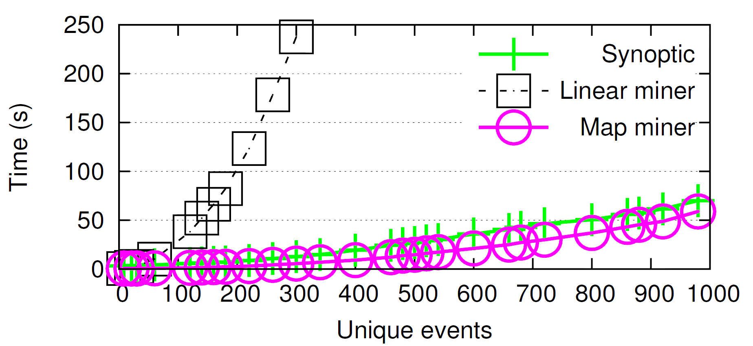
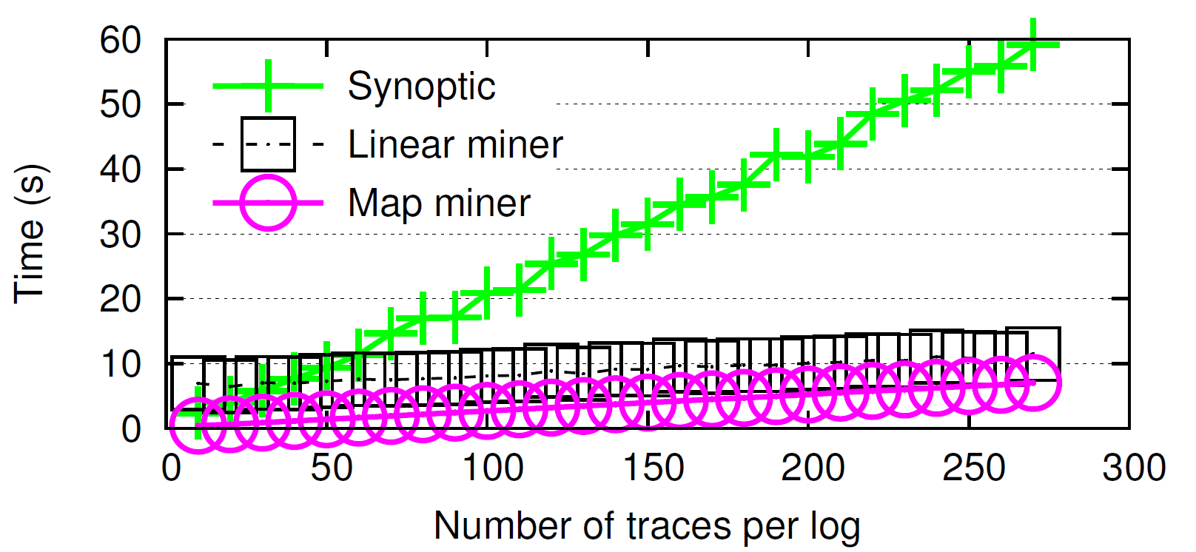
Texada vs. Synoptic
Texada performs favourably against Synoptic’s miner on three property types it is specialized to mine.
More results in paper.
Texada algs benefit from log-level short-circuiting.
Notes:
Texada’s miners performed favourably against synoptic, especially against the map miner. Here we see the number of traces per log increasing and the time it took to mine all these properties. We see that both miners do well here, probably because Texada short-circuits on traces. The take-away is that many specialized miners built for other tools may not all be super good, and it could be useful to have a general miner which is good for most properties instead of re-writing inference code again.
take-away: last bullet point

Slide 29
Texada vs. Perracotta
Perracotta performs favourably against Texada:
Perracotta’s algorithm particularly effective at reducing instantiation effect on runtime.
Further memoization work (along with good expiration policies) might help reduce instantiation effect
Unique events (10K events/trace, 20 traces/log) | Perracotta | Texada (map miner)
120 | 0.85 s | 2.42 s
160 | 0.97 s | 4.07 s
260 | 1.42 s | 10.21 s
Texada can mine a wide variety of properties
Texada can mine concurrent sys. properties
Texada has reasonable performance



Notes:
Perracotta is optimizied for these events by trading away the effect of runtime on increasing instantiations – since there are two variables in these formulae, the number of instantiations runs N^2. Clearly, this strategy works well for the 2-prop type formulae and Texada’s current memo policies can’t keep up with it. While Texada can’t generally adopt optimization policies for pc or other miners due to the generality, we could try to get memo working better
Point: yes, there are strategies to cut down on time, but they are highly specialized (can’t take up O(n^m) size)

Slide 30
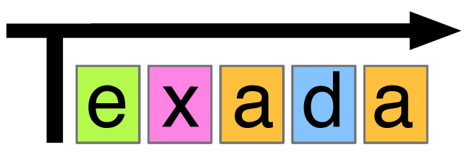
Conclusion
Many temporal spec miners, unclear which to use
Texada: general LTL spec miner
confirms expected behavior, discovers unexpected use patterns
prototyped confidence measures (future work to improve this)
can examine concurrent system logs
Open source and ready to use:
https://bitbucket.org/bestchai/texada/
Notes:
We’ve mentioned that the space of temporal spec miners is vast and difficult to know which one to use. We provide an all-in-one tool that mines general LTL props from textual logs and that will be useful for stuff. Texada is open source and can be used here, or in a browser based demo. I’ll be giving a tool demo Friday morning and you can come see our tool demo time Friday at 2. thanks.

