Slide 1
MIST 4610 – Data Management and Analytics
Dr. Nikhil Srinivasan
MIS@Terry

Slide 2
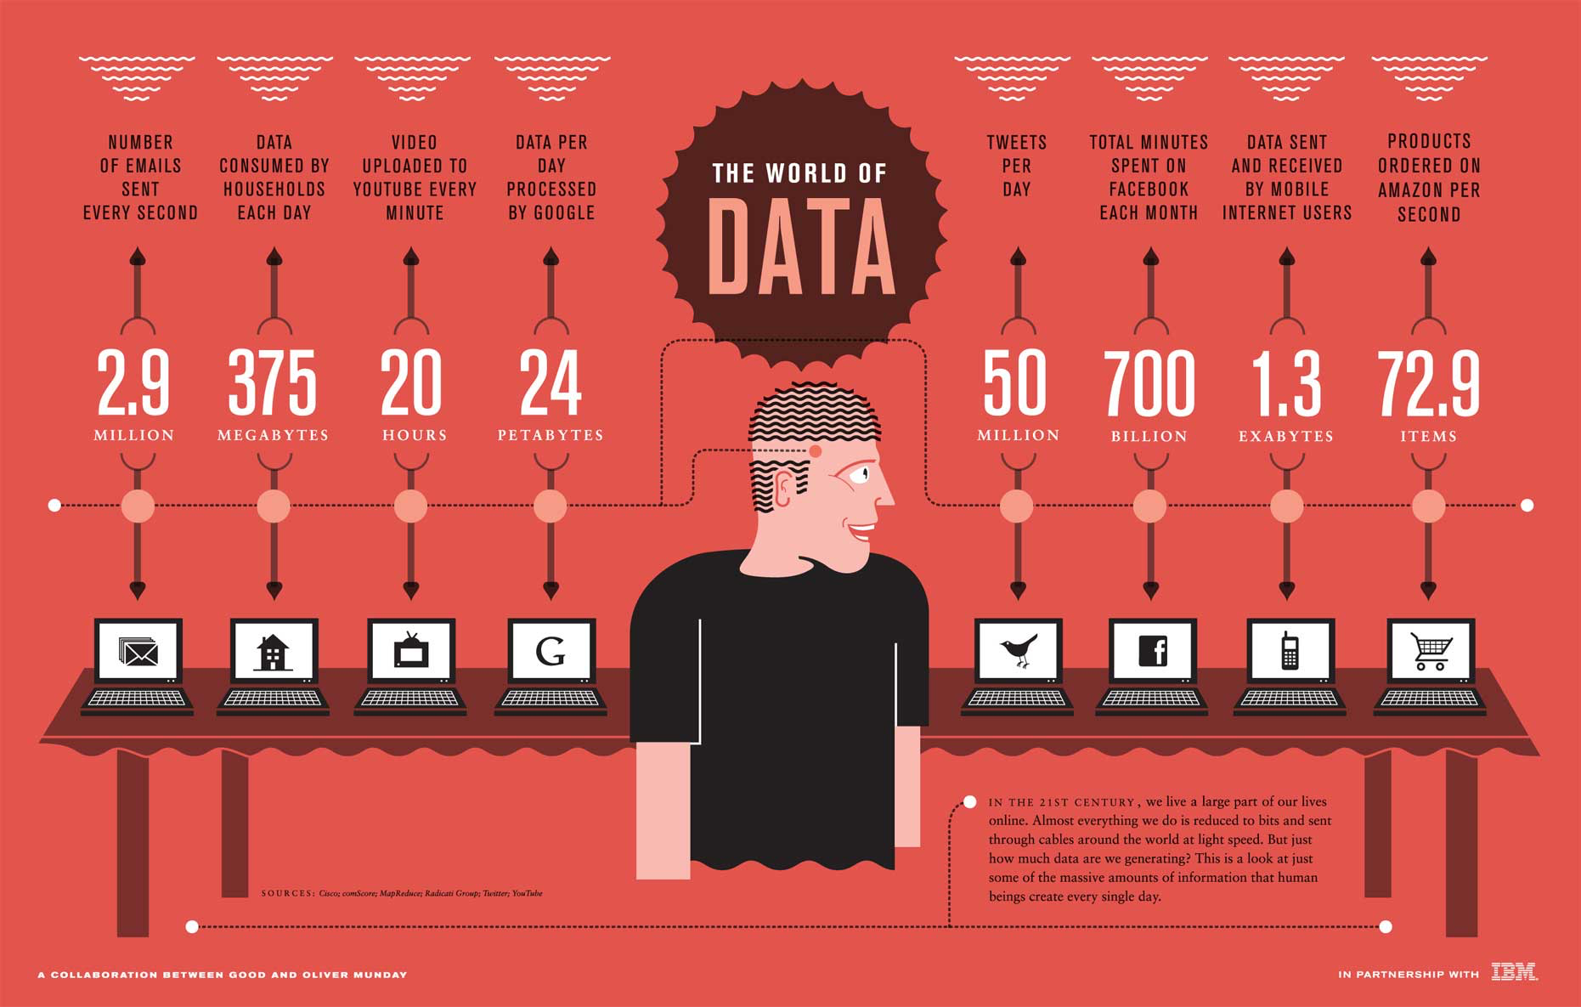
The data deluge
Overwhelming flow of data and information

Slide 3
The data deluge
Specialized, local and interconnected knowledge
Winnowing it down
Algorithms
People

Slide 4
The data deluge
A variety of challenges posed
Protecting Privacy
Providing Security
Saving Energy
Extracting Value

Slide 5
Managing Data

Slide 6
Data management
What are some examples of data individuals need to manage?
What technologies do individuals use to manage data?
What characteristics do these technologies have?

Slide 7
Individual data management
Internal memory is limited
External memory extends internal memory
Internal
Small
Fast
Convenient
External
Larger
Slower
Not as convenient

Slide 8
Organizational data management
Organizations, like people, need to remember many things
Deciding where and how to store data frequently involves a trade-off
Organizational data are used and generated by a variety of information systems

Slide 9
Types of information systems
Type of IS | System's purpose
TPS | Transaction processing system: Collects and stores data from routine transactions
MIS | Management information system: Converts data from a TPS into information for planning, controlling, and managing an organization
DSS | Decision support system: Supports managerial decision making by providing models for processing and analysing data
EIS | Executive information system: Provides senior management with information necessary to monitor organizational performance, and develop and implement strategies
OLAP | Online analytical processing: Presents a multidimensional, logical view of data
Data mining | Uses statistical analysis and artificial intelligence techniques to identify hidden relationships in data
BI | Business intelligence: Systems for gathering, storing, analyzing, and accessing data to improve decision-making

Slide 10
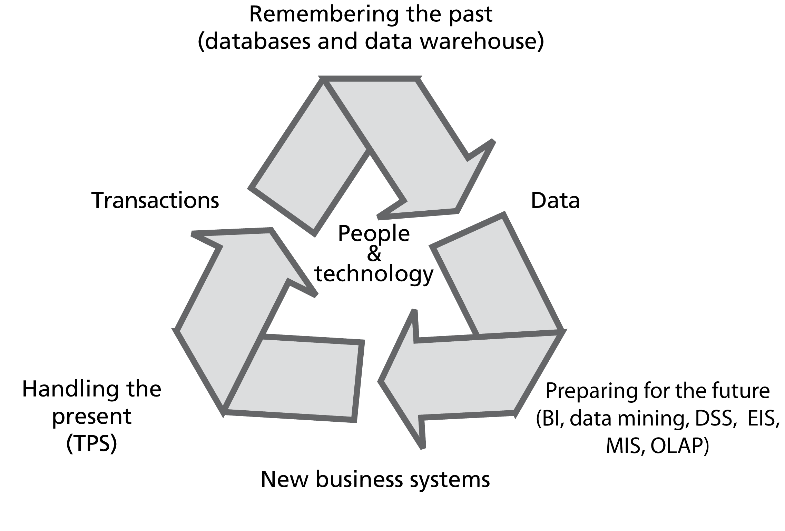
The information systems cycle

Slide 11
Questions about Data
What are some attributes we would like data
to have?
Notes:
According to The Data Warehousing Institute (TDWI), “The Cost of bad or ‘dirty’ data exceeds $600 Billion dollars for US businesses annually.”

Slide 12
Attributes of Data
Sharable
Transportable
Secure
Accurate
Timely
Relevant

Slide 13
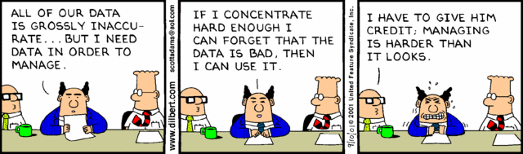

Slide 14
Components of Organizational Memory
People/Conversations
Tables/Documents
Video/Images/Graphics/Multimedia
Models
Knowledge/Decisions
Specialized memories

Slide 15
Data management systems timeline
File systems
1954 – 2012
Hierarchical
1964 – 2012
Spatial
1969 – 2012
Relational
1971 – 2012
Object-oriented
1989 – 2012
Network
Hadoop distributed file system
1969 – 1979
2008 – 2012
1960
1965
1970
1975
1980
1985
1990
1995
2000
2005
2010
2015

Slide 16
Questions about data management systems?
What problems do data management systems still have?
Notes:
Lack of Integration, Control, Reality
Interface is poor
Delays in report requests
Redundancy

Slide 17
Problems with data mgmt systems
Redundancy
Lack of data control
Interface issues
Lack of integration
Lack of reality

Slide 18
The challenge
Organizations that effectively use data, information, and knowledge are more successful
The challenge is to develop data management and exploitation skills across an organization
Many organizations do not make effective use of the data they already have
Data management is an enduring problem for nearly all organizations and societies

Slide 19
Information
Effective information management must begin by thinking about how people use information—not with how people use machines.
Thomas Davenport

Slide 20
Key characteristics of the early 21st century
High velocity global change
Changing international relationships
Emergence of China as an economic power
Trading blocs
Globalization of business
Emergence of influential information-based organizations
Apple, eBay, Google, Facebook, Microsoft, SAP

Slide 21
The information age
Built on sand
Silicon chips
Fiber optics
Borderless
A free flow of:

Slide 22
Eras of information systems
Era | Focus | Period | Technology | Networks
1 | Take information work to the computer | 1950s – mid-1970s | Batch | Few data networks
2 | Take information work to the employee | Mid-1970s – mid-1990s | Host/terminal | Spread of private networks
3 | Take information work to the customer and other stakeholders | Mid-1990s - present | Browser/server | Public networks

Slide 23
Information and organizational change
Organizations are goal seeking
Information supports goal seeking

Slide 24
Goal setting information
Anchoring and adjusting
Planning
Demographic trends
Economic forecasts
Benchmarking
Competitors’ actions

Slide 25
Gap information
Problem identification
A gap between expectations and performance
Scorekeeping
Quantitative
Qualitative
Use of critical success factors to determine variables to measure

Slide 26
Gap information
Detecting the gap
Problem identification
Exception reports
Scorekeeping
Routine reports

Slide 27
Change information
Closing the gap
Problem solution
Determining the cause(s)
Identifying alternatives
Analysis of alternatives

Slide 28
Information as a means of change
Information can be a source of competitive advantage
Information can be built into products and services
Marketing
Frequent flyer programs
Customer service
Information technology used to improve service
Empowerment
Sharing information with employees
Giving employees freedom to make decisions

Slide 29
Managerial work
Managers implement organizational change
Managerial work is:
Fragmented
Brief
Frequently disturbed
High velocity
Action oriented rather than contemplative

Slide 30
Managerial communication
Preference for oral communication
Extensive use of networks
Information source
Way of getting things done
Formal reporting systems
Infrequently used
Source of confirming information

Slide 31
Managerial information requirements
Expect relevant information
Expectations continually change

Slide 32
Characteristics of Information
Hardness
Richness

Slide 33
Information hardness (Hard vs. soft data)
Minerals | Scale | Data
Talc | 1 | Unidentified source-rumors, gossip, and hearsay
Gypsum | 2 | Identified nonexpert source - opinions, feelings, ideas
Calcite | 3 | Identified expert source - predictions, speculations, forecasts, estimates
Fluorite | 4 | Unsworn testimony - explanations, justifications, assessments, interpretations
Apatite | 5 | Sworn testimony - explanations, justifications, assessments, interpretations
Orthoclase | 6 | Budgets, formal plans
Quartz | 7 | News reports, non-financial data, industry statistics, survey data
Topaz | 8 | Unaudited financial statements, government statistics
Corundum | 9 | Audited financial statements, government statistics
Diamond | 10 | Stock exchange and commodity market data

Slide 34
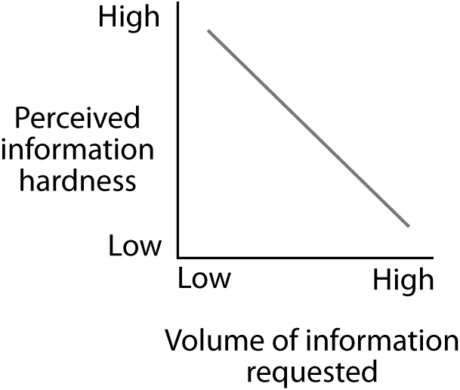
Demand varies with hardness of information
Use multiple sources in search of reliability

Slide 35
Information richness
Richest |  |  |  | Leanest
Face-to-face | Telephone | Personal documents (letters and memos) | Impersonal written documents | Numeric documents
Managers seek rich information to resolve equivocality
Information systems typically deliver lean information

Slide 36
Information Richness
Does the rich and lean media distinction apply in todays world of communication technologies

Slide 37
Demand varies with responsibilities
S
h
o
r
t
-
t
e
r
m
M
e
d
i
u
m
-
t
e
r
m
L
o
n
g
-
t
e
r
m
i
n
f
o
r
m
a
t
i
o
n
i
n
f
o
r
m
a
t
i
o
n
i
n
f
o
r
m
a
t
i
o
n
O
p
e
r
a
t
i
o
n
a
l
S
e
n
i
o
r
m
a
n
a
g
e
r
e
x
e
c
u
t
i
v
e

Slide 38
Information satisficing
Decision overload is a problem
Satisficing
Accept first satisfactory decision
Collect enough information to make a satisfactory decision
Lowers quality of decision making

Slide 39
Organizational Knowledge
Cognitive knowledge
Advanced skills
System understanding and trained intuition
Self-motivated creativity
Know what
Know how
Know why
Care why

Slide 40
Information Integration
Consolidation of disparate systems
Comprehensive view for managers
Integrated interface to organizations data warehouse

