Slide 1
Modeling Data and SQL

Slide 2
Data Modeling and SQL
Data Model
Graphical description
Relational Model
SQL
Data definition language
Data manipulation language
Data independence

Slide 3
Codd’s Relational Model
Relation
Analogous to a table or set
Relational database
Collection of relations
Tables
Collection of facts

Slide 4

An entity
Some thing in the environment that we want to keep track of
Represented by a rectangle
An instance is a particular occurrence of an entity

Slide 5
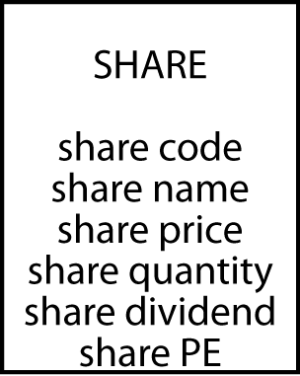
Attributes
An attribute is a discrete data element that describes an entity
Attribute names must be unique within a data model
Attribute names must be meaningful

Slide 6
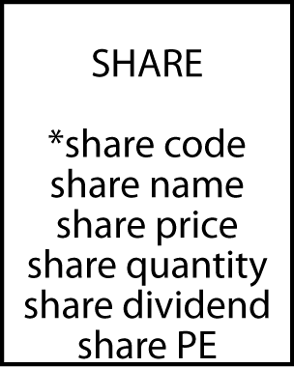
Identifiers
Every instance of an entity must be uniquely identified
An identifier can be an attribute or collection of attributes
An identifier can be created if there is no obvious attribute(s)
A leading asterisk denotes an identifier

Slide 7
Terms
Database
Collection of related files (tables)
Records
One row in a table for 1 instance of data
Fields
Columns for fine details of an instance

Slide 8
Rules for creating a table
Each entity becomes a table
The entity name becomes the table name
Each attribute becomes a column
The identifier becomes the primary key
Note: In MySQL having one or more spaces in a table name or attribute name will cause problems. Use the underscore (e.g., share_code) or an upper-case character (e.g., ShareCode).

Slide 9
Exercise
Design a data model for recording details of Olympic cities
See http://en.wikipedia.org/wiki/List_of_Olympic_Games_host_cities

Slide 10
Exercise
Install MySQL Workbench & Community Server
OS X
MySQL workbench
MySQL Community Server
Instructions
Windows
MySQL Installer
Instructions
The install wizard will ask you to create a username and password for the MySQL server. You will need this when you create a connection to the server

Slide 11
Defining a table with SQL
CREATE TABLE share (
shrcode CHAR(3),
shrfirm VARCHAR(20)NOT NULL,
shrprice DECIMAL(6,2),
shrqty DECIMAL(8),
shrdiv DECIMAL(5,2),
shrpe DECIMAL(2),
PRIMARY KEY(shrcode));

Slide 12
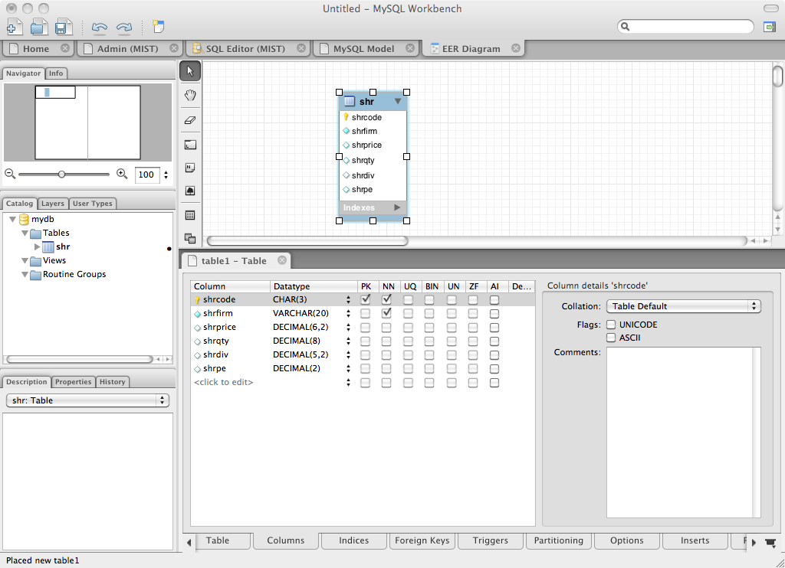
Defining a table with MySQL workbench

Slide 13
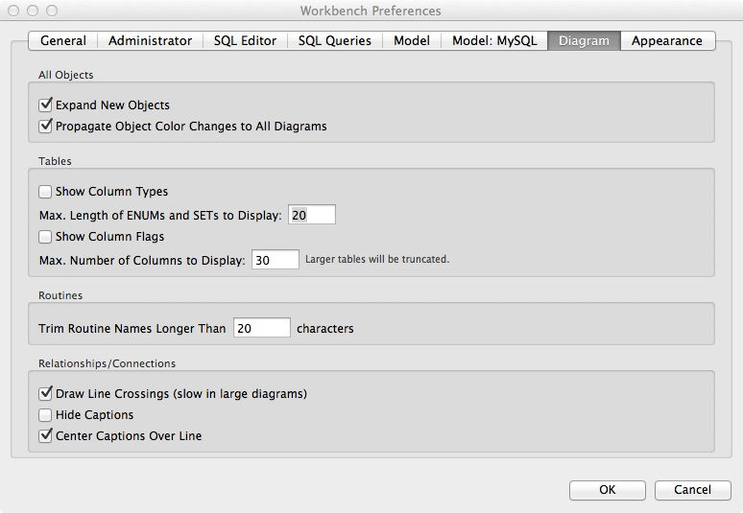
MySQL Workbench preferences
Hide column type
Hide column flag

Slide 14

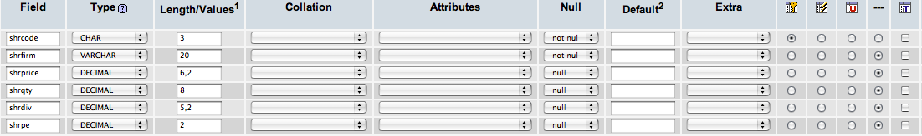
Defining a table with phpMyAdmin

Slide 15
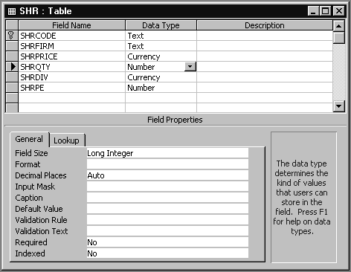
Defining a table with MS Access

Slide 16
Allowable data types - SQL standard -
Numeric | integer | A 31-bit signed binary value
 | smallint | A 15-bit signed binary value
 | float(p) | A scientific format number of p binary digits precision
 | decimal(p,q) | A packed decimal number of p digits total length; q decimal places to the right of the decimal point may be specified
String | char(n) | A fixed length character string of n characters
 | varchar(n) | A variable length character string up to n characters
 | text | A variable-length character string of up to 65,535 characters
Date/time | date | Date in the form yyyymmdd
 | time | Time in the form hhmmss
 | timestamp | A combination of date and time to the nearest microsecond
 | time with time zone | Same as time, with the addition of an offset from UTC of the specified time
 | timestamp with time zone | Same as timestamp, with the addition of an offset from UTC of the specified time
(partial list)

Slide 17
The share table (Text database)
share
shrcode | shrfirm | shrprice | shrqty | shrdiv | shrpe
FC | Freedonia Copper | 27.50 | 10529 | 1.84 | 16
PT | Patagonian Tea | 55.25 | 12635 | 2.50 | 10
AR | Abyssinian Ruby | 31.82 | 22010 | 1.32 | 13
SLG | Sri Lankan Gold | 50.37 | 32868 | 2.68 | 16
ILZ | Indian Lead & Zinc | 37.75 | 6390 | 3.00 | 12
BE | Burmese Elephant | 0.07 | 154713 | 0.01 | 3
BS | Bolivian Sheep | 12.75 | 231678 | 1.78 | 11
NG | Nigerian Geese | 35.00 | 12323 | 1.68 | 10
CS | Canadian Sugar | 52.78 | 4716 | 2.50 | 15
ROF | Royal Ostrich Farms | 33.75 | 1234923 | 3.00 | 6

Slide 18
Inserting rows with SQL
INSERT INTO share
(shrcode,shrfirm,shrprice,shrqty,shrdiv,shrpe)
VALUES ('FC','Freedonia Copper',27.5,10529,1.84,16);
OR
INSERT INTO share
VALUES ('FC','Freedonia Copper',27.5,10529,1.84,16);

Slide 19
Importing from a text file
LOAD DATA LOCAL INFILE
'/Users/rtw/desktop/share.txt' INTO TABLE SHARE
FIELDS TERMINATED BY ','
ENCLOSED BY "'"
LINES TERMINATED BY '\r’
FC,'Freedonia Copper',27.5,10529,1.84,16
PT,'Patagonian Tea',55.25,12635,2.5,10
AR,'Abyssinian Ruby',31.82,22010,1.32,13
SLG,'Sri Lankan Gold',50.37,32868,2.68,16
ILZ,'Indian Lead & Zinc',37.75,6390,3,12
BE,'Burmese Elephant',0.07,154713,0.01,3
BS,'Bolivian Sheep',12.75,231678,1.78,11
NG,'Nigerian Geese',35,12323,1.68,10
CS,'Canadian Sugar',52.78,4716,2.5,15
ROF,'Royal Ostrich Farms',33.75,1234923,3,6

Slide 20
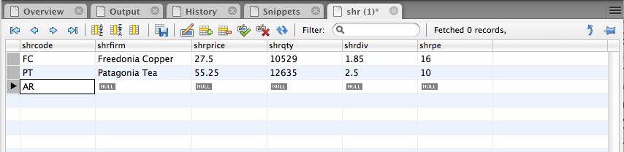
Inserting rows with MySQL Workbench

Slide 21
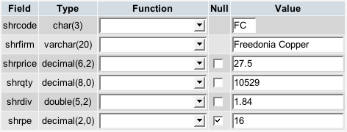
Inserting rows with phpMyAdmin

Slide 22
Exercise
Use MySQL Workbench to design your data model for recording details of Olympic cities
Create a table and add rows for the first three Olympics

Slide 23
Querying a table
List all data in the share table.
SELECT * FROM share;
(This is a natural language statement)
(This is a SQL statement)
shrcode | shrfirm | shrprice | shrqty | shrdiv | shrpe
FC | Freedonia Copper | 27.50 | 10529 | 1.84 | 16
PT | Patagonian Tea | 55.25 | 12635 | 2.50 | 10
AR | Abyssinian Ruby | 31.82 | 22010 | 1.32 | 13
SLG | Sri Lankan Gold | 50.37 | 32868 | 2.68 | 16
ILZ | Indian Lead & Zinc | 37.75 | 6390 | 3.00 | 12
BE | Burmese Elephant | 0.07 | 154713 | 0.01 | 3
BS | Bolivian Sheep | 12.75 | 231678 | 1.78 | 11
NG | Nigerian Geese | 35.00 | 12323 | 1.68 | 10
CS | Canadian Sugar | 52.78 | 4716 | 2.50 | 15
ROF | Royal Ostrich Farms | 33.75 | 1234923 | 3.00 | 6

Slide 24
Project - Creates a new virtual table
Choosing columns
A vertical slice (select values in specified columns (e.g., shrfirm, shrpe)
share
shrcode | shrfirm | shrprice | shrqty | shrdiv | shrpe
FC | Freedonia Copper | 27.50 | 10529 | 1.84 | 16
PT | Patagonian Tea | 55.25 | 12635 | 2.50 | 10
AR | Abyssinian Ruby | 31.82 | 22010 | 1.32 | 13
SLG | Sri Lankan Gold | 50.37 | 32868 | 2.68 | 16
ILZ | Indian Lead & Zinc | 37.75 | 6390 | 3.00 | 12
BE | Burmese Elephant | 0.07 | 154713 | 0.01 | 3
BS | Bolivian Sheep | 12.75 | 231678 | 1.78 | 11
NG | Nigerian Geese | 35.00 | 12323 | 1.68 | 10
CS | Canadian Sugar | 52.78 | 4716 | 2.50 | 15
ROF | Royal Ostrich Farms | 33.75 | 1234923 | 3.00 | 6

Slide 25
Project
Report a firm’s name and price-earnings ratio.
SELECT shrfirm, shrpe FROM share;
shrfirm | shrpe
Freedonia Copper | 16
Patagonian Tea | 10
Abyssinian Ruby | 13
Sri Lankan Gold | 16
Indian Lead & Zinc | 12
Burmese Elephant | 3
Bolivian Sheep | 11
Nigerian Geese | 10
Canadian Sugar | 15
Royal Ostrich Farms | 6

Slide 26
Restrict - Creates a new virtual table containing some rows of an existing table
Choosing rows (e.g., PE ratio <12)
A horizontal slice
share
shrcode | shrfirm | shrprice | shrqty | shrdiv | shrpe
FC | Freedonia Copper | 27.50 | 10529 | 1.84 | 16
PT | Patagonian Tea | 55.25 | 12635 | 2.50 | 10
AR | Abyssinian Ruby | 31.82 | 22010 | 1.32 | 13
SLG | Sri Lankan Gold | 50.37 | 32868 | 2.68 | 16
ILZ | Indian Lead & Zinc | 37.75 | 6390 | 3.00 | 12
BE | Burmese Elephant | 0.07 | 154713 | 0.01 | 3
BS | Bolivian Sheep | 12.75 | 231678 | 1.78 | 11
NG | Nigerian Geese | 35.00 | 12323 | 1.68 | 10
CS | Canadian Sugar | 52.78 | 4716 | 2.50 | 15
ROF | Royal Ostrich Farms | 33.75 | 1234923 | 3.00 | 6

Slide 27
Restrict - Creates a new virtual table that contains some rows of an existing table
Display records for all firms whose price-earnings ratio is less than 12. SELECT * FROM share WHERE shrpe < 12;
shrcode | shrfirm | shrprice | shrqty | shrdiv | shrpe
PT | Patagonian Tea | 55.25 | 12635 | 2.50 | 10
BE | Burmese Elephant | 0.07 | 154713 | 0.01 | 3
BS | Bolivian Sheep | 12.75 | 231678 | 1.78 | 11
NG | Nigerian Geese | 35.00 | 12323 | 1.68 | 10
ROF | Royal Ostrich Farms | 33.75 | 1234923 | 3.00 | 6

Slide 28
Project and restrict combo
Choosing rows and columns
List the name, price, quantity, and dividend of each firm where the number of shares held is at least 100,000.
SELECT shrfirm, shrprice, shrqty, shrdiv
FROM share WHERE shrqty >= 100000;
shrfirm | shrprice | shrqty | shrdiv
Burmese Elephant | 0.07 | 154713 | 0.01
Bolivian Sheep | 12.75 | 231678 | 1.78
Royal Ostrich Farms | 33.75 | 1234923 | 3.00

Slide 29
Primary key retrieval
A query using the primary key returns at most one row
(Purpose/power of primary key is guarantee of unique row selection)
Display the firm whose code is AR.
SELECT * FROM share WHERE shrcode = 'AR';
shrcode | shrfirm | shrprice | shrqty | shrdiv | shrpe
AR | Abyssinian Ruby | 31.82 | 22010 | 1.32 | 13

Slide 30
Exercise
Report the name and price of those shares where the share price is greater than 10

Slide 31
Primary key retrieval
A query that does not use the primary key can return more than one row
Report firms with a dividend of 2.50.
SELECT * FROM share WHERE shrdiv = 2.5;
shrcode | shrfirm | shrprice | shrqty | shrdiv | shrpe
PT | Patagonian Tea | 55.25 | 12635 | 2.50 | 10
CS | Canadian Sugar | 52.78 | 4716 | 2.50 | 15

Slide 32
IN
Used with a list of values
Report data on firms with codes of FC, AR, or SLG.
SELECT * FROM share WHERE shrcode IN ('FC','AR','SLG');
or
SELECT * FROM share WHERE shrcode = 'FC' OR
shrcode = 'AR' OR shrcode = 'SLG';
shrcode | shrfirm | shrprice | shrqty | shrdiv | shrpe
FC | Freedonia Copper | 27.50 | 10529 | 1.84 | 16
AR | Abyssinian Ruby | 31.82 | 22010 | 1.32 | 13
SLG | Sri Lankan Gold | 50.37 | 32868 | 2.68 | 16

Slide 33
NOT IN
Not in a list of values Report all firms other than those with the code CS or PT.
SELECT * FROM share WHERE shrcode NOT IN ('CS', 'PT’);
is equivalent to
SELECT * FROM share WHERE shrcode <> 'CS' AND shrcode <> 'PT';
shrcode | shrfirm | shrprice | shrqty | shrdiv | shrpe
AR | Abyssinian Ruby | 31.82 | 22010 | 1.32 | 13
SLG | Sri Lankan Gold | 50.37 | 32868 | 2.68 | 16
ILZ | Indian Lead & Zinc | 37.75 | 6390 | 3.00 | 12
BE | Burmese Elephant | 0.07 | 154713 | 0.01 | 3
BS | Bolivian Sheep | 12.75 | 231678 | 1.78 | 11
NG | Nigerian Geese | 35.00 | 12323 | 1.68 | 10
ROF | Royal Ostrich Farms | 33.75 | 1234923 | 3.00 | 6

Slide 34
Ordering output
Ordering columns
Columns are reported in the order specified in the SQL command
Ordering rows
Rows are ordered using the ORDER BY clause

Slide 35
Ordering columns
SELECT shrcode, shrfirm FROM share WHERE shrpe = 10;
SELECT shrfirm, shrcode FROM share WHERE shrpe = 10;
shrcode | shrfirm
PT | Patagonian Tea
NG | Nigerian Geese
shrfirm | shrcode
Patagonian Tea | PT
Nigerian Geese | NG

Slide 36
Ordering rows
List all firms where PE is at least 12. Order the report in descending PE. Where PE ratios are identical, list firms in alphabetical order.
SELECT * FROM share WHERE shrpe >= 12
ORDER BY shrpe DESC, shrfirm;
shrcode | shrfirm | shrprice | shrqty | shrdiv | shrpe
FC | Freedonia Copper | 27.50 | 10529 | 1.84 | 16
SLG | Sri Lankan Gold | 50.37 | 32868 | 2.68 | 16
CS | Canadian Sugar | 52.78 | 4716 | 2.50 | 15
AR | Abyssinian Ruby | 31.82 | 22010 | 1.32 | 13
ILZ | Indian Lead & Zinc | 37.75 | 6390 | 3.00 | 12

Slide 37
Practice Exercise 1: Using the Chapter3 database Entity & Table named STUDENT
Attributes of the entity/columns of the table
Write queries to:
List the table of students
List first name, middle initial, last name, & state for all students
List last name, first name, & middle initial for all students
List all information for students from Georgia (‘GA’)
List all information for students not from Georgia
List the last and first names of all students from South Carolina (‘SC’), Alabama (‘AL’), or Georgia (‘GA’)
STUDENT
* studentID
f_name
middle_init
l_name
city
state
zip

Slide 38
Practice Exercise 1.1
Use the ClassicModels database (refer to the data model present on the text website)
List out the entire contents of the Customers table
List out the customer name for those customers from the USA and from France
List out the customer name for those customers from USA and France that have a credit limit greater than 75000
List out names for products where the quantity of product in stock is more than 5000 units
List out the names of products and the MSRP and buy price if the product is a type of classic car. Order the results in descending order of the MSRP.

Slide 39
Calculating
Display firm name, price, quantity, and firm yield.
SELECT shrfirm, shrprice, shrqty,
shrdiv/shrprice*100 as YIELD FROM share;
shrfirm | shrprice | shrqty | yield
Freedonia Copper | 27.50 | 10,529 | 6.69
Patagonian Tea | 55.25 | 12,635 | 4.52
Abyssinian Ruby | 31.82 | 22,010 | 4.15
Sri Lankan Gold | 50.37 | 32,868 | 5.32
Indian Lead & Zinc | 37.75 | 6,390 | 7.95
Burmese Elephant | 0.07 | 154,713 | 14.29
Bolivian Sheep | 12.75 | 231,678 | 13.96
Nigerian Geese | 35.00 | 12,323 | 4.80
Canadian Sugar | 52.78 | 4,716 | 4.74
Royal Ostrich Farms | 33.75 | 1,234,923 | 8.89

Slide 40
Built-in functions
COUNT, AVG, SUM, MIN, and MAX
Find the average dividend.
SELECT AVG(shrdiv) AS avgdiv FROM share;
What is the average yield for the portfolio?
SELECT AVG(shrdiv/shrprice*100) AS avgyield FROM share;
avgdiv
2.03
avgyield
7.53

Slide 41
Built-in function COUNT
You can use the COUNT built-in function to determine the number of rows or non-Null values in a Result Set.
Use COUNT(*) to find out the number of rows in the entire set.
Use COUNT (column name) to find out the number of rows with non-null values for that column.

Slide 42
Subqueries
A query within a query
Report all firms with a PE ratio greater than the average for the portfolio.
SELECT shrfirm, shrpe FROM share WHERE shrpe >(SELECT AVG(shrpe)FROM share);
shrfirm | shrpe
Freedonia Copper | 16
Abyssinian Ruby | 13
Sri Lankan Gold | 16
Indian Lead & Zinc | 12
Canadian Sugar | 15

Slide 43
Practice Exercise 2 Entity & Table named ITEM
Write queries to:
List all items
List all items whose price is greater than $25
List the item name for items that cost < $100
List the average price of items whose category is ‘toy’
List the item name and price for items that cost more than the average price of all items
List all items in descending order by price
List the number of items
Attributes of the entity/columns of the table
ITEM
* itemID
item_name
item_category
item_price

Slide 44
Practice Exercise 1.2
Use the ClassicModels database (refer to the data model present on the text website)
How many customers are present in the database?
What is the average payment amount made?
List out the names of customers whose credit limit is greater than the average credit limit.
List out the name of the customer who has the greatest credit limit.
List out the total value of all orders placed.

Slide 45
Regular expression
A concise and flexible method for string searching
Commands are handled by a regular expression processor
Supported by many programming languages

Slide 46
Regular expression
Search for a string
List all firms containing ‘Ruby’ in their name.
SELECT shrfirm FROM share
WHERE shrfirm REGEXP 'Ruby';
shrfirm
Abyssinian Ruby

Slide 47
Regular expression
Search for alternative strings
[a|b] finds 'a' or 'b'
| is the alternation symbol
List the firms containing gold or zinc in their name.
SELECT * FROM share
WHERE shrfirm
REGEXP 'gold|zinc|Gold|Zinc';

Slide 48
Regular expression
Search for a beginning string
^ means at the start of the string
List the firms whose name begins with Sri.
SELECT * FROM share
WHERE shrfirm REGEXP '^Sri';

Slide 49
Regular expression
Search for a ending string
$ means at the end of the string
List the firms whose name ends in Geese.
SELECT shrfirm
FROM share
WHERE shrfirm REGEXP 'Geese$';

Slide 50
Exercise
List names of shares whose name contains sheep or geese

Slide 51
DISTINCT
Eliminating duplicate rows
Find the number of different PE ratios.
SELECT COUNT(DISTINCT shrpe) AS 'Different PEs' FROM share;
Different PEs
8
DISTINCT column-name is not implemented by all relational systems

Slide 52
DISTINCT
Eliminating duplicate rows
Report the different values of the PE ratio.
SELECT DISTINCT shrpe FROM share;
shrpe
3
6
10
11
12
13
15
16

Slide 53
Practice Exercise 3 Entity & Table named STUDENT
Attributes of the entity/columns of the table
Write queries to:
List the first name, middle initial, and last name for students whose last name begins with an ‘S’
List the students who have the letter ‘A’ or ‘a’ somewhere in their first name
Display the number of students from Georgia
List each city for students in the table – do not repeat city names
STUDENT
* studentID
f_name
middle_init
l_name
city
state
zip

Slide 54
Practice Exercise 1.3
Use the ClassicModels database (refer to the data model present on the text website)
List out all the countries where the organization has customers
List out the different status’es that orders can have
List out the names of customers if they have ‘Gift’ or ‘gift’ in their names.
List out products from the 1960’s or 1970’s
List out how many different countries does the organization have customers.

Slide 55
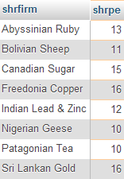
BETWEEN – Specifying a range (range includes the values listed)
List the firm name and share PE for those firms whose PE is at least 10 and as much as 20.
SELECT shrfirm, shrpe
FROM share
WHERE shrpe BETWEEN 10 AND 20;

Slide 56
Practice Exercise 4 Entity & Table named ITEM
Write queries to:
List the item name and category for all items whose price is greater than or equal to $10 and less than or equal to $50. List the items with the most expensive one first.
List the item category, item ID, and item name of all items that cost at least $5 and up to $20. Order the items in alphabetical order by item category. List items in the same category in order by price, with the lowest price first.
List all items that fall in the $20 to $40 price range in ascending order by item name.
Attributes of the entity/columns of the table
ITEM
* itemID
item_name
item_category
item_price

Slide 57
DELETE - deleting rows
Erase the data for Burmese Elephant. All the shares have been sold.
DELETE FROM share
WHERE shrfirm = 'Burmese Elephant';

Slide 58
UPDATE - changing rows
Change the share price of FC to 31.50.
UPDATE share
SET shrprice = 31.50
WHERE shrcode = 'FC';

Slide 59
UPDATE - changing rows
Increase the total number of shares for Nigerian Geese by 10% because of the recent bonus issue.
UPDATE share
SET shrqty = shrqty*1.1
WHERE shrfirm = 'Nigerian Geese';

Slide 60
Quotes
Three kinds of quotes
Single ' (must be straight not curly)
Double " (must be straight not curly)
Back ` ( left of 1 key)
In MySQL, the first two are equivalent and can be used interchangeably
SELECT `person first` FROM person WHERE `person last` = "O'Hara";

Slide 61
Summary
Introduced
Entity
Attribute
Identifier
SQL
CREATE
INSERT
SELECT
DELETE
UPDATE

