Slide 1
MIST 4610 – Data Mgmt and Analytics
Nikhil Srinivasan
MIS@Terry

Slide 2
The Many-to-Many Relationship
Fearful concatenation of circumstances
Daniel Webster

Slide 3
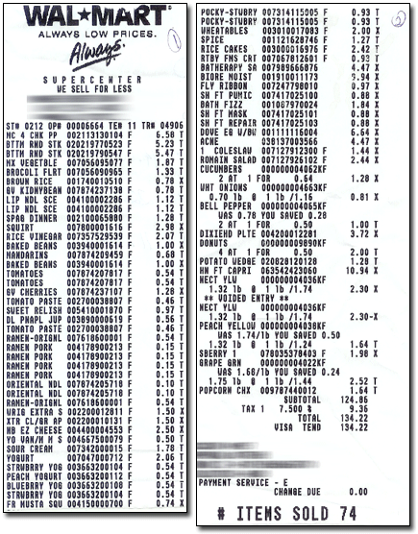
Notes:
http://www.mdmproofing.com/iym/products/receipt-splitter/

Slide 4
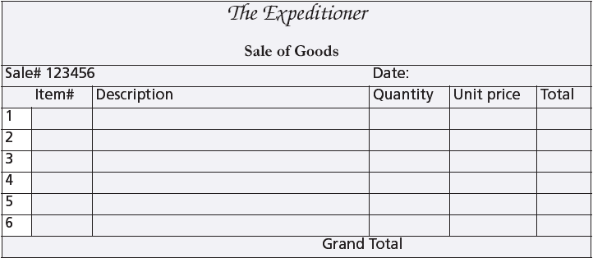
A sales form

Slide 5
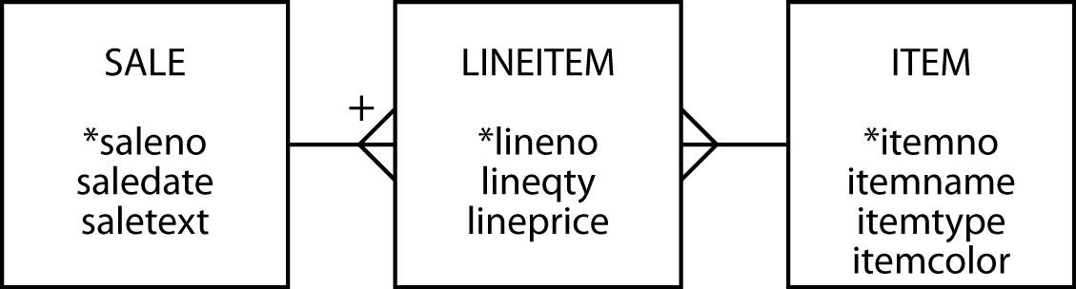
The many-to-many relationship
Create a third entity to map an m:m relationship
An associative entity
The + on the crow's foot indicates that LINEITEM is identified by concatenating saleno and lineno
LINEITEM is known as a weak entity, and it has an identifying relationship with SALE

Slide 6
Preference settings
Foreign key same name as primary key
Associative table name of form tableA_tableB

Slide 7
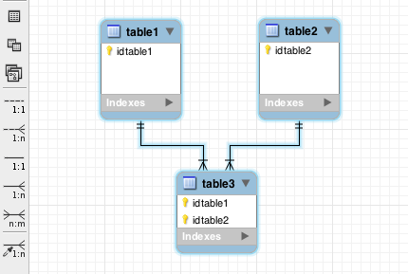
The many-to-many relationship
MySQL Workbench
m:m symbol

Slide 8
The many-to-many relationship
MySQL Workbench
Identifying
relationship
Non-identifying
relationship

Slide 9
Why a third entity?
Store data about the relationship
Think of an m:m as two 1:m relationships

Slide 10
Creating a relational database
Same rules apply
The associative table has two foreign keys
One for each of the entities in the m:m relationship
A foreign key can also be part of the primary key of an associative entity
lineitem
lineno | lineqty | lineprice | saleno | itemno
1 | 1 | 4.50 | 1 | 2
1 | 1 | 25.00 | 2 | 6
2 | 1 | 20.00 | 2 | 16
3 | 1 | 25.00 | 2 | 19

Slide 11
Creating a relational database
CREATE TABLE sale (
saleno INTEGER,
saledate DATE NOT NULL,
saletext VARCHAR(50),
PRIMARY KEY(saleno));
CREATE TABLE item (
itemno INTEGER,
itemname VARCHAR(30) NOT NULL,
itemtype CHAR(1) NOT NULL,
itemcolor VARCHAR(10),
PRIMARY KEY(itemno));
CREATE TABLE lineitem (
lineno INTEGER,
lineqty INTEGER NOT NULL,
lineprice DECIMAL(7,2) NOT NULL,
saleno INTEGER,
itemno INTEGER,
PRIMARY KEY(lineno,saleno),
CONSTRAINT fk_has_sale FOREIGN KEY(saleno) REFERENCES sale(saleno),
CONSTRAINT fk_has_item FOREIGN KEY(itemno) REFERENCES item(itemno));

Slide 12
Exercise
A keen field hockey fan wants to keep track of which countries won which medals in the various summer Olympics for both the men’s and women’s events
Design a data model
Create the database
Populate with data for the last two Olympics
http://en.wikipedia.org/wiki/Field_hockey_at_the_Summer_Olympics

Slide 13
A three table join
Specify two matching conditions with the associative table in both join conditions
SELECT * FROM sale JOIN lineitem
ON sale.saleno = lineitem.saleno
JOIN item ON item.itemno = lineitem.itemno;

Slide 14
A three table join
List the names of items, quantity, and value of items sold on January 16, 2011
SELECT itemname, lineqty, lineprice, lineqty*lineprice
AS total FROM sale JOIN lineitem
ON lineitem.saleno = sale.saleno
JOIN item ON item.itemno = lineitem.itemno
WHERE saledate = '2011-01-16';
itemname | lineqty | lineprice | total
Pocket knife—Avon | 1 | 0.00 | 0.00
Safari chair | 50 | 36.00 | 1800.00
Hammock | 50 | 40.50 | 2025.00
Tent—8 person | 8 | 153.00 | 1224.00
Tent—2 person | 1 | 60.00 | 60.00

Slide 15
In-class Practice (ClassicModels)
Write a query to list out the names of products, their product line and the number of customers that have purchased them.
Write a query to list out the product vendor and the number of different customers they have shipped orders to.
Write a query to list the names of customers that have ordered products from only a single productline.

Slide 16
EXISTS
Existential qualifier
Returns true or false
Returns true if the table contains at least one row satisfying the specified condition
Report all clothing items (type “C”) for which a sale is recorded
SELECT itemname, itemcolor FROM item
WHERE itemtype = 'C'
AND EXISTS (SELECT * FROM lineitem WHERE lineitem.itemno = item.itemno);
itemname | itemcolor
Hat—Polar Explorer | Red
Boots—snake proof | Black
Pith helmet | White
Stetson | Black

Slide 17
itemno | itemname | itemtype | itemcolor
1 | Pocket knife—Nile | E | Brown
2 | Pocket knife—Avon | E | Brown
3 | Compass | N | —
4 | Geopositioning system | N | —
5 | Map measure | N | —
6 | Hat—Polar Explorer | C | Red
7 | Hat—Polar Explorer | C | White
8 | Boots—snake proof | C | Green
9 | Boots—snake proof | C | Black
10 | Safari chair | F | Khaki
11 | Hammock | F | Khaki
12 | Tent—8 person | F | Khaki
13 | Tent—2 person | F | Khaki
14 | Safari cooking kit | E | —
15 | Pith helmet | C | Khaki
16 | Pith helmet | C | White
17 | Map case | N | Brown
18 | Sextant | N | —
19 | Stetson | C | Black
20 | Stetson | C | Brown
SELECT itemname, itemcolor FROM item
WHERE itemtype = 'C’
AND EXISTS (SELECT * FROM lineitem WHERE lineitem.itemno = item.itemno);
lineno | lineqty | lineprice | saleno | itemno
1 | 1 | 4.5 | 1 | 2
1 | 1 | 25 | 2 | 6
2 | 1 | 20 | 2 | 16
3 | 1 | 25 | 2 | 19
4 | 1 | 2.25 | 2 | 2
1 | 1 | 500 | 3 | 4
2 | 1 | 2.25 | 3 | 2
1 | 1 | 500 | 4 | 4
2 | 1 | 65 | 4 | 9
3 | 1 | 60 | 4 | 13
4 | 1 | 75 | 4 | 14
5 | 1 | 10 | 4 | 3
6 | 1 | 2.25 | 4 | 2
1 | 50 | 36 | 5 | 10
2 | 50 | 40.5 | 5 | 11
3 | 8 | 153 | 5 | 12
4 | 1 | 60 | 5 | 13
5 | 1 | 0 | 5 | 2
itemname | itemcolor
Hat—Polar Explorer | Red
Boots—snake proof | Black
Pith helmet | White
Stetson | Black

Slide 18
NOT EXISTS
Returns true if the table contains no rows satisfying the specified condition
Report all clothing items (type “C”) that have not been sold
SELECT itemname, itemcolor FROM item
WHERE itemtype = 'C'
AND NOT EXISTS
(SELECT * FROM lineitem
WHERE item.itemno = lineitem.itemno);
itemname | itemcolor
Hat—Polar Explorer | White
Boots—snake proof | Green
Pith helmet | Khaki
Stetson | Brown

Slide 19
itemno | itemname | itemtype | itemcolor
1 | Pocket knife—Nile | E | Brown
2 | Pocket knife—Avon | E | Brown
3 | Compass | N | —
4 | Geopositioning system | N | —
5 | Map measure | N | —
6 | Hat—Polar Explorer | C | Red
7 | Hat—Polar Explorer | C | White
8 | Boots—snake proof | C | Green
9 | Boots—snake proof | C | Black
10 | Safari chair | F | Khaki
11 | Hammock | F | Khaki
12 | Tent—8 person | F | Khaki
13 | Tent—2 person | F | Khaki
14 | Safari cooking kit | E | —
15 | Pith helmet | C | Khaki
16 | Pith helmet | C | White
17 | Map case | N | Brown
18 | Sextant | N | —
19 | Stetson | C | Black
20 | Stetson | C | Brown
SELECT itemname, itemcolor FROM item
WHERE itemtype = 'C'
AND NOT EXISTS
(SELECT * FROM lineitem
WHERE item.itemno = lineitem.itemno);
lineno | lineqty | lineprice | saleno | itemno
1 | 1 | 4.5 | 1 | 2
1 | 1 | 25 | 2 | 6
2 | 1 | 20 | 2 | 16
3 | 1 | 25 | 2 | 19
4 | 1 | 2.25 | 2 | 2
1 | 1 | 500 | 3 | 4
2 | 1 | 2.25 | 3 | 2
1 | 1 | 500 | 4 | 4
2 | 1 | 65 | 4 | 9
3 | 1 | 60 | 4 | 13
4 | 1 | 75 | 4 | 14
5 | 1 | 10 | 4 | 3
6 | 1 | 2.25 | 4 | 2
1 | 50 | 36 | 5 | 10
2 | 50 | 40.5 | 5 | 11
3 | 8 | 153 | 5 | 12
4 | 1 | 60 | 5 | 13
5 | 1 | 0 | 5 | 2
itemname | itemcolor
Hat—Polar Explorer | White
Boots—snake proof | Green
Pith helmet | Khaki
Stetson | Brown

Slide 20
Exercise
Report all brown items that have been sold
Report all brown items that have not been sold
Using ClassicModels
List the first and last name of employee’s with the title ‘Sales Rep’ that do not service any Customers.
List the names of products that have not been ordered.

Slide 21
Set operations
UNION
Equivalent to OR
INTERSECT
Equivalent to AND

Slide 22
UNION
List all items that were sold on January 16, 2011, or are brown.
SELECT itemname FROM item JOIN lineitem
ON item.itemno = lineitem.itemno
JOIN sale ON lineitem.saleno = sale.saleno
WHERE saledate = '2011-01-16'
UNION
SELECT itemname FROM item WHERE itemcolor = 'Brown';
itemname
Hammock
Map case
Pocket knife—Avon
Pocket knife—Nile
Safari chair
Stetson
Tent—2 person
Tent—8 person

Slide 23
INTERSECT
List all items that were sold on January 16, 2011, and are brown.
SELECT itemname FROM item JOIN lineitem
ON item.itemno = lineitem.itemno
JOIN sale ON lineitem.saleno = sale.saleno
WHERE saledate = '2011-01-16'
INTERSECT
SELECT itemname FROM item WHERE itemcolor = 'Brown';
itemname
Pocket knife—Avon
INTERSECT not supported by MySQL

Slide 24
Conclusion
Introduced
m:m relationship
Associative entity
Weak entity
EXISTS
Set operations

