Slide 1
One-to-One and Recursive Relationships
Nikhil Srinivasan
MIS@Terry

Slide 2
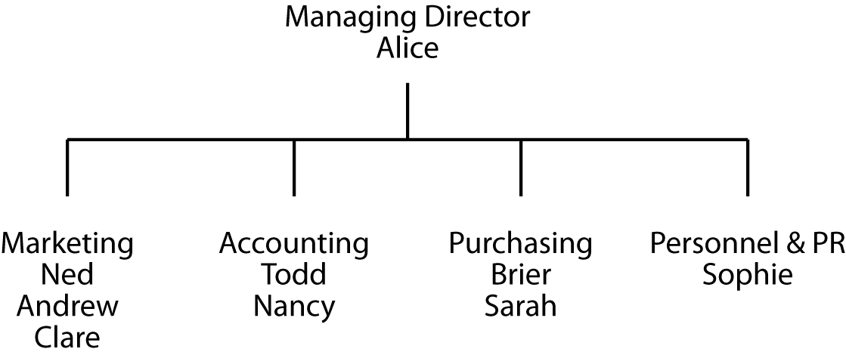
An organization chart
Every structure for presenting data has an underlying data model

Slide 3
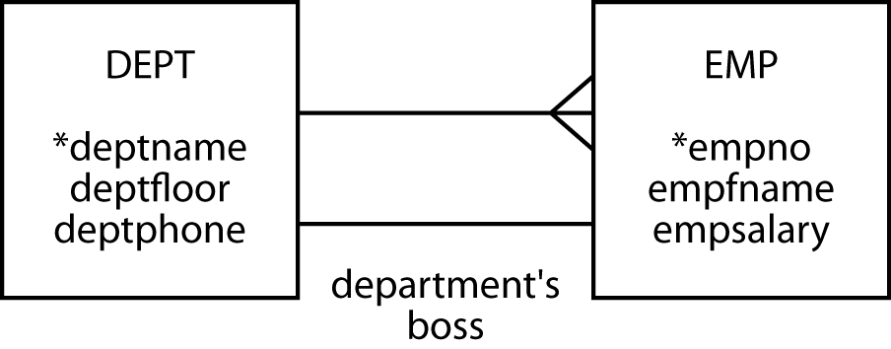
Modeling a 1:1 relationship
1:1 relationship is labeled
A relationship descriptor
Obvious relationships are not labeled

Slide 4
Labeling a relationship Workbench Preferences > Diagram
Turn off hide captions

Slide 5
Labeling a relationship Edit Relationship
Enter caption
or
blank an unwanted captions

Slide 6
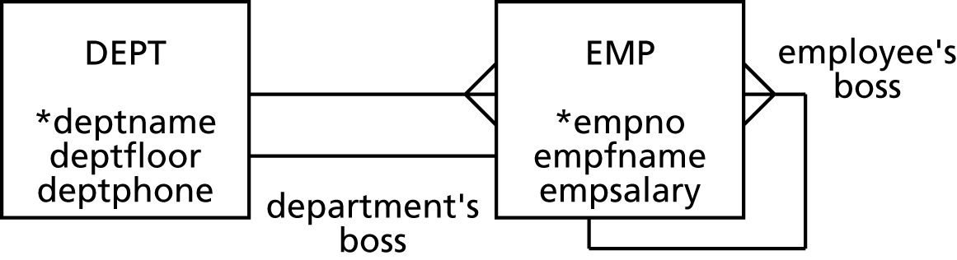
Modeling a recursive relationship
A recursive relationship relates an entity to itself
Label recursive relationships

Slide 7
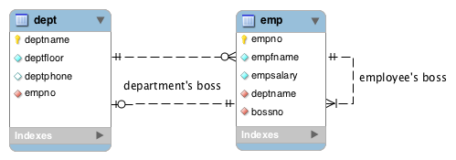
MySQL Workbench

Slide 8
Mapping a 1:1 relationship
Usual rules apply
Where do you put the foreign key?
DEPT
EMP
What is mandatory?
A department must have a boss?
An employee must be a boss?
Opt for the entity with the mandate

Slide 9
Mapping a recursive relationship
Usual rules
1:m
The entity gets an additional column for the foreign key
Need a name different from the primary key

Slide 10
Results of the mapping
dept
deptname | deptfloor | deptphone | empno
Management | 5 | 2001 | 1
Marketing | 1 | 2002 | 2
Accounting | 4 | 2003 | 5
Purchasing | 4 | 2004 | 7
Personnel & PR | 1 | 2005 | 9
emp
empno | empfname | empsalary | deptname | bossno
1 | Alice | 75000 | Management
2 | Ned | 45000 | Marketing | 1
3 | Andrew | 25000 | Marketing | 2
4 | Clare | 22000 | Marketing | 2
5 | Todd | 38000 | Accounting | 1
6 | Nancy | 22000 | Accounting | 5
7 | Brier | 43000 | Purchasing | 1
8 | Sarah | 56000 | Purchasing | 7
9 | Sophie | 35000 | Personnel & PR | 1

Slide 11
Creating the tables
CREATE TABLE dept (
deptname VARCHAR(15),
deptfloor SMALLINT NOT NULL,
deptphone SMALLINT NOT NULL,
empno SMALLINT NOT NULL,
PRIMARY KEY(deptname));
CREATE TABLE emp (
empno SMALLINT,
empfname VARCHAR(10),
empsalary DECIMAL(7,0),
deptname VARCHAR(15),
bossno SMALLINT,
PRIMARY KEY(empno),
CONSTRAINT fk_belong_dept FOREIGN KEY(deptname)
REFERENCES dept(deptname),
CONSTRAINT fk_has_boss foreign key (bossno)
REFERENCES emp(empno));
There is no foreign key constraint for empno in dept, because it requires the matching primary key in emp exist. However, the matching foreign key in emp can’t be created until the matching primary key in dept exists. An infinite circle of references.

Slide 12
Inserting rows
INSERT INTO emp (empno, empfname, empsalary, deptname,bossno)
VALUES (1,'Alice',75000,'Management');
INSERT INTO emp VALUES (2,'Ned',45000,'Marketing',1);
INSERT INTO emp VALUES (3,'Andrew',25000,'Marketing',2);
INSERT INTO emp VALUES (4,'Clare',22000,'Marketing',2);
INSERT INTO emp VALUES (5,'Todd',38000,'Accounting',1);
INSERT INTO emp VALUES (6,'Nancy',22000,'Accounting',5);
INSERT INTO emp VALUES (7,'Brier',43000,'Purchasing',1);
INSERT INTO emp VALUES (8,'Sarah',56000,'Purchasing',7);
INSERT INTO emp VALUES (9,'Sophie',35000,'Personnel',1);
Order the INSERTs to avoid referential integrity problems

Slide 13
Exercise
Several Olympic events are team sports (e.g., basketball, relays) and some involve a pair of athletes (e.g., kayaking, rowing, beach volleyball)
A team can have a captain
A country has a flag bearer
There can be some husband and wife pairs at a games (e.g., Jared Tallent and Claire Woods from Australia)
Draw a data model to record these details

Slide 14
Querying a 1:1 relationship
List the salary of each department’s boss.
SELECT empfname, deptname, empsalary FROM emp
WHERE empno IN (SELECT empno FROM dept);
empfname | deptname | empsalary
Alice | Management | 75000
Ned | Marketing | 45000
Todd | Accounting | 38000
Brier | Purchasing | 43000
Sophie | Personnel & PR | 35000

Slide 15
Querying a 1:1 relationship
List the salary of each department’s boss.
SELECT empfname, dept.deptname, empsalary FROM emp JOIN dept
ON dept.empno = emp.empno;
empfname | deptname | empsalary
Alice | Management | 75000
Ned | Marketing | 45000
Todd | Accounting | 38000
Brier | Purchasing | 43000
Sophie | Personnel & PR | 35000

Slide 16
Joining a table with itself
Find the salary of Nancy’s boss.
wrk
empno | empfname | empsalary |  | deptname | bossno
1 | Alice | 75000 |  | Management
2 | Ned | 45000 |  | Marketing | 1
3 | Andrew | 25000 |  | Marketing | 2
4 | Clare | 22000 |  | Marketing | 2
5 | Todd | 38000 |  | Accounting | 1
6 | Nancy | 22000 |  | Accounting | 5
7 | Brier | 43000 |  | Purchasing | 1
8 | Sarah | 56000 |  | Purchasing | 7
9 | Sophie | 35000 |  | Personnel & PR | 1
boss
empno | empfname | empsalary |  | deptname | bossno
1 | Alice | 75000 |  | Management
2 | Ned | 45000 |  | Marketing | 1
3 | Andrew | 25000 |  | Marketing | 2
4 | Clare | 22000 |  | Marketing | 2
5 | Todd | 38000 |  | Accounting | 1
6 | Nancy | 22000 |  | Accounting | 5
7 | Brier | 43000 |  | Purchasing | 1
8 | Sarah | 56000 |  | Purchasing | 7
9 | Sophie | 35000 |  | Personnel & PR | 1

Slide 17
Querying a recursive relationship
Find the salary of Nancy’s boss.
SELECT wrk.empfname, wrk.empsalary, boss.empfname, boss.empsalary
FROM emp wrk JOIN emp boss
ON wrk.bossno = boss.empno
WHERE wrk.empfname = 'Nancy’;
wrk |  |  |  |  |  | boss
empno | empfname | empsalary | deptname |  | bossno | empno | empfname | empsalary | deptname |  | bossno
2 | Ned | 45,000 | Marketing |  | 1 | 1 | Alice | 75,000 | Management
3 | Andrew | 25,000 | Marketing |  | 2 | 2 | Ned | 45,000 | Marketing |  | 1
4 | Clare | 22,000 | Marketing |  | 2 | 2 | Ned | 45,000 | Marketing |  | 1
5 | Todd | 38,000 | Accounting |  | 1 | 1 | Alice | 75,000 | Management
6 | Nancy | 22,000 | Accounting |  | 5 | 5 | Todd | 38,000 | Accounting |  | 1
7 | Brier | 43,000 | Purchasing |  | 1 | 1 | Alice | 75,000 | Management
8 | Sarah | 56,000 | Purchasing |  | 7 | 7 | Brier | 43,000 | Purchasing |  | 1
9 | Sophie | 35,000 | Personnel & PR |  | 1 | 1 | Alice | 75,000 | Management
wrk.empfname | wrk.empsalary | boss.empfname | boss.empsalary
Nancy | 22000 | Todd | 38000

Slide 18
Querying a recursive relationship
Find the names of employees who earn more than their boss.
SELECT wrk.empfname
FROM emp wrk JOIN emp boss
ON wrk.bossno = boss.empno
WHERE wrk.empsalary > boss.empsalary;
wrk |  |  |  |  |  | boss
empno | empfname | empsalary | deptname |  | bossno | empno | empfname | empsalary | deptname |  | bossno
2 | Ned | 45,000 | Marketing |  | 1 | 1 | Alice | 75,000 | Management
3 | Andrew | 25,000 | Marketing |  | 2 | 2 | Ned | 45,000 | Marketing |  | 1
4 | Clare | 22,000 | Marketing |  | 2 | 2 | Ned | 45,000 | Marketing |  | 1
5 | Todd | 38,000 | Accounting |  | 1 | 1 | Alice | 75,000 | Management
6 | Nancy | 22,000 | Accounting |  | 5 | 5 | Todd | 38,000 | Accounting |  | 1
7 | Brier | 43,000 | Purchasing |  | 1 | 1 | Alice | 75,000 | Management
8 | Sarah | 56,000 | Purchasing |  | 7 | 7 | Brier | 43,000 | Purchasing |  | 1
9 | Sophie | 35,000 | Personnel & PR |  | 1 | 1 | Alice | 75,000 | Management
empfname
Sarah

Slide 19
Exercise (Text db, emp table)
Find the names of employees in the same department as their boss
List the name of the boss and the number of employees they supervise.
List the name of the department, the boss of the department and the number of employees they supervise.

Slide 20
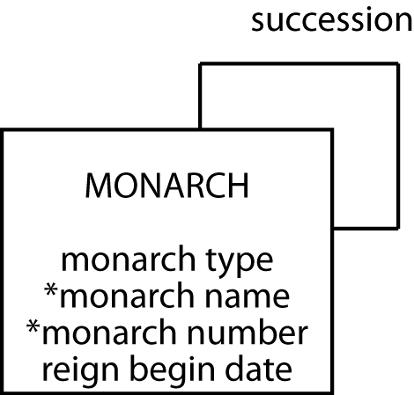
Modeling a 1:1 recursive relationship
The English monarchy

Slide 21
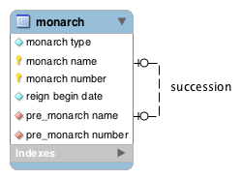
MySQL Workbench

Slide 22
Mapping a 1:1 recursive relationship
monarch
montype | monname | monnum | rgnbeg | premonname | premonnum
Queen | Victoria | I | 1837/6/20 | William | IV
King | Edward | VII | 1901/1/22 | Victoria | I
King | George | V | 1910/5/6 | Edward | VII
King | Edward | VIII | 1936/1/20 | George | V
King | George | VI | 1936/12/11 | Edward | VIII
Queen | Elizabeth | II | 1952/2/6 | George | VI

Slide 23
Enforcing a 1:1 recursive relationship
A 1:1 recursive relationship means that the foreign key must be unique for its column
There can be only one matching primary key
Add a UNIQUE INDEX constraint to the foreign key column
A uniqueness constraint does not prevent the column from being NULL

Slide 24
Creating the table
CREATE TABLE monarch (
montype VARCHAR(5),
monname VARCHAR(15) NOT NULL,
monnum VARCHAR(5) NOT NULL,
rgnbeg DATE,
premonname VARCHAR(15),
premonnum VARCHAR(5),
PRIMARY KEY(monname,monnum),
UNIQUE INDEX uniq_monarch (premonname,premonnum),
CONSTRAINT fk_monarch
FOREIGN KEY (premonname, premonnum)
REFERENCES monarch(monname, monnum));
Enforces 1:1 recursive relationship

Slide 25
Mapping 1:1 recursive &1:m recursive
Both add a foreign key to the same table
1:1 recursive
Specify that the foreign key must be unique
1:m recursive
No uniqueness specification

Slide 26
Mapping 1:1 recursive &1:m recursive
Spouse must be a unique column
Multiple people can have same father

Slide 27
Inserting rows
INSERT INTO monarch (montype,monname, monnum,rgnbeg)
VALUES ('King','William','IV','1830-06-26');
INSERT INTO monarch
VALUES ('Queen','Victoria','I','1837-06-20','William','IV');
INSERT INTO monarch
VALUES ('King','Edward','VII','1901-01-22','Victoria','I');
INSERT INTO monarch
VALUES ('King','George','V','1910-05-06','Edward','VII');
INSERT INTO monarch
VALUES ('King','Edward','VIII','1936-01-20','George','V');
INSERT INTO monarch
VALUES ('King','George','VI','1936-12-11','Edward','VIII');
INSERT INTO monarch
VALUES ('Queen','Elizabeth','II','1952-02-06','George','VI');

Slide 28
Exercise
Design a database to record details of all Olympic cities
Recognize that a city can host an Olympics more than once, though a particular Olympics is in only one city at a time
Recognize that each Olympics has only one predecessor and successor

Slide 29
Querying a 1:1 recursive relationship
Who preceded Elizabeth II?
SELECT premonname, premonnum FROM monarch
WHERE monname = 'Elizabeth' and monnum = 'II';
premonname | premonnum
George | VI

Slide 30
Querying a 1:1 recursive relationship
Was Elizabeth II's predecessor a king or queen?
SELECT pre.montype FROM monarch cur JOIN monarch pre
ON cur.premonname = pre.monname AND cur.premonnum = pre.monnum
WHERE cur.monname = 'Elizabeth'
AND cur.monnum = 'II';
montype
King
cur
montype | monname | monnum | rgnbeg | premonname | premonnum
Queen | Elizabeth | II | 1952/2/6 | George | VI
pre
montype | monname | monnum | rgnbeg | premonname | premonnum
King | George | VI | 1936/12/11 | Edward | VIII

Slide 31
Querying a 1:1 recursive relationship
List the kings and queens of England in ascending chronological order.
SELECT montype, monname, monnum, rgnbeg
FROM monarch ORDER BY rgnbeg;
montype | monname | monnum | rgnbeg
Queen | Victoria | I | 1837-06-20
King | Edward | VII | 1901-01-22
King | George | V | 1910-05-06
King | Edward | VIII | 1936-01-20
King | George | VI | 1936-12-11
Queen | Elizabeth | II | 1952-02-06

Slide 32
Exercise
When did the reign of the monarch preceding Elizabeth II ‘s begin.
What was the duration of the reign of every monarch (look up DATEDIFF)

Slide 33
Exercise
Add details of the last three summer Olympics’ cities
Use SQL to determine which city was the host before London in 2008.

Slide 34
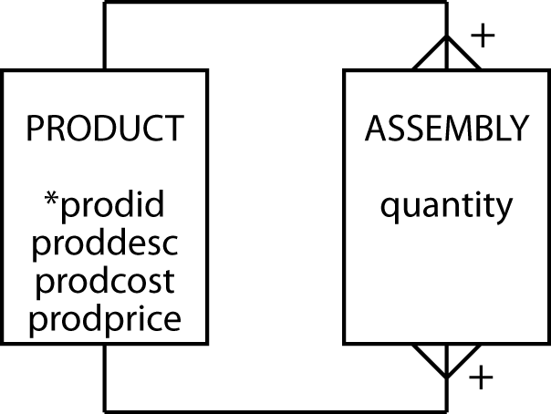
Modeling an m:m recursive relationship
Bill of materials problem
A product can appear as part of many other products and can be made up of many products

Slide 35
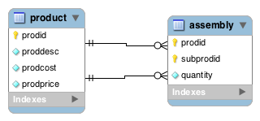
Modeling an m:m recursive relationship

Slide 36
Mapping an m:m recursive relationship
product
prodid | proddesc | prodcost | prodprice
1000 | Animal photography kit |  | 725
101 | Camera | 150 | 300
102 | Camera case | 10 | 15
103 | 70-210 zoom lens | 125 | 200
104 | 28-85 zoom lens | 115 | 185
105 | Photographer’s vest | 25 | 40
106 | Lens cleaning cloth | 1 | 1.25
107 | Tripod | 35 | 45
108 | 16 GB SDHC memory card | 30 | 30
assembly
quantity | prodid | subprodid
1 | 1000 | 101
1 | 1000 | 102
1 | 1000 | 103
1 | 1000 | 104
1 | 1000 | 105
2 | 1000 | 106
1 | 1000 | 107
4 | 1000 | 108
Notes:
2000 Safari kit
2001 5 Tent
10 Animal photo kits
Create a row in product for Safari Kit [2000 Safari Kit 20000]
Create row in assembly for Safari Kit [5 2000 2001]
10 2000 1000]

Slide 37
Creating the tables
CREATE TABLE product (
prodid INTEGER,
proddesc VARCHAR(30),
prodcost DECIMAL(9,2),
prodprice DECIMAL(9,2),
PRIMARY KEY(prodid));
CREATE TABLE assembly (
quantity INTEGER NOT NULL,
prodid INTEGER,
subprodid INTEGER,
PRIMARY KEY(prodid, subprodid),
CONSTRAINT fk_assembly_product FOREIGN KEY(prodid)
REFERENCES product(prodid),
CONSTRAINT fk_assembly_subproduct FOREIGN KEY(subprodid)
REFERENCES product (prodid));

Slide 38
Exercise
In a round-robin tournament, each contestant meets all other contestants in turn
In the Olympics, it is common for an event with a large pool of contestants to be broken into groups, with a round-robin tournament in each group to determine who advances from the group to the next level
Design a data model to record details of a round-robin competition

Slide 39
Querying an m:m recursive relationship
List the product identifier of each component of the animal photography kit.
SELECT subprodid FROM product JOIN assembly
ON product.prodid = assembly.prodid;
WHERE proddesc = 'Animal photography kit'
subprodid
101
106
107
105
104
103
102
108

Slide 40
Querying an m:m recursive relationship
List the product description and cost of each component of the animal photography kit.
SELECT proddesc, prodcost FROM product
WHERE prodid IN
(SELECT subprodid FROM product JOIN assembly
ON proddesc = 'Animal photography kit'
WHERE product.prodid = assembly.prodid);
proddesc | prodcost
Camera | 150.00
Camera case | 10.00
70-210 zoom lens | 125.00
28-85 zoom lens | 115.00
Photographer’s vest | 25.00
Lens cleaning cloth | 1.00
Tripod | 35.00
16 GB SDHC memory card | 30.00

Slide 41
Exercise
What is the cost to put together each kits (i.e Animal and Budget photography kit)
What is the profit on each kit.

Slide 42
Exercises
Model the following situations
Friendship
Course prerequisites
A matrix organization where a person can report to multiple people

Slide 43
Exercise
Insert data in the round-robin database for the 2012 Football (Soccer) competition for Group A, with four teams
See http://www.london2012.com/football/schedule-and-results/
How many ties were there in Group A?
Use the ISO two-character country code to identify countries
http://en.wikipedia.org/wiki/ISO_3166-1_alpha-2

Slide 44
Exercise
Model a diagram
Notes:
http://www.digibarn.com/collections/posters/tongues/ComputerLanguagesChart-med.png

Slide 45
Conclusion
Introduced
Recursive relationship
Self-referential constraint
Self-join

Slide 46
Practice Exercises
Using DEPT and EMP tables
Find the departments where all the employees earn less than their boss.
Find the names of employees who are in the same department as their boss (as an employee).
List the departments having an average salary greater than $ 25,000.
List the departments where the average salary of the employees, excluding the boss, is greater than $ 25,000.
List the names and manager of the employees of the Marketing department who have a salary greater than $ 25,000.
List the names of the employees who earn more than any employee in the Marketing department.

