Slide 1
MIST 4610 – Data Management and Analytics (More on) Data Modeling
Nikhil Srinivasan
MIS@Terry

Slide 2
Data modeling
A technique for modeling data
Method for determining what data and relationships should be stored in a database
A graphical representation of a database
Communicates a database design
The goal: identify the facts to be stored in the database
Data modeling requires a partnership between client and analyst
Iterative process – trial and revision
The data model is a working document

Slide 3
Data Modeling - The building blocks
Entity – thing about which data should be stored (basic building block)
Attribute – describes an entity (singular and unique within the model)
Relationship – describes a linkage between two entities
Relationship descriptors designate/describe instances between entities (1:1, 1:m, m:m)
Identifier – uniquely distinguishes an instance of an entity

Slide 4
Data model quality
A well-formed data model
A high fidelity image

Slide 5
A well-formed data model
Construction rules obeyed
No ambiguity
All entities, attributes, relationships, and identifiers are defined
Names are meaningful to the client

Slide 6
A high fidelity image
Faithfully describes the world it is supposed to represent
Relationships are of the correct degree
Data model is complete, understandable, and accurate
The data model makes sense to the client

Slide 7
Quality improvement
Is the level of detail correct?
Are all exceptions handled?
Is the model accurate?

Slide 8
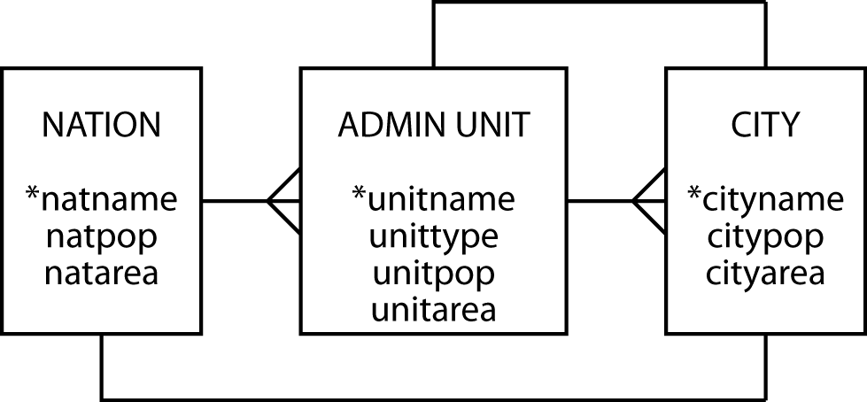
Pure geography
Can a nation have more than one capital?
Can a city be the capital of more than one state?

Slide 9
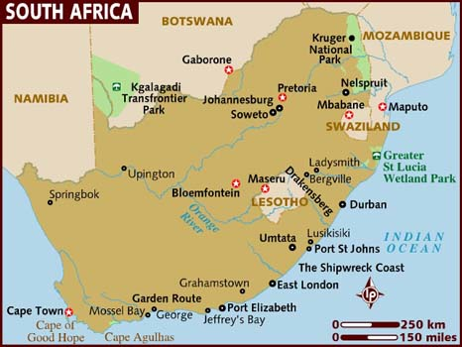
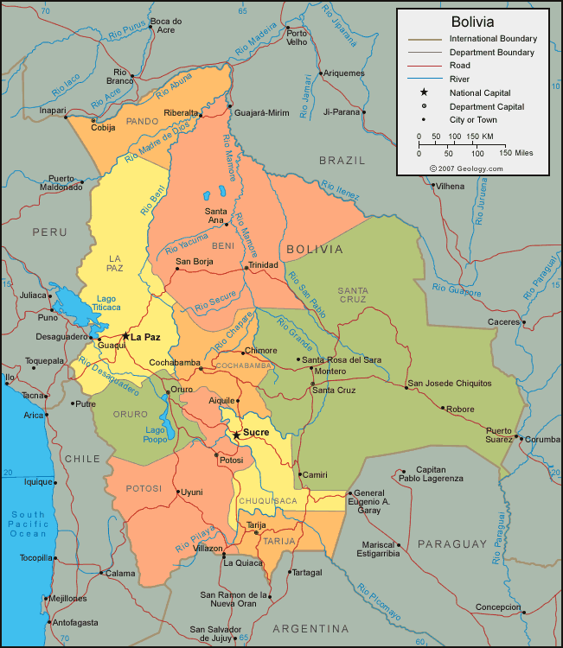
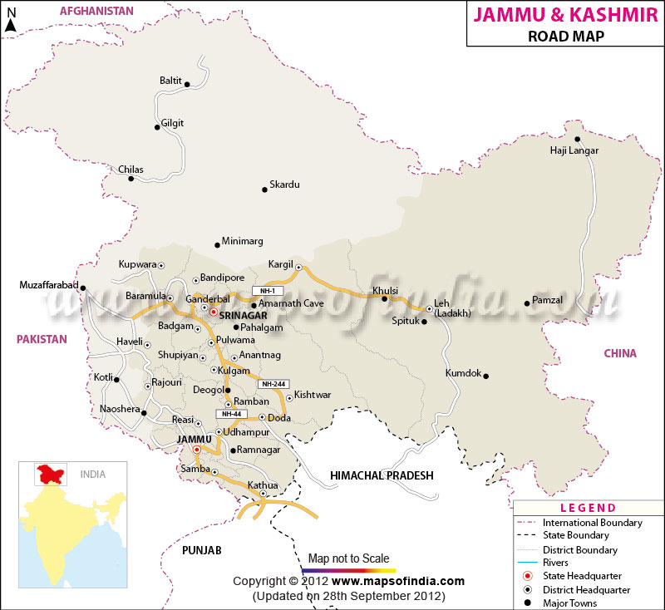
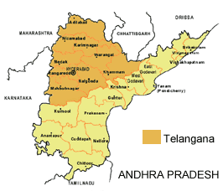
Notes:
http://www.lonelyplanet.com/maps/africa/south-africa/
http://geology.com/world/bolivia-satellite-image.shtml
http://www.mapsofindia.com/maps/jammuandkashmir/jammuandkashmirroads.htm
http://www.rediff.com/news/report/formation-of-telangana-fast-becoming-a-reality/20130726.htm

Slide 10
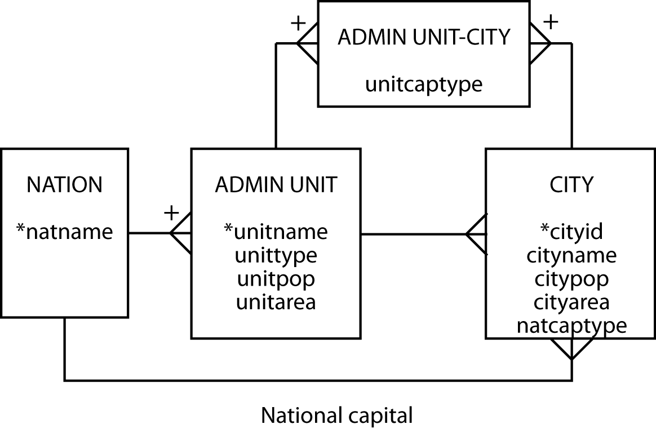
Geography revised

Slide 11
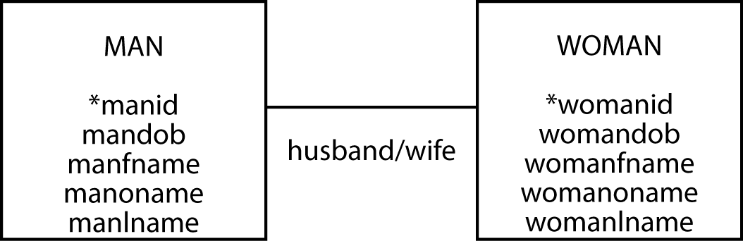
Family matters - Take 1 (initial fragment) Describe the marriage/family relationship
1-1 relationship, marriage date?
Same attributes
Can the entities be combined?

Slide 12
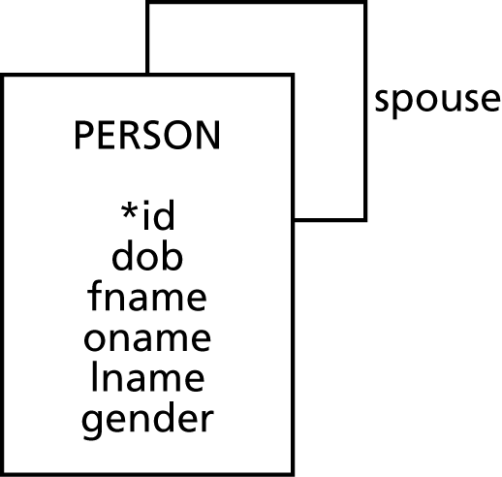
Family matters - Take 2
Add gender attribute
Generalize relationship label to spouse
Is it truly a 1-1 relationship?
What about multiple marriages?

Slide 13
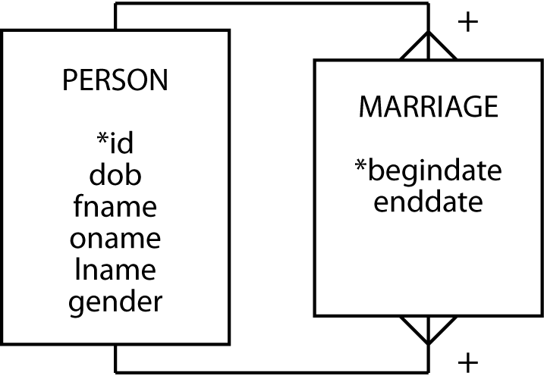
Family matters - Take 3
Convert to m:m
Add date attributes
What if there is no
begindate?
Multiple marriages

Slide 14
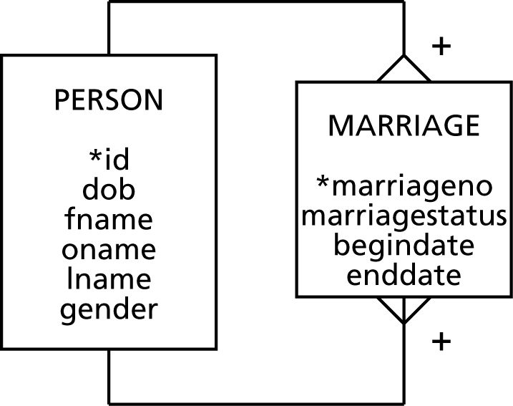
Family matters - Take 4
Add marriageno as
identifier
Add marriage status
What about children?

Slide 15
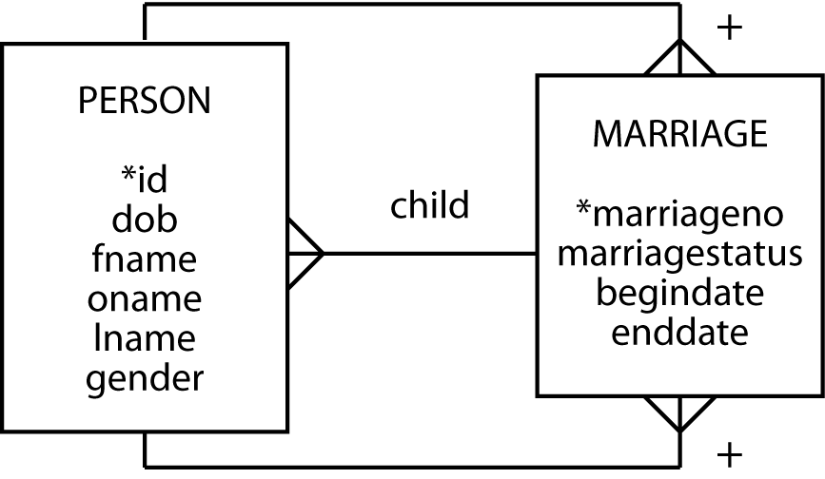
Family matters - Take 5
Add child relationship
What about a single parent?
Etc……

Slide 16
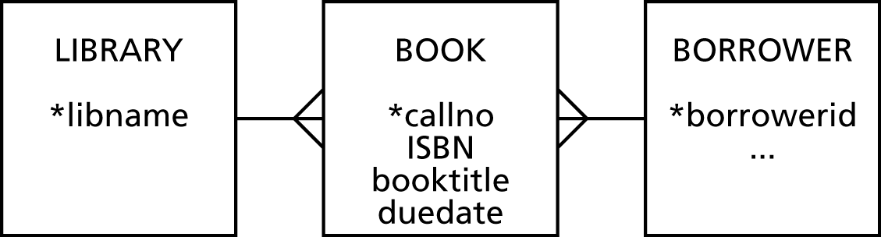
Bookish matters - Take 1
Book is not a physical thing
A copy is what you borrow

Slide 17
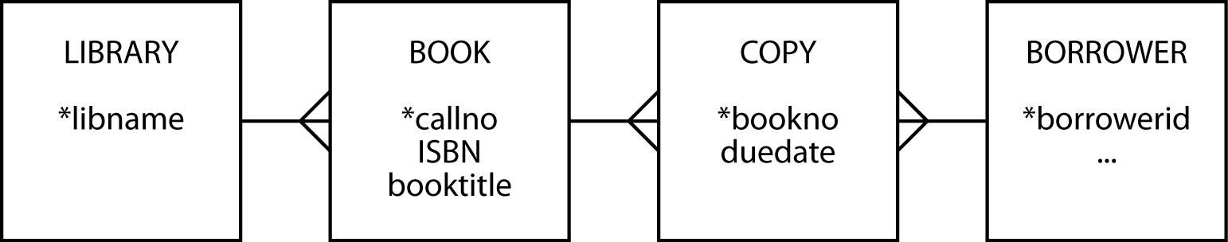
Bookish matters - Take 2
This model records only the current borrower of a copy of a book

Slide 18
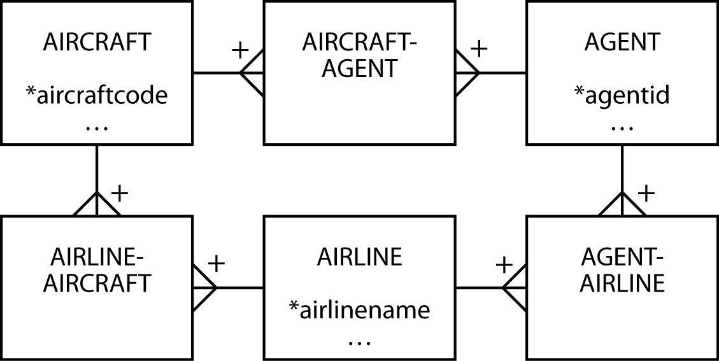
A ménage à trois for entities - Take 1

Slide 19
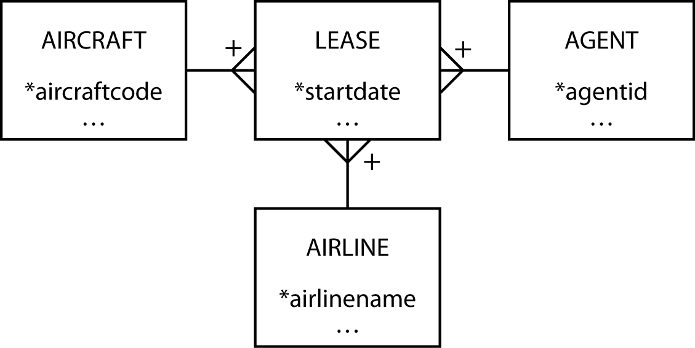
A ménage à trois for entities - Take 2

Slide 20
Golf statistics - take 1

Slide 21
Golf statistics – take 2

Slide 22
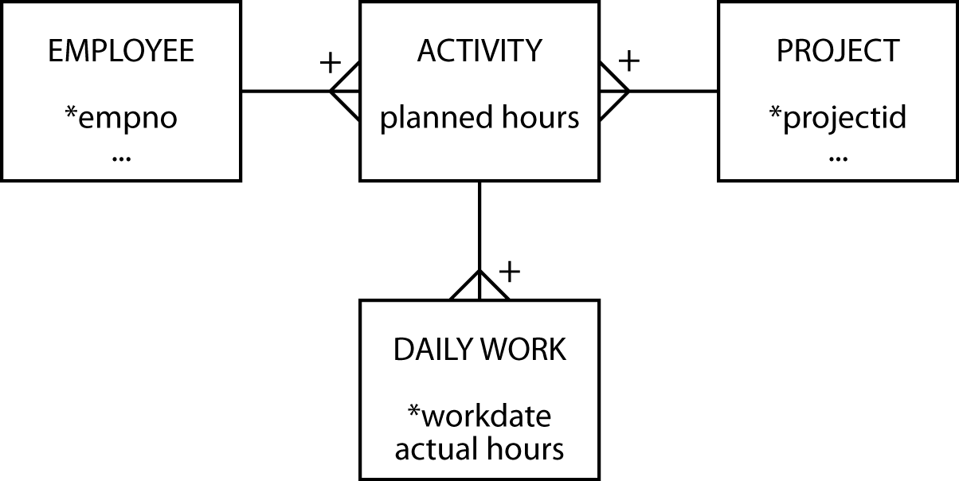
Planning and doing - take 1

Slide 23
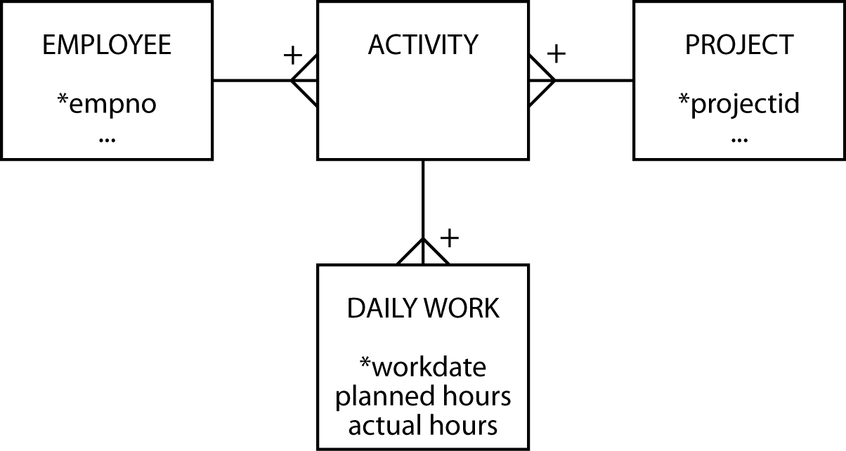
Planning and doing - take 2

Slide 24
Data Modeling
Steve operates a cinema chain and has given you the following information: “I have many cinemas. Each cinema can have multiple theaters. Movies are shown throughout the day starting at 11 a.m. and finishing at 1 a.m. Each movie is given a two-hour time slot. We never show a movie in more than one theater at a time, but we do shift movies among theaters because seating capacity varies. I am interested in knowing how many people, classified by adults and children, attended each showing of a movie. I vary ticket prices by movie and time slot. For instance, Lassie Get Lost is 50 cents for everyone at 11 a.m. but is 75 cents at 11 p.m.”

Slide 25
Data Modeling
A real estate investment company own many shopping malls. Each mall contains many shops. To encourage rental of its shops, the company gives a negotiated discount to retailers who have shops in more than one mall. Each shop generates an income stream that can vary from month to month because rental is based on a flat rental charge and a negotiated percentage of sales revenue. Also each shop has monthly expenses for scheduled and unscheduled maintenance. The company uses the data to compute its monthly net income per square meter for each shop and for ad-hoc querying.

Slide 26
Modality & Cardinality
Modality is also known as optionality
Cardinality indicates the range of instances in a relationship
Modality defines the minimum number of instances
Cardinality and modality are linked

Slide 27
Cardinality
Cardinality | Modality | Meaning
0,1 | Optional | There can be zero or one instances of the entity relative to the other entity
0,n |  | There can be zero or many instances of the entity relative to the other entity
1,1 | Mandatory | There is exactly one instance of the entity relative to the other entity
1,n |  | The entity must have at least one and can have many instances relative to the other entity
Modality defines the minimum number of instances (rows)
Cardinality indicates the range of instances (rows) in a relationship

Slide 28
Minimalist approach
Focus has been on identifying the basic cardinality (1:m or m:m?)
Now add greater precision
Is it 0,1 or 1,1?
Learn the basics and then add more detail

Slide 29
Modality & Cardinality (Reminder)
Modality is also known as optionality
Cardinality indicates the range of instances in a relationship
Modality defines the minimum number of instances
Cardinality and modality are linked

Slide 30
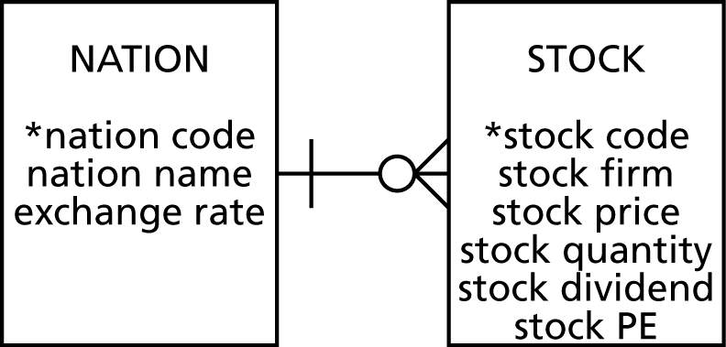
Modality
Optional entity
Cardinality is 0
Indicated by O
Mandatory entity
Cardinality is 1
indicated by l (bar)
Mandatory that an instance of Stock have an instance of Nation
Optional that an instance of Nation have an instance of Stock

Slide 31
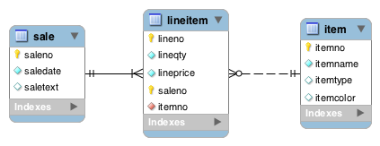
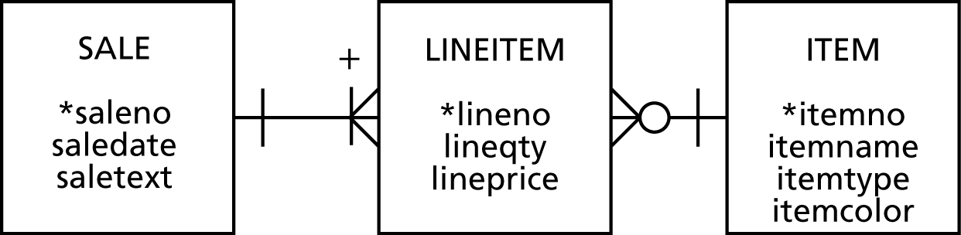
Modality

Slide 32
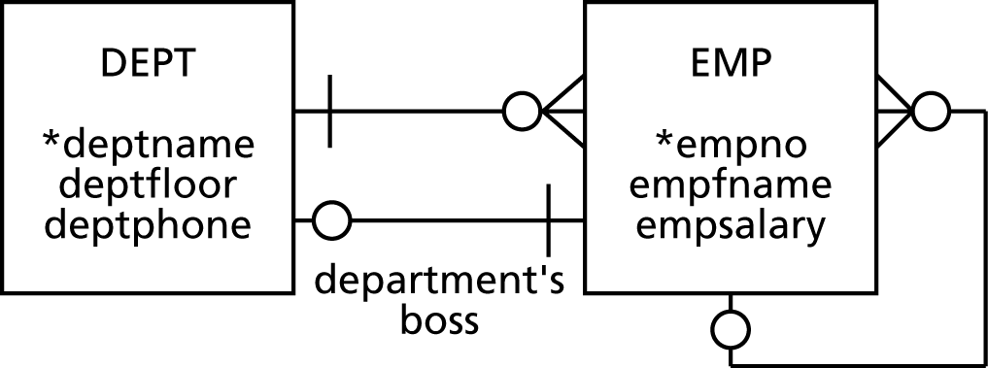
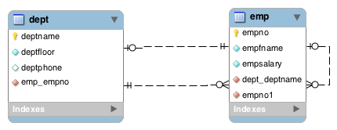
Modality
employee’s boss

Slide 33
Modality
Adds additional information to a data model
If a relationship is mandatory, then add a constraint
Could be
Referential integrity constraint
Application logic

Slide 34
Entity types
Independent
Dependent
Associative
Aggregate
Subordinate

Slide 35
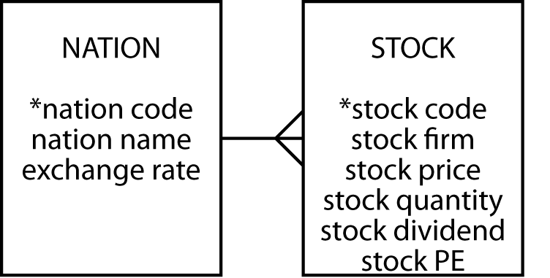
Independent
Often a starting point
Prominent in the client's mind
Often related to other independent entities

Slide 36
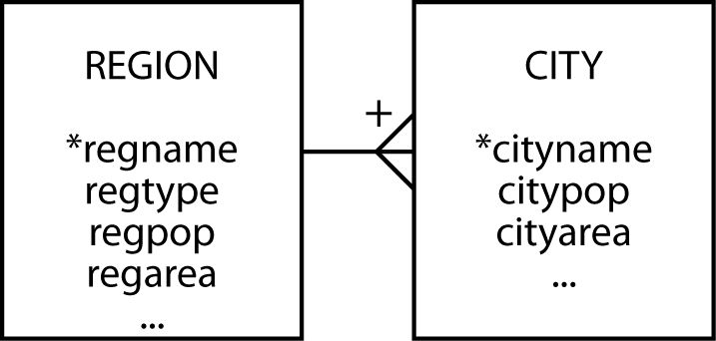
Dependent
Relies on another entity for its existence and identification
Can become independent if given an arbitrary identifier

Slide 37
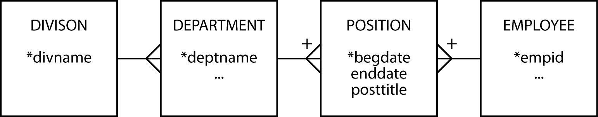
Associative
A by-product of an m:m relationship
Typically between independent entities
Can store current or historical data
Can become independent if given an arbitrary identifier

Slide 38
Aggregate
Created from several different entities that have a common prefix or suffix
Commonly used with addresses or names

Slide 39
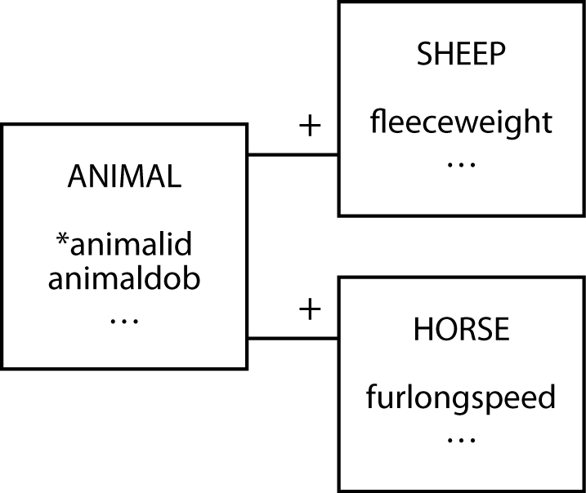
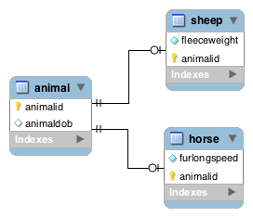
Subordinate
An entity with data that can vary among instances

Slide 40
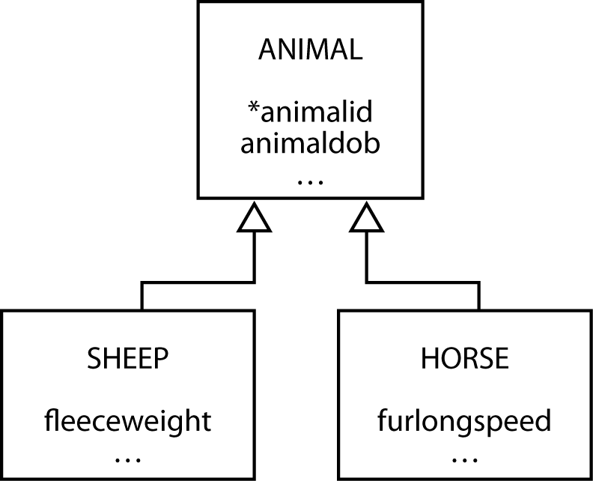
Generalization
A relationship between a more general element and a more specific element

Slide 41
Generalization
Map with one table for each entity
For each of the subtype entities the primary key is that of the supertype entity
You must also make this column a foreign key so that a subtype cannot be inserted without the presence of the matching supertype

Slide 42
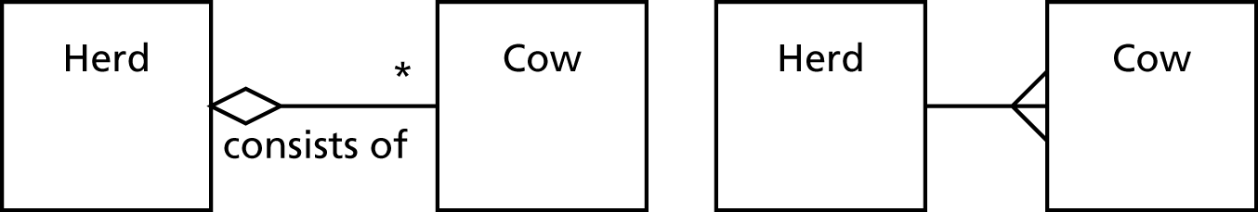
UML aggregation
Aggregation is a part-whole relationship between two entities

Slide 43

UML shared aggregation
One entity owns another entity, but other entities can own that entity as well

Slide 44

UML composite aggregation
One entity exclusively owns the other entity

Slide 45
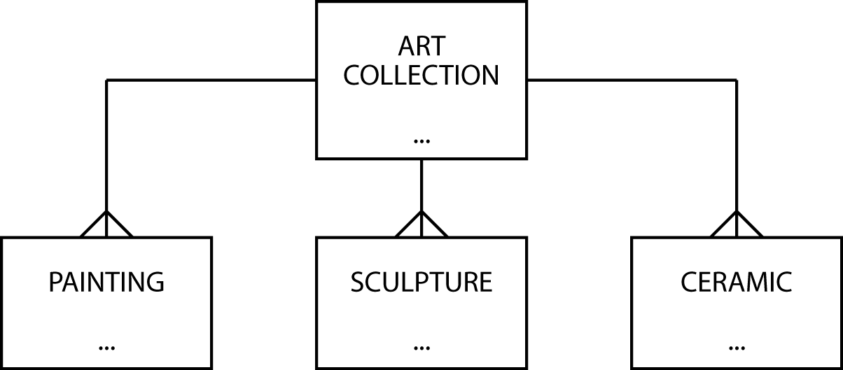
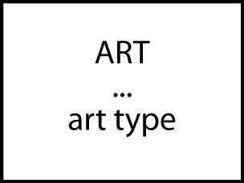
Data model contraction

Slide 46
Hints on data modeling
The model will expand and contract
Invent identifiers where necessary
Identifiers should have only one purpose – identification
A data model does not imply ordering
Create an attribute if ordering of instances is required
An attribute’s meaning must be consistent

Slide 47
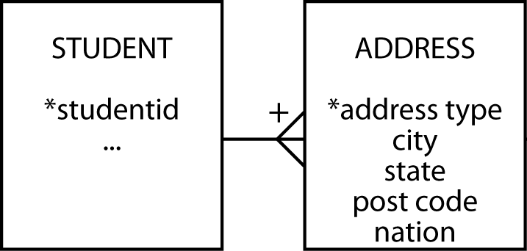
Names and addresses
The query test -- if an attribute has parts, are any of the parts ever likely to appear in a query?
Have an understanding on representing names and addresses in a data model

Slide 48
Hints on data modeling
Select names carefully
Synonyms—different words that have the same meaning
Get clients to settle on a common word or use views
Homonyms—same word has different meanings
Clarify to avoid confusion
Naming associative entities
Concatenate entity names if there is no obvious real world name
Uncover all exceptions
Label relationships to avoid ambiguity
Keep the data model well-formed and accurate

Slide 49
Meaningful identifiers
An identifier is meaningful when some attributes of the entity can be inferred from the identifier’s value
Advantages | Disadvantages
Recognizable and easy to remember | Identifier exhaustion
Administrative simplicity | Reality changes
 | Loss of meaningfulness
e.g., Telephone number
Area code 706
City code 769

Slide 50
Recommendation
Nothing is lost and much is gained by using non-meaningful identifiers
Non-meaningful identifiers serve their sole purpose well
They uniquely identify an entity
Attributes are used to describe the characteristics of the entity
A clear distinction between the role of identifiers and attributes creates fewer data management problems

Slide 51
Practice
An organization has several managers who work on one or more projects. Each project has an id, a name, and a goal. A manager always uses certain IT equipment items on a given project. A piece of equipment has an id, a description, and a date of purchase. The organization wishes to record the date when a given IT equipment item was assigned to a particular manager working on a specific project, as well as the total number of hours the manager has used the IT equipment for the project. Basic information about each manager should be kept. Each project has a manager as its leader, who will follow the project from its inception to its completion. It is possible for a manager to lead more than one project.
Draw the data model to accurately represent the situation above

Slide 52
Key points
A high-fidelity data model handles all exceptions
Identifiers need only identify an instance
Data modeling skills take time to develop

