Slide 1
JOINs and Normalization
Nikhil Srinivasan
MIS@Terry

Slide 2
JOINS

Slide 3
SQL JOIN
A SQL join clause combines rows from two or more database tables into a single table.
It locates related column values in the two tables.
A query can contain zero, one, or multiple JOIN operations.

Slide 4
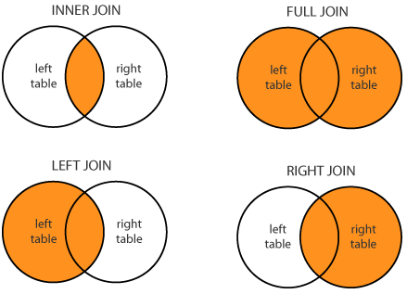
Different types of JOINs:
(INNER) JOIN: Select records that have matching values in both tables.
LEFT (OUTER) JOIN: Select records from the first (left) table with matching records from right table.
RIGHT (OUTER) JOIN: Select records from the second (right) table with matching records from left table.
FULL (OUTER) JOIN: Selects all records that match either left or right table records.

Slide 5
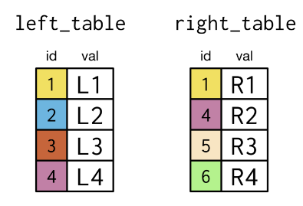
ILLUSTRATING JOINS
We will work with 2 tables: left_table and right_table to understand the topic better.
Key
Key

Slide 6
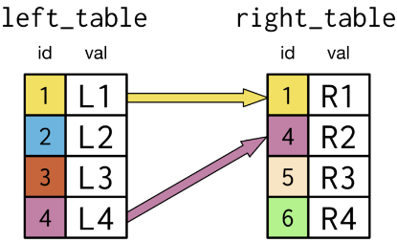
INNER JOIN
Definition: Inner Join will select all rows from both participating tables as long as there is a match between the columns.
We look for matches in the right table corresponding to all entries in the key field in the left table.

Slide 7
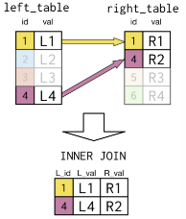
INNER JOIN
Result:

Slide 8
INNER JOIN
Syntax:
SELECT id, l.val AS l_val, r.val AS r_val
FROM left_table l
INNER JOIN right_table r
ON l.id= r.id;

Slide 9
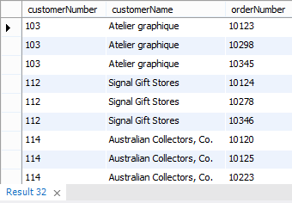
Example from Database:
Aim: Retrieve Order number corresponding to each customer
select C.customerNumber, C.customerName, O.orderNumber
from Customers C
inner join Orders O on C.customerNumber=O.customerNumber;

Slide 10
LEFT JOIN
Definition: Left Join returns all records from the left table and the matched records from the right table.
If there is no match, result is NULL from the right side.
Example:

Slide 11

Result: id l_val r_val
Syntax:
SELECT id, l.val AS l_val, r.val AS r_val
FROM left_table l
LEFT JOIN right_table r
ON l.id= r.id;

Slide 12
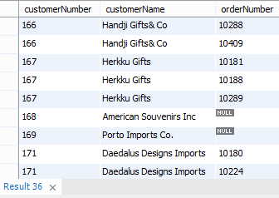
Example from Database (Left Join):
Aim: Retrieve Order numbers corresponding to each customer
select C.customerNumber, C.customerName, O.orderNumber
from Customers C
left join Orders O on C.customerNumber=O.customerNumber;

Slide 13
RIGHT JOIN
Definition: Right Join returns all records from the right table and the matched records from the left table.
If there is no match, result is NULL from the left side.
Example:

Slide 14

Result: id l_val r_val
Syntax:
SELECT id, l.val AS l_val, r.val AS r_val
FROM left_table l
RIGHT JOIN right_table r
ON l.id= r.id;

Slide 15
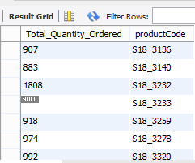
Example from Database (Right Join):
Aim: Retrieve Total quantity ordered for each product
select sum(O.quantityOrdered) Total_Quantity_Ordered, P.productCode
from OrderDetails O
RIGHT JOIN Products P
on P.productCode=O.productCode
group by P.productCode;

Slide 16
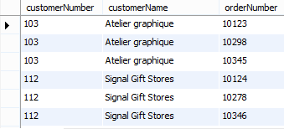
Note: You may also have a case where all records match in both left and right tables. In that scenario, there would be no null records in the output.
Aim: Retrieve Order numbers corresponding to each customer
select C.customerNumber, C.customerName, O.orderNumber
from Customers C
right join Orders O on C.customerNumber=O.customerNumber;

Slide 17
OUTER JOIN
Definition: Outer Join returns all the rows from the left table and all the rows from the right table.
If there are rows in “left_table" that do not have matches in “right_table", or if there are rows in “right_table" that do not have matches in “left_table", those rows will be listed as well.
Example:

Slide 18
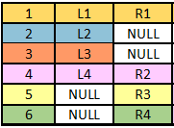
Result: id l_val r_val
Syntax:
SELECT id, l.val AS l_val, r.val AS r_val
FROM left_table l
OUTER JOIN right_table r
ON l.id= r.id;

Slide 19
Example from Database (Outer Join):
Aim: Retrieve Order numbers corresponding to each customer
MySQL doesn't support Full Join. You could instead use a UNION of Left and Right joins as depicted below:
select C.customerNumber, C.customerName, O.orderNumber
from Customers C
left join Orders O on C.customerNumber=O.customerNumber
UNION
select C.customerNumber, C.customerName, O.orderNumber
from Customers C
right join Orders O on C.customerNumber=O.customerNumber
where C.customerNumber IS NULL;
;

Slide 20
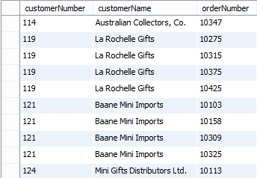
Outer Join: (Continued)

Slide 21
Practice
Write a query to list out the name of every customer and number of orders placed by them.
Write a query to list out the names of sales reps and the number of customers represented by them.

Slide 22
Normalization

Slide 23
Normalization
An alternative database design tool to data modeling
A theoretical foundation for the relational model
Application of a series of rules that gradually improve the design

Slide 24
Functional dependency
A relationship between attributes in an entity
One or more attributes determine the value of another attribute
An identifier functionally determines all the attributes of an entity
stock code → firm name, stock price, stock quantity, stock dividend
If we know stock code we know the value of firm name, etc.
Multivalued dependency
Formulae
(stock dividend, stock price) → yield

Slide 25
Full functional dependency
Yield is fully functionally dependent on stock dividend and stock price because both of these attributes are required to determine the value of yield
(stock dividend, stock price) → yield
Determinant
An attribute that fully functionally determines another attribute
e.g., stock code determines stock PE

Slide 26
Multidetermination
A given value can determine multiple values
A multidetermines B
A → → Β
e.g., Department multidetermines course
Multivalued dependency means functional dependencies are multivalued

Slide 27
Attribute relationships
One-to-one
A value of an attribute determines the value of another attribute and vice versa
A → B and B → Α
e.g.,
CH → Switzerland
Switzerland → CH

Slide 28
Attribute relationships
One-to-many
A value of one attribute determines the value of another attribute but not vice versa
country name → currency unit
currency unit not → country name

Slide 29
Attribute relationships
Many-to-many
Neither attribute determines the other
A not → B
B not → A
country name not → language
language not → country name
French and Flemish is spoken in Belgium
French is spoken in many countries

Slide 30
Normal forms
A classification of relations
Stacked like a set of Russian dolls
Innermost is first normal form

Slide 31
First normal form (1NF)
All rows must have the same number of columns
Single valued attributes only

Slide 32
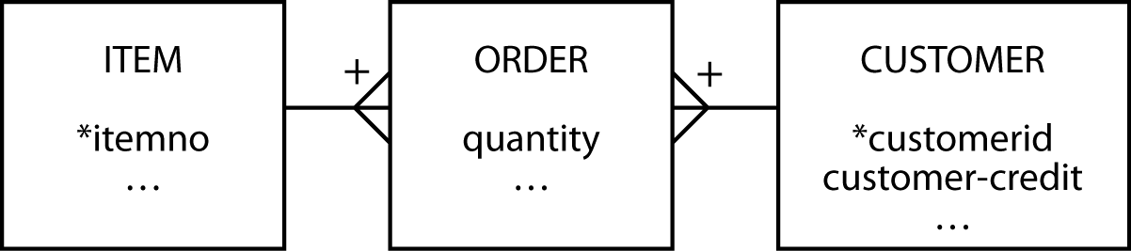
Second normal form (2NF)
Violated when a nonkey column is a fact about part of the primary key
A column is not fully functionally dependent on the primary key
customer-credit in this case
order
itemno | customerid | quantity | customer-credit
12 | 57 | 25 | OK
34 | 679 | 3 | POOR

Slide 33
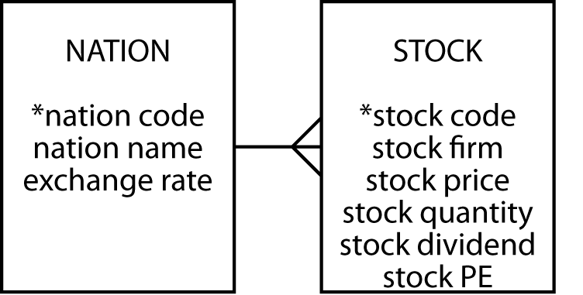
Third normal form (3NF)
Violated when a nonkey column is a fact about another nonkey column
A column is not fully functionally dependent on the primary key
exchange rate in this case
stock
stock code | nation | exchange rate
MG | USA | 0.67
IR | AUS | 0.46

Slide 34
Other Normal Forms
Bryce-Codd Normal Form (BCNF)
Fourth Normal Form
Fifth Normal Form
Domain-Key Normal Form (DKNF)

Slide 35
Data modelling and normalization
Data modelling is often an easier path to good database design
A high-fidelity data model will be of high normal form
5NF is likely to create the most problems
Check for special rules

Slide 36
Data modeling methods
A widely known model is Chen's entity-relationship (E-R) approach
There is no standard for the E-R method
Nearly all data modeling approaches are very similar because they share common concepts
Learning is readily transferable between methods

Slide 37
Representing relationships
The various dialects are most distinctive in the ways in which relationships are represented
Knowledge is very transferable between dialects

Slide 38
Goal
Learn to think like a data modeler
Different dialects and greater precision (e.g., cardinality) come easily once the basics are mastered

Slide 39
Key points
Normalization is one approach to data modeling
The are multiple representations for data model
Learning to model is difficult
Learning to represent a model is easy

