Slide 1
Organizational intelligence technologies
There are three kinds of intelligence: one kind understands things for itself, the other appreciates what others can understand, the third understands neither for itself nor through others. This first kind is excellent, the second good, and the third kind useless.
Machiavelli, The Prince, 1513.

Slide 2
Organizational intelligence
Organizational intelligence is the outcome of an organization’s efforts to collect store, process, and interpret data from internal and external sources
Intelligence in the sense of gathering and distributing information

Slide 3
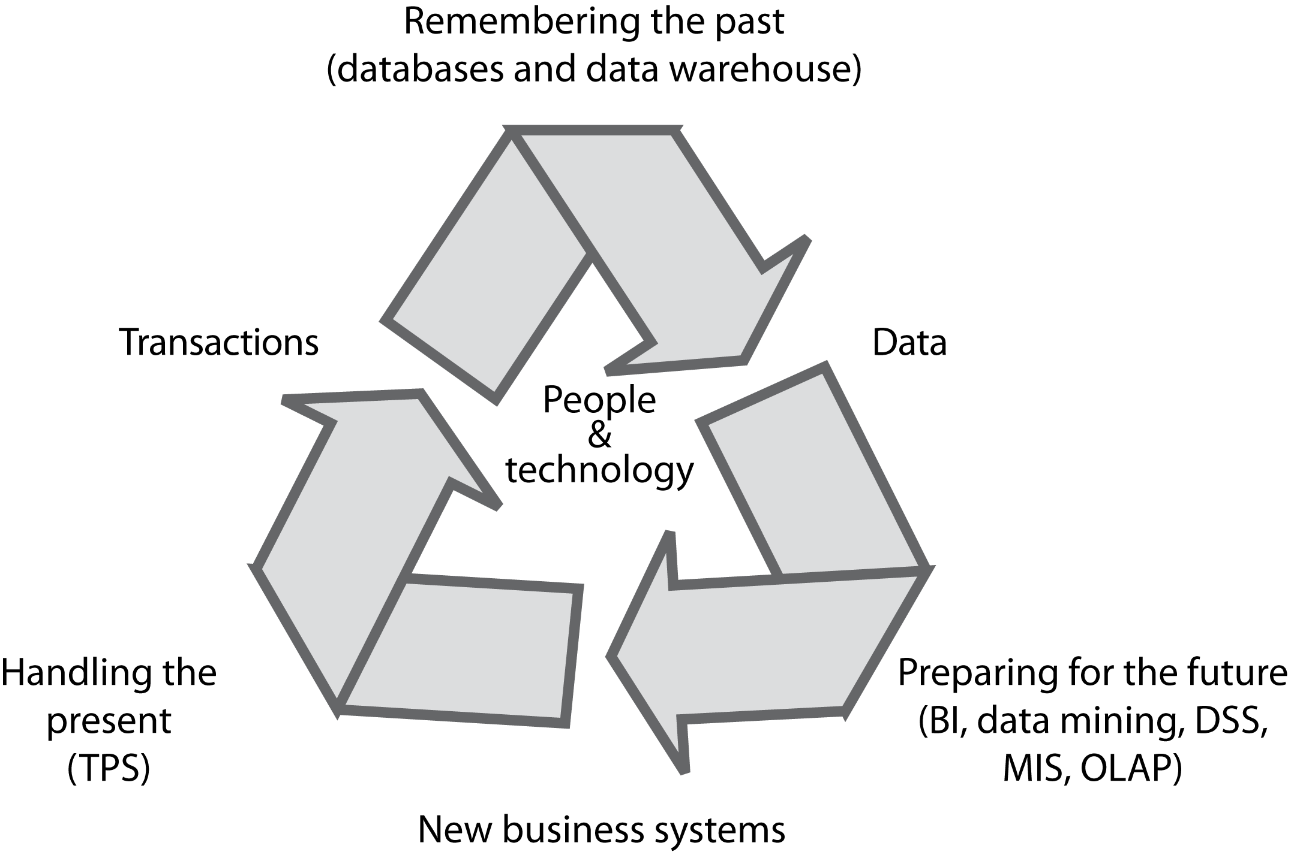
The information systems cycle

Slide 4
The problem
Organizational memory is fragmented
Different systems
Different database technologies
Different locations
An underused intelligence system containing undetected key facts about customers

Slide 5
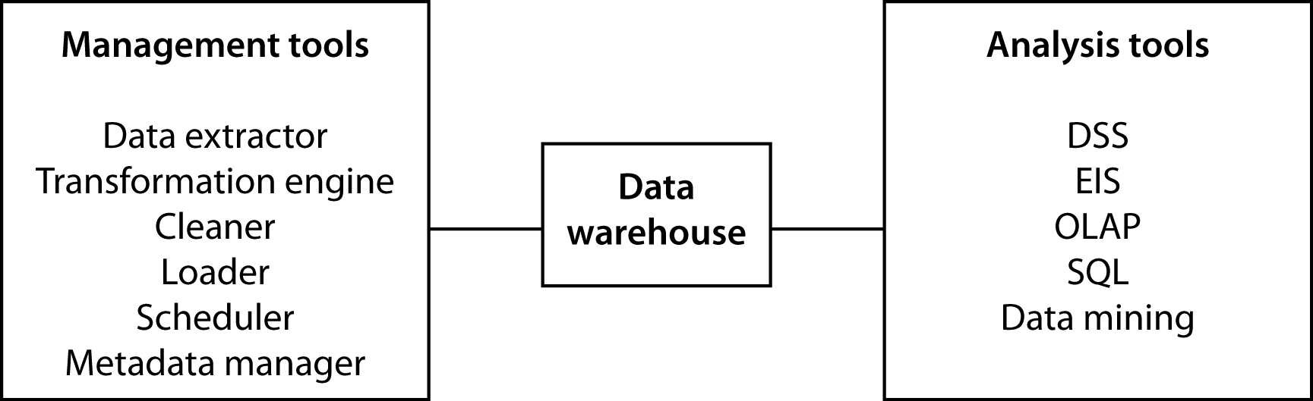
The data warehouse
A repository of organizational data
Can be measured in petabytes (10¹⁵)

Slide 6
Managing the data warehouse
Extraction
Transformation
Cleaning
Loading
Scheduling
Metadata

Slide 7
Extraction
Pulling data from existing systems
Operational systems were not designed for extraction to load into a data warehouse
Applications are often independent entities
Time consuming and complex
An ongoing process

Slide 8
Transformation
Encoding
m/f, male/female to M/F
Unit of measure
inches to cms
Field
sales-date to salesdate
Date
dd/mm/yy to yyyy/mm/dd

Slide 9
Cleaning
Same record stored in different departments
Multiple records for a company
Multiple entries for the same organization
Misuse of data entry fields

Slide 10
Scheduling
A trade-off
Too frequent is costly
Infrequently means old data

Slide 11
Metadata
A data dictionary containing additional facts about the data in the warehouse
Description of each data type
Format
Coding standards
Meaning
Operational system source
Transformations
Frequency of extracts

Slide 12
Warehouse architectures
Centralized
Federated
Tiered

Slide 13
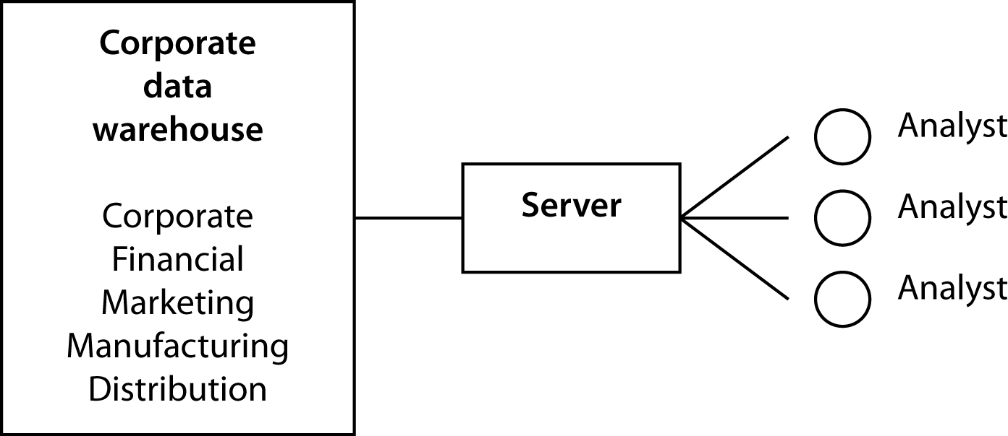
Centralized data warehouse

Slide 14
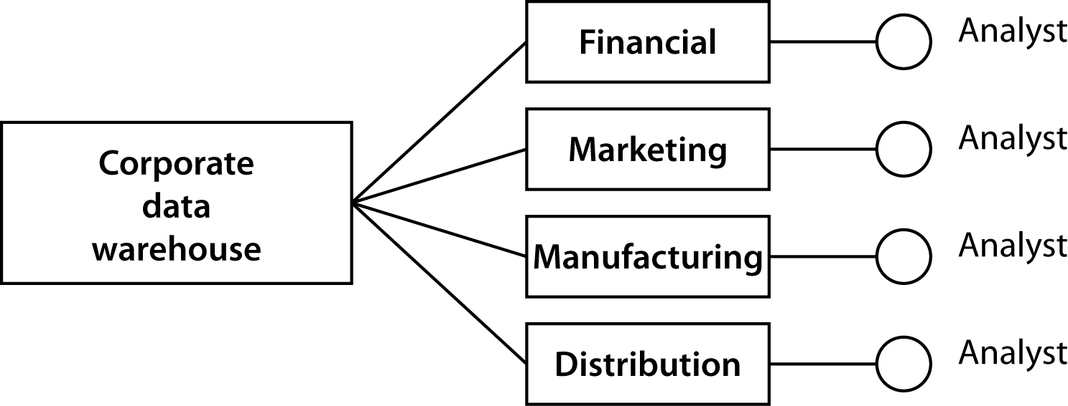
Federated data warehouse

Slide 15
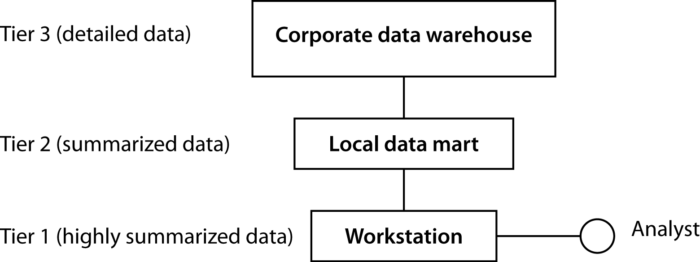
Tiered data warehouse

Slide 16
The hardware/software decision
The default is rapidly becoming
Hadoop for file management
MapReduce for programming
Commodity nodes for processing

Slide 17
Exploiting data stores
Verification and discovery
Data mining
OLAP

Slide 18
Verification and discovery
Verification | Discovery
What is the average sale for in-store and catalog customers? | What is the best predictor of sales?
What is the average high school GPA of students who graduate from college compared to those who do not? | What are the best predictors of college graduation?

Slide 19
OLAP
Relational model was not designed for data synthesis, analysis, and consolidation
This is the role of spreadsheets and other special purpose software
Need to complement RDBMS technology with a multidimensional view of data

Slide 20
TPS versus OLAP
TPS | OLAP
Optimize for transaction volume | Optimize for data analysis
Process a few records at a time | Process summarized data
Real time update as transactions occur | Batch update (e.g., daily)
Based on tables | Based on hypercubes
Raw data | Aggregated data
SQL is widely used | MDX becoming a standard

Slide 21
ROLAP
A relational OLAP
A multidimensional model is imposed on a relational structure
Relational is a mature technology with extensive data management features
Not as efficient as OLAP

Slide 22
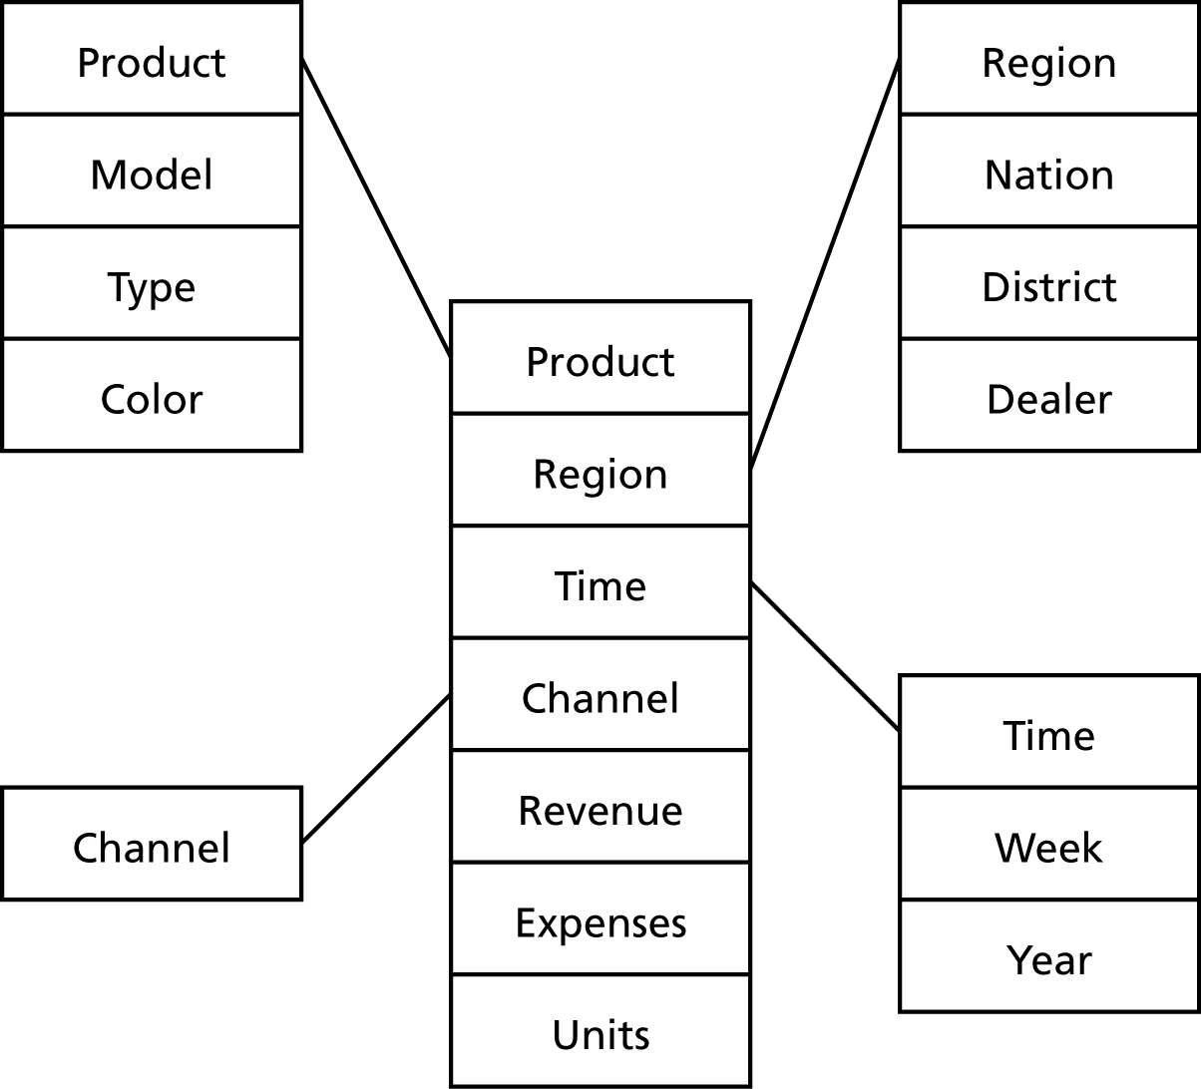
The star structure
A central fact table is connected to multiple dimensional tables
A single join can relate the fact table with any one of the dimensional tables

Slide 23
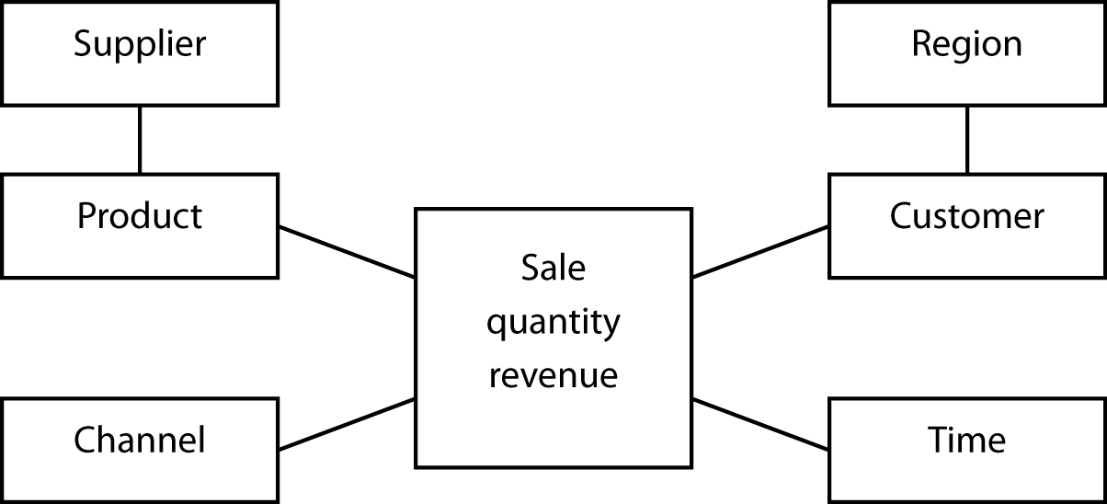
The snowflake structure
An extension of the star schema to handle very large dimensional tables
Multiple joins might be required to fetch data.

Slide 24
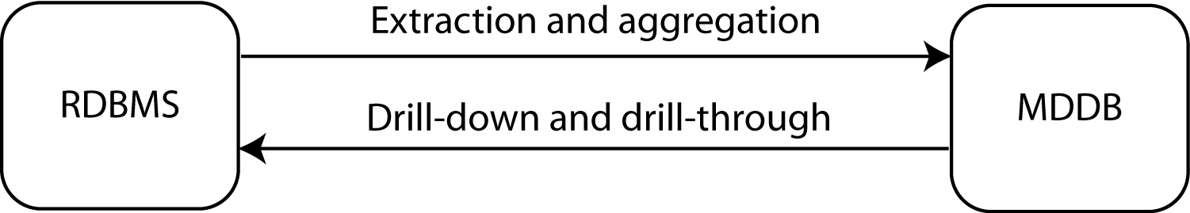
The link between RDBMS and MDDB

Slide 25
MDDB design
Key concepts
Variable dimensions
What is tracked
Sales
Identifier dimensions
Tagging what is tracked
Time, product, and store of sale

Slide 26
Prompts for identifying dimensions
Prompt | Example
When? | June 5, 2013 10:27am
Where? | Paris
What? | Tent
How? | Catalog
Who? | Young adult woman
Why? | Camping trip to Bolivia
Outcome? | Revenue of €624.00
Transaction data
Face recognition or credit card co.
Social media
Transaction data

Slide 27
Exercise
An international hotel chain has asked you to design a multidimensional database for its marketing department. What identifier and variable dimensions would you select?

Slide 28
Data mining
The search for relationships and patterns
Applications
Database marketing
Predicting bad loans
Detecting flaws in VLSI chips
Identifying quasars

Slide 29
Data mining functions
Associations
85 percent of customers who buy a certain brand of wine also buy a certain type of pasta
Sequential patterns
32 percent of female customers who order a red jacket within six months buy a gray skirt
Classifying
Frequent customers as those with incomes about $50,000 and having two or more children
Clustering
Market segmentation
Predicting
Predict the revenue value of a new customer based on that person’s demographic variables

Slide 30
Data mining technologies
Decision trees
Genetic algorithms
K-nearest-neighbor method
Neural networks
Data visualization

Slide 31
SQL-99 and OLAP
SQL can be tedious and inefficient
The following questions require four queries
Find the total revenue
Report revenue by location
Report revenue by channel
Report revenue by location and channel

Slide 32
SQL-99 extensions
GROUP BY extended with
GROUPING SETS
ROLLUP
CUBE
MySQL supports only ROLLUP and in a slightly different format

Slide 33
GROUPING SETS
SELECT location, channel, SUM(revenue)
FROM exped
GROUP BY GROUPING SETS (location, channel);

Slide 34
GROUPING SETS
Location | Channel | Revenue
null | Catalog | 108762
null | Store | 347537
null | Web | 27166
London | null | 214334
New York | null | 39123
Paris | null | 143303
Sydney | null | 29989
Tokyo | null | 56716

Slide 35
ROLLUP
SELECT location, channel, SUM(revenue)
FROM exped
GROUP BY ROLLUP (location, channel);

Slide 36
ROLLUP
Location | Channel | Revenue
null | null | 483465
London | null | 214334
New York | null | 39123
Paris | null | 143303
Sydney | null | 29989
Tokyo | null | 56716
London | Catalog | 50310
London | Store | 151015
London | Web | 13009
New York | Catalog | 8712
New York | Store | 28060
New York | Web | 2351
Paris | Catalog | 32166
Paris | Store | 104083
Paris | Web | 7054
Sydney | Catalog | 5471
Sydney | Store | 21769
Sydney | Web | 2749
Tokyo | Catalog | 12103
Tokyo | Store | 42610
Tokyo | Web | 2003

Slide 37
CUBE
SELECT location, channel, SUM(revenue)
FROM exped
GROUP BY CUBE (location, channel);

Slide 38
Location | Channel | Revenue
null | Catalog | 108762
null | Store | 347537
null | Web | 27166
null | null | 483465
London | null | 214334
New York | null | 39123
Paris | null | 143303
Sydney | null | 29989
Tokyo | null | 56716
London | Catalog | 50310
London | Store | 151015
London | Web | 13009
New York | Catalog | 8712
New York | Store | 28060
New York | Web | 2351
Paris | Catalog | 32166
Paris | Store | 104083
Paris | Web | 7054
Sydney | Catalog | 5471
Sydney | Store | 21769
Sydney | Web | 2749
Tokyo | Catalog | 12103
Tokyo | Store | 42610
Tokyo | Web | 2003
CUBE

Slide 39
MySQL version of ROLLUP
SELECT location, FORMAT(SUM(revenue),0)
FROM exped
GROUP BY location WITH ROLLUP;
SELECT location, channel, FORMAT(SUM(revenue),0)
FROM exped
GROUP BY location, channel WITH ROLLUP;

Slide 40
Exercises
Using ClassicModels
Compute total payments by country without and with ROLLUP
Compute total payments by country and year without and with ROLLUP
Compute total value of orders by country, and product line without and with ROLLUP

Slide 41
SQL OLAP extensions
Useful
Not as powerful as MDDB tools

Slide 42
Conclusion
Data management is an evolving discipline
Data managers have a dual responsibility
Manage data to be in business today
Manage data to be in business tomorrow
Data managers now need to support organizational intelligence technologies

