Slide 1
MySQL Procedures AND CASE-WHEN

Slide 2
Procedures
Procedures are queries stored on the server
CREATE PROCEDURE statement (no parameters)
CREATE PROCEDURE aProcedureName()
SELECT customerName, COUNT(*)
FROM Customers JOIN Orders ON Customers.customerNumber = Orders.customerNumber
GROUP BY Customers.customerNumber;
CALL aProcedureName();

Slide 3
Procedures
With input parameters (can have multiple parameters)
CREATE PROCEDURE countOrdersOfCustomersIn(IN aCountry VARCHAR(10))
SELECT customerName, COUNT(*)
FROM Customers
JOIN Orders USING (customerNumber) #USING is Similar to ON Clause, works with same PK-FK names
WHERE Customers.country = aCountry
GROUP BY Customers.customerNumber;

Slide 4
Procedures
Procedures with Inputs and Outputs
CREATE PROCEDURE countOrdersOfCustomersInOut(IN aCountry VARCHAR(10), OUT numberOfCustomers INT)
SELECT COUNT(*)
INTO numberOfCustomers
FROM Customers
JOIN Orders USING (customerNumber) #USING is Similar to ON Clause, works with same PK-FK names
WHERE Customers.country = aCountry;
CALL countOrdersOfCustomersInOut('France', @numberOfCustomers);
SELECT @numberOfCustomers;

Slide 5
CASE statements
Contains a WHEN, THEN, and ELSE statement(s) for the conditions and what to do if each condition is true
Finishes with END AS for the name of the new column
CASE WHEN x = 0 THEN ‘X’
WHEN x = 1 THEN ‘Y’
ELSE ‘Z’ END AS new_column

Slide 6
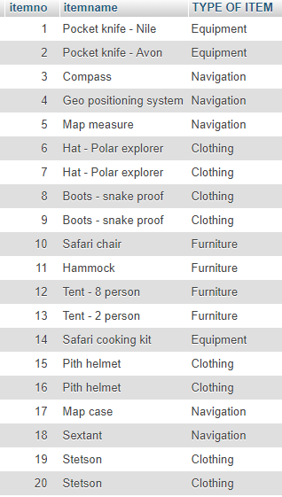
CASE statements
SELECT itemno, itemname,
CASE
when itemtype = "E" then "Equipment"
when itemtype = "C" then "Clothing"
when itemtype = "N" then "Navigation"
when itemtype = "F" then "Furniture"
else "UNKNOWN" end as "TYPE OF ITEM"
FROM item

Slide 7

CASE statements combined with BUILT-IN
SELECT
SUM(CASE WHEN productCode REGEXP '^S10' THEN quantityOrdered END) AS qty_ordered_S10,
SUM(CASE WHEN productCode REGEXP '^S12' THEN quantityOrdered END) AS qty_ordered_S12,
SUM(CASE WHEN productCode NOT REGEXP '^S12' AND productCode NOT REGEXP '^S10' THEN quantityOrdered END) AS qty_ordered_SXX
FROM OrderDetails

Slide 8

Alternatively (without the case statement)
SELECT 'quty_ordered_S10' as product_prefix, SUM(quantityOrdered)
FROM OrderDetails
WHERE productCode REGEXP '^S10'
UNION
SELECT 'quty_ordered_S12' as product_prefix, SUM(quantityOrdered)
FROM OrderDetails
WHERE productCode REGEXP '^S12'
UNION
SELECT 'quty_ordered_Sxx' as product_prefix, SUM(quantityOrdered)
FROM OrderDetails
WHERE productCode NOT REGEXP '^S12' AND productCode NOT REGEXP '^S10'

