Slide 1

Employee Attrition Analysis
Carolina Craus
DS 6306 Fall 2022
Notes:
Hello, My name is Carolina Craus and today I will be presenting an Employee Attrition Analysis.

Slide 2
Agenda
Introduction to Data
Exploratory Data Analysis
Model to Predict Salary
Model to Predict Attrition
Conclusion & Recommendations for the Future
Notes:
First, I will be introducing the data and then I will go through the Exploratory Data Analysis. Following, I will present the models for predicting salary and attrition, and conclude with my final recommendations.

Slide 3
Data
870 employees
36 variables
9 Categorical Variables
27 Numeric Variables
No missing Data
Notes:
The data set provided had information on 870 employees from the company and 37 variables to look at, out of which 9 categorical variables and 27 numeric variables. There was no missing data or duplicates in the data.

Slide 4
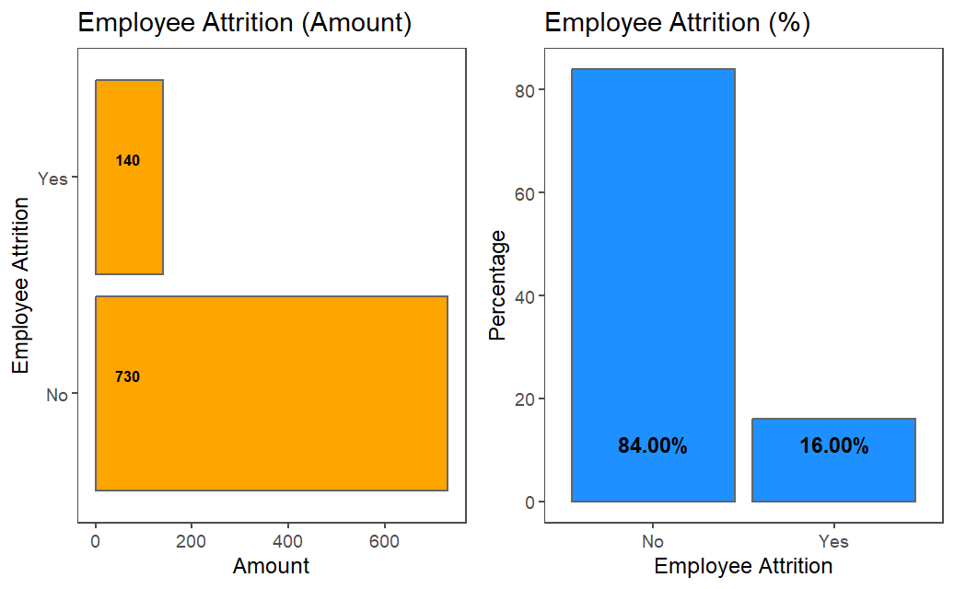
Attrition
84 % of employees had No Attrition
16% of employees had Attrition
Notes:
Here, we can see that 730, or 84% of employees did not have Attrition and 140, or 16% did have Attrition.

Slide 5
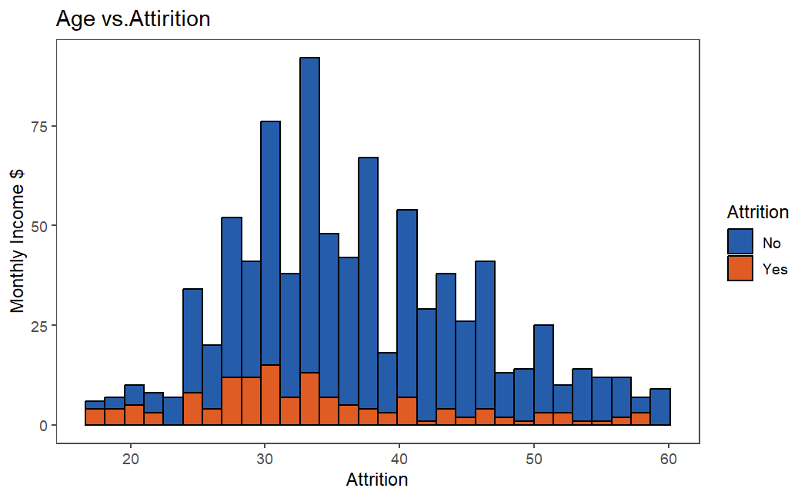
Attrition & Age
Higher Attrition Rates for younger employees, especially age 20-30
Notes:
Here we can see that there are higher attrition rates for younger employees, especially age 20 to 30.

Slide 6
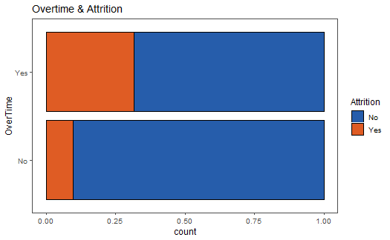
Atttrition & Over Time
Higher Attrition Rates with Overtime
Notes:
This graph shows that OverTime leads to higher Attrition

Slide 7
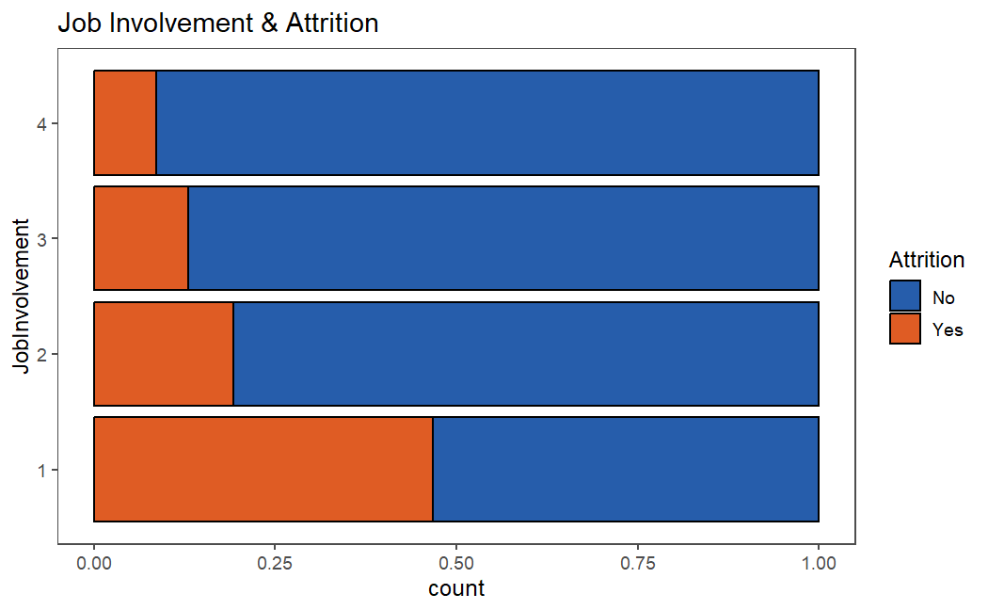
Attrition & Job Involvement
As Job Involvement increases, the rate of Attrition decreases

Slide 8
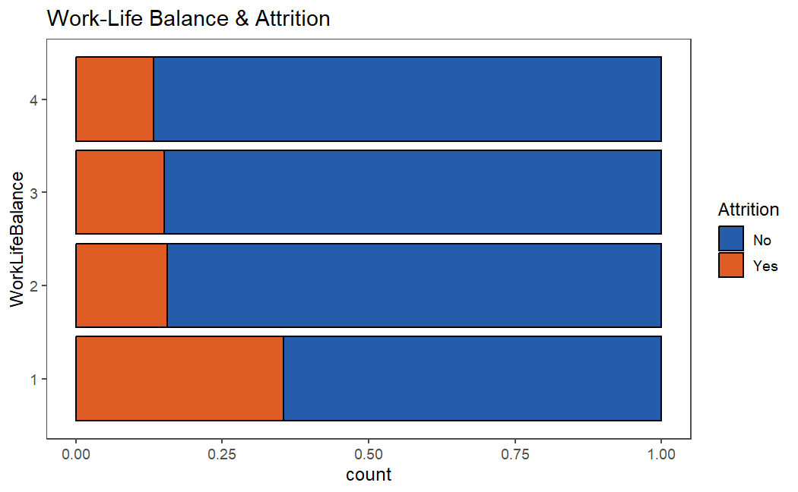
Attrition & Work Life Balance
Employees with very low Work Life Balance are more likely to experience Attrition

Slide 9
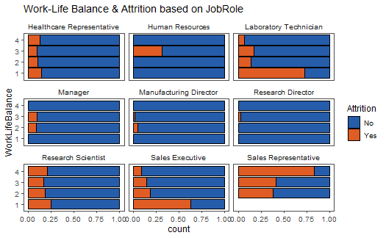
Attrition & Work Life Balance based on Job Role
Attrition varies among Job Roles with Sales Representatives experience the highest rates of Attrition.

Slide 10
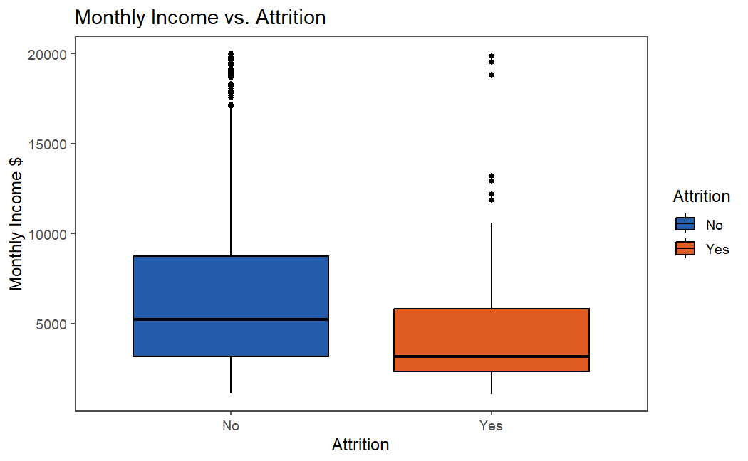
Attrition & Monthly Income
Employees with lower monthly income are more likely to experience Attrition

Slide 11
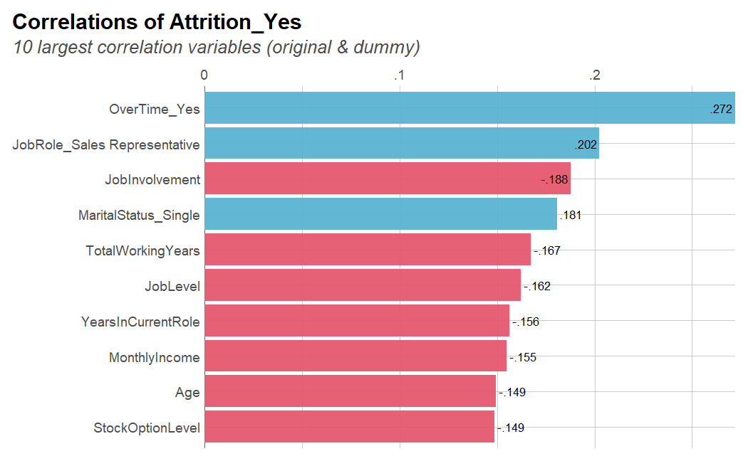
10 Largest Correlations with Yes Attrition

Slide 12
Linear Regression Model to Predict Salary
Multiple Linear Regression model on Monthly Income related to the following important variables:
Job Level, Total Working Years, Job Role, & Age
RMSE = $1,027.34

Slide 13
KNN Model to Predict Attrition
NO
YES
Accuracy = 73.68 %
Sensitivity = 76.43%
Specificity = 73.15%
Variables Used
Over Time, Environment Satisfaction, Num Companies Worked For, Age, Job Involvement, Monthly Income, Marital Status, Stock Option Level
NO
534
33
YES
196
103
Notes:
For the KNN model, classifies data points based on the points that are most similar to it. It uses test data to make an “educated guess” on what an unclassified point should be classified as. The model used 11 variables and had an Accuracy of

Slide 14
Naïve Bayes Model to Predict Attrition
Accuracy = 72.76%
Sensitivity = 77.86%
Specificity = 71.78%
Variables Used
Business Travel, Environment Satisfaction, Job Level, Num Companies Worked, Work Life Balance, Job Role, Age, Distance From Home, and Over Time
NO
YES
NO
524
31
YES
206
109
Notes:
Next, we created a Naive Bayes model which classifier assumes that the presence of a particular feature in a class is unrelated to the presence of any other feature.

Slide 15
Top 3 Factors that Influence Attrition
Conclusions & Recommendations
KNN and Naïve Bayes Model have the similar results across the board on performance for predicting Attrition. This is something to be further investigated.
Increasing Job Involvement can improve Attrition Rates in the company. Some ways this could be done:
Encourage Flexibility
Ask for Feedback from Employees
Hold Regular Social Gatherings
Reduce Over Time work. Some ways this could be done:
Cross-train Employees
Match Staff for Demand
Over Time
Monthly Income
Job Involvement
Notes:
From my analysis, the top 3 factors that influence attrition are Over Time, Monthly Income, and Job Involvement. Some final conclusions

Slide 16
Thank you!
Please reach out if you have any questions or comments!
Carolina Craus
carocraus@gmail.com
Carocraus.github.io

