Slide 1
Msquared

Slide 2
Summary
Laser | Wellenlänge λ (nm) | M² (d1) | M² (d2) | Waist d1 (µm) | Waist d2 (µm) | z₀ d1 (mm) | z₀ d2 (mm)
Thorlabs | 1576.293 | 2.245 | 1.005 | 67.75 | 72.12 | 2.52 | 2.48
uniphase1023p | 631.805000 | 1.001934e+00 | 1.002065e+00 | 6.619994e-05 | 6.580495e-05 | 8.190836e-03 | 8.142906e-03
uniphase1103p11777 | 631.805000 | 1.023531e+00 | 1.024350e+00 | 5.650190e-05 | 5.657037e-05 | 5.927028e-03 | 6.100544e-03
uniphase1103p110838 | 632.006000 | 1.011973e+00 | 1.016288e+00 | 5.596138e-05 | 5.563604e-05 | 6.240200e-03 | 6.028967e-03
uniphase11122p | 632.208000 | 1.002911e+00 | 9.997115e-01 | 5.899176e-05 | 5.927440e-05 | 5.957803e-05 | 7.037906e-03
uniphase1507p0 | 634.822000 | 9.882001e-01 | 9.827970e-01 | 5.660866e-05 | 5.954137e-05 | 9.935290e-03 | 9.115662e-03

Slide 3
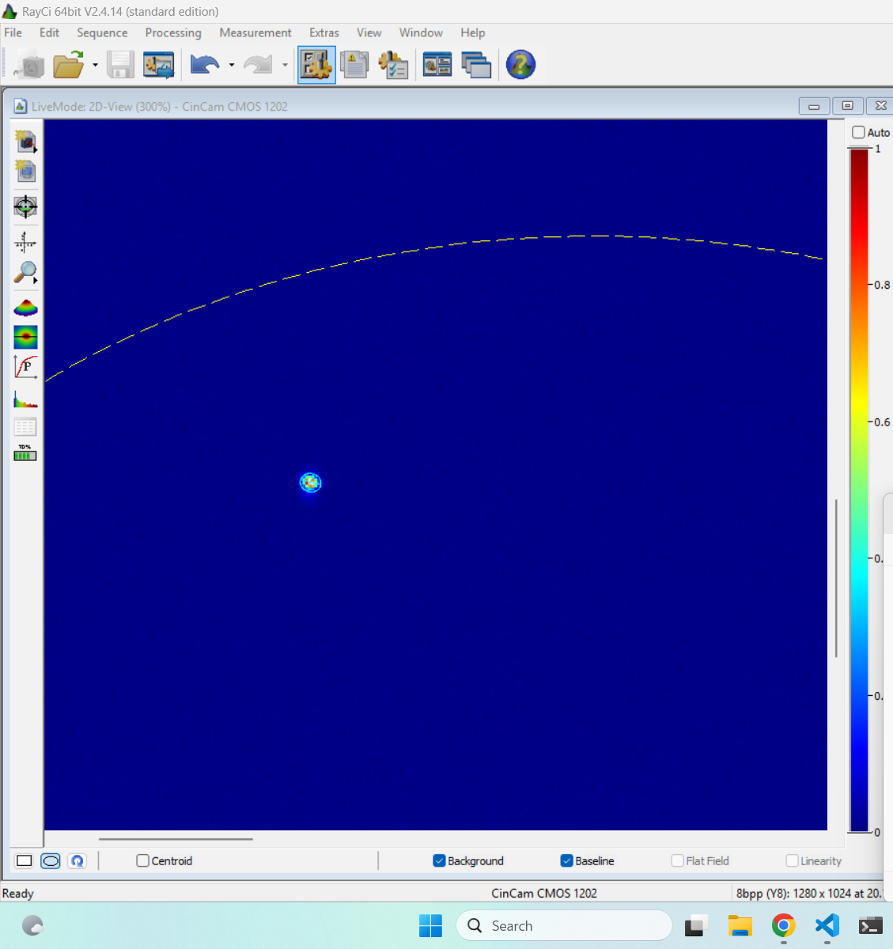
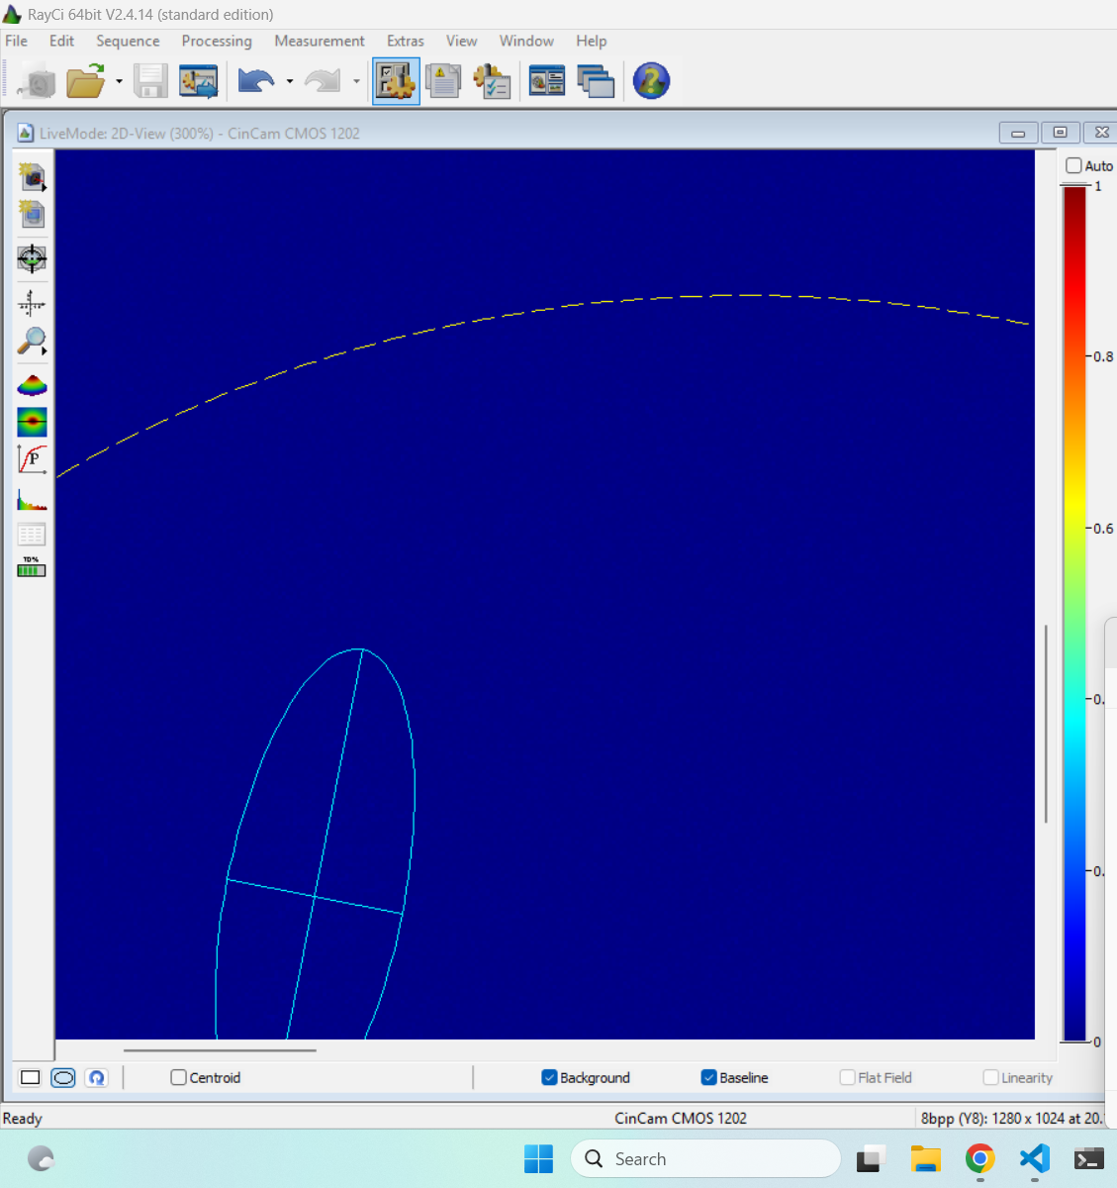
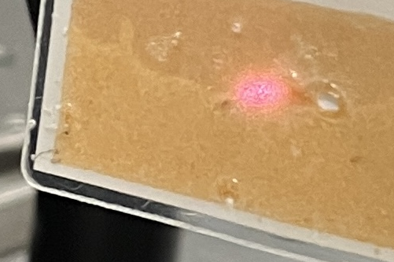
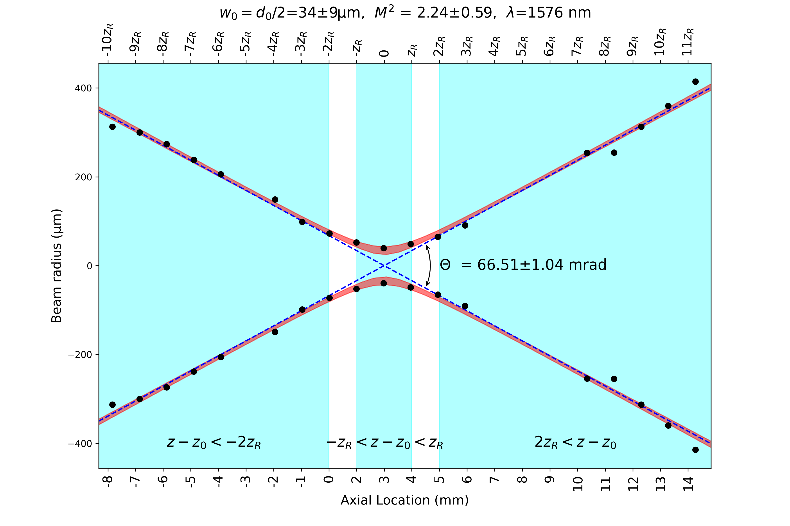
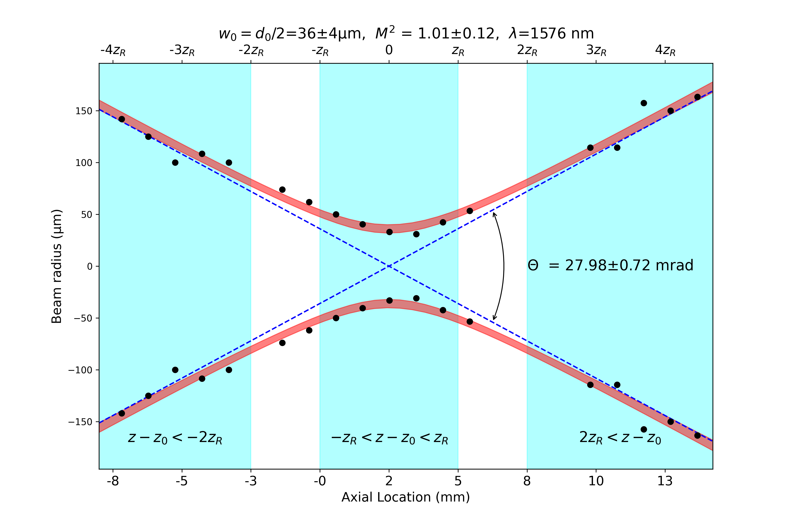

Thorlabs
focus
outside
d2
d1

Slide 4
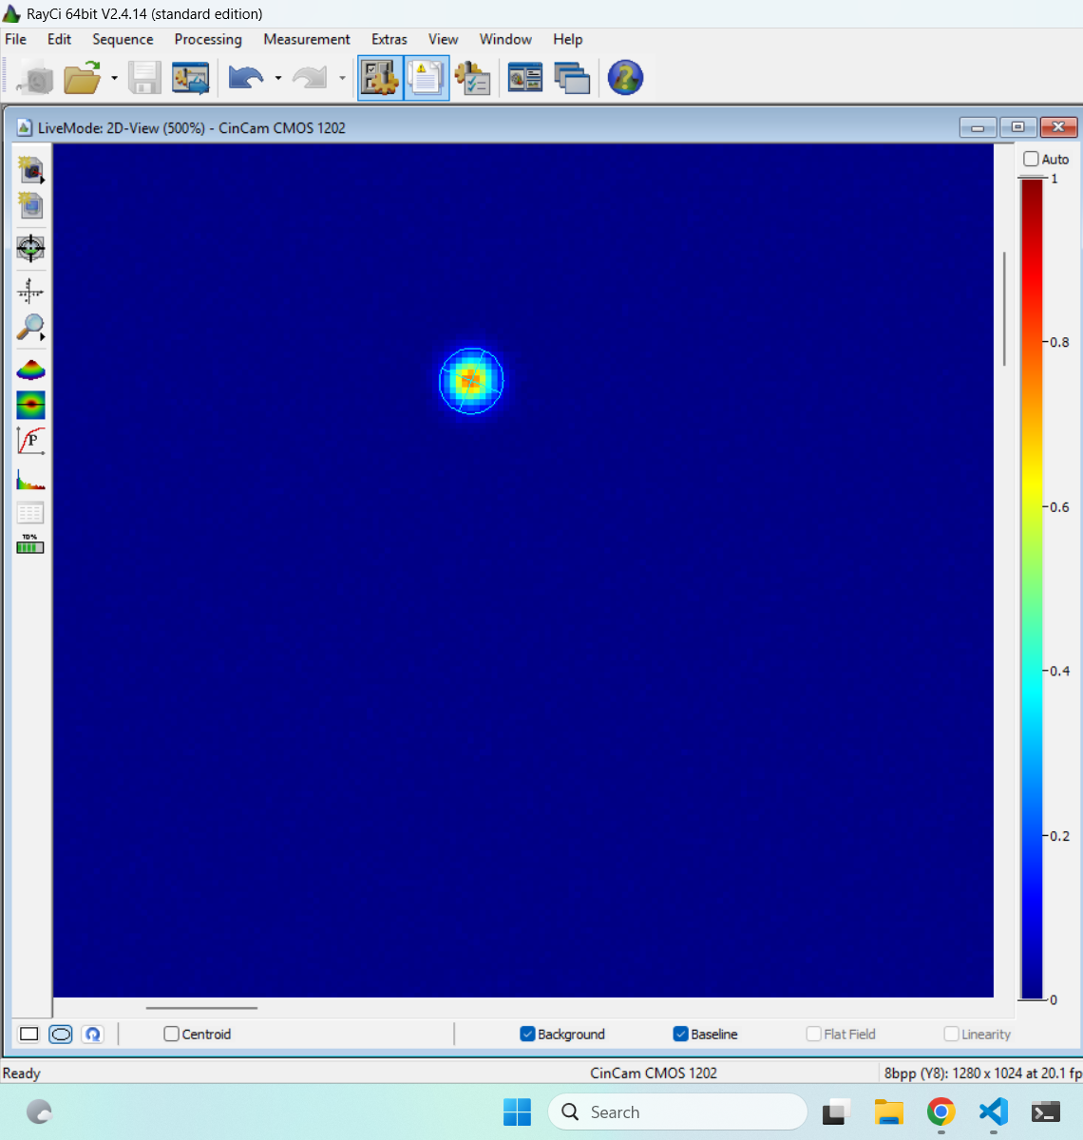
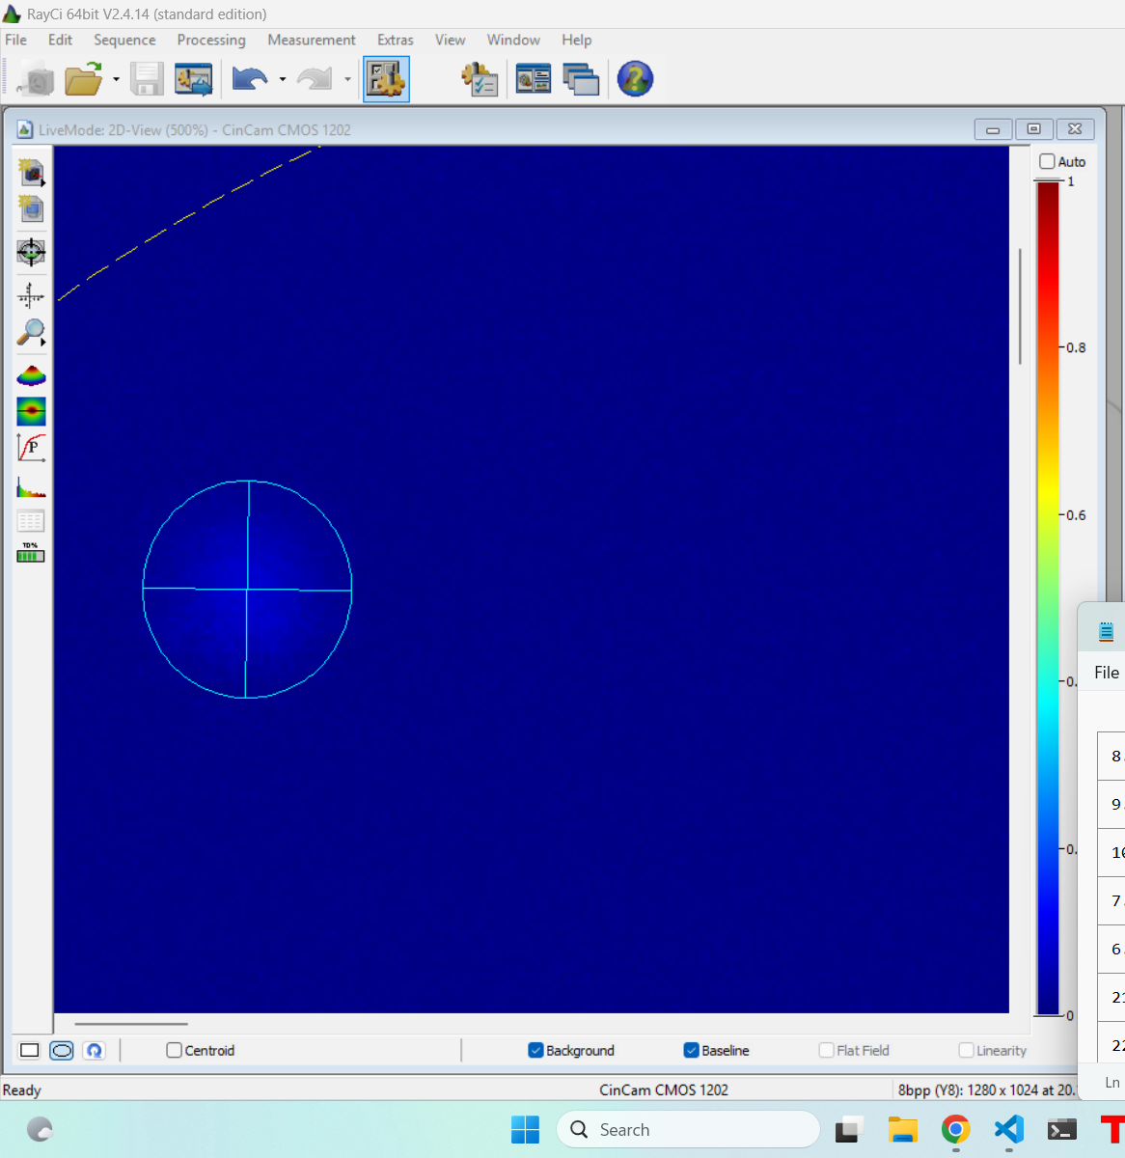
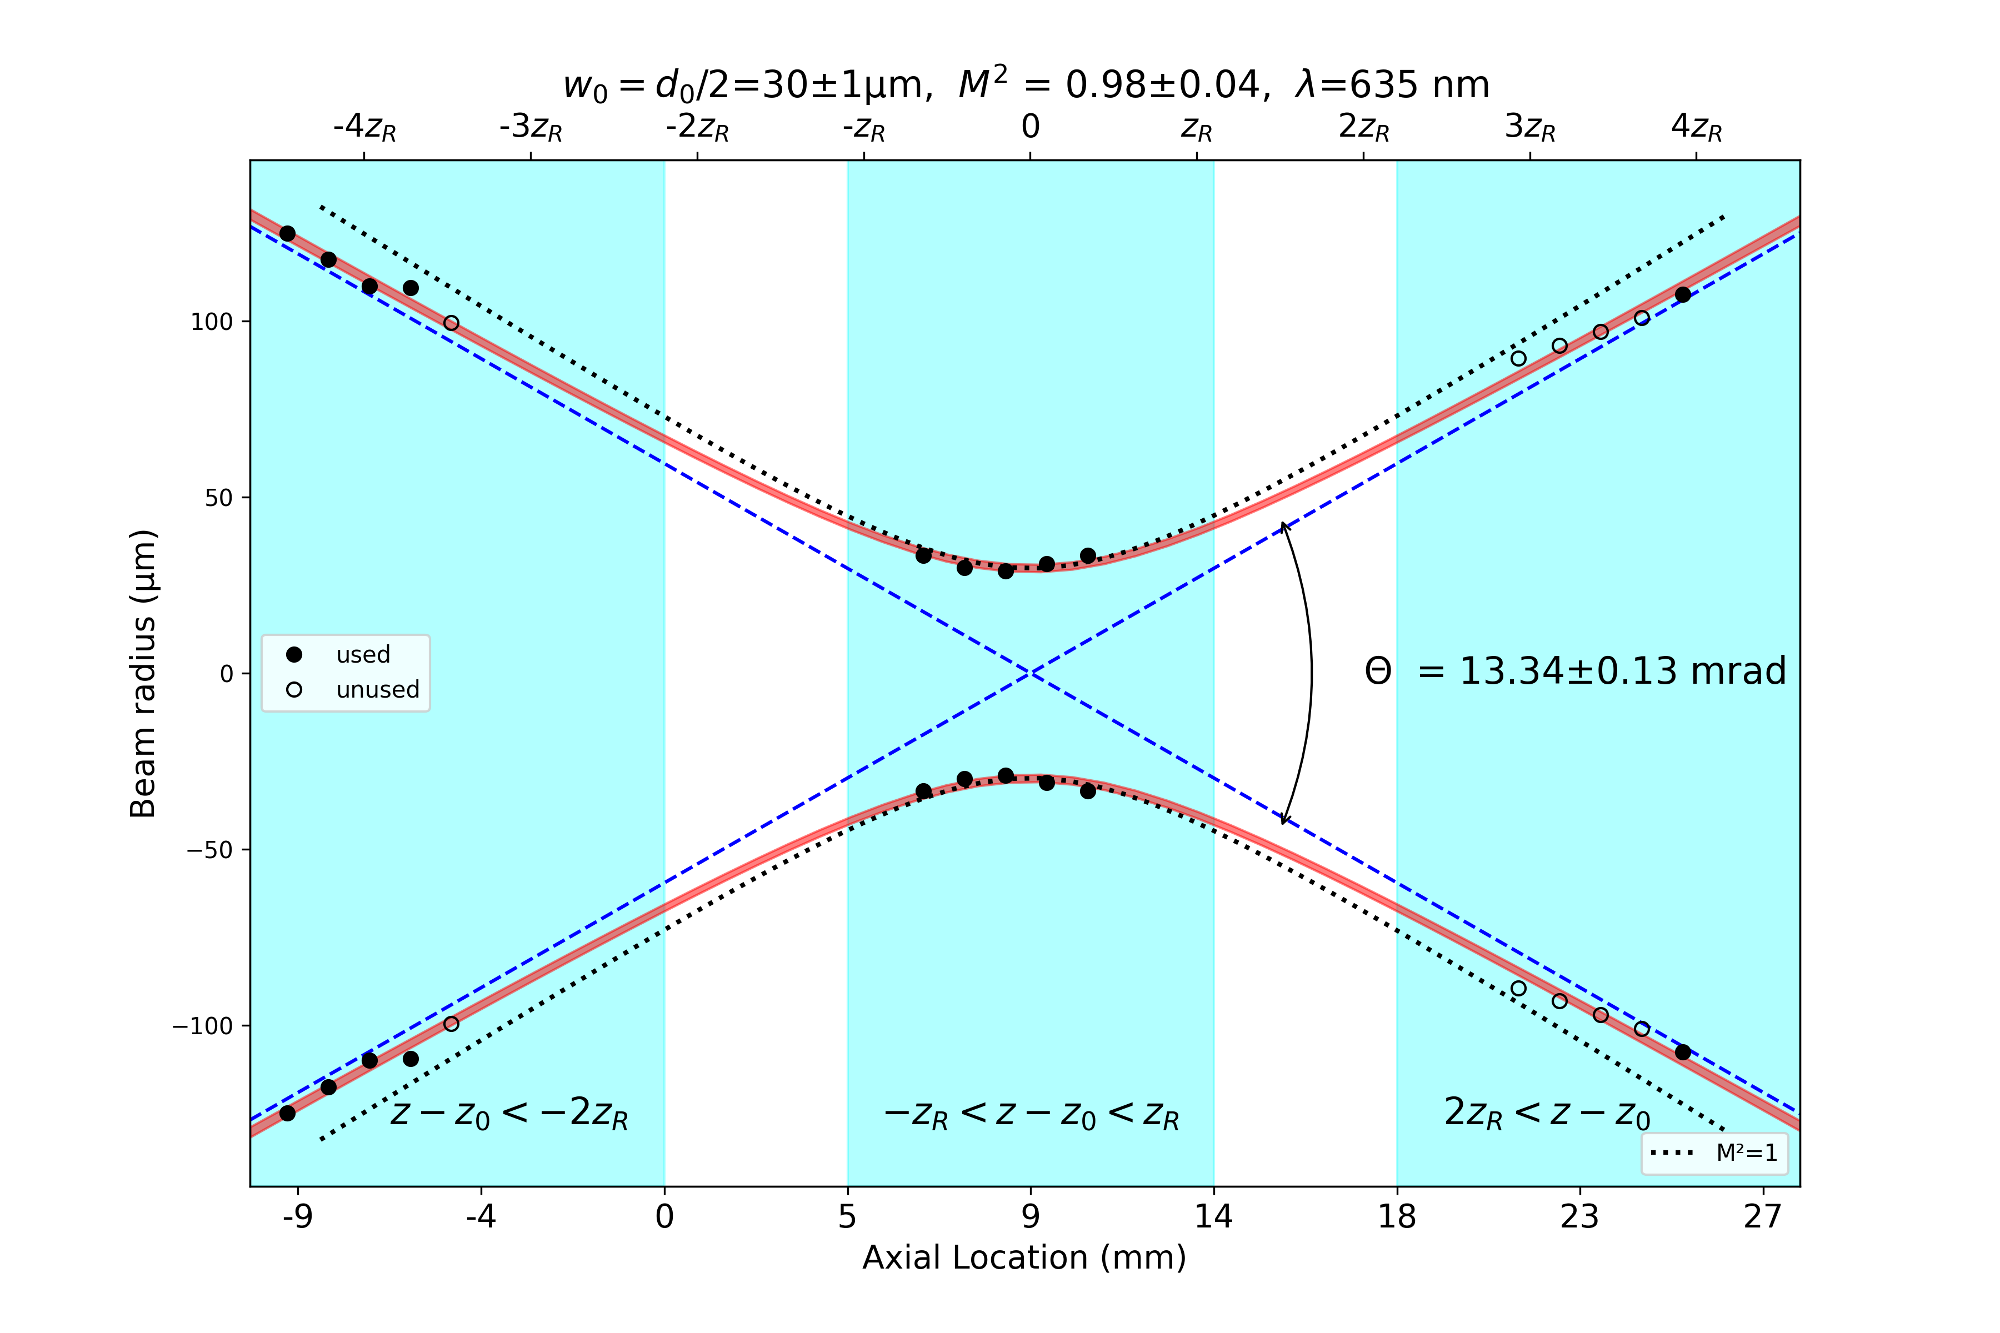
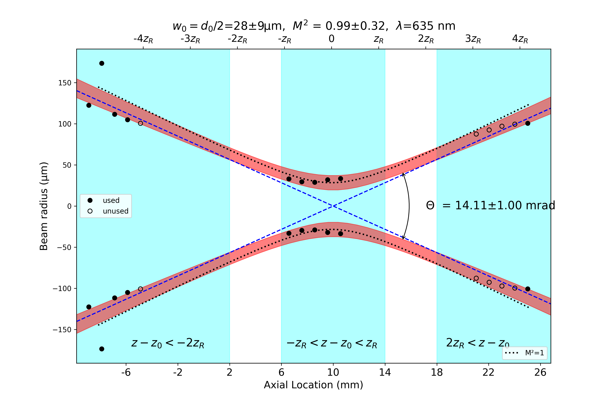
Uniphase 1507
d2
d1

Slide 5
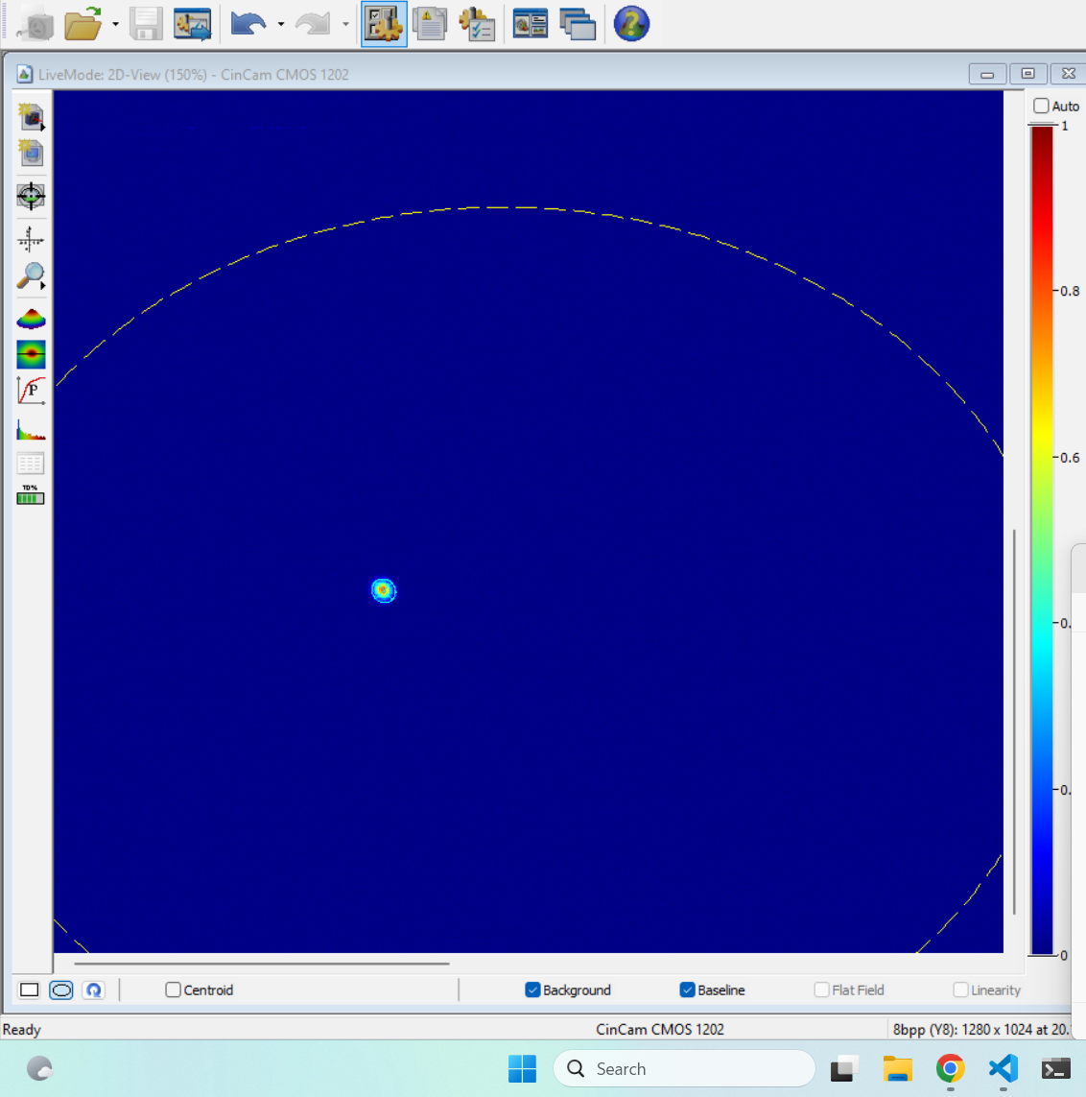
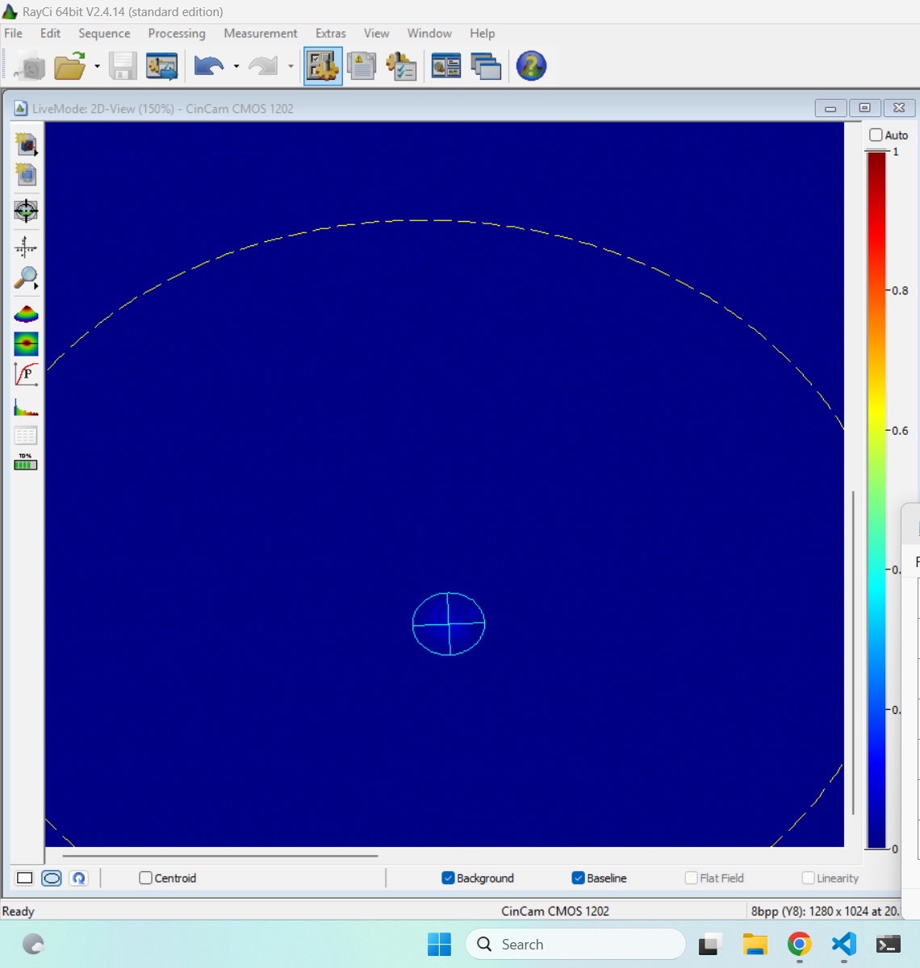
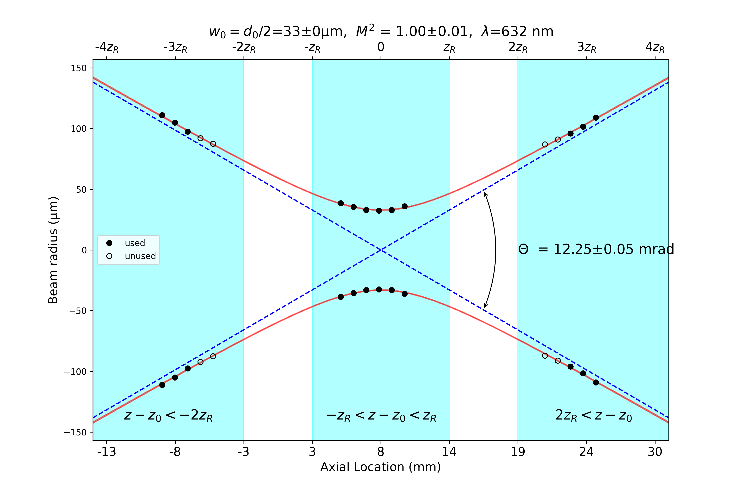
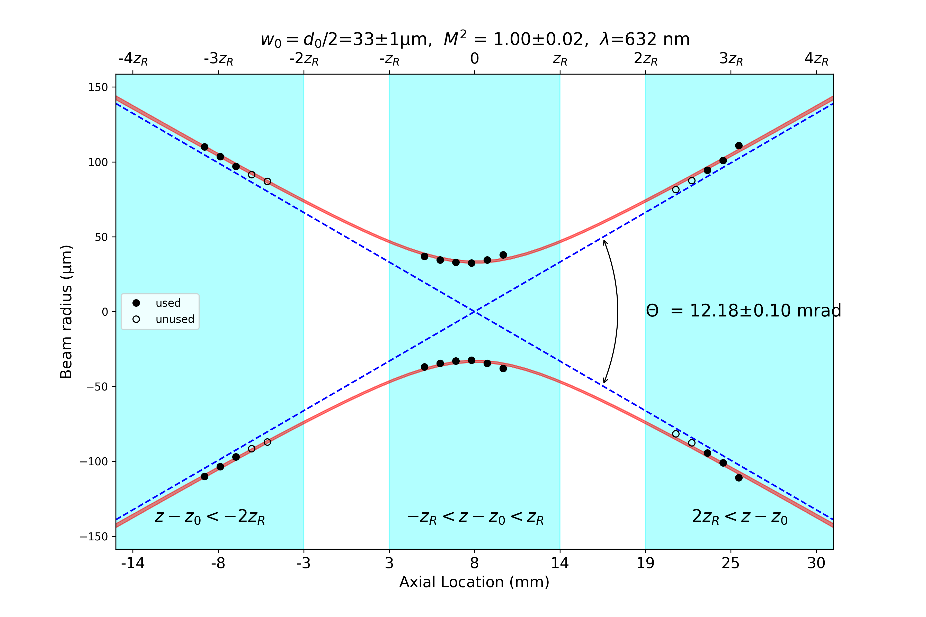
Uniphase 1023p
d2
d1

Slide 6
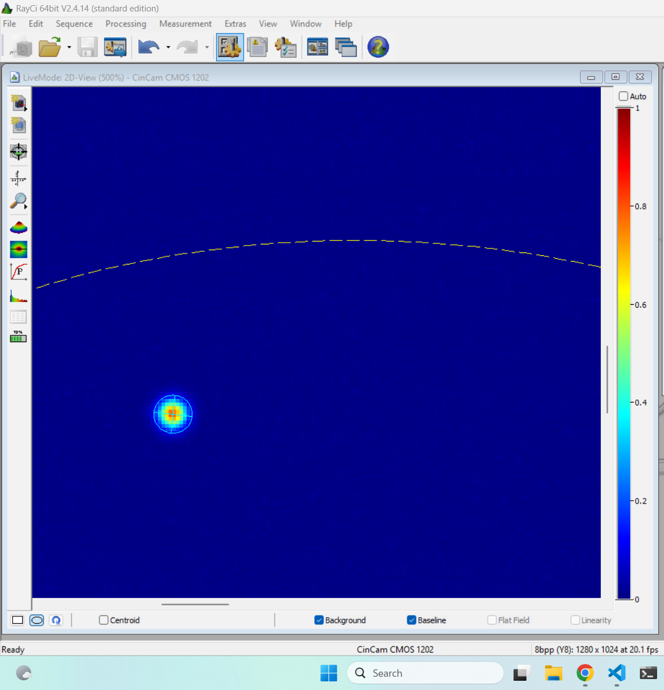
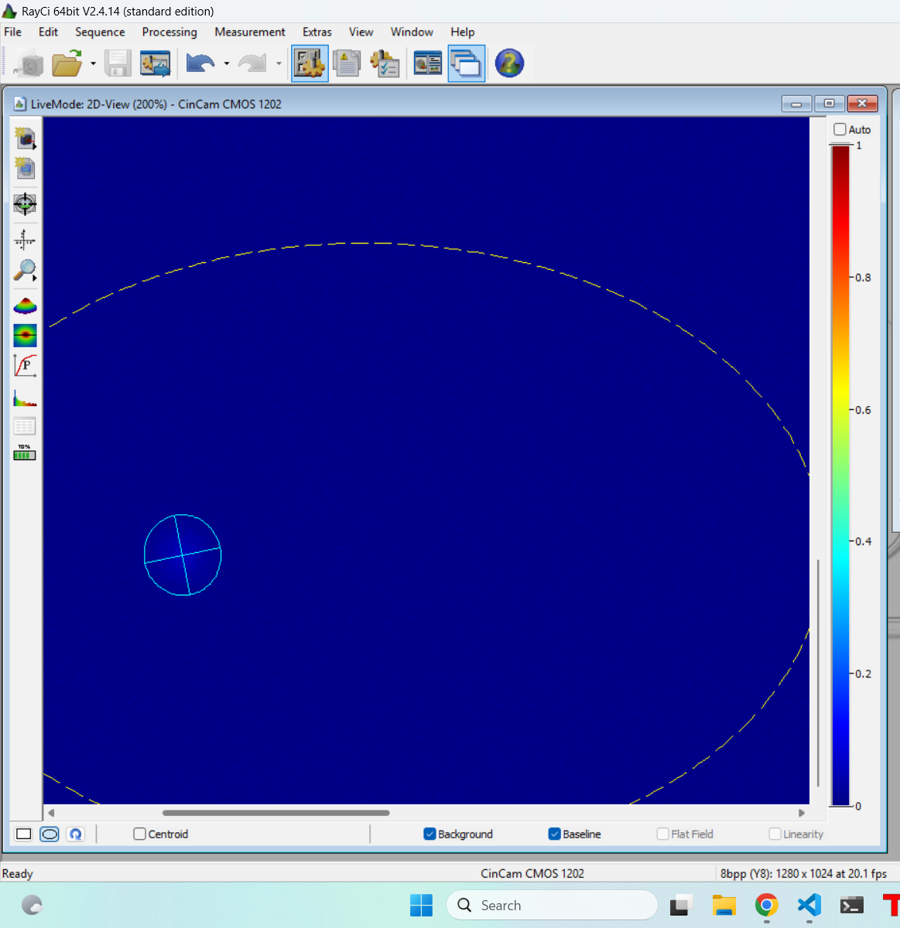
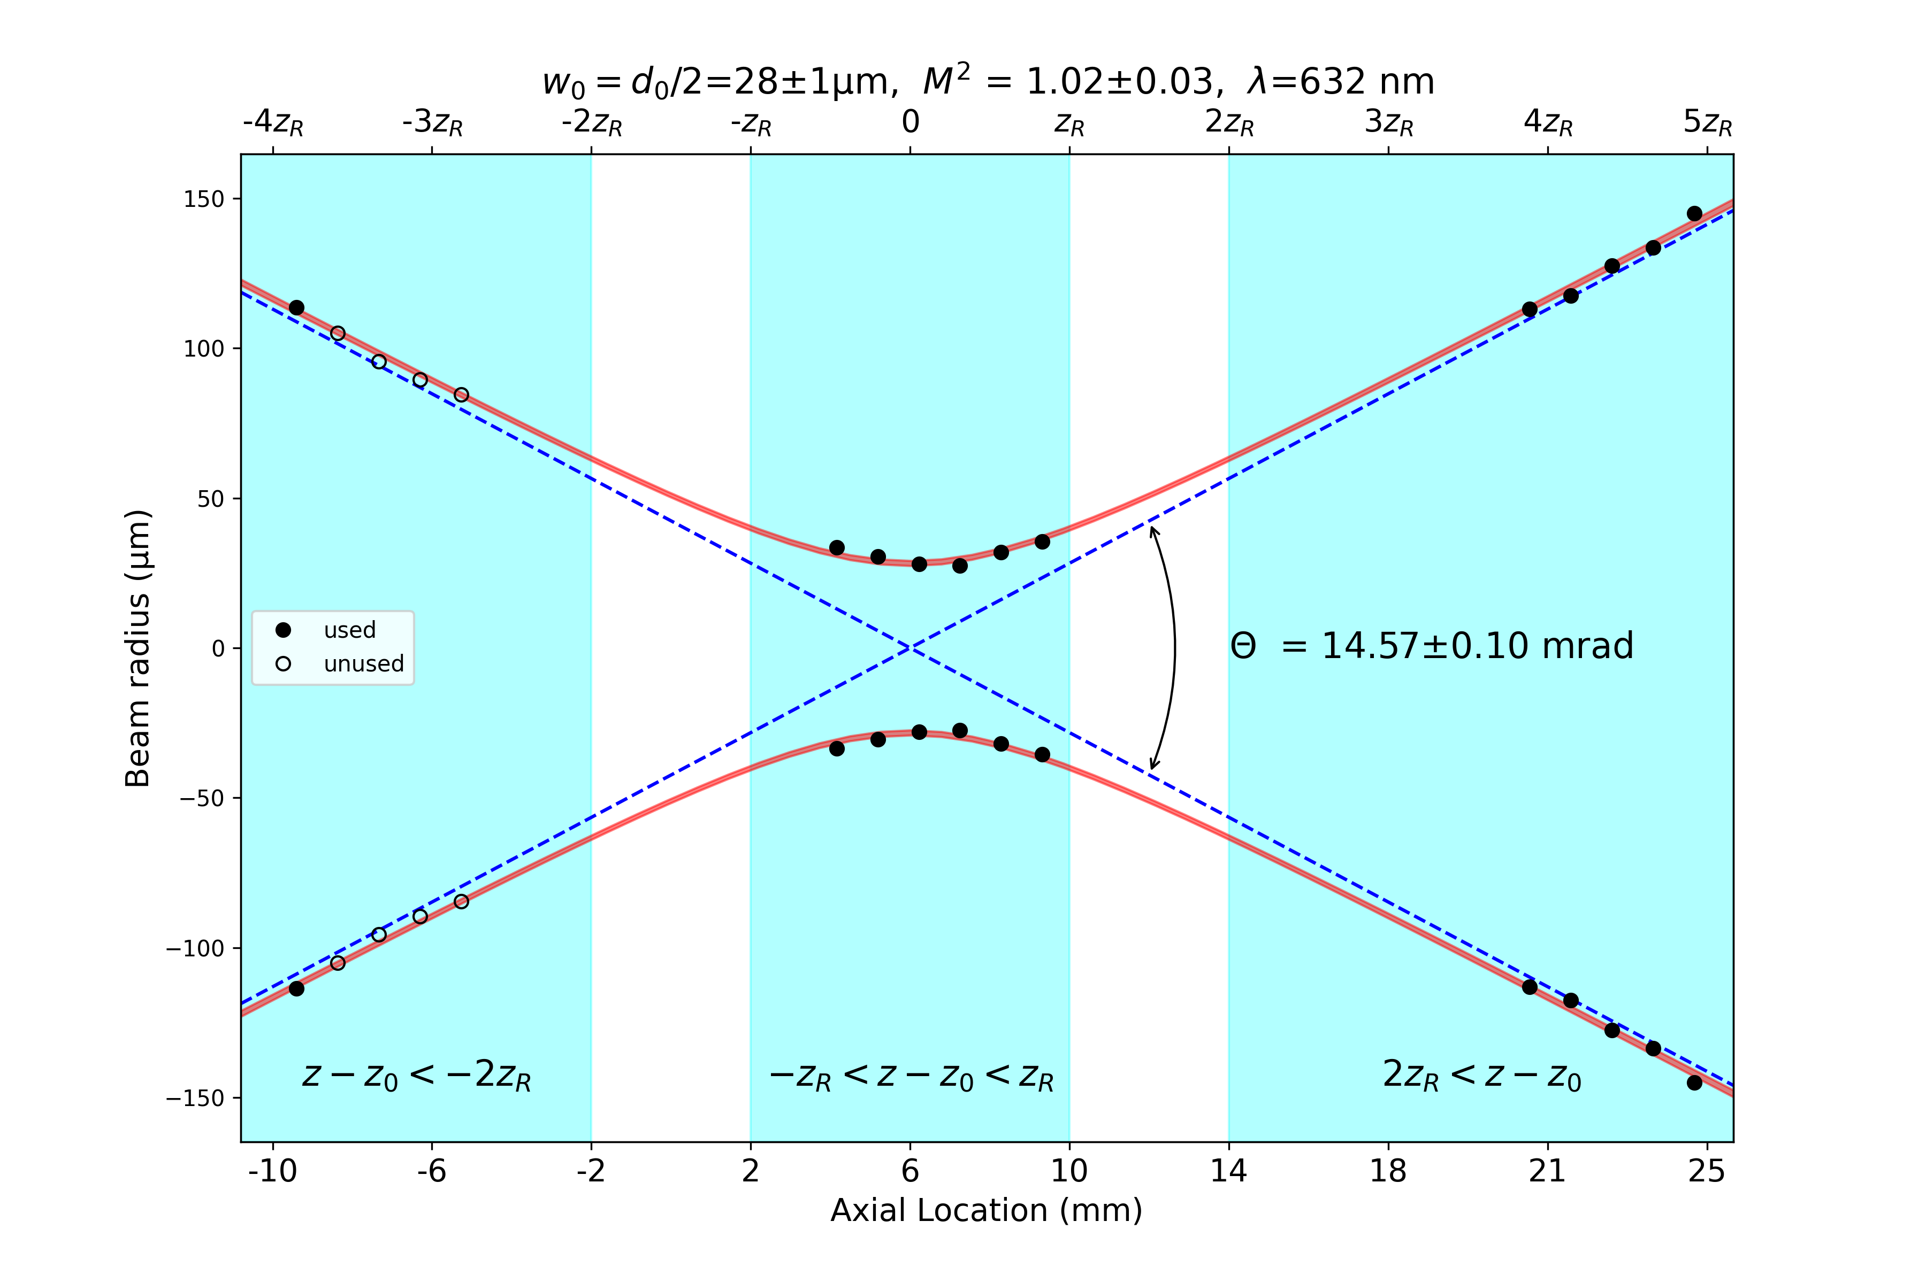
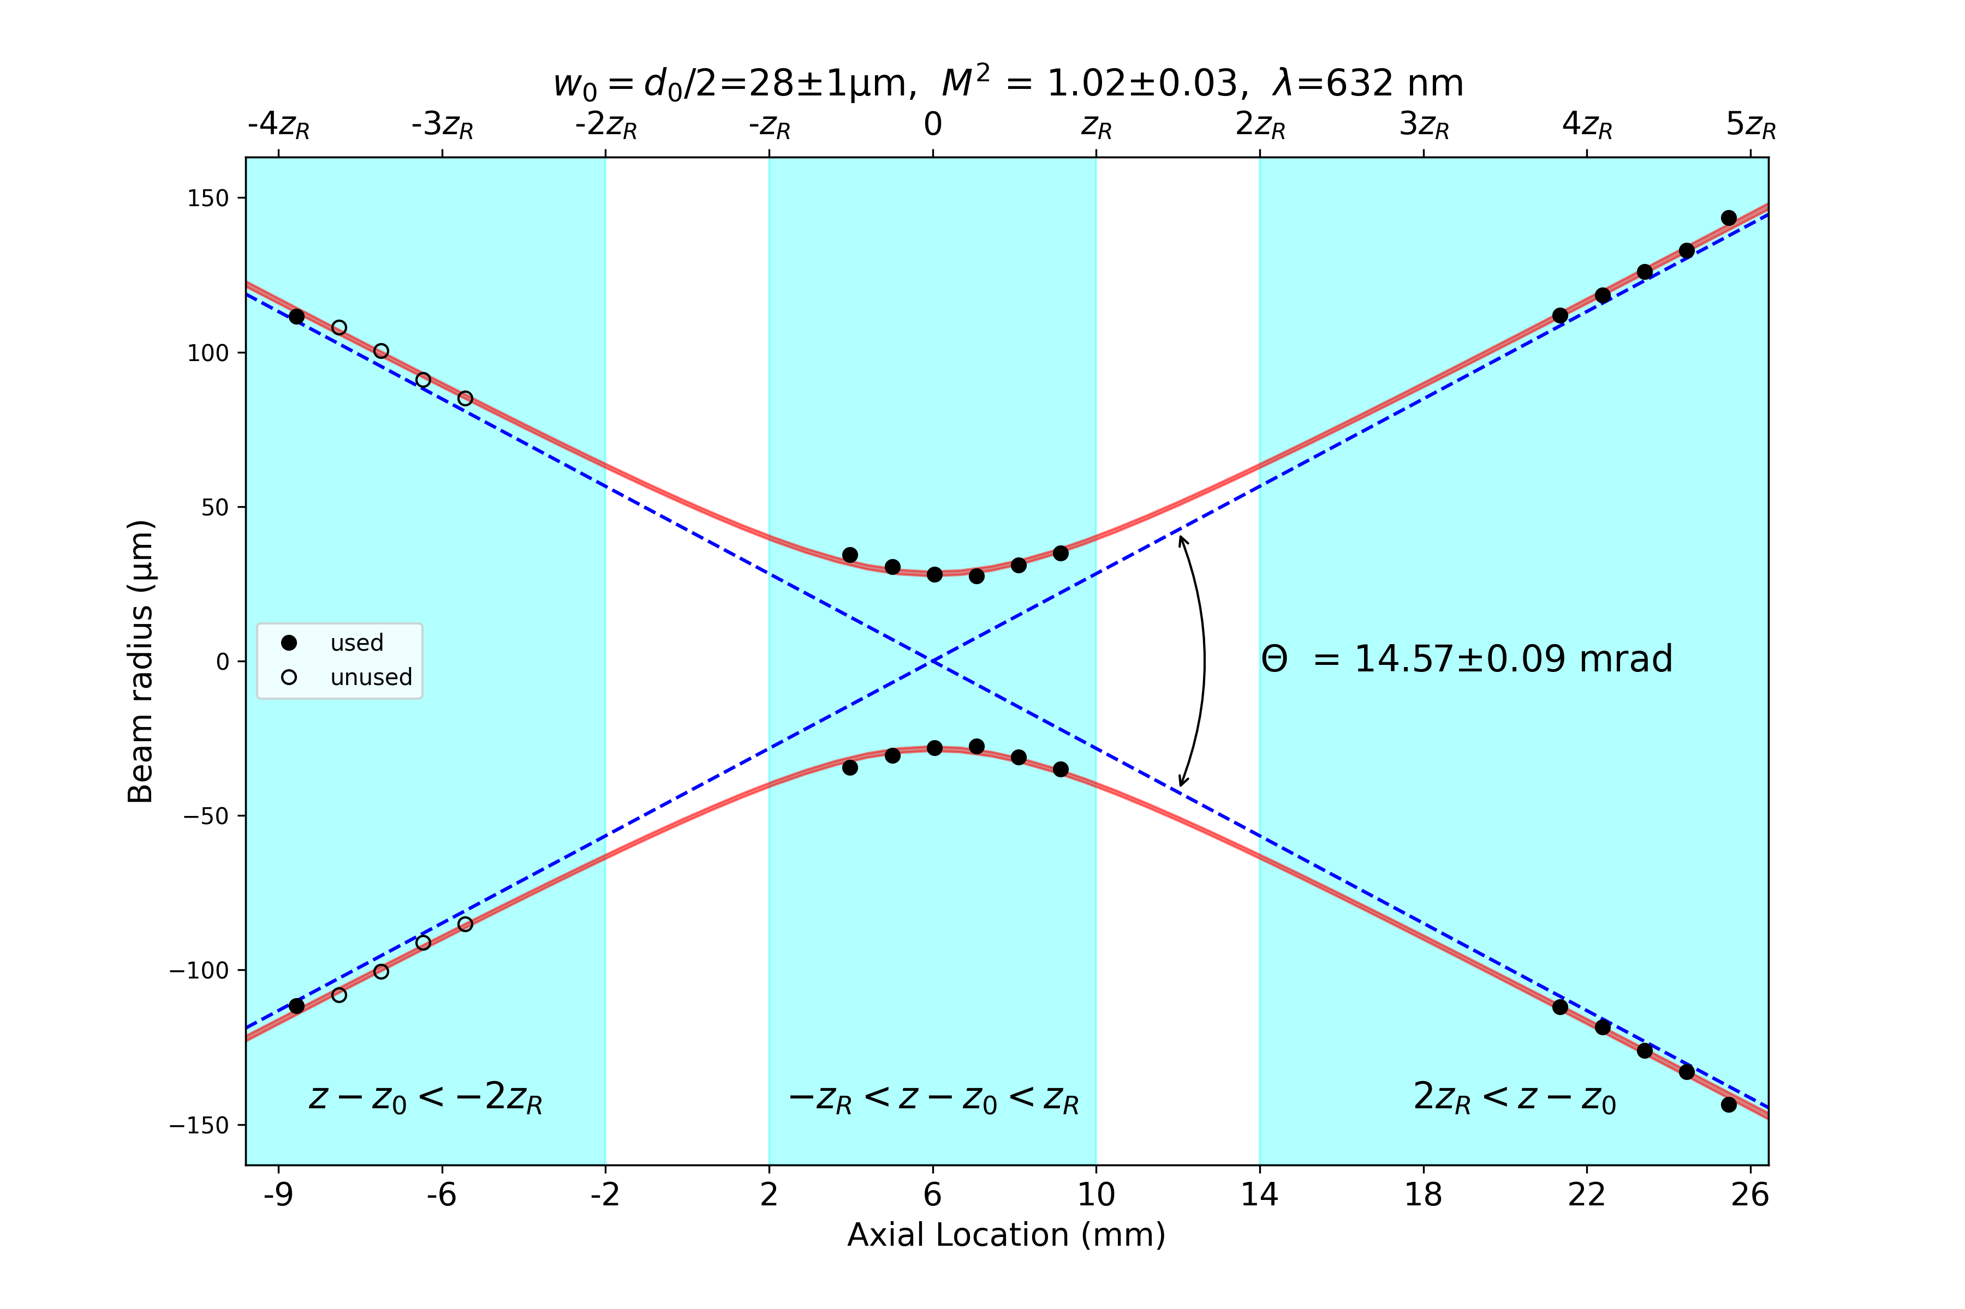
Uniphase 1103p11777
d2
d1

Slide 7
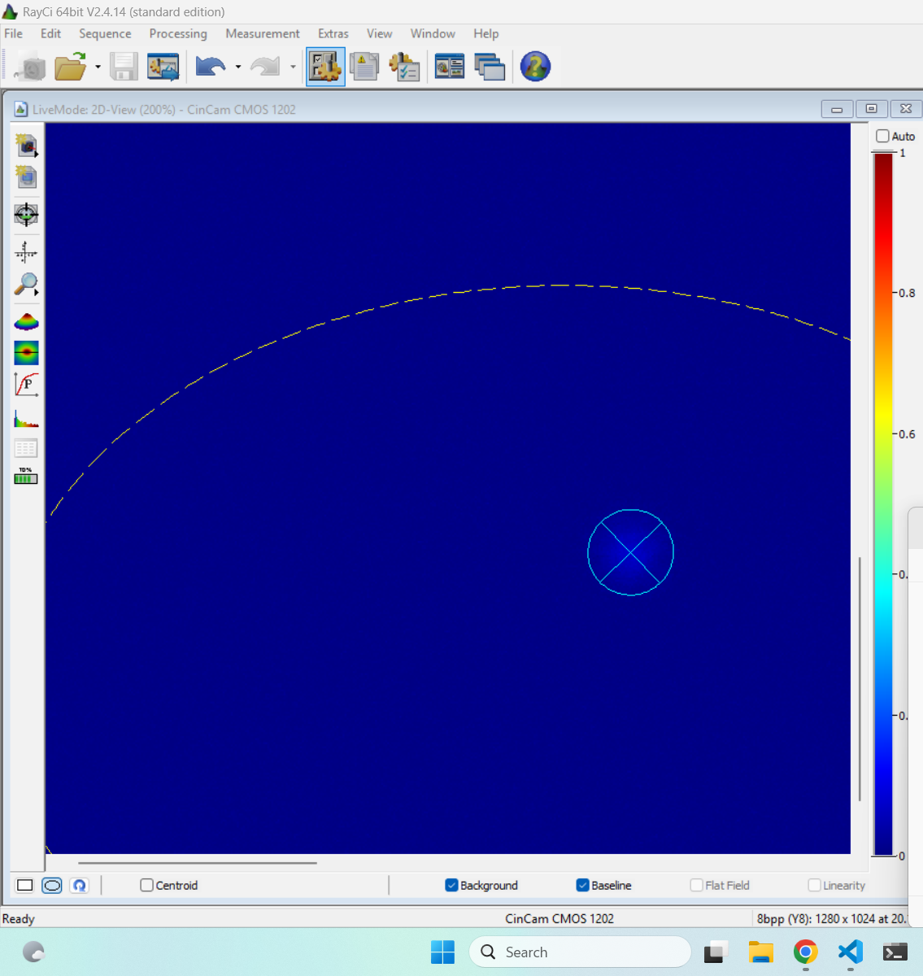
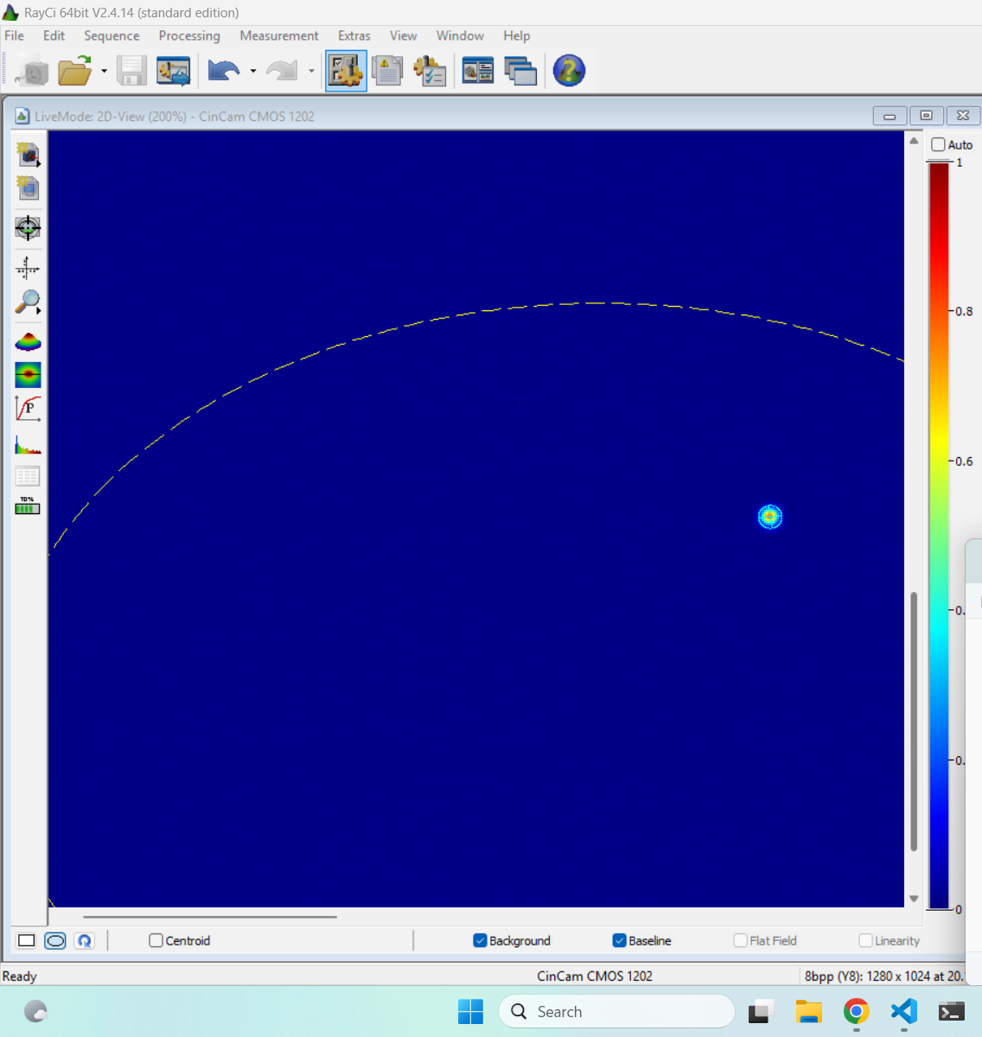
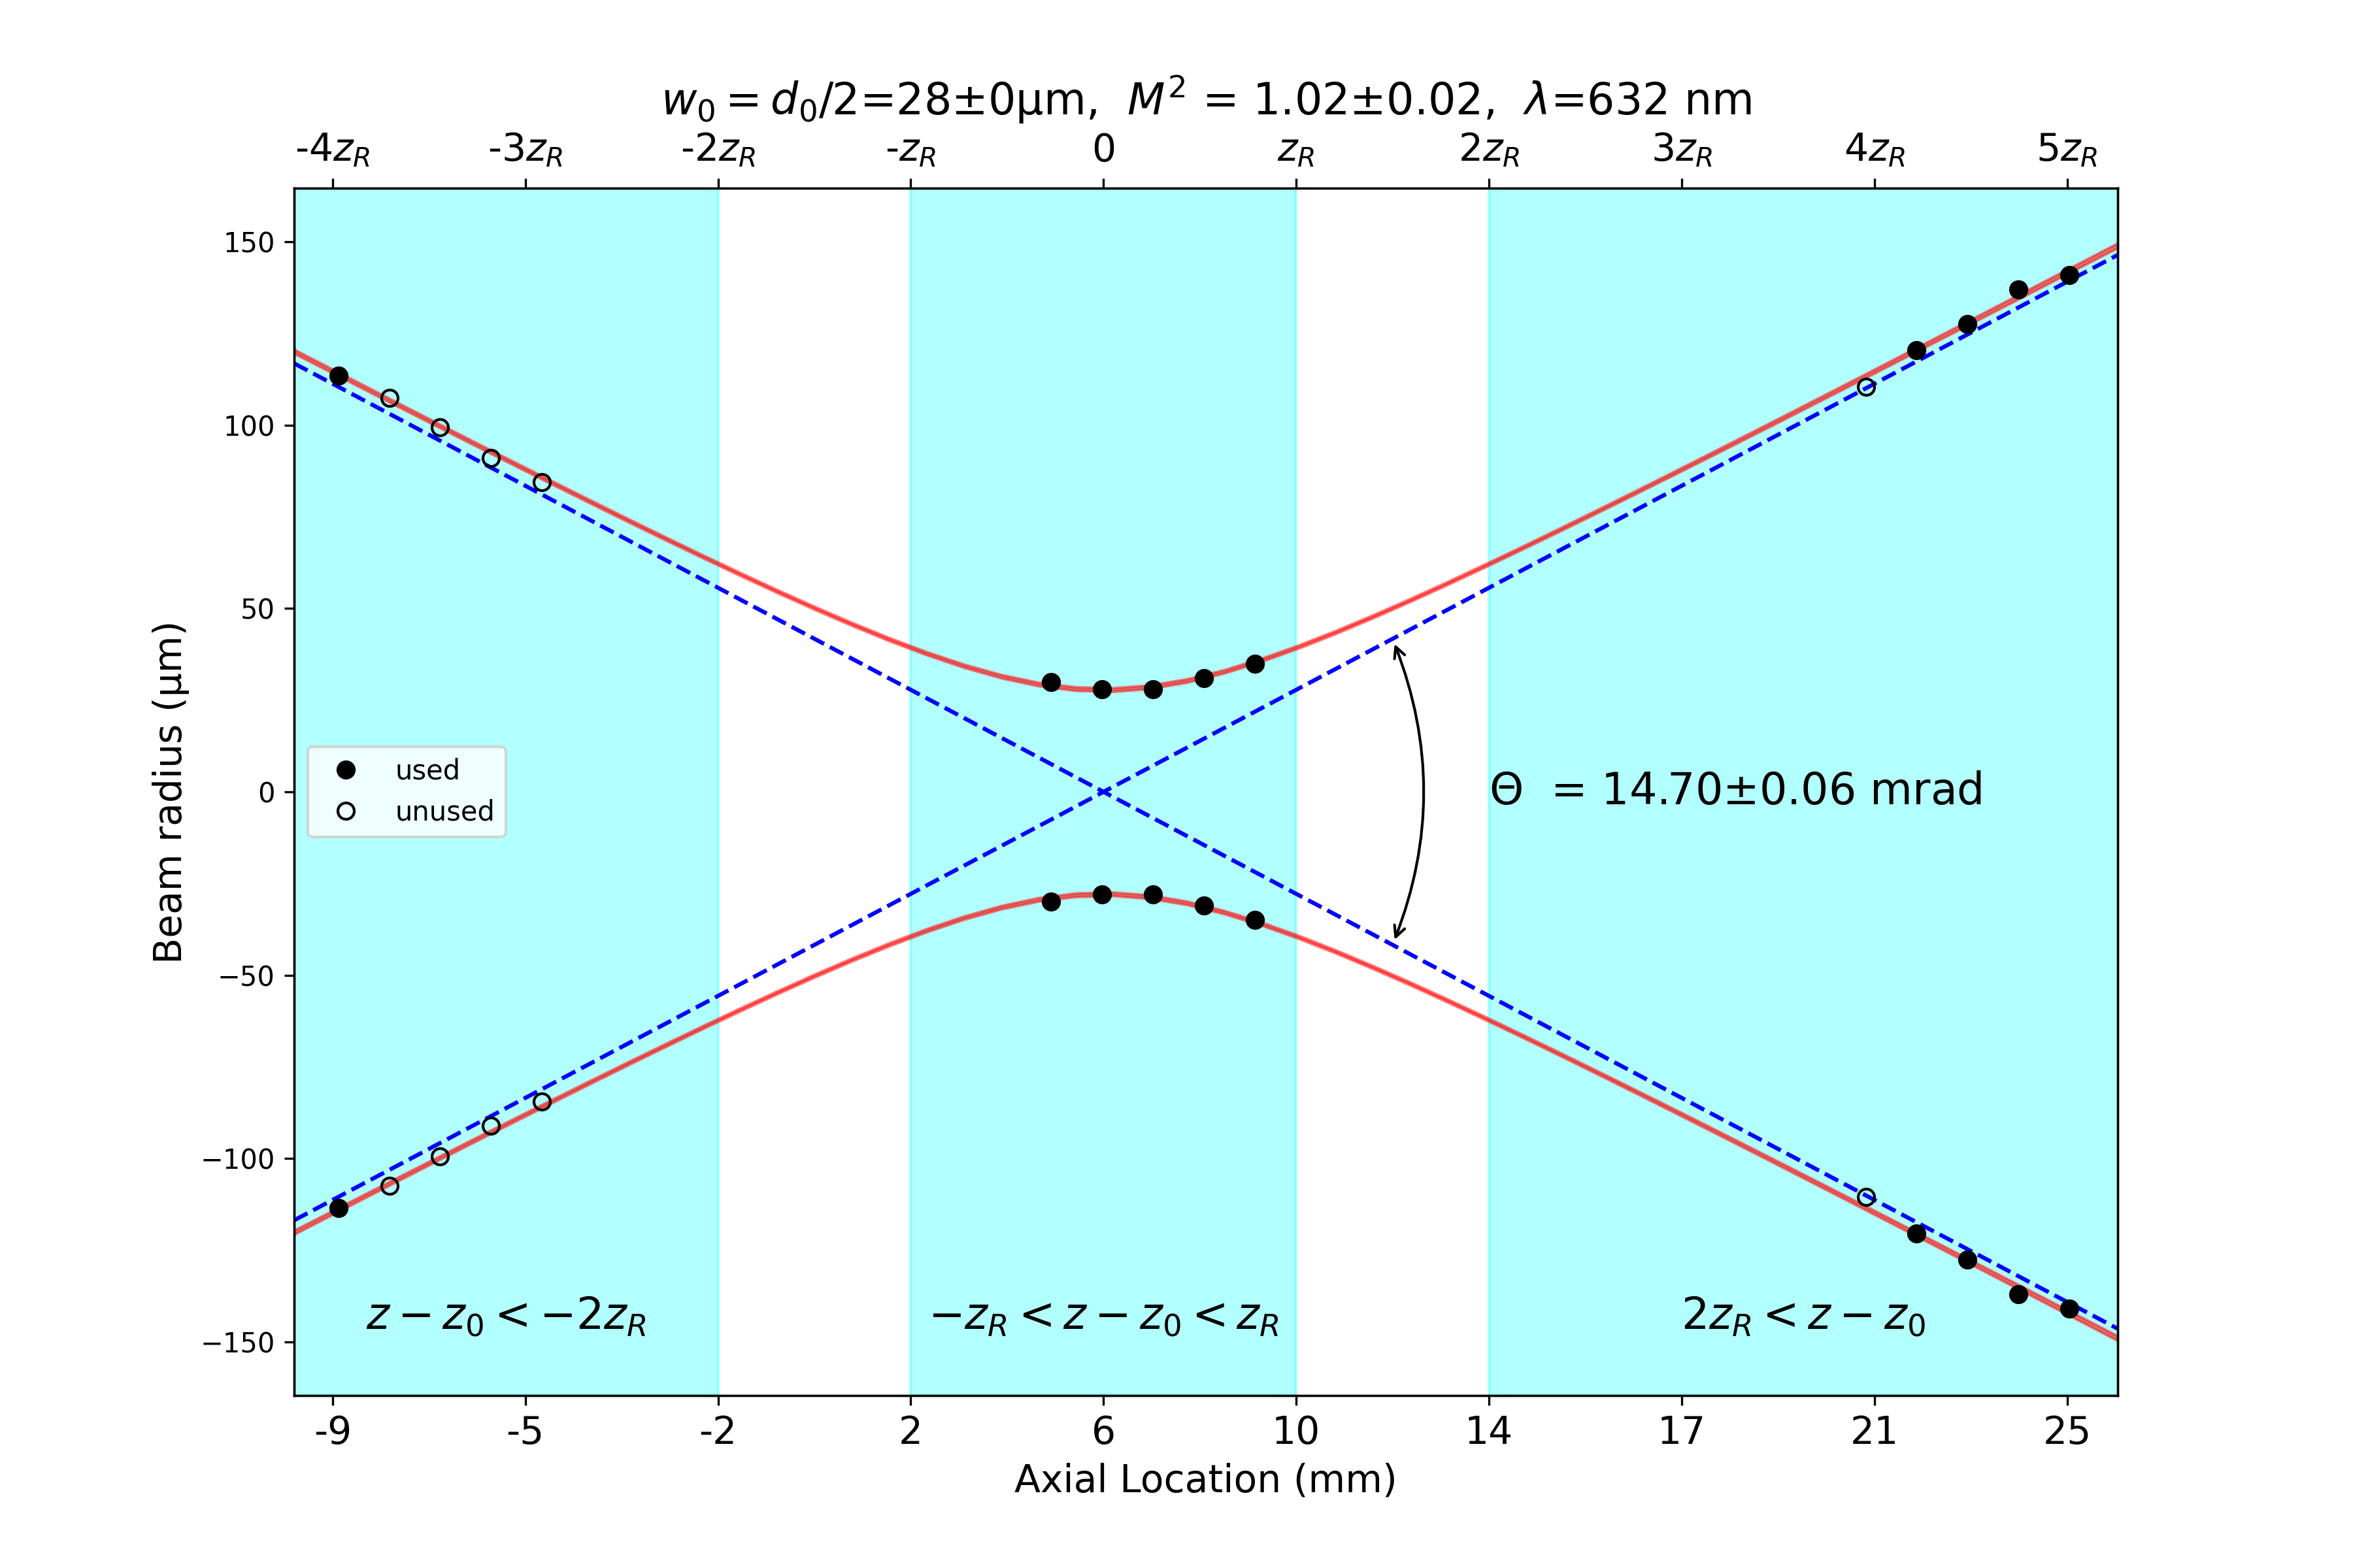
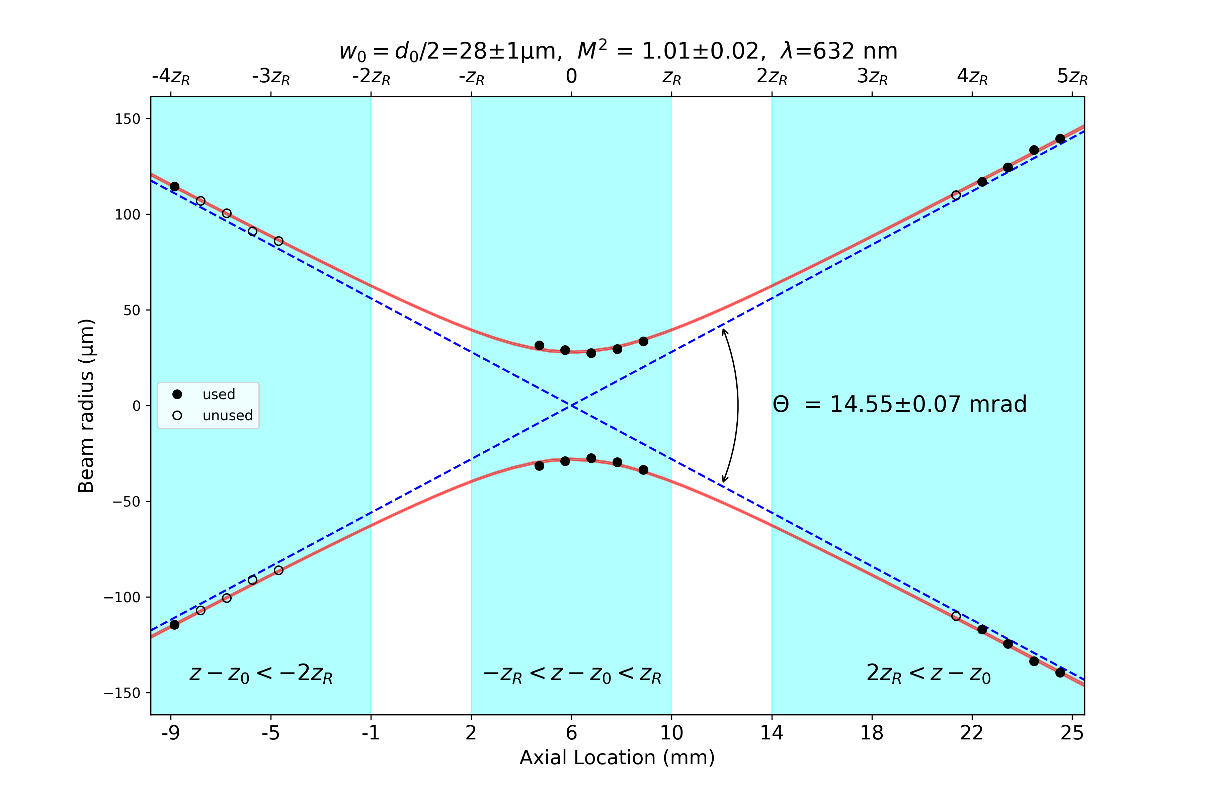
Uniphase 1103p110838
d2
d1

Slide 8
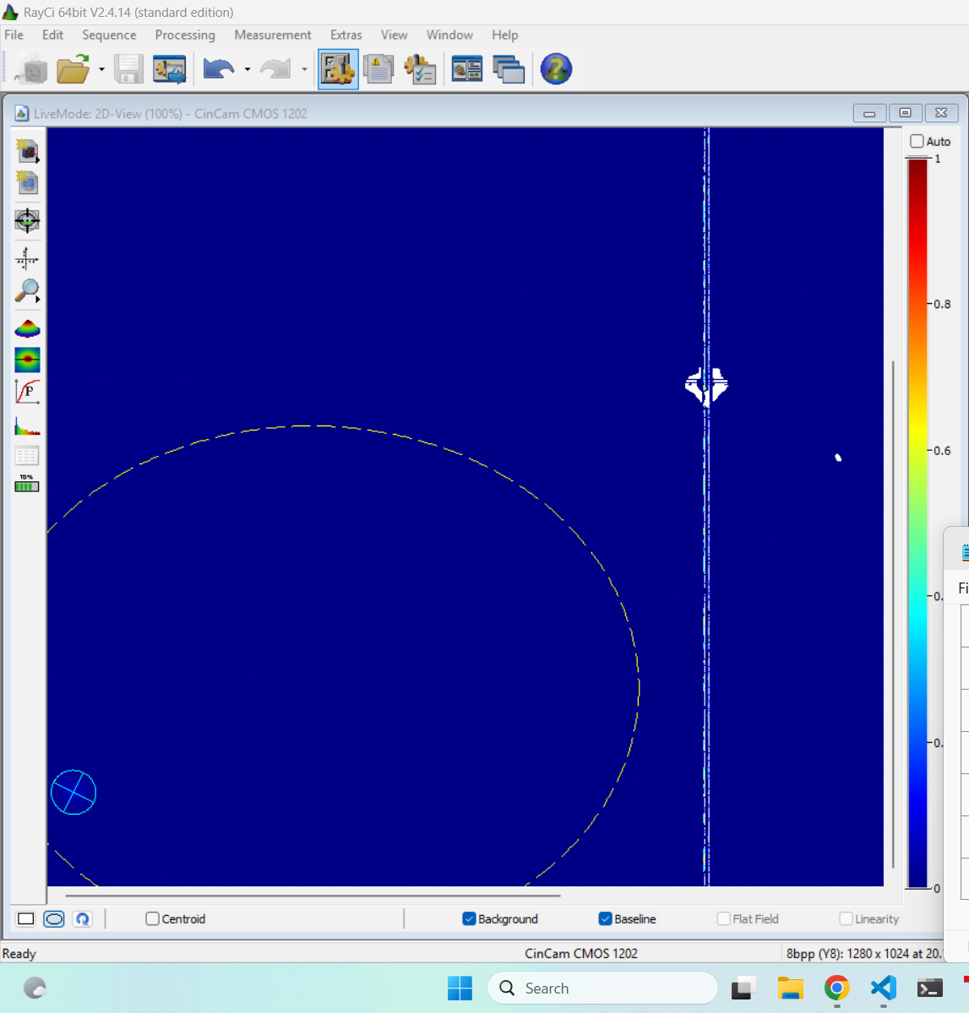
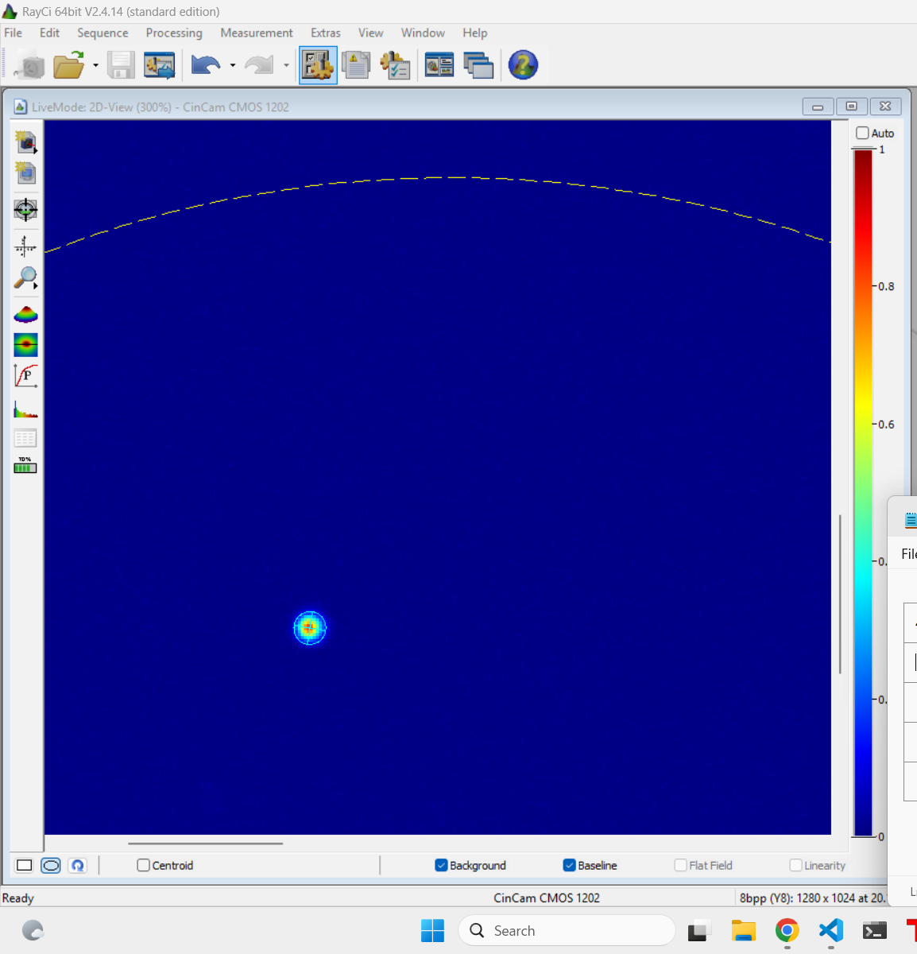
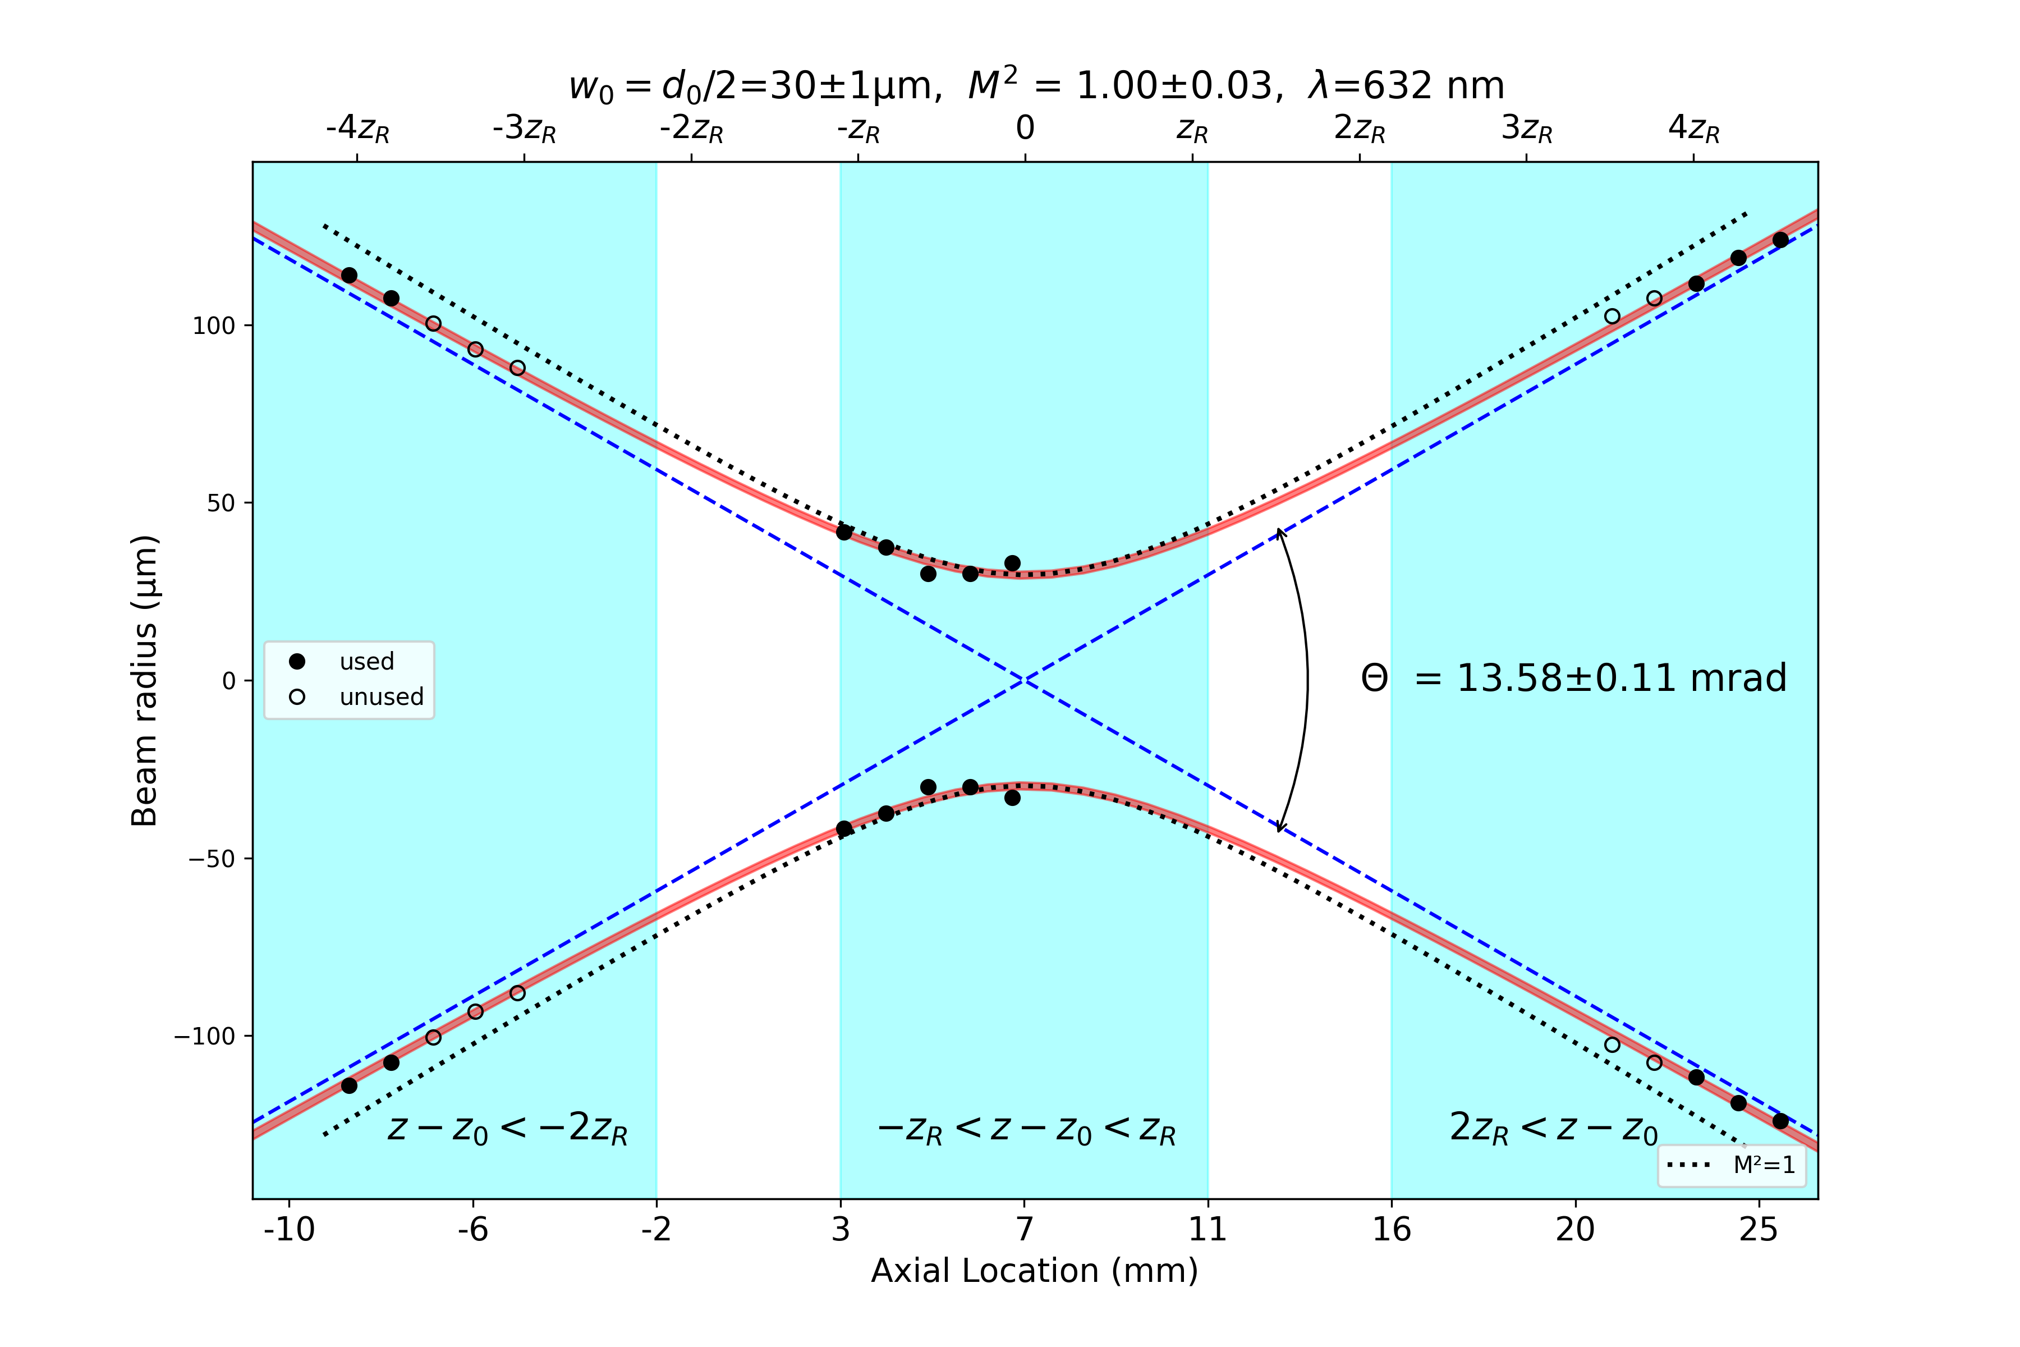
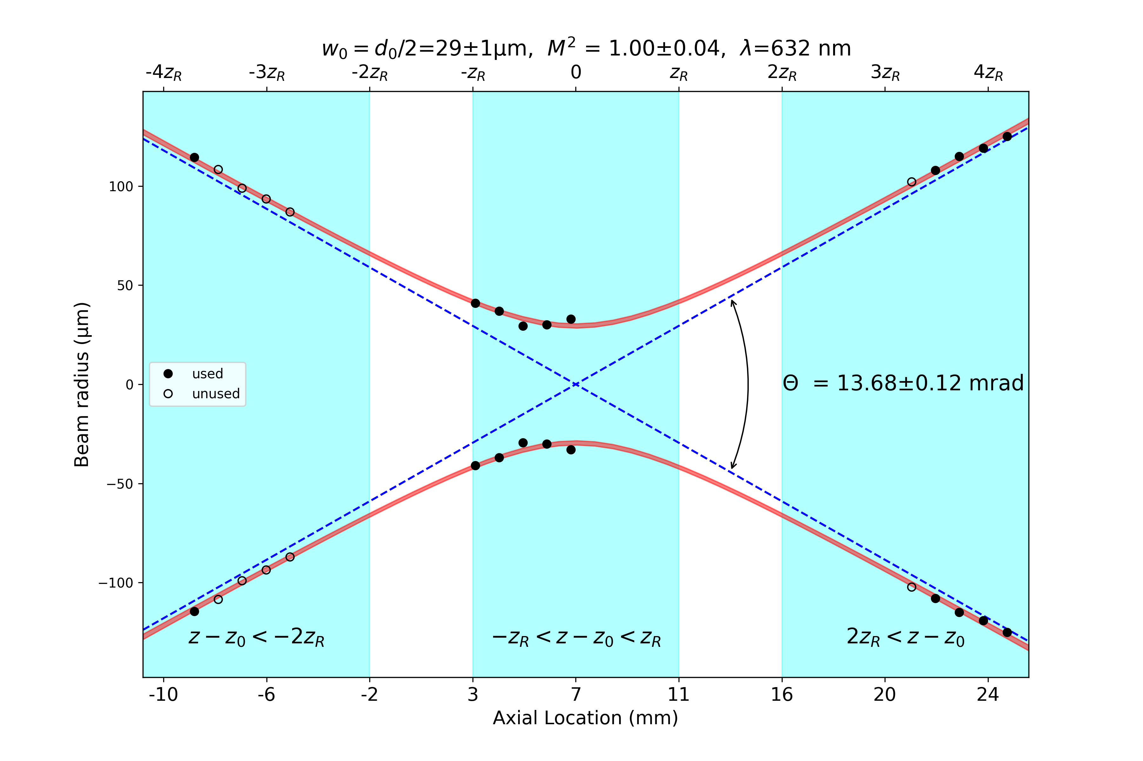
Uniphase1122p
d2
d1

