Slide 1
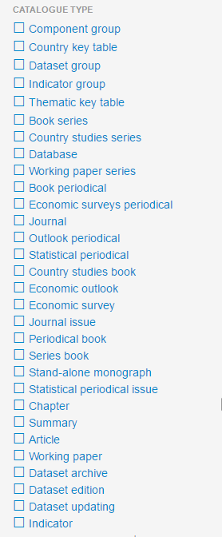
Thematic Grouping
Series & Periodicals
Books
Components
Papers
Data

